Slide 1
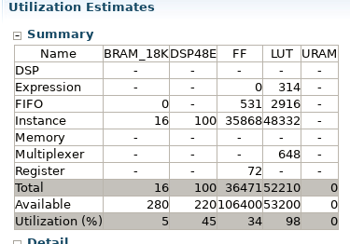
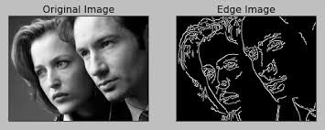
<Project Title> Sotirios Panagiotou and Konstantinos Lazaridis N.T.U.A., Erasmus M.C.
url
Summary of what you did
Plan – what you tried
Final project – what you ended up doing
Block diagram?
What did you learn, or what was interesting/difficult?
Results, Image?

