Slide 1
Predicting coding question quality using Stack Overflow ratings
Trondheim – Gjøvik – Ålesund
IMT4904 Master thesis – Spring 2016 Master Applied Computer Science – Web, Mobile, Games
130533 – Knut Lucas Andersen

Slide 2
Overview
Stack Overflow (SO)
What is a question?
Support Vector Machine (SVM)
Methodology
Experiments and Results
Summary
Demo
References
Trondheim – Gjøvik – Ålesund

Slide 3
Stack Overflow (SO)
Released late 2008
A Question-Answering (QnA) community for programmers
Model which Stack Exchange is built on
Uses gamification to reward users for participation
Reputation
Votes
Badges
Accepted answer
Bounty
Who are the experts?
Cost of rating answers (0.15$ for rating on Amazon mTurk)
What defines a good Question and Answer on SO?
Trondheim – Gjøvik – Ålesund

Slide 4
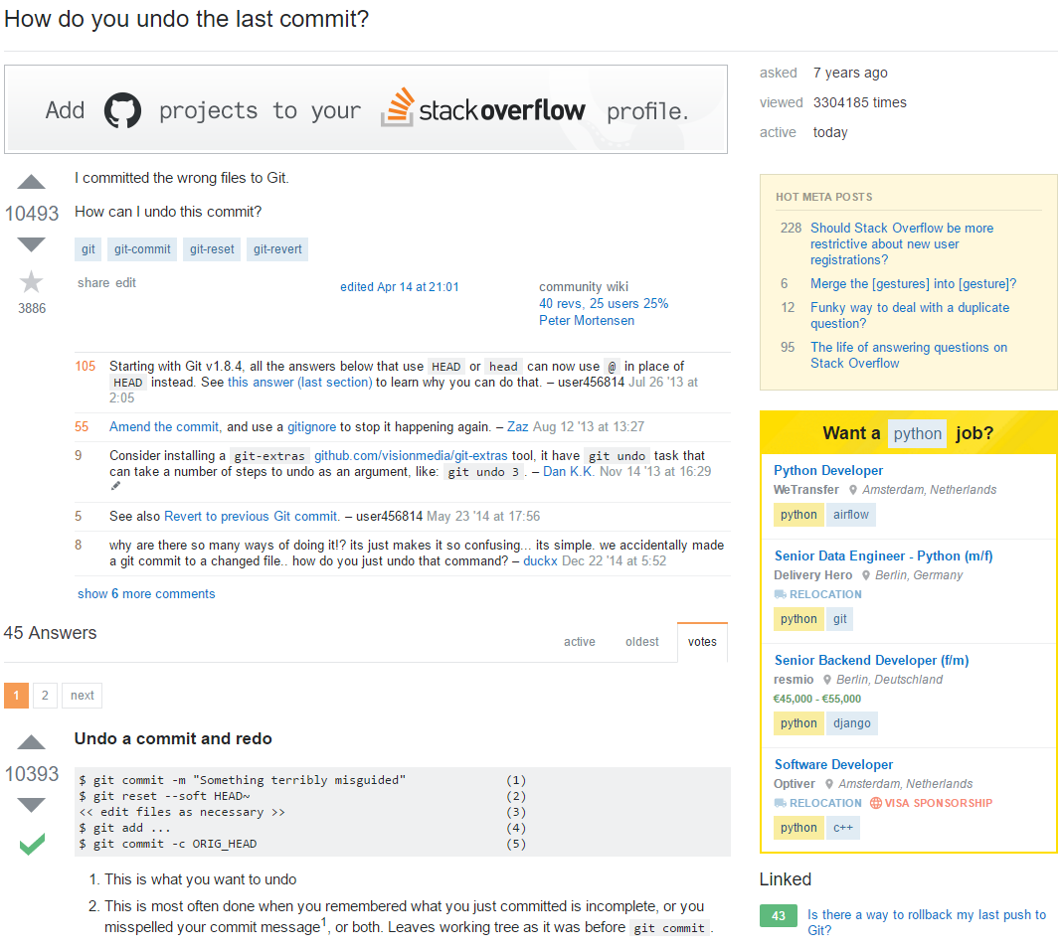
Trondheim – Gjøvik – Ålesund
[1]

Slide 5
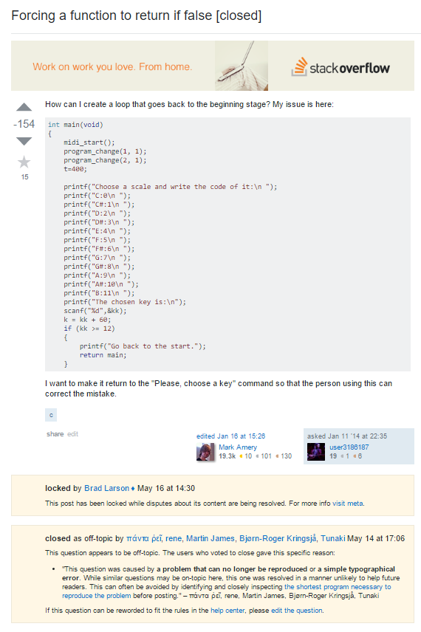
Trondheim – Gjøvik – Ålesund
[2]

Slide 6
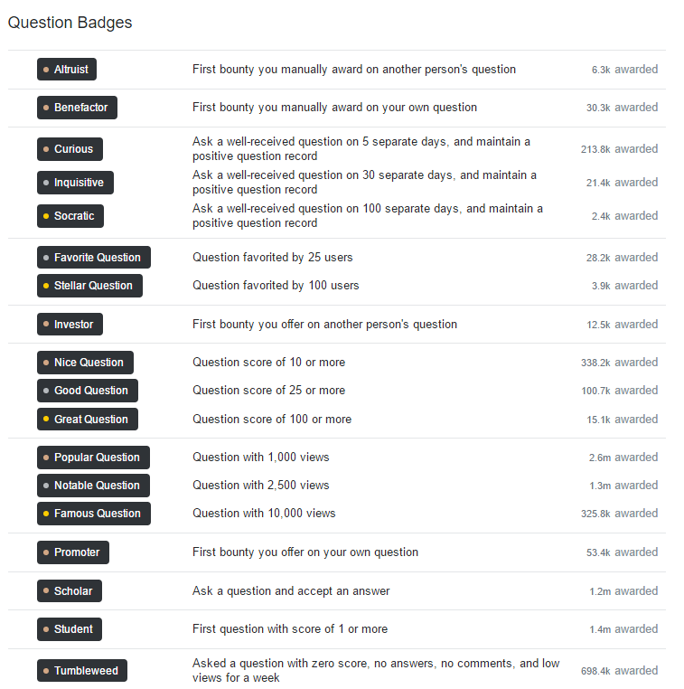
Trondheim – Gjøvik – Ålesund
[3]

Slide 7
What is a question?
Factoid vs. Broad questions
In education: Learn something new, or evaluate knowledge
Could be the goal of your research
The quality of a question can be equal to the quality of the answer
Question classification: Categorizing questions
WH-words
Bag-of-Words and N-grams
Word mapping and processing
Trondheim – Gjøvik – Ålesund

Slide 8
Support Vector Machine (SVM)
Good for regression and classification problems
Main focus is binary classification
Often used for text classification
Separates classes by using a hyperplane
Four kernels:
Linear
Radial Basis Function (RBF)
Polynomial
Sigmoid
Trondheim – Gjøvik – Ålesund

Slide 9
Methodology
Data set based on data dump from Stack Exchange Archive
Contains XML files based on table content
Imported data into MySQL database
Imported data from MySQL database into Pandas.DataFrame
Development: Python 3.5 and Scikit-learn (0.18.dev0)
Question processing
Selecting questions and features
Selecting estimator and parameters for classification
Trondheim – Gjøvik – Ålesund

Slide 10
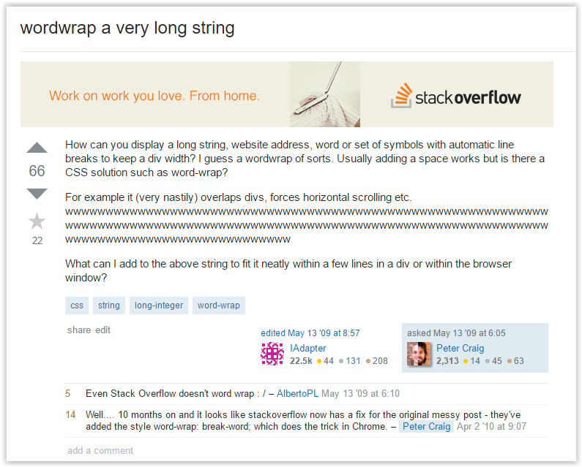
Trondheim – Gjøvik – Ålesund
[4]

Slide 11
Experiments and Results
6 different features
Code samples
Hexadecimal
Homework (synonyms for homework)
Links
Numerical
Tags
All features
4 different experiments
Unprocessed data set vs. all singular feature, and all questions
Unprocessed data set vs. all singular features, and question occurence only
Unprocessed data set vs. selected set of features only
Stochastic Gradient Descent (SGD) as classifier
Trondheim – Gjøvik – Ålesund

Slide 12
Summary
Stack overflow as a question quality metric
Limitations and issues
Further work
Code blocks, Links and Numerical as a feature set
Code analysis
Sentiment analysis
Version numbering
Trondheim – Gjøvik – Ålesund

Slide 13
Demo
Trondheim – Gjøvik – Ålesund

Slide 14
Thanks for listening
Trondheim – Gjøvik – Ålesund

Slide 15
References
[1] http://stackoverflow.com/questions/927358/how-do-you-undo-the-last-commit
[2] http://stackoverflow.com/questions/21068763/forcing-a-function-to-return-if-false
[3] http://stackoverflow.com/help/badges
[4] http://stackoverflow.com/questions/856307/wordwrap-a-very-long-string
Amazon mTurk: https://www.mturk.com/mturk/welcome
Trondheim – Gjøvik – Ålesund

