Slide 1
SEAL: Fault-Tolerant Neuron Model for Spiking Neural Networks on Unreliable DRAM Systems
Authors: Ryoji Kobayashi¹², Ngo-Doanh Nguyen³⁴, and Khanh N. Dang²
¹ Graduate School of Engineering, The University of Tokyo, Japan
² School of Computer Science and Engineering, The University of Aizu, Japan
³ DITEN, University of Genoa, Italy
⁴ Information Technology Institute, Vietnam National University, Vietnam

Slide 2
Presentation Outline
Introduction
Proposed Methodology
Evaluation
Conclusion and Future Work
References

Slide 3
Presentation Outline
Introduction
Proposed Methodology
Evaluation
Conclusion and Future Work
References

Slide 4
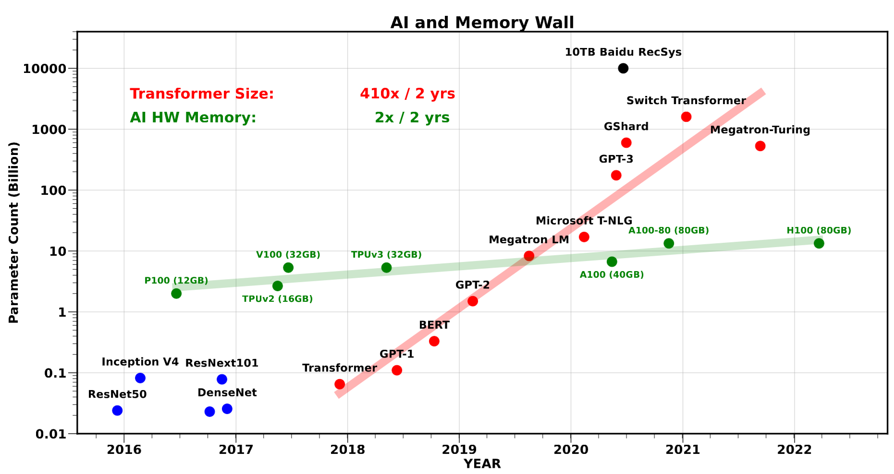
Introduction
AI workloads demand intense memory access
E.g., GPT-3 has over 100 billion parameters
A. Gholami et al., Micro’24 [1]
Notes:
The number of parameters, in turn, memory access, in the AL workloads is ever-increasing
3D DRAM is a promising solution to mitigate the so-called memory wall problem
High bandwidth & low latency

Slide 5
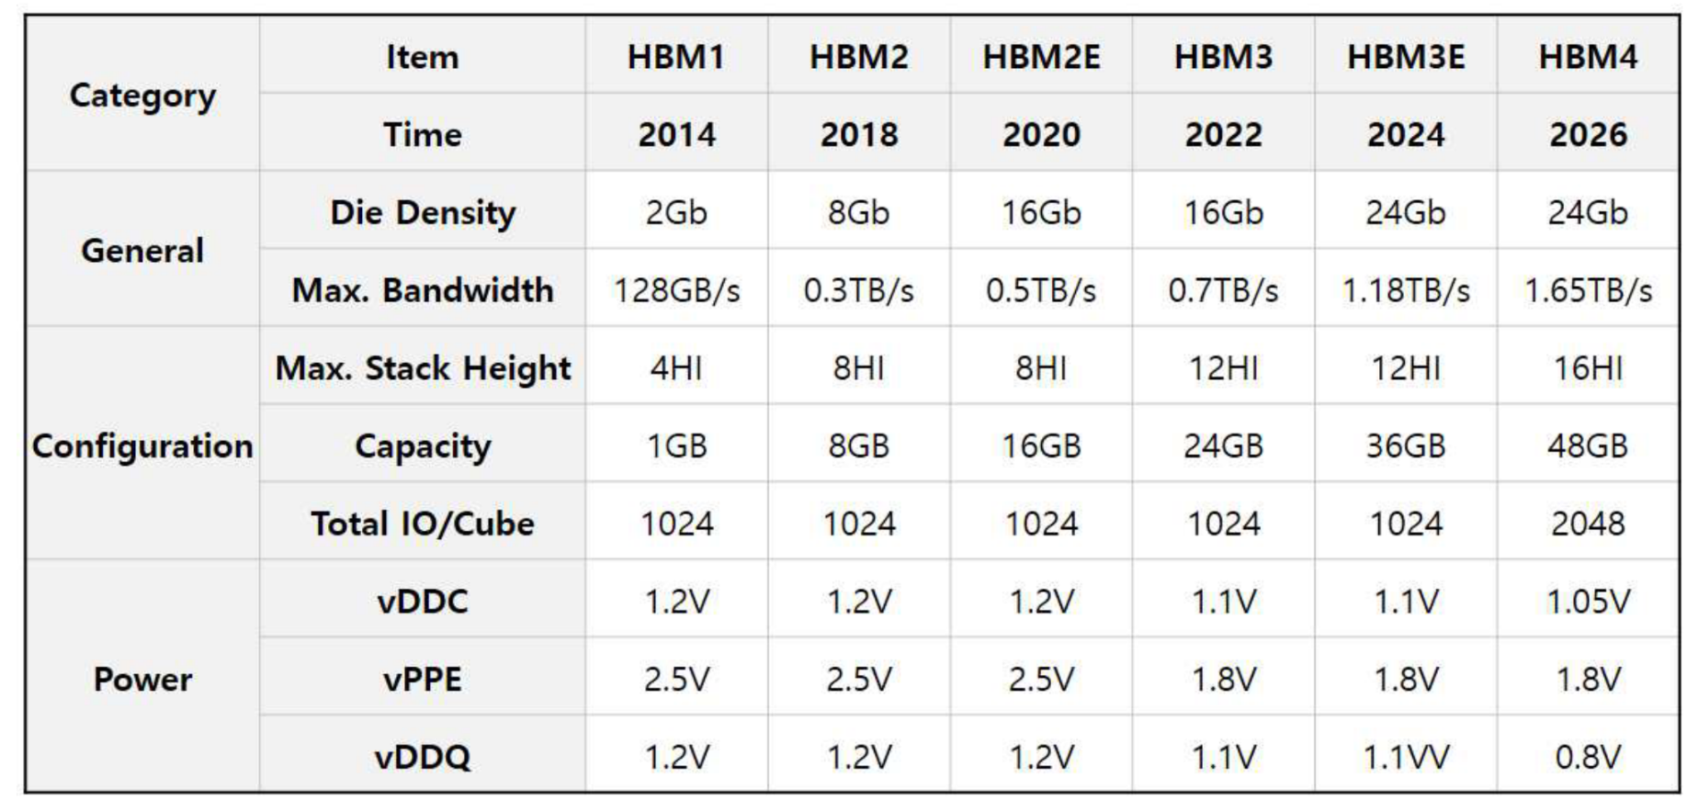
Introduction
3D-DRAM provides high-bandwidth & low-latency memory access
E.g., HBM3 provides up to 0.7TB/s
K. Kim and M. Park, IMW’24 [2]
Notes:
The number of parameters, in turn, memory access, in the AL workloads is ever-increasing
3D DRAM is a promising solution to mitigate the so-called memory wall problem
High bandwidth & low latency

Slide 6





Motivation & Contribution
High accumulation exacerbates retention failure
Data collapse in network parameters
E.g., Bit-flipping in weights
4th DRAM Die
MSB
LSB
TSVs
$$w_{0}$$
0
0
1
0
0
1
1
0
3rd DRAM Die
$$w_{1}$$
0
0
0
1
0
0
0
0
2nd DRAM Die
Temperature
$$w_{2}$$
0
0
0
1
1
0
0
1
Retention Failure
1st DRAM Die
…
…
Logic Die
$$w_{n−1}$$
0
0
0
0
1
1
1
1
Package Substrate
$$w_{n}$$
0
0
0
1
0
0
0
1
3D DRAM
Example of Bit-Flipping
Notes:
In exchange for high performance of 3D DRAM, heat accumulation leads to an increase in retention failure due to high temperature
Increase leakage current
Induce data loss by flipping stored bits
Propose a fault-tolerant spiking neuron called SEAL
SEAL is designed to
Neutralize retention failure (dominance of 1-to-0 error)
Minimize HW modification from LIF with an independent peripheral controller

Slide 7
Motivation & Contribution
High accumulation exacerbates retention failure
Data collapse in network parameters
E.g., Bit-flipping in weights
Self-Error-Adaptive LIF (SEAL)
Neutralize retention failure at runtime
Minimize modification from LIF neuron
4th DRAM Die
MSB
LSB
TSVs
$$w_{0}$$
0
0
1
0
0
1
1
0
3rd DRAM Die
$$w_{1}$$
0
0
0
1
0
0
0
0
2nd DRAM Die
Temperature
$$w_{2}$$
0
0
0
1
1
0
0
1
Retention Failure
1st DRAM Die
…
…
Logic Die
$$w_{n−1}$$
0
0
0
0
1
1
1
1
Package Substrate
$$w_{n}$$
0
0
0
1
0
0
0
1
3D DRAM
Example of Bit-Flipping
Notes:
Heat accumulation leads to an increase in retention failure due to high temperature
Increase leakage current
Induce data loss by flipping stored bits
Propose a fault-tolerant spiking neuron called SEAL
SEAL is designed to
Neutralize retention failure (dominance of 1-to-0 error)
Minimize HW modification from LIF with an independent peripheral controller

Slide 8
Why SEAL?
Prior works mostly rely on synapse-based fault recovery [3-5]
Exponential scaling of HW overhead
SEAL is a neuron-based approach
Linear scaling of HW overhead
Hardware-friendly & network agnostic fault-tolerance mechanism
With the best error recovery among SOTAs
Notes:
Why SEAL?
Prior works mostly rely on synapse-based fault recovery, which is exponential
Neuron-based approach is preferable as it linearly scales
- Furthermore, SEAL shows the best accuracy improvement among SOTAs (see Evaluation)

Slide 9
Presentation Outline
Introduction
Proposed Methodology
Evaluation
Conclusion and Future Work
References

Slide 10


Proposed Methodology
Semantics of retention failure
Fractional => Decrease
Fractional
1$→$0
10110100
1$→$0
10110001
01011001
01010001
Sign
Fractional
Sign
Fractional
Notes:
Semantics of retention failure vary with the fault position
Fractional part => weight values decrease

Slide 11

Proposed Methodology
Semantics of retention failure
Fractional => Decrease
Sign-bit => Increase
Fractional
1$→$0
10110100
1$→$0
10110001
01011001
01010001
Sign
Fractional
Sign
Fractional
Sign-bit
10110100
1$→$0
00110001
Sign
Fractional
Notes:
Sign-bit => weight values increase

Slide 12
Proposed Methodology
Store with inverted sign-bit
Fractional => Decrease
Sign-bit => Decrease
Fractional
1$→$0
10110100
1$→$0
10110001
01011001
01010001
Sign
Fractional
Sign
Fractional
Sign-bit
00110100
10110100
1$→$0
00110001
10110001
Sign
Fractional
Inverted
Inverted
Notes:
Inconsistency of semantics can be solved by storing the inverted sign-bit
Can be easily satisfied with bit-wise inversion
Retention failure consistently corresponds to value decrease

Slide 13
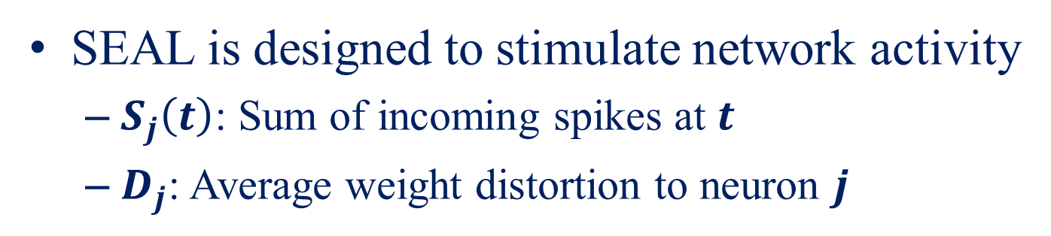
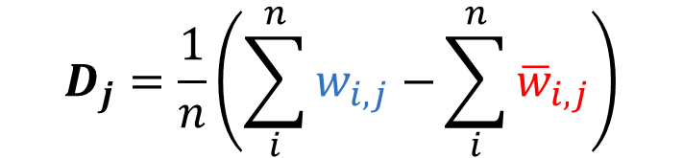
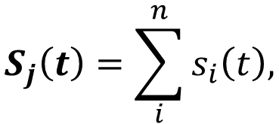
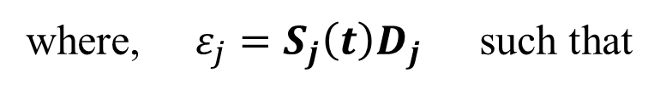
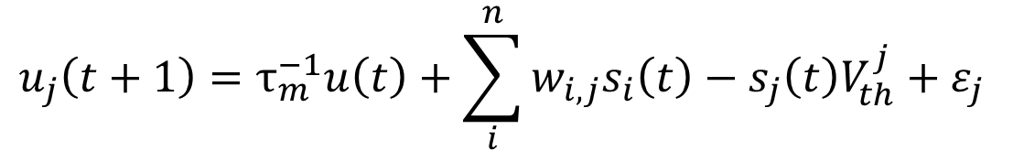
Proposed Methodology
SEAL is designed to stimulate network activity
$S_{j}\left(t\right)$: Sum of incoming spikes at $t$
$D_{j}$: Average weight distortion to neuron $j$
Proposed error adaptive term
$$u_{j}\left(t+1\right)=τ_{m}^{−1}u\left(t\right)+\sum_{i}^{n}{w_{i,j}s_{i}\left(t\right)−s_{j}\left(t\right)V_{th}^{j}+ε_{j} }$$
LIF equation
where, $ε_{j}=S_{j}\left(t\right)D_{j}$ such that
Correct weight
$$S_{j}\left(t\right)=\sum_{i}^{n}{s_{i}\left(t\right),}$$
$$D_{j}=\frac{1}{n}\left(\sum_{i}^{n}{w_{i,j}−}\sum_{i}^{n}{{\overline{w}}_{i,j}}\right)$$
Affected weight
Notes:
SEAL works as an excitatory factor in the network by compensating for the decrease in weight value
Error adaptive term is introduced to LIF equation

Slide 14
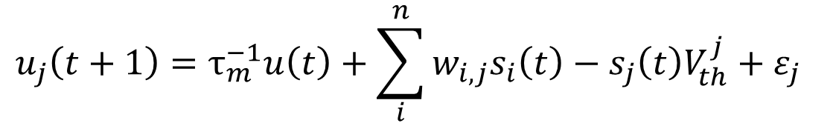
Proposed Methodology
Virtual Synaptic Weight (VSW) to minimize the modification from the LIF neuron
Proposed error adaptive term
$$u_{j}\left(t+1\right)=τ_{m}^{−1}u\left(t\right)+\sum_{i}^{n}{w_{i,j}s_{i}\left(t\right)−s_{j}\left(t\right)V_{th}^{j}+ε_{j} }$$
LIF equation
Notes:
Virtual synaptic weight (VSW) is to minimize LIF modification

Slide 15
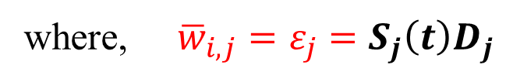
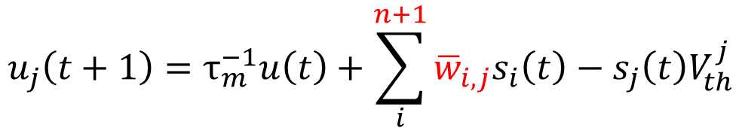
Proposed Methodology
Virtual Synaptic Weight (VSW) to minimize the modification from the LIF neuron
Proposed error adaptive term
$$u_{j}\left(t+1\right)=τ_{m}^{−1}u\left(t\right)+\sum_{i}^{n}{w_{i,j}s_{i}\left(t\right)−s_{j}\left(t\right)V_{th}^{j}+ε_{j} }$$
LIF equation
Introducing VSW
$$u_{j}\left(t+1\right)=τ_{m}^{−1}u\left(t\right)+\sum_{i}^{n+1}{{\overline{w}}_{i,j}s_{i}\left(t\right)−s_{j}\left(t\right)V_{th}^{j}}$$
LIF equation
where, ${\overline{w}}_{i,j}=ε_{j}=S_{j}\left(t\right)D_{j}$
Notes:
Error adaptive term is integrated into the LIF equation
HW modification is minimal

Slide 16
Proposed Methodology
Illustration of how SEAL works
Input
Bit-flipping
1
01001100
2
LIF
0
00101110
2
Output
0
11010101
2
1
00010001
2
Notes:
Example of how SEAL works;
Architecture of LIF neuron-based network

Slide 17




Proposed Methodology
Illustration of how SEAL works
Input
Bit-flipping
1
01001100
2
LIF
0
00101110
2
Output
0
11010101
2
1
00010001
00011001
“1” (Always-on state)
2
2
Virtual Synaptic Weight
$D_{j}$ = 00110010
x
2
$S_{j}(t)$ = 0.50
10
Correct weight
$$S_{j}\left(t\right)=\sum_{i}^{n}{s_{i}\left(t\right),}$$
$$D_{j}=\frac{1}{n}\left(\sum_{i}^{n}{w_{i,j}−}\sum_{i}^{n}{{\overline{w}}_{i,j}}\right)$$
Affected weight
Notes:
Example of how SEAL works;
Architecture of SEAL neuron-based network
How D and S are computed
LIF neuron has an additional synapse with an always-on virtual synaptic weight

Slide 18
Proposed Methodology
Illustration of how SEAL works
Input
Bit-flipping
Reuse of LIF neuron
1
01001100
2
LIF
0
00101110
2
Output
0
11010101
2
1
00010001
00011001
“1” (Always-on state)
2
2
Virtual Synaptic Weight
$D_{j}$ = 00110010
x
2
$S_{j}(t)$ = 0.50
10
Correct weight
$$S_{j}\left(t\right)=\sum_{i}^{n}{s_{i}\left(t\right),}$$
$$D_{j}=\frac{1}{n}\left(\sum_{i}^{n}{w_{i,j}−}\sum_{i}^{n}{{\overline{w}}_{i,j}}\right)$$
Affected weight
Notes:
Example of how SEAL works;
Therefore, SEAL is achieved without major modification from conventional LIF
Can reuse LIF neuron

Slide 19
Proposed Methodology
Overview of hardware implementation
DRAM Dies
Neuron Computing Core
Crossbar
Memory Interface
TSV
VSW Controller
Controller
To Neuron Array
Spike Decoder
LIF Array
Network Interface
Index Array
…
Index #1
LUT
Index #2
…
VSW Controller
Index #i
…
Index #N
VSW Interface
Flow Controller
From Network Interface
Notes:
Hardware architecture is modeled;
DRAM dies are stacked on top of the logic die
Neural computing core (PE) encompasses the LIF array and VSW controller
VSW controller is composed of two main LUTs
Note: Fundamental concept can be applied to other system architectures (e.g., HBM and planar DRAM)

Slide 20
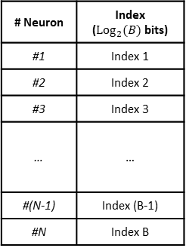
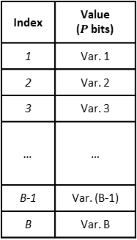
Proposed Methodology
Overview of hardware implementation
# Neuron | Index (${Log}_{2}{(B)}$ bits)
#1 | Index 1
#2 | Index 2
#3 | Index 3
… | …
#(N-1) | Index (B-1)
#N | Index B
Index | Value ($P$ bits)
1 | Var. 1
2 | Var. 2
3 | Var. 3
… | …
B-1 | Var. (B-1)
B | Var. B
Decoder
Decoder
Mux
Mux
To Neuron Array
Spike Decoder
Index Array
R/W
Index #1
LUT
VSW Interface
Addr
Addr
Spk
Lyr
In-Spike
Index #2
Value
Extractor
LUT Controller
Input Decoder
Spike Counter
…
VSW Controller
Index #i
…
Index #N
VSW Interface
Flow Controller
From Network Interface
Notes:
Details of LUTs in the VSW controller;
One is for the neuron-index table, another is for index-VSW
VSW interface manages LUT access

Slide 21


Proposed Methodology
LUT implementation strategy
Use binning approximation
Exact $D_{j}$(16 bits)
Bin Assignment Table
Index (3 bits)
New $D_{j}$
5.022
ID | Range | Base Val.
0 | 3.51 – 4.00 | 3.51
1 | 4.01 – 4.50 | 4.01
2 | 4.51 – 5.00 | 4.51
3 | 5.01 – 5.50 | 5.01
4 | 5.51 – 6.00 | 5.51
5 | 6.01 – 6.50 | 6.01
6 | 6.51 – 7.00 | 6.51
7 | 7.01 – 7.50 | 7.01
3 (011)
5.01
4.817
2 (010)
4.51
4.251
1 (001)
4.01
7.338
7 (111)
7.01
# Neurons
………
………
………
4.990
2 (010)
4.51
6.174
5 (101)
6.51
3.907
0 (000)
3.51
Notes:
Details of LUT implementation in the VSW controller;
Storing all VSW values is inefficient
Binning approximation enables the compression of LUT size and HW overhead

Slide 22
Proposed Methodology
LUT implementation strategy
Use binning approximation
Save overheads
Exact $D_{j}$(16 bits)
Bin Assignment Table
Index (3 bits)
New $D_{j}$
5.022
ID | Range | Base Val.
0 | 3.51 – 4.00 | 3.51
1 | 4.01 – 4.50 | 4.01
2 | 4.51 – 5.00 | 4.51
3 | 5.01 – 5.50 | 5.01
4 | 5.51 – 6.00 | 5.51
5 | 6.01 – 6.50 | 6.01
6 | 6.51 – 7.00 | 6.51
7 | 7.01 – 7.50 | 7.01
3 (011)
5.01
4.817
2 (010)
4.51
4.251
1 (001)
4.01
7.338
7 (111)
7.01
# Neurons
………
………
………
4.990
2 (010)
4.51
6.174
5 (101)
6.51
3.907
0 (000)
3.51

Slide 23
Presentation Outline
Introduction
Proposed Methodology
Evaluation
Conclusion and Future Work
References

Slide 24
Evaluation
Accuracy assessment:
Network architecture and benchmark
MNIST (MLP), F-MNIST (VGG5), CIFAR-10 (VGG16)
Insert single-bit faults randomly to trained weights
1-to-0 bit-flipping @ 100%, 90%, 80% ratio
Change granularity of binning approximation
Hardware evaluation:
Logic synthesis with Synopsys Design Compiler
45nm technology node
Memory modeling:
DESTINY[6] tool to model 3D-DRAM with 45nm node
Notes:
Evaluation is for two major factors: accuracy and HW overhead
Accuracy is assessed through software execution by inserting random retention faults
Hardware overhead is obtained from synthesis tools for the logic part / DESTINY tool for 3D DRAM

Slide 25
Evaluation
Impact on benchmark accuracy
Notes:
SEAL always outperforms LIF neuron
Maximum benefit at 100% ratio
Substantial reliability benefits under error-biased environments

Slide 26
Evaluation
Impact on benchmark accuracy
+54.60%
+13.04%
+54.87%
Notes:
SEAL always outperforms LIF neuron
Maximum benefit at 100% ratio
Substantial reliability benefits under error-biased environments

Slide 27
Evaluation
Characteristics of accuracy
SEAL can be both excitatory and inhibitory factors
=> Constantly providing better accuracy than the LIF neuron
Notes:
SEAL can excite and suppress network activity
SEAL always provides better accuracy than LIF
Works as a modulator of the network

Slide 28
Evaluation
Impact of binning approximation
Depends on network architectures & workloads
Notes:
Binning approximation is acceptable depending on the network type and dataset.
For example;
BIN-16 and -8 show better or equivalent accuracy to baseline
BIN-4 depends on the network model and benchmark

Slide 29
Evaluation
Impact of binning approximation
Depends on network architectures & workloads
Even improve accuracy
Significant drop
Notes:
Binning approximation is acceptable depending on the network type and dataset.
For example;
BIN-16 and -8 show better or equivalent accuracy to baseline
BIN-4 depends on the network model and benchmark

Slide 30
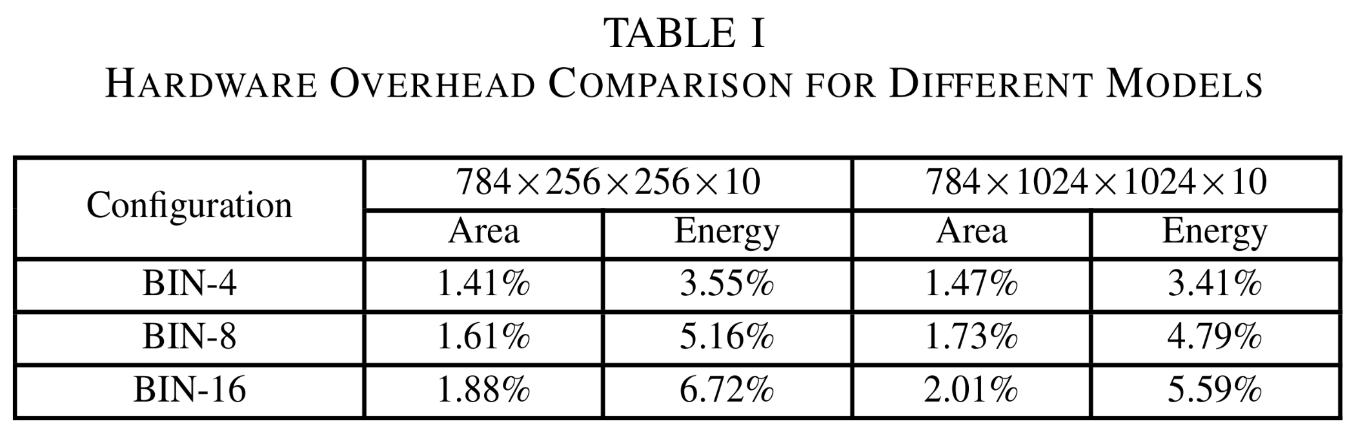
Evaluation
Hardware evaluation
Modest overheads
Notes:
Hardware overhead is modest
This is because SEAL overhead is proportional to neuron size rather than the number of synapses, which prior works rely on

Slide 31
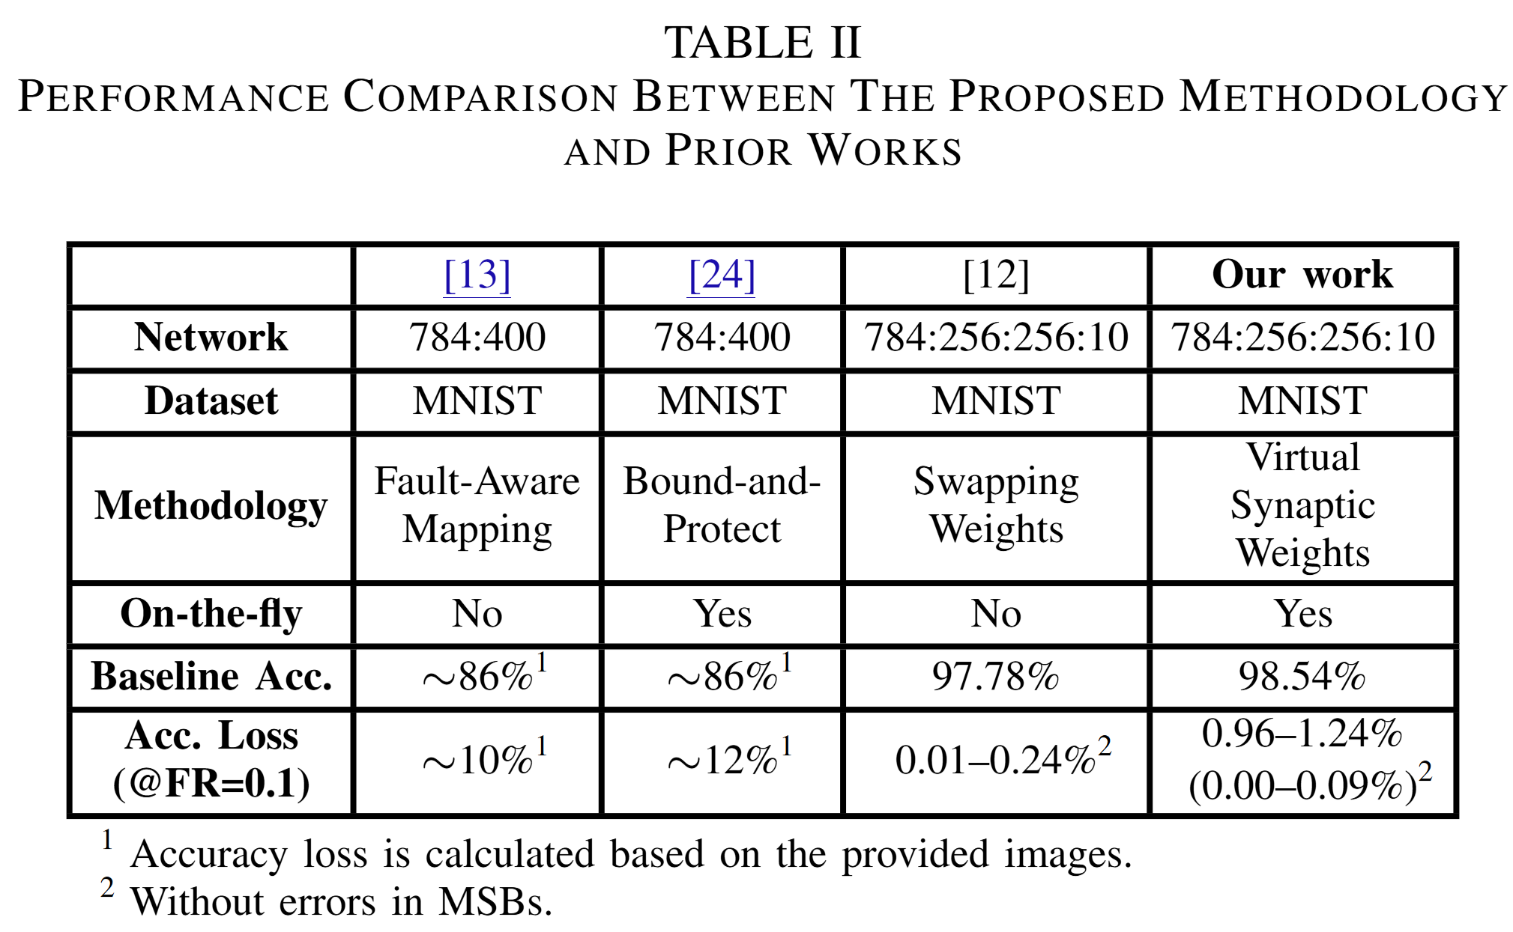
Evaluation
Comparison to prior arts
ICCAD’21 [1]
DAC’22 [2]
TCPMT’24 [3]
Notes:
Best accuracy recovery among SOTAs

Slide 32
Presentation Outline
Introduction
Proposed Methodology
Evaluation
Conclusion and Future Work
References

Slide 33
Conclusion & Future Works
SEAL neuron compensates for retention failure
Virtual Synaptic Weight (VSW) minimizes the modification from the LIF neuron
VSW controller is independent of neuron types
Results show enhanced fault-tolerance and reasonable HW overhead
Future works include thermal-aware fault-tolerance based on SEAL
Notes:
SEAL is designed to deal with retention failure
VSW concept minimize HW modification from LIF neuron
Results show feasibility and HW efficiency

Slide 34
Presentation Outline
Introduction
Proposed Methodology
Evaluation
Conclusion and Future Work
References

Slide 35
References
[1] A. Gholami et al., “AI and Memory Wall,” IEEE Micro, 2024.
[2] K. Kim and M.-j. Park, “Present and Future, Challenges of High Bandwidth Memory (HBM),” in 2024 IEEE International Memory Workshop (IMW). IEEE, 2024, pp. 1–4.
[3] R. V. W. Putra et al., “ReSpawn: Energy-Efficient Fault-Tolerance for Spiking Neural Networks considering Unreliable Memories,” in 2021 IEEE/ACM International Conference on Computer-Aided Design (ICCAD). IEEE, 2021, pp. 1–9.
[4] R. V. W. Putra et al., “SoftSNN: Low-Cost Fault Tolerance for Spiking Neural Network Accelerators under Soft Errors,” in Proceedings of the 59th ACM/IEEE Design Automation Conference, 2022, pp. 151–156.
[5] N.-D. Nguyen et al., “NOMA: A Novel Reliability Improvement Methodology for 3-D IC-based Neuromorphic Systems,” IEEE Transactions on Components, Packaging and Manufacturing Technology, 2024.
[6] M. Poremba et al., “DESTINY: A tool for modeling emerging 3D NVM and eDRAM caches,” in 2015 Design, Automation & Test in Europe Conference & Exhibition (DATE). IEEE, 2015, pp. 1543–1546.

Slide 36

THANK YOU

