Slide 1
Implementation and Evaluation of a Model Transfer and Integration Workflow for Distributed Spiking Neural Network Learning
Hayato Takimoto
s1300183
Supervised by Khanh N. Dang
August 10, 2026
Notes:
English:
Hello everyone. I am Hayato Takimoto. Today, I will present my graduation thesis titled “Implementation and Evaluation of a Model Transfer and Integration Workflow for Distributed Spiking Neural Network Learning.”
Japanese:
皆さん、こんにちは。滝本颯人です。本日は、「分散Spiking Neural Network学習のためのModel Transfer and Integration Workflowの実装と評価」という卒業論文について発表します。

Slide 2
Table of Contents
1. Introduction
2. Proposal
3. Evaluation
4. Conclusion
1
Notes:
English:
This presentation has four sections: Introduction, Proposal, Evaluation, and Conclusion.
Japanese:
本発表は、Introduction、Proposal、Evaluation、Conclusionの4つのセクションで構成されています。

Slide 3
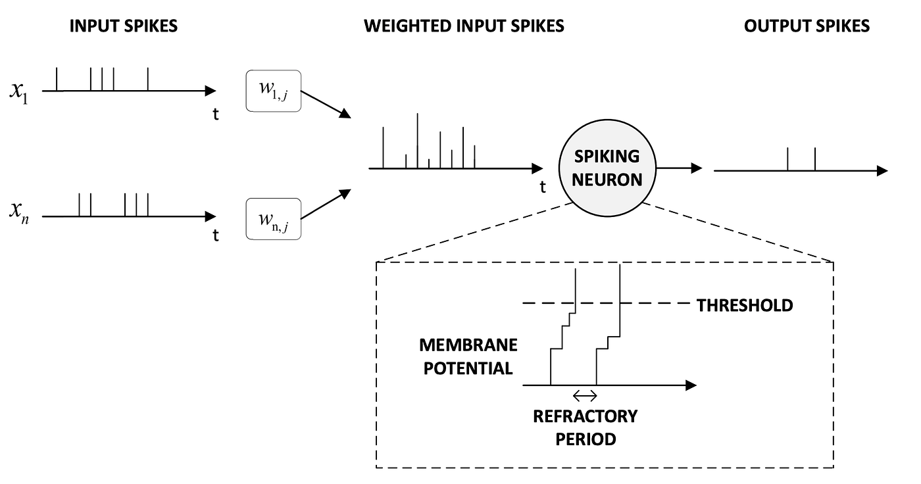
Spiking Neural Networks
xi​: input spike
wi,j: connection weight
t: time
j: spiking neuron
Image → spike trains → output spikes [1]
2
Notes:
English:
First, I will explain Spiking Neural Networks, or SNNs. SNNs process information using discrete spikes over time. For image recognition, an image is converted into spike trains, processed by spiking neurons, and then converted into output spikes.
Japanese:
まず、Spiking Neural Networks、つまりSNNについて説明します。SNNは、時間方向の離散的なspikeを使って情報を処理します。画像認識では、画像をspike trainsに変換し、spiking neuronsで処理した後、output spikesとして出力します。

Slide 4
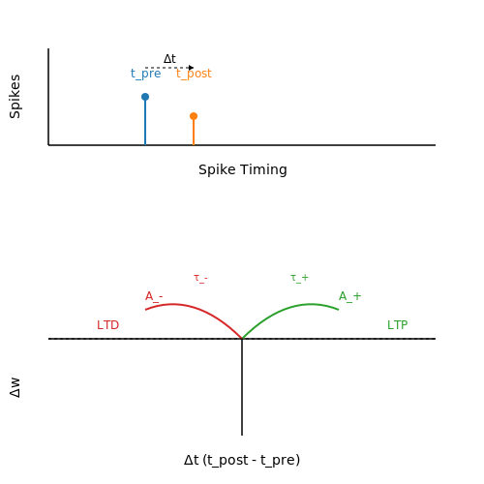
Spike-Timing-Dependent Plasticity
Basic relation
Δt = tpost − tpre
Δw = A+ exp(−Δt / τ+) if Δt > 0 Δw = −A− exp( Δt / τ−) if Δt < 0
Pre → Post weight increases
Post → Pre weight decreases
Learning depends on spike timing [2]
Symbols
Δt: spike timing difference
t_pre, t_post: pre-/post-synaptic spike times
Δw: change in synaptic weight
A+, A−: max increase/decrease
τ+, τ−: time constants
3
Notes:
English:
This slide shows Spike-Timing-Dependent Plasticity, or STDP. STDP changes synaptic weights based on spike timing. If the pre-synaptic spike comes first, the connection becomes stronger. If the order is reversed, the connection becomes weaker.
Japanese:
このスライドでは、Spike-Timing-Dependent Plasticity、つまりSTDPを示しています。STDPは、spikeのタイミングに基づいてsynaptic weightを変化させます。pre-synaptic spikeが先に発生した場合は接続が強くなり、順番が逆の場合は接続が弱くなります。

Slide 5
EnsembleSTDP
Subset 1
SNN sub-model 1
Training dataset
Split
Subset 2
SNN sub-model 2
Collect
・・・
・・・
Merge
Subset N
SNN sub-model N
Compression
Key point
Distributed local learning [3]
Final model
Centralized merge and compression
4
Notes:
English:
EnsembleSTDP divides the training dataset into subsets and trains SNN sub-models independently. After training, the sub-models are collected, merged, and compressed into one final model. This enables distributed local learning, but requires centralized processing after training.
Japanese:
EnsembleSTDPでは、training datasetを複数のsubsetに分け、SNN sub-modelをそれぞれ独立に学習します。学習後、sub-modelを集めてmergeとcompressionを行い、1つのfinal modelにします。これによりdistributed local learningが可能になりますが、学習後にはcentralized processingが必要です。

Slide 6
Research Motivation
Parallel sub-model training can reduce training time. [3]
But model-related file transfer, delayed senders, and receiver-side processing may reduce this benefit.
This study evaluates workflow completion time and final merged-model accuracy.
5
Notes:
English:
Previous EnsembleSTDP research showed that parallel sub-model training can reduce training time. However, after training, model-related files still need to be transferred, merged, compressed, and evaluated. Therefore, this study focuses on the post-training workflow and the factors that affect workflow completion time and final accuracy.
Japanese:
先行するEnsembleSTDP研究では、parallel sub-model trainingによってtraining timeを短縮できることが示されています。しかし、学習後もmodel-related filesのtransfer、merge、compression、evaluationが必要です。そのため本研究では、学習後のworkflowと、workflow completion timeおよびfinal accuracyに影響する要因に注目します。

Slide 7
Table of Contents
1. Introduction
2. Proposal
3. Evaluation
4. Conclusion
6
Notes:
English:
Next, I will explain the proposed workflow.
Japanese:
次に、提案するworkflowについて説明します。

Slide 8
Overall Experimental Setup
Sender Nodes
Communication
Receiver Node
Processing
vm-node1
model_*.pth assignments_*.pth proportions_*.pth
Merge + Compression
vm-node2 model_*.pth assignments_*.pth proportions_*.pth
TCP ZeroMQ gRPC
vm-node0 Collect received sub-model files
MNIST Evaluation
・・・
TCP Reliable stream-based file transfer
ZeroMQ Lightweight message-based file transfer
gRPC Structured RPC-based file transfer
Final Model Accuracy
vm-nodeN model_*.pth assignments_*.pth proportions_*.pth
7
Notes:
English:
This slide shows the experimental setup. Each sender stores one trained sub-model as three files: model, assignments, and proportions. The files are sent to vm-node1 using TCP, ZeroMQ, or gRPC. After receiving them, vm-node1 performs merge, compression, and MNIST evaluation.
Japanese:
このスライドでは、実験構成を示しています。各senderは、1つのtrained sub-modelをmodel、assignments、proportionsの3ファイルとして保持します。これらをTCP、ZeroMQ、またはgRPCでvm-node1へ送信します。受信後、vm-node1でmerge、compression、MNIST evaluationを行います。

Slide 9
Sub-model and Quality Evaluation
MNIST subset
Sub-model
Sender VM
Receiver
part of training data
one independently
trained SNN
stores one
sub-model
merge, compress,
and evaluate
Transferred as three files:
model_*.pth
assignments_*.pth
proportions_*.pth
8
Notes:
English:
One sub-model is one SNN trained independently on part of the MNIST training data. Each sender transfers three model-related files. I evaluate sub-model quality using standalone MNIST accuracy before integration, and check its effect by removing or replacing a low-accuracy sub-model.
Japanese:
本研究では、1つのsub-modelを、MNIST training dataの一部で独立に学習した1つのSNNとします。各senderは3つのmodel-related filesを送信します。Sub-model qualityは、integration前のstandalone MNIST accuracyで評価し、低精度のsub-modelを除外または置き換えることで、その影響を確認します。

Slide 10
Table of Contents
1. Introduction
2. Proposal
3. Evaluation
4. Conclusion
9
Notes:
English:
Next, I will explain the evaluation and results.
Japanese:
次に、評価方法と実験結果について説明します。

Slide 11
Evaluation Objectives
What to Evaluate
Why
Workflow feasibility
→Model Transfer and Integration
Workflow completion time
→ Sequential vs. Concurrent → Controlled Straggler → Arrival Skew
Receiver-side processing
→ Bottleneck Breakdown
Final merged-model accuracy
→ Same accuracy across protocols → Impact of a Low-Accuracy Sub-model
Confirm successful transfer and integration
Evaluate execution mode and sender timing
Identify the dominant bottleneck
Examine protocol and sub-model quality
10
Notes:
English:
There are four evaluation objectives. First, workflow feasibility checks whether transfer and integration finish correctly. Second, workflow completion time checks execution mode, stragglers, and arrival skew. Third, bottleneck breakdown identifies the most time-consuming receiver-side stage. Finally, final merged-model accuracy separates the effect of communication from sub-model quality. These evaluations show what should be improved first.
Japanese:
評価目的は4つあります。1つ目のworkflow feasibilityでは、transferとintegrationが正しく完了するかを確認します。2つ目のworkflow completion timeでは、execution mode、straggler、arrival skewの影響を確認します。3つ目のbottleneck breakdownでは、receiver側で最も時間がかかる処理を特定します。最後に、final merged-model accuracyでは、communicationの影響とsub-model qualityの影響を分けて確認します。これらの評価によって、どこを優先して改善すべきかを判断します。

Slide 12
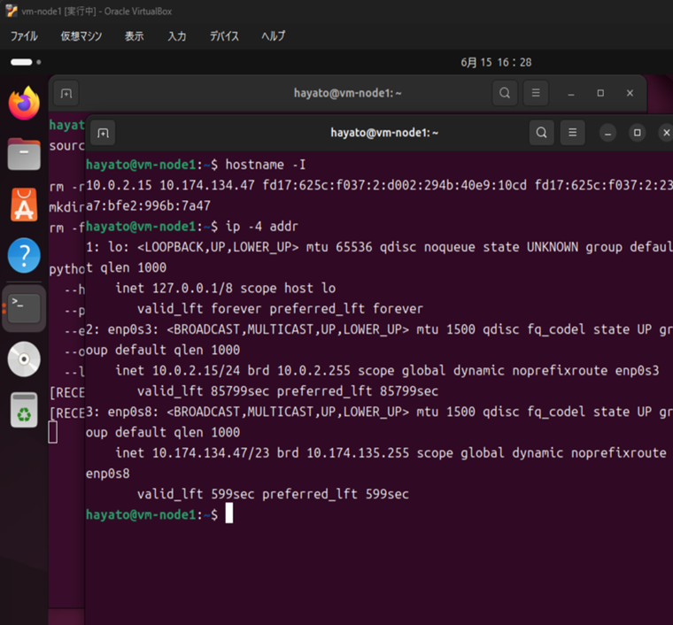
Experimental Environment
Receiver VM example
Environment:
Ubuntu VMs / VirtualBox
Receiver:
vm-node1
Senders:
up to 9 sender VMs
Protocols:
TCP / ZeroMQ / gRPC
Dataset:
MNIST test set (10,000)
Framework:
BindsNET [4]
Sender VMs → Receiver VM → Merge / Compression → MNIST Evaluation
vm-node1 running in Oracle VirtualBox
11
Notes:
English:
The experiments used Ubuntu virtual machines on VirtualBox. vm-node1 was the receiver, with up to nine sender VMs. I compared TCP, ZeroMQ, and gRPC. The final merged model was evaluated with 10,000 MNIST test samples using BindsNET.
Japanese:
実験には、VirtualBox上のUbuntu virtual machineを使用しました。receiverはvm-node1で、最大9台のsender VMを使用しました。通信方式としてTCP、ZeroMQ、gRPCを比較しました。Final merged modelはBindsNETを使用し、10,000件のMNIST test samplesで評価しました。

Slide 13
Proposed Timing Measurement Method
Receiver-side timestamps
span
Corrected transfer time
= Σ sender span
Sender 1
t_first
t_last
span
T_corrected =
sum over senders (t_last,sender - t_first,sender)
Sender 2
t_first
t_last
...
span
Removes manual idle time
Not pure network latency
Sender N
t_first
t_last
Concurrent execution metrics
Global span: first received file → last received file
Arrival skew: earliest sender arrival → latest sender arrival
Global span
Arrival skew
12
Notes:
English:
This slide shows the timing measurement method. I use receiver-side timestamps. For each sender, I measure the time from its first received file to its last received file and add these spans. This removes manual waiting time, but it is not pure network latency. For concurrent execution, I also use global span and arrival skew.
(このスライドでは、時間測定方法を示します。receiver側で記録したtimestampを使用します。各senderについて、最初に受信したファイルから最後に受信したファイルまでの時間を測り、それらのspanを合計します。これにより手動操作による待機時間を除外できますが、純粋なnetwork latencyではありません。Concurrent executionでは、global spanとarrival skewも使用します。)

Slide 14
Result 1: Workflow Feasibility
Purpose: Verify workflow feasibility and final model correctness.
Configuration
Final neurons
Accuracy
3-sender asymmetric
300
0.8676
9-sender symmetric
800
0.8800
9-sender asymmetric, initial
1000
0.5719
9-sender asymmetric, improved
1000
0.8232
3-sender asymmetric: TCP = ZeroMQ = gRPC = 0.8676
TCP, ZeroMQ, and gRPC successfully transferred the required model-related files.
13
Notes:
English:
Result 1 evaluates workflow feasibility. TCP, ZeroMQ, and gRPC all transferred the required files and completed integration. In the 3-sender asymmetric configuration, all three approaches produced the same final accuracy of 0.8676. This confirms that the workflow works correctly with all three approaches.
Japanese:
Result 1では、workflow feasibilityを評価します。TCP、ZeroMQ、gRPCのすべてで必要なファイルを転送し、integrationまで完了できました。3-sender asymmetric構成では、3つの方式すべてでfinal accuracyは0.8676でした。これにより、3つの通信方式すべてでworkflowが正しく動作することを確認しました。

Slide 15
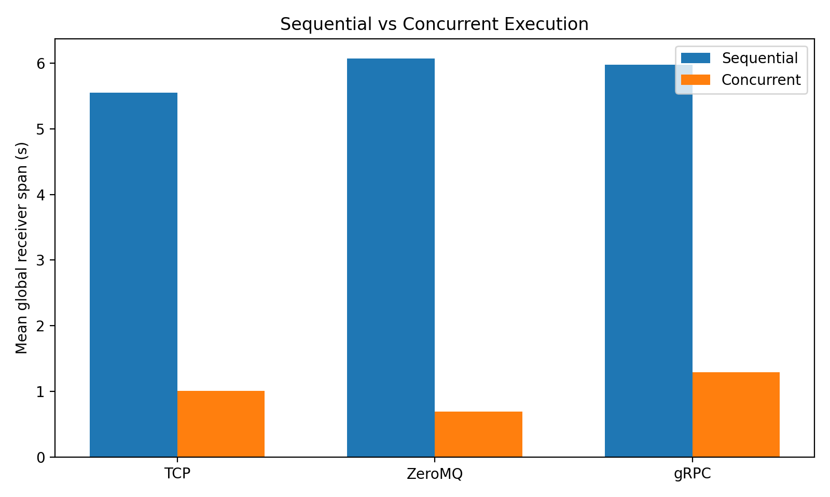
Result 2-A: Sequential vs Concurrent Execution
Purpose: Determine whether concurrent execution reduces workflow completion time.
Approach
Reduction
TCP
81.90%
ZeroMQ
88.64%
gRPC
78.37%
The reduction ranged from 78.37% to 88.64%.
Sender execution mode has a large impact on the overall completion time.
14
Notes:
English:
Result 2-A compares sequential and concurrent execution. Concurrent execution reduced the global receiver-side span for all three approaches by about 78 to 89 percent. This shows that sender execution mode has a large effect on workflow completion time.
Japanese:
Result 2-Aでは、sequential executionとconcurrent executionを比較します。Concurrent executionにより、3つすべての方式でglobal receiver-side spanが約78％から89％短縮されました。この結果から、sender execution modeがworkflow completion timeに大きく影響することが分かります。

Slide 16
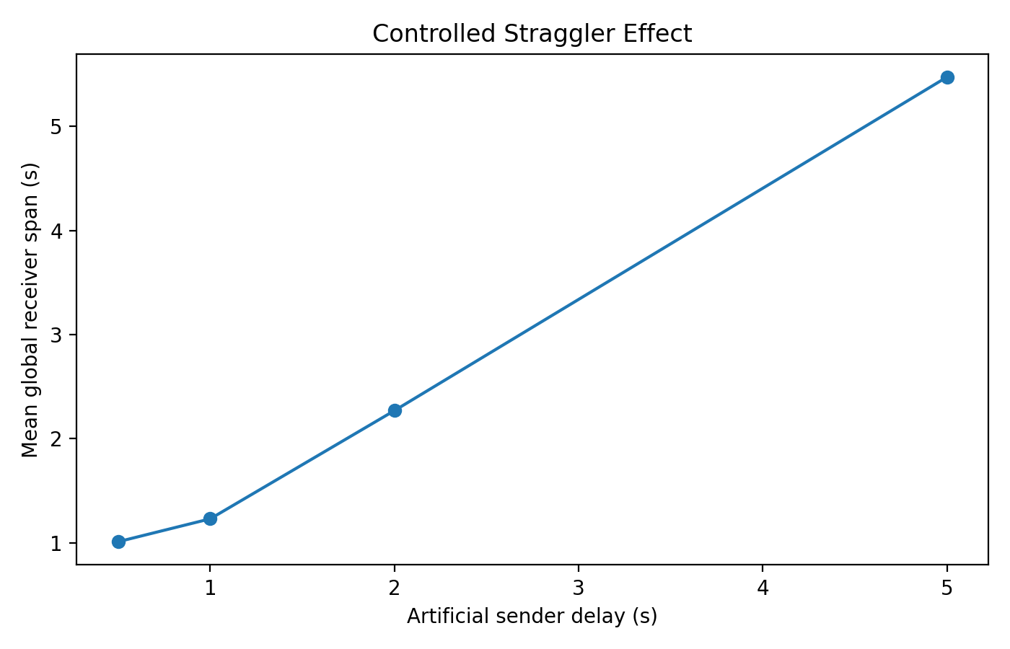
Result 2-B: Controlled Straggler Effect
Purpose: Examine whether one delayed sender determines global completion time.
Delay
Global span
0.5 s
1.009 s
1.0 s
1.229 s
2.0 s
2.269 s
5.0 s
5.475 s
• Delay added to one sender
• Delay ↑ → global span ↑
• One straggler can determine completion time
15
Notes:
English:
Result 2-B examines the controlled straggler effect. I added an artificial delay to one sender. As the delay increased, the global span also increased. With a five-second delay, the global span was about 5.48 seconds. One delayed sender can therefore determine the overall completion time.
Japanese:
Result 2-Bでは、controlled straggler effectを確認します。1つのsenderに人工的な遅延を追加しました。遅延が大きくなるにつれてglobal spanも増加しました。5秒の遅延ではglobal spanは約5.48秒でした。このことから、1台の遅れたsenderが全体の完了時間を決める可能性があると分かります。

Slide 17
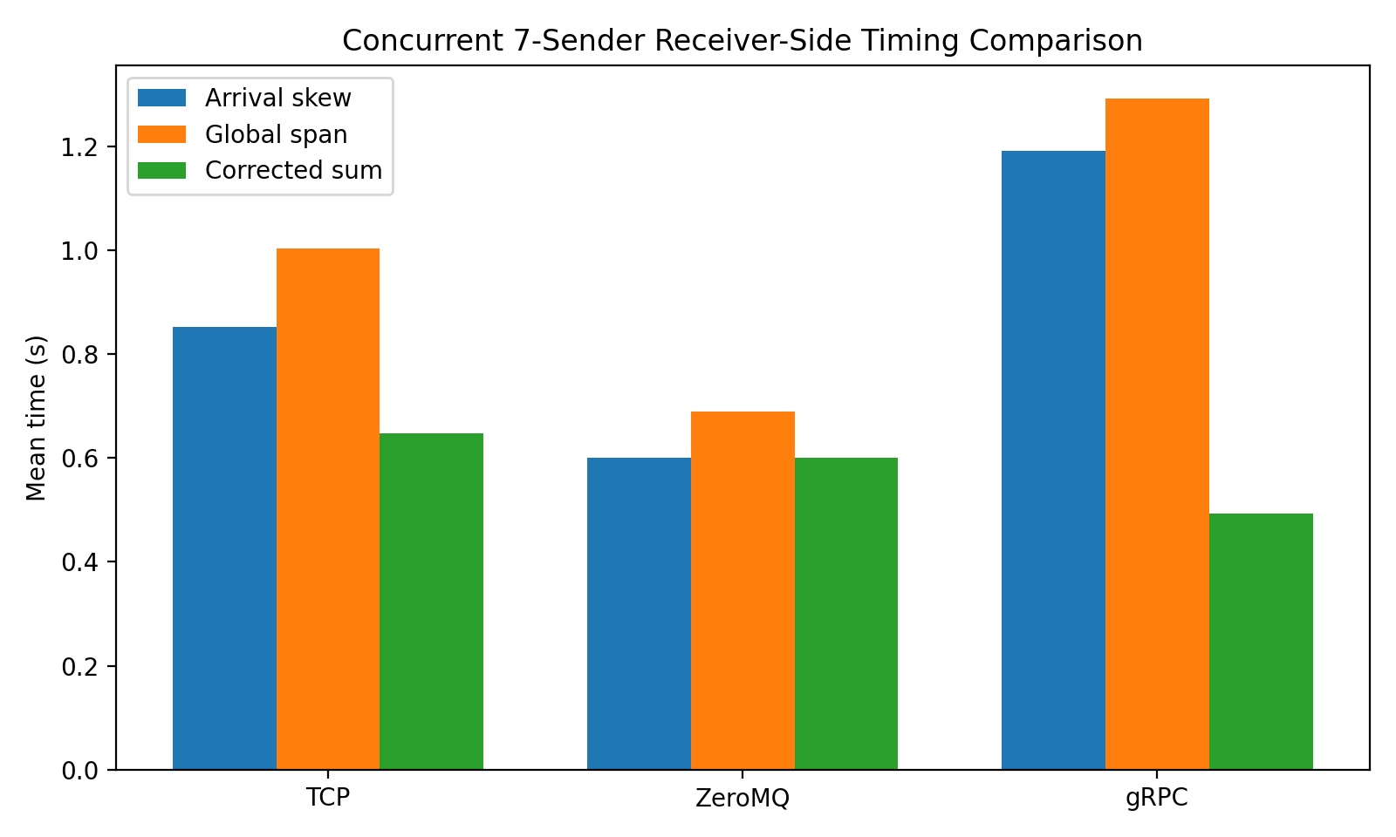
Result 2-C: Arrival Skew in Concurrent Execution
Purpose: Evaluate the effect of sender arrival imbalance on global completion.
gRPC:
• per-sender span: 0.070 s
• arrival skew: 1.193 s
• global span: 1.293 s
Finding
• Short sender span ≠ short global span
• Arrival skew increases completion time
16
Notes:
English:
Result 2-C analyzes arrival skew. gRPC had the shortest mean per-sender span, about 0.070 seconds. However, its arrival skew was about 1.193 seconds, and its global span was 1.293 seconds. Fast individual transfers do not always lead to fast global completion.
Japanese:
Result 2-Cでは、arrival skewを分析します。gRPCのmean per-sender spanは約0.070秒で最も短い値でした。しかし、arrival skewは約1.193秒、global spanは1.293秒でした。つまり、個々の転送が速くても、全体の完了が必ず速くなるわけではありません。

Slide 18
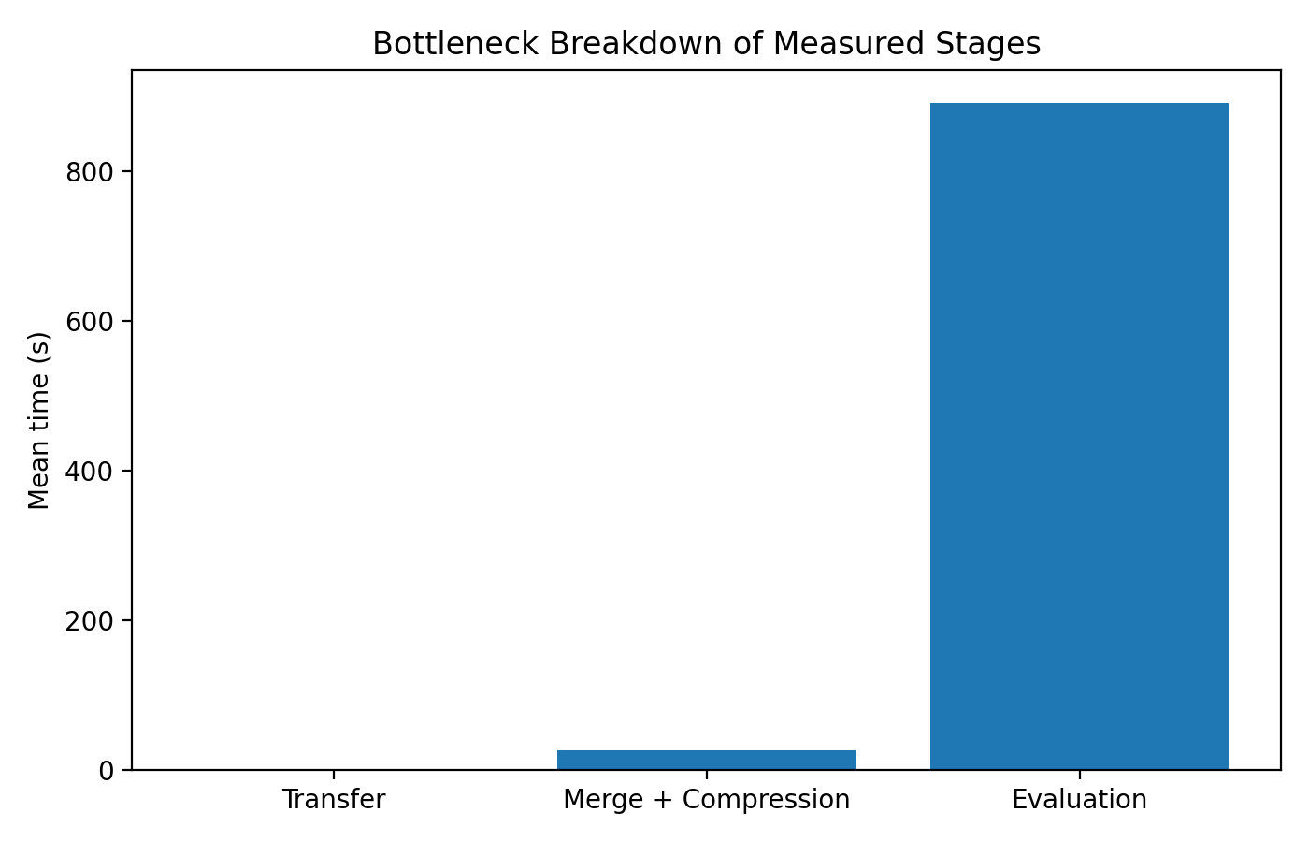
Result 3: Receiver-Side Bottleneck
Purpose: Identify the dominant receiver-side processing stage.
Stage
Mean time
Transfer
1.26 s
Merge + compression
26.23 s
Evaluation
890.75 s
Evaluation accounted for about 97% of the measured workflow time.
17
Notes:
English:
Result 3 identifies the receiver-side bottleneck. Transfer took about 1.26 seconds, merge plus compression took about 26.23 seconds, and MNIST evaluation took about 890.75 seconds. Evaluation accounted for about 97 percent of the measured workflow time, so it was the dominant processing cost.
Japanese:
Result 3では、receiver-side bottleneckを確認します。Transferは約1.26秒、merge plus compressionは約26.23秒、MNIST evaluationは約890.75秒でした。Evaluationは測定したworkflow timeの約97％を占めており、この実験では最も大きなprocessing costでした。

Slide 19
Result 4: Final Model Quality
Impact of a Low-Accuracy Sub-model
Check
Condition
Accuracy
Original model_1
250 neurons, 0-6000
0.5349
Remove model_1
model_2-9 only
0.8033
Change data range
250 neurons, 6000-12000
0.7358
Change neurons
200 neurons, 0-6000
0.8290
These results indicate that sub-model quality, rather than the communication approach, was a major factor in the low asymmetric-model accuracy.
18
Notes:
English:
Result 4 evaluates final model quality. The original model_1 had a standalone accuracy of 0.5349. When I removed it, merged-model accuracy increased to 0.8033. Changing the training data range or neuron count also improved accuracy. This shows that sub-model quality strongly affected the asymmetric-model accuracy.
Japanese:
Result 4では、final model qualityを評価します。元のmodel_1のstandalone accuracyは0.5349でした。このsub-modelを除外すると、merged-model accuracyは0.8033まで上昇しました。また、training data rangeやneuron countを変更した場合もaccuracyが改善しました。この結果から、sub-model qualityがasymmetric-model accuracyに強く影響していたことが分かります。

Slide 20
Table of Contents
1. Introduction
2. Proposal
3. Evaluation
4. Conclusion
19
Notes:
English:
Finally, I will summarize the conclusion.
Japanese:
最後に、結論をまとめます。

Slide 21
Conclusion and Future Work
Conclusion
Implemented and validated the model-transfer and receiver-side integration workflow using TCP, ZeroMQ, and gRPC.
Workflow performance depended on sender coordination, receiver-side processing, and sub-model quality—not on communication approach alone.
Future work
Evaluate the workflow on physical devices and different types of devices.
Improve sender coordination and reduce receiver-side processing cost.
20
Notes:
English:
In conclusion, I implemented and validated the model-transfer and receiver-side integration workflow using TCP, ZeroMQ, and gRPC. Performance depended not only on communication, but also on sender coordination, receiver-side processing, and sub-model quality. Future work will evaluate physical and different types of devices, improve sender coordination, and reduce receiver-side processing cost.
Japanese:
結論として、TCP、ZeroMQ、gRPCを用いたmodel-transfer and receiver-side integration workflowを実装し、動作を確認しました。性能はcommunicationだけでなく、sender coordination、receiver-side processing、sub-model qualityにも左右されました。今後は、physical and heterogeneous devicesでの評価、sender coordinationの改善、receiver-side processing costの削減を行います。

Slide 22
References
[1] W. Maass, “Networks of spiking neurons: The third generation of neural network models,” Neural Networks, vol. 10, no. 9, pp. 1659–1671, 1997.
[2] H. Markram, W. Gerstner, and P. J. Sjöström, “Spike-Timing-Dependent Plasticity: A Comprehensive Overview,” Frontiers in Synaptic Neuroscience, vol. 4, Art. 2, 2012.
[3] Y. Hanyu and K. N. Dang, “EnsembleSTDP: Distributed in-situ Spike Timing Dependent Plasticity Learning in Spiking Neural Networks,” 2024 IEEE 17th International Symposium on Embedded Multicore/Many-core Systems-on-Chip (MCSoC), pp. 434–440, 2024.
[4] H. Hazan et al., “BindsNET: A Machine Learning-Oriented Spiking Neural Networks Library in Python,” Frontiers in Neuroinformatics, vol. 12, Art. 89, 2018.
Research group GitHub: https://github.com/klab-aizu
EnsembleSTDP source code: https://github.com/klab-aizu/EnsembleSTDP
21
Notes:
English:
These are the main references and open-source repositories used in this research.
Japanese:
こちらが、本研究で使用した主な参考文献とopen-source repositoryです。

Slide 23
Thank you for your attention!
Any questions?
22
Notes:
English:
Thank you for your attention. I would be happy to answer any questions.
Japanese:
ご清聴ありがとうございました。質問があればお願いします。

