Slide 1

SpikeGAN: An Energy-Efficient Spiking Generative Adversarial Network Design
Team Zynapse
Yuga Hanyu, Atharv Sharma and Aruki Komatsuzaki
School of Computer Science and Engineering University of Aizu, Fukushima, Japan E-mail: {m5291018, m5292015, s1310244}@u-aizu.ac.jp
Date: March 6, 2026

Slide 2
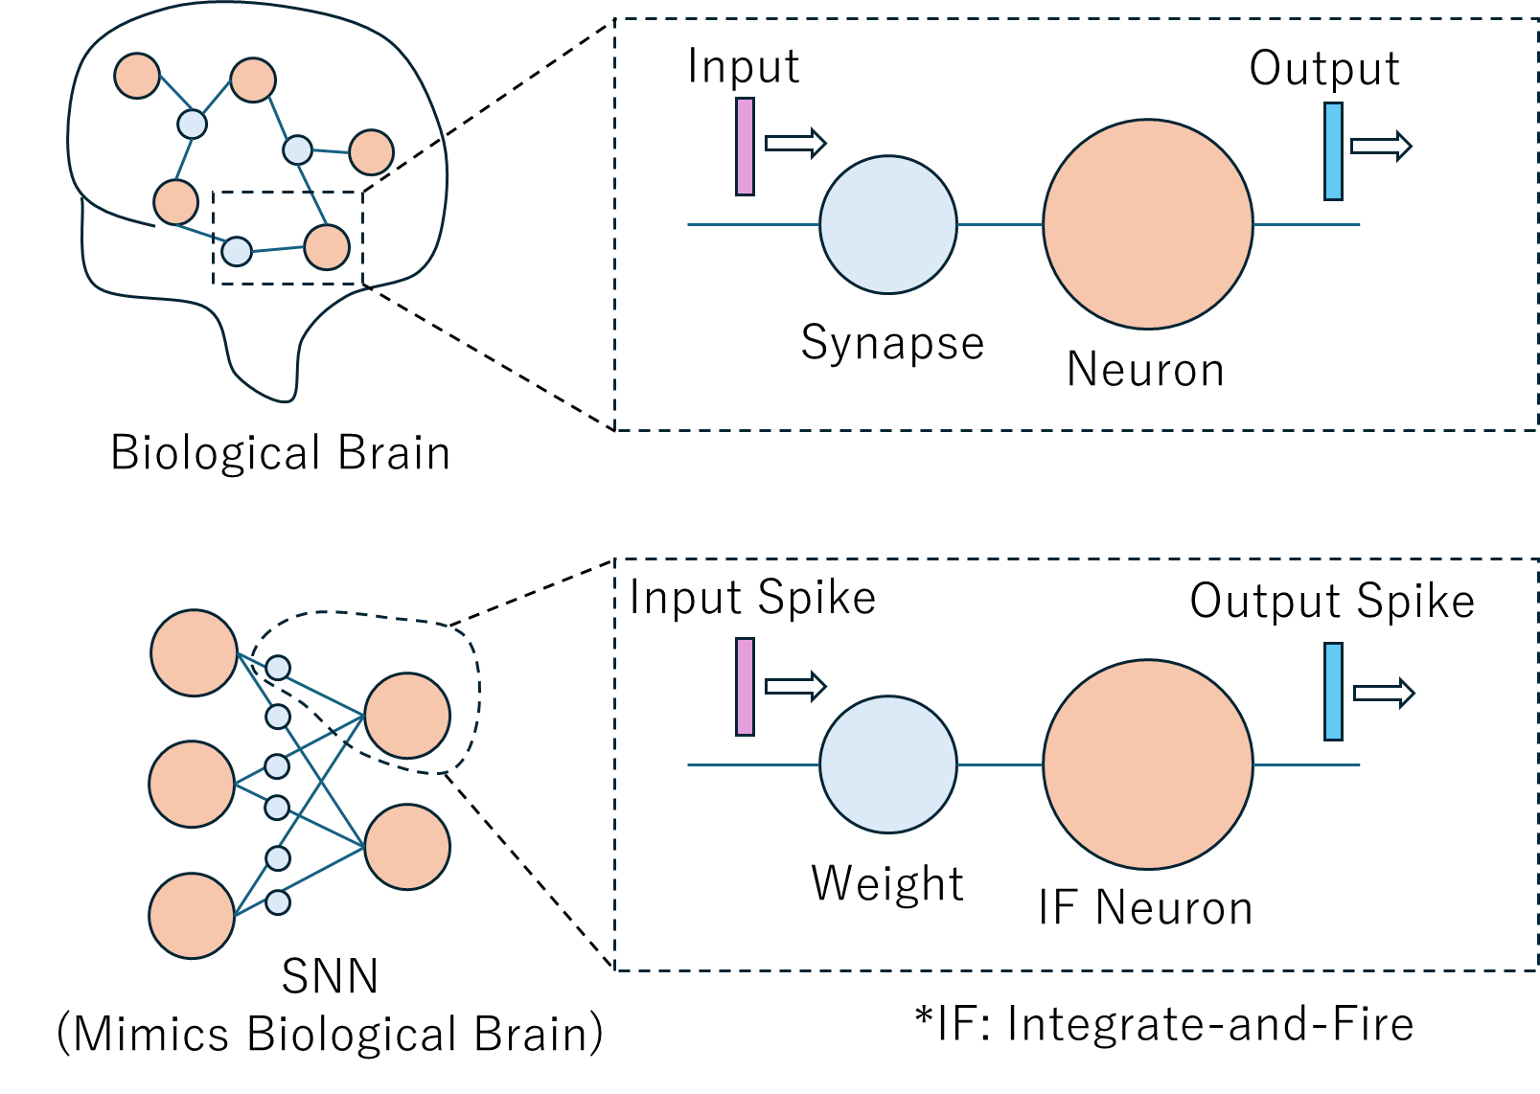
Spiking Neural Networks (SNNs)
SNNs offer great energy efficiency.
Event-Driven processing: computes only when there is a spike.
Addition-and-Accumulation: computation consists of only addition and accumulation of spikes.
Fig. 1 Biological brain and Spiking Neural Network

Slide 3
Design Flow
❶ Training & Conversion on Software
Train Generative Adversarial Networks
Convert Generator ANN to SNN
Export Generator SNN’s Parameters
❷ Chip Implementation
RTL
Simulation
ASIC & FPGA Implementation
Synthesis
Fig. 2 Design flow of spiking implementation of GAN on Chip

Slide 4
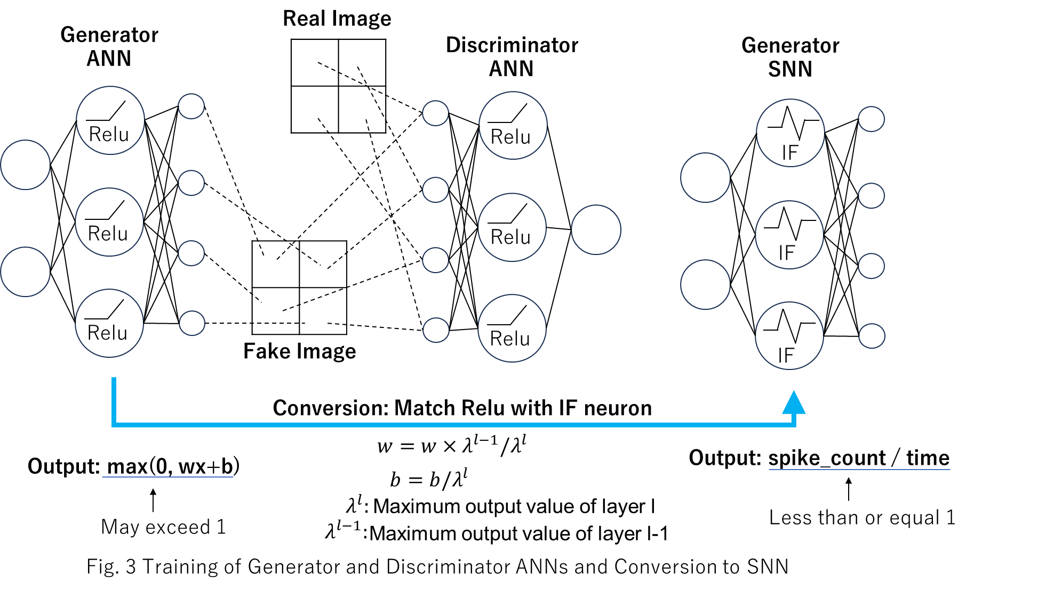
Training and Conversion
Fig. 3 Training of generator and discriminator ANNs and conversion to SNN

Slide 5
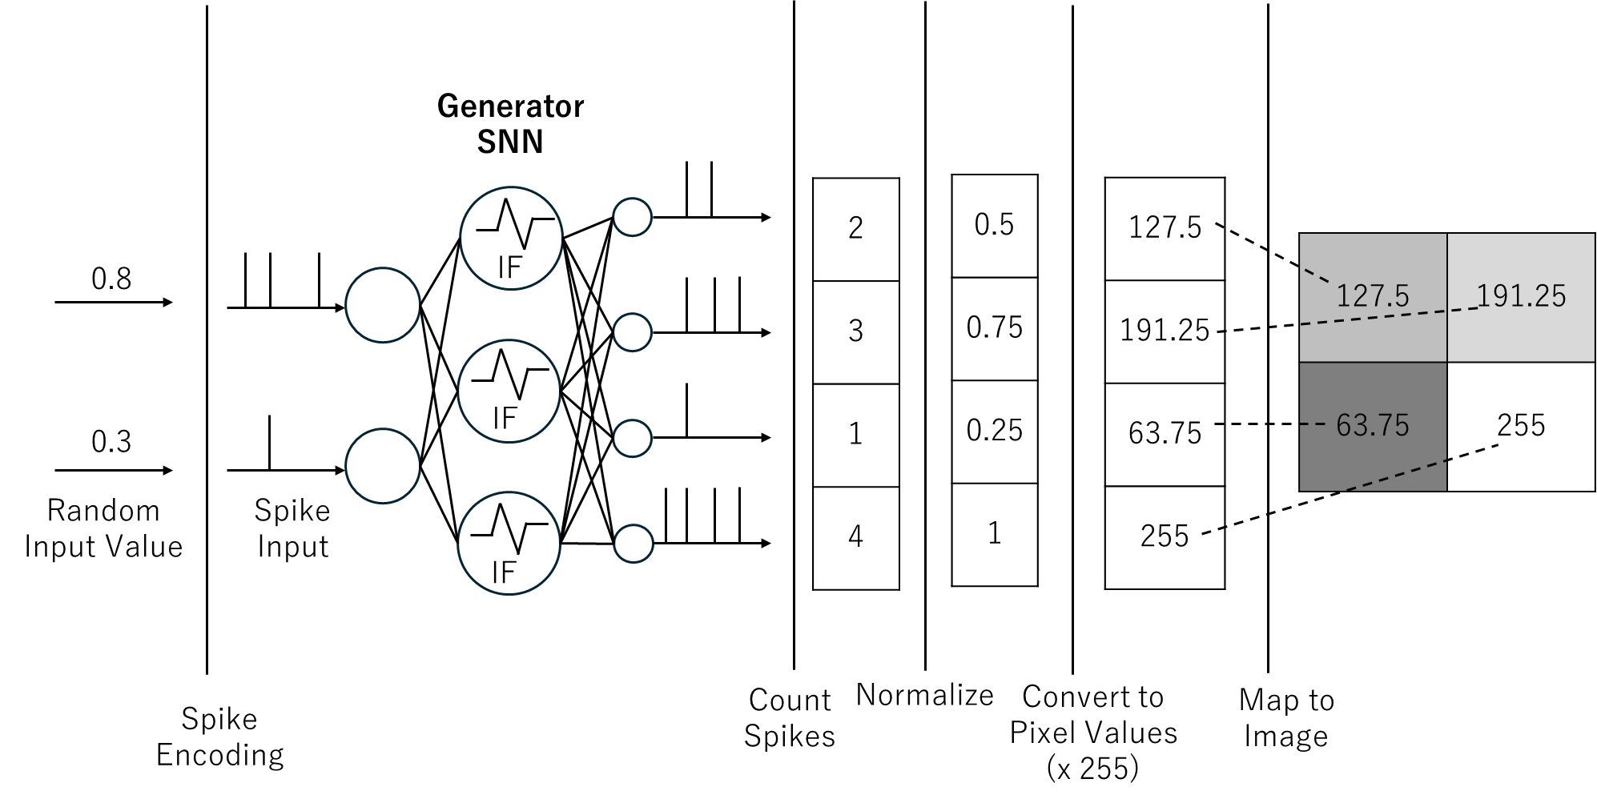
How to Obtain Image from SNN
Fig. 4 Obtaining image from SNN

Slide 6
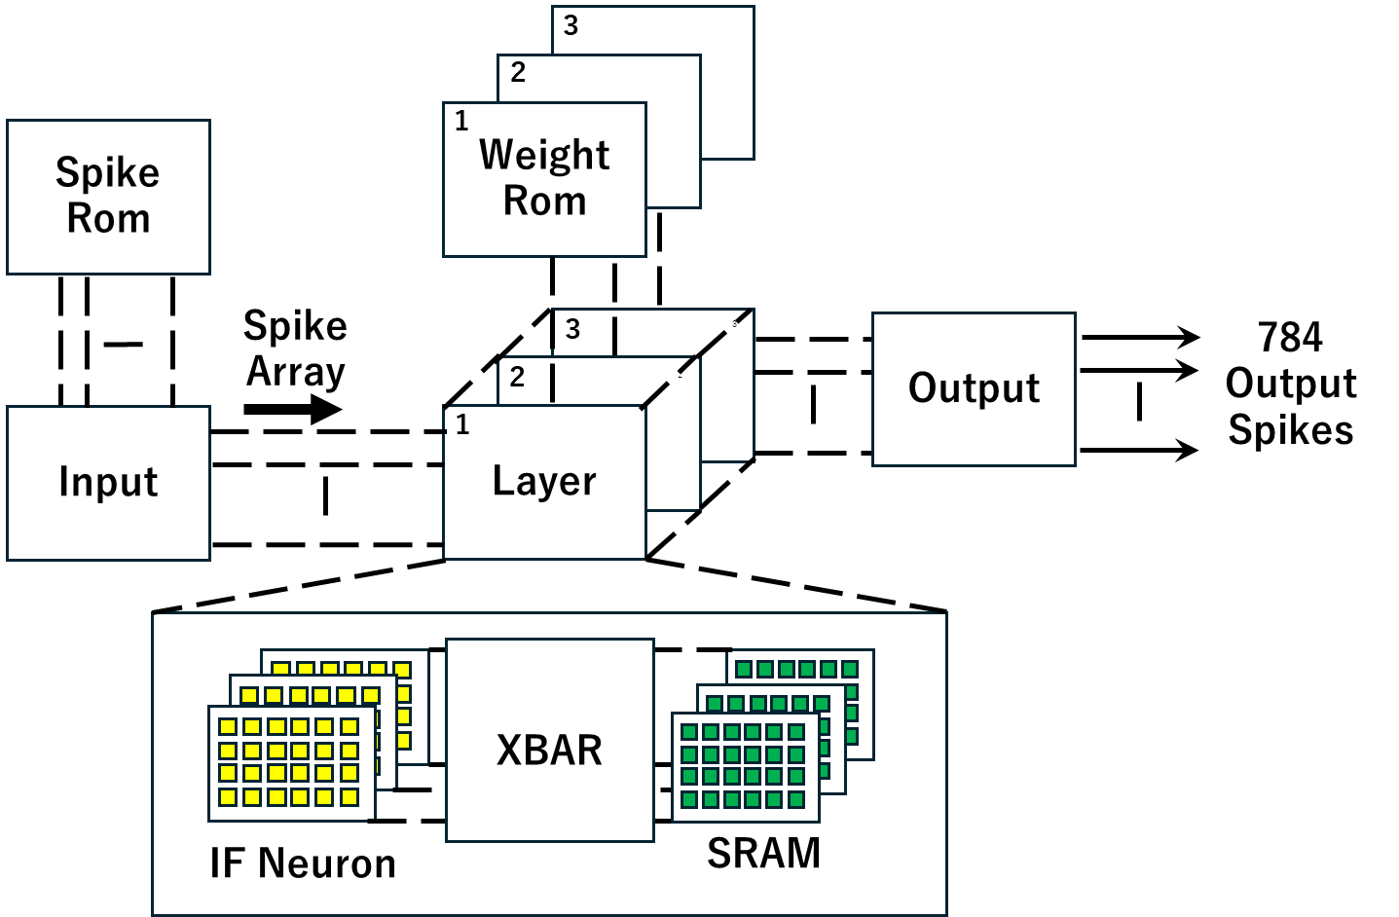
Architecture
Synapse Crossbar
: Active
: Inactive
: Axon
: Dendrite
d₀
d₁
d₂
d_{n-1}
a_{n}
d_{n}
a₀
. . . .
a₁
N
n
. . . .
N
Decoder
Input Spike
a₂
Generator
Decoder
. . . .
Encoder
From other Clusters
Input Spike
. . .
. . .
. . .
. . .
To other Clusters
a_{n-1}
. . . .
Address Out.
m
IF Array
IF Neuron
x
N
Fig. 5 Architecture of chip implementation
Fig. 6 Computing Core

Slide 7
Evaluation
Tools
GAN model training on software: Python, Pytorch library
ASIC implementation: Synopsys Design Compiler
FPGA implementation: Vivado 2019.1 and Artix-100T
Technology node: CMOS PDK 45nm
Model Setup
Training data: MNIST Handwritten Digits
Training numbers: 600 images per batch x 15 epochs
Generator model size:
RTL Simulation: 100x1200x1200x784
ASIC and FPGA Implementation: 100x64x64x784
Evaluation Methodology
Comparison between software and RTL simulation outputs
Implementation results in ASIC and FPGA

Slide 8
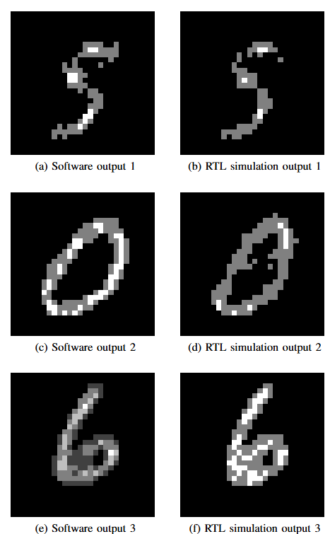
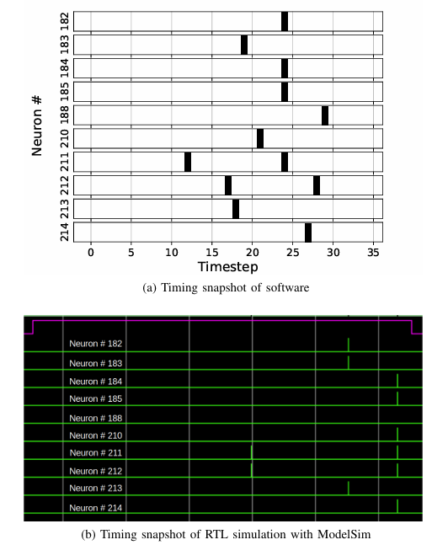
RTL Simulation
Fig. 7 Software and RTL Spike
Timing Comparison
Fig. 8 Software and RTL
Output Image Comparison

Slide 9
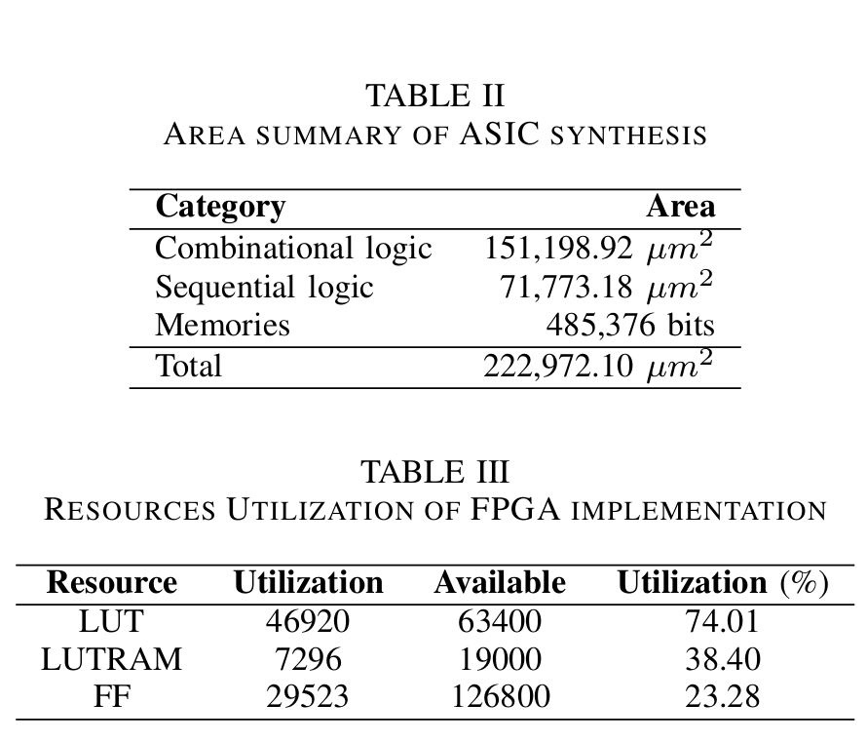
ASIC & FPGA Implementation
Tools
ASIC implementation: Synopsys Design Compiler
FPGA implementation: Vivado 2019.1 and Artix-100T
Technology node: CMOS PDK 45nm
Network structure: 100x64x64x784

Slide 10
Conclusion
ANN-based GAN was trained and generator was converted to the equivalent SNN.
Synthesis & implementation were also successfully performed for ASIC and FPGA.
Limitation: Due to memory constraint on-chip, model size needs to be reduced.
Future work: Power consumption analysis for both ANN and SNN generator on chip & implement compression techniques.

Slide 11
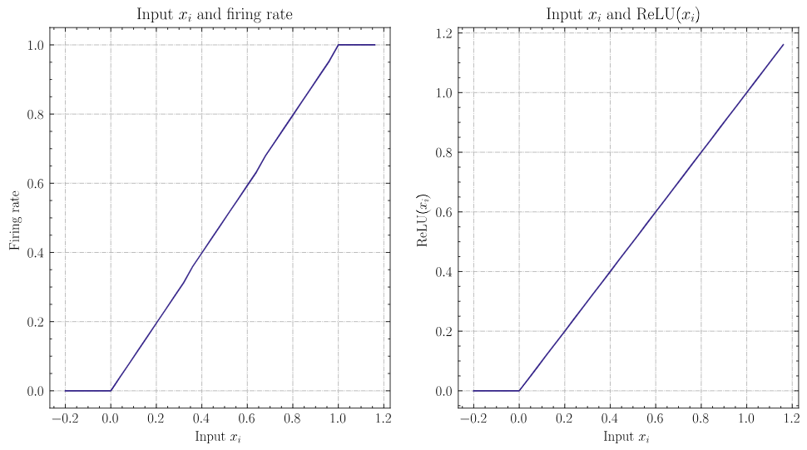
Difference Between ReLu and IF Neuron
IF Neuron
ReLu
Outputs from ReLu and IF neurons are similar.
Output from IF neuron (firing rate) can not exceed 1.
Weight normalization is necessary to match ReLu and IF neuron.

