Slide 1
102: neural network core
106：neural array
105
111: memory bank
SN₁
WMB
106: neural array
102: neural network core
WMB
104
SN₂
…
SN₃
WMB
…
NI
WM
SN_{N}
NA
105: memory
NI
104: network interface
110: neural circuit
103: on-chip network
107: router
112: on-chip network link
CPU
109
108: inter-chip link
101: neural network processor

Slide 2
202: Neuron Model
203: Input of Neuron Model
204: Accumulation function
201: Neural Network Model
205: Activation function
202: Neuron Model
Input
Input
Σ
output
f
…
…
Input
…
…
…
207: Output of Neuron Model
206: communicating between two neuron
図3

Slide 3
302: Approximate Neuron Model
203
304: Approximate Accumulation function
305: Approximate Activation function
301: Approximate Neural Network Model
302: Approximate Neuron Model
Input
Input
Σ
f
output
…
…
Input
…
…
…
207
206
図4

Slide 4
Start
Initial set of approximate operators
Downsize
Evaluate approximate operators on the target application
Set of non-dominated approximate operators
Reduce the number of approximate operators
Remove approximate operators based on quality constraint
Downsize
Minimum set of
approximate operators
Design space exploration on the target application
Design optimization flow
Select optimal solutions for
the target application
Finish
図2

Slide 5




Initiate
Yes
Record result (e.g., HW overheads, quality)
No
Non-dominated sorting & selection of recorded data
Extract top-rank
Set of non-dominated approximate operators
Fig. K2

Slide 6









Op. 1
Op. 2
Initial set of approximate operators
Op. 3
Application
……
2. Replace operators
……
3. Record the result in the database
Database
Name | Quality | Power | …
 |  |  | …
 |  |  | …
… | … | … | …
 |  |  | …
Fig. K3

Slide 7




Database
Name | Quality | Power | …
 |  |  | …
 |  |  | …
… | … | … | …
 |  |  | …
Quality loss
Quality loss
1. Non-dominated sorting
3rd rank
2nd rank
1st rank
Power
Power
Set of non-dominated approximate operators
2. Extract 1st rank
……
……
Fig. K6

Slide 8





















Database
Y
Name | X | Y
 | 2 | 2
 | 5.5 | 3
 | 3 | 2.5
 | 1 | 1
 | 5 | 4
 | 1.5 | 4
5
4
3
2
1
1
2
3
4
5
X
Y
Y
Y
5
5
5
4
4
4
3
3
…
3
2
2
2
1
1
1
1
2
3
4
5
X
1
2
3
4
5
X
1
2
3
4
5
X
Rank 1
Rank 2
Rank 4
Fig. K7
Notes:
Numerical example of non-dominated selection

Slide 9




Initialize k = 0
Set of non-dominated approximate operators
Sort in descending order of quality
No
k = k + 1
Yes
Yes
No
k == 0
Yes
Fail in optimization
No
Minimum set of approximate operators
Fig. K8

Slide 10





Set of non-dominated approximate operators
……
Sort in descending order of quality
……
…
High quality
Low quality
Fig. K9

Slide 11







…
High quality
Low quality
Minimum set of approximate operators
Name | Quality | …
 | 90% | …
 | 82% | …
 | 75% | …
 | 68% | …
… | … | …
 | 43% | …
 | 30% | …
Name | Quality | …
 | 90% | …
 | 82% | …
 | 75% | …
 | 68% | …
… | … | …
 | 43% | …
 | 30% | …
Removed
Fig. K10

Slide 12

Start optimization
Minimum set of approximate operators
Initialize population (duplication)
Generate new population
Evaluate solutions on target application
Continue?
Yes
No
Finish optimization
Fig. K11
Notes:
Overview of the optimization flow. (Similar to the general GA process)

Slide 13





Minimum set of approximate operators
Yes
Continue?
No
Finish initialization
Fig. K12
Notes:
Method to initialize population

Slide 14











……
Duplicate by #genes
……
Solution 0
# genes
……
Solution 1
# genes
……
……
Solution N-1
# genes
Fig. K13
Notes:
Illustration of the method for initializing the initial population

Slide 15









Can approximate?
No
Yes
Valid?
Yes
No
Increment approximation level by one
Yes
No
Fig. K14
Notes:
Method to generate new population

Slide 16
Approximate operators
Population (current)
1
2
3
4
(a)
1
1
3
2
(b)
4
1
2
1
High quality
Low quality
(a)
(b)
Chose one gene
(e.g. #0)
Chose one gene
(e.g. #0)
Chose one gene
(e.g. #2)
1
1
3
2
4
1
2
1
4
1
2
1
Possible to degrade it?
Possible to degrade it?
Possible to degrade it?
Yes
No
Yes
1
1
3
2
4
1
2
1
4
1
2
1
Increment by one
Repeat
Increment by one
2
1
3
2
4
1
3
1
(a)
1
1
3
2
(b)
4
1
2
1
2
1
3
2
4
1
3
1
Population (next)
Inserted
Fig. K15
Notes:
Illustration of the method to generate new population

Slide 17

Evaluate solutions on the target application
Solution | Quality | …
#1 | 90% | …
#2 | 88% | …
#3 | 83% | …
#4 | 72% | …
… | … | …
#N-1 | 43% | …
#N | 30% | …
Solution | Quality | …
#1 | 90% | …
#2 | 88% | …
#3 | 83% | …
#4 | 72% | …
… | … | …
#N-1 | 43% | …
#N | 30% | …
Remove from the population
Produce the next generation from the remaining solutions
Fig. K16
Notes:
Illustrate the method of selection based on user-defined constraint with Qsol

Slide 18
Start
Test the target application by inserting bit errors in the data & formulate a prediction model
Pre-processing
Determine the redownloading interval time
Execute the redownloading process after every interval
Continue until the system is terminated
Online process
No
Terminated?
Yes
Finish
Fig. K17
Notes:
Overall flow of redownloading process

Slide 19
Initiate
Randomly insert data errors into the application program
Monte Carlo simulation
Evaluate the quality with data errors
Repeat?
Record result (Error and quality)
Yes
No
Prediction modeling with regression analysis
Finish
Fig. K18
Notes:
The methodology to test the target application with fault insertion and prediction modeling

Slide 20

Testing result
Quality
# Test | Error Rate | Quality
1 | 0.1% | 98%
2 | 0.5% | 95%
3 | 1.0% | 86%
4 | 5.0% | 70%
5 | 10.0% | 42%
Regression analysis
Error Rate
Prediction modeling
Fig. K19
Notes:
Example of prediction modeling with linear approximation

Slide 21



Quality
Initiate
80%
①
①
Decide the minimum application quality
E.g., 80% quality
②
Estimate the maximum error rate from the prediction model
Error Rate
②
Prediction model
③
Calculate the optimal time interval
③
Finish
Redownloading interval
Fig. K20
Notes:
The methodology to determine the redownloading interval based on the prediction model

Slide 22
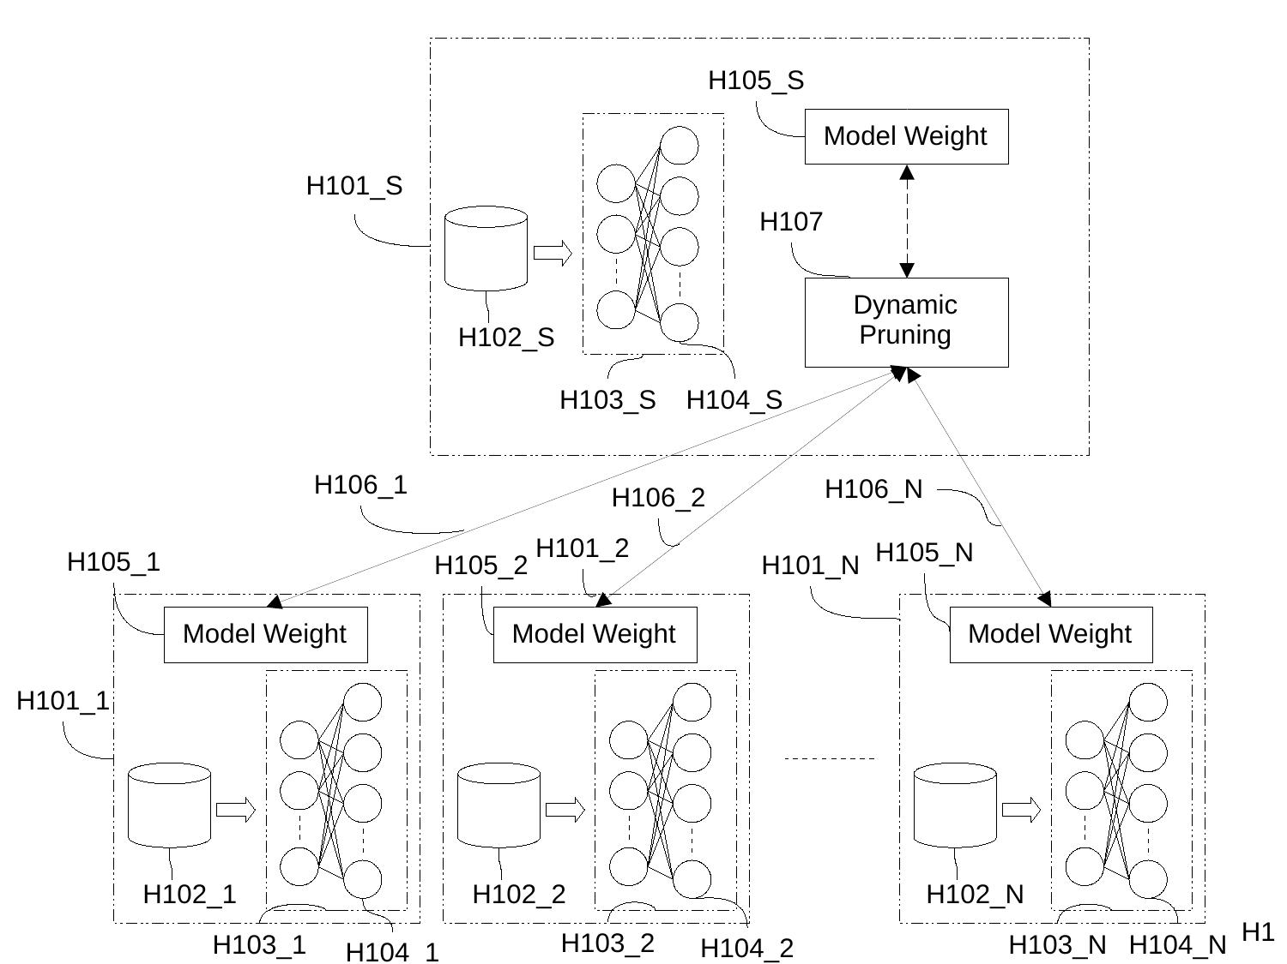

Slide 23
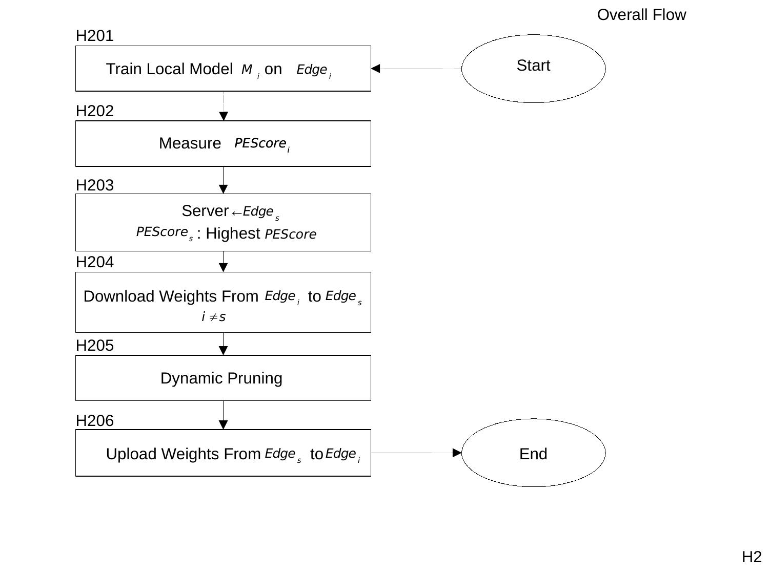

Slide 24
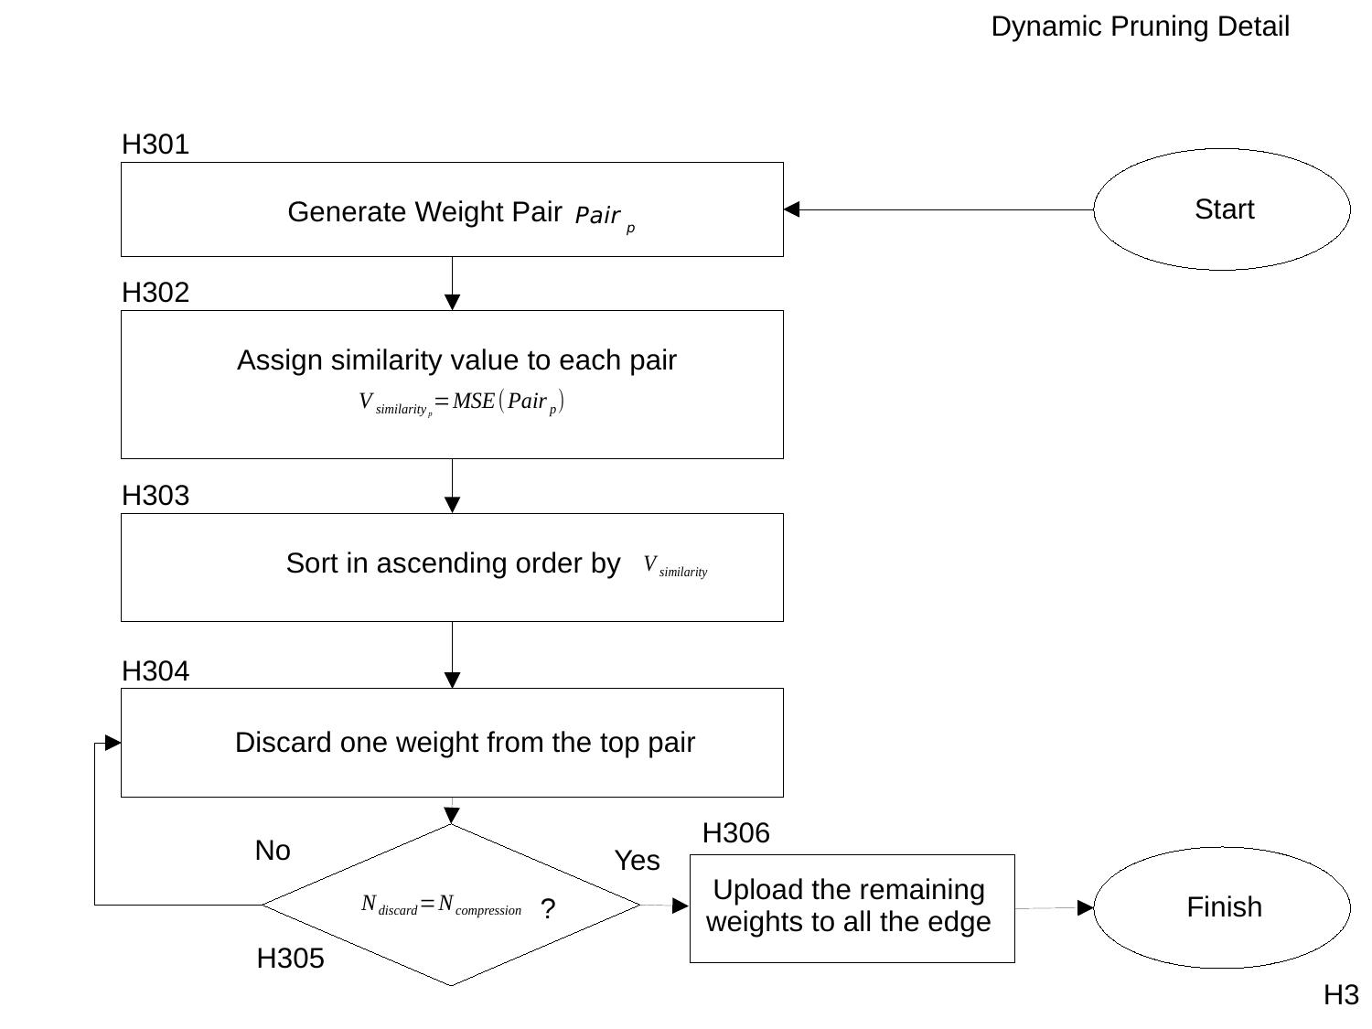

Slide 25
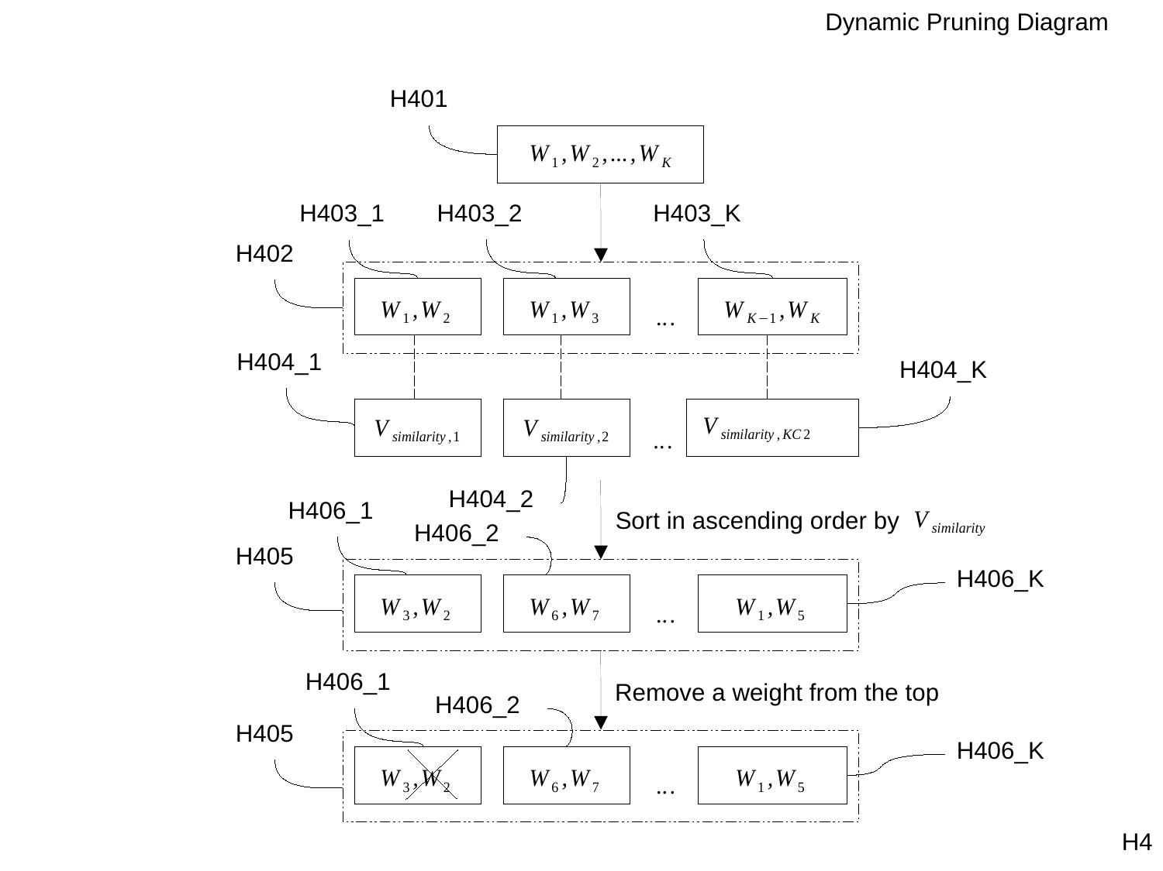

Slide 26
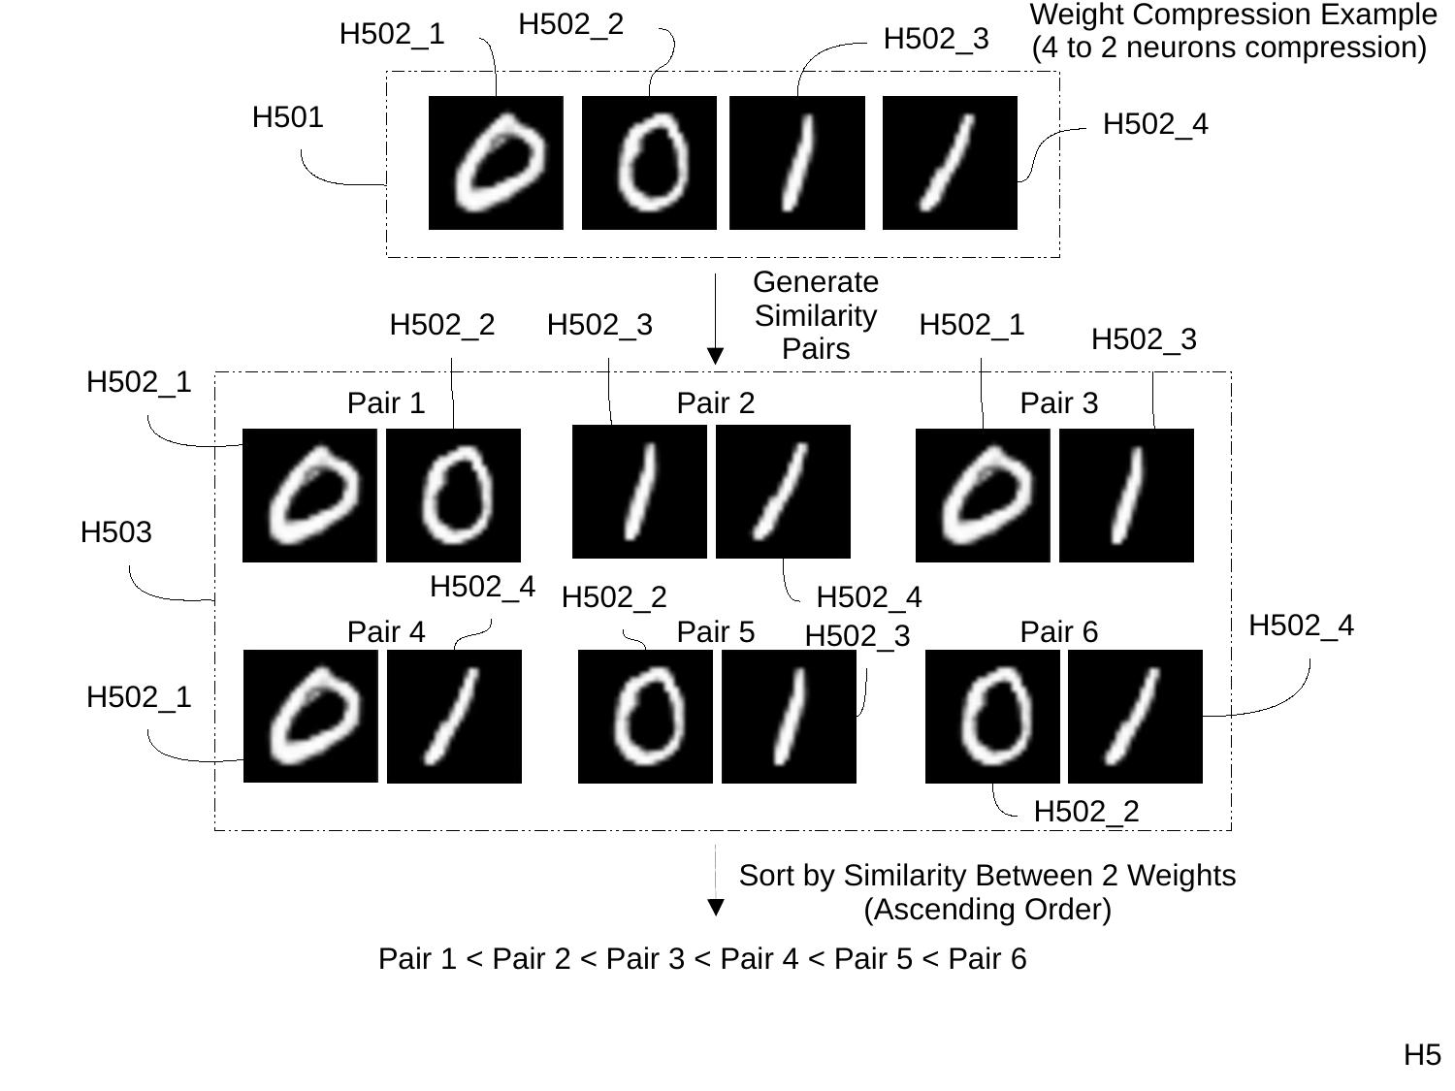

Slide 27
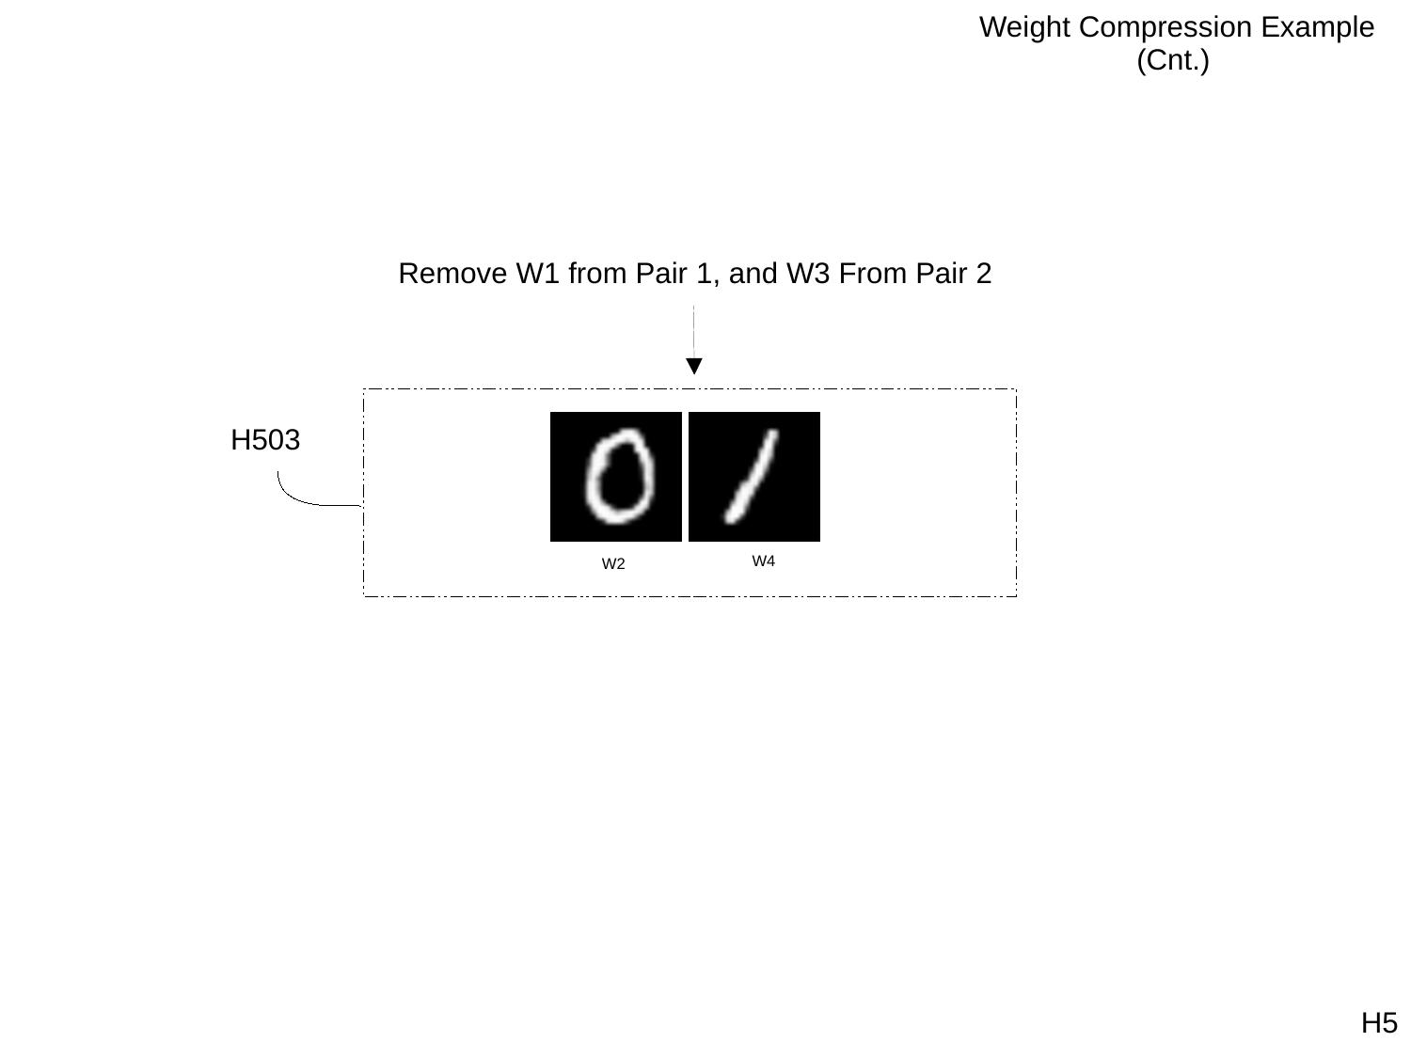

Slide 28
