Slide 1
Low-power AI computing system
School of Computer Science and Engineering
Assoc. Prof.
DANG Nam Khanh, KOBAYASHI Ryoji, HANYU Yuga, WANG Zhishang, BEN ABDALLAH Abderazek

Slide 2
Contents
（目次）
1. General Description of the Invention
(発明内容の概要)
2. Prospective Applications
(想定される用途)
3. Prospective Market/Business
(想定される業界）
4. Challenges for Practical Use
(実用化に向けた課題)
5. Patent Claims
(特許請求の範囲)
Q & A

Slide 3
1. General Description of the Invention[1]
(発明内容の概要[1])
Technical Background (技術概要)
An AI computing system consists of a computing unit, a memory, a storage, a communication, and an energy supply module.
A neural network processor is a processor that performs training and inference computation on neural network models.
Approximate computing is a method that uses an inaccurate or approximate circuit instead of the exact circuit.
A neural network model has a plurality of the neurons via their respective synapses.

Slide 4
1. General Description of the Invention[1]
(発明内容の概要[1])
Description of the Invention (発明内容の概要)
A design methodology for Low-Power AI Computing System:
Reduction of approximation circuit optimization search space based on the quality control parameter, followed by design space exploration.
For voltage scaling, memory correction approach by periodical re-downloading based on the ratio of induced error is used.
For dynamic pruning, temporal pruning based on similarity between neurons is used.

Slide 5
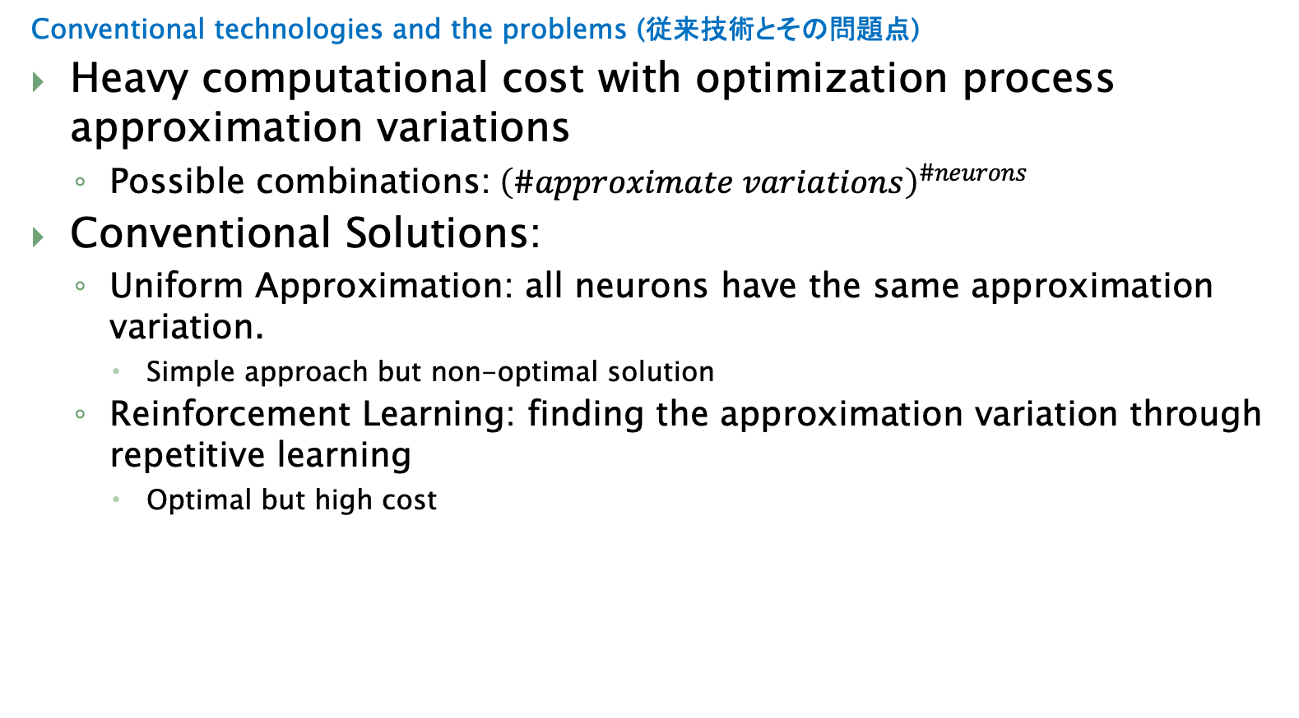
1. General Description of the Invention[2]
(発明内容の概要[2])
Conventional technologies and the problems (従来技術とその問題点)
Heavy computational cost with optimization process approximation variations
Possible combinations:${\left(\#approximate variations\right)}^{\#neurons}$
Conventional Solutions:
Uniform Approximation: all neurons have the same approximation variation.
Simple approach but non-optimal solution
Reinforcement Learning: finding the approximation variation through repetitive learning
Optimal but high cost

Slide 6
1. General Description of the Invention[2]
(発明内容の概要[2])
Conventional technologies and the problems (従来技術とその問題点)
Limited adaptability to fluctuating energy supply
A conventional method applies dynamic voltage scaling without an error recovery scheme
Error Recovery can be done with Error Correction Code (ECC)
ECC introduces extra information which leads to increase in power consumption
A conventional method needs a simpler AI model for less power consumption:
Several models need to be stored
Switching between model is not energy efficient

Slide 7
1. General Description of the Invention[2]
(発明内容の概要[2])
Description of the Invention (発明内容の概要)
102: neural network core
106：neural array
105
111: memory bank
SN₁
WMB
106: neural array
102: neural network core
WMB
104
SN₂
…
SN₃
WMB
…
NI
WM
SN_{N}
NA
105: memory
NI
104: network interface
110: neural circuit
103: on-chip network
107: router
112: on-chip network link
CPU
109
108: inter-chip link
101: neural network processor
Fig. 1. Overview of the neural network processor.

Slide 8
1. General Description of the Invention[2]
(発明内容の概要[2])
Description of the Invention (発明内容の概要)
Idea #1: reducing the search space
Start with a list of operators (approximate variations of a function).
A function could be addition, multiplication, etc…
Rank the operations in non-dominated lists.
Remove the “over-space” operators.
If the operator is ”too accurate” for the application
And it has high power consumption
The operator is not kept for optimizing

Slide 9
1. General Description of the Invention[2]
(発明内容の概要[2])
Description of the Invention (発明内容の概要)
202: Neuron Model
203: Input of Neuron Model
204: Accumulation function
201: Neural Network Model
205: Activation function
202: Neuron Model
Input
Input
Σ
f
output
…
…
Input
…
…
…
207: Output of Neuron Model
206: communicating between two neuron
Fig. 2: Examples of a neural network.

Slide 10
1. General Description of the Invention[2]
(発明内容の概要[2])
Description of the Invention (発明内容の概要)
302: Approximate Neuron Model
203
304: Approximate Accumulation function
305: Approximate Activation function
301: Approximate Neural Network Model
302: Approximate Neuron Model
Input
Input
Σ
f
output
…
…
Input
…
…
…
207
206
Fig. 3: Approximate neural network.

Slide 11
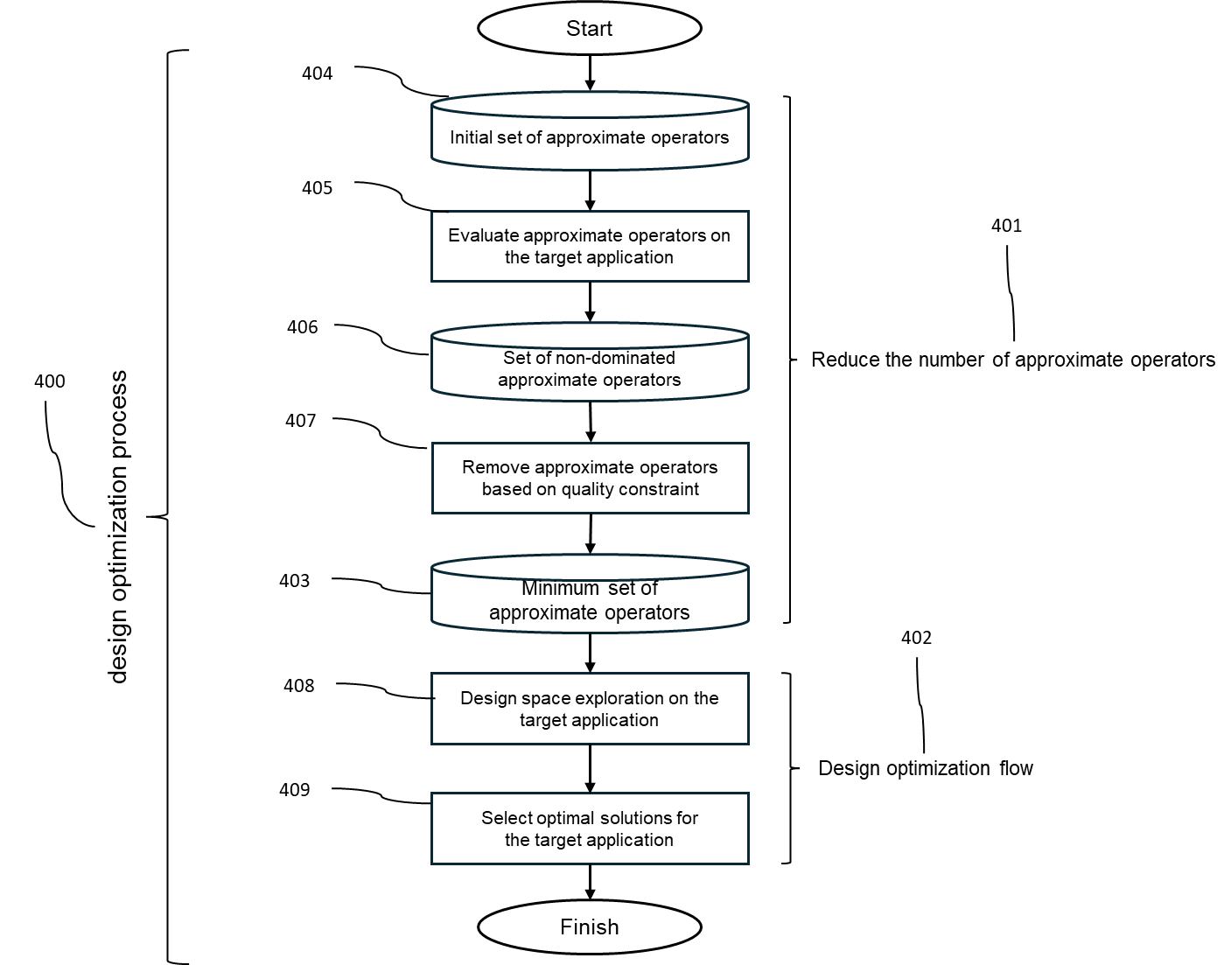
1. General Description of the Invention[2]
(発明内容の概要[2])
Description of the Invention (発明内容の概要)
Fig. 4: Overview of the optimization process.

Slide 12
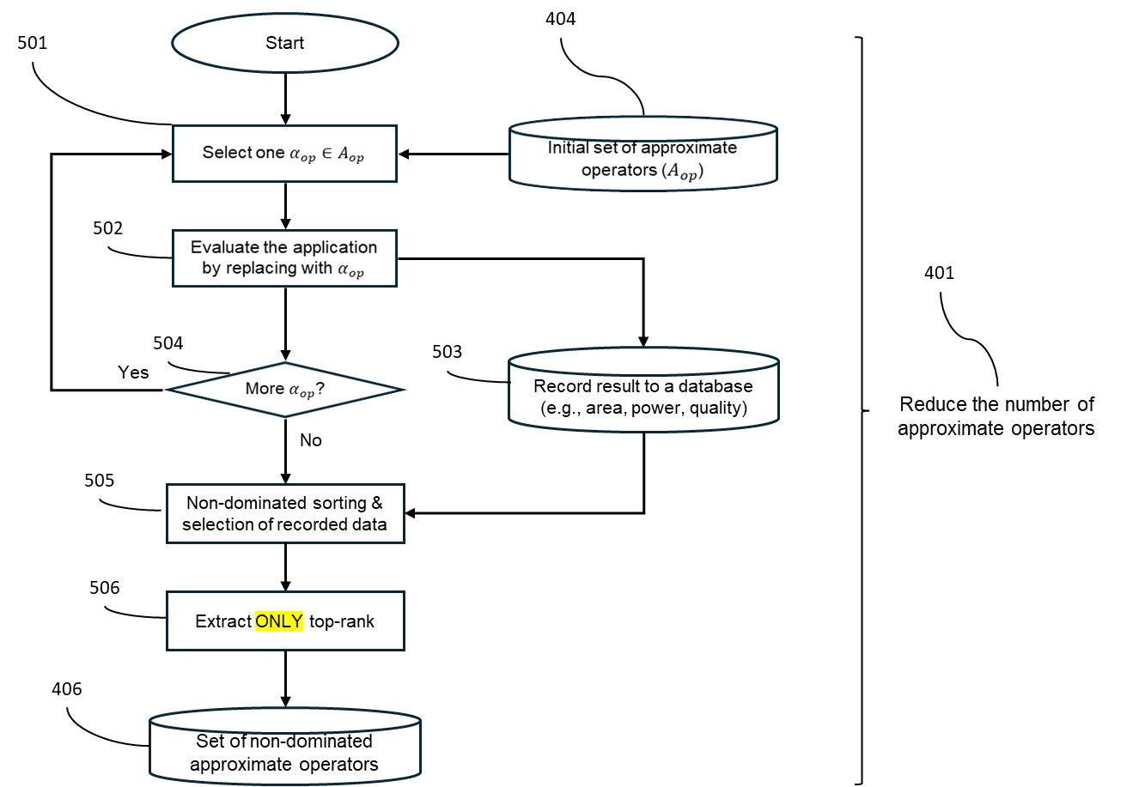
1. General Description of the Invention[2]
(発明内容の概要[2])
Description of the Invention (発明内容の概要)
Fig. 5: Algorithm to find the non-dominated approximate operators.

Slide 13
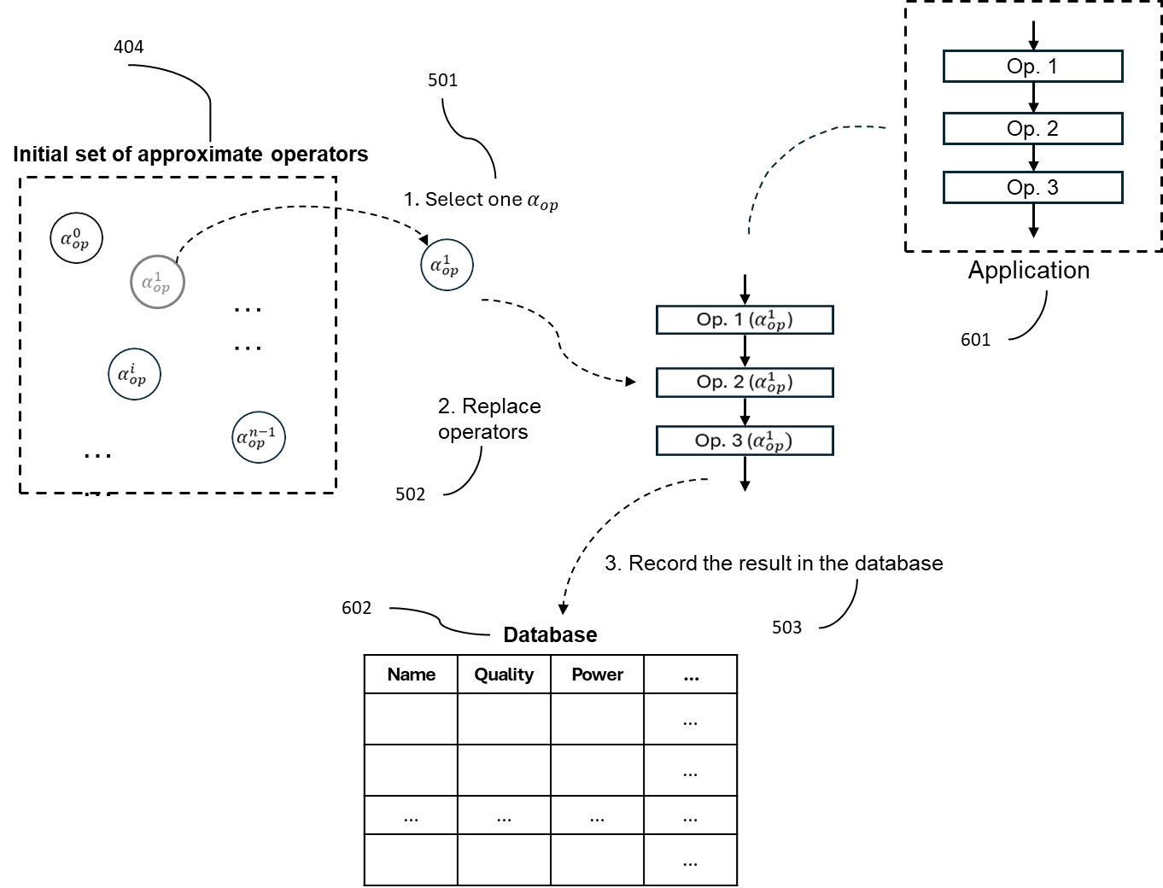
1. General Description of the Invention[2]
(発明内容の概要[2])
Description of the Invention (発明内容の概要)
Fig. 6: Target application evaluation with each approximate operator.

Slide 14
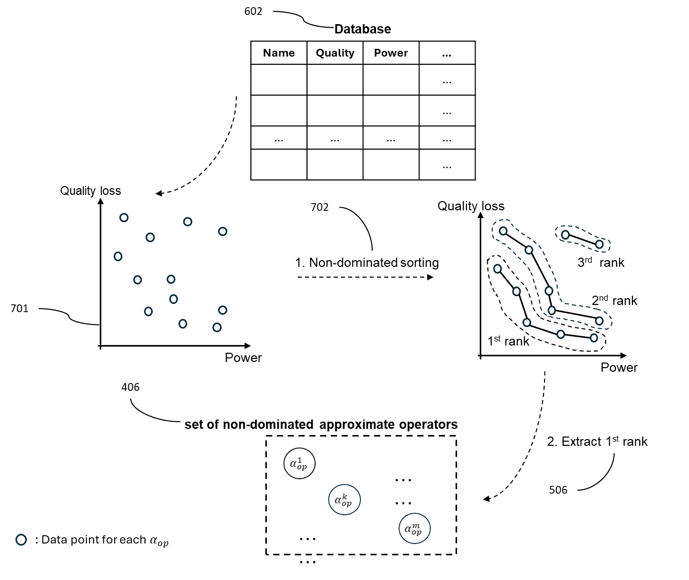
1. General Description of the Invention[2]
(発明内容の概要[2])
Description of the Invention (発明内容の概要)
Fig. 7: Process of non-dominated selection.

Slide 15
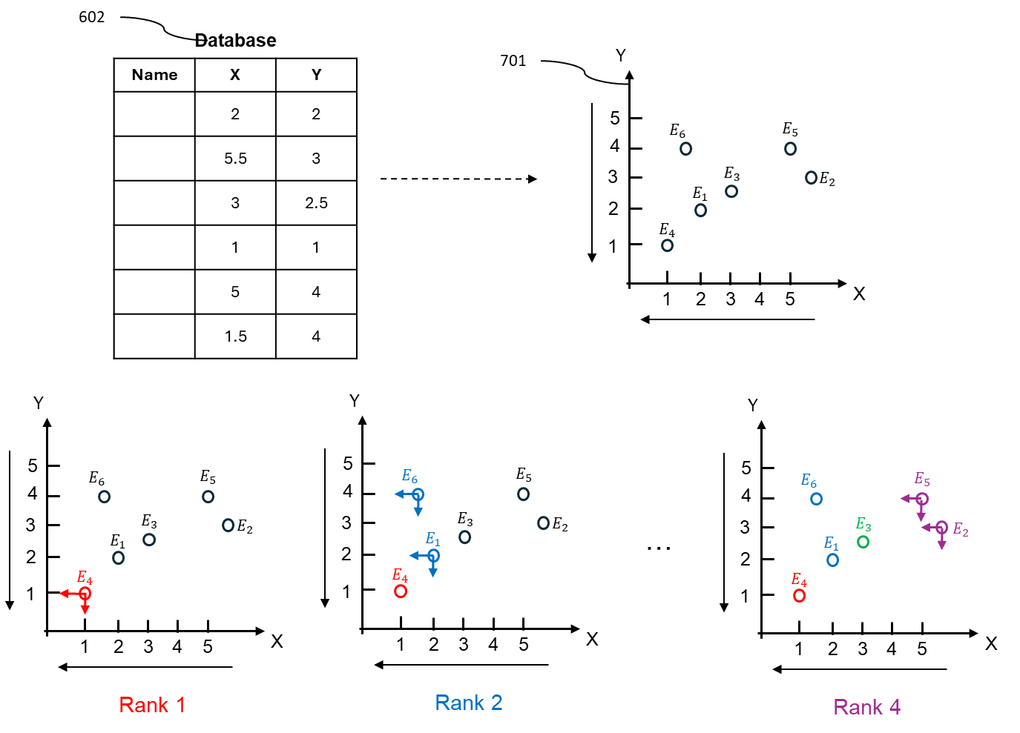
1. General Description of the Invention[2]
(発明内容の概要[2])
Description of the Invention (発明内容の概要)
Fig. 8: Numerical example of assigning ranks to each solution in non-dominated selection.

Slide 16
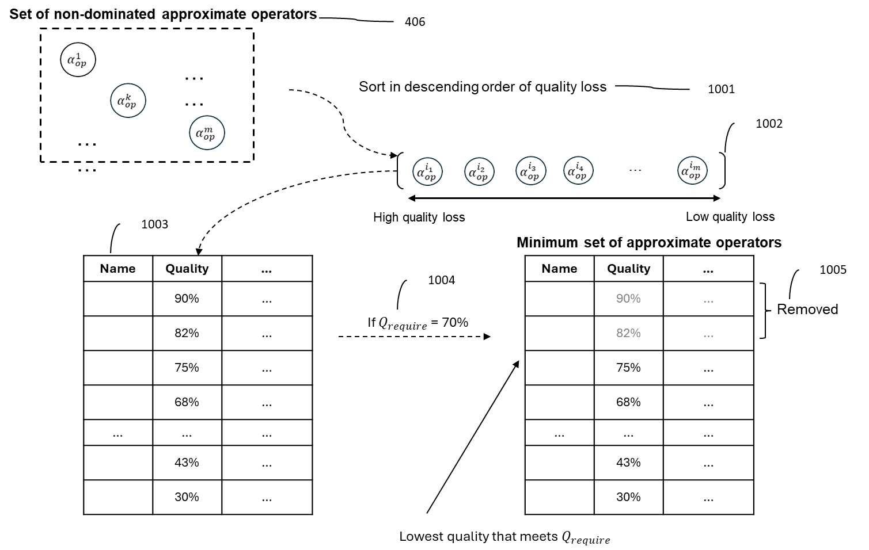
1. General Description of the Invention[2]
(発明内容の概要[2])
Description of the Invention (発明内容の概要)
Fig. 10: Process to generate the minimum set of approximate operators.

Slide 17
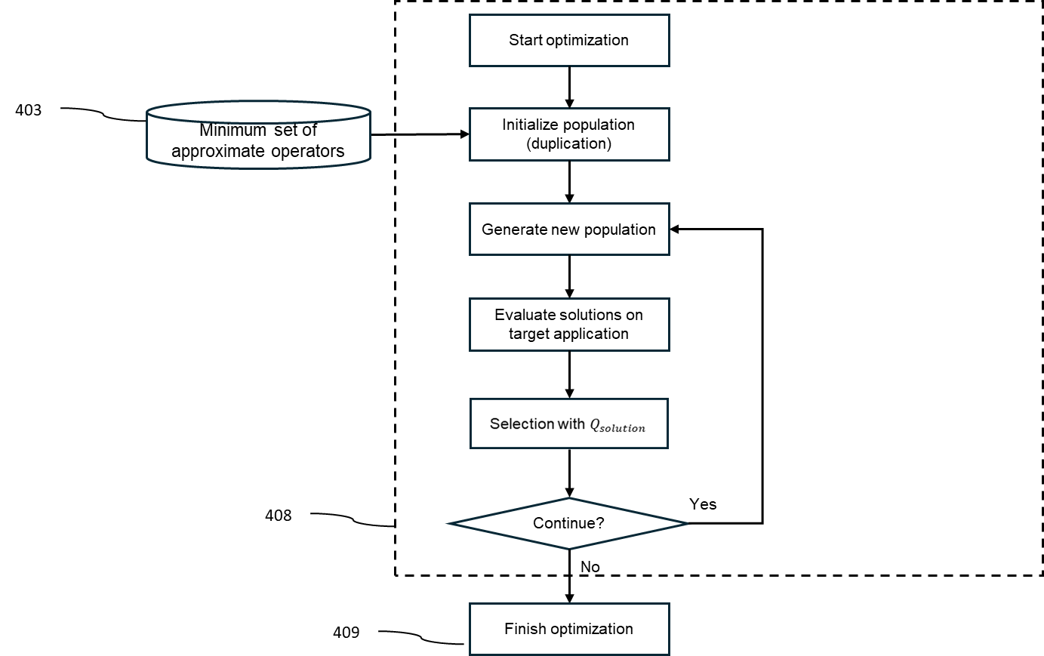
1. General Description of the Invention[2]
(発明内容の概要[2])
Description of the Invention (発明内容の概要)
Fig. 10-2: Genetic Algorithm for finding the approximate operator combination.

Slide 18
1. General Description of the Invention[2]
(発明内容の概要[2])
Referenced Patents
特開2025-146538 (Our patent), in paragraph 45
This patent provides “on-the-fly” adjustment.
Our idea #1 provides the findings before manufacturing. No ”on-the-fly” adjustment is provided in our idea #1.

Slide 19
1. General Description of the Invention[2]
(発明内容の概要[2])
Description of the Invention (発明内容の概要)
Idea #2: “re-download” the model
Weights/parameters will be corrupted over time.
Example: Lowering the voltage leads to bit flip(s)
AI applications can handle weight corruption, but not at a high rate
This idea proposes a mechanism for how and when to correct
Replace the corrupted weight with a mirror copy

Slide 20
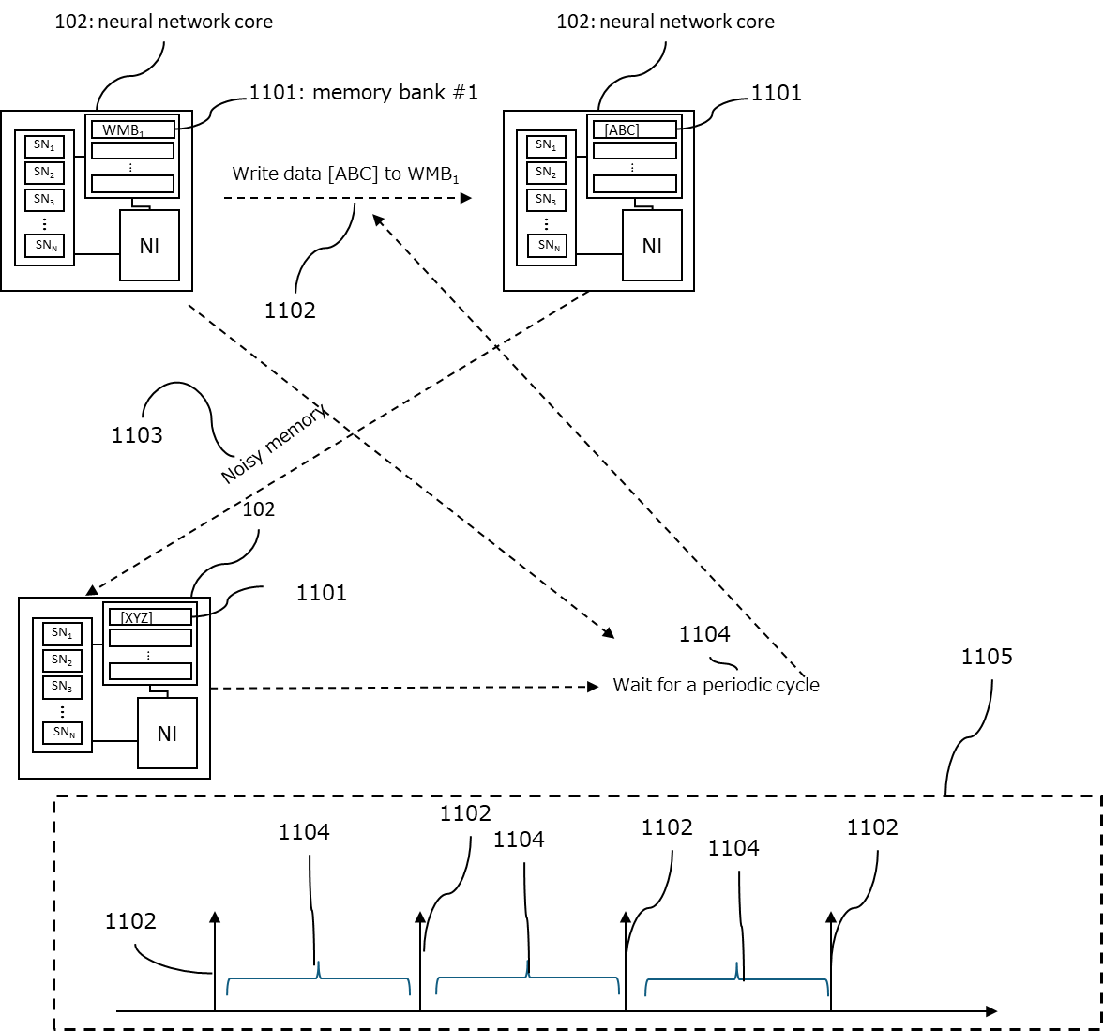
1. General Description of the Invention[2]
(発明内容の概要[2])
Description of the Invention (発明内容の概要)
Fig. 11: Overview of memory redownloading mechanism.

Slide 21
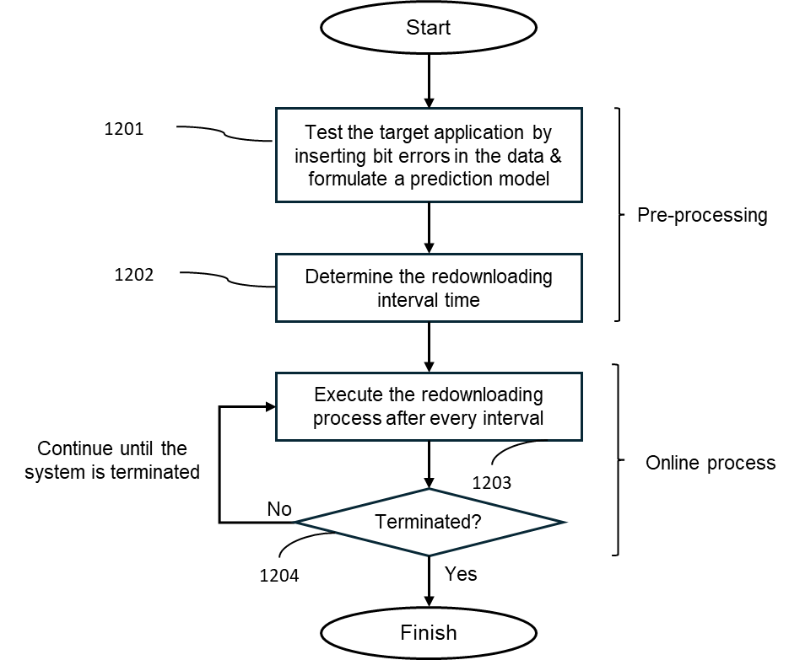
1. General Description of the Invention[2]
(発明内容の概要[2])
Description of the Invention (発明内容の概要)
Fig. 12: Redownloading process.

Slide 22
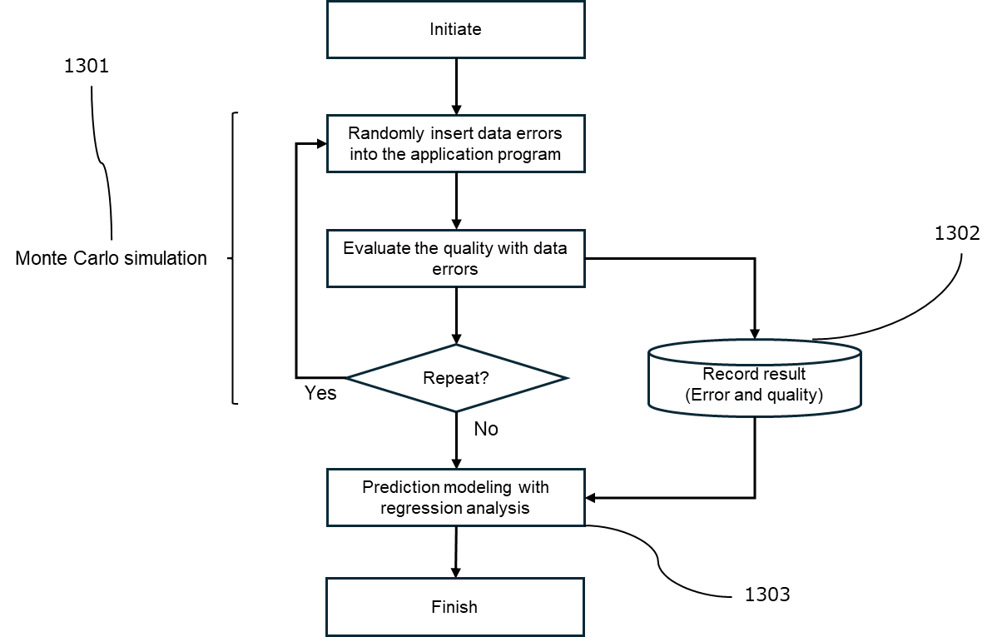
1. General Description of the Invention[2]
(発明内容の概要[2])
Description of the Invention (発明内容の概要)
Fig. 13: BER-Accuracy prediction model.

Slide 23
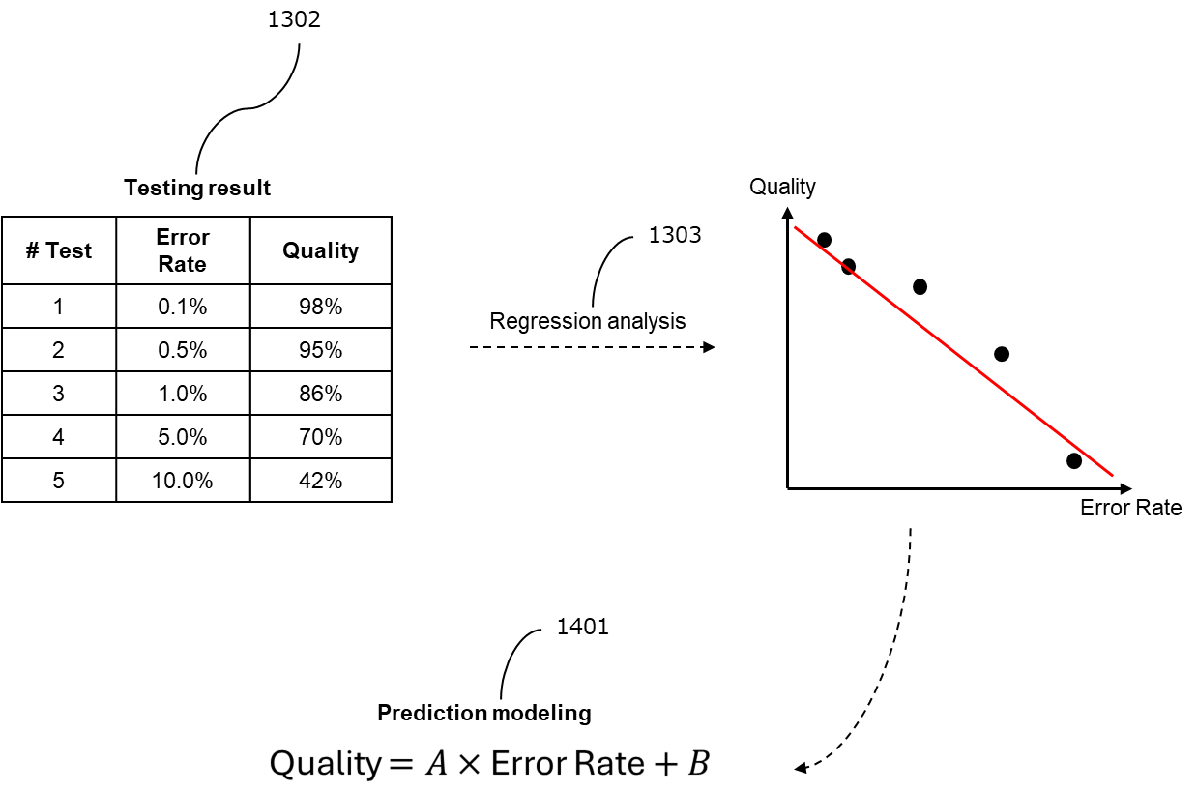
1. General Description of the Invention[2]
(発明内容の概要[2])
Description of the Invention (発明内容の概要)
Fig. 14: Example of a prediction model formulation.

Slide 24
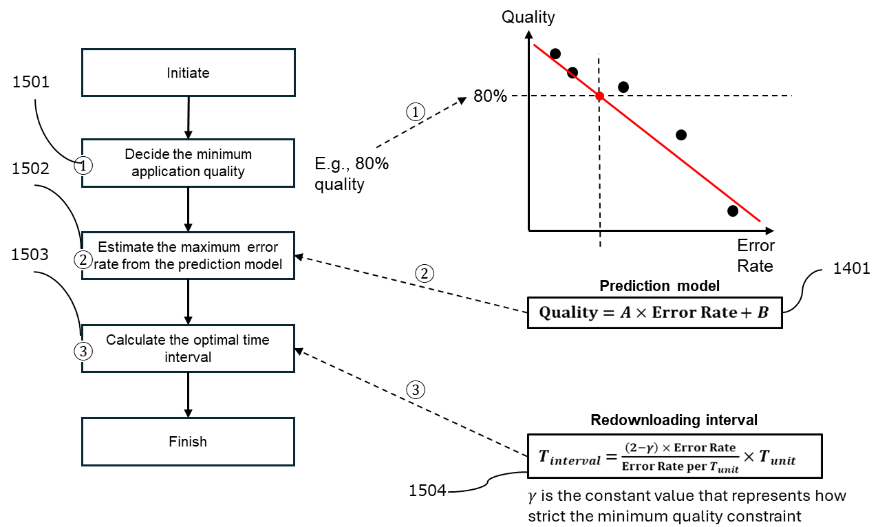
1. General Description of the Invention[2]
(発明内容の概要[2])
Description of the Invention (発明内容の概要)
Fig. 15: Methodology for determining the redownloading time interval with a prediction model.

Slide 25
1. General Description of the Invention[2]
(発明内容の概要[2])
Referenced Patents
特開2025-146538 (Our patent), in paragraph 45
This patent provides “on-the-fly” adjustment. It shares the same idea of “lowering the voltage” as in idea #2.
Key difference:
In 特開2025-146538 , no correction is added. It accepts the distortion of the weight and relies on an AI model to tolerate.
In idea #2, we provide a correction, which is an improvement
WO-A1-2025/141421, in paragraph 78
This patent is about OSRAM, which is low-power and can retain its value.
The paragraph 78 is believed to be about updating or “not” updating the weight.
The mechanism about “re-download” or “update” is simply to write in the memory so the similarity is not important
Key diffierence: we claim the finding out of the period and triggering the mechanism.

Slide 26
1. General Description of the Invention[2]
(発明内容の概要[2])
Description of the Invention (発明内容の概要)
Idea #3: “dynamically prune” the neuron
Given any model, neurons are paired if they share the input/output connection
Similarity comparison is done between pairs
Sort to Indices of high to low similarity
Extract the list of indices
Dynamically prune during the run-time
If A is strongly similar to B
Prune A
B handles both the tasks of A and B

Slide 27
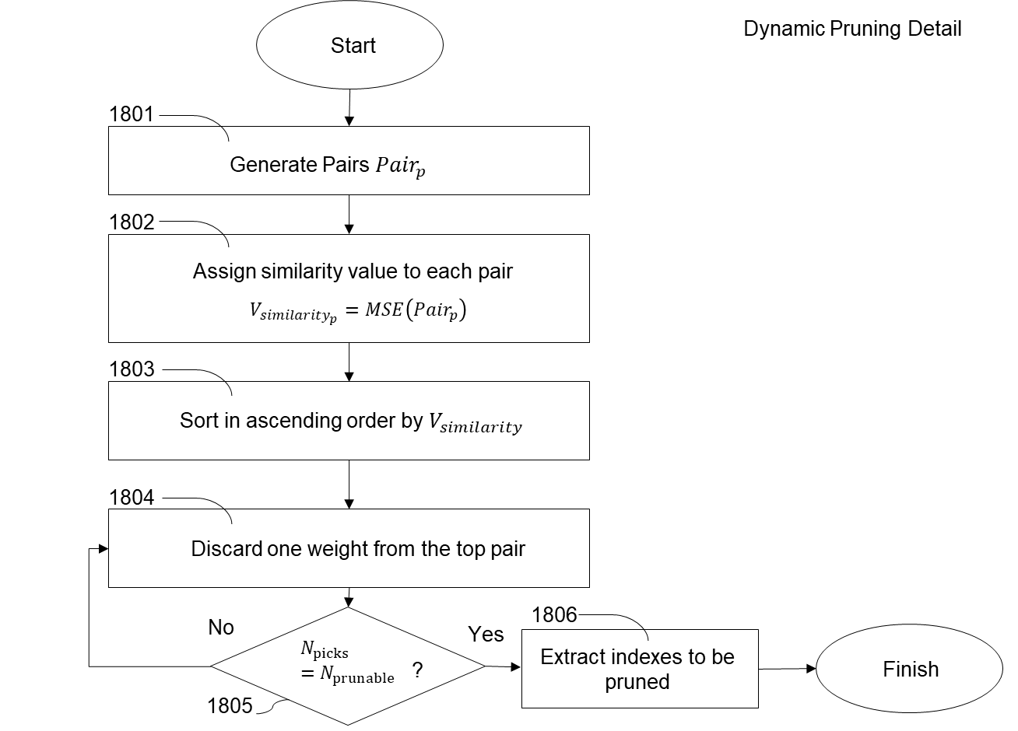
1. General Description of the Invention[2]
(発明内容の概要[2])
Description of the Invention (発明内容の概要)
Fig. 18: Flow to generate prunable neuron indices.

Slide 28
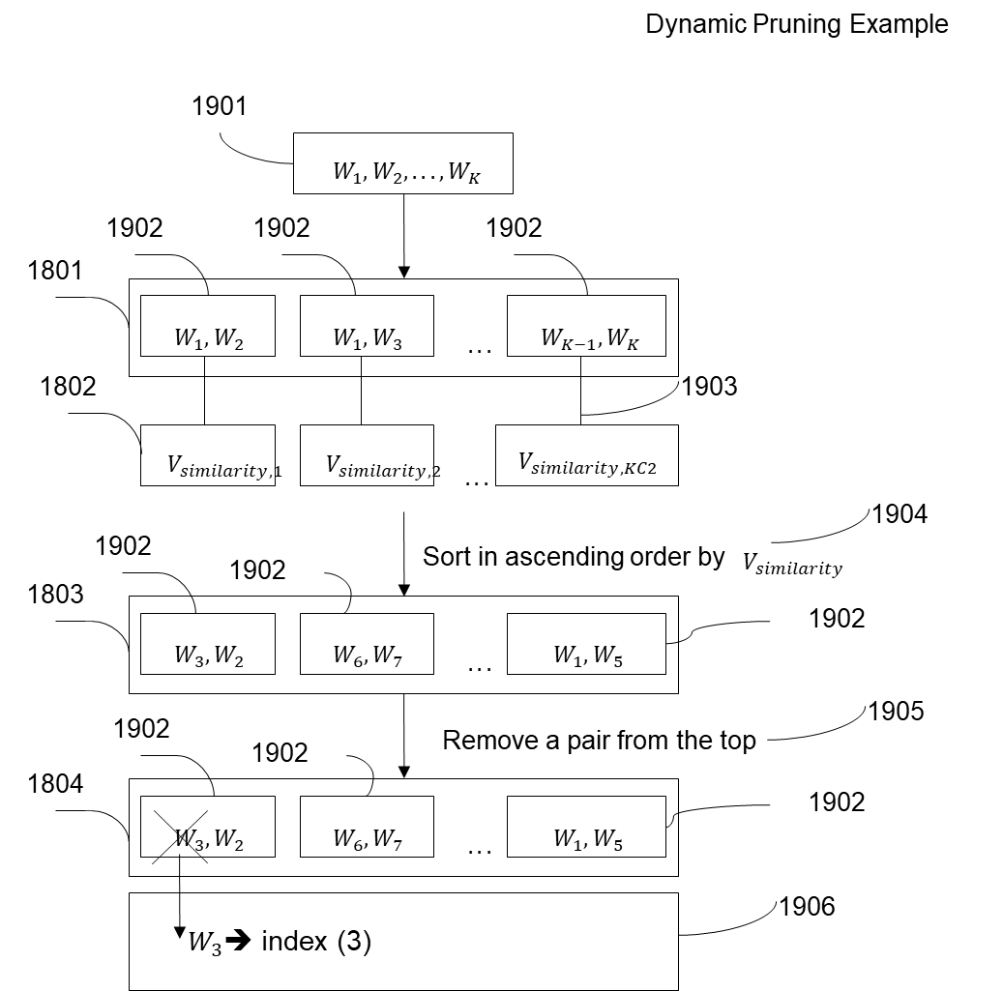
1. General Description of the Invention[2]
(発明内容の概要[2])
Description of the Invention (発明内容の概要)
Fig. 19: Example for Fig.18.

Slide 29
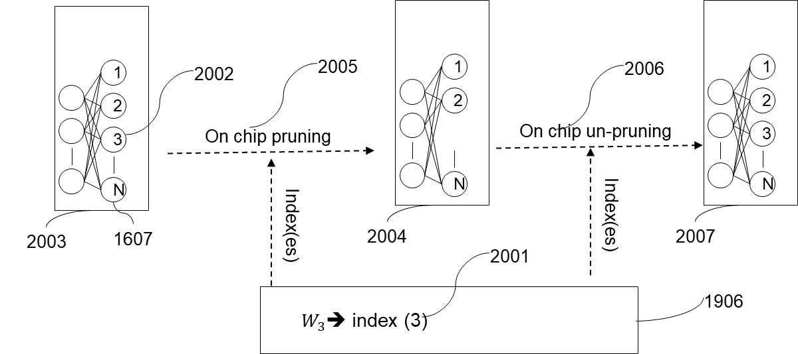
1. General Description of the Invention[2]
(発明内容の概要[2])
Description of the Invention (発明内容の概要)
Fig. 20: How to prune a neuron from network.

Slide 30
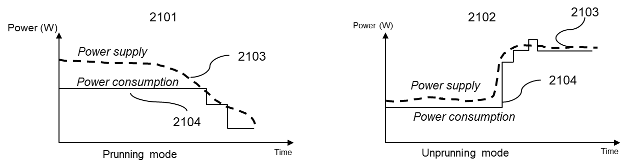
1. General Description of the Invention[2]
(発明内容の概要[2])
Description of the Invention
Fig. 21: How to adjust power by pruning.

Slide 31
1. General Description of the Invention[2]
(発明内容の概要[2])
Referenced Patents
特開2025-146538 (Our patent), in paragraph 45
This patent provides “on-the-fly” adjustment. Idea #3 is also an on-the fly adjusment.
Key difference:
In 特開2025-146538 , it increases or decreases the voltage
In idea #3, we prune or un-prune neurons
特開2025-060937 , in paragraph 266
This patent is to claim that the neuron can be pruned without changing the performance. This is quite a well-know idea.
Key differences:
We provide a mechanism to prune dynamically.
After training or potential pruning, the model is download.
A list of prunable neuron is kept.
During operation, we can prune or un-prune dynamically

Slide 32
2. Prospective Applications
(想定される用途）
Industrial applications
Perform low-power edge computing applications
Image classification
Human detection
Land slide detection
Source of energy supply:
Solar energy
Windmill
Battery

Slide 33
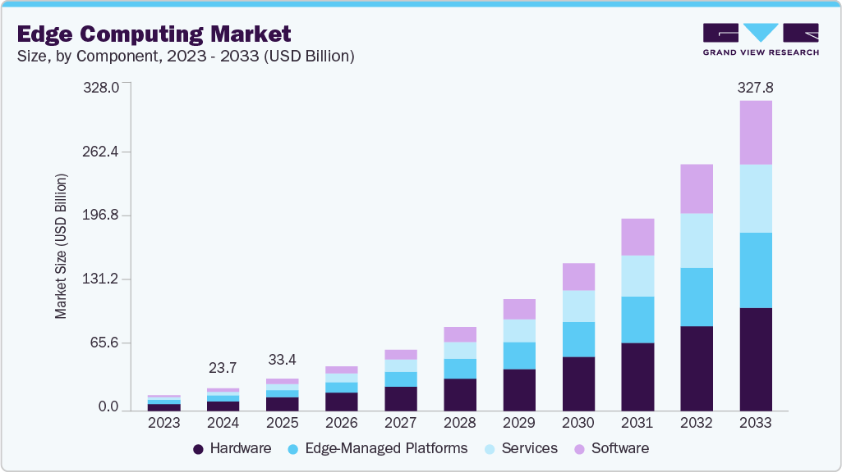
3. Prospective Market/Business[2] – Market Size
(想定される業界[2] ～ 市場規模）
https://www.grandviewresearch.com/industry-analysis/edge-computing-market

Slide 34

3. Prospective Market/Business[2] – Eco-systems
(想定される業界[2] ～ 市場規模）
https://www.marketsandmarkets.com/Market-Reports/edge-computing-market-133384090.html

Slide 35
4. Challenges for Practical Use
(実用化に向けた課題)
Technically, there are no challenges to realize this technology.

Slide 36
5. Patent Claims
(特許請求の範囲)
Country(s) for Application(出願国)
Japan
Patent Claims(特許請求の範囲)
An aspect of the disclosure provides a method to adapt power consumption in AI chips. The method consists of lightweight approximate circuit optimization, and voltage scaling with error correction mechanism.
A temporal pruning based on neuron similarities is proposed for adapting power consumption to fluctuating energy supply.

Slide 37
Q & A

Slide 38
Appendix

Slide 39
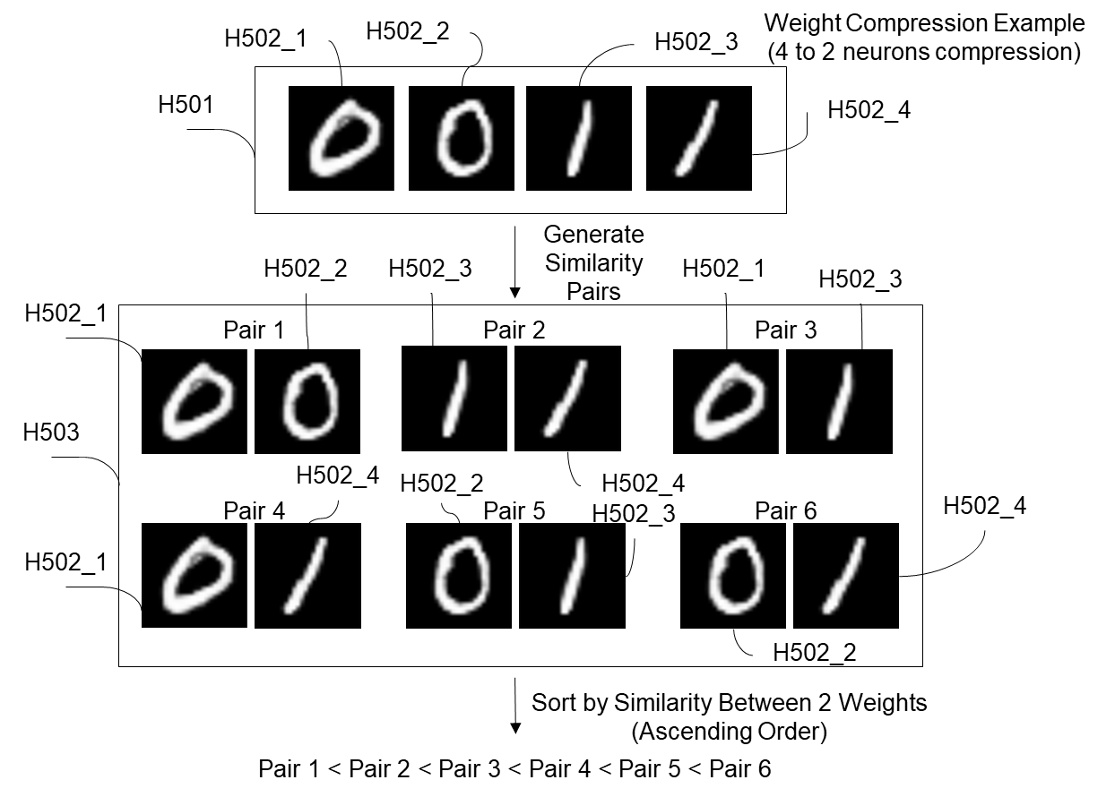
1. General Description of the Invention[2]
(発明内容の概要[2])
Description of the Invention (発明内容の概要)

Slide 40


1. General Description of the Invention[2]
(発明内容の概要[2])
Description of the Invention (発明内容の概要)
Weight Compression Example (Cnt.)
Remove W1 from Pair 1, and W3 From Pair 2
H503
W2
W4

Slide 41
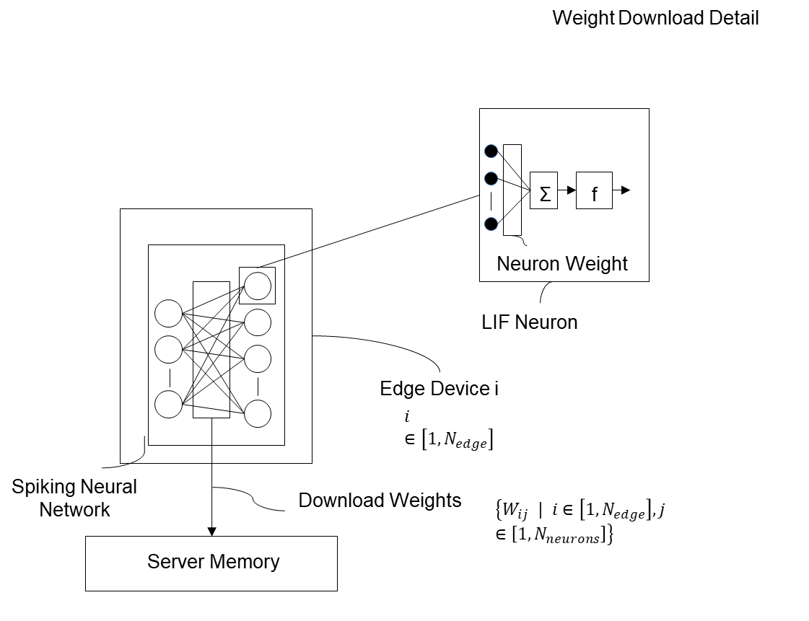
1. General Description of the Invention[2]
(発明内容の概要[2])
Description of the Invention (発明内容の概要)

Slide 42





1. General Description of the Invention[2]
(発明内容の概要[2])
Description of the Invention (発明内容の概要)
Minimum set of approximate operators
Yes
Continue?
No
Finish initialization

Slide 43
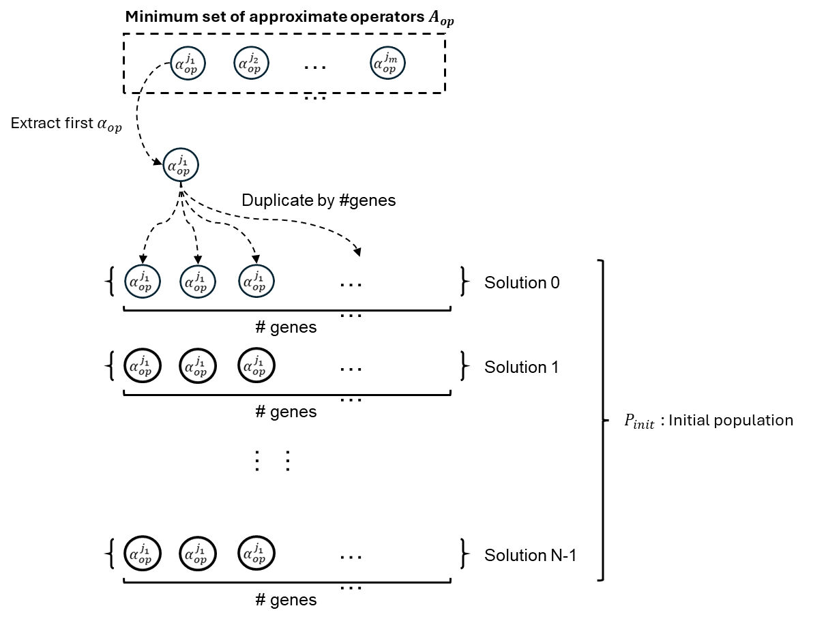
1. General Description of the Invention[2]
(発明内容の概要[2])
Description of the Invention (発明内容の概要)

Slide 44
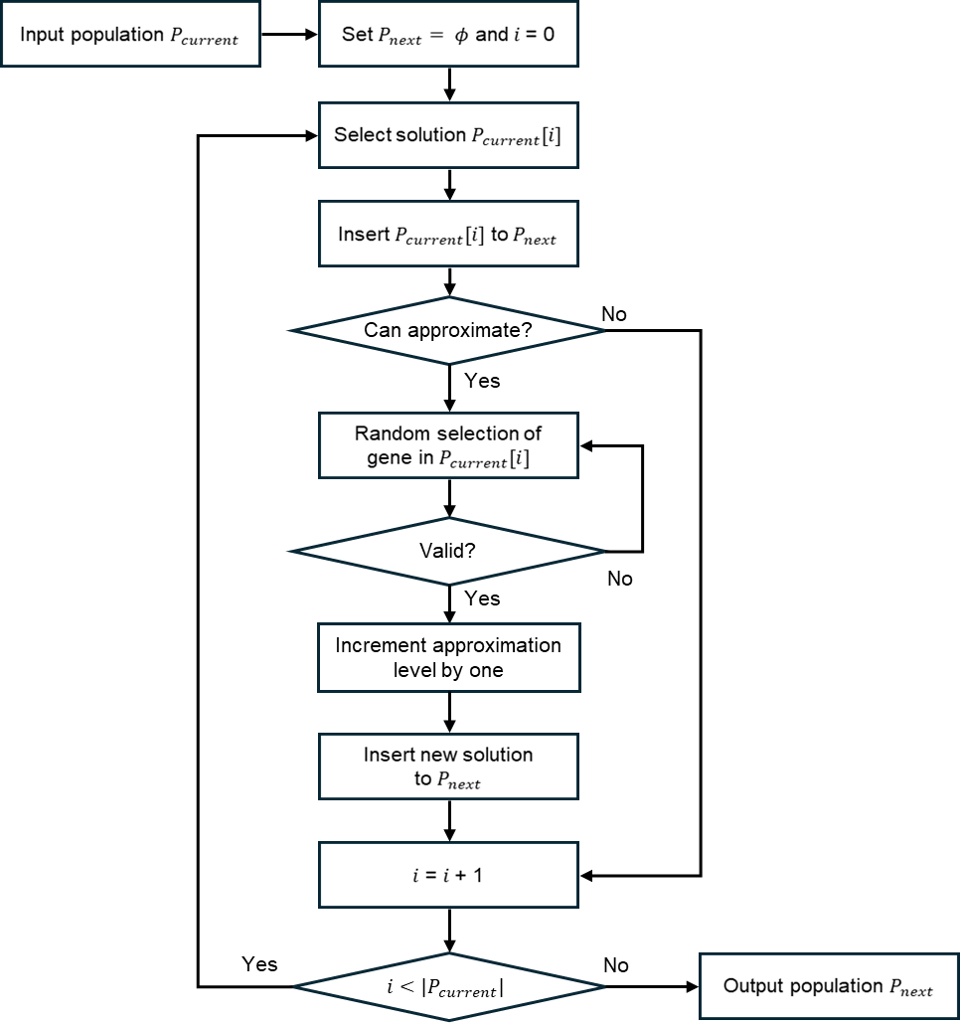
1. General Description of the Invention[2]
(発明内容の概要[2])
Description of the Invention (発明内容の概要)

Slide 45
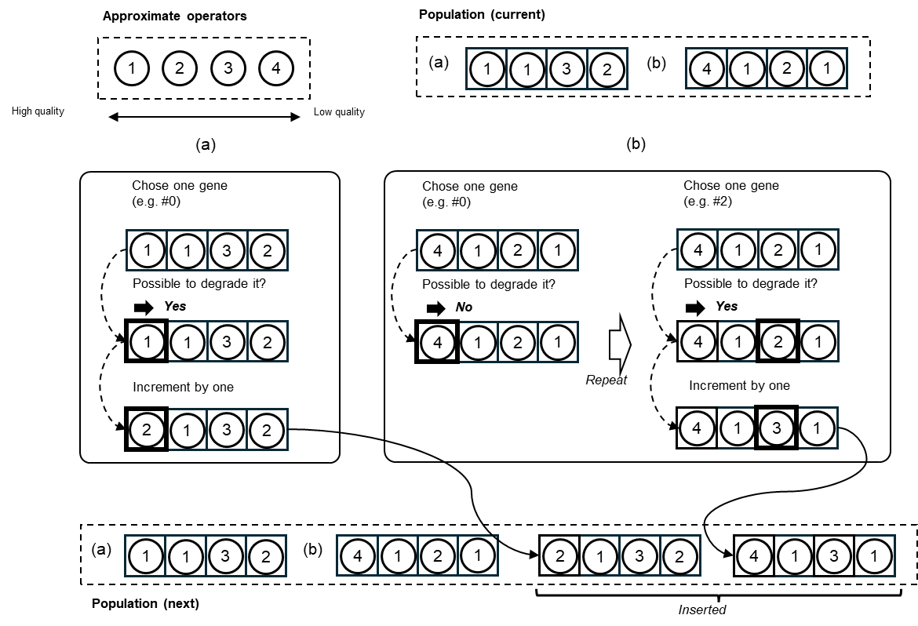
1. General Description of the Invention[2]
(発明内容の概要[2])
Description of the Invention (発明内容の概要)

Slide 46
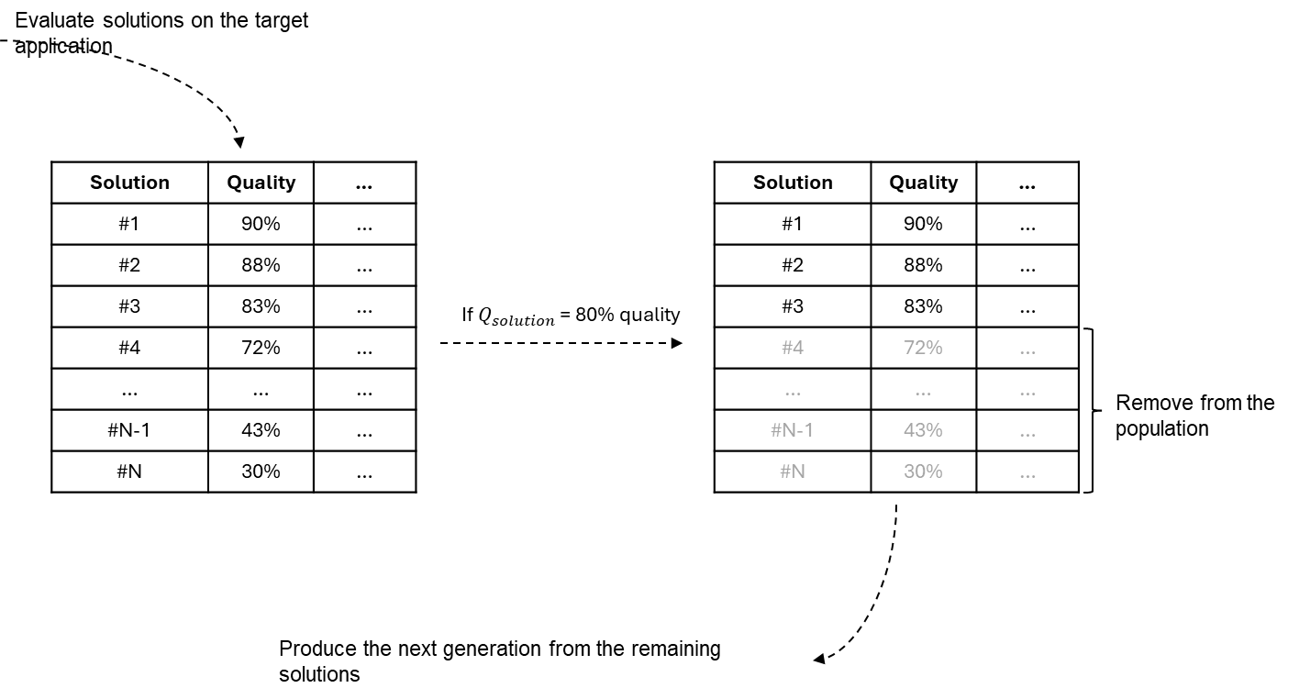
1. General Description of the Invention[2]
(発明内容の概要[2])
Description of the Invention (発明内容の概要)

Slide 47

1. General Description of the Invention[2]
(発明内容の概要[2])
Description of the Invention (発明内容の概要)

Slide 48
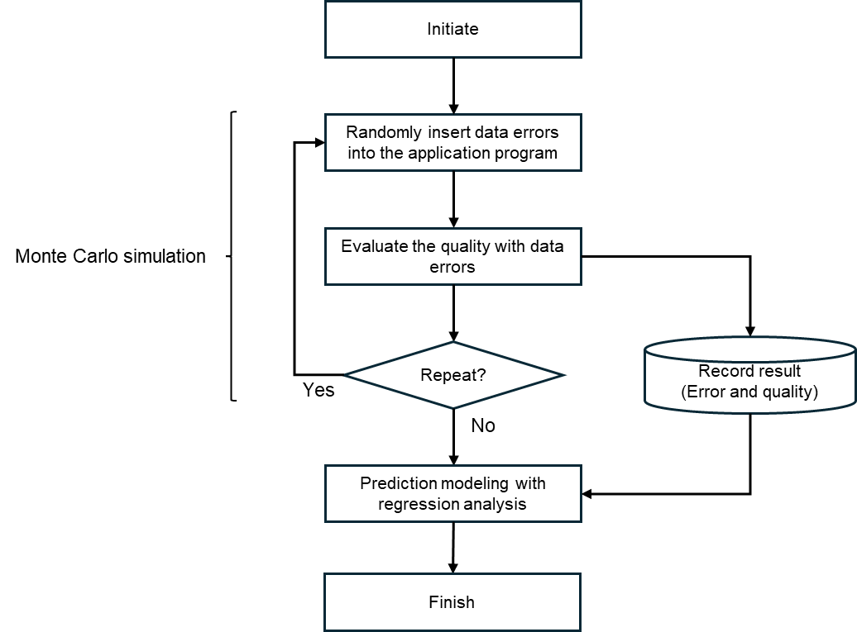
1. General Description of the Invention[2]
(発明内容の概要[2])
Description of the Invention (発明内容の概要)

Slide 49


