Slide 1

An Efficient Hardware Implementation of Spiking Neural Network Using Approximate Izhikevich Neuron
School of Computer Science and Engineering University of Aizu, Fukushima, Japan Auther: Ryoji Kobayashi* and Khanh N. Dang† E-mali: {*s1290176, †khanh}@u-aizu.ac.jp

Slide 2
Outline
Introduction
Biological Neuron Model
Proposed Method
Evaluation Methodology & Result
Conclusion

Slide 3
Outline
Introduction
Biological Neuron Model
Proposed Method
Evaluation Methodology & Result
Conclusion

Slide 4
Introduction
Hidden
Input
Output
……
Combine
......................
……
......................
……
……
……
[1] E. Izhikevich, “Simple model of spiking neurons,” 2003.
Biological neuron model
Spiking behavior
Many hardware resources
High-power consumption
Large-scale Spiking Neural Net.
Complex tasks
Noise resilience
Many neurons

Slide 5
Outline
Introduction
Biological Neuron Model
Proposed Method
Evaluation Methodology & Result
Conclusion

Slide 6
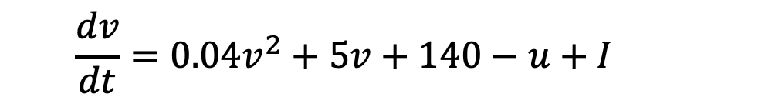
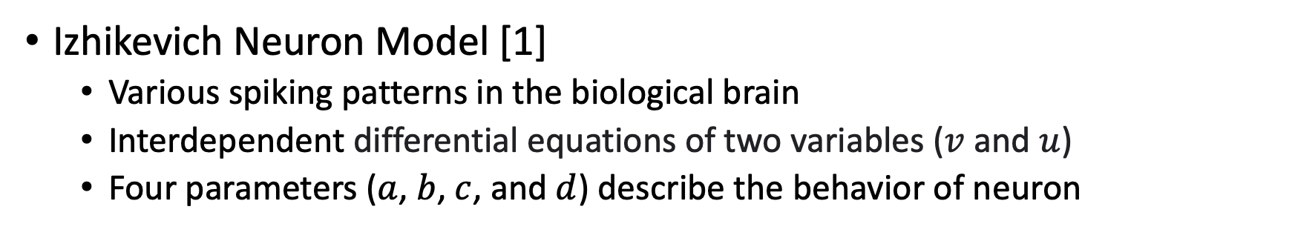
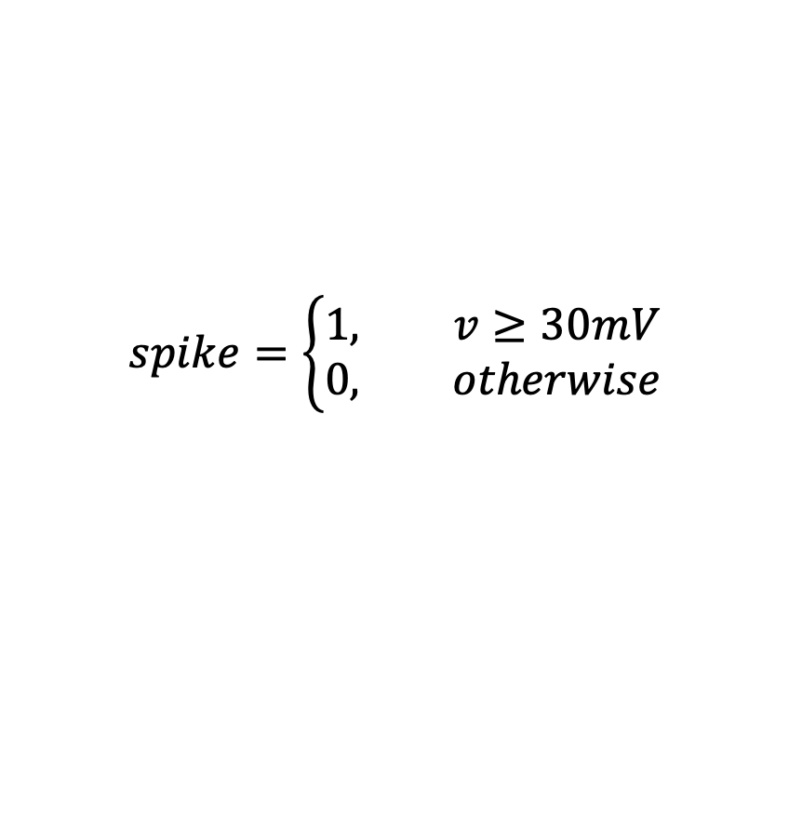
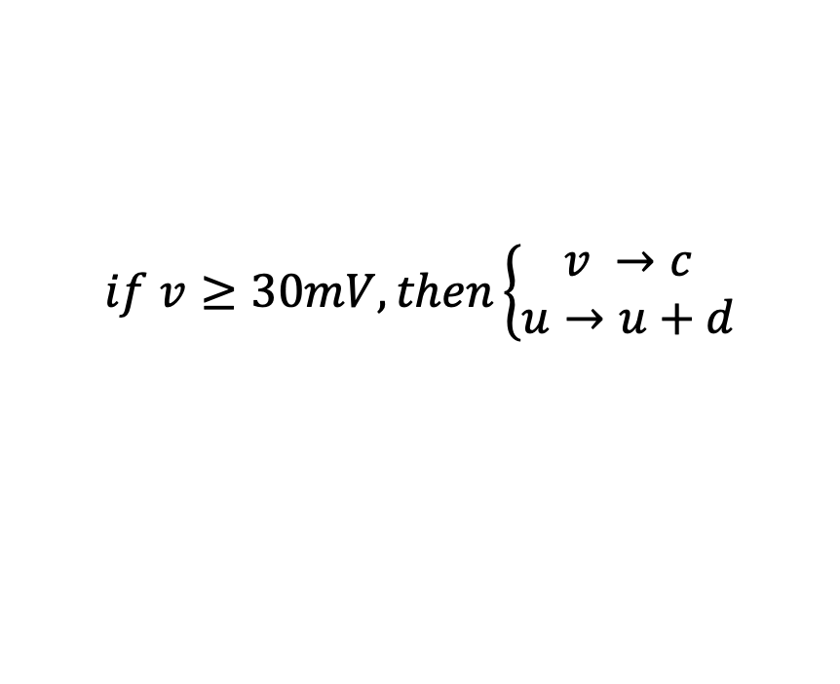
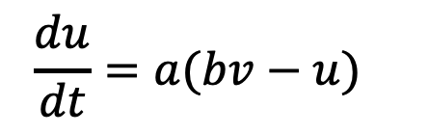
Biological Neuron Model (1)
Izhikevich Neuron Model [1]
Various spiking patterns in the biological brain
Interdependent differential equations of two variables ($v$ and $u$)
Four parameters ($a$,$b$, $c$, and $d$) describe the behavior of neuron
$$\frac{dv}{dt}=0.04v^{2}+5v+140−u+I$$
$$\frac{du}{dt}=a(bv−u)$$
(2)
(1)
$$spike=\left\{\begin{aligned}1, v≥30mV \\ &0, otherwise\end{aligned}\right.$$
$$if v≥30mV, then\left\{\begin{aligned}v →c \\ &u→u+d\end{aligned}\right.$$
and
(3)
High complexity for hardware implementation

Slide 7
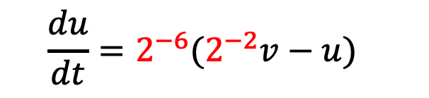
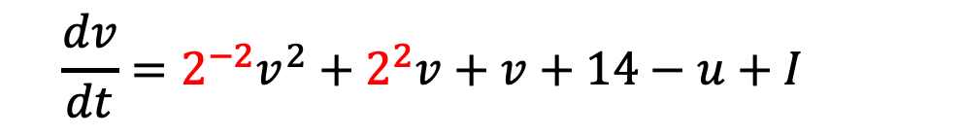
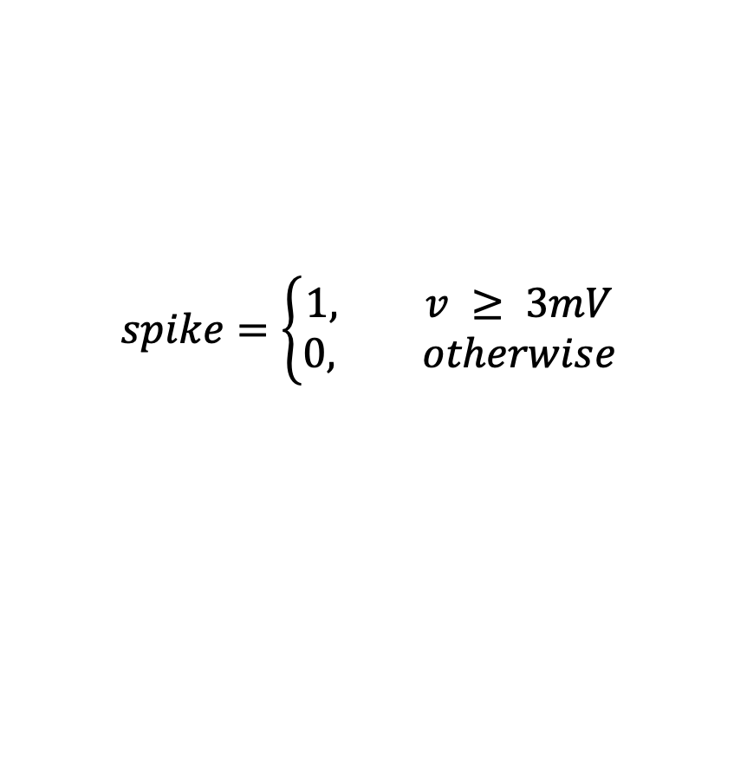
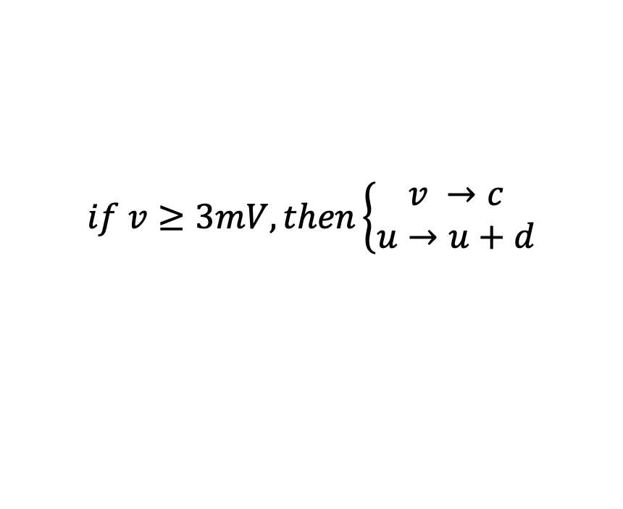
Biological Neuron Model (2)
Hardware-Oriented Modified Izhikevich Neuron model [2]
The coefficient and parameters are approximated to the power of 2
Shift operations in hardware -> No hardware resources
All variables are scaled down by a factor of 10
Requires fewer bits -> Reduced wire connections
$$\frac{dv}{dt}=2^{−2}v^{2}+2^{2}v+v+14−u+I$$
$$\frac{du}{dt}=2^{−6}(2^{−2}v−u)$$
(5)
(4)
$$spike=\left\{\begin{aligned}1, v ≥ 3mV \\ &0, otherwise\end{aligned}\right.$$
$$if v≥3mV, then\left\{\begin{aligned}v →c \\ &u→u+d\end{aligned}\right.$$
(6)
and

Slide 8
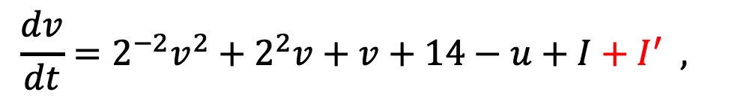

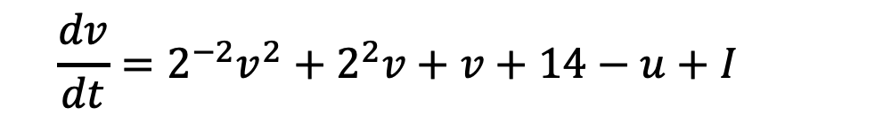
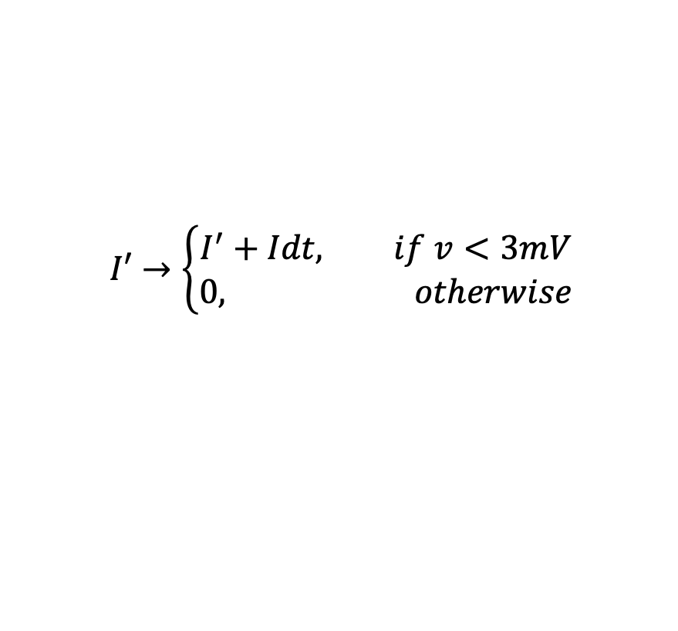
Biological Neuron Model (3)
The input spike is sparse
Cannot accumulate the input -> No spikes
Define the new variable $I′$ to make sure the neuron spikes
Can produce spiking patterns shown in [2]
$$\frac{dv}{dt}=2^{−2}v^{2}+2^{2}v+v+14−u+I$$
(4)
$$\frac{dv}{dt}=2^{−2}v^{2}+2^{2}v+v+14−u+I+I^{′} ,$$
$$I′→\left\{\begin{aligned}I^{′}+Idt, if v<3mV \\ &0, otherwise\end{aligned}\right.$$
Still requires many hardware resources
More reduced?

Slide 9
Outline
Introduction
Biological Neuron Model
Proposed Method
Evaluation Methodology & Result
Conclusion

Slide 10
Proposed Method (1)
Approximate Computing
Allowance of accuracy loss -> reduced implementation costs
Effective for error-tolerant application
Multimedia Processing
Machine Learning
Approximate Arithmetic Units
Approx. Adder
Approx. Multiplier
Realized by circuit level approximation
However?
Produce noises in the computing
Noise resilience of Spiking Neural Net.

Slide 11
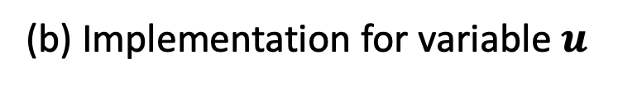
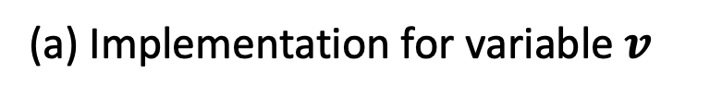
Proposed Method (2)
Block diagram of Izhikevich neuron model
(a) Implementation for variable $v$
(b) Implementation for variable $u$

Slide 12
Proposed Method (3)
Many combinations of Approx. Arithmetic Units
Different hardware costs and accuracy on different parts
Implementation of the Izhikevich neuron model
10 adders
1 multiplier
How to find the optimal combination?
Open-source framework leveraging statistical or ML models to find Pareto-Optimal design [3]

Slide 13
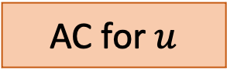
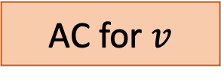
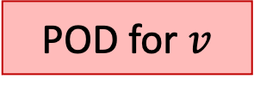
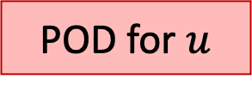
Proposed Method (4)
The process to generate the set of approx. neurons
AC for $v$
AC for $u$
Set of Approx. Units [4]
Approx. Framework [3]
Vivado toolchains
POD for $v$
POD for $u$
AC : Approx. Circuit POD : Pareto-Optimal Design
Approx. Neurons

Slide 14
Outline
Introduction
Biological Neuron Model
Proposed Method
Evaluation Methodology & Result
Conclusion

Slide 15
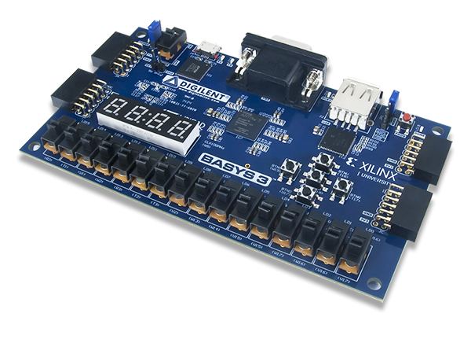
Evaluation Methodology (1)
Izhikevich neuron was implemented in Verilog-HDL to obtain hardware costs
Vivado 2019.1 toolchain
Xilinx xc7a35t1cpg236-1 FPGA board
- Area Cost (# LUT, Slice, etc.)
- Computation Delay
- Power Consumption (Static, Dynamic)

Slide 16
Evaluation Methodology (2)
Spiking Neural Net. was simulated in Python using Accurate neuron or Approx. neuron
400, 1600, 6400 neurons
MNIST datasets
STDP training
Classification & Evaluation
MNIST datasets
Trade-offs (Accuracy vs. HW costs)
Spiking Neural Net. model

Slide 17
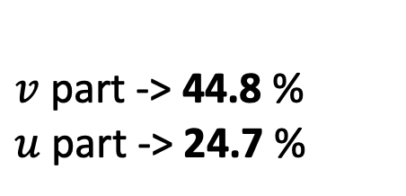
Result: Area
The trade-offs between accuracy and area cost with 400 neurons
The best accuracy
Acc.
Best Accuracy (> 1)
The area cost is reduced by:
$v$part -> 44.8 %
$u$ part -> 24.7 %
Single Izhikevich Neuron
reduced by 40.3 %

Slide 18
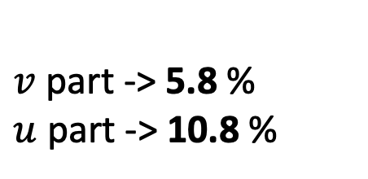
Result: Delay
The trade-offs between accuracy and computation delay with 400 neurons
The best accuracy
Acc.
Best Accuracy
(> 1)
The computation delay is reduced by:
$v$part -> 5.8 %
$u$ part -> 10.8 %

Slide 19
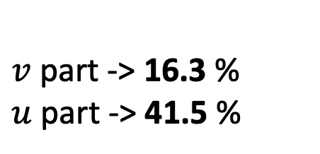
Result: Power
The trade-offs between accuracy and power consumption with 400 neurons
The best accuracy
Acc.
Best Accuracy
(> 1)
The power consumption is reduced by:
$v$part -> 16.3 %
$u$ part -> 41.5 %
Single Izhikevich Neuron
reduced by 24.2 %

Slide 20
Result: Accuracy
Accuracy with different numbers of neurons
TABLE 1 The summary of classification accuracy for 10,000 test data
Accuracy gain
-> +1.1 %
Accuracy loss -> -1.5 %

Slide 21
Outline
Introduction
Biological Neuron Model
Proposed Method
Evaluation Methodology & Result
Conclusion

Slide 22
Conclusion
Approximate Computing was leveraged to implement the Izhikevich neuron model.
Many different combinations of Approximate Arithmetic Units were explored.
In the best case, the area cost and power consumption were reduced by 40.3 % and 24.2 % respectively, having 1.5 % accuracy loss.

Slide 23
References
[1] E. Izhikevich, “Simple model of spiking neurons,” IEEE Transactions on Neural Networks, vol. 14, no. 6, pp. 1569–1572, 2003.
[2] A. J. Leigh, M. Mirhassani, and R. Muscedere, “An efficient spiking neuron hardware system based on the Hardware-Oriented Modified Izhikevich Neuron (HOMIN) model,” IEEE Transactions on Circuits and Systems II: Express Briefs, vol. 67, no. 12, pp. 3377–3381, 2020.
[3] B. S. Prabakaran et al., “Xel-FPGAs: An end-to-end automated exploration framework for approximate accelerators in FPGA-based systems,” in 2023 IEEE/ACM International Conference on Computer Aided Design (ICCAD). IEEE, 2023, pp. 1–9.
[4] V. Mrazek et al, “Evoapprox8b: Library of approximate adders and multipliers for circuit design and benchmarking of approximation methods,” in Design, Automation & Test in Europe Conference & Exhibition (DATE), 2017. IEEE, 2017, pp. 258–261.

Slide 24
Thank you for your attention!

Slide 25

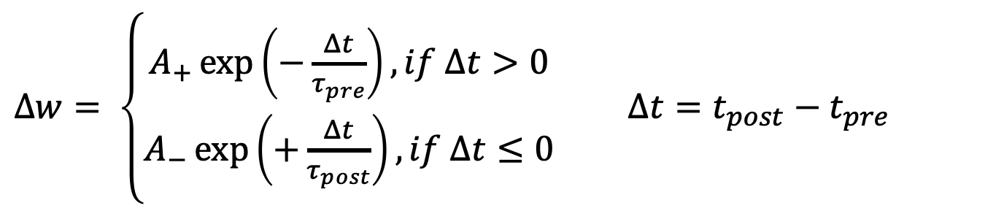
Training Method
Spike-timing-dependent plasticity (STDP) learning rule
Biological process to adjust the strength of connection between neurons
Pre
Post
Pre:
t
Post:
t
$$∆t$$
$Δw= \left\{\begin{aligned}A_{+}\exp\left(−\frac{Δt}{τ_{pre}}\right), if Δt>0 \\ A_{−}\exp\left(+\frac{Δt}{τ_{post}}\right), if Δt≤0\end{aligned}\right.$ $Δt=t_{post}−t_{pre}$

Slide 26
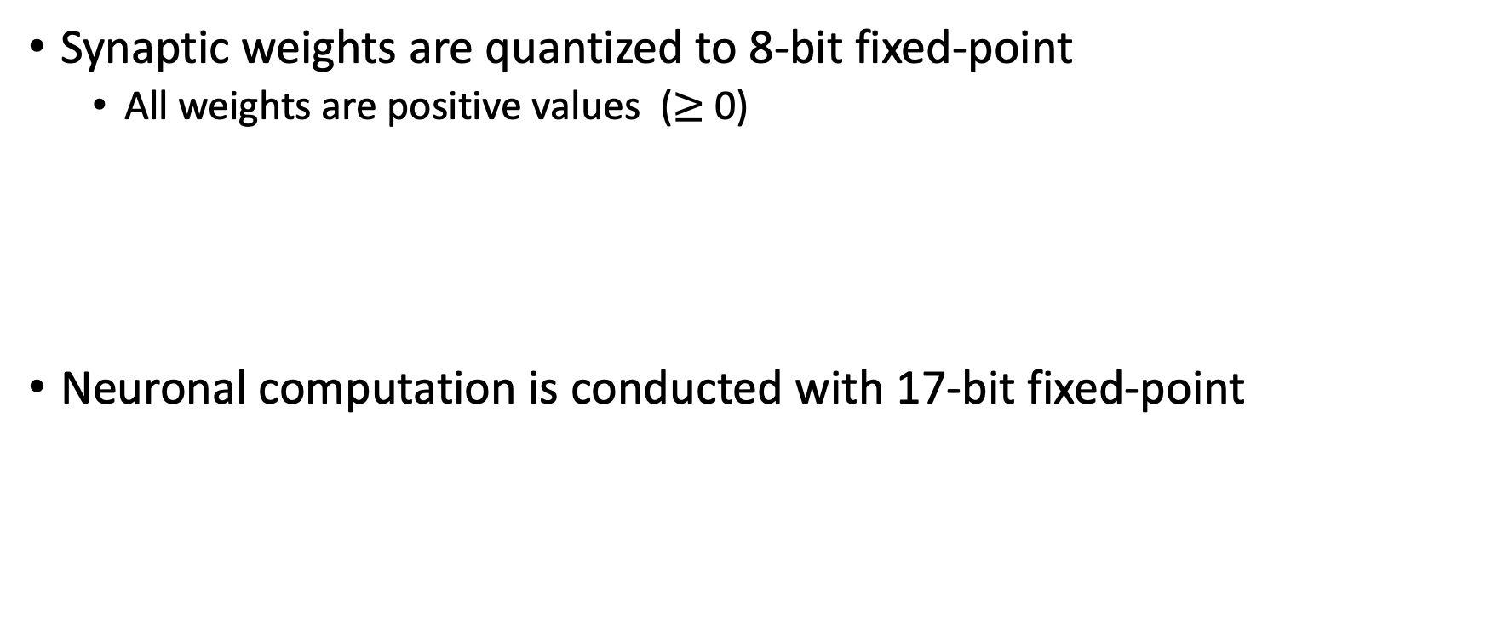
Fixed-Point Representation
Synaptic weights are quantized to 8-bit fixed-point
All weights are positive values ($≥$ 0)
Neuronal computation is conducted with 17-bit fixed-point
8-bit
e.g., 0.296875 =
0
1
0
0
1
1
0
0
Fractional
1-bit
8-bit
8-bit
e.g., -6.296875 =
1
0
0
0
0
0
1
1
0
0
1
0
0
1
1
0
0
sign
Integer
Fractional
Radix Point

Slide 27
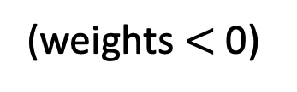
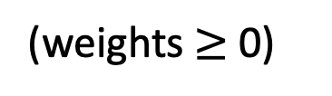
Spiking Neural Net. model
Encoded Images
Composed of two layers
Input layer
Equal to input image size (= 784 neurons for MNIST)
Output layer (Excitatory layer)
400, 1600, 6400 neurons
Accurate or Approx. neurons
Inhibitory Connections
Fixed negative weight
Input (28 x 28)
(weights $≥$ 0)
t
Output (Acc. or Approx.)
(weights $<$ 0)
Inhibitory Connections

