Slide 1

Evolutionary Algorithm for STDP-based Spiking Neural Network Model Compression
Author: Yuga Hanyu*, Zhishang Wang† and Khanh N. Dang†
School of Computer Science and Engineering University of Aizu, Fukushima, Japan E-mail: {*m5291018, †zwang, †khanh}@u-aizu.ac.jp
Date: December 16, 2025

Slide 2
Outline
Introduction
Proposed Method
Evaluation & Result
Conclusion

Slide 3
Outline
Introduction
Proposed Method
Evaluation & Result
Conclusion

Slide 4
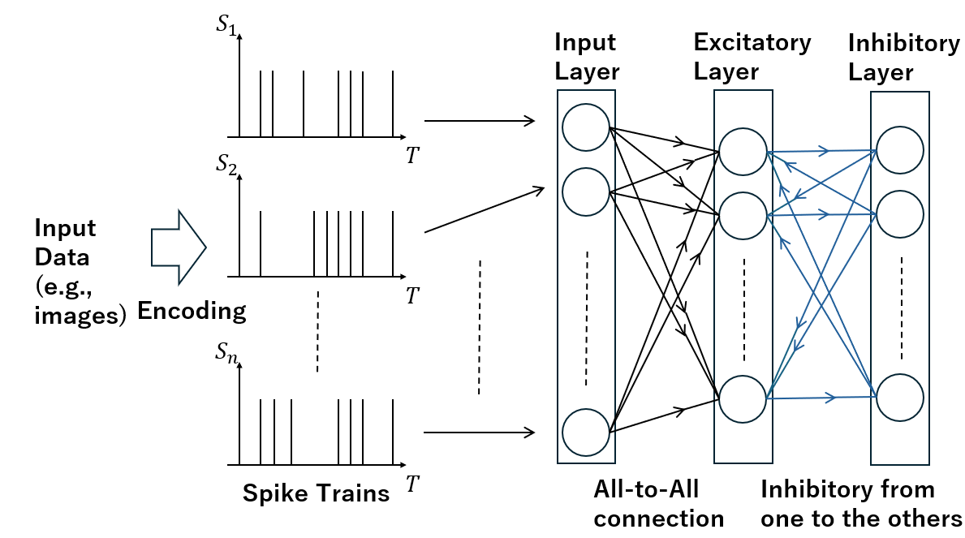
Spiking Neural Network
Spiking Neural Networks (SNNs) use spikes to communicate information
Compared to traditional Artificial Neural Networks, SNNs are energy efficient
Fig. 1 Structure of an SNN

Slide 5
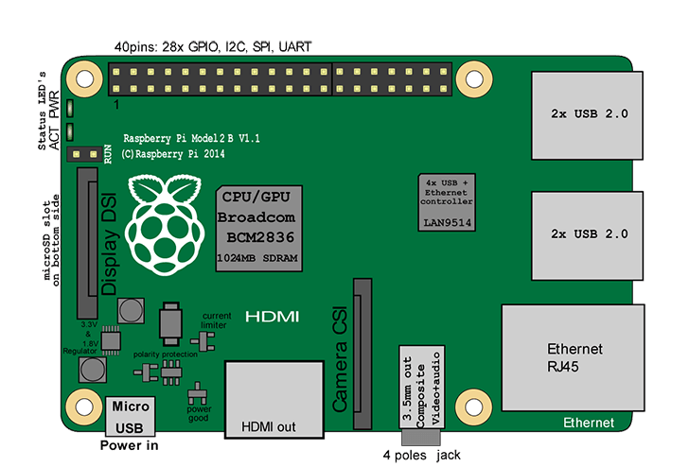
SNN on-chip learning
SNNs are suitable for on-chip learning
On-chip learning devices network size limitations
Compression on number of neurons is necessary for such devices
Original
SNN model
Smaller
SNN model
Compression
Deploy
Fig. 2 Compression of an SNN
Notes:
I would like to introduce about my research. My research is about training multiple SNN models then merge them into one model. This way of training offers several benefits such as faster training process and collaborative learning. For example, if we decompose dataset and model into 10 datasets and 10 models, the training process becomes 10 times faster excluding the merging process after that. Also, since we will be working on separate dataset, we can do collaborative learning such as train small models in different places, then merge them to create one model that can perform in every place. My main goal is to propose a model merging method that is both computationally efficient and able to produce high accuracy

Slide 6
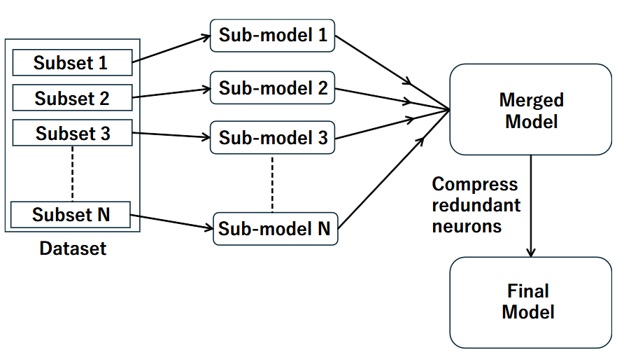
On-Chip Ensemble Learning
Split a dataset, train sub-models, and merge into one model
Fig. 3 Overview of Ensemble Learning [1]

Slide 7
Limitations
Performance Loss: Increased number of sub-models degrades final accuracy
Limited Compression Metric: Only the redundancy between the neurons were considered
->Not suitable for models with no redundant neurons

Slide 8
Our contributions
Genetic Algorithm (GA) neuron compression: More robust to the increased number of sub-models
Comprehensive neuron metric: Combination of small test and neuron redundancy metric

Slide 9
Outline
Introduction
Proposed Method
Evaluation & Result
Conclusion

Slide 10
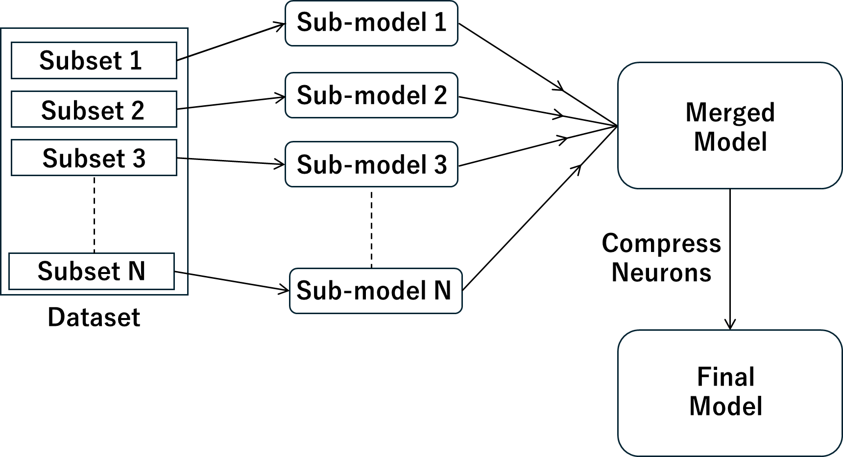
Overall Flow
Notes:
This is the architecture of each individual SNN model. The number of neurons in each layer is arbitrary. Weights are assigned to each connection between the layers, and the weights between input layer and excitatory layer are learning parameters. First, input spikes gets multiplied by weights and proceeds to excitatory layer. Then, if any of the neurons in excitatory layer emits a spike because of input, that neuron sends inhibitory signal to other neurons through inhibitory layer. This is to prevent several neurons from outputting similar spike patterns, making the learning more diverged.

Slide 11

Chromosome Network Representation
Chromosome: Binary array represents neuron selection
Input Layer
Excitatory Layer
Chromosome
0 | 1 | 0 | 1
Discard
Neuron
Keep
Neuron
Notes:
This is the principle of compressing models. We compress models by removing one of the overlapping neurons. This is because if we have overlapping neurons in the final model, that does not contribute to performance. To compress models without losing performance, we need to remove overlapping neurons. From observing 2D receptive fields of both neurons, we can determine which neurons to remove. However, this is not a practical way with bigger models. We need to come up with an algorithm to perform this automatically.

Slide 12
GA Neuron Compression Flow
Start
SNN Model
Initialize Population
Elitism & Parent Selection
Crossover
Compression
Number
False
Neurons to
remove
Termination
Condition
Mutation
True
End
Notes:
This is the architecture of each individual SNN model. The number of neurons in each layer is arbitrary. Weights are assigned to each connection between the layers, and the weights between input layer and excitatory layer are learning parameters. First, input spikes gets multiplied by weights and proceeds to excitatory layer. Then, if any of the neurons in excitatory layer emits a spike because of input, that neuron sends inhibitory signal to other neurons through inhibitory layer. This is to prevent several neurons from outputting similar spike patterns, making the learning more diverged.

Slide 13
Initialize Population
Start
SNN Model
Initialize Population
Elitism & Parent Selection
Crossover
Compression
Number
False
Neurons to
remove
Termination
Condition
Mutation
True
End
Notes:
This is the architecture of each individual SNN model. The number of neurons in each layer is arbitrary. Weights are assigned to each connection between the layers, and the weights between input layer and excitatory layer are learning parameters. First, input spikes gets multiplied by weights and proceeds to excitatory layer. Then, if any of the neurons in excitatory layer emits a spike because of input, that neuron sends inhibitory signal to other neurons through inhibitory layer. This is to prevent several neurons from outputting similar spike patterns, making the learning more diverged.

Slide 14
Initialize Population (Cnt.)
Chromosome 1
Chromosome 2
Chromosome 3
0 | 1 | 0 | 1
1 | 1 | 0 | 0
1 | 0 | 0 | 1
Population
Chromosome 1
Neurons before compression: 4
Neuron 1: Discard
Neuron 2: Keep
Neuron 3: Discard
Neuron 4: Keep
0 | 1 | 0 | 1
Notes:
This is the system architecture of ensemble learning. Each model trains on different subset of data and merged into one model. In this example, we compress each model by 14 neurons before merge. This is to keep the size of final model not too big. How we can compress without losing performance is the main challenge in ensemble learning.

Slide 15
Initialize Population (Cnt.)
Chromosome Evaluation 1: Network Testing
Input Layer
Excitatory Layer
Chromosome 1
0 | 1 | 0 | 1
Deactivate
Neuron
Keep
Neuron
Notes:
This is the principle of compressing models. We compress models by removing one of the overlapping neurons. This is because if we have overlapping neurons in the final model, that does not contribute to performance. To compress models without losing performance, we need to remove overlapping neurons. From observing 2D receptive fields of both neurons, we can determine which neurons to remove. However, this is not a practical way with bigger models. We need to come up with an algorithm to perform this automatically.

Slide 16




Initialize Population (Cnt.)
Chromosome Evaluation 2: Redundancy Penalty
Chromosome 1
Chromosome 2
0 | 1 | 0 | 1
1 | 1 | 0 | 0
Chromosome 1 has more redundancy: Subtract penalty from test result
Notes:
This is the principle of compressing models. We compress models by removing one of the overlapping neurons. This is because if we have overlapping neurons in the final model, that does not contribute to performance. To compress models without losing performance, we need to remove overlapping neurons. From observing 2D receptive fields of both neurons, we can determine which neurons to remove. However, this is not a practical way with bigger models. We need to come up with an algorithm to perform this automatically.

Slide 17
Initialize Population (Cnt.)
Chromosome 1
Chromosome 2
Chromosome 3
0 | 1 | 0 | 1
1 | 1 | 0 | 0
1 | 0 | 0 | 1
0.69
0.70
0.72
Generation 1 Complete

Slide 18
Elitism & Parent Selection
Start
SNN Model
Initialize Population
Elitism & Parent Selection
Crossover
Compression
Number
False
Neurons to
remove
Termination
Condition
Mutation
True
End
Notes:
This is the architecture of each individual SNN model. The number of neurons in each layer is arbitrary. Weights are assigned to each connection between the layers, and the weights between input layer and excitatory layer are learning parameters. First, input spikes gets multiplied by weights and proceeds to excitatory layer. Then, if any of the neurons in excitatory layer emits a spike because of input, that neuron sends inhibitory signal to other neurons through inhibitory layer. This is to prevent several neurons from outputting similar spike patterns, making the learning more diverged.

Slide 19
Elitism & Parent Selection (Cnt.)
Chromosome 1
Chromosome 2
Chromosome 3
0 | 1 | 0 | 1
1 | 1 | 0 | 0
1 | 0 | 0 | 1
0.69
0.70
0.72
Generation 1
Chromosome 3
1 | 0 | 0 | 1
0.72
Generation 2
Notes:
This is the principle of compressing models. We compress models by removing one of the overlapping neurons. This is because if we have overlapping neurons in the final model, that does not contribute to performance. To compress models without losing performance, we need to remove overlapping neurons. From observing 2D receptive fields of both neurons, we can determine which neurons to remove. However, this is not a practical way with bigger models. We need to come up with an algorithm to perform this automatically.

Slide 20
Elitism & Parent Selection (Cnt.)
Randomly select 2 parents
Chromosome 1
Chromosome 2
Chromosome 3
0 | 1 | 0 | 1
1 | 1 | 0 | 0
1 | 0 | 0 | 1
0.69
0.70
0.72
Generation 1
Parent 1
Parent 2
Notes:
This is the principle of compressing models. We compress models by removing one of the overlapping neurons. This is because if we have overlapping neurons in the final model, that does not contribute to performance. To compress models without losing performance, we need to remove overlapping neurons. From observing 2D receptive fields of both neurons, we can determine which neurons to remove. However, this is not a practical way with bigger models. We need to come up with an algorithm to perform this automatically.

Slide 21
Crossover
Start
SNN Model
Initialize Population
Elitism & Parent Selection
Crossover
Compression
Number
False
Neurons to
remove
Termination
Condition
Mutation
True
End
Notes:
This is the architecture of each individual SNN model. The number of neurons in each layer is arbitrary. Weights are assigned to each connection between the layers, and the weights between input layer and excitatory layer are learning parameters. First, input spikes gets multiplied by weights and proceeds to excitatory layer. Then, if any of the neurons in excitatory layer emits a spike because of input, that neuron sends inhibitory signal to other neurons through inhibitory layer. This is to prevent several neurons from outputting similar spike patterns, making the learning more diverged.

Slide 22
Crossover (Cnt.)
Chromosome 1
(Parent 1)
0 | 1 | 0 | 1
Chromosome 3
(Parent 2)
1 | 0 | 0 | 1
Child 1
1 | 1 | 0 | 1
Child 2
0 | 0 | 0 | 1
Crossover Point 1
Crossover Point 2
Notes:
This is the principle of compressing models. We compress models by removing one of the overlapping neurons. This is because if we have overlapping neurons in the final model, that does not contribute to performance. To compress models without losing performance, we need to remove overlapping neurons. From observing 2D receptive fields of both neurons, we can determine which neurons to remove. However, this is not a practical way with bigger models. We need to come up with an algorithm to perform this automatically.

Slide 23
Mutation
Start
SNN Model
Initialize Population
Elitism & Parent Selection
Crossover
Compression
Number
False
Neurons to
remove
Termination
Condition
Mutation
True
End
Notes:
This is the architecture of each individual SNN model. The number of neurons in each layer is arbitrary. Weights are assigned to each connection between the layers, and the weights between input layer and excitatory layer are learning parameters. First, input spikes gets multiplied by weights and proceeds to excitatory layer. Then, if any of the neurons in excitatory layer emits a spike because of input, that neuron sends inhibitory signal to other neurons through inhibitory layer. This is to prevent several neurons from outputting similar spike patterns, making the learning more diverged.

Slide 24
Mutation (Cnt.)
Mutation: Chromosome correction & Swap mutation
If summation > target (2)
Child 1
Child 1
1 | 1 | 0 | 1
0 | 1 | 0 | 1
Randomly flip 1s
Randomly swap positions
If summation < target (2)
Child 2
Child 2
0 | 0 | 0 | 1
1 | 0 | 0 | 1
Randomly flip 0s
Randomly swap positions
Notes:
This is the principle of compressing models. We compress models by removing one of the overlapping neurons. This is because if we have overlapping neurons in the final model, that does not contribute to performance. To compress models without losing performance, we need to remove overlapping neurons. From observing 2D receptive fields of both neurons, we can determine which neurons to remove. However, this is not a practical way with bigger models. We need to come up with an algorithm to perform this automatically.

Slide 25
Mutation (Cnt.)
Child 1
Child 2
Chromosome 3
1 | 1 | 0 | 0
1 | 0 | 1 | 0
1 | 0 | 0 | 1
Generation 2
Notes:
This is the principle of compressing models. We compress models by removing one of the overlapping neurons. This is because if we have overlapping neurons in the final model, that does not contribute to performance. To compress models without losing performance, we need to remove overlapping neurons. From observing 2D receptive fields of both neurons, we can determine which neurons to remove. However, this is not a practical way with bigger models. We need to come up with an algorithm to perform this automatically.

Slide 26
Outline
Introduction
Proposed Method
Evaluation & Result
Conclusion

Slide 27
Evaluation & Result
Setup:
Machine: core i7-13700K, Nvidia RTX4070
Model:
Learning Model: pre-and-post-synaptic STDP
Programming and Library: Python, BindsNet [2]
5 sub-models, 100 neurons each, merged into a 300 model
(200 neurons compressed)
2 sub-models, 250 neurons each, merged into a 300 model
(200 neurons compressed)
Criterion:
Classification Accuracy
Processing Speed of Compression

Slide 28
GA vs Similarity (Centralized & Ensemble)
Learning Method | Compression Case | Compression Method | Training Time | Compression Time | Accuracy
Centralized | 300 | No compression [2]. | 80.02 minutes | N/A | 88.87%
Ensemble | 5×100-200 | Similarity (Manhattan Dist.) [1] | 15.72 minutes | 2.5 seconds | 85.42%
 |  | Our Genetic Algorithm | 15.72 minutes | 78.3 minutes | 88.46%
Ensemble | 2×250-200 | Similarity (MSE) [1] | 39.5 minutes | 5.9 seconds | 89.28%
 |  | Our Genetic Algorithm | 39.5 minutes | 77.5 minutes | 90.45%

Slide 29
GA vs Similarity (Single Model)
Compression Case | Compression Method | Compression Time | Accuracy
150-50 | Similarity (MSE) [1] | 0.4 seconds | 84.03%
 | Our Genetic Algorithm | 46.8 minutes | 85.28%
300-100 | Similarity (Cosine Similarity) [1] | 1.8 seconds | 87.97%
 | Our Genetic Algorithm | 52.4 minutes | 88.67%
500-200 | Similarity (Manhattan Dist.) [1] | 4.1 seconds | 90.55%
 | Our Genetic Algorithm | 60.9 minutes | 90.96%

Slide 30
Outline
Introduction
Proposed Method
Evaluation & Result
Conclusion

Slide 31
Conclusion
GA achieves higher accuracy with longer time
GA is more robust to the number of sub-models in EnsembleSTDP [1]
Appropriate application will be on-chip learning & server-side compression

Slide 32
Reference
[1] H. Yuga and K. N. Dang, “Ensemblestdp: Distributed in-situ spiketiming dependent plasticity learning in spiking neural networks,” in 2024IEEE 17th International Symposium on Embedded Multicore/Many-coreSystems-on-Chip (MCSoC). IEEE, 2024, pp. 434–440.
[2] P. U. Diehl and M. Cook, “Unsupervised learning of digit recognition using spike-timing-dependent plasticity,” Frontiers in computational neuroscience, vol. 9, p. 99, 2015.

Slide 33
Thank you for your attention!
Notes:
Always end with a thank you slide
_ Ask if there is any question

