Slide 1

FSPC: A Lossy Spike Compression Through Correlated-AER Merging In Spiking Neural Networks
Authors: Satvik Ganesh, Hanyu Yuga, Zhishang Wang, Khanh N. Dang
School of Computer Science and Engineering
University of Aizu, Fukushima, Japan
E-mail: {s1302003, m5291018, zwang, khanh}@u-aizu.ac
Date: December 15-18 2025

Slide 2
Content
Background
Motivation
Proposed Method
Results
Conclusion

Slide 3
Content
Background
Spiking Neural Networks
LIF Neuron
Rate Coding
AER
Pattern Mining Algorithms
Motivation
Proposed Method
Results
Conclusion

Slide 4
Spiking Neural Networks (SNNs)
Designed to mimic biological neurons, use spikes to convey information [1]
Input Layer
Hidden Layers
Output Layer
Input Spikes
Output Spikes
Spike Encoding
Spike Decoding
Input
Data
(Eg: Images)
Output
Data
(Eg: Neuron
Index)
j
w_{ji}
i
j: Pre-synaptic neuron
i: Post-synaptic neuron
w_{ji} : Synaptic weight between i and j
Fig. 1: Structure of SNN
Notes:
SNNs are 3rd generation of neural networks.
Designed to mimic biological neurons, use spikes to convey information.
Due to this, promise energy efficiency.
Figure shows how input is converted to spike trains, fed to the network and then the output is obtained.

Slide 5
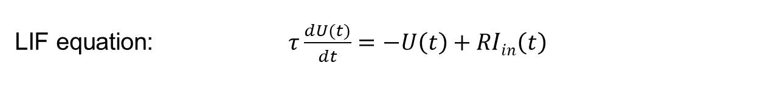
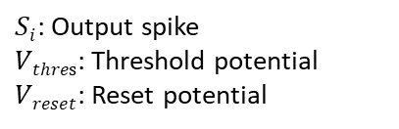
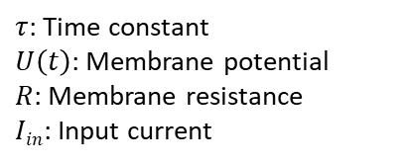
Leaky Integrate and Fire (LIF) Neuron
$τ$: Time constant
$U\left(t\right)$: Membrane potential
$R$: Membrane resistance
$Iin$: Input current
$Si$: Output spike
$Vthres$: Threshold potential
$Vreset$: Reset potential
I_{in}
Inputs
Dendrites
V_{thres}
t
Axon
U(t)
V_{reset}
t
t
S_{i}
Neuron
Body
Output
t
t
(a)
(b)
LIF equation: $τ\frac{dU(t)}{dt}=−U\left(t\right)+RIin\left(t\right)$
Fig. 2: (a) LIF potential dynamics (b) A typical SNN neuron
Notes:
LIF combines bio-plausibility with computational efficiency.
Left fig shows the LIF potential dynamics.
Here every input spike results in an increase in potential but the potential leaks over time.
When the threshold is reached, an output spike is released.
Formulized with the given equation.
Right fig shows a typical SNN neuron, input spikes are received at the dendrites and the output spikes are released at the axon.

Slide 6

Rate Coding
Rate Coding
Input = 0
Input Data
B(n=1, p=0)
No. of steps
t
Input = 0.5
B(n=1, p=0.5)
t
Input = 1
B(n=1, p=1)
t
Input data is repeated for a number of steps
Binomial distribution of input features used to identify the spike
Fig. 3: Rate Coding for SNNs
Notes:
Converts input intensity into spiking frequency or firing rate
Pixels intensities are used as input features for spike generation
Black pixel means no spike will be generated
Grey pixel means there is 50% chance of spike generation
White pixel means 100% chance of spike generation

Slide 7
Address Event Representation
Neuromorphic protocol encoding timing and location of spike events [2]
Only conveys the timing and location of active spikes
Location and timing of active spike is recorded
Neuron
Neuron
0 | 1 | 2 | 3
0 | 1 | 2 | 3
0
1
2
1 | 0 | 0 | 1
0 | 0 | 1 | 1
1 | 0 | 1 | 0
0
1
2
0 |  |  | 3
 |  | 2 | 3
0 |  | 2
Time Step
Time Step
Spike Data
AER Data
Fig. 4: Spike to AER conversion
Notes:
The figure shows that only timing and location of active spikes (1) are recorded.

Slide 8
Pattern Mining Algorithms
Find interesting and relevant patterns in dataset
FP-Growth: Builds an FP-Tree to directly extract frequent patterns [3]
FP-Max: Uses an FP-Tree with pruning to find only maximal frequent patterns [4]

Slide 9
Content
Background
Motivation
Proposed Method
Results
Conclusion

Slide 10
Motivation
Rate coding: Simple & noise-resilient, but higher spikes = higher energy & latency
Limits scalability in resource-constrained systems

Slide 11
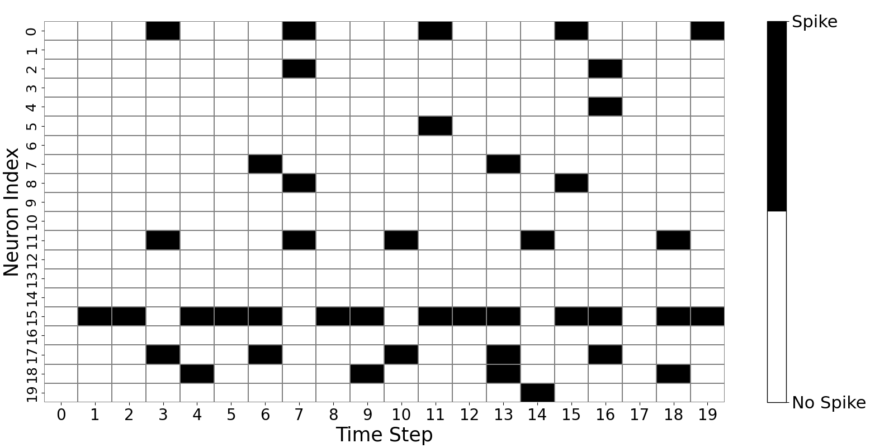
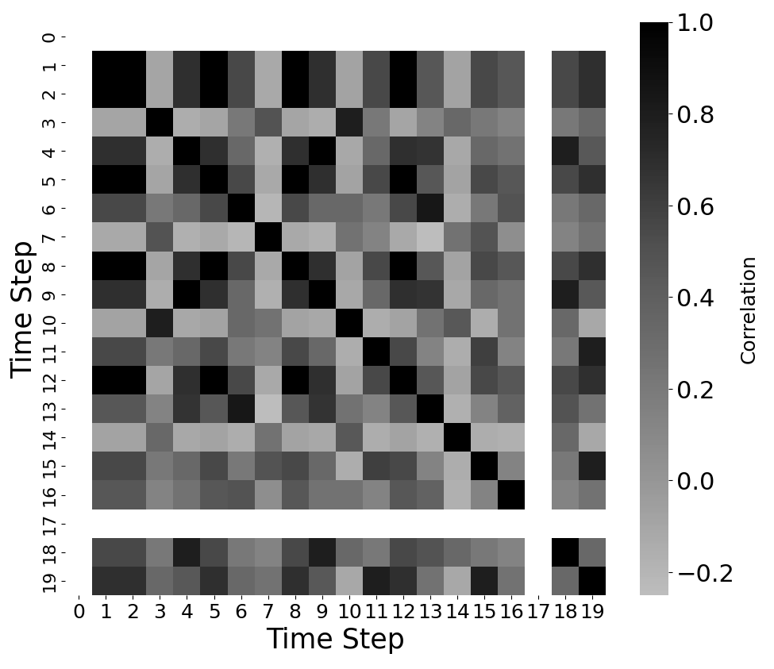
Observation during Rate Coding
Neurons fire in groups at the same timestep (Fig. 5)
Highly similar spike patterns observed at timesteps 4, 9, 18 in hidden layer
~30.50% spike similarity (Jaccard), so moderate–high temporal redundancy
Fig. 5: Temporal redundancy in spikes of a 784-20-10 SNN trained via BPTT on MNIST.

Slide 12
Our Contributions
Frequent Spike Pattern Compression (FSPC): A framework for compressing co-firing neuron activity in SNNs
Leverages pattern mining algorithms to identify neuron sets that frequently fire together
Merges these co-firing sets to reduce overall spike data size

Slide 13
Content
Background
Motivation
Proposed Method
Pattern Finding Phase
Compression Phase
Results
Conclusion

Slide 14
Proposed Method Overview
Key Steps:
Pattern Finding Phase
Compression Phase
(1)
Pattern Finding Phase
(2)
Compression Phase
Extract spike tensor from layer l_{n}
Compress FSPs with Symbols
Symbols
Encode spike tensor to AER
No. of FSPs
Decompress symbols with FSPs
Pattern Mining Function extracts FSPs
Decode AER to spike tensor
Symbols
Find FSPs in AER data
PMT
Send spike tensor to layer l_{n+1}
Fig. 6: FSPC Framework
Notes:
Figure shows the overall framework of FSPC

Slide 15
Important Terms
Frequent Spike Pattern (FSP): Set of neurons firing simultaneously at same timestep
Pattern Match Threshold (PMT): Value (0–1) defining the minimum proportion of FSP neurons that must appear in AER data for a valid match
The required number of FSP neurons in the AER data is:
N_{required} = ⌈PMT × |FSP Set|⌉
|FSP Set| = number of neurons in FSP set
⌈⌉ = ceiling function

Slide 16
Location of FSPC in SNN
Input
Layer
Layer
I_{n}
Layer I_{n+1}
Output
Layer
FSPC
Fig. 7: Location of FSPC in SNN

Slide 17
(1) Pattern Finding Phase
Extract spike tensor from layer l_{n} and encode it to AER
Spike Data
Encode to AER Data
Neuron Index
0 | 1 | 2 | 3 | 4 | 5 | 6 | 7
0 | 1 | 2 | 3 | 4 | 5 | 6 | 7
0
1
2
3
4
5
6
7
1 | 0 | 1 | 0 | 0 | 1 | 1 | 0
1 | 1 | 0 | 0 | 1 | 0 | 0 | 1
0 | 1 | 1 | 0 | 0 | 1 | 1 | 0
1 | 0 | 1 | 0 | 0 | 1 | 1 | 0
1 | 1 | 0 | 0 | 1 | 0 | 1 | 0
1 | 0 | 1 | 0 | 0 | 1 | 1 | 1
1 | 0 | 1 | 0 | 0 | 1 | 1 | 0
1 | 0 | 1 | 0 | 1 | 1 | 0 | 0
0
1
2
3
4
5
6
7
0 |  | 2 |  |  | 5 | 6
0 | 1 |  |  | 4 |  |  | 7
 | 1 | 2 |  |  | 5 | 6
0 |  | 2 |  |  | 5 | 6
0 | 1 |  |  | 4 |  | 6
0 |  | 2 |  |  | 5 | 6 | 7
0 |  | 2 |  |  | 5 | 6
0 |  | 2 |  | 4 | 5
Convert to AER format
Time Step

Slide 18
(1) Pattern Finding Phase
Extract FSPs using Pattern Mining Algorithms and assign them to symbols
Encoded AER Data
Extracted FSPs are assigned to symbols
0 | 1 | 2 | 3 | 4 | 5 | 6 | 7
0
1
2
3
4
5
6
7
0 |  | 2 |  |  | 5 | 6
0 | 1 |  |  | 4 |  |  | 7
 | 1 | 2 |  |  | 5 | 6
0 |  | 2 |  |  | 5 | 6
0 | 1 |  |  | 4 |  | 6
0 |  | 2 |  |  | 5 | 6 | 7
0 |  | 2 |  |  | 5 | 6
0 |  | 2 |  | 4 | 5
Pattern Mining Algorithms extract FSP
α₁ = {0, 2, 5, 6}
α₂ = {1, 4}
FSP = 2

Slide 19
(1) Pattern Finding Phase
Find the presence of FSPs in AER data
Encoded AER Data
Find FSPs in AER
0 | 1 | 2 | 3 | 4 | 5 | 6 | 7
0 | 1 | 2 | 3 | 4 | 5 | 6 | 7
0
1
2
3
4
5
6
7
0 |  | 2 |  |  | 5 | 6
0 | 1 |  |  | 4 |  |  | 7
 | 1 | 2 |  |  | 5 | 6
0 |  | 2 |  |  | 5 | 6
0 | 1 |  |  | 4 |  | 6
0 |  | 2 |  |  | 5 | 6 | 7
0 |  | 2 |  |  | 5 | 6
0 |  | 2 |  | 4 | 5
0
1
2
3
4
5
6
7
0 |  | 2 |  |  | 5 | 6
0 | 1 |  |  | 4 |  |  | 7
 | 1 | 2 |  |  | 5 | 6
0 |  | 2 |  |  | 5 | 6
0 | 1 |  |  | 4 |  | 6
0 |  | 2 |  |  | 5 | 6 | 7
0 |  | 2 |  |  | 5 | 6
0 |  | 2 |  | 4 | 5
Scanning AER for the extracted FSPs

Slide 20
(2) Compression Phase
Compress FSPs with Symbols in AER data
FSPs in AER
Compress FSPs to Symbols
0 | 1 | 2 | 3 | 4 | 5 | 6 | 7
0 | 1 | 2 | 3 | 4 | 5 | 6 | 7
0 |  | 2 |  |  | 5 | 6
0 | 1 |  |  | 4 |  |  | 7
 | 1 | 2 |  |  | 5 | 6
0 |  | 2 |  |  | 5 | 6
0 | 1 |  |  | 4 |  | 6
0 |  | 2 |  |  | 5 | 6 | 7
0 |  | 2 |  |  | 5 | 6
0 |  | 2 |  | 4 | 5
0
1
2
3
4
5
6
7
α₁
 | α₂
α₁
 | α₂
α₁
α₁
0 |  |  |  |  |  |  | 7
 | 1 | 2 |  |  | 5 | 6
0 |  |  |  |  |  | 6
 |  |  |  |  |  |  | 7
0 |  | 2 |  | 4 | 5
0
1
2
3
4
5
6
7
0 |  | 2 |  |  | 5 | 6
0 | 1 |  |  | 4 |  |  | 7
 | 1 | 2 |  |  | 5 | 6
0 |  | 2 |  |  | 5 | 6
0 | 1 |  |  | 4 |  | 6
0 |  | 2 |  |  | 5 | 6 | 7
0 |  | 2 |  |  | 5 | 6
0 |  | 2 |  | 4 | 5
Replacing selected FSPs with α₁ and α₂
Compressed FSPs

Slide 21
(2) Compression Phase
Decompress Symbols with FSP in AER data
Compressed Symbols
Decompress Symbols to FSPs
0 | 1 | 2 | 3 | 4 | 5 | 6 | 7
0 | 1 | 2 | 3 | 4 | 5 | 6 | 7
0
1
2
3
4
5
6
7
α₁
 | α₂
α₁
 | α₂
α₁
α₁
0 |  |  |  |  |  |  | 7
 | 1 | 2 |  |  | 5 | 6
0 |  |  |  |  |  | 6
 |  |  |  |  |  |  | 7
0 |  | 2 |  | 4 | 5
0
1
2
3
4
5
6
7
0 |  | 2 |  |  | 5 | 6
0 | 1 |  |  | 4 |  |  | 7
 | 1 | 2 |  |  | 5 | 6
0 |  | 2 |  |  | 5 | 6
0 | 1 |  |  | 4 |  | 6
0 |  | 2 |  |  | 5 | 6 | 7
0 |  | 2 |  |  | 5 | 6
0 |  | 2 |  | 4 | 5
Replacing symbols α₁ and α₂ with their FSPs
Compressed FSPs

Slide 22
(2) Compression Phase
Decode recovered AER to spike tensor and send to layer l_{n+1}
AER Data
Decode to Spike Data
0 | 1 | 2 | 3 | 4 | 5 | 6 | 7
0 | 1 | 2 | 3 | 4 | 5 | 6 | 7
0
1
2
3
4
5
6
7
0 |  | 2 |  |  | 5 | 6
0 | 1 |  |  | 4 |  |  | 7
 | 1 | 2 |  |  | 5 | 6
0 |  | 2 |  |  | 5 | 6
0 | 1 |  |  | 4 |  | 6
0 |  | 2 |  |  | 5 | 6 | 7
0 |  | 2 |  |  | 5 | 6
0 |  | 2 |  | 4 | 5
0
1
2
3
4
5
6
7
1 | 0 | 1 | 0 | 0 | 1 | 1 | 0
1 | 1 | 0 | 0 | 1 | 0 | 0 | 1
0 | 1 | 1 | 0 | 0 | 1 | 1 | 0
1 | 0 | 1 | 0 | 0 | 1 | 1 | 0
1 | 1 | 0 | 0 | 1 | 0 | 1 | 0
1 | 0 | 1 | 0 | 0 | 1 | 1 | 1
1 | 0 | 1 | 0 | 0 | 1 | 1 | 0
1 | 0 | 1 | 0 | 1 | 1 | 0 | 0
Revert AER data to spike data

Slide 23
Compression Types
α₁ = {0, 2, 5, 6}
α₂ = {1, 4}
Lossless compression
Lossy
compression
PMT = 1
PMT = 0.7
0 | 1 | 2 | 3 | 4 | 5 | 6 | 7
0 | 1 | 2 | 3 | 4 | 5 | 6 | 7
0
1
2
3
4
5
6
7
0 |  | 2 |  |  | 5 | 6
0 | 1 |  |  | 4 |  |  | 7
 | 1 | 2 |  |  | 5 | 6
0 |  | 2 |  |  | 5 | 6
0 | 1 |  |  | 4 |  | 6
0 |  | 2 |  |  | 5 | 6 | 7
0 |  | 2 |  |  | 5 | 6
0 |  | 2 |  | 4 | 5
0
1
2
3
4
5
6
7
0 |  | 2 |  |  | 5 | 6
0 | 1 |  |  | 4 |  |  | 7
 | 1 | 2 |  |  | 5 | 6
0 |  | 2 |  |  | 5 | 6
0 | 1 |  |  | 4 |  | 6
0 |  | 2 |  |  | 5 | 6 | 7
0 |  | 2 |  |  | 5 | 6
0 |  | 2 |  | 4 | 5
Pattern at timestep 2 and 7: ⌈0.7*4⌉ = 3
elements of α₁ present
Notes:
FSPC supports both lossless and lossy compression, controlled by PMT.
PMT = 1 indicates lossless compression while PMT < 1 means lossy compression.
In PMT = 0.7, the pattern in timesteps 2 and 7 is chosen as ¾ elements of alpha_1 are present.
It should be noted that in lossy compression, the recovered spike data may not be same as the initial one.

Slide 24
Content
Background
Motivation
Proposed Method
Results
Conclusion

Slide 25
Evaluation and Result
Model Configuration:
Datasets Used: MNIST, Fashion-MNIST (3000 images out of 10000)
Framework Used: snnTorch
Pattern Mining Algorithms: mlxtend fpmax [5], PAMI’s FP-growth and maxFP-growth [6]
Minimum Support Value: 0.25 (0.35 for four-layer SNN in F-MNIST)
Criteria: Evaluation based on PMT and FSP
Model | Input Neurons (IN) | Hidden Neurons (HN) | Output Neurons (ON)
Three-layer | 784 | 100 | 10
Four-layer | 784 | 100 (HN1), 60 (HN2) | 10

Slide 26
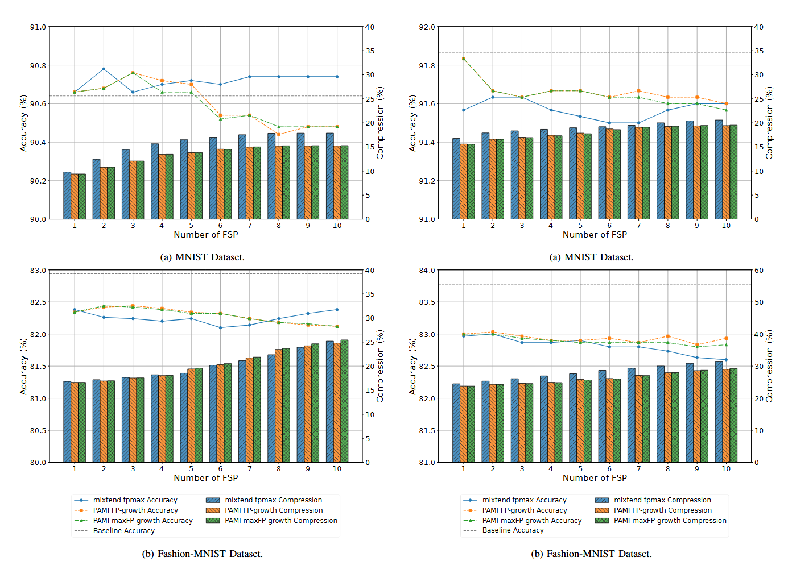
Evaluation based on FSP
fpmax: accuracy stabilizes
fpmax: accuracy falling
FP-growth/maxFP-growth: accuracy falling
FP-growth/maxFP-growth: accuracy stabilizes
0.26% avg. accuracy drop
1.16% avg. accuracy drop
20.59% max compression
31.50% max compression
(a) MNIST Dataset
(b) F-MNIST Dataset
*PMT = 0.65
Fig. 8: Evaluation of FSPC between layer HN1–HN2 in a 784-100-60-10 neuron SNN with respect to FSP
Notes:
In graphs, the left vertical axis is accuracy and right vertical axis is compression.
The horizonal axis shows number of FSPs
Compression increases with FSP in both datasets
Avg. Accuracy either drops or stabilizes

Slide 27
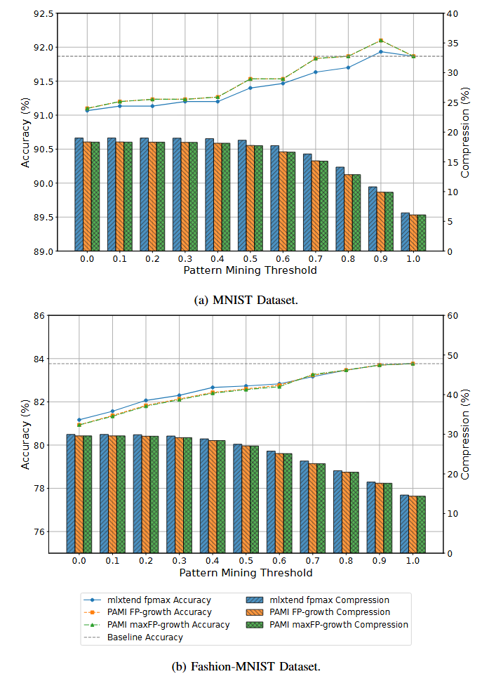
Evaluation based on PMT
Fpmax/FP-growth/maxFP-growth: accuracy increases
12.59% loss in compression
15.29% loss in compression
(a) MNIST Dataset
(b) F-MNIST Dataset
*FSP = 1
Fig. 9: Evaluation of FSPC between layer HN1–HN2 in a 784-100-60-10 neuron SNN with respect to PMT
Notes:
Similar here as well
PMT increase linked with decrease in compression and increase in accuracy

Slide 28
Content
Background
Motivation
Proposed Method
Results
Conclusion

Slide 29
Conclusion
Lossy spike compression proposed for SNNs
12–15% spike-data reduction with 1–3% accuracy loss
Can improve simulation efficiency and support adaptive, hardware-aware compression
Future: Integrate into training & develop faster, scalable mining algorithms

Slide 30
References
[1] W. Maass, “Networks of spiking neurons: The third generation of neural network models,” Electron. Colloquium Comput. Complex., vol. TR96, 1996.
[2] M. A. Mahowald, “Vlsi analogs of neuronal visual processing: A synthesis of form and function,” PhD dissertation, California Institute of Technology, Pasadena, CA, USA, May 1992
[3] J. Han et al., “Mining frequent patterns without candidate generation,” in ACM SIGMOD Conference, 2000, pp. 1–12.
[4] G. Grahne and J. Zhu, “High performance mining of maximal frequent itemsets,” in Proceedings of the 6th SIAM International Workshop on High Performance Data Mining, 2003, p. 34.
[5] S. Raschka, “Mlxtend: Providing machine learning and data science utilities and extensions to python’s scientific computing stack,” The Journal of Open Source Software, vol. 3, no. 24, Apr. 2018.
[6] U. K. Rage et al., “Pami: An open-source python library for pattern mining,” Journal of Machine Learning Research, vol. 25, no. 209, pp.1–6, 2024.

Slide 31
Thank you for your attention!

