Slide 1

Advancing Neuromorphic AI for Energy-Efficient and Sustainable Computing
優れたエネルギー効率と持続可能なコンピューティングに向けたニューロモルフィックAIの発展
Sustainable Computing Cluster
November 26th, 2025
Notes:
Good afternoon. My name is DANG Nam Khanh.
Today, I will talk about Advancing Neuromorphic AI for Energy-Efficient and Sustainable Computing.
Thank you very much for the opportunity to speak today. I appreciate your time and attention.

Slide 2
Contents
Why Energy Efficient and Sustainable AI Computing
How to advance neuromorphic AI for Sustainability
What are we doing for Energy Efficient and Sustainable Computing
Conclusion & Future Outlook
Notes:
This slide shows the talk outline.
I will answer three questions:
Why energy-efficient and sustainable computing matters
How neuromorphic AI can support sustainability
What our cluster is doing
Finally, I will conclude the talk.

Slide 3
Contents
Why Energy Efficient and Sustainable AI Computing
How to advance neuromorphic AI for Sustainability
What are we doing for Energy Efficient and Sustainable Computing
Conclusion & Future Outlook

Slide 4
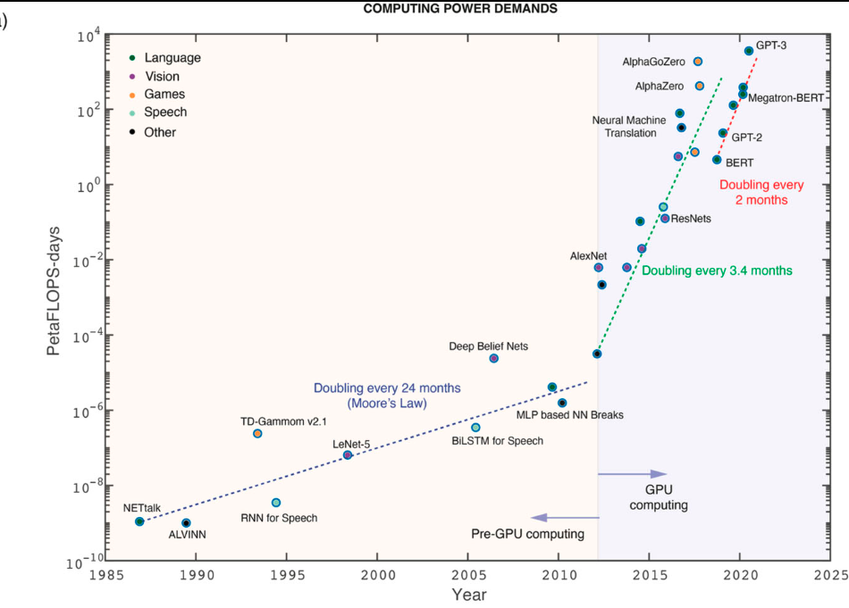
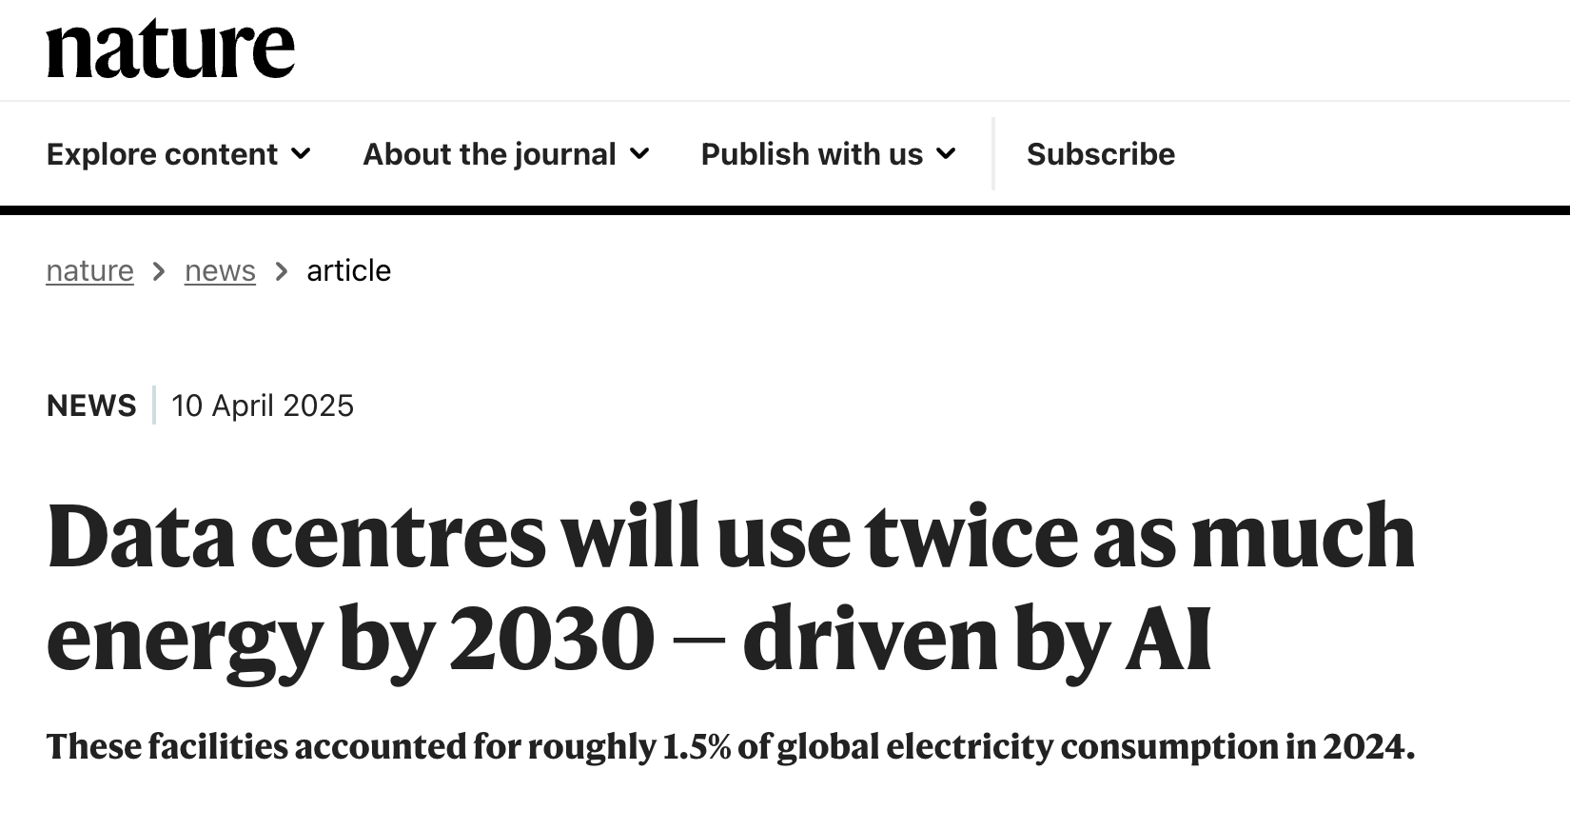
The raising demand in AI computing
Computing power demands for AI. Source: https://pubs.aip.org/aip/apm/article/12/10/109201/3317314
Notes:
As you know, AI is becoming a dominant computing paradigm worldwide, appearing in many industries and daily life. A major concern is the rapidly growing demand for computing power, as shown in the slide. <STOP for Japanese Translation> One important consequence of this rapid growth is power consumption. As reported in Nature, data centers are expected to consume around 1.5% of global electricity by 2030, largely driven by AI computing.

Slide 5
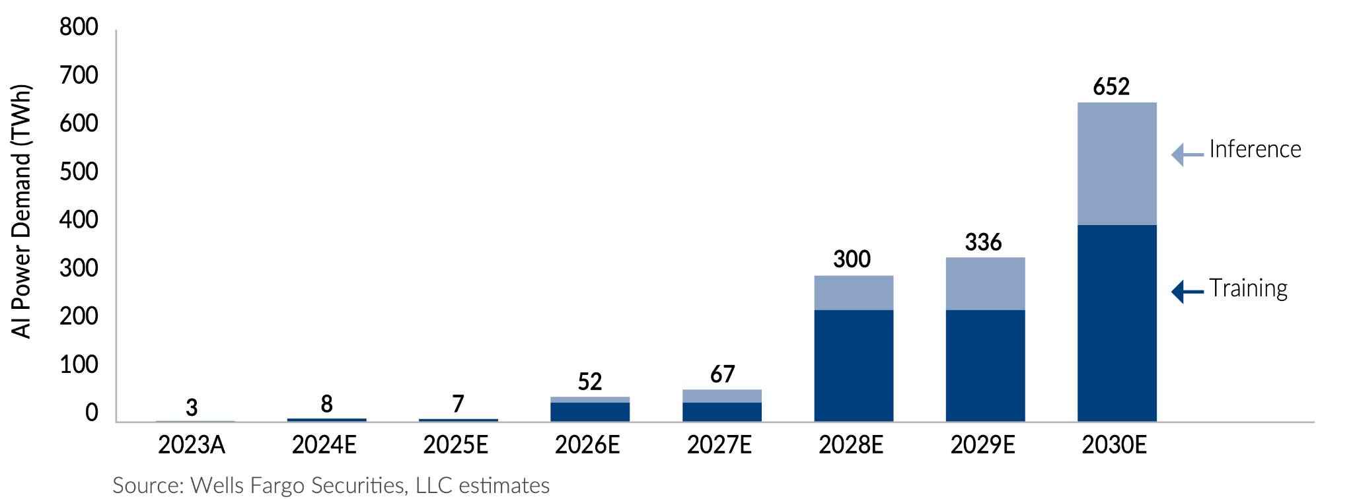
Demand based AI power consumption
Electricity production Japan in 2024: 981 TWh
The energy needed to train and run AI models is expected to multiply from 3 terawatt-hours (TWh) in 2023 to 652TWh in 2030.
Notes:
The energy required to train and operate AI models is also increasing rapidly. It is projected to grow from 3 terawatt-hours in 2023 to 652 terawatt-hours in 2030.
For comparison, Japan’s total electricity production in 2024 is about 981 terawatt-hours.

Slide 6
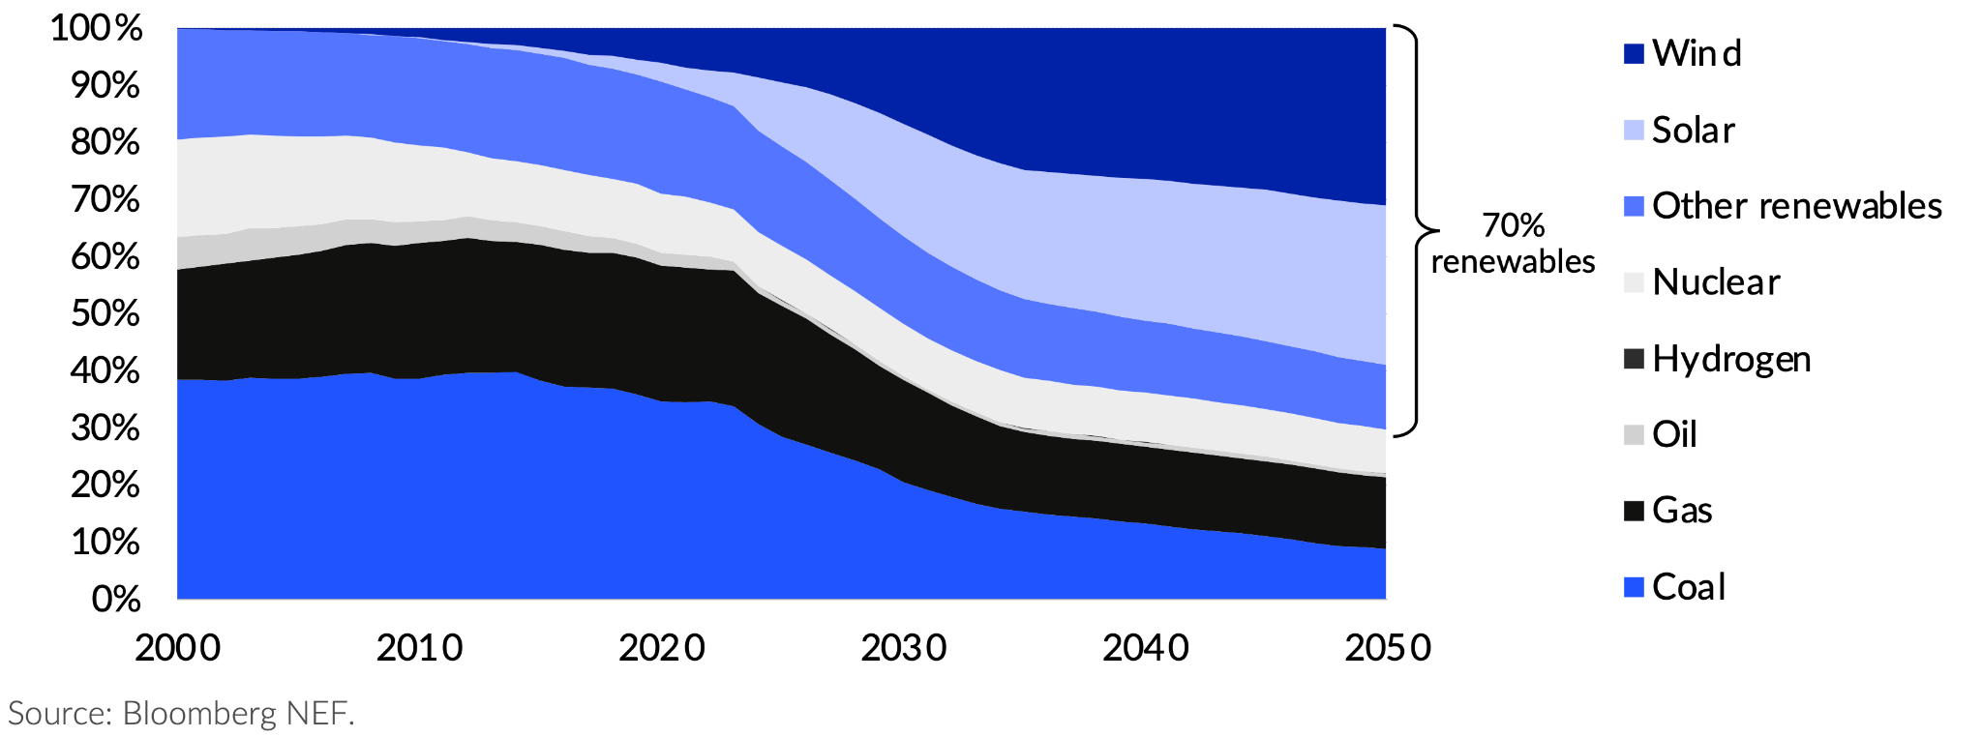
Renewable energy projection
Aiming for more renewable energy ⇒ still a long term project
Energy for AI/Datacenter is a challenging problem for sustainability
Notes:
For sustainability, we must consider the environmental impact of computing. By 2050, global renewable energy may reach about 70%.

Slide 7
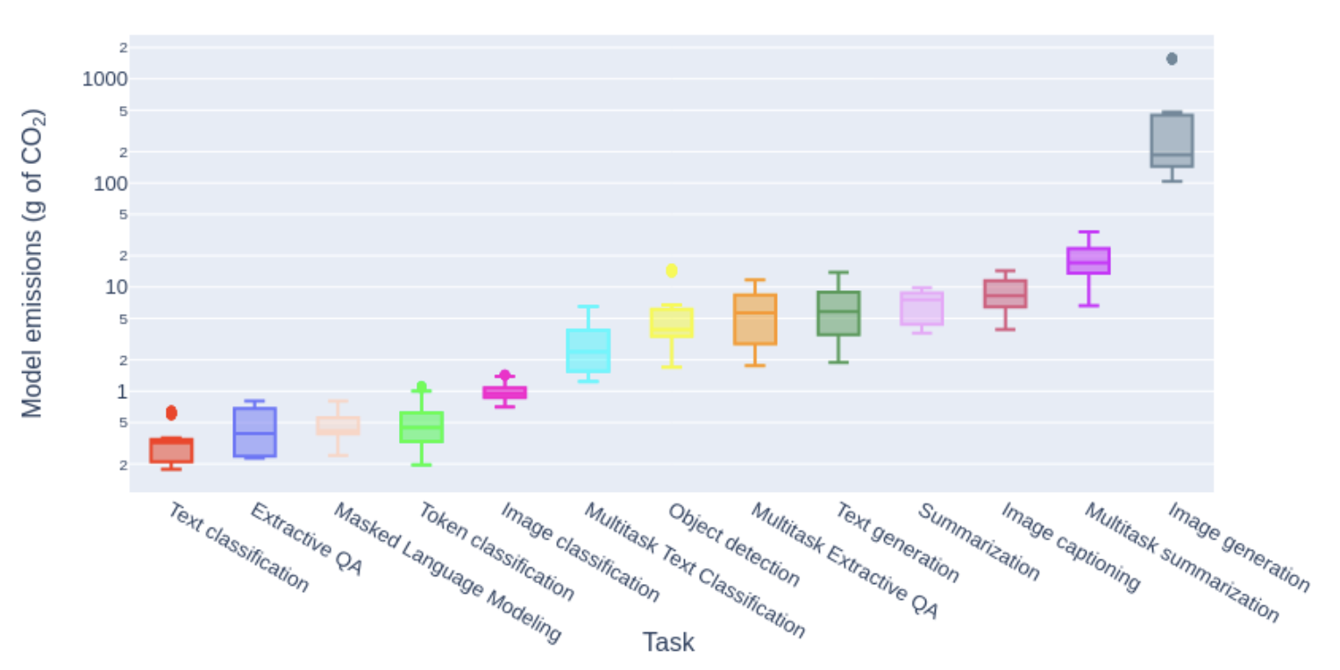
Carbon Footprint for AI tasks
Generating 1,000 images with a powerful AI model is responsible for roughly as much carbon dioxide as driving the equivalent of 6.5 km
Source: Hugging Face,Carnegie Mellon University [URL]
Notes:
This slide also shows the carbon footprint of AI tasks. One of the heaviest workloads is generative AI.
For example, generating 1,000 images is similar to driving 6.5 kilometers.
<STOP for Japanese Translation> AI is growing rapidly and requires more computing power and energy.
Therefore, developing AI that is energy-efficient and sustainable is essential.

Slide 8
How to reduce operational carbon emissions
Improve the cleanliness of the energy supply
More renewable energy, offsetting with energy harvesting
Place the AI systems nearby renewable energy
Better hardware for better energy efficiency
More energy efficient CPU/GPU/Accelerator offers better solutions
Develop more efficient ML models:
Shrink the model
Embrace sparsity
Energy-driven adaptivity
Source: Google
Notes:
To reduce the operational carbon footprint of AI, there are three main approaches:
Improve the cleanliness of the energy supply
Use better hardware to increase energy efficiency
Develop more efficient AI models

Slide 9
Contents
Why Energy Efficient and Sustainable AI Computing
How to advance neuromorphic AI for Sustainability
What are we doing for Energy Efficient and Sustainable Computing
Conclusion & Future Outlook
Notes:
Next, How to advance neuromorphic AI for Sustainability

Slide 10
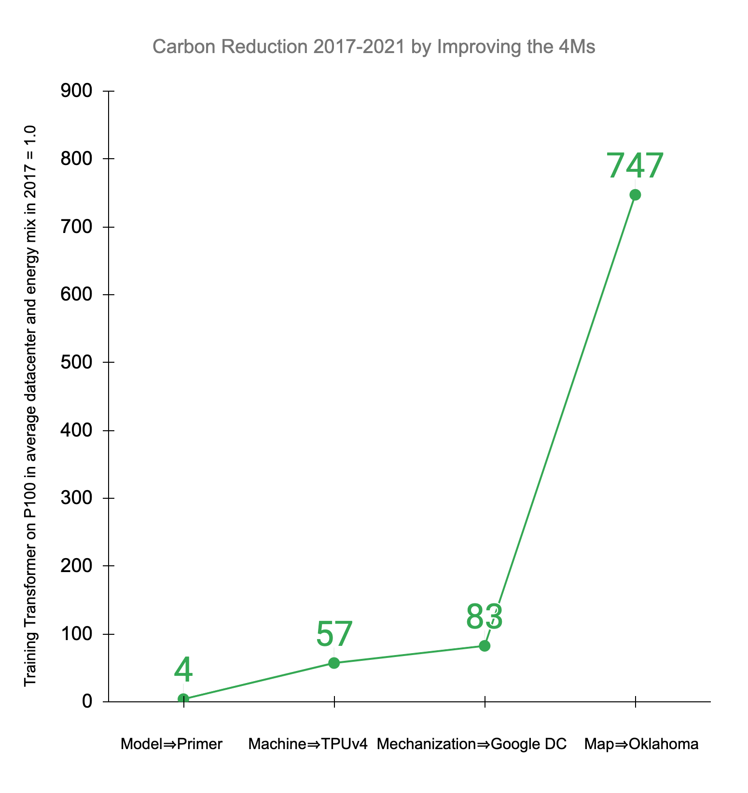
How to reduce operational carbon emissions
For example: 4M by Google
Model: Use network architecture search to get more efficient model.
Machine: better machine for better energy
Mechanization: move the computing to better datacenter
Map Optimization: pick the cleanliest datacenter for computing → encourage the new clean datacenter
Source: Google
Notes:
A similar approach, called 4M—Model, Machine, Mechanization, and Map optimization—was used by Google. By applying all four Ms, they were able to reduce the carbon footprint by about 700 times.

Slide 11
The key aspects of AI computing
Computation
Communication
Storage
for energy efficient and sustainable computing, the key aspects should be approached
System/Module #1
System/Module #2
A
C
Computation
C
Computation
E
B
communication
D
Memory access
Storage
Storage
A
B
D
E
Notes:
In our Cluster, we mainly focus on the computing aspect. In short, there are key aspects to consider:
Three traditional hardware aspects: computing, communication, and storage

Slide 12
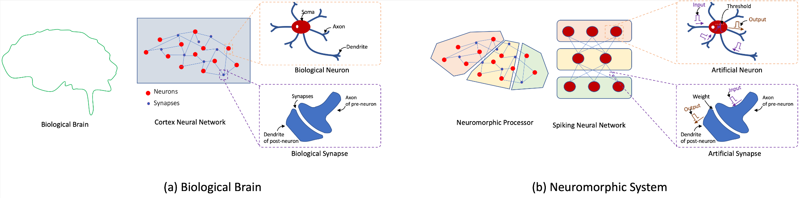
Neuromorphic AI: an overview
Biological Brain and Neuromorphic System.
Neuromorphic AI mimics the structure and functionality of biological neural systems
Neuromorphic AI uses event-driven processing, activating components only when necessary, unlike traditional systems which are always running.
Q: How does neuromorphic AI can advance the energy-efficient and sustainable computing future?
Notes:
This slide provides an overview of neuromorphic AI. Neuromorphic AI mimics the operation of the biological brain, using action potentials, or spikes, for both computing and communication.
The question we ask here is: “How can neuromorphic AI advance an energy-efficient and sustainable computing future?”

Slide 13
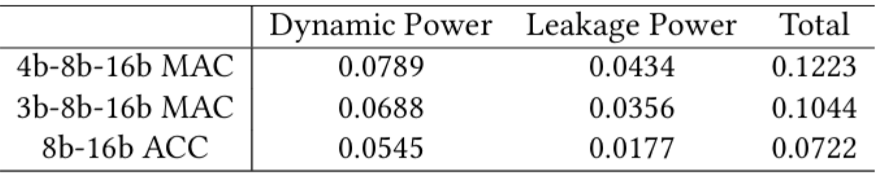
Computation
Computationally, neuromorphic AI allows low complexity due to its inputs: spikes or action potentials.
Spikes are represented as binary values which allows the AI system to operate with ACC (addition-and-accumulation unit) instead of MAC (Multiply-and-Accumulation unit)
↓ -14.63%
↓ - 40.96%
Neuromorphic AI
Energy results with 22nm technology. Source: NUS, Singapore
Notes:
First, regarding computing, neuromorphic AI uses spikes, which reduces computational power, as shown in this table.

Slide 14
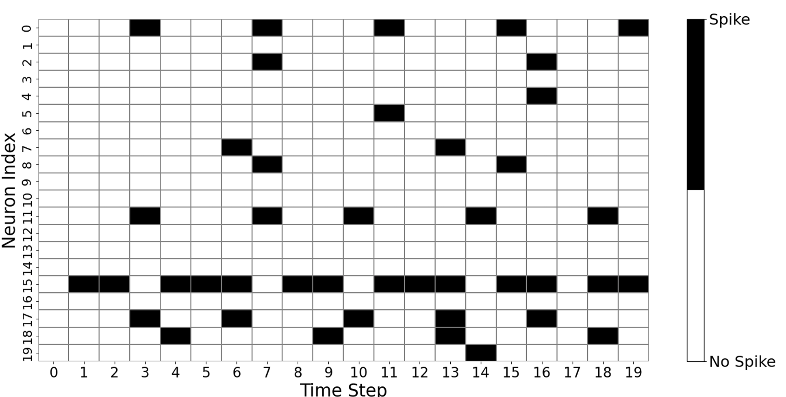
Communication
Since Neuromorphic AI use spikes as communication, only binary (0 or 1) values needed to be transferred.
Spikes are also sparse, which allows less communication between modules/systems
Output spikes per time of a layer of 20 neuron of an SNN.
Notes:
Second, the spikes in neuromorphic AI are usually binary (0 or 1) and sparse. This sparsity helps reduce communication, which in turn reduces energy consumption.

Slide 15
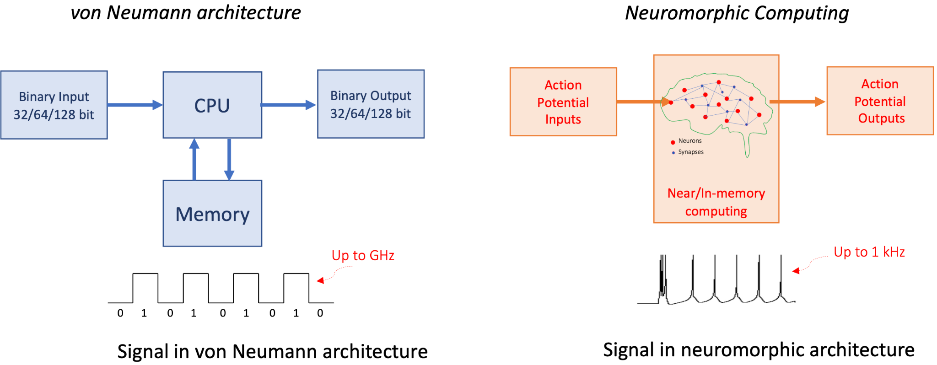
Storage
Data
Compute
Data
von Neuman architectures require back-and-forth data transferring between memory and CPU/GPU
Neuromorphic architecture targets integrating memory and computing together
Notes:
Next, regarding storage, neuromorphic AI moves toward in-memory or near-memory processing.
Memory is no longer on a separate chip;
<STOP for Japanese Translation> instead, memory and computing are integrated in a close system, which helps to reduce memory access and energy consumption.

Slide 16
Contents
Why Energy Efficient and Sustainable AI Computing
How to advance neuromorphic AI for Sustainability
What are we doing for Energy Efficient and Sustainable Computing
Conclusion & Future Outlook
Notes:
Now, we will discuss what our Sustainable Computing Cluster is doing in this area.

Slide 17
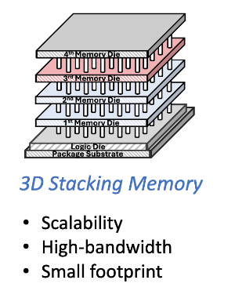
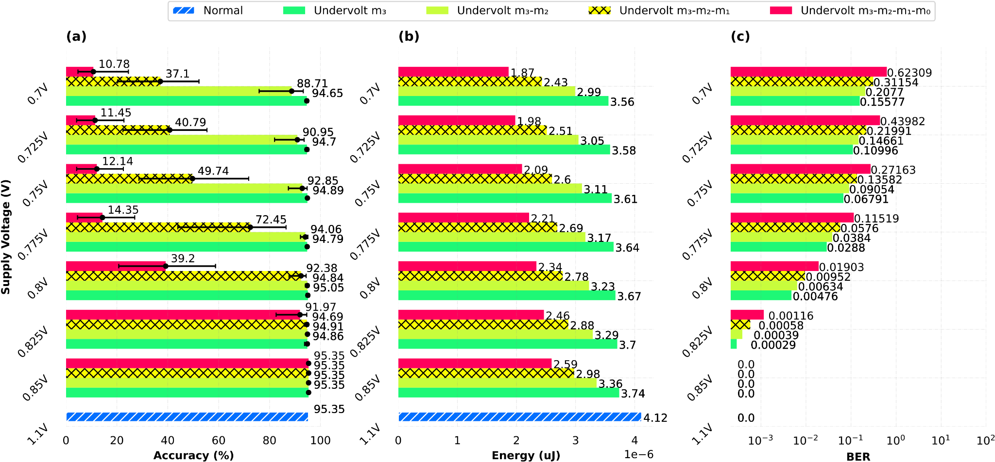
Our approach on energy-efficient and sustainable AI (1)
On memory aspect – Our Stacking Memory Design:
Split memory into multiple dies in 3D-ICs.
Each die to host different bit indexes
Fine grain control of each die for reducing power.
Energy/Accuracy result for 3D Stacking memory: 21% energy reduction with similar accuracy.
Source: https://ieeexplore.ieee.org/document/10269541
Notes:
First, we have our stacked memory design. We divide the memory into several silicon layers and apply different control strategies for each layer.
This approach allows us to reduce energy consumption by about 20% while maintaining similar accuracy.

Slide 18
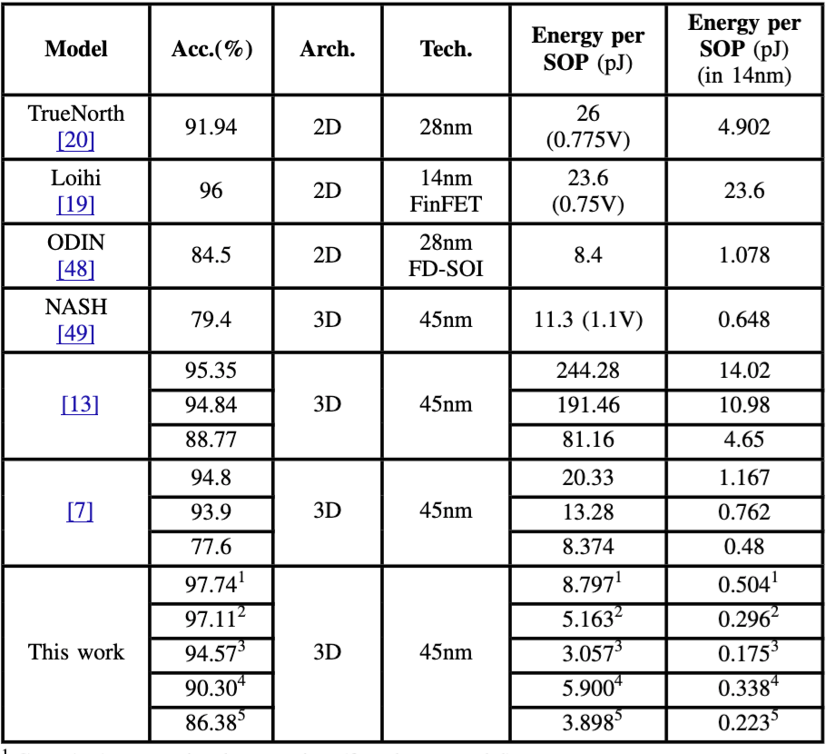
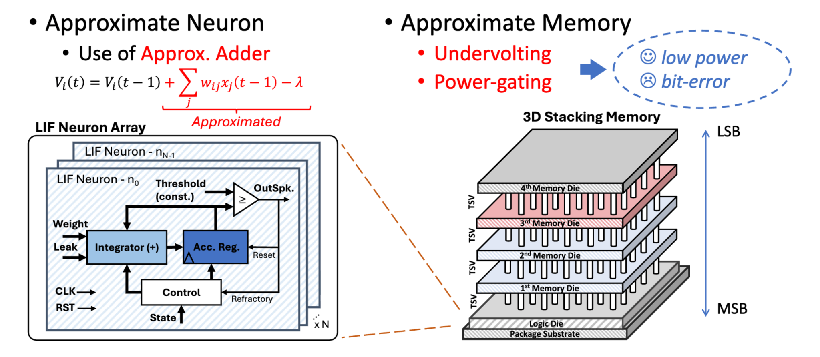
Our approach on energy-efficient and sustainable AI (2)
On computation aspect – Our Approximation Neuron Searching Framework:
Energy/Accuracy result for approximate design:
28% energy reduction with similar accuracy
70% energy reduction with 5% accuracy loss.
80x/40x time smaller energy per synaptic per operation than TrueNorth/Loihi-1
Source: https://ieeexplore.ieee.org/document/11122553
Notes:
For computation, we adopt our approximate computing design. In addition, we have developed an evolutionary algorithm to find the optimal configuration.
(STOP for Japanese Translation) Here are the results.
(STOP for Japanese Translation) This approach reduces energy consumption by up to 70% with only a small loss in accuracy.

Slide 19
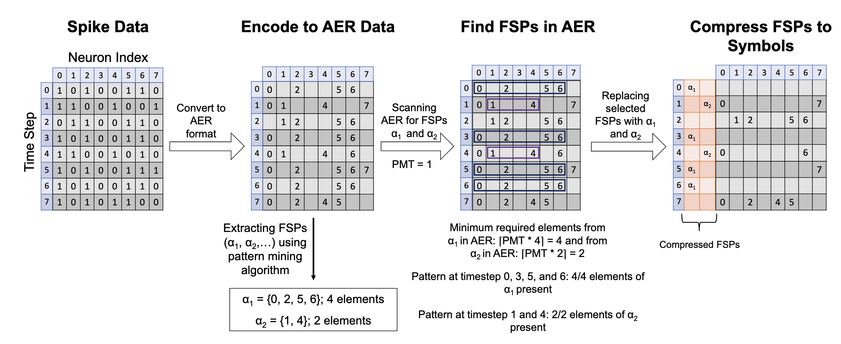
Our approach on energy-efficient and sustainable AI (3)
On communication aspect – Our Spike Compression Framework:
Naturally, neurons are likely to spikes together given the same input spikes.
Group the frequently spike pattern (FSP) neuron to reduce the communication load.
Instead of multiple spikes, we send only one spike to represent a group of neuron
Result for spike compression:
10+% spike communication reduction without accuracy loss
30+% energy reduction with 1.2% accuracy loss.
Notes:
Next, let us talk about communication. As we already know, spikes are sparse, but we have found a way to group spikes together. Instead of sending multiple spikes individually, we only need to send one.
(STOP for Japanese Translation) This approach leads to 10% spike reduction without accuracy loss, and 30% spike reduction with only 1.5% accuracy loss

Slide 20
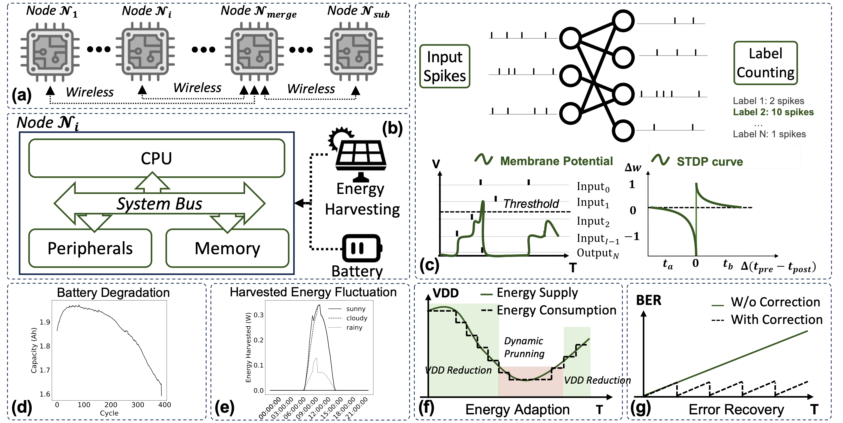
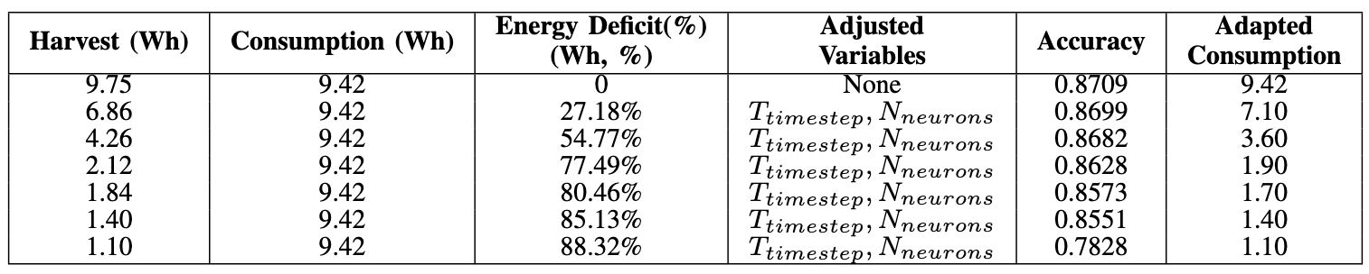
Our approach on energy-efficient and sustainable AI (4)
On model adaption aspect – Our Caborn-Neutral AI framework:
On-chip learning result with energy-adaption → achieve Operational Carbon Neutrality
(a) Distributed system for serverless multti-chip learning; (b) node architecture; (c) SNN model with on-chip unsupervised STDP and lateral inhibition; (d) battery capacity degradation over charge–discharge cycles; (e) estimated power harvested using a 1-W solar panel under varying weather; (f) energy-adaptive consumption under fluctuating supply; (g) error-recovery method for reducing BER.
Notes:
As we have discussed, neuromorphic AI is energy-efficient and can be sustainable. With our methods, we can achieve even greater energy reduction.
What can we achieve with this? Here is the ultimate AI model: a carbon-neutral AI framework.
(STOP for Japanese Translation)
Depending on the available energy from harvesting, we can adjust the AI model to consume only that energy, so no external power is required.

Slide 21
Contents
Why Energy Efficient and Sustainable AI Computing
How to advance neuromorphic AI for Sustainability
What are we doing for Energy Efficient and Sustainable Computing
Conclusion & Future Outlook
Notes:
Next, I will present the conclusion and future outlook.

Slide 22
Conclusion
With the current trend of AI system, energy consumption and related carbon emission will be major issues.
Neuromorphic AI offers the new solution with lower complexity in computing, adaptivity.
Combining neuromorphic AI with advanced techniques open the pathway for low-power AI platform.
Future outlook: enhancing on-chip learning and scalble multi-chip neuromorphic AI can offer better solutions.
Notes:
AI growth raises energy and carbon concerns. Neuromorphic AI offers efficient, adaptive computing. Our approaches can reduce even more energy. Future outlook: better on-chip learning and multi-chip scalability.

Slide 23
Thank you for your attentions!
Notes:
Thank you for your attention.

