Slide 1
Designing Spiking Neural Network on Embedded Systems with On-Chip Learning Ability
s1300053 Komatsu Yamato
Supervised by DANG Nam Khanh
2026/2/4
Notes:
Today, I will present my graduation thesis titled 'Designing Spiking Neural Network on Embedded Systems with On-Chip Learning Ability'.

Slide 2
Content
Research Introduction
Objective and Approach
Overall System
Experimental Results
Discussion
Conclusion
Notes:
The content should be bief

Slide 3
Content
Research Introduction
Objective and Approach
Overall System
Experimental Results
Discussion
Conclusion
Notes:
Before jumping to a new section, add a new slide:
Hide the other sections
Highlight the current section

Slide 4
Research Introduction: Why Spiking Neural Networks?
Human Brain Efficiency:
Advanced cognitive processing with only ~20W power [1].
Spiking Neural Networks(SNNs):
Mimics brain's mechanism using "spikes" (pulse signals) [2].
Next-gen power-saving AI technology.
Goal: Apply SNNs to embedded systems.
Notes:
Research Introduction:Why Spiking Neural Networks?
The human brain is efficient, using only 20 watts. SNNs mimic this mechanism with 'spike' signals, making them energy-efficient. Therefore, my goal is to apply SNNs to embedded systems. 「人間の脳は効率的で、わずか20ワットしか使いません。 SNNは『スパイク』信号でこの仕組みを模倣しており、エネルギー効率が良いです。 そのため、私の目標はSNNを組み込みシステムに応用することです。」

Slide 5
Content
Research Introduction
Objective and Approach
Overall System
Experimental Results
Discussion
Conclusion
Notes:
Before jumping to a new section, add a new slide:
Hide the other sections
Highlight the current section

Slide 6
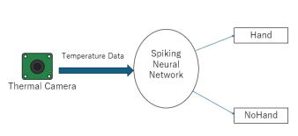
Objective and Approach
Objective
Goal: Detect "Hand" in low-resolution thermal images using SNN.
Focus: Verify practicality on embedded systems.
Approach Overview
Input: Low-resolution thermal images (24x32 pixels) for efficiency.
Model: SNN trained with BPTT (Backpropagation Through Time).
Task: Binary classification ("Hand" vs. "Not Hand").
Notes:
"My objective is to detect 'Hands' in low-resolution thermal images using SNNs. For the approach: I use efficient 24 by 32 pixel images. The model is an SNN trained with BPTT. The task is to classify 'Hand' or 'Not Hand’.”
「目的は、SNNを使って低解像度熱画像から『手』を検出することです。 アプローチとして、 効率的な24x32ピクセルの画像を使い、 モデルはBPTTで学習させたSNNです。 タスクは『Hand』か『Not Hand』への分類です。」

Slide 7
Content
Research Introduction
Objective and Approach
Overall System
Experimental Results
Discussion
Conclusion
Notes:
Before jumping to a new section, add a new slide:
Hide the other sections
Highlight the current section

Slide 8
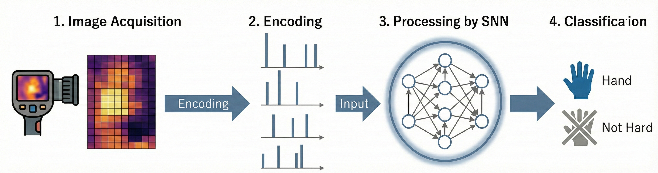
Overall System Flow
1. Image Acquisition
A thermal camera acquires temperature data of 24x32 pixels.
2. Encoding
Converts static thermal images into time-series spike trains that the SNN can process. The higher the pixel brightness, the higher the spike frequency.
3. Processing by SNN Spike trains are input into the SNN to integrate information and extract features over multiple time steps.
4. Classification Determines "Hand" or "Not Hand" based on the activity of output layer neurons.
Notes:
"The system flows in four steps. First, the camera acquires thermal data. Second, we encode it into spike trains—brighter pixels mean more spikes. Third, the SNN extracts features over time. Finally, it classifies the image as 'Hand' or 'Not Hand’.”
「システムの処理は4つのステップで進みます。 まず、カメラが熱データを取得します。 次に、それをスパイク列に変換します（明るいピクセルほどスパイクが増えます）。 3つ目に、SNNが時間をかけて特徴を抽出します。 最後に、画像が『Hand』か『Not Hand』かを分類します。」

Slide 9
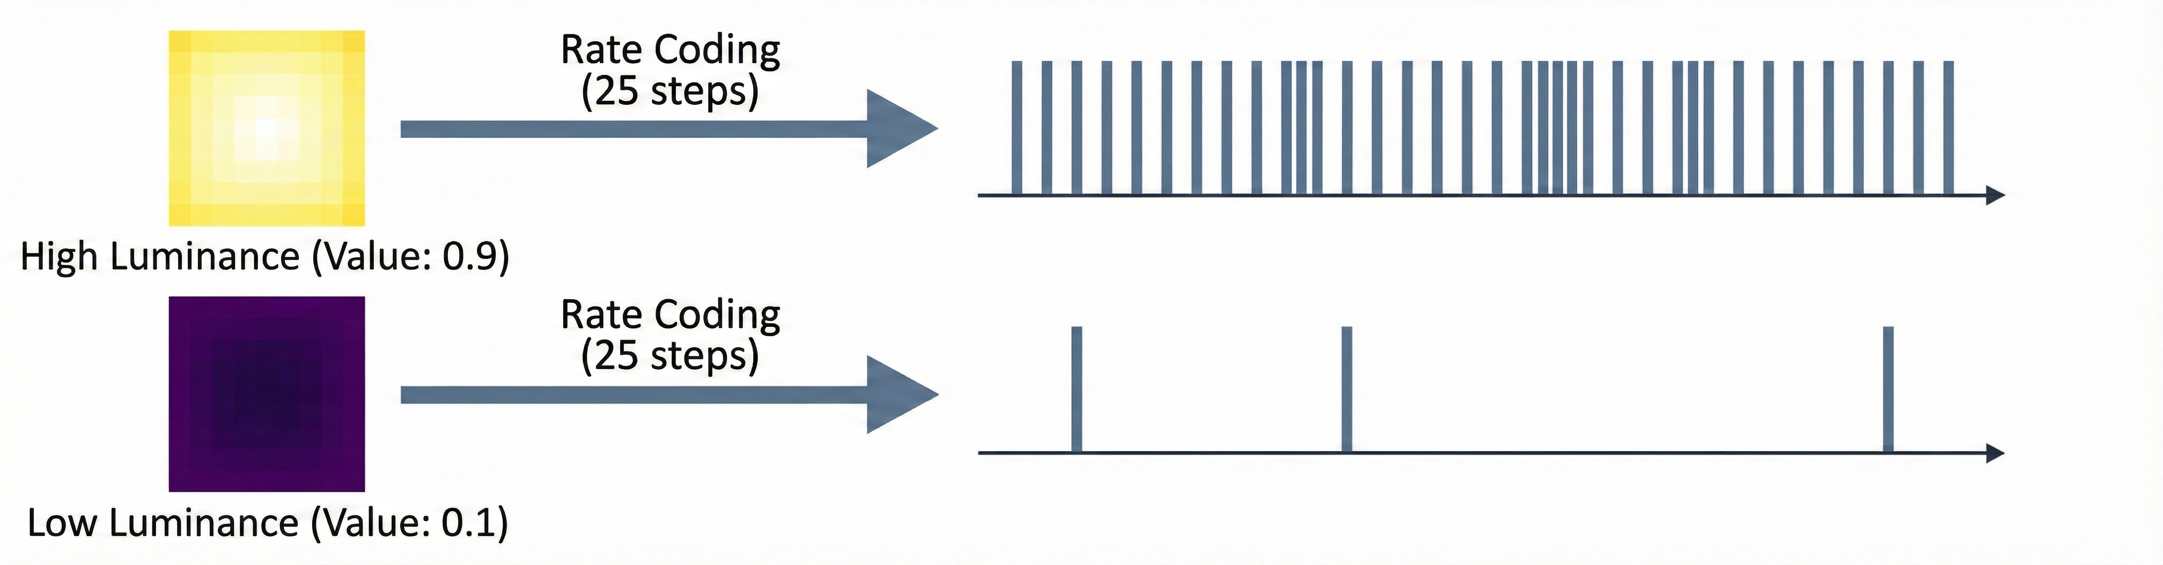
Encoding Method
Rate Coding: Represent pixel value by spike frequency to handle static images.
Processing Procedure
Normalize each thermal image to a range of 0 to 1.
Spike Generation: Pixel value = Probability of spike at each step (Total: 25 steps).
As a result, high-temperature pixels (larger values) generate high-frequency spike trains, while low pixels generate low-frequency spike trains.
Notes:
Let me explain the encoding method. I used 'Rate coding'. This method converts pixel values into spike frequency. First, we normalize the thermal image to a range of 0 to 1. These values become the probability of a spike at each time step. As a result, high-temperature pixels generate many spikes, while low-temperature pixels generate few spikes.（エンコーディング手法について説明します。「レートコーディング」を使用しました。これはピクセル値をスパイクの頻度に変換する方法です。まず画像を0から1に正規化します。この値が各ステップでのスパイク発生確率になります。結果として、高温のピクセルは多くのスパイクを、低温のピクセルは少ないスパイクを生成します。）

Slide 10
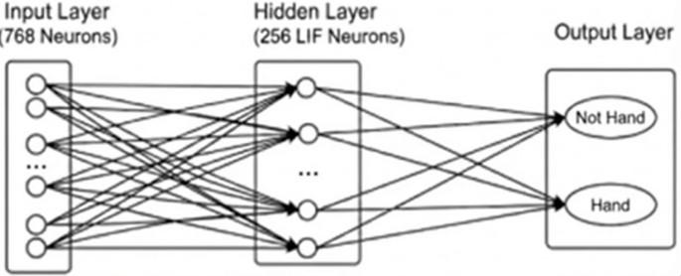
SNN Model Configuration
Neuron Model:
Leaky Integrate-and-Fire (LIF)
Features : Low computational cost & widely used.
Mechanism : Integrates input spikes → Fires when threshold is exceeded.
Network Architecture
Constructed a 3-layer fully connected network.
Input Layer: 768 neurons (equivalent to 24x32 pixels).
Hidden Layer: 256 LIF neurons.
Output Layer: 2 LIF neurons (corresponding to "Not Hand" and “Hand" classes).
Notes:
"Next, I will explain the model configuration. We used the Leaky Integrate-and-Fire neuron, or LIF. It is efficient and widely used. It integrates spikes and fires when a threshold is exceeded. As for the network, we built a 3-layer fully connected structure. The input layer has 768 neurons, matching the pixels. The hidden layer has 256 neurons. Finally, the output layer has 2 neurons for classification."
「次に、モデル構成について説明します。 私たちはLeaky Integrate-and-Fireニューロン、略してLIFを使用しました。 これは効率的で、広く使われています。 スパイクを統合し、閾値を超えたときに発火します。 ネットワークに関しては、3層の全結合構造を構築しました。 入力層は768ニューロンで、ピクセル数と一致しています。 隠れ層は256ニューロンです。 最後に、出力層は分類用の2ニューロンです。」

Slide 11
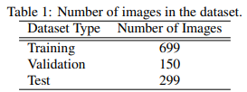
Data Collection
Device Used
Sensor: Low-resolution thermal camera (24x32 pixels).
Dataset Construction
Classes: "Hand" vs. "Not Hand".
Robustness: "Not Hand" includes hot/cold objects (e.g., hot drinks) to prevent overfitting.
Data Split: Divided into Training, Validation, and Test sets.
Notes:
For data collection, I used a low-resolution thermal camera. I collected images for two categories: 'Hand' and 'Not Hand'. To make the model stronger, the 'Not Hand' category includes not only empty space but also other hot and cold objects. I used 699 images for training, 150 for validation, and 299 for testing.（データ収集には低解像度サーマルカメラを使いました。「Hand」と「Not Hand」の2カテゴリの画像を集めました。モデルを頑健にするため、「Not Hand」には空空間だけでなく、他の高温・低温物体も含めました。学習用に699枚、検証用に150枚、テスト用に299枚を使用しました。）

Slide 12
Content
Research Introduction
Objective and Approach
Overall System
Experimental Results
Discussion
Conclusion
Notes:
Before jumping to a new section, add a new slide:
Hide the other sections
Highlight the current section

Slide 13
Experimental Results 1: Classification Accuracy
Evaluation Setup
Comparison: Trained model on GPU vs. Raspberry Pi.
Classification accuracy on GPU
Classification accuracy on Raspberry Pi
 | Hand(%) | Not Hand(%)
Hand | 90.0% (269) | 10.0% (30)
Not Hand | 27.1% (81) | 72.9% (218)
 | Hand(%) | Not Hand(%)
Hand | 90.0% (269) | 10.0% (30)
Not Hand | 25.8% (77) | 74.2% (222)
Findings
"Hand" Class: Achieved high accuracy (~ 90%) in both environments.
"Not Hand" Class: Misclassification rate remains relatively high.
Notes:
"Now, let's look at the results. This slide shows the classification accuracy. I evaluated the model on a GPU and a Raspberry Pi. Please look at the 'Hand' row. The accuracy was about 90% on both devices. However, for the 'Not Hand' class, the misclassification rate was relatively high." （結果を見ていきましょう。このスライドは分類精度です。GPUとラズパイで評価しました。「Hand」の行を見てください。両方のデバイスで約90%の精度が出ました。しかし、「Not Hand」クラスについては、誤分類率が比較的高くなりました。）

Slide 14
Experimental Results 2: Inference Speed
Evaluation Setup
Comparison: Measured inference time per frame (GPU vs. Raspberry Pi).
Environment | Average inference time
GPU | 4.73ms
Raspberry Pi | 29.51ms
Findings
The inference speed on Raspberry Pi was about 6 times slower than on the GPU.
However, the speed of about 30ms per frame is within a practical range for many real-time embedded applications.
Notes:
"Next is the inference speed. The GPU took about 4.7 milliseconds per frame. The Raspberry Pi took about 29.5 milliseconds. Although the Raspberry Pi is slower, a speed of about 30 milliseconds is fast enough for real-time applications." （次は推論速度です。GPUは1フレーム約4.7ミリ秒でした。ラズパイは約29.5ミリ秒でした。ラズパイの方が遅いですが、約30ミリ秒という速度はリアルタイムアプリには十分な速さです。）

Slide 15
Content
Research Introduction
Objective and Approach
Overall System
Experimental Results
Discussion
Conclusion
Notes:
Before jumping to a new section, add a new slide:
Hide the other sections
Highlight the current section

Slide 16
Discussion ①: Maintaining Performance in Embedded Environments
・Consistent Accuracy
・Achieved ～ 90% accuracy for “Hand” class on both GPU and Raspberry Pi.
・Hardware Independence
・Maintained performance on resource-constrained platforms.
・Significance
・Demonstrates the practicality of SNNs for embedded systems.
Notes:
"I will now discuss the results. First, about maintaining performance. The accuracy for the 'Hand' class was almost identical on the GPU and the Raspberry Pi. This shows that my SNN model does not depend on hardware performance. It can work well even on embedded systems like Raspberry Pi." （考察に入ります。まず性能維持についてです。「Hand」クラスの精度はGPUとラズパイでほぼ同じでした。これは、私のSNNモデルがハードウェア性能に依存しないことを示しています。ラズパイのような組込みシステムでも十分に動作します。）

Slide 17
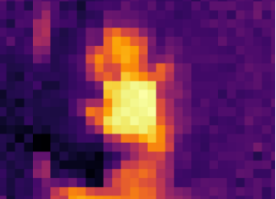
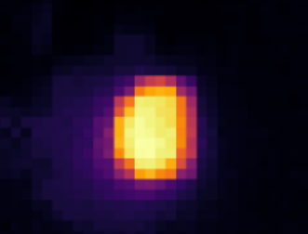
Discussion ②: Analysis of Causes for False Positives
Problem
False Positives: "Not Hand" often misclassified as "Hand".
Cause Analysis
Source of Error: High-temperature objects (e.g., hot drinks).
Model Behavior: Learned temperature intensity, not semantic shape.
Reasoning: Since thermal images represent humans as "high heat regions," the model confuses them with other hot objects.
Correctly Classified Hand
Misclassified Hot Object
Notes:
"Next, I analyzed the false positives. Why did the model make mistakes? The main cause was other hot objects. In thermal images, humans appear just as 'hot areas'. So, the model learned that 'High Heat equals Hand'. Please look at the images. The top is a hand. The bottom is a hot object. Because their heat patterns look similar, the model confused them.
「次に、偽陽性について分析しました。 なぜモデルは間違えたのでしょうか？ 主な原因は、他の高温物体でした。 サーマル画像では、人間は単なる『熱い領域』として映ります。 そのため、モデルは『高熱＝手』であると学習してしまいました。 画像をご覧ください。上が手で、下が高温物体です。 熱のパターンが似ているため、モデルはそれらを混同してしまいました。」

Slide 18
Content
Research Introduction
Objective and Approach
Overall System
Experimental Results
Discussion
Conclusion
Notes:
Before jumping to a new section, add a new slide:
Hide the other sections
Highlight the current section

Slide 19
Conclusion
Conclusion
High Accuracy: Achieved ~90% accuracy on Raspberry Pi (comparable to GPU).
Efficiency: Confirmed SNN suitability for embedded systems.
Limitation: False positives caused by non-human hot objects.
Future Work
Shape Recognition: Incorporate spatial features (e.g., CNN layers).
Multi-modal: Integrate motion or other sensor data.
Notes:
Finally, I would like to summarize my research and talk about future work. First, let's look at the conclusion. We achieved about 90% accuracy on the Raspberry Pi. This performance is almost the same as the GPU. This shows that SNNs are suitable for embedded systems. However, there is a limitation. The model sometimes mistakes hot objects for humans. To solve this, we have two plans for future work. First, we want to add shape recognition, using CNN layers. Second, we plan to use motion data or other sensors.

Slide 20
References
[1] Wolfgang Maass, “Networks of spiking neurons:The third generation of neural network models,” NeuralNetworks, vol. 10, no. 9, pp. 1659–1671, 1997.
[2] Michael Pfeiffer and Thomas Pfeil, “Deep learn-ing with spiking neurons: Opportunities and chal-lenges,” Frontiers in Neuroscience, vol. 12, Article774, 2018.
[3] Anthony N. Burkitt, “A review of the integrate-and-fire neuron model,” Biological Cybernetics, vol.95, no. 1, pp. 1–19, 2006.
[4] Fred Rieke, David Warland, Rob de Ruyter vanSteveninck, and William Bialek, Spikes: Exploring theNeural Code, MIT Press, 1997.
[5] Paul J. Werbos, “Backpropagation through time:What it does and how to do it,” Proceedings of the IEEE,vol. 78, no. 10, pp. 1550–1560, 1990.
[6] Emre O. Neftci, Hesham Mostafa, and Friede-mann Zenke, “Surrogate gradient learning in spikingneural networks,” IEEE Signal Processing Magazine,vol. 36, no. 6, pp. 61–63, 2019.
[7] Peter U. Diehl and Matthew Cook, “Unsuper-vised learning of digit recognition using spike-timing-dependent plasticity,” Frontiers in Computational Neu-roscience, vol. 9, Article 99, 2015.
[8] Jason K. Eshraghian, Max Ward, Emre O. Neftci,et al., “snnTorch: A Python library for spiking neu-ral networks,” Frontiers in Neuroinformatics, vol. 17,Article 116, 2023.
[9] Giacomo Indiveri and Shih-Chii Liu, “Mem-ory and information processing in neuromorphic sys-tems,” Proceedings of the IEEE, vol. 103, no. 8, pp.1379–1397, 2015.

Slide 21
Thank you for your attention!
Notes:
Always end with a thank you slide
_ Ask if there is any question

