Slide 1


GreenMorph: Sustainable Neuromorphic Computing through Energy-Harvesting and Energy-Driven Online STDP Learning
Author: Yuga Hanyu, Subbaiah Ravi Hariprakash, Abderazek Ben Abdallah, Zhishang Wang, Khanh N. Dang
University of Aizu, Fukushima, Japan
May 26, 2026
Notes:
Good afternoon, everyone.
I am Yuga Hanyu from the University of Aizu.
The paper title is “GreenMorph: Sustainable Neuromorphic Computing through Energy-Harvesting and Energy-Driven Online STDP Learning”.

Slide 2


Outline
Introduction
Proposed Framework
Evaluation
Conclusion
Notes:
This is the outline.

Slide 3
Outline
Introduction
Proposed Framework
Evaluation
Conclusion
Notes:
First, I‘d like to introduce about the background and motivation of this research.

Slide 4

Introduction
Edge AI
Energy Supply
Fixed Energy
Consumption
Solar Energy
(Can reduce up to 60% [2])
Demand: ~+19% annually [1]
Supply
Energy
Battery Capacity
(Degrades 0.98–1.71%/cycle [3])
Energy
Consumption
Time
Small Device
Time
AI Model
Solar Panel
Battery
Fig. 1 Edge AI and Energy
Notes:
As Artificial Intelligence become more prevalent in our society, the demand for Edge AI systems is increasing.
In typical Edge AI systems, a small device runs an AI model, which is powered by stand alone energy source such as solar panel, battery, or mix of both.
However, their energy supply can fluctuate depending on weather and battery condition.
On the other hand, the energy consumption of the Edge AI is fixed based on the AI model.
So, if supply energy is lower than the consumption, the system can not run.
If supply energy is higher than the consumption, it wastes energy.

Slide 5
Introduction (cnt.)
Model Downscaling [4]
Voltage/Frequency
Scaling [5]
Weight
Quantization [6]
Power
Floating Point
Integer
1.2 | 2.3
1.5 | 3.1
1 | 2
2 | 3
Voltage
Fig. 2 Common Energy Saving Methods
Notes:
Common solutions for the energy challenges for Edge AI are either downscaling the model, voltage/frequency scaling for the circuit, or weight quantization for less computational energy.

Slide 6
Introduction (cnt.)
Spiking Neural Networks (SNNs) [7]
Spike
Input Spikes
Output Spikes
V
Threshold
Membrane
Potential
Time
Fig. 3 Spiking Neural Networks
Notes:
Another approach is the use of Spiking Neural Networks for the AI model, which offers energy efficient alternative to conventional ANNs, and suitable under energy constraint environment.
The energy efficiency of SNN comes from the event driven nature and the multiplication less computation, requiring only addition to the membrane potential for each spike.

Slide 7













Introduction (cnt.)
Spike-Timing-Dependent-Plasticity (STDP) [8]
Pre-Synaptic Spike
Post-Synaptic Spike
$$Δw$$
$$1$$
$$w$$
Neuron
$$t_{post}>t_{pre}$$
$$Δw$$
$$0$$
$$t_{post}=t_{pre}$$
$$Δw$$
No Update
$$−1$$
$$t_{post}<t_{pre}$$
$$Δw$$
$$0$$
$$Δ(t_{post}−t_{pre})$$
Fig. 4 Spike-Timing-Dependent-Plasticity
Notes:
For small devices, Spike-Timing-Dependent-Plasticity provides with less computationally demanding training for SNNs compared to backpropagation learning.
STDP updates the weight value based on only the times of two spikes, reflecting the contribution of input spikes to the output spikes.

Slide 8
Introduction (cnt.)
Challenges:
Unstable energy supply for edge AI systems.
Simple energy reduction leads to suboptimal performance.
Supply
Energy
Wasted Energy
Wasted Energy
Energy
Consumption
Fixed Model Size
Fig. 5 Simple Energy Reduction
Time
Notes:
The current challenges for Edge AI systems are, unstable energy supply, that simple energy reduction leads to suboptimal performance.
With the fixed energy consumption and AI model, it can not extract the best performance and wastes energy.

Slide 9
Introduction (cnt.)
Our contributions:
Dynamic energy adaptation framework for Spiking Neural Networks.
Similarity-based neuron pruning to minimize performance loss.
Supply
Energy
Energy
Consumption
Dynamic Model Size
Fig. 6 Dynamic Energy Adaptation
Time
Notes:
To address those challenges, we developed dynamic energy adaptation framework for Spiking Neural Networks.
We also developed similarity-based neuron pruning to minimize the performance loss after the pruning.
The goal of the framework is to extract the best AI performance under the fluctuating supply energy.

Slide 10
Outline
Introduction
Proposed Framework
Evaluation
Conclusion
Notes:
Next, I will explain the proposed framework.

Slide 11











Overview
Preparation Phase
Configuration Phase
Operation Phase
Weather
Model
Energy Estimation
For Training
For Inference
Adjust:
Adjust:
$$T_{timesteps}$$
$$T_{timesteps}$$
&
Inference
Harvested Energy
(Wh)
$$N_{neurons}$$
$$N_{neurons}$$
Similarity-based Pruning
Data Collection
$$N_{train}$$
SNN Model
${(T}_{timesteps, }^{∗}N_{neurons}^{∗}$, $E_{train}^{∗})$
STDP Learning
$$T_{timesteps}$$
$$T_{timesteps}$$
$$N_{neurons}$$
$$N_{neurons}$$
Parameter-Consumption
Relation (equation)
$$N_{train}$$
Neuron to Prune
Fig. 7 Framework Overview
Notes:
Here is the overview of the framework.
It has mainly 3 phases, preparation, configuration, and operation.
--- Preparation Phase ---
It starts by taking 2 inputs weather model and SNN model.
In preparation phase, energy estimation is performed to obtain the total harvested energy.
Also, the data points consist of number of timesteps, neurons, and the corresponding energy consumption are collected.
Based on these data, the relations between model parameter and energy consumption are obtained in the form of equation.
--- Configuration Phase ---
Based on the harvested energy and parameter-consumption relation, the model parameters are adjusted in configuration phase.
For training, numbers of timesteps, neurons, and training data are adjusted in this order.
This is because we want to retain the neurons and training data as much as possible for training.
For inference, numbers of timesteps and neurons are adjusted at the same time, followed by similarity-based pruning.
--- Operation Phase ---
After adjusting the model paramours, SNN is trained by STDP learning, or performs inference.

Slide 12
Overview
Preparation Phase
Configuration Phase
Operation Phase
Weather
Model
Energy Estimation
For Training
For Inference
Adjust:
Adjust:
$$T_{timesteps}$$
$$T_{timesteps}$$
&
Inference
Harvested Energy
(Wh)
$$N_{neurons}$$
$$N_{neurons}$$
Similarity-based Pruning
Data Collection
$$N_{train}$$
SNN Model
${(T}_{timesteps, }^{∗}N_{neurons}^{∗}$, $E_{train}^{∗})$
STDP Learning
$$T_{timesteps}$$
$$T_{timesteps}$$
$$N_{neurons}$$
$$N_{neurons}$$
Parameter-Consumption
Relation (equation)
$$N_{train}$$
Neuron to Prune
Fig. 7 Framework Overview
Notes:
I’d like to go through preparation phase in detail.

Slide 13

Preparation Phase (Energy Estimation)
Energy (W)
Location
(Latitude
&
Longitude)
1.00
$$Σ$$
Weather Model
(1-Wp Solar Panel)
Total Energy
Harvested
(Wh)
Time Period
Time
Fig. 8 Estimation of Harvested Energy
Notes:
In energy estimation, the weather model takes in location of the device, and the time period where energy is accumulated.
Weather model estimates the energy harvest over the next time period.
By taking the summation over time, total energy harvested is obtained.

Slide 14
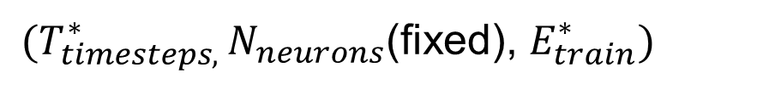

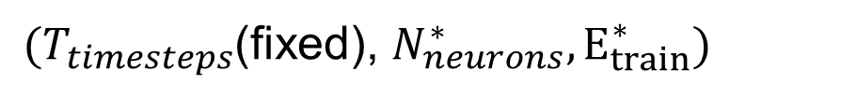
Preparation Phase (For Training)
Collect data points
Derive general equation
${(T}_{timesteps, }^{∗}N_{neurons}$(fixed), $E_{train}^{∗})$
$$T_{timesteps}=a×E_{train}+b$$
Linear relation [9]
${(T}_{timesteps}$(fixed), $N_{neurons}^{∗}, E_{train}^{∗})$
$$N_{neurons}=a×E_{train}^{d}+b×E_{train}+c$$
Non-linear relation [9]
Notes:
Here, we obtain the relation between parameters and training energy.
T_timestep is number of timesteps, N_neurons is number of neurons, and E_train is the corresponding energy consumption.
a, b, c are the coefficients for the equations.
First, we collect data points while only changing the number of timesteps.
Based on the timesteps and training energy, this equation is derived as the relation between timesteps and energy is known to be linear.
Next, we collect data points while only changing the number of neurons.
Similarly, this equation is derived.
The relation between the number of neuron and energy is non-linear, because the energy consumption is also impacted by the activity level of each neuron.

Slide 15
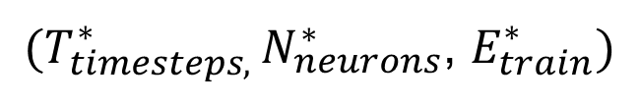
Preparation Phase (For Inference)
Collect data points
${(T}_{timesteps, }^{∗}N_{neurons}^{∗}$, $E_{train}^{∗})$
Derive general equation
$$E(N_{neurons}, T_{timesteps})=aN_{neurons}^{d}+bT_{timesteps}+C$$
Notes:
Here, we obtain the relation between parameters and inference energy.
Unlike for training, data points are collected while changing both the number of timesteps and neurons.
Then this general equation is derived.
The number of timesteps belongs to the linear term and the number of neuron belongs to non-linear term.

Slide 16
Overview
Preparation Phase
Configuration Phase
Operation Phase
Weather
Model
Energy Estimation
For Training
For Inference
Adjust:
Adjust:
$$T_{timesteps}$$
$$T_{timesteps}$$
&
Inference
Harvested Energy
(Wh)
$$N_{neurons}$$
$$N_{neurons}$$
Similarity-based Pruning
Data Collection
$$N_{train}$$
SNN Model
${(T}_{timesteps, }^{∗}N_{neurons}^{∗}$, $E_{train}^{∗})$
STDP Learning
$$T_{timesteps}$$
$$T_{timesteps}$$
$$N_{neurons}$$
$$N_{neurons}$$
Parameter-Consumption
Relation (equation)
$$N_{train}$$
Neuron to Prune
Fig. 7 Framework Overview
Notes:
After obtaining the amount of energy to be harvested and the model parameter and consumption relations, the model parameters are adjusted, in order for it to run under the harvested energy.
First, I’ll explain configuration phase for training.

Slide 17
Configuration Phase
Reduce
Reduce Timesteps
Reduce Training Data
Fig. 12 Timestep Reduction and Pruning
Notes:
In the configuration, we will reduce the energy consumption through reduction of timesteps, neurons, and reduction of training data.
Reduction of timesteps shortens the execution time, and reduction of neuron reduces the computation.
Reduction of training data also shortens the execution time, however, this is the last solution after both timesteps and neurons reduction fail to adapt energy consumption.

Slide 18
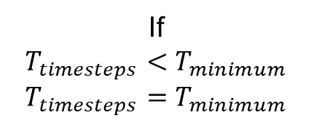

Configuration Phase (Training)
Adjust number of timesteps
Adjust number of neurons
$$T_{timesteps}=a×E_{train}+b$$
$$N_{neurons}=a×E_{train}^{d}+b×E_{train}+c$$
Total Energy
Harvested
Total Energy
Harvested
If
$$T_{timesteps}<T_{minimum}$$
$$T_{timesteps}=T_{minimum}$$
Reduce Timesteps
Reduce Number of Neuron
Fig. 9 Timesteps and Neurons Configuration
Notes:
The configuration for training starts with adjusting number of timesteps.
It is calculated by substituting the total energy harvested to the general equation we derived earlier.
T_timesteps is the number of timesteps, E_train is the corresponding energy consumption, and a, b are the coefficients.
However, if the number of timesteps is too low, the performance drops significantly.
So, we define the lower bound.
If the calculated value is less than the lower bound, timesteps is fixed to the lower bound and we proceed to neurons adjustment.
Similarly, number of neurons is calculated by substituting the total energy harvested to the general equation.
N_neuron is the number of neurons, and E_train is the corresponding energy consumption, a, b, c are the coefficients.

Slide 19
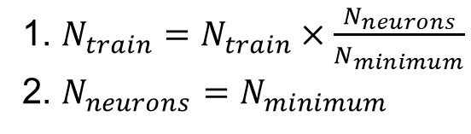
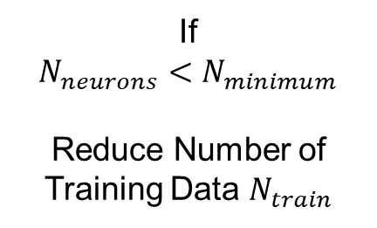
Configuration Phase (Training)(cnt.)
If
$$N_{neurons}<N_{minimum}$$
Reduce Number of Training Data $N_{train}$
1. $N_{train}=N_{train}×\frac{N_{neurons}}{N_{minimum}}$
2. $N_{neurons}=N_{minimum}$
Fig. 10 Training Data Reduction
Notes:
For a severe energy constraint, timesteps and neurons adjustment are not sufficient.
In that case, we reduce the number of training data to further reduce the energy consumption.
Here, training data is proportional to the calculated number of neurons, and neurons are fixed to the lower bound.

Slide 20
Overview
Preparation Phase
Configuration Phase
Operation Phase
Weather
Model
Energy Estimation
For Training
For Inference
Adjust:
Adjust:
$$T_{timesteps}$$
$$T_{timesteps}$$
&
Inference
Harvested Energy
(Wh)
$$N_{neurons}$$
$$N_{neurons}$$
Similarity-based Pruning
Data Collection
$$N_{train}$$
SNN Model
${(T}_{timesteps, }^{∗}N_{neurons}^{∗}$, $E_{train}^{∗})$
STDP Learning
$$T_{timesteps}$$
$$T_{timesteps}$$
$$N_{neurons}$$
$$N_{neurons}$$
Parameter-Consumption
Relation (equation)
$$N_{train}$$
Neuron to Prune
Fig. 7 Framework Overview
Notes:
Next, I’ll explain the configuration phase for inference.

Slide 21

Configuration Phase (Inference)
$$E(N_{neurons},T_{timesteps})=aN_{neurons}^{d}+bT_{timesteps}+C$$
Sequential-Least-Squares-Programming
$$\min_{N_{neurons}, T_{timesteps}}{{\left[E_{inference}−E\left(N_{neurons}, T_{timesteps}\right)\right]}^{2}}$$
Total Energy
Harvested
$${T_{timesteps}, N}_{neurons}$$
Notes:
For inference, the numbers of neurons and timesteps are simultaneously calculated from the energy harvested.
E_(N_neurons, T_timesteps) is the energy consumption given N_neurons and T_timesteps, and a, b, c are the coefficients.
However, the energy harvested can not be directly substituted to this derived equation.
So, we perform Sequential-Least-Squares-Programming.
This optimization process minimized the difference between the harvested energy and energy consumption.
After the process, the numbers of timesteps and neurons are obtained.

Slide 22







Configuration Phase (Inference)(cnt.)
1. Measure Distance (MSE) Between Neurons
2. Sort in ascending order
Weights of Neuron 1
$$MSE(W_{1}, W_{2})$$
$$MSE\left(W_{1}, W_{2}\right)<$$
$$MSE\left(W_{1}, W_{3}\right)<$$
$$MSE(W_{2}, W_{3})$$
$$MSE(W_{1}, W_{3})$$
The Most Similar
$$MSE(W_{2}, W_{3})$$
Neuron To Be Pruned: Neuron 1 ($W_{1}$)
Mean Squared Error
Fig. 11 Similarity-Based Neuron Pruning
Notes:
In adjusting number of neurons, we can not randomly remove neurons since the model is already trained.
So, we perform similarity-based neuron pruning.
It starts by measuring the distances for all the neuron pair.
Distance is defined by mean squared error.
Then the neuron pairs are sorted in order of small distance value.
Neuron pair with the lowest distance is considered to be the most similar.
To minimize the impact to the performance, one of the neurons in the most similar pair is pruned.

Slide 23
Configuration Phase (Inference)(cnt.)
Adjust Timesteps & Prune Neuron
Prune
Reduce Timesteps
Fig. 12 Timestep Reduction and Pruning
Notes:
Finally, the model is adjusted based on the calculated timesteps and neurons to be pruned.

Slide 24
Outline
Introduction
Proposed Framework
Evaluation
Conclusion
Notes:
Next is the evaluation for the proposed framework.

Slide 25
Evaluation Setup
Implemented in: Python and BindsNet [10] Library
Device: Raspberry Pi 5
Model Architecture: Single Layer Feedforward with Lateral Inhibitory Signal
Training Method: Spike-Timing-Dependent-Plasticity [8]
Weather Condition: Open-Sourced Quartz-Solar-Forecast [11]
Battery Simulation: Battery-Dataset-Preprocessing-Code-Library [12]
Evaluation: Single model & Ensemble Learning [13]
Notes:
The framework is implemented in Python and BindsNet library.
Energy consumption is measured on Raspberry Pi 5.
Model Architecture is Single Layer Feedforward with Lateral Inhibitory Signal.
Models were trained by STDP.
Weather and battery condition were simulated using open-source libraries.
Evaluation contains single model training, inference and Ensemble Learning, which is a common learning method to combine multiple models for better accuracy.

Slide 26
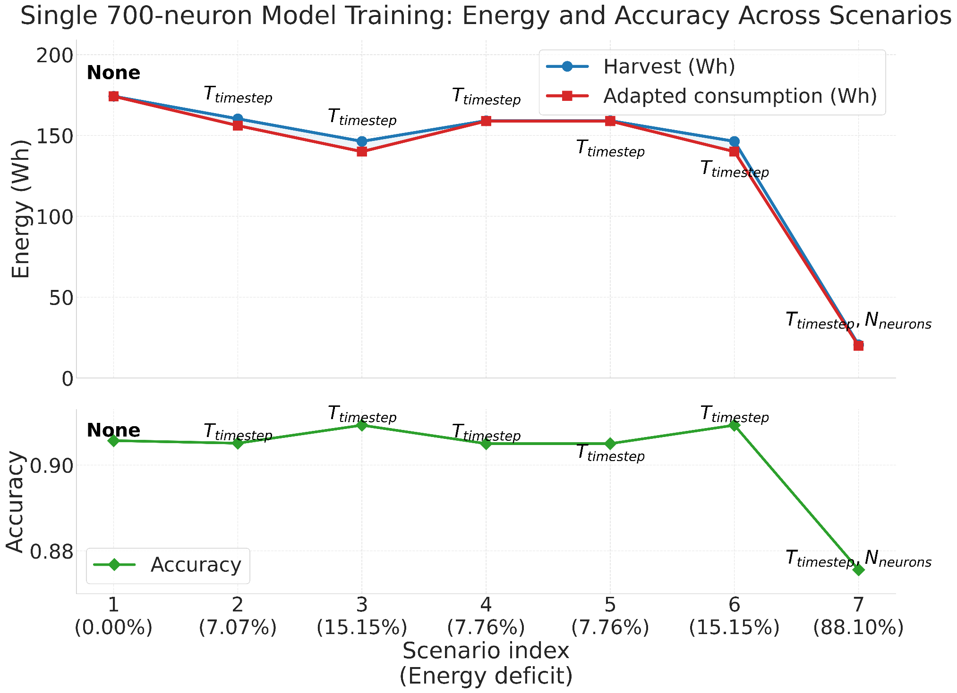
Single 700-neuron Model Training
Notes:
This is the result for single 700-neuron model training under difference energy deficit cases.
The framework is adapting the energy consumption to the harvested energy while minimizing the wasted energy.
For a minor energy deficits up to 15%, which is typical deficit for sunny and cloudy condition, only the number of timesteps is adjusted and there is no major accuracy loss.
However, for a major energy deficit around 88% in rainy day or other severe conditions, the system needs to adjust both timesteps and neurons, and accuracy drops about 3%.

Slide 27
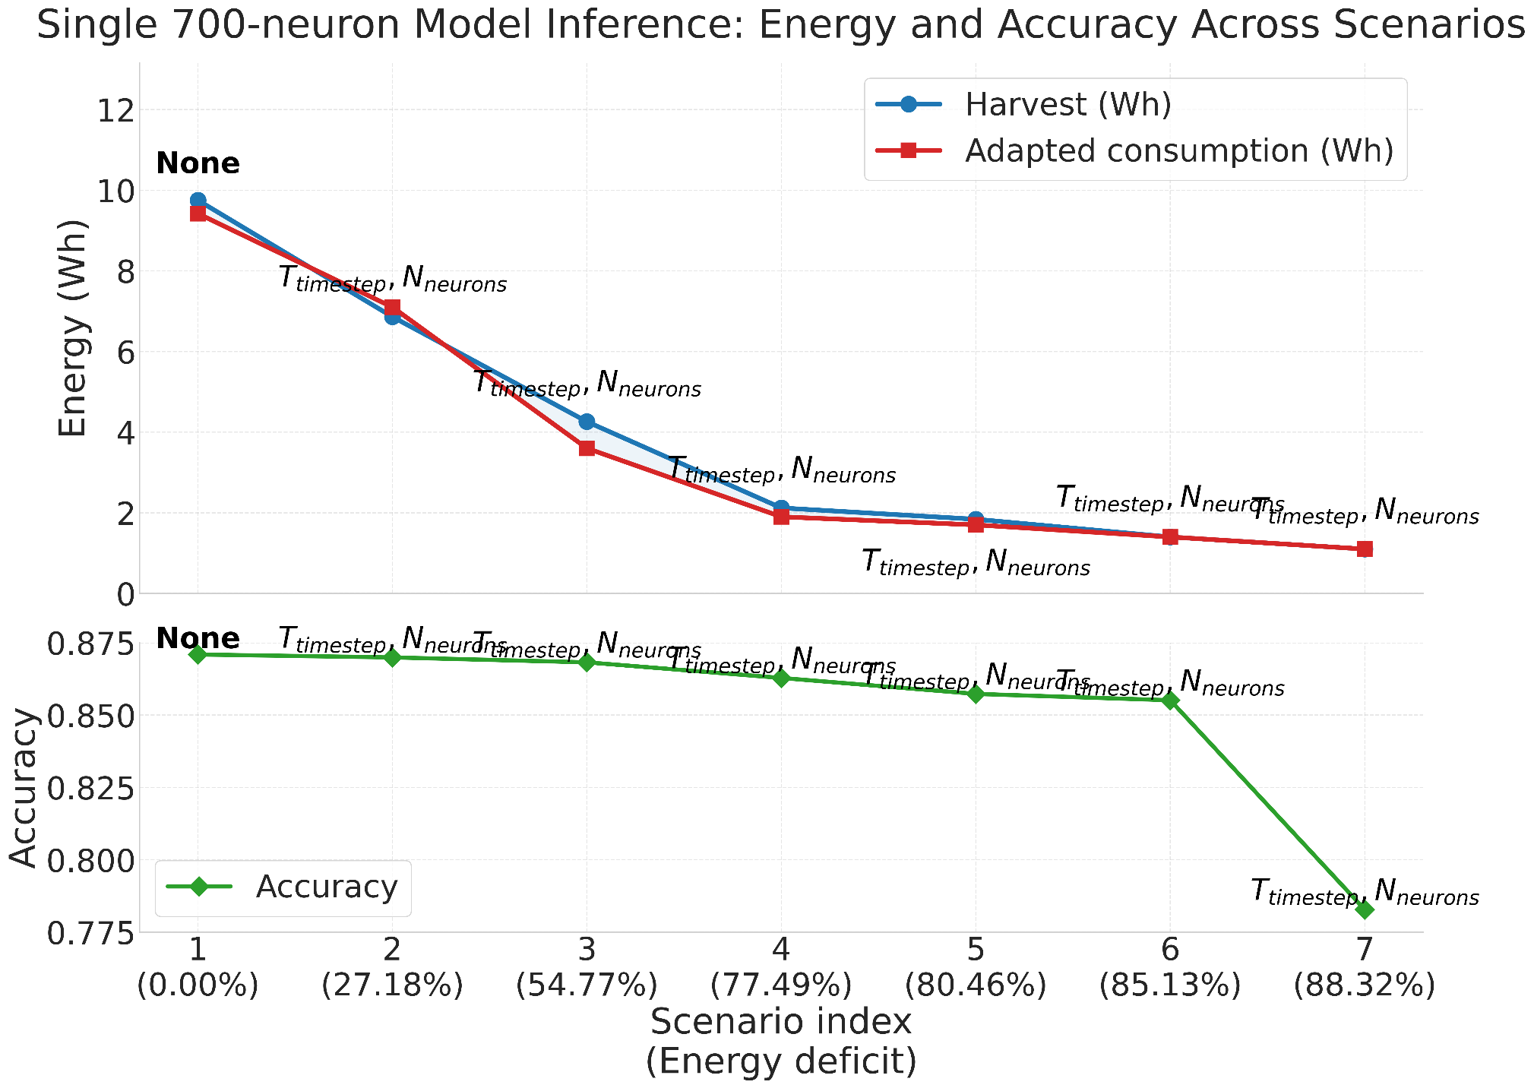
Single 700-neuron Model Inference
Notes:
This is the result for single 700-neuron model inference.
Unlike in training, both timesteps and neurons are adjusted at the same time.
Up to 85% deficit, there is no major accuracy loss, demonstrating the effectiveness of similarity-based neuron pruning combined with timestep adjustment.

Slide 28
Ensemble Learning
Evaluation Setup: 70-neuron * 10 nodes
Node 1
Merged Node
Local Data 1
Merge
Nodes
Node 2
Local Data 2
Node N
Local Data N
Fig. 13 Ensemble Learning Architecture
Notes:
Next evaluation is for Ensemble Learning.
Here multiple node trains the model separately, and merged to one model once the training is complete.
For this evaluation, there are 10 nodes, 70 neurons per node.

Slide 29
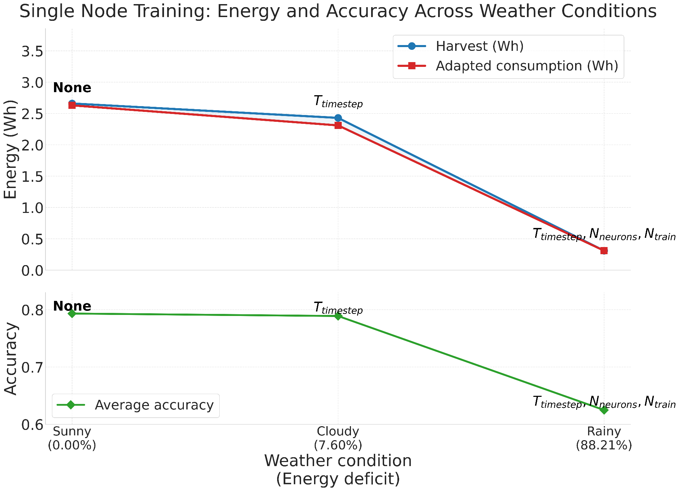
Ensemble Learning: Single Node Training
Notes:
Each node was trained under different weather condition.
For the sunny condition no adjustment is necessary.
For the cloudy condition, only timesteps is adjusted.
For the rainy condition, all the numbers of timesteps, neurons, and training data needed to adjusted.

Slide 30
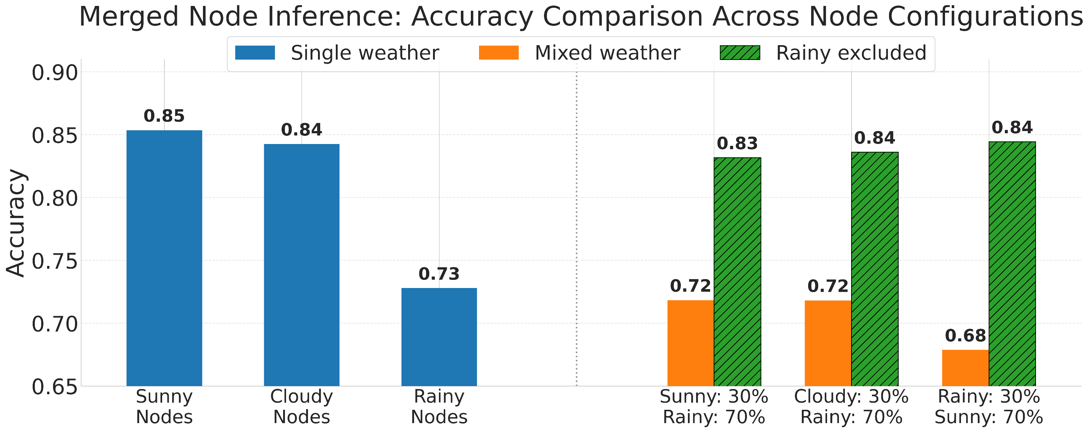
Ensemble Learning: Merged Node
Notes:
This is the result for the merged node.
We can see the accuracy corresponds with the weather condition, with the highest accuracy for merging sunny nodes.
We also merged the nodes trained under different weather condition.
Here for instance, 3 sunny nodes and 7 rainy nodes are merged, resulting in lower accuracy.
However, simply excluding rainy nodes recovers accuracy.
The same trend can be observed for other mix cases.
So, for Ensemble Learning for Edge AI systems, excluding the model trained under poor condition can be considered for a better performance.

Slide 31
Outline
Introduction
Proposed Framework
Evaluation
Conclusion
Notes:
I’d like to conclude the talk.

Slide 32
Conclusion
GreenMorph framework offers best AI performance under fluctuating energy supply.
The framework dynamically reduces SNN energy consumption up to
85.13% with 1.5% accuracy loss.
Future work will expand the parameter adjustment to hardware
for further energy reduction.
Notes:
GreenMorph framework offers reasonable AI performance under fluctuating energy supply by dynamically adapting energy consumption and model parameters.
The framework dynamically reduces SNN energy consumption up to 88.32% with minimal accuracy loss.
For the future work, the framework will expand the parameter adjustment to hardware parameters such as voltage/frequency scaling for further energy reduction.

Slide 33
Reference
[1] "Edge AI revenue will reach USD157bn by 2030 globally, STL Partners predicts in brand new forecast," STL Partners, Jan. 29, 2025. [Online]. Available: https://stlpartners.com/press/edge-ai-revenue-to-reach-usd157bn-2030/
[2] A. Bamisile et al., "The environmental factors affecting solar photovoltaic output," Renewable and Sustainable Energy Reviews, vol. 208, Art. no. 115073, Jan. 2025, doi: 10.1016/j.rser.2024.115073. [Online]. Available: https://www.sciencedirect.com/science/article/pii/S1364032124007998
[3] M. Ligorati, J. Geyer‐Klingeberg, T. E. Günther, and A. W. Rathgeber, "Degradation of lithium-ion batteries: A meta-analysis," Chemical Engineering Journal, vol. 506, Art. no. 158947, 2026, doi: 10.1016/j.cej.2026.158947. [Online]. Available: https://www.sciencedirect.com/science/article/pii/S138589472601987X.
Notes:
Here are the references.

Slide 34
Reference
[4] D. Blalock et al., “What is the state of neural network pruning?” Proceedings of machine learning and systems, vol. 2, pp. 129–146, 2020
[5] T. Kolpe et al., “Enabling Improved Power Management in Multicore Processors through Clustered DVFS,” in 2011 Design, Automation & Test in Europe. IEEE, 2011, pp. 1–6
[6] M. Nagel et al., “A white paper on neural network quantization,” arXiv preprint arXiv:2106.08295, 2021
[7] A. B. Abdallah and K. N. Dang, “Neuromorphic computing principles and organization,” 2022
[8] P. U. Diehl and M. Cook, “Unsupervised learning of digit recognition using spike-timing-dependent plasticity,” Frontiers in computational neuroscience, vol. 9, p. 99, 201

Slide 35
Reference
[9] Z. Yan, Z. Bai, and W.-F. Wong, “Reconsidering the energy efficiency of spiking neural networks,” arXiv preprint arXiv:2409.08290, 2024
[10] H. Hazan et al., “Bindsnet: A machine learning-oriented spiking neural networks library in python,” Frontiers in neuroinformatics, vol. 12, p. 89, 2018
[11] P. Dudfield et al., “open-source-quartz-solar-forecast,” Mar. 2025. [Online]. Available: https://github.com/openclimatefix/open-source-quartz-solar-forecast
[12] F. Wang et al., “Physics-Informed Neural Network for Lithium-Ion Battery Degradation Stable Modeling and Prognosis,” Nature Communications, vol. 15, no. 1, p. 4332, 20
[13] H. Yuga and K. N. Dang, “EnsembleSTDP: Distributed in-situ spike timing dependent plasticity learning in spiking neural networks,” in 2024 IEEE 17th International Symposium on Embedded Multicore/Many-core Systems-on-Chip (MCSoC). IEEE, 2024, pp. 434–440

Slide 36
Thank you for your attention!

