Slide 1
Low-Power Spiking Neural Network with Clock-gating technique
S1290033
Rui Shiota

Slide 2
Content
Introduction
Methodology
Results
Disucussion
Conclusion
Reference

Slide 3
Introduction
SNNs and LIF Neuron
Knowledge of Power

Slide 4

SNNs and LIF Neuron
Spiking Neural Networks (SNNs)
Brain-inspired models
Mimics biological neurons
Communicates and computes using spikes
Leaky Integrate-and-Fire (LIF) neuron
if Σ(inspike[i] * weight[i]) Threshold
outspike = 1
else
outspike =0

Slide 5
Knowledge of Power
Power = Dynamic Power + Static Power
Dynamic Power = Internal Power + Switching Power
Static Power = Leakage Power
Internal Power: voltage
Switching Power: switching activity
Leakage Power: voltage and size of the modules

Slide 6
Methodology
Procedure
Design of LIF Neuron
Outspike Computation
Clock Gating Overview
Applying Clock Gating

Slide 7
Procedure
Order | Task
1 | Implementation of conventional LIF neuron
2 | Simulation
3 | Synthesis
4 | Post-synthesis simulation
5 | Power estimation
6 | Same process with clock-gated LIF neuron
7 | Comparing results

Slide 8
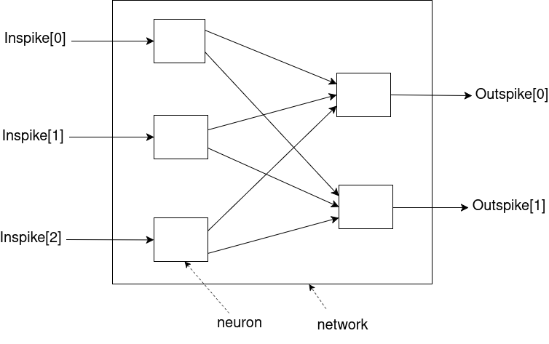
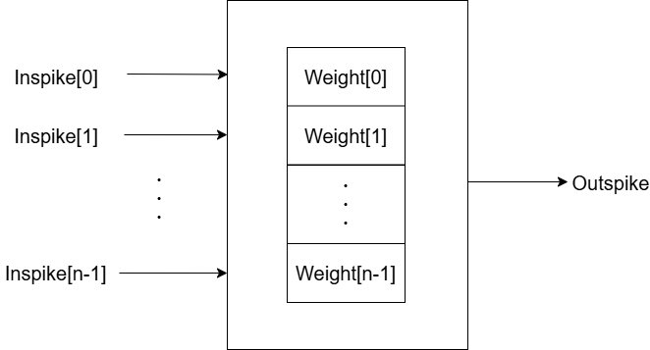
Design of LIF Neuron
Overall architecture of LIF Neuron
Neuron architecture
Each neurons have one memory
The number of weight is determined by the number of inspike
Implement 3:2 network

Slide 9
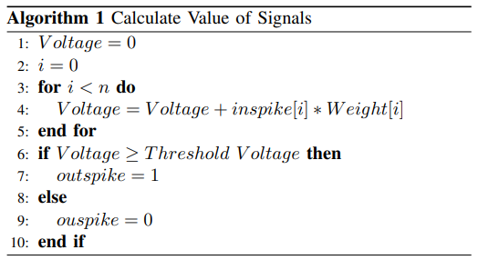
Outspike Computation
i: index of inspike and Weight
n: number of bit of them

Slide 10
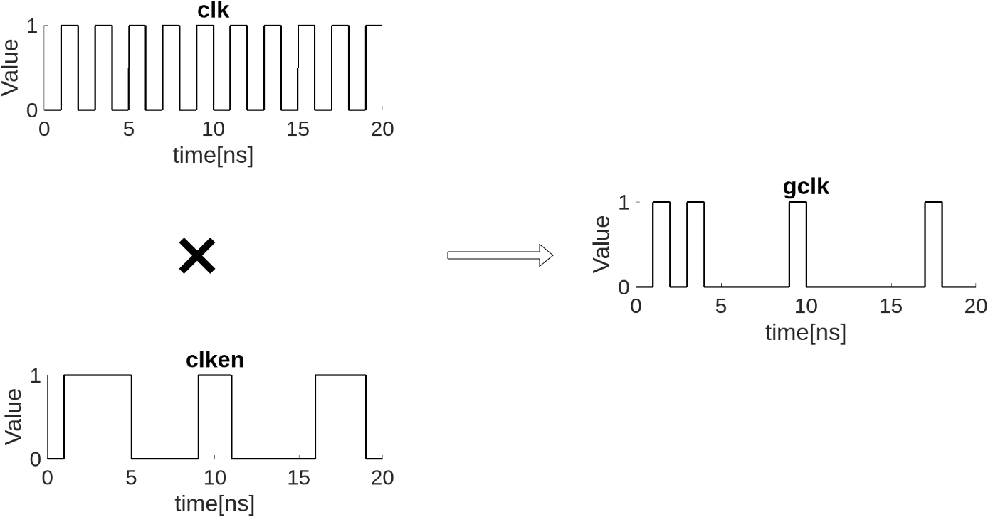
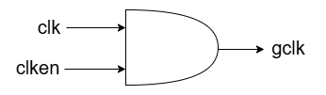
Clock Gating Overview
gclk = clk ∧ clken

Slide 11
Applying Clock Gating
To maintain accuracy,
Reading of weights by first layer neurons ~ output signal computation ➝ clock enable signal is "1"
~ Reading of weights by first layer neurons again ➝ clock enable signal is "0"

Slide 12
Results
Experimental Information
Simulation of Conventional Network
Simulation of Clock-gated Network
Simulation of Constantly Clock-gated Network
Power Comparison of Conventional and Clock-gated Neuron
Power Comparison of Conventional and Clock-gated Network

Slide 13
Experimental Information
Experiment
Coding: Verilog HDL
① In neuron unit
② In network unit
Simulation time: 435 ns
Clock cycle: 10 ns
Tool: ModelSim (simulation)
Synopsys Design Complier (synthesis)
Synopsys PrimeTime (power estimation)

Slide 14
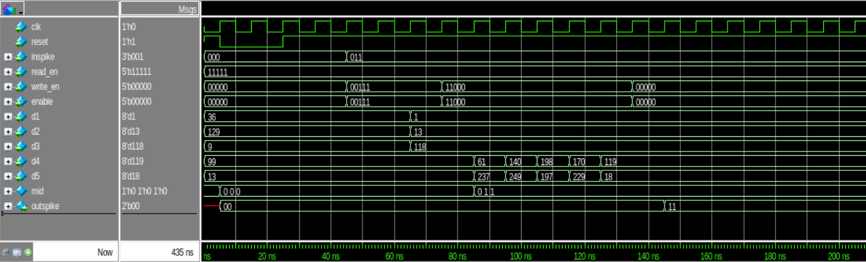
Simulation of Conventionl Network
Computation is done every time clock rises

Slide 15
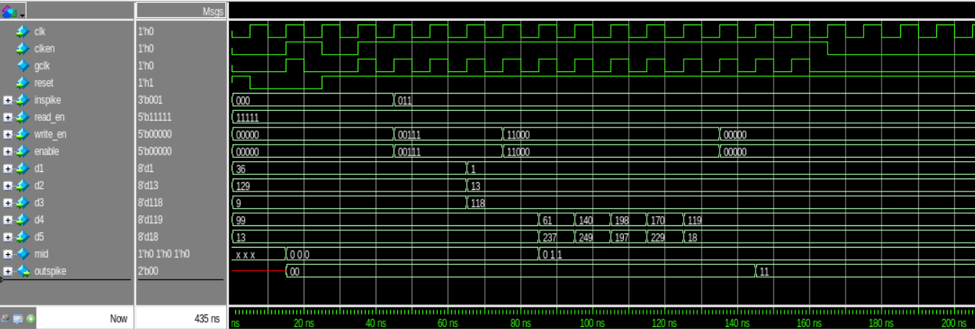
Simulation of Clock-gated Network
Network works at this timing

Slide 16
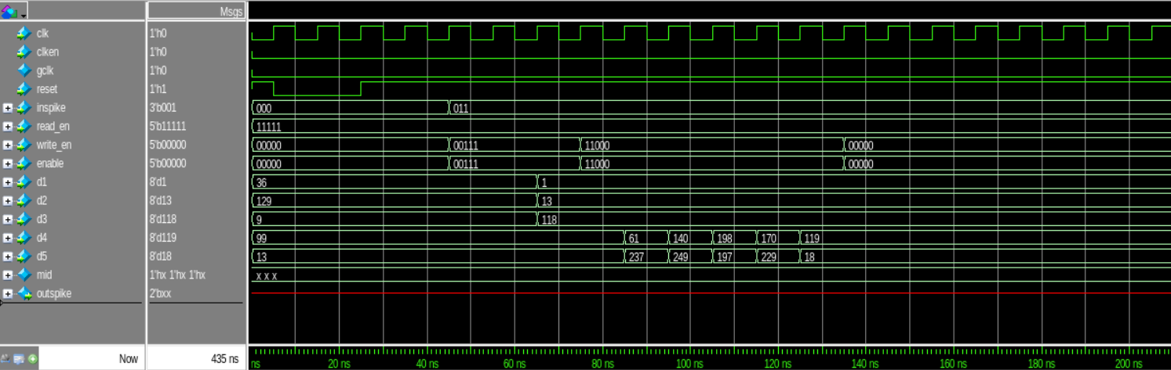
Simulation of Constantly Clock-gated Network
Clock enable is always "0"
No computation

Slide 17

Power Comparison of Conventional and Clock-gated Neuron
Dynamic Power: 26.23%
Static Power: unchanged
Total Power: 21.77%

Slide 18

Power Comparison of Conventional and Clock-gated Network
Comparison of Conventional and Clock-gated Network
Dynamic Power: 30.23%
Static Power: almost unchanged
Total Power: 24.70%
Comparison of Conventional and Constantly Clock-gated Network
Dynamic Power: 97.53%
Static Power: 2.95%
Total Power: 80.28%

Slide 19
Discussion
successfully reduced power
Maintaining accuracy
Investigated maximum reduction

Slide 20
Conclusion
LIF neuron with and without clock gating
Simulation, synthesis and power estimation
Reduction of power consumption
21.77% in neuron units
24.70% in network units

Slide 21
Reference
[1] Prithwineel Paul, Petr Sosik, Lucie Ciencialova, “A survey on learning models of spiking neural membrane systems and spiking neural networks“, arXiv, March 2024.
[2] Wei Fang, Zhaofei Yu, Yanqi Chen, Timothee Masquelier, Tiejun Huang, Yonghong Tian, “Incorporating Learnable Membrane Time Constant to Enhance Learning of Spiking Neural Networks“, arXiv, August 2021.
[3] Xiaoyan Fang, Derong Liu, Shukai Duan, Lidan Wang, “Memristive LIF Spiking Neuron Model and Its Application in Morse Code“, frontiers, April 2022.
[4] Bennie Mols, “Making AI more energy efficient with neuromorphic computing“, CWI, March 2024.
[5] David Patterson, Joseph Gonzalez, Urs H¨olzle, Quoc Le, Chen Liang, Lluis-Miquel Munguia, Daniel Rothchild, David So, Maud Texier, and Jeff Dean, “The Carbon Footprint of Machine Learning Training Will Plateau, Then Shrink“, IEEE, July 2024.
[6] Carole-Jean Wu, Ramya Raghavendra, Udit Gupta, Bilge Acun, Newsha Ardalani, Kiwan Maeng, Gloria Chang, Fiona Aga Behram, James Huang, Charles Bai, Michael Gschwind, Anurag Gupta, Myle Ott, Anastasia Melnikov, Salvatore Candido, David Brooks, Geeta Chauhan, Benjamin Lee,Hsien-HsinS.Lee, BugraAkyildiz, MaximilianBalandat, Joe Spisak,Ravi Jain, MikeRabbat,KimHazelwood, “Sustainable AI: Environmental Implications, Challenges and Opportunities“, arXiv, March 2024.
[7] Nandita Srinivasana, Navamitha.S.Prakasha, Shalakha.Da, Sivaranjani.Da, Swetha Sri Lakshmi.Ga, B.Bala Tripura Sundari, “Power Reduction by Clock Gating Technique“, ScienceDirect, November 2015.
[8] Wenzhe Guo, Mohammed E. Fouda, Ahmed M. Eltawil and Khaled Nabil Salama, “ Neural Coding in Spiking Neural Networks: A Comparative Study for Robust Neuromorphic Systems“, frontiers, March 2021.

Slide 22
Thank you for your attention!

Slide 23
Back up slides
You don't present it
If you got questions about it, you can show

