Slide 1
Low-Power Spiking Neural Network with Clock-gating technique
s1290033
Rui Shiota

Slide 2
Content
Abstract
Agenda
Introduction
Objectives
Clock Gating Overview
Methodology
Research Progress
Schedule

Slide 3
Abstract
Design SNNs with and without clock gating
Estimate power consumption
Compare results

Slide 4
Agenda
How much power consumption can be reduced
How to do to apply clock gating
When to apply clock gating

Slide 5
Overview of power consumption of AI and SNNs
Power consumption of AI
Uses a lot of electricity
Dameges environment
Generates CO2
Spiking Neural Networks (SNNs)
Brain-inspired model
Mimics biological neurons
Communicates and computes using spikes

Slide 6
Importance of energy efficiency and high power consumption in SNNs
Importance of energy efficiency
Can become from 100 to 1,000 times more energy -efficient
High power consumption in SNNs hardware implementations
Works more efficiently than non-neuromorphic systems
However, affects the environment
Possible to put much more AI into chips

Slide 7
Objectives
①Reduce power consumption maintaining accuracy
Become energy-efficint
Prevent from using electricity wastefully
②Reduce further by sacrificing accuracy
Suppress of generation of CO2
Work with ultra-low-power

Slide 8
Clock Gating Overview (1)
Clock gating: technique for reducing dynamic power
SNN
conduct a large amount of computation
need large-scale computational resources
Application of clock gating
Reduce operational expenses and environmental effect
Increase Battery life

Slide 9
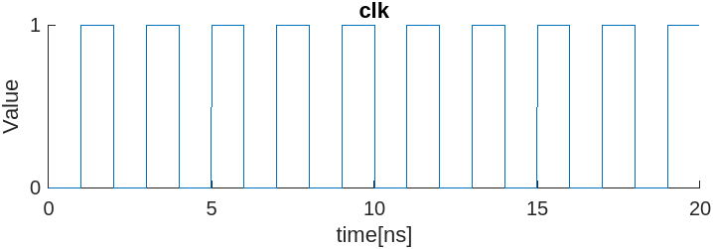
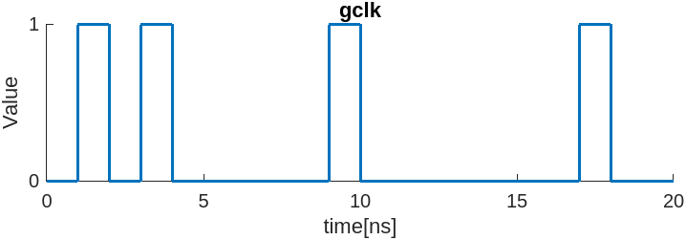
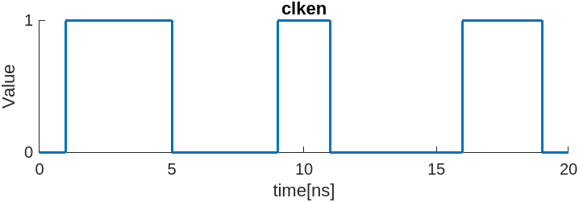
Clock Gating Overview (2)
gclk = clk ∧ clken
clk
gclk
clken

Slide 10
Methodology (1)
Preparation codes of conventional circuit
Simulation
Synthesis
Post-synthesis simulation
Power estimation
Do the same tasks with clock-gated circuit

Slide 11
Methodology (2)
How
Introduce clock enable signal as input
add cell to calculate gated clock signal
Strategy
Decide on standard to apply clock gating depending on the number of rising spikes

Slide 12
Modification of code for SNN
Follow tutorial (finished)
Apply clock gating technique
Estimate power consumption
Compare result of power consumption between original and clock-gated SNN

Slide 13
Research Progress
Finish
Interruption
Simulation
(Tutorial)
Applying of clock gating
Power estimation
Comparison of result
Resume
Graduation thesis
Presentation Slide
Doing

Slide 14
Schedule
Task | Deadline
Meeting​ | January 21
Graduation thesis | January
Graduation presentation | February 17, 18

Slide 15
Reference
[1] Prithwineel Paul, Petr Sosik, Lucie Ciencialova, “A survey on learning models of spiking neural membrane systems and spiking neural networks”, March 2024
[2] Nandita Srinivasana, Navamitha.S.Prakasha, Shalakha.Da, Sivaranjani.Da, Swetha Sri Lakshmi.Ga, B.Bala Tripura Sundari, “Power Reduction by Clock Gating Technique”, November 2015
[3] David Patterson, Joseph Gonzalez, Urs Hölzle, Quoc Le, Chen Liang, Lluis-Miquel Munguia, "The Carbon Footprint of Machine Learning Training Will Plateau, Then Shrink", June 2022
[4] Carole-Jean Wu, Ramya Raghavendra, Udit Gupta, Bilge Acun, Newsha Ardalani, Kiwan Maeng, Gloria Chang, Fiona Aga Behram, James Huang, Charles Bai, Michael Gschwind, Anurag Gupta, Myle Ott, Anastasia Melnikov, Salvatore Candido, David Brooks, Geeta Chauhan, Benjamin Lee, Hsien-Hsin S. Lee, Bugra Akyildiz, Maximilian Balandat, Joe Spisak, Ravi Jain, Mike Rabbat, Kim Hazelwood, "Sustainable AI: Environmental Implications, Challenges and Opportunities", January 2022

Slide 16
Thank you for your attention!

