Slide 1
Research Progress Report Seminar Spiking Neural Network with 3-D IC-based Stacking Memory
Ngo-Doanh NGUYEN - m5262108
Supervised by Prof. DANG Nam Khanh
2023-12-01

Slide 2
Agenda
Motivation
Approach & Methodology
Proposal Hardware Architecture
Results
Conclusion

Slide 3
Agenda
Motivation
Approach & Methodology
Proposal Hardware Architecture
Results
Conclusion

Slide 4
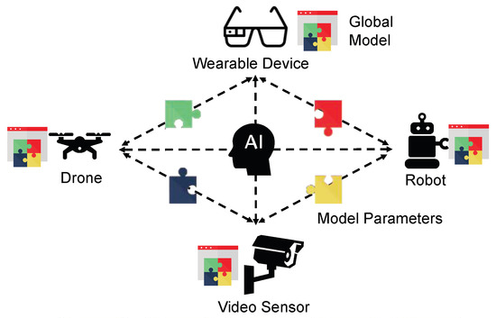
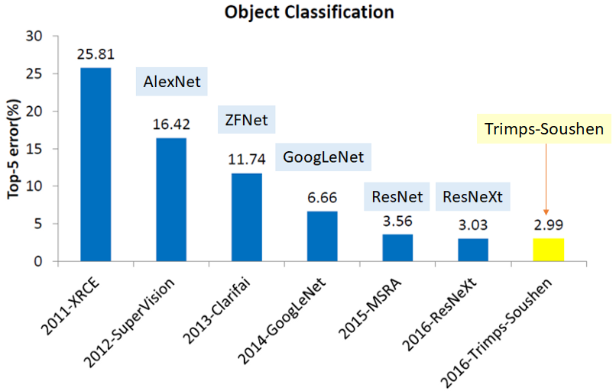
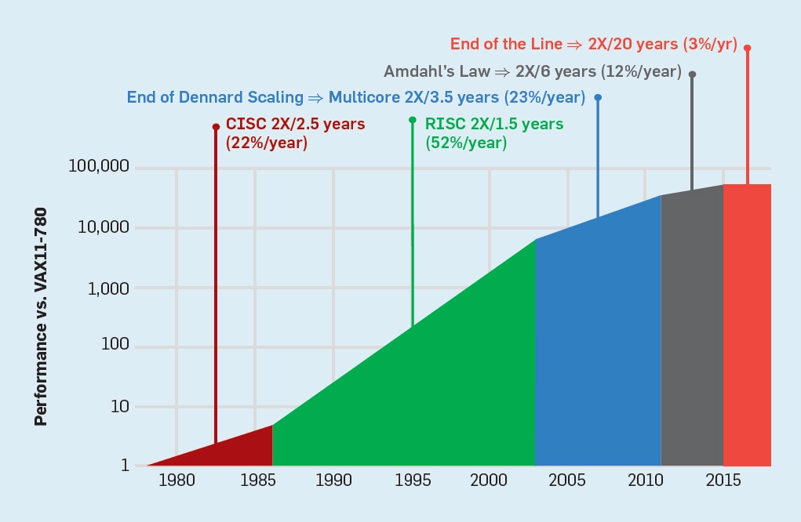


Motivation
10-20 Billion Op.
Weight size > 200MB
*Y. Du. Decentralized Smart IoT. Encyclopedia
*S. H. Tsang. Towards Data Science
*J.Hennessy, D. Patterson 2019 CACM
Computational Power
for Edge Devices
High Complexity
for Edge Devices
End of Moore's Law
AI Enabled Devices
Spiking Neural Net.
3-D Stacking Arch.
- Improve Data Transfer
Efficiency
+ Reduce Latency
+ Reduce Power
- Lightweight Inference
- Reduce Power Consumption
- Reduce Memory Footprint
- Reduce Hardware Area
- Reduce Latency
- Reduce Power Consumption
- Reduce Hardware Footprint
=> Low-power Spiking Neural Network with 3D-stacking-memory

Slide 5
Agenda
Motivation
Approach
Proposal Hardware Architecture
Results
Conclusion

Slide 6
Approaches (1)
From 2D Architecture to 3D Architecture
Reduce hardware footprint
Shorten data movement
Reduce power delivery
(n+a) x (m+b)
(2n + a) x (2m + b)
n x m
Mem 1
Mem 0
3rd Memory Die
2nd Memory Die
Mem 2
Processing Elements
1st Memory Die
Logic Die
Logic Die
Package Substrate
Package Substrate
2D hardware architecture
3D hardware architecture

Slide 7
Approaches (2)
Each layer in 3D architecture can have isolated power rails
Power-gating*, voltage-scaling** differently for each layer
Reduce supply voltage for low-priority layer or power-gate it
Maintain supply voltage for high-priority layer
3rd Memory Die
Power rails
Power rail
2nd Memory Die
1st Memory Die
*Power-gate = Remove supply voltage to reduce power consumption
**Voltage-scaling = Reduce supply voltage to reduce power consumption
Logic Die
Package Substrate
Power management for each layer

Slide 8
Recap: Supply Voltage in Digital Circuits
V_{DD} (V)
Bit
Normal operation
Undervolting operation
Powergating operation
1
Expected Voltage
V_{T}=V_{DD}/2
Real Voltage
0
0
t(s)
V_{DD} (V)
Bit
1
Reduced Voltage
V_{T}=V_{DD}/2
Real Voltage
0
0
t(s)
V_{DD} (V)
Bit
1
Powergated
V_{T}=V_{DD}/2
Real Voltage
0
0
t(s)

Slide 9

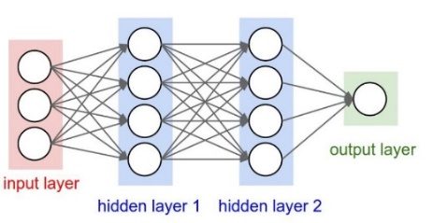

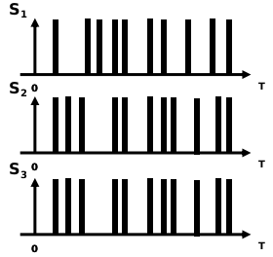
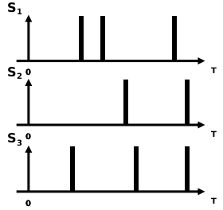

Approaches (3)
Spike Neural Network is spatial and temporal sparse
Lightweight inference
Low power delivery
SNN has noise resilience
Against the affection of power-gate & voltage-scaling
Information
Training
SNN Model
Enc.
HW
Impl.
Input Spike
Processing
Output Spike

Slide 10
Agenda
Motivation
Approach & Methodology
Proposal Hardware Architecture
Results
Conclusion

Slide 11
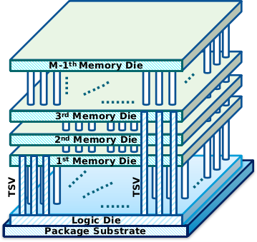
Proposal Hardware Architecture
3D Neuromorphic Computing Core (3D-NCC)
Split memory into subsets placed in multiple layers
Power-gate & under-voltage are applied separately to each memory layer => Lower power consumption
In-situ dynamic quantization for synaptic weights => Maintain accuracy
Weight
W_{i} [0:n-1] = 11 1001 ... 1101
Layer
m₀
m₁
m₂
...
m_{M-1}
Bits
11
100
1
...
1101
Mth Memory Die - m_{M-1}
1st Memory Die - m₀
Address
Decoder
...
Synapse Val.
TSV
TSV
...
x M
3D-NCC Architecture
Bit weight organization

Slide 12
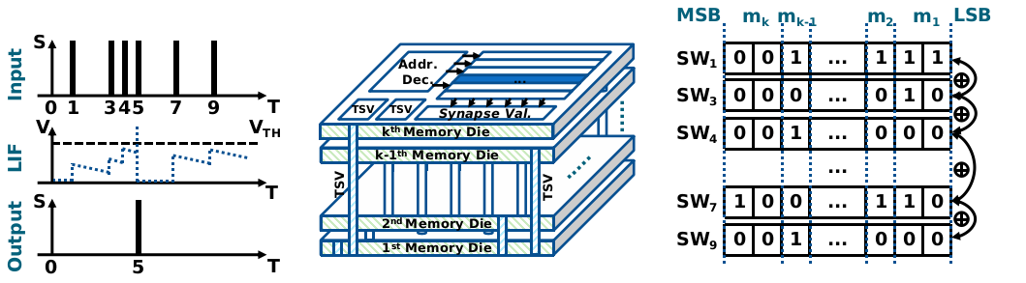
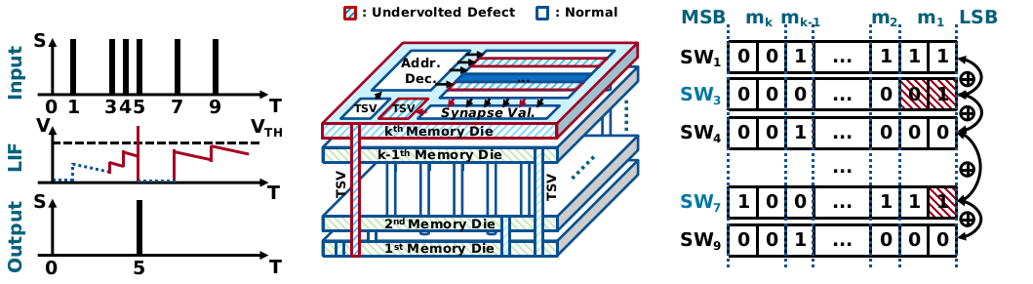
Weight operation (1)
Operation of 3D-NCC under normal condition
Operation of 3D-NCC with under-volting top layer
Output
stays the
same
Flipped bits
due to under-
volting

Slide 13
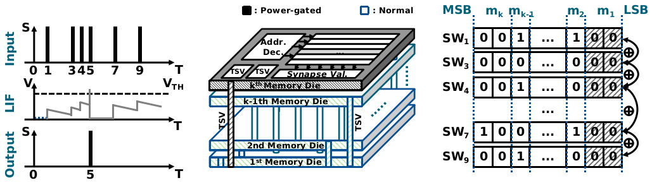
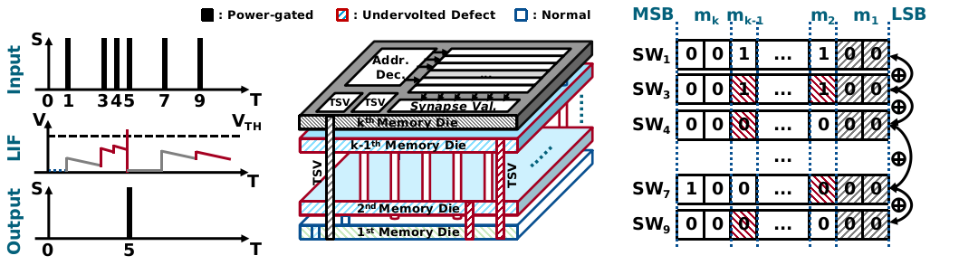
Weight operation (2)
Operation of 3D-NCC under power-gating top layer
Operation of 3D-NCC with both PG & UV
bits are
treated as
zeros
Output
stays the
same

Slide 14
Agenda
Motivation
Approach & Methodology
Proposal Hardware Architecture
Results
Conclusion

Slide 15
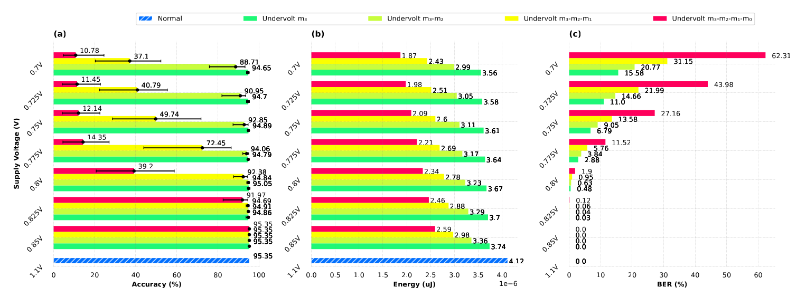
Accuracy vs. Power (1)
Dataset: MNIST; SNN config. = 784:48:10 (1 3D-NCC)
Power extraction with PrimeTime Synopsys
Lib: NANGATE 45nm + OpenRAM + FreePDK 3D45 TSV
Undervolt each layer (one-by-one) with the same volt.
reduce ~30% energy
while maintaining
accuracy
Accuracy per Volt.
Energy per Volt.
Bit Error Rate per Volt.

Slide 16
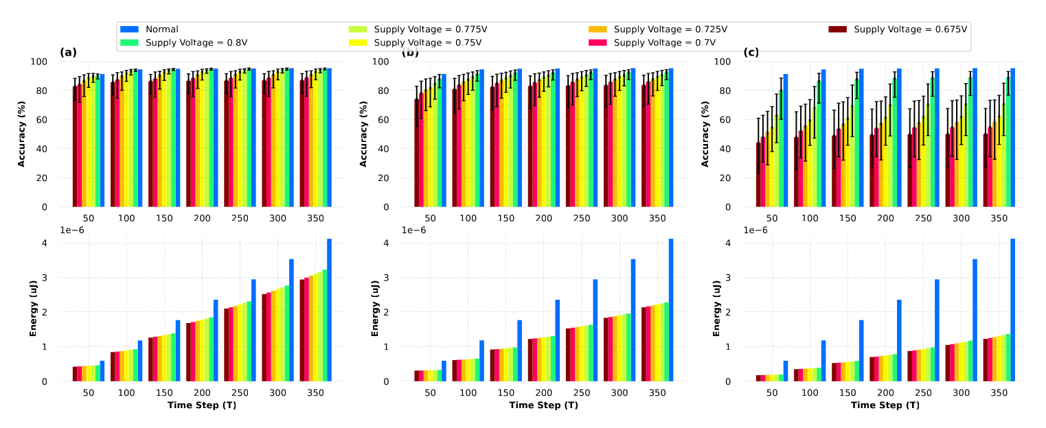
Accuracy vs. Power (2)
Using both power-gating or under-volting for each layer
reduce 3x energy
while reducing
~6.5% accuracy
UV two top layers
PG top layer &
UV second top layer
PG two top layers &
UV two bottom layers

Slide 17
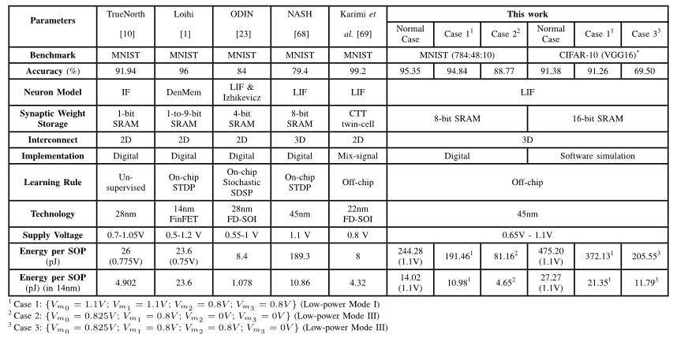
Comparison
Setup voltage supplies as in case 1, case 2 and case 3
[1]
[2]
[3]
[4]
[5]
~22% accuracy drop in big network

Slide 18
Agenda
Motivation
Approach & Methodology
Proposal Hardware Architecture
Results
Conclusion

Slide 19
Conclusion
3D SNN architecture called 3D-NCC
Split memory word into subsets placed in separated layer
Apply power-gating & voltage-scaling to memory layer(s)
Reduce power consumption while maintaining accuracy
In-situ dynamic quantization
UV two top layer reduces 21.62% power consumption with 0.51% accuracy loss
PG two top layer & UV two bottom layers reduce 66.77% power consumption with 6.58% accuracy loss

Slide 20
Schedule
- Prepare & submit the draft of the master's thesis
- Polish the draft of master's thesis and submit the final version
- Fix the thesis according the reviews of referees
Now - 04.12.23
04.12.23 - 26.01.24
16.02.24 - 22.02.24
Submit the draft of thesis
Prepare presentation slides
Submit the final thesis
Thesis presentation
Review & submit the final thesis
04.12.23 - 26.12.23
26.01.24 - 16.02.24
- Prepare the presentation slides based on publication materials
- The presentation day
(16.02.24)

Slide 21
References
[1] F. Akopyan et al., “TrueNorth: Design and tool flow of a 65 mW 1 million neuron programmable neurosynaptic chip,” IEEE Trans. Comput. Aided Design Integr. Circuits Syst., vol. 34, no. 10, pp. 1537–1557, Oct. 2015.
[2] M. Davies et al., “Loihi: A neuromorphic manycore processor with on-chip learning,” IEEE Micro, vol. 38, no. 1, pp. 82–99, Jan. 2018.
[3] C. Frenkel, C. Frenkel, M. Lefebvre, J.-D. Legat, and D. Bol, “A 0.086-mm2 12.7-pJ/SOP 64k-synapse 256-neuron online-learning digital spiking neuromorphic processor in 28nm CMOS,” IEEE Trans. Biomed. Circuits Syst., vol. 13, no. 1, pp. 145–158, Feb. 2019.
[4] O. M. Ikechukwu, K. N. Dang, and A. B. Abdallah, “On the design of a fault-tolerant scalable three dimensional NoC-based digital neuromorphic system with on-chip learning,” IEEE Access, vol. 9, pp. 64331–64345, 2021.
[5] M. Karimi, A. S. Monir, R. Mohammadrezaee, and B. Vaisband, “CTT-based scalable neuromorphic architecture,” IEEE J. Emerg. Sel. Topics Circuits Syst., vol. 13, no. 1, pp. 96–107, Mar. 2023.

Slide 22
Publications
Journal (Published)
N. -D. Nguyen, A. B. Ahmed, A. B. Abdallah and K. N. Dang, "Power-Aware Neuromorphic Architecture With Partial Voltage Scaling 3-D Stacking Synaptic Memory," in IEEE Transactions on Very Large Scale Integration (VLSI) Systems, doi: 10.1109/TVLSI.2023.3318231.
N. -D. Nguyen, X. -T. Tran, A. B. Abdallah and K. N. Dang, "An In-Situ Dynamic Quantization With 3D Stacking Synaptic Memory for Power-Aware Neuromorphic Architecture," in IEEE Access, vol. 11, pp. 82377-82389, 2023, doi: 10.1109/ACCESS.2023.3301560.
Conference: (Accepted)
N. -D. Nguyen and K. N. Dang, “A Novel Yield Improvement Approach for 3D Stacking Neuromorphic Architecture”, 16th IEEE International Symposium on Embedded Multicore /Manycore SoCs (MCSoC-2023), Dec 18th-21th, Singapore, Singapore.

Slide 23
Thank you for your attention.

Slide 24
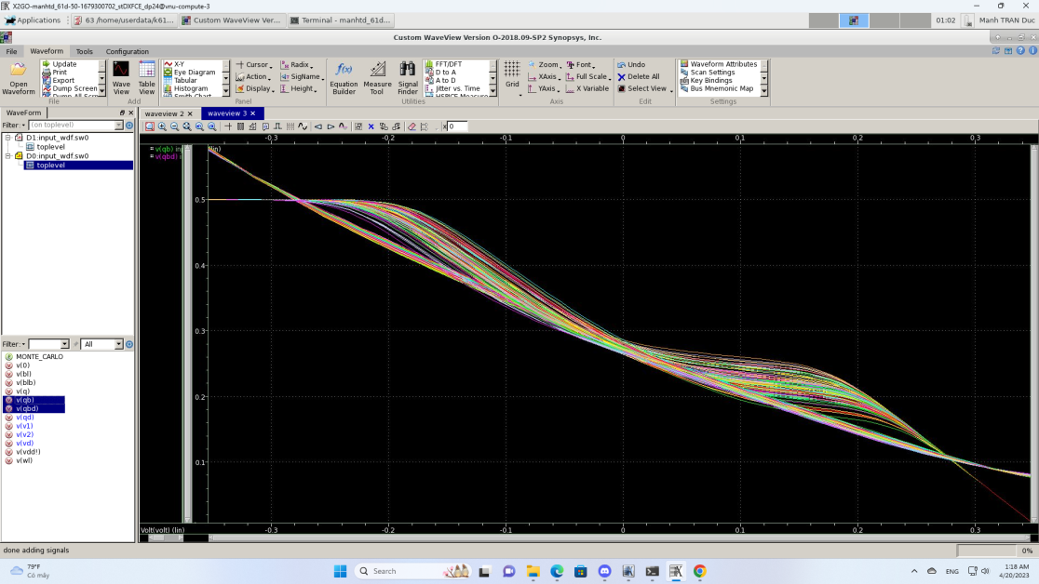
Signal Noise Margin
SNM is to get the Bit Error Rate of memory (SNM<0.1)
6T SRAM (FreePDK NANGATE 45nm)
HSPICE simulation + mathematical computations
Monte Carlo simulation
Signal Noise Margin of 6T SRAM

