Slide 1
An Overview of My Initial Steps in Neuromorphic Computing
Yassine Khedher
m5281019
May 31st 2024
Notes:
Keep this slide clean
Do not add line number here

Slide 2
Content
Research Introduction
Dynamic quantization
Pruning
Research progress
Done
Doing
Todo
Schedule
Notes:
The content should be bief

Slide 3
Content
Research Introduction
Dynamic quantization
Pruning
Research progress
Done
Doing
Todo
Schedule
Notes:
Before jumping to a new section, add a new slide:
Hide the other sections
Highlight the current section

Slide 4
Research introduction
Research topic
Dynamic quantization and pruning
Notes:
- My research is about Dynamic quantization and pruning
-> techniques to compress model size for deployment, allowing speed up and energy saving without significant accuracy losses.

Slide 5
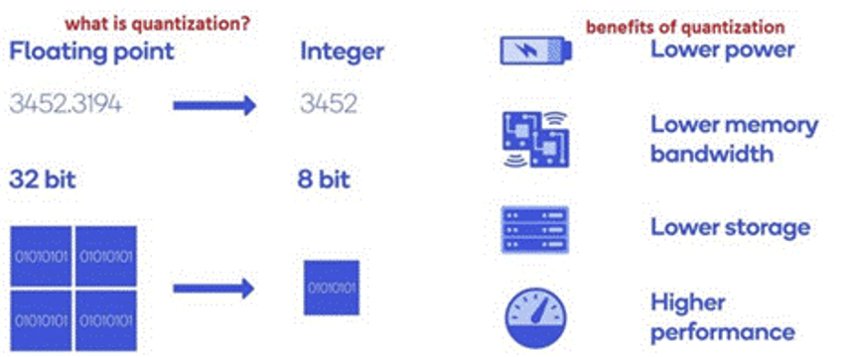
Dynamic quantization
Notes:
• Quantizing a network means converting it to use reduced resources and a precision integer representation for the weights and activations.
This saves on model size and allows the use of higher throughput math operations.

Slide 6
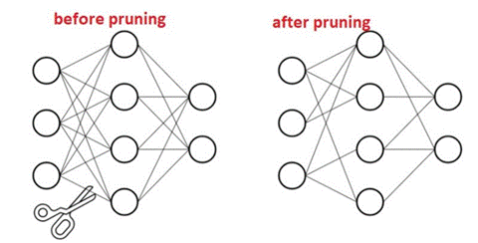
Pruning
Notes:
Pruning is a technique which involves removing individual weights from the model that are close to zero or are not contributing significantly to the model's output.
Pruning can significantly reduce the size of a learning model
can also improve the speed of model inference by removing unnecessary weights and connections

Slide 7
Content
Research Introduction
Dynamic quantization
Pruning
Research progress
Done
Doing
Todo
Schedule
Notes:
Before jumping to a new section, add a new slide:
Hide the other sections
Highlight the current section

Slide 8
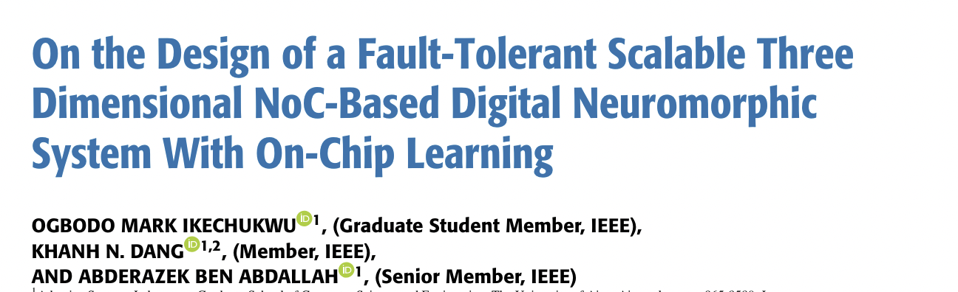
Research Progress | Completed
I have completed reading the following paper:
Notes:
Briefly talk about what you have done
If possible. Highlight it in the overall architecture/system figure

Slide 9
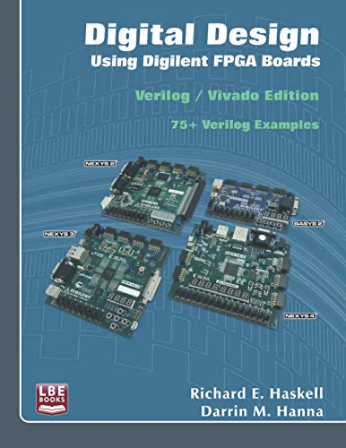
Research Progress | On-going
Reading about Verilog HDL
and hardware basics
Notes:
Explain what you are doing now
_ Talk about what is the challenge
_ Suggest about the solution

Slide 10
Research Progress | Todo
Planning on finishing the reading of materials
Start focusing on Dynamic quantization and pruning
Read more papers
Notes:
Explain what you are doing now
_ Talk about what is the challenge
_ Suggest about the solution

Slide 11
Content
Research Introduction
Dynamic quantization
Pruning
Research progress
Done
Doing
Todo
Schedule
Notes:
Before jumping to a new section, add a new slide:
Hide the other sections
Highlight the current section

Slide 12
Schedule
Time | May 2024 | May 2025 | … | Jan 2026
Task 1
Task 2
Task 1: Finish reading the textbook
Task 2: Reading papers that are related to the field

Slide 13
Thank you for your attention!
Notes:
Always end with a thank you slide
_ Ask if there is any question

