Slide 1
An Overview of My Initial Steps in Neuromorphic Computing
Yassine Khedher
m5281019
June 28th 2024
Notes:
Keep this slide clean
Do not add line number here

Slide 2
Content
Research Introduction
Dynamic quantization
Pruning
Research progress
Done
Doing
Todo
Schedule
Notes:
The content should be bief

Slide 3
Content
Research Introduction
Dynamic quantization
Pruning
Research progress
Done
Doing
Todo
Schedule
Notes:
Before jumping to a new section, add a new slide:
Hide the other sections
Highlight the current section

Slide 4
Research introduction
Research topic
Dynamic quantization and pruning
Notes:
- My research is about Dynamic quantization and pruning
-> techniques to compress model size for deployment, allowing speed up and energy saving without significant accuracy losses.

Slide 5
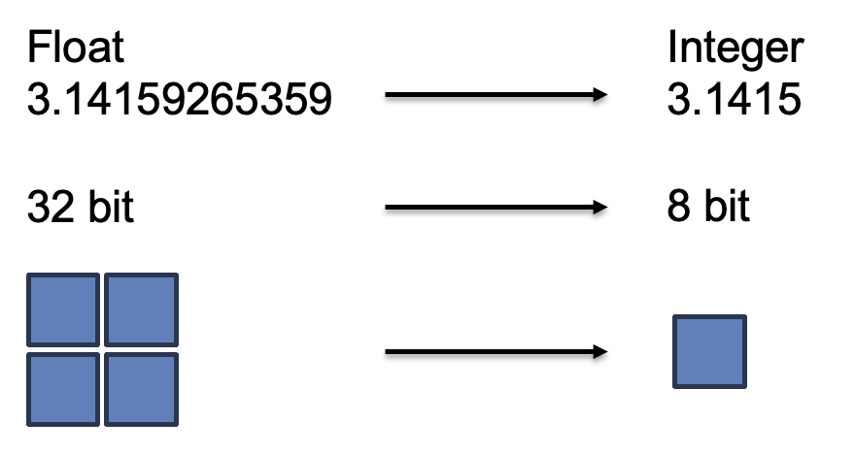
Research introduction
Dynamic quantization
• Reduces precision of weights in SNNs to improve efficiency
• Adapts precision levels during training
Reduce model size
lowers energy consumption
⚠︎ Accuracy
Notes:
Dynamic quantization reduces the precision of weights and activations in SNNs to improve efficiency. It adapts precision levels during training, which aligns with the discrete nature of spike-based processing
This technique reduces model size, speeds up computations, and lowers energy consumption,
though it must balance precision to maintain accuracy

Slide 6
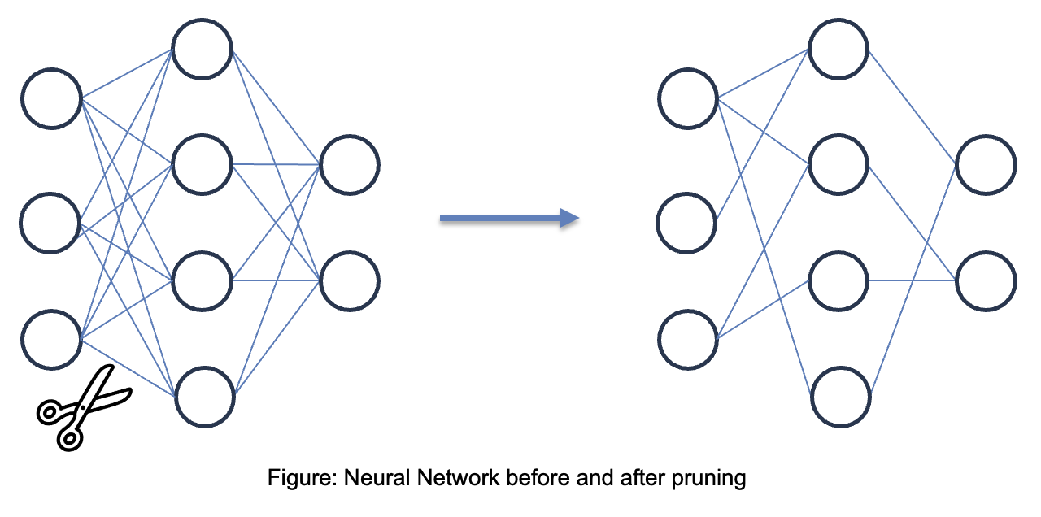
Research introduction
Pruning
Notes:
Pruning is a technique which involves removing individual weights from the model that are redundant or close to zero or are not contributing significantly to the model's output.
Pruning can significantly reduce the size of a learning model by reducing it’s complexity
can also improve the speed of model inference by removing unnecessary weights and connections
However the network must adapt to these structural changes to maintain performance

Slide 7
Content
Research Introduction
Dynamic quantization
Pruning
Research progress
Done
Doing
Todo
Schedule
Notes:
Before jumping to a new section, add a new slide:
Hide the other sections
Highlight the current section

Slide 8
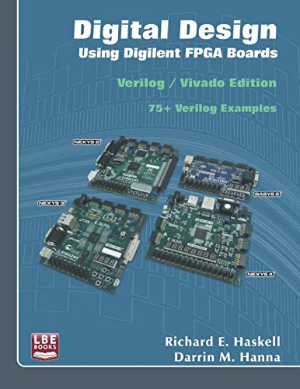
Research Progress | Completed
Comprehensive Guide: Covers digital design fundamentals using Verilog HDL.
FPGA Focus: Utilizes Digilent BASYS and NEXYS boards for practical examples.
Core Topics:
Basic Logic: Gates, Boolean algebra, and Karnaugh maps.
Combinational & Sequential Logic: Multiplexers, counters, and shift registers.
Arithmetic Circuits: Adders, multipliers, and arithmetic logic units (ALUs).
State Machines: Design and implementation of Mealy and Moore machines.
Advanced Applications: VGA controller design and USB/PS2 interfacing.
Practical Examples: Over 75 complete examples demonstrating real-world applications.
Notes:
Briefly talk about what you have done
If possible. Highlight it in the overall architecture/system figure

Slide 9
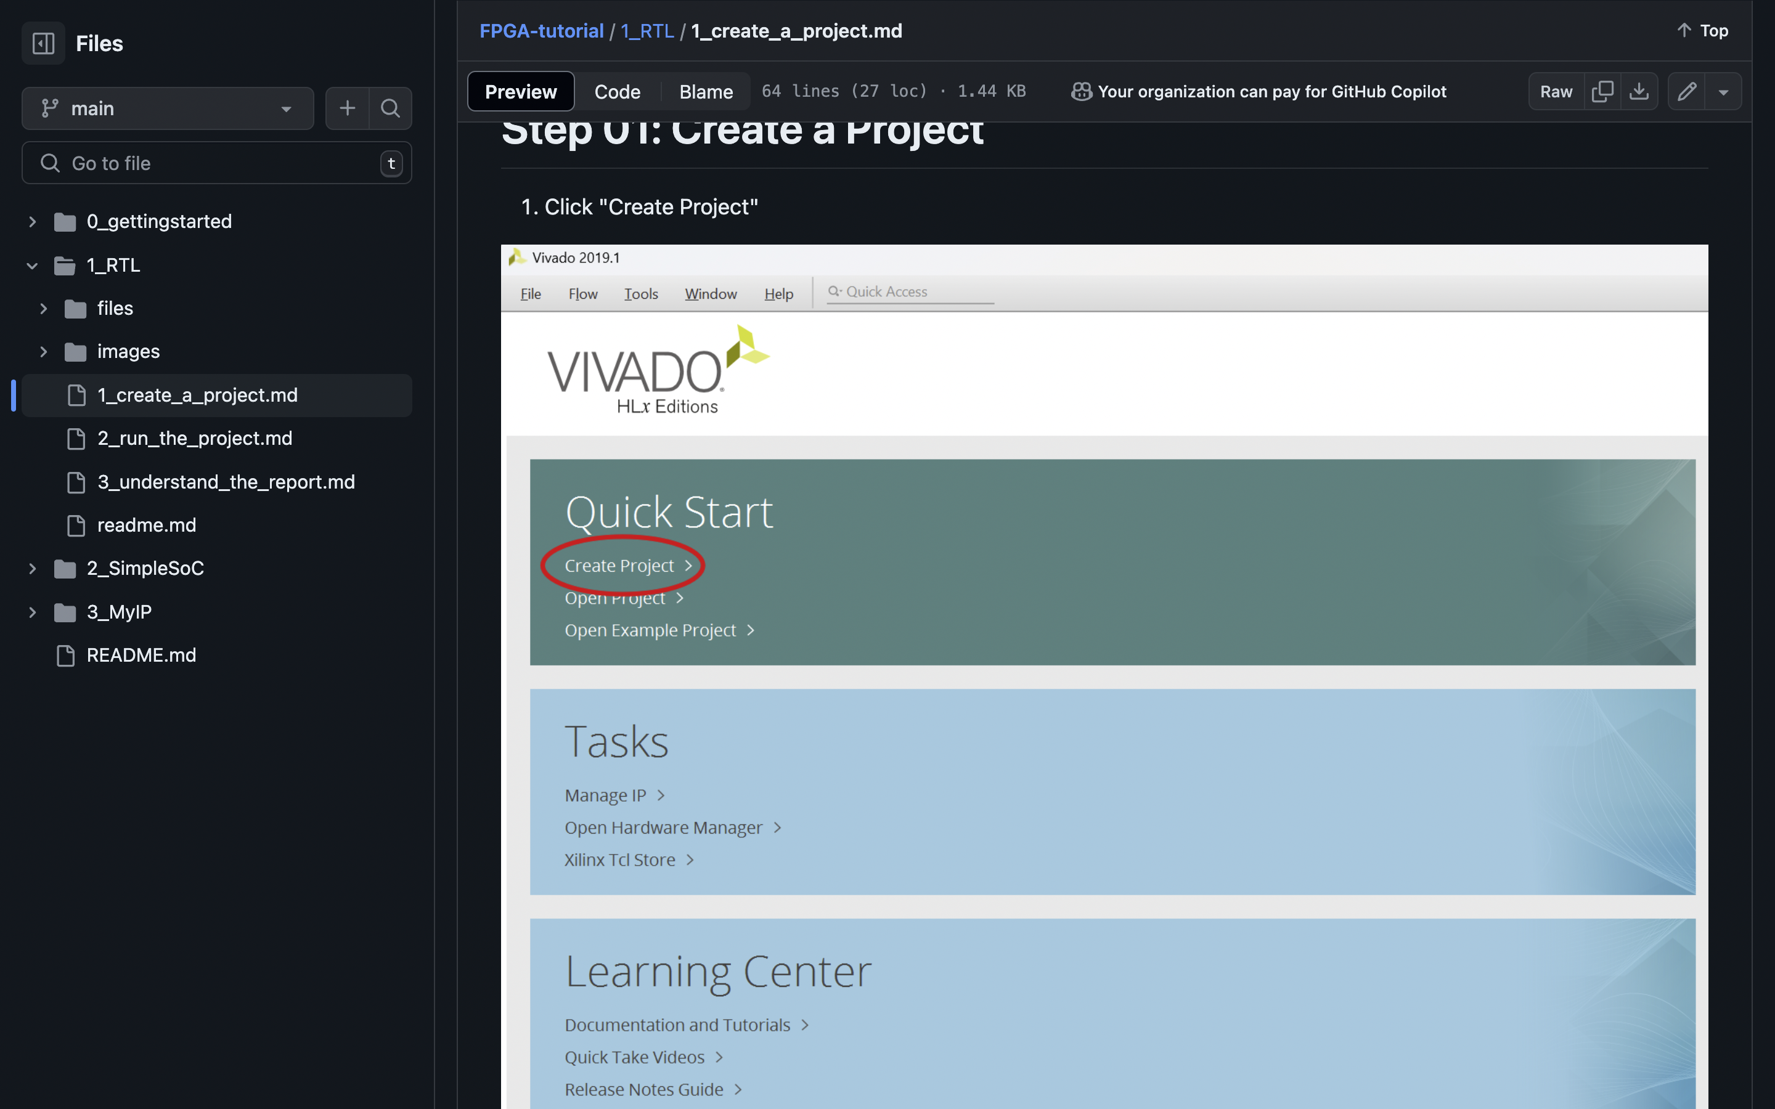
Research Progress | On-going
RTL Implementation
into FPGA Tutorial.
Notes:
Explain what you are doing now
_ Talk about what is the challenge
_ Suggest about the solution

Slide 10
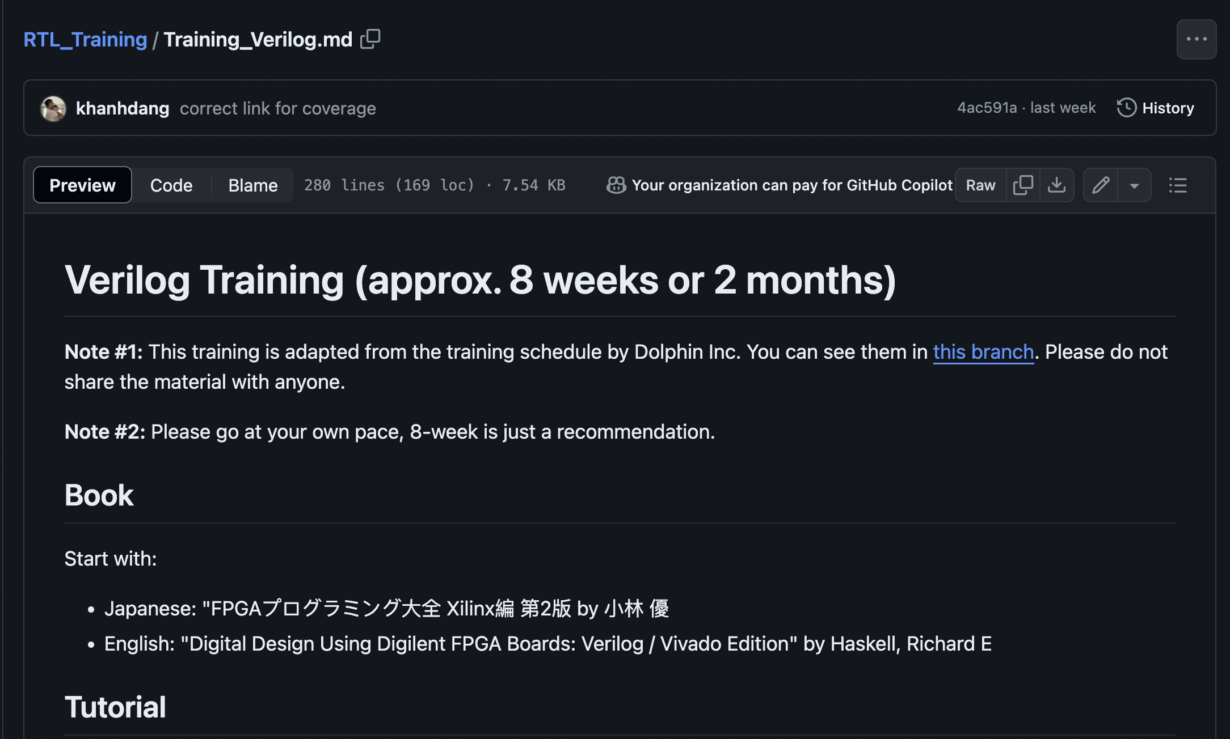
Research Progress | Todo
Do the 8-week RTL Training
from the github
Read papers about Dynamic
quantization and pruning
Notes:
Explain what you are doing now
_ Talk about what is the challenge
_ Suggest about the solution

Slide 11
Content
Research Introduction
Dynamic quantization
Pruning
Research progress
Done
Doing
Todo
Schedule
Notes:
Before jumping to a new section, add a new slide:
Hide the other sections
Highlight the current section

Slide 12
Schedule
Time | June 2024 | July 2024 | Aug 2024 |  | Jan 2026
FPGA Tutorial
RTL Training
Reading papers

Slide 13
Thank you for your attention!
Notes:
Always end with a thank you slide
_ Ask if there is any question

