Slide 1
An Overview of My Research Progress
Yassine Khedher
m5281019
June 28th 2024
Notes:
Keep this slide clean
Do not add line number here

Slide 2
Content
Research Introduction
Research progress
Completed
On-going
To-do
Schedule
Notes:
The content should be bief

Slide 3
Content
Research Introduction
Research progress
Completed
On-going
To-do
Schedule
Notes:
Before jumping to a new section, add a new slide:
Hide the other sections
Highlight the current section

Slide 4
Research introduction
Dynamic quantization & pruning
Quantization:
Reduces precision of weights and activations.
Pruning:
Removes connections/neurons to reduce model size.
Notes:
(+) Decreased memory usage, faster inference
(-) Reduced accuracy, sensitivity to noise.
(+) Smaller models, potential for better generalization.
(-) Loss of network robustness, requires retraining

Slide 5
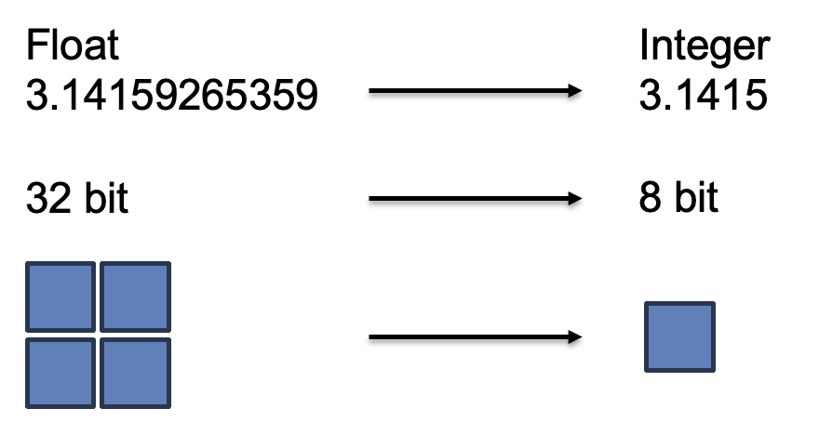
Research introduction
Dynamic quantization
• Reduces precision of weights in SNNs to improve efficiency
• Adapts precision levels during training
Reduce model size
lowers energy consumption
⚠︎ Accuracy
Notes:
Dynamic quantization reduces the precision of weights and activations in SNNs to improve efficiency. It adapts precision levels during training, which aligns with the discrete nature of spike-based processing
This technique reduces model size, speeds up computations, and lowers energy consumption,
though it must balance precision to maintain accuracy

Slide 6
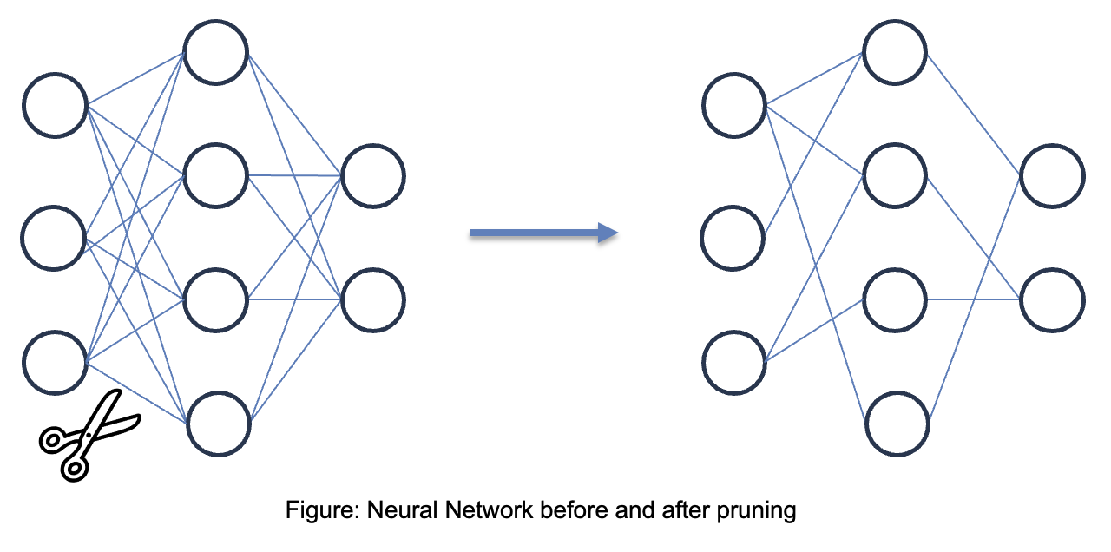
Research introduction
Pruning
Notes:
Pruning is a technique which involves removing individual weights from the model that are redundant or close to zero or are not contributing significantly to the model's output.
Pruning can significantly reduce the size of a learning model by reducing it’s complexity
can also improve the speed of model inference by removing unnecessary weights and connections
However the network must adapt to these structural changes to maintain performance

Slide 7
Content
Research Introduction
Research progress
Completed
On-going
To-do
Schedule
Notes:
Before jumping to a new section, add a new slide:
Hide the other sections
Highlight the current section

Slide 8
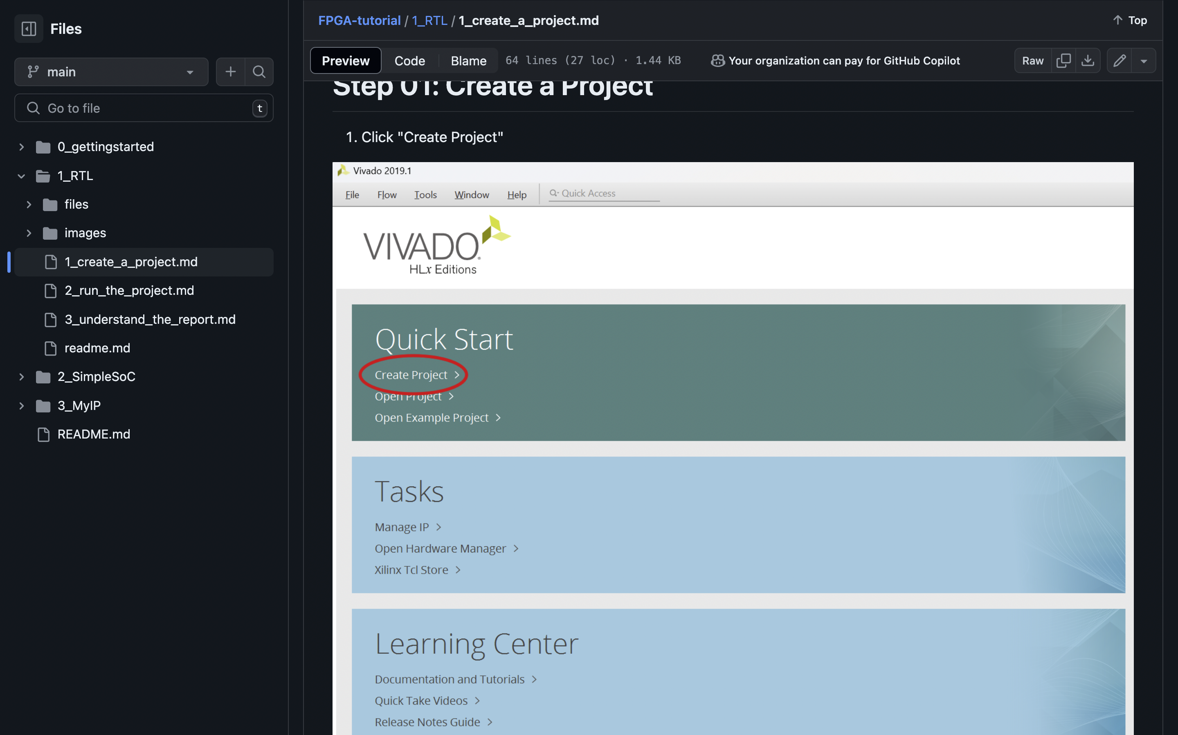
Research Progress | Completed
RTL Implementation
into FPGA Tutorial.
Paper reading (RPR)
Notes:
Briefly talk about what you have done
If possible. Highlight it in the overall architecture/system figure

Slide 9
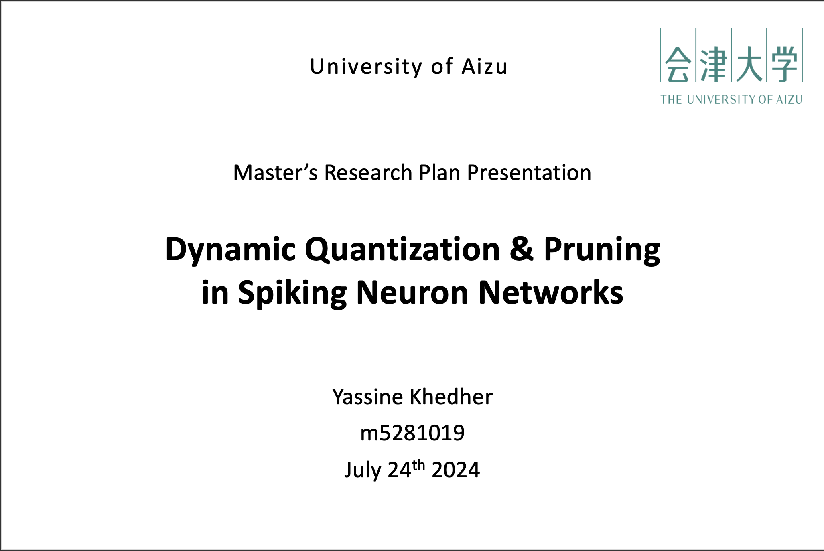
Research Progress | On-going
Writing the Research Plan
Presentation on 24-07
Reading more papers
Notes:
Explain what you are doing now
_ Talk about what is the challenge
_ Suggest about the solution

Slide 10
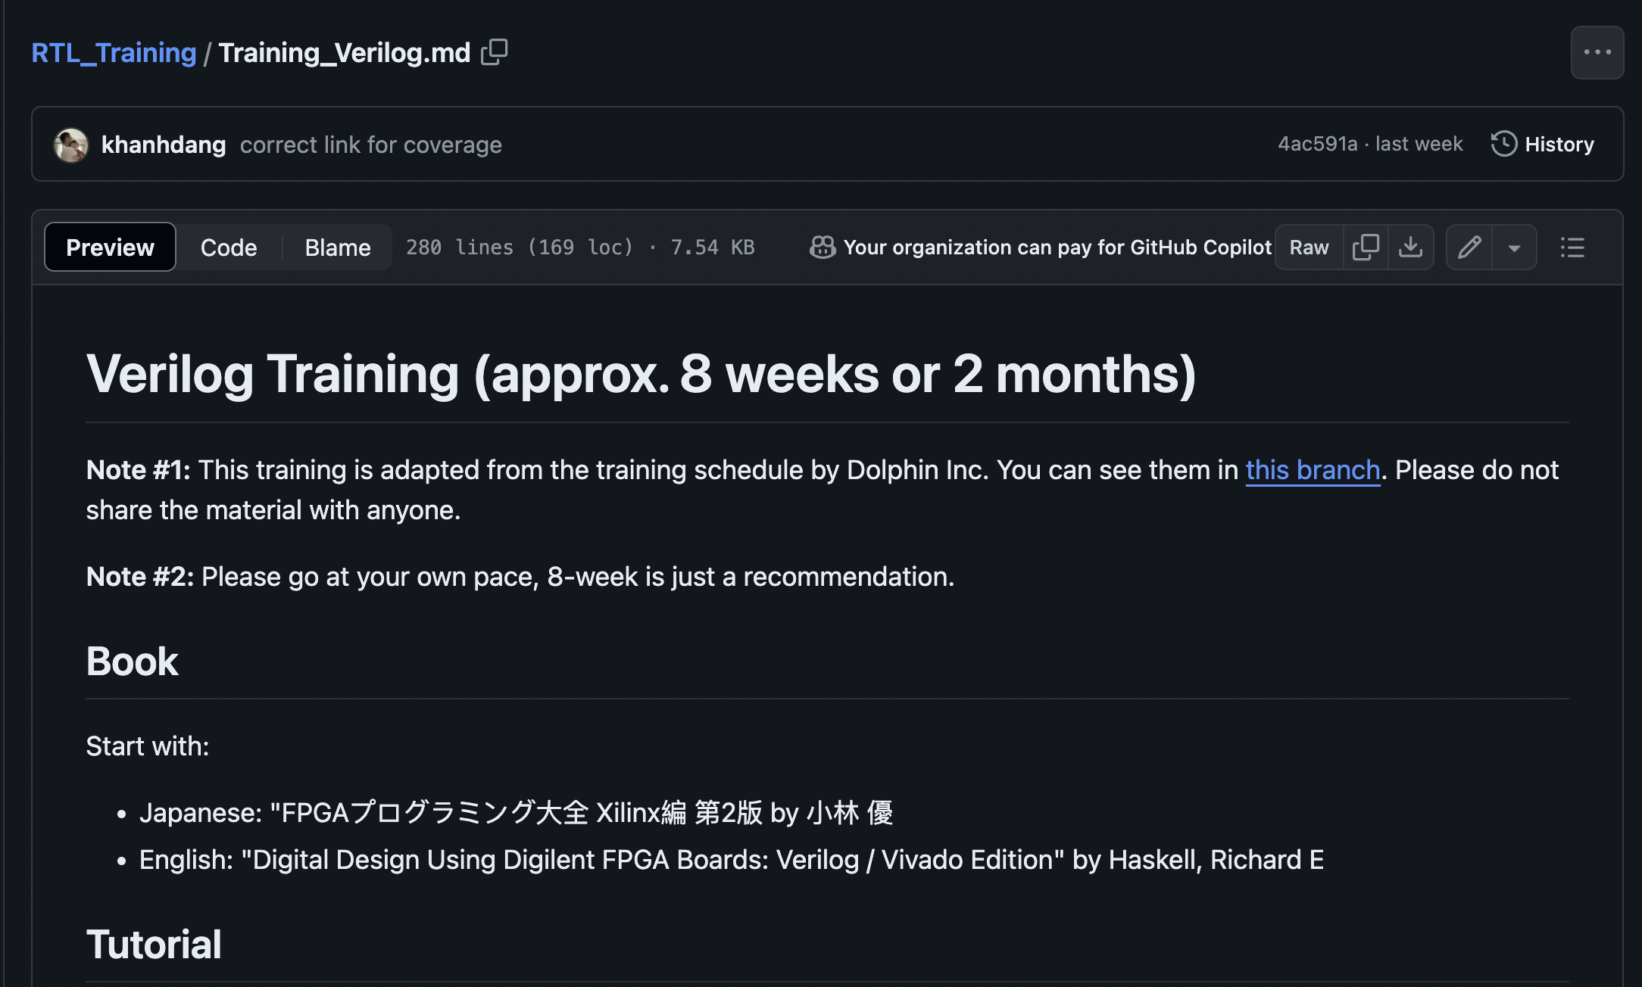
Research Progress | To-do
Start the 8-week RTL Training
from the github
Read more papers
Notes:
Explain what you are doing now
_ Talk about what is the challenge
_ Suggest about the solution

Slide 11
Content
Research Introduction
Research progress
Completed
On-going
To-do
Schedule
Notes:
Before jumping to a new section, add a new slide:
Hide the other sections
Highlight the current section

Slide 12
Schedule
Task \ Time | July 2024 | Aug 2024 | Sep 2024 | … | Jan 2026
Research Plan prep
RTL Training
Reading papers

Slide 13
Thank you for your attention!
Notes:
Always end with a thank you slide
_ Ask if there is any question

