Slide 1
The Hardware Impact of Quantization and Pruning for Weights in Spiking Neural Networks
Research Paper Reading
RPR
C. J. Schaefer, P. Taheri, M. Horeni and S. Joshi,
"The Hardware Impact of Quantization and Pruning for Weights in Spiking Neural Networks," in IEEE Transactions on Circuits and Systems II: Express Briefs, vol. 70, no. 5, pp. 1789-1793, May 2023, doi: 10.1109/TCSII.2023.3260701.
Presenter: Yassine Khedher
m5281019

Slide 2
Overview
Introduction
Methods
Spiking Neural Networks
Quantization
Pruning
Energy Evaluation
Results
Conclusion

Slide 3
Overview
Introduction
Methods
Spiking Neural Networks
Quantization
Pruning
Energy Evaluation
Results
Conclusion

Slide 4
Introduction
Context of the Work:
Spiking Neural Networks (SNNs) are gaining traction due to their ability to process temporal data efficiently.
Energy efficiency and computational overhead are critical challenges in deploying SNNs in practical applications.
Quantization and pruning are techniques used to optimize SNNs for better performance and energy efficiency.
Motivation of the Work:
The need for energy-efficient models in resource-constrained environments like IoT devices.
Current methods of quantization and pruning need thorough evaluation to understand their combined impact on SNNs.
Aim to investigate how these techniques affect the energy consumption and accuracy of SNNs.
Contribution of the Work:
Provides a detailed analysis of the combined effects of quantization and pruning on SNNs.
Offers insights into the energy-accuracy trade-offs in SNNs using an Eyeriss-like architecture.
Proposes optimized methods for implementing quantization and pruning in SNNs to enhance efficiency without compromising accuracy.

Slide 5
Overview
Introduction
Methods
Spiking Neural Networks
Quantization
Pruning
Energy Evaluation
Results
Conclusion

Slide 6
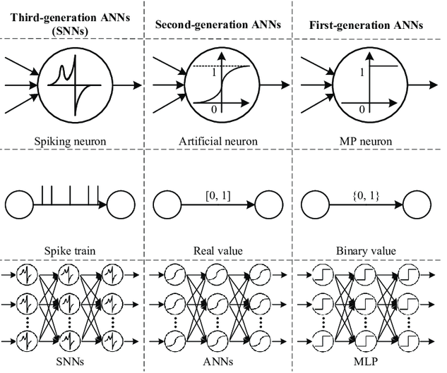
Spiking Neural Networks
Definition:
SNNs are neural networks that use spikes to represent and transmit information.
Key Characteristics:
Mimic biological neural activity, suitable for event-driven processing.
Uses Leaky Integrate-and-Fire (LIF) neuron model
Advantages:
Reduced energy consumption, high efficiency in low-power and real-time applications.
Application:
Focus on gesture recognition from DVS cameras which generate event-based data.

Slide 7
Quantization
Quantization:
Process of reducing the precision of weights in a neural network.
Implementation in Paper:
Used ternary quantization, simplifying weights to three possible values.
Benefits:
Decreases memory usage and computation requirements without significant accuracy loss.
2.3
2
5.2
5
7.1
2.9
7
3
3.7
4
4.8
7.3
5
7
4.2
4
5.6
6
Figure: Example of Qunatization

Slide 8
Pruning
Pruning:
Removing less significant weights from the network to create a sparser model.
Method in Paper:
Applied global unstructured pruning to achieve sparsity in the network.
Benefits:
Reduces model size, enhances computational efficiency, and lowers energy consumption.
Figure: Example of Pruning

Slide 9
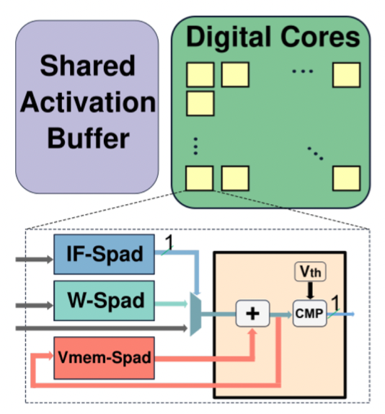
Energy Evaluation
• The Eyeriss-like architecture implements a grid of digital processing elements (PEs).
• It uses sparsity-aware techniques for input spikes, weights, and output spikes.
• Features include clock gating, input read skipping, and sparse representation schemes.
• Energy estimation is performed using high-level component-based tools calibrated to a 28 nm CMOS node.
• The analysis incorporates spike activity statistics and tensor-sparsity statistics for efficient dataflows.
Figure: Eyeriss-like spiking architecture consisting of a shared activation buffer connected to an array of digital cores. A single digital core has dedicated memory for inputs (IF-Spad), weights (W-Spad), state (Vmem-Spad) and spiking threshold (Vth). The digital cores possess arithmetic components, e.g., an accumulator or a comparator (CMP) for spike generation.

Slide 10
Overview
Introduction
Methods
Spiking Neural Networks
Quantization
Pruning
Energy Evaluation
Results
Conclusion

Slide 11
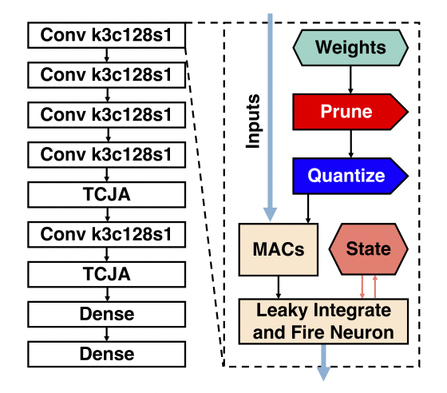
Experiment Environment
Evaluated on the DVS gesture dataset using spike-count for classification.
Baseline model has 8-bit quantized weights with 97.57% accuracy.
Pruning and quantization applied to weights as shown in the schematic.
Fine-tuning involved pre-trained floating point weights for 50 epochs with a specific learning rate schedule.
Figure: On the left: schematic SNN architecture proposed using stacked spiking convolution blocks with 3×3 weight kernels, 128 output channels and striding of 1. Followed by temporal-channel joint attention (TCJA) blocks and spiking dense blocks for classification
On the right: a simplified flow within a spiking layer: weights are first pruned and then quantized (pre- processing), inputs are multiplied and accumulated with preprocessed weights before being fed into the logic of the leaky integrate and fire neurons, which additionally relies on a stored state (membrane potential).

Slide 12
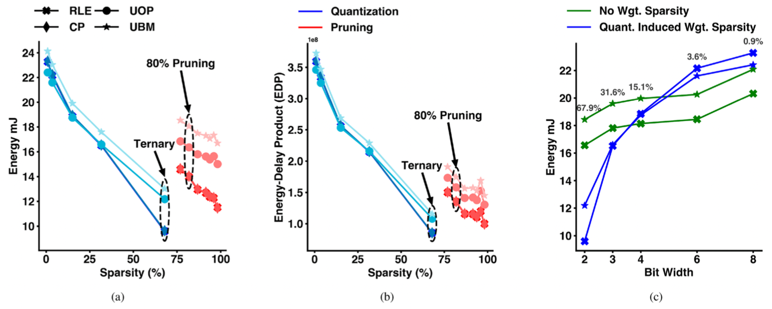
Pruning and Quantization Evaluation
Quantization
Impact: Quantization effectively reduces memory and computational load with minor accuracy degradation.
Figure: Shows the impact of different quantization levels on accuracy and energy consumption.
Insights: Ternary quantization maintains high accuracy while offering significant energy savings.
Pruning
Impact: Pruning up to 80% sparsity retains accuracy but offers substantial energy savings.
Figure: Displays results showing how different sparsity levels affect performance and energy use.
Insights: Beyond 80% sparsity, accuracy drops significantly, balancing sparsity and performance is crucial.
Figure: The Effect of sparsity on energy and energy-delay product (EDP)

Slide 13
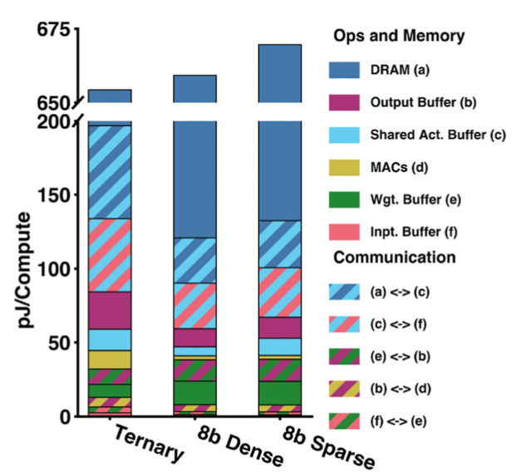
Normalized Energy Breakdown
Ternarization incurs minimal DRAM access, improving efficiency.
8-bit sparse models face higher energy costs due to metadata overhead.
Data movement to/from the shared activation buffer is a significant energy cost.
Figure: A breakdown of normalized energy for different data-movement and operations for three different configurations

Slide 14
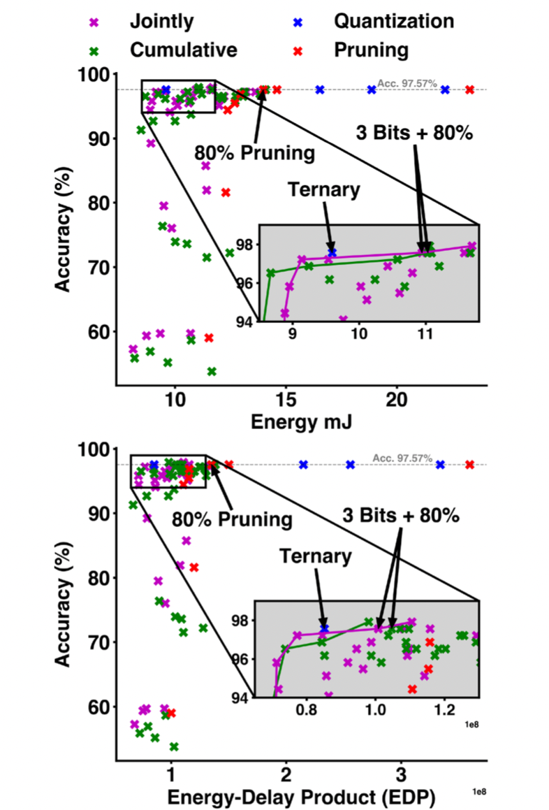
Accuracy vs. Energy Trade-Off
Comparison of strategies for quantizing and pruning on accuracy and energy/EDP.
Ternary quantization maintains accuracy while reducing energy costs.
Mixed pruning and quantization schemes offer fine-grained trade-offs on the Pareto curve.
Hybrid approaches deliver multiple models on the accuracy-efficiency frontier.
Figure: Illustration of accuracy vs. energy trade-off (top) and accuracy vs. tradeoff between energy-delay product (bottom) for studied model compression techniques.

Slide 15
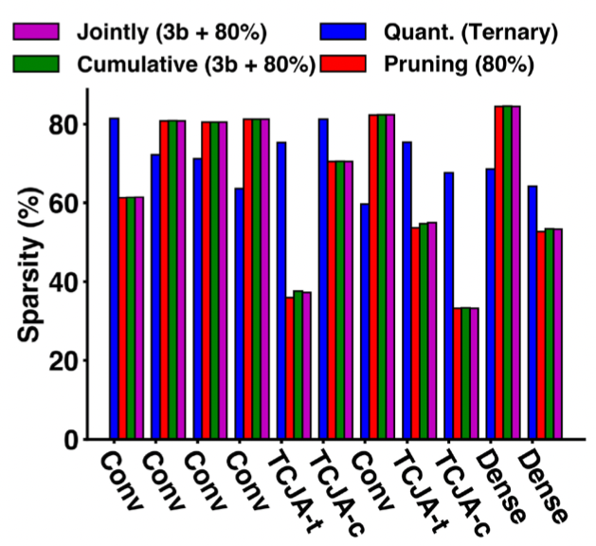
Sparsity Insights
Comparison of layer sparsity statistics for different compression techniques.
Pruning and mixed schemes show similar sparsity distribution among layers.
Ternary quantization results in different sparsity distribution, providing energy advantages.
Non-uniform impact of sparsity across layers influences energy consumption.
Figure: Sparsity insight into the SNN model for the smallest iso-accurate models for quantization, pruning, cumulative quantization & pruning and joint quantization & pruning.

Slide 16
Overview
Introduction
Methods
Spiking Neural Networks
Quantization
Pruning
Energy Evaluation
Results
Conclusion

Slide 17
Conclusion
Main idea: Enhancing hardware efficiency through quantization and pruning by experimenting with Energy-accuracy trade-off in SNNs.
Contributions to the field:
Hybrid pruning and quantization schemes offer fine-grained control over energy and accuracy.
Demonstrating significant energy and memory savings with minimal performance loss
Potential for SNNs in resource-constrained applications
Potential improvements and new research questions:
Adapting quantization levels in real-time
Implementing dynamic pruning strategies
Balancing accuracy, energy efficiency, and hardware performance

Slide 18
References
C. J. Schaefer, P. Taheri, M. Horeni and S. Joshi, "The Hardware Impact of Quantization and Pruning for Weights in Spiking Neural Networks," in IEEE Transactions on Circuits and Systems II: Express Briefs, vol. 70, no. 5, pp. 1789-1793, May 2023, doi: 10.1109/TCSII.2023.3260701.
Wang, Xiangwen & Lin, Xianghong & Dang, Xiaochao. (2020). Supervised learning in spiking neural networks: A review of algorithms and evaluations. Neural Networks. 125. 258-280. 10.1016/j.neunet.2020.02.011.

Slide 19
Thank you for your attention.

Slide 20
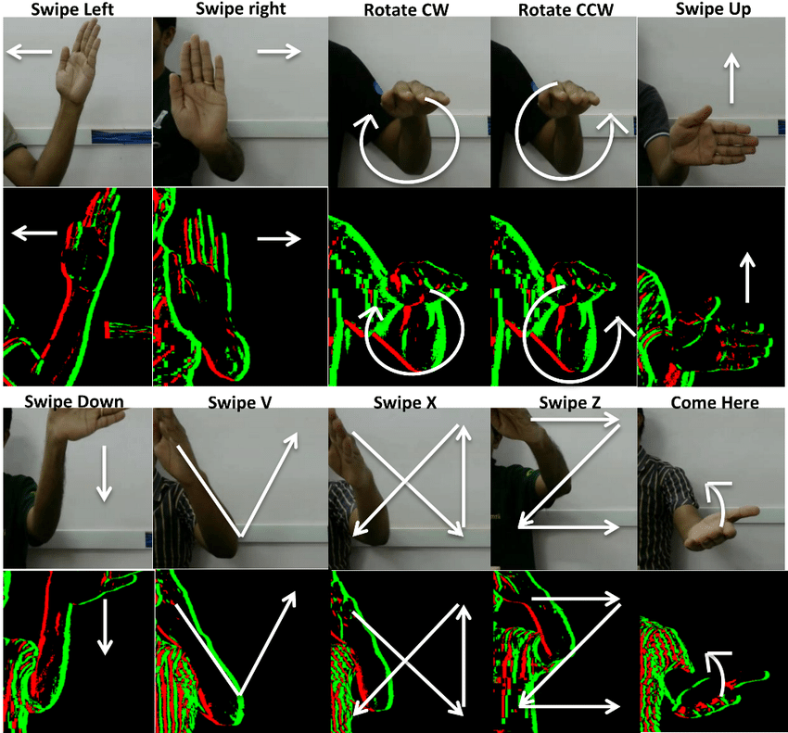
DVS Dataset
The DVS gesture dataset consists of event-based data used for gesture recognition.
Contains temporal data captured by Dynamic Vision Sensors.
Provides a challenging benchmark for evaluating the performance of SNNs.

Slide 21
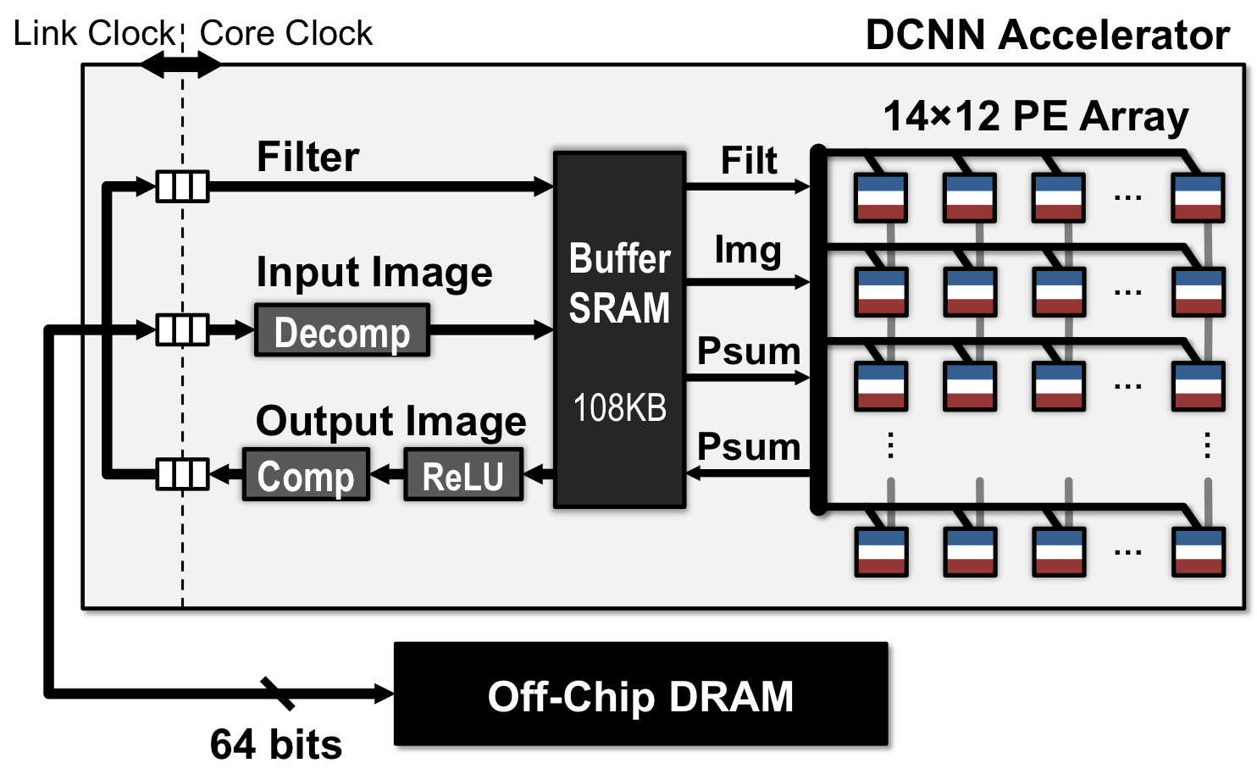
Eyeriss-Like Architecture
The Eyeriss-like architecture is designed for efficient neural network processing.
Features include a grid of PEs, shared activation buffers, and scratchpad memories.
Utilizes sparsity-aware techniques and high-level energy estimation tools.
Aimed at optimizing energy consumption for SNN workloads in this paper.

