Slide 1
An Overview of My Initial Steps in Neuromorphic Computing
Research Progress Seminar
RPS
m5281019
Yassine Khedher

Slide 2
Outline
Background
Motivation
Related Work
Learning Phase
Journal Paper
Textbook
Schedule

Slide 3
Outline
Background
Motivation
Related Work
Learning Phase
Journal Paper
Textbook
Schedule

Slide 4
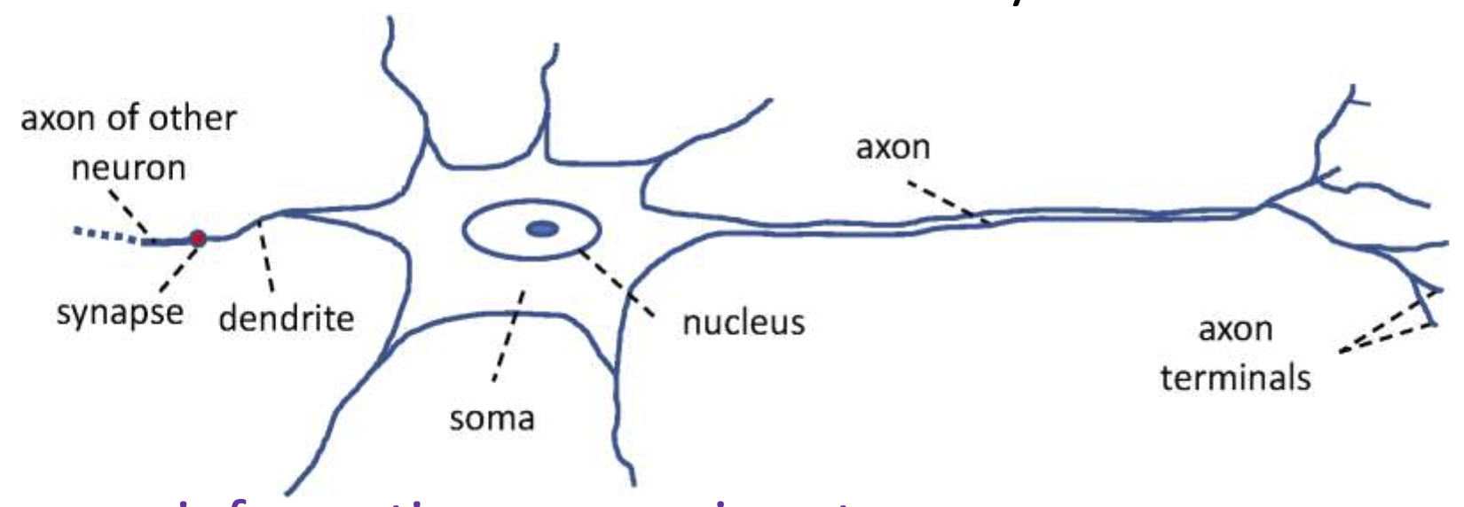
Introduction
Neuromorphic Computing
is a method of computer engineering in which elements of a computer are modeled after systems in the human brain and nervous system.
[1]

Slide 5
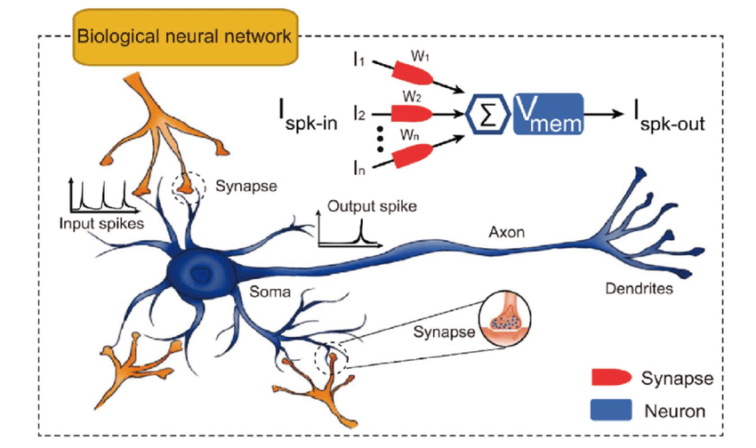
Introduction
Spiking Neuron Networks (SNNs)
[2]

Slide 6
Outline
Background
Motivation
Related Work
Learning Phase
Journal Paper
Textbook
Schedule

Slide 7
Motivation
Energy Efficiency in Neuromorphic Systems
Neuromorphic computers are modelled after the human brain, which consumes only about 20 watts with almost 100 billion neurons
energy consumption is crucial for the future of neuromorphic computing.
Neuromorphic technology and SNNs naturally have lower power consumption than traditional computer architectures.
-> But how can we improve the energy consumption further?

Slide 8
Motivation
Dynamic Quantization
Dynamic Quantization means converting a network to use a reduced precision integer representation for the weights and/or activations at run-time.
Float
3.14159265359
Integer
3.1415
32 bit
8 bit

Slide 9

Pruning
Consists of removing redundant computations from the neural network
x
x
x
x
Figure: Neural Network before and after pruning

Slide 10
Outline
Background
Motivation
Related Work
Learning Phase
Journal Paper
Textbook
Schedule

Slide 11
Related Work
Dynamic Quantization and Pruning in Deep Learning [3]
This paper demonstrated how quantization and pruning can be applied to deep neural networks to reduce computational and memory requirements while maintaining model accuracy.
Applications and Challenges in SNNs [4]
The methods proposed in the paper can inspire similar strategies for SNNs, such as dynamically adjusting synaptic weights precision and pruning less active spikes or synapses to improve power efficiency.

Slide 12
Outline
Background
Motivation
Related Work
Learning Phase
Journal Paper
Textbook
Schedule

Slide 13
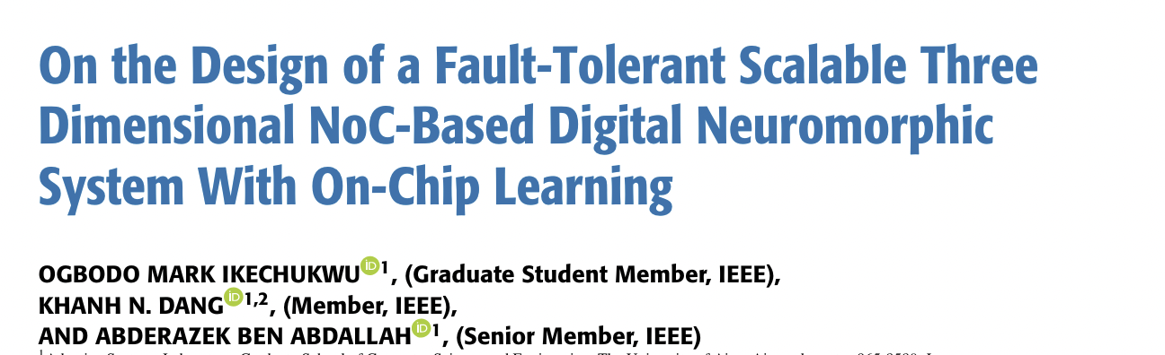
Key Reading
Journal Paper

Slide 14
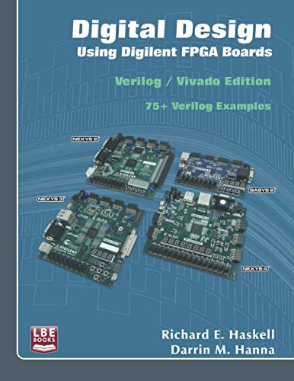
Key Reading
Textbook
1. FPGA Basics & Digital Design:
- Understanding FPGAs.
- Core principles of digital circuit design.
2. Verilog Programming:
- Key syntax and practical implementation for FPGAs.
3. Hardware Implementation Techniques:
- Translating designs into efficient hardware circuits.

Slide 15
Outline
Background
Motivation
Related Work
Learning Phase
Journal Paper
Textbook
Schedule

Slide 16
Schedule
Time | Task
April 2024 | Setup and getting started with the research / environment
May 2024 | Finish reading the textbook and papers
June 2024 | RTL Simulation Exercises + Reading more papers
July 2024 | …

Slide 17
References
Neuromorphic Computing Principles and Organization (First Edition)
Authors: Abderazek Ben Abdallah, Khanh N. Dang. ISBN10: 3030925242, ISBN-13: 978-3030925246 [1]
Magnetic Skyrmions for Unconventional Computing - Scientific Figure on ResearchGate. Available from: https://www.researchgate.net/figure/The-skyrmionic-neuromorphic-computing-devices-a-Illustration-of-a-biological-nervous_fig3_346143727 [2]
Pruning and Quantization for Deep Neural Network Acceleration: A Survey
Authors:Tailin Liang, John Glossner, Lei Wang, Shaobo Shi, Xiaotong Zhang arXiv:2101.09671 [cs.CV] [3]
• O. M. Ikechukwu, K. N. Dang and A. B. Abdallah, "On the Design of a Fault-Tolerant Scalable Three Dimensional NoC-Based Digital Neuromorphic System With On-Chip Learning," in IEEE Access, vol. 9, pp. 64331-64345, 2021, doi: 10.1109/ACCESS.2021.3071089.
• C. J. Schaefer, P. Taheri, M. Horeni and S. Joshi, "The Hardware Impact of Quantization and Pruning for Weights in Spiking Neural Networks," in IEEE Transactions on Circuits and Systems II: Express Briefs, vol. 70, no. 5, pp. 1789-1793, May 2023, doi: 10.1109/TCSII.2023.3260701. [5]

Slide 18
Thank you for your attention!

