Slide 1
Carbon-Neutral Ensemble Spike-Timing-Dependent Plasticity Learning
Yuga Hanyu
This is a collaboration work: E3STDP Project
22 July 2025
Notes:
Keep this slide clean
Do not add line number here

Slide 2
Content
Research Introduction
System architecture
Research progress
Done
Doing
Todo
Schedule
Notes:
The content should be bief

Slide 3
Content
Research Introduction
System architecture
Research progress
Done
Doing
Todo
Schedule
Notes:
Before jumping to a new section, add a new slide:
Hide the other sections
Highlight the current section

Slide 4
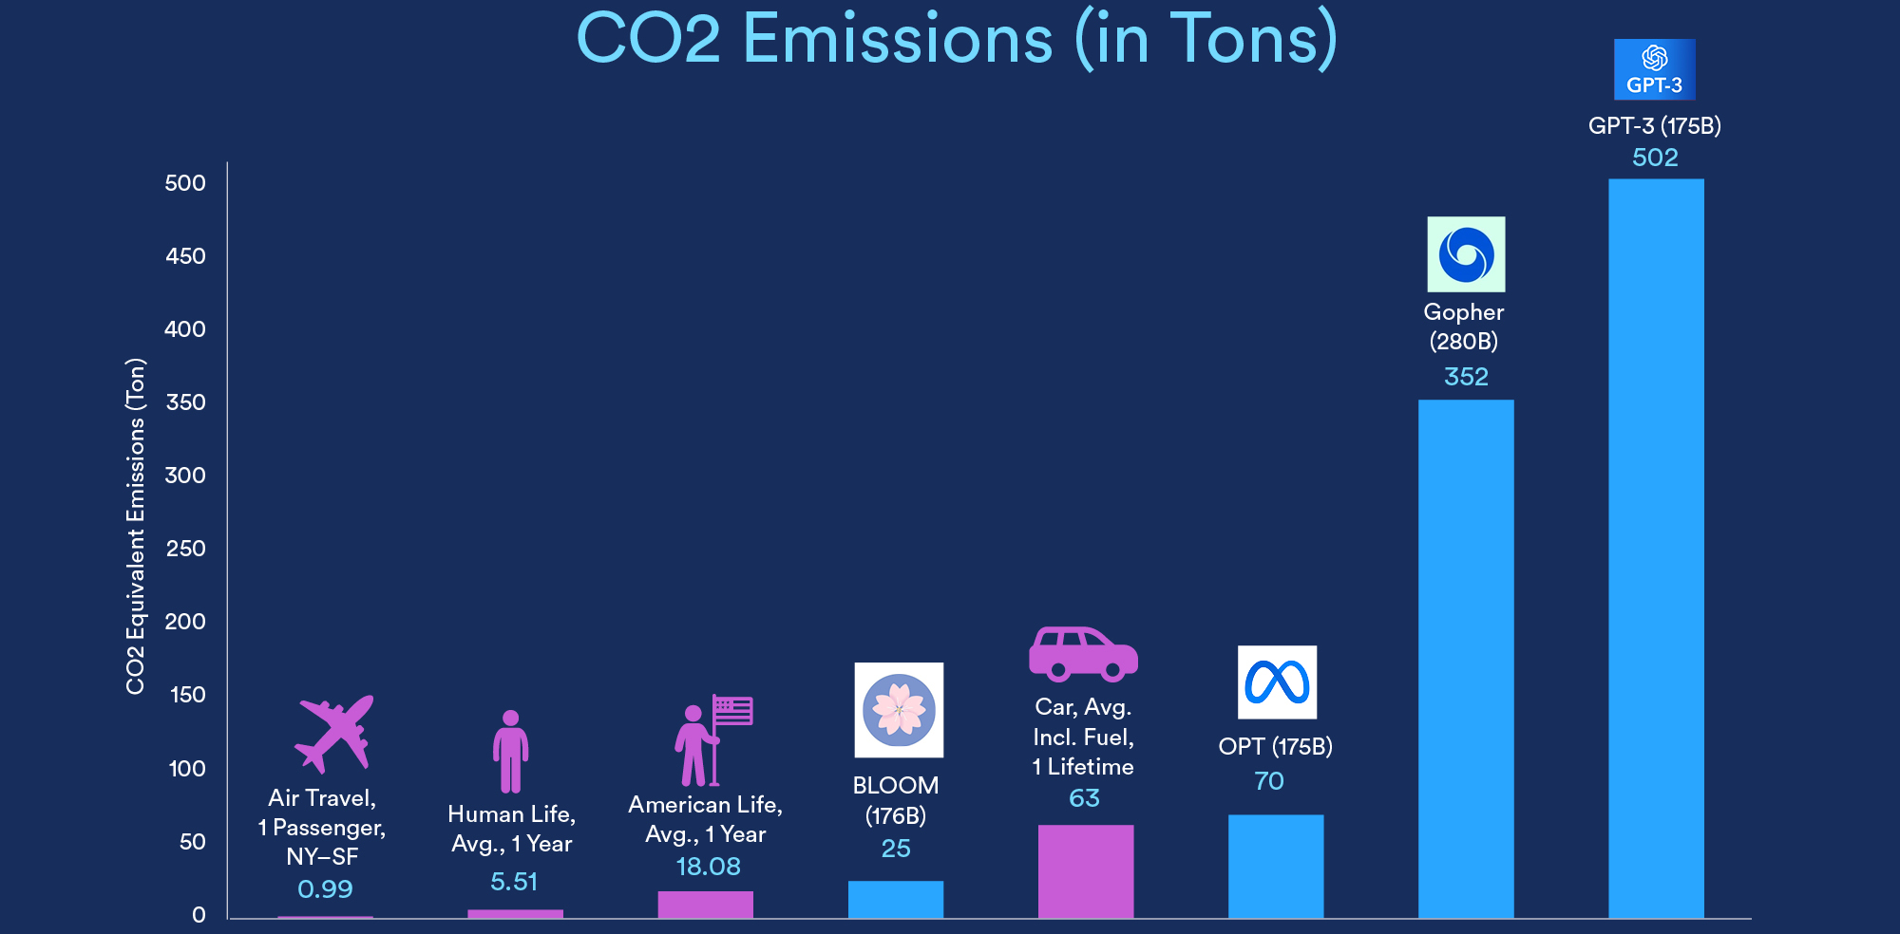
Research introduction
(Stanford HAI, 2023 State of AI in 14 Charts, Chart 3)
Notes:
I would like to introduce about my research. My research is about training multiple SNN models then merge them into one model. This way of training offers several benefits such as faster training process and collaborative learning. For example, if we decompose dataset and model into 10 datasets and 10 models, the training process becomes 10 times faster excluding the merging process after that. Also, since we will be working on separate dataset, we can do collaborative learning such as train small models in different places, then merge them to create one model that can perform in every place. My main goal is to propose a model merging method that is both computationally efficient and able to produce high accuracy

Slide 5
Research introduction
66% of the global population regularly uses AI [1]
AI systems account for 2.1-3.9% of carbon emissions [2]
Sustainable and energy efficient AI system is necessary
-> We propose the use of Spiking Neural Networks (SNNs) combined with on-chip low-power techniques
Notes:
I would like to introduce about my research. My research is about training multiple SNN models then merge them into one model. This way of training offers several benefits such as faster training process and collaborative learning. For example, if we decompose dataset and model into 10 datasets and 10 models, the training process becomes 10 times faster excluding the merging process after that. Also, since we will be working on separate dataset, we can do collaborative learning such as train small models in different places, then merge them to create one model that can perform in every place. My main goal is to propose a model merging method that is both computationally efficient and able to produce high accuracy

Slide 6
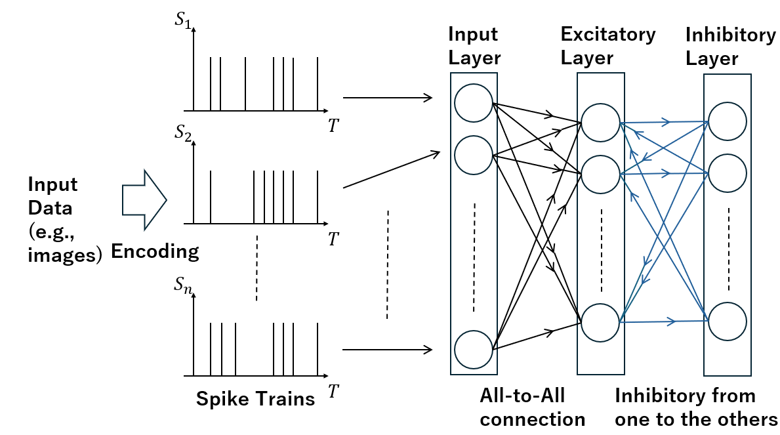
Spiking Neural Network
Spiking Neural Networks (SNNs) use spikes to communicate information [3]
Compared to traditional ANNs, SNNs are energy efficient [4]
Fig. 1 Structure of an SNN

Slide 7
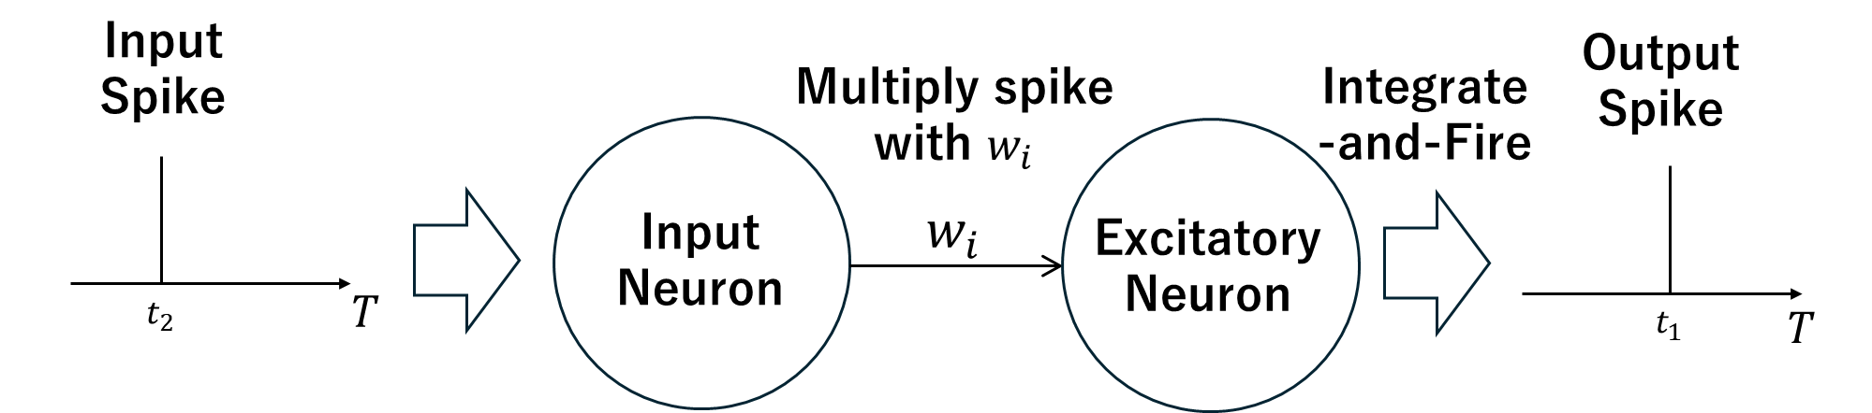
Spike Timing Dependent Plasticity
STDP is a learning method based on spike timings
lightweight computation & great energy efficiency [5]
suitable for on-chip learning
Timings of two spikes
Fig. 2 Input and output spikes

Slide 8
Content
Research Introduction
System Architecture
Research progress
Done
Doing
Todo
Schedule
Notes:
Before jumping to a new section, add a new slide:
Hide the other sections
Highlight the current section

Slide 9
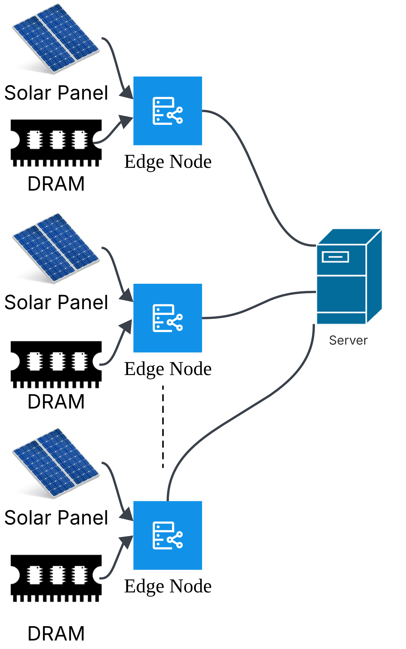
Overall Architecture
Arbitrary number of
edge nodes and a server
Each node has solar panel and DRAM
Solar energy = energy consumption
for all the edge nodes
Fig. 3 Overall Architecture

Slide 10
Steps to achieve Net 0 computation
Adjust the System for Net 0
Recover the Lost Accuracy
Train SNN models
Estimate
Net Energy

Slide 11
Steps to achieve Net 0 computation
Adjust the System for Net 0
Recover the Lost Accuracy
Train SNN models
Estimate
Net Energy

Slide 12
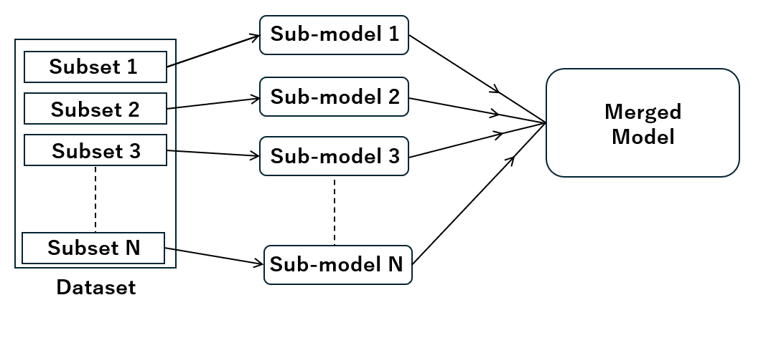
EnsembleSTDP
Fig. 5 Overview of EnsembleSTDP
Fig. 3 Overall Architecture

Slide 13
EnsembleSTDP (Cnt.)
EnsembleSTDP is energy efficient training for local SNNs
84% less energy compared to training a single model
Reduced learning complexity for a single SNN
Transferring weights consumes less energy than training data

Slide 14
Steps to achieve Net 0 computation
Adjust the System for Net 0
Recover the Lost Accuracy
Train SNN models
Estimate
Net Energy

Slide 15
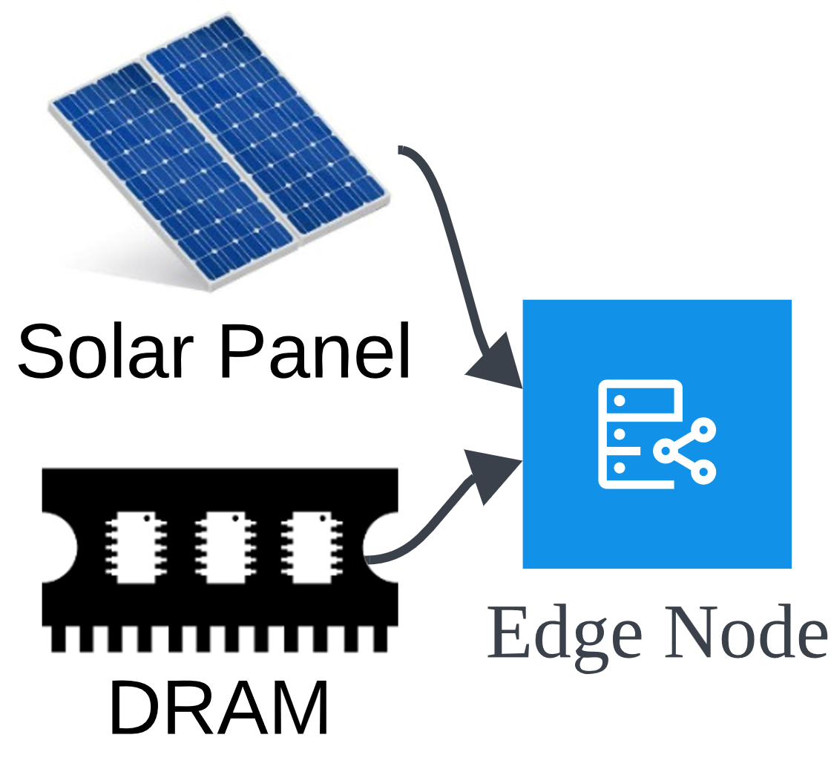
Estimation of Net Energy
Energy Requirement(%)

Slide 16
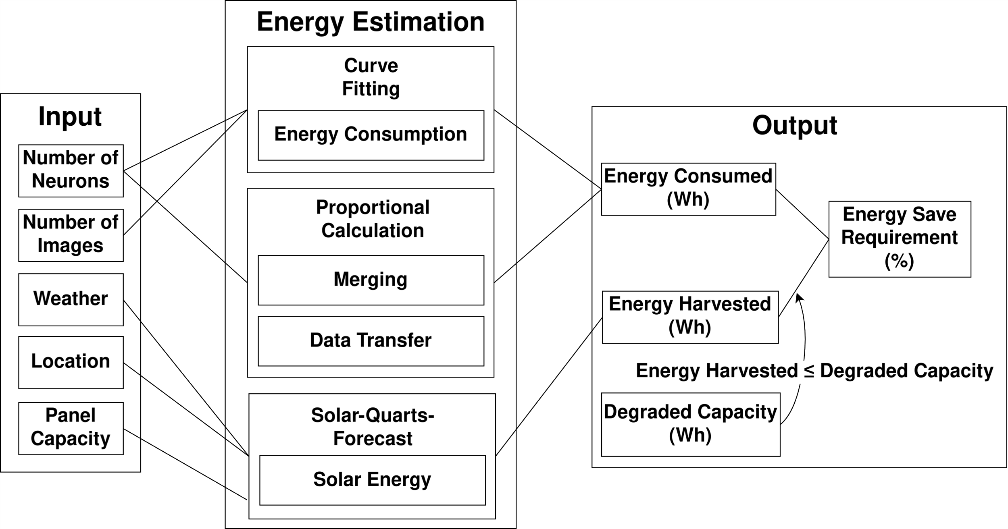
Estimation of Net Energy (Cnt.)
Fig. 6 Energy Estimation Framework

Slide 17
Steps to achieve Net 0 computation
Adjust the System for Net 0
Recover the Lost Accuracy
Train SNN models
Estimate
Net Energy

Slide 18
DRAM Configuration
Energy Requirement(%)
Reduce DRAM Energy Consumption

Slide 19
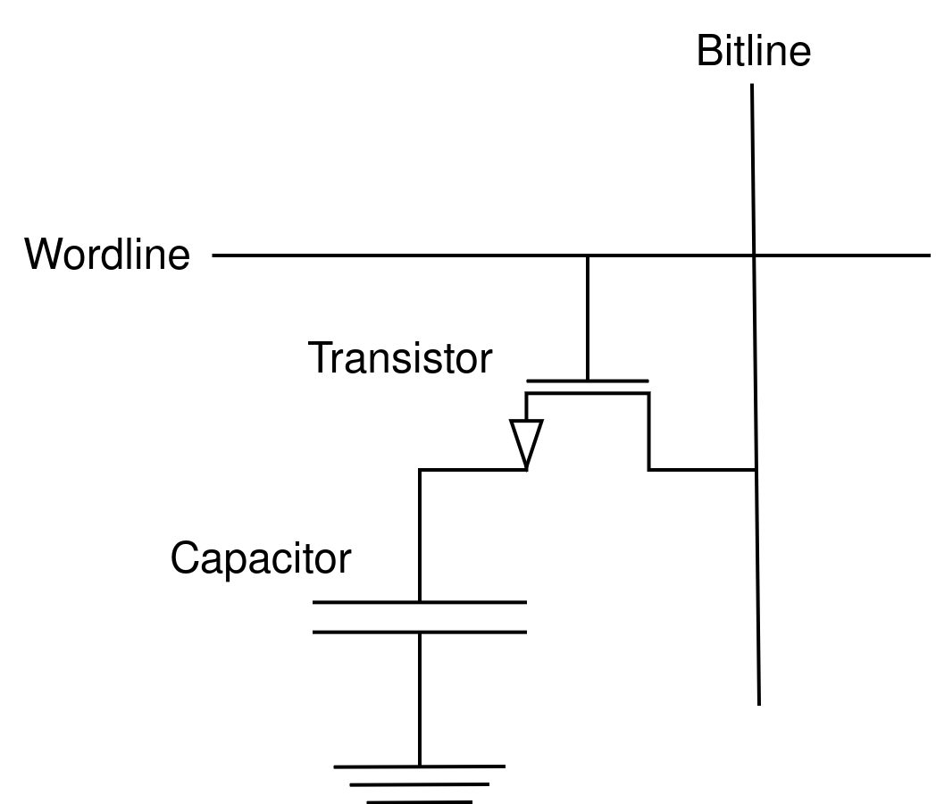
DRAM Configuration
DRAM stores weights of SNNs
Each DRAM cell has
capacitor & transistor
Stored value corresponds to the
charged voltage of capacitor
Fig. 7 DRAM Cell

Slide 20
DRAM Configuration (Cnt.)
Energy consumption is reduced by
undervolting the DRAM
Undervolting induces bit error:
value flips from 1 -> 0
Table 2 DRAM Configurations and corresponding BER

Slide 21
Accuracy Prediction
Accuracy of the SNN on Edge Node?
Undervolted
Notes:
This is the architecture of each individual SNN model. The number of neurons in each layer is arbitrary. Weights are assigned to each connection between the layers, and the weights between input layer and excitatory layer are learning parameters. First, input spikes gets multiplied by weights and proceeds to excitatory layer. Then, if any of the neurons in excitatory layer emits a spike because of input, that neuron sends inhibitory signal to other neurons through inhibitory layer. This is to prevent several neurons from outputting similar spike patterns, making the learning more diverged.

Slide 22

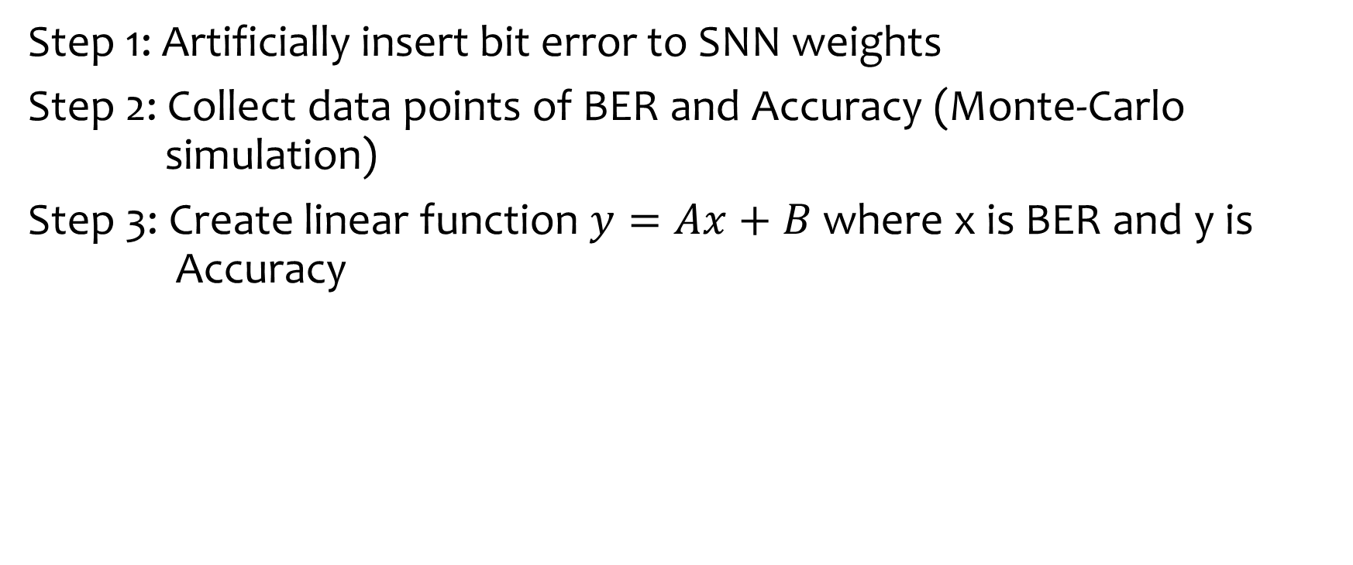
Accuracy Prediction (Cnt.)
Step 1: Artificially insert bit error to SNN weights
Step 2: Collect data points of BER and Accuracy (Monte-Carlo simulation)
Step 3: Create linear function $y=Ax+B$ where x is BER and y is Accuracy
BER | Accuracy
0.01 | 90%
0.05 | 85%
0.1 | 80%
0.2 | 70%
$$y=Ax+B$$
Predict accuracy from BER
*Linear function consumes less memory than table

Slide 23
Steps to achieve Net 0 computation
Adjust the System for Net 0
Recover the Lost Accuracy
Train SNN models
Estimate
Net Energy

Slide 24
Redownloading weights
Predicted accuracy < minimum accuracy requirement, download fresh trained weight from the server
Redownloading also occurs periodically overtime
Weight
Value
Redownload
Redownload
Time

Slide 25
Content
Research Introduction
Overall system/architecture
Research progress
Done
Doing
Todo
Schedule
Notes:
Before jumping to a new section, add a new slide:
Hide the other sections
Highlight the current section

Slide 26
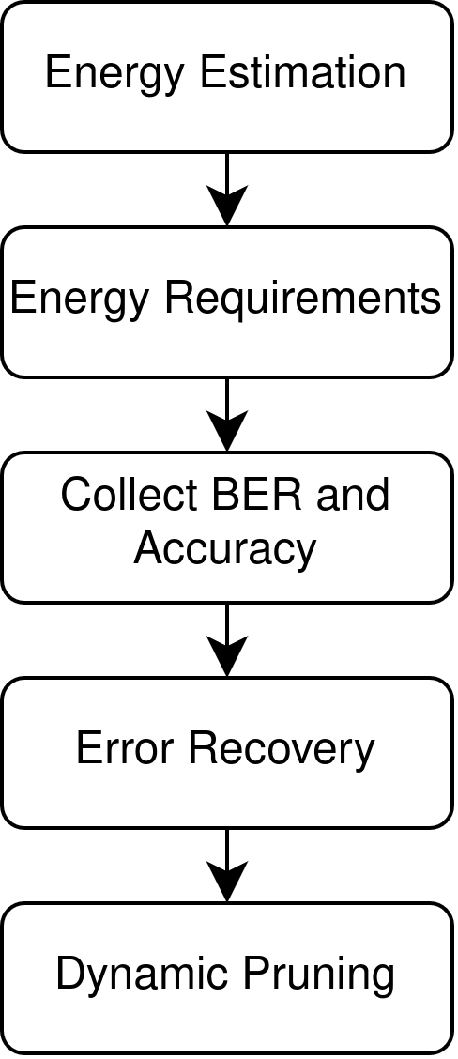
Research Progress | Done
Evaluation of energy estimation
Collection of Energy Requirements
given various conditions
Data of BER Accuracy relation
Notes:
Here is what I have done so far. Training two models separately on different datasets, and simply concatenating neurons from two models. This is considered inefficient but primitive way of merging. In this step, it was important to confirm merging gives the better classifying accuracy due to the more diverged neurons in the final model. And manually compressing models and merge. This step was also important to make sure the merging is beneficial with good way of compressing.

Slide 27
Research Progress | Todo
Collect data for error recovery
Collect data for dynamic pruning
Notes:
Here is what I have done so far. Training two models separately on different datasets, and simply concatenating neurons from two models. This is considered inefficient but primitive way of merging. In this step, it was important to confirm merging gives the better classifying accuracy due to the more diverged neurons in the final model. And manually compressing models and merge. This step was also important to make sure the merging is beneficial with good way of compressing.

Slide 28
Content
Research Introduction
Overall system/architecture
Research progress
Done
Doing
Todo
Schedule
Notes:
Before jumping to a new section, add a new slide:
Hide the other sections
Highlight the current section

Slide 29
Schedule
 | July 22-25 | July 28- August 1 | August 4-8
Error recovery data and report
Collect Data of Dynamic Pruning and report
Carefully read the paper and edit

Slide 30
References
[1] University of Melbourne & KPMG International. Trust, Attitudes and Use of Artificial Intelligence: A Global Study 2025.
[2] K. Kirkpatrick, “The carbon footprint of artificial intelligence,” Communications of the ACM, vol. 66, no. 8, pp. 17–19, Jul. 2023.
[3] P. A. Merolla et al., “A million spiking-neuron integrated circuit with a scalable communication network and interface,” Science, vol. 345, no. 6197, pp. 668–673, 2014.
[4] P. U. Diehl, D. Neil, J. Binas, M. Cook, S.-C. Liu, and M. Pfeiffer “Fast-classifying, high-accuracy spiking deep networks through weight and threshold balancing,” International Joint Conference on Neural Networks (IJCNN), 2015.

Slide 31
References
[5] Unsupervised learning of digit recognition using spike-timing-dependent plasticity” Frontiers in Computational Neuroscience, vol. 9, p. 99, 2015.

Slide 32
Thank you for your attention!
Notes:
Always end with a thank you slide
_ Ask if there is any question

