Slide 1
Energy Estimation of Spiking Neural Networks
Yuga Hanyu
m5291018
10 June 2025
Notes:
Keep this slide clean
Do not add line number here

Slide 2
Content
Research Introduction
System architecture
Research progress
Done
Doing
Todo
Schedule
Notes:
The content should be bief

Slide 3
Content
Research Introduction
System architecture
Research progress
Done
Doing
Todo
Schedule
Notes:
Before jumping to a new section, add a new slide:
Hide the other sections
Highlight the current section

Slide 4
Research introduction
Running large Neural Networks (NNs) locally is difficult
EnsembleSTDP is one of the solutions
Objective: Achieve Net Zero (energy consumption < solar energy)
Energy estimation framework is necessary
Notes:
I would like to introduce about my research. My research is about training multiple SNN models then merge them into one model. This way of training offers several benefits such as faster training process and collaborative learning. For example, if we decompose dataset and model into 10 datasets and 10 models, the training process becomes 10 times faster excluding the merging process after that. Also, since we will be working on separate dataset, we can do collaborative learning such as train small models in different places, then merge them to create one model that can perform in every place. My main goal is to propose a model merging method that is both computationally efficient and able to produce high accuracy

Slide 5
Content
Research Introduction
System Architecture
Research progress
Done
Doing
Todo
Schedule
Notes:
Before jumping to a new section, add a new slide:
Hide the other sections
Highlight the current section

Slide 6
EnsembleSTDP
Sub-model 1
Subset 1
Sub-model 2
Subset 2
Merged Model
Subset 3
Sub-model 3
Subset N
Sub-model N
Dataset
SNN models
Notes:
This is the architecture of each individual SNN model. The number of neurons in each layer is arbitrary. Weights are assigned to each connection between the layers, and the weights between input layer and excitatory layer are learning parameters. First, input spikes gets multiplied by weights and proceeds to excitatory layer. Then, if any of the neurons in excitatory layer emits a spike because of input, that neuron sends inhibitory signal to other neurons through inhibitory layer. This is to prevent several neurons from outputting similar spike patterns, making the learning more diverged.

Slide 7
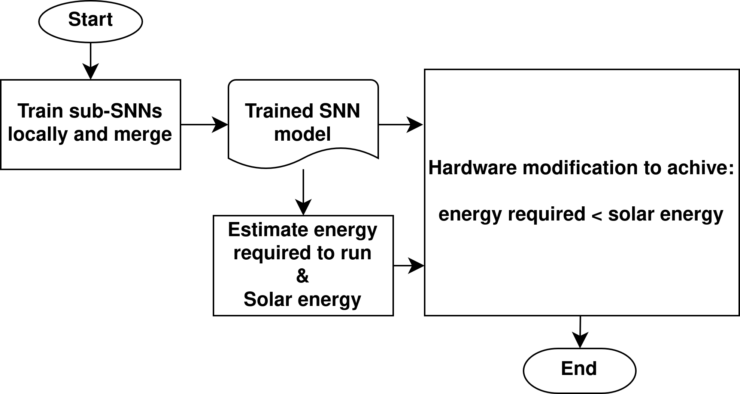
Overall Flow
Notes:
This is the architecture of each individual SNN model. The number of neurons in each layer is arbitrary. Weights are assigned to each connection between the layers, and the weights between input layer and excitatory layer are learning parameters. First, input spikes gets multiplied by weights and proceeds to excitatory layer. Then, if any of the neurons in excitatory layer emits a spike because of input, that neuron sends inhibitory signal to other neurons through inhibitory layer. This is to prevent several neurons from outputting similar spike patterns, making the learning more diverged.

Slide 8
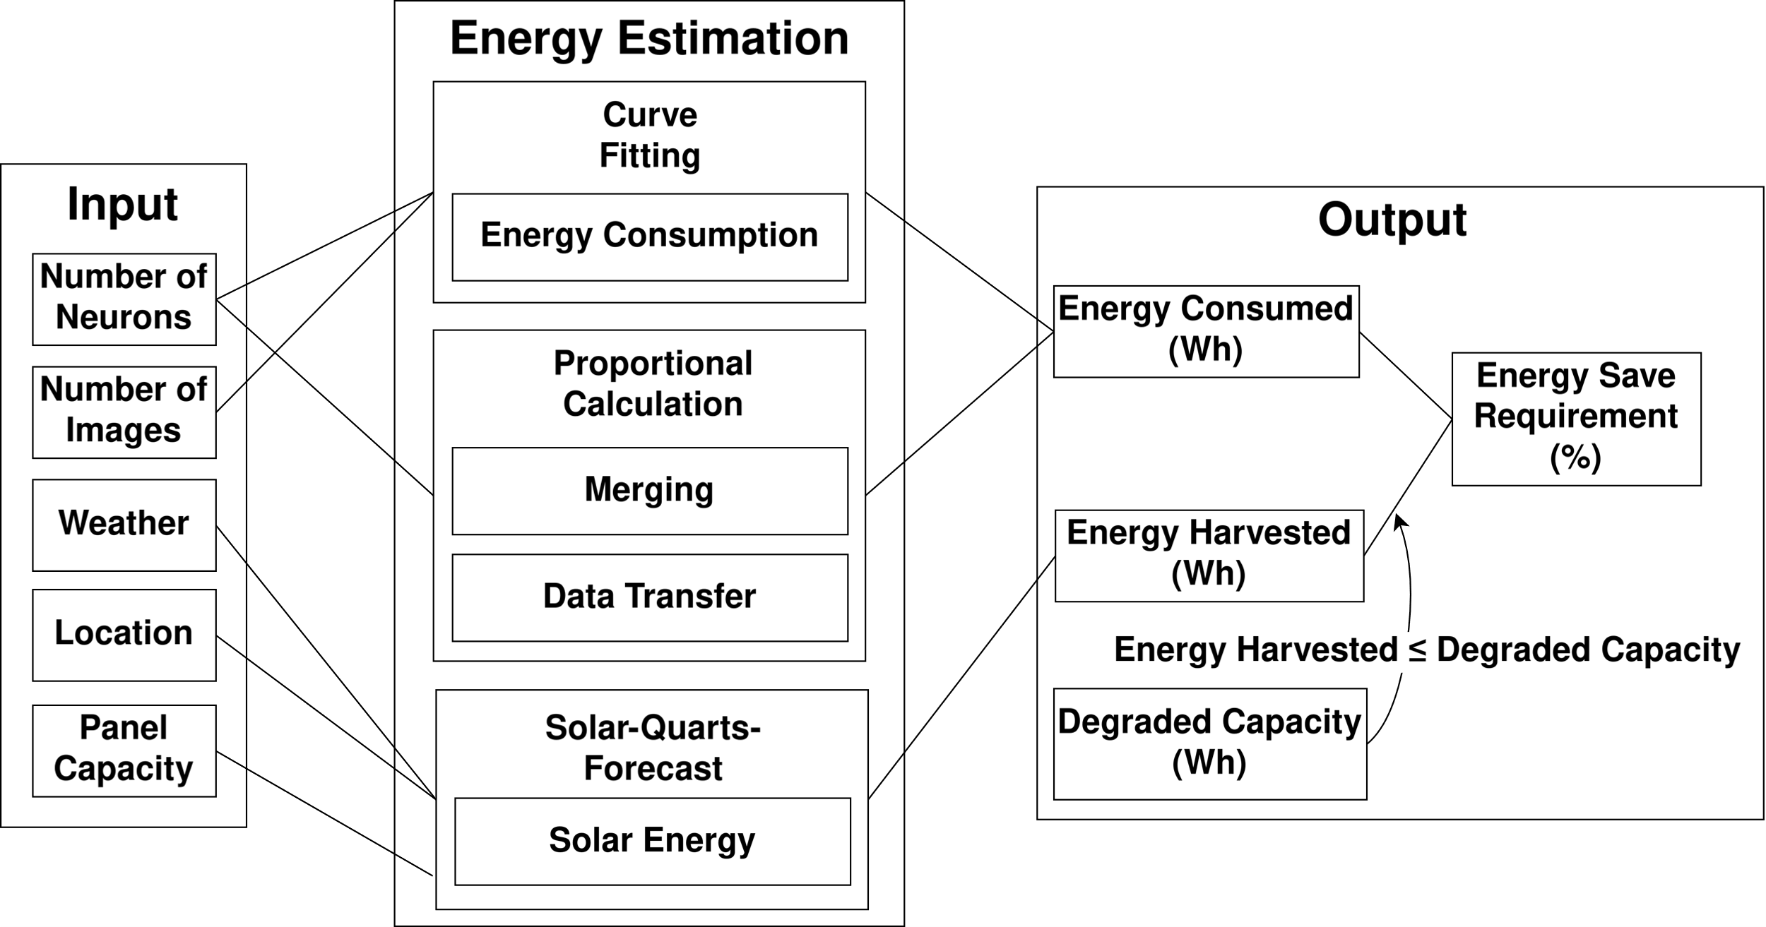
Energy Estimation Framework
Notes:
This is the architecture of each individual SNN model. The number of neurons in each layer is arbitrary. Weights are assigned to each connection between the layers, and the weights between input layer and excitatory layer are learning parameters. First, input spikes gets multiplied by weights and proceeds to excitatory layer. Then, if any of the neurons in excitatory layer emits a spike because of input, that neuron sends inhibitory signal to other neurons through inhibitory layer. This is to prevent several neurons from outputting similar spike patterns, making the learning more diverged.

Slide 9
1. SNN Energy Consumption
Notes:
This is the architecture of each individual SNN model. The number of neurons in each layer is arbitrary. Weights are assigned to each connection between the layers, and the weights between input layer and excitatory layer are learning parameters. First, input spikes gets multiplied by weights and proceeds to excitatory layer. Then, if any of the neurons in excitatory layer emits a spike because of input, that neuron sends inhibitory signal to other neurons through inhibitory layer. This is to prevent several neurons from outputting similar spike patterns, making the learning more diverged.

Slide 10
1. SNN Energy Consumption (cnt.)
1.1 Collect data points
One data point:
Number of neurons, Number of inputs, Energy Consumption (Wh)
1.2 Apply curve fitting method (scipy.optimize library)
(n_neurons, n_inputs) -> Energy Consumption (Wh)

Slide 11
2. Data Transfer / Merging Energy
Notes:
This is the architecture of each individual SNN model. The number of neurons in each layer is arbitrary. Weights are assigned to each connection between the layers, and the weights between input layer and excitatory layer are learning parameters. First, input spikes gets multiplied by weights and proceeds to excitatory layer. Then, if any of the neurons in excitatory layer emits a spike because of input, that neuron sends inhibitory signal to other neurons through inhibitory layer. This is to prevent several neurons from outputting similar spike patterns, making the learning more diverged.

Slide 12
2. Data Transfer / Merging Energy (cnt.)
2.1 Obtain data size of trained models (bytes)
2.2 Calculate transfer energy from device specs
Voltage(V) x Current(A) x Data Size(MB) / WiFi speed (Mbps)
= Energy (Wh)

Slide 13
3. Solar Energy
Notes:
This is the architecture of each individual SNN model. The number of neurons in each layer is arbitrary. Weights are assigned to each connection between the layers, and the weights between input layer and excitatory layer are learning parameters. First, input spikes gets multiplied by weights and proceeds to excitatory layer. Then, if any of the neurons in excitatory layer emits a spike because of input, that neuron sends inhibitory signal to other neurons through inhibitory layer. This is to prevent several neurons from outputting similar spike patterns, making the learning more diverged.

Slide 14
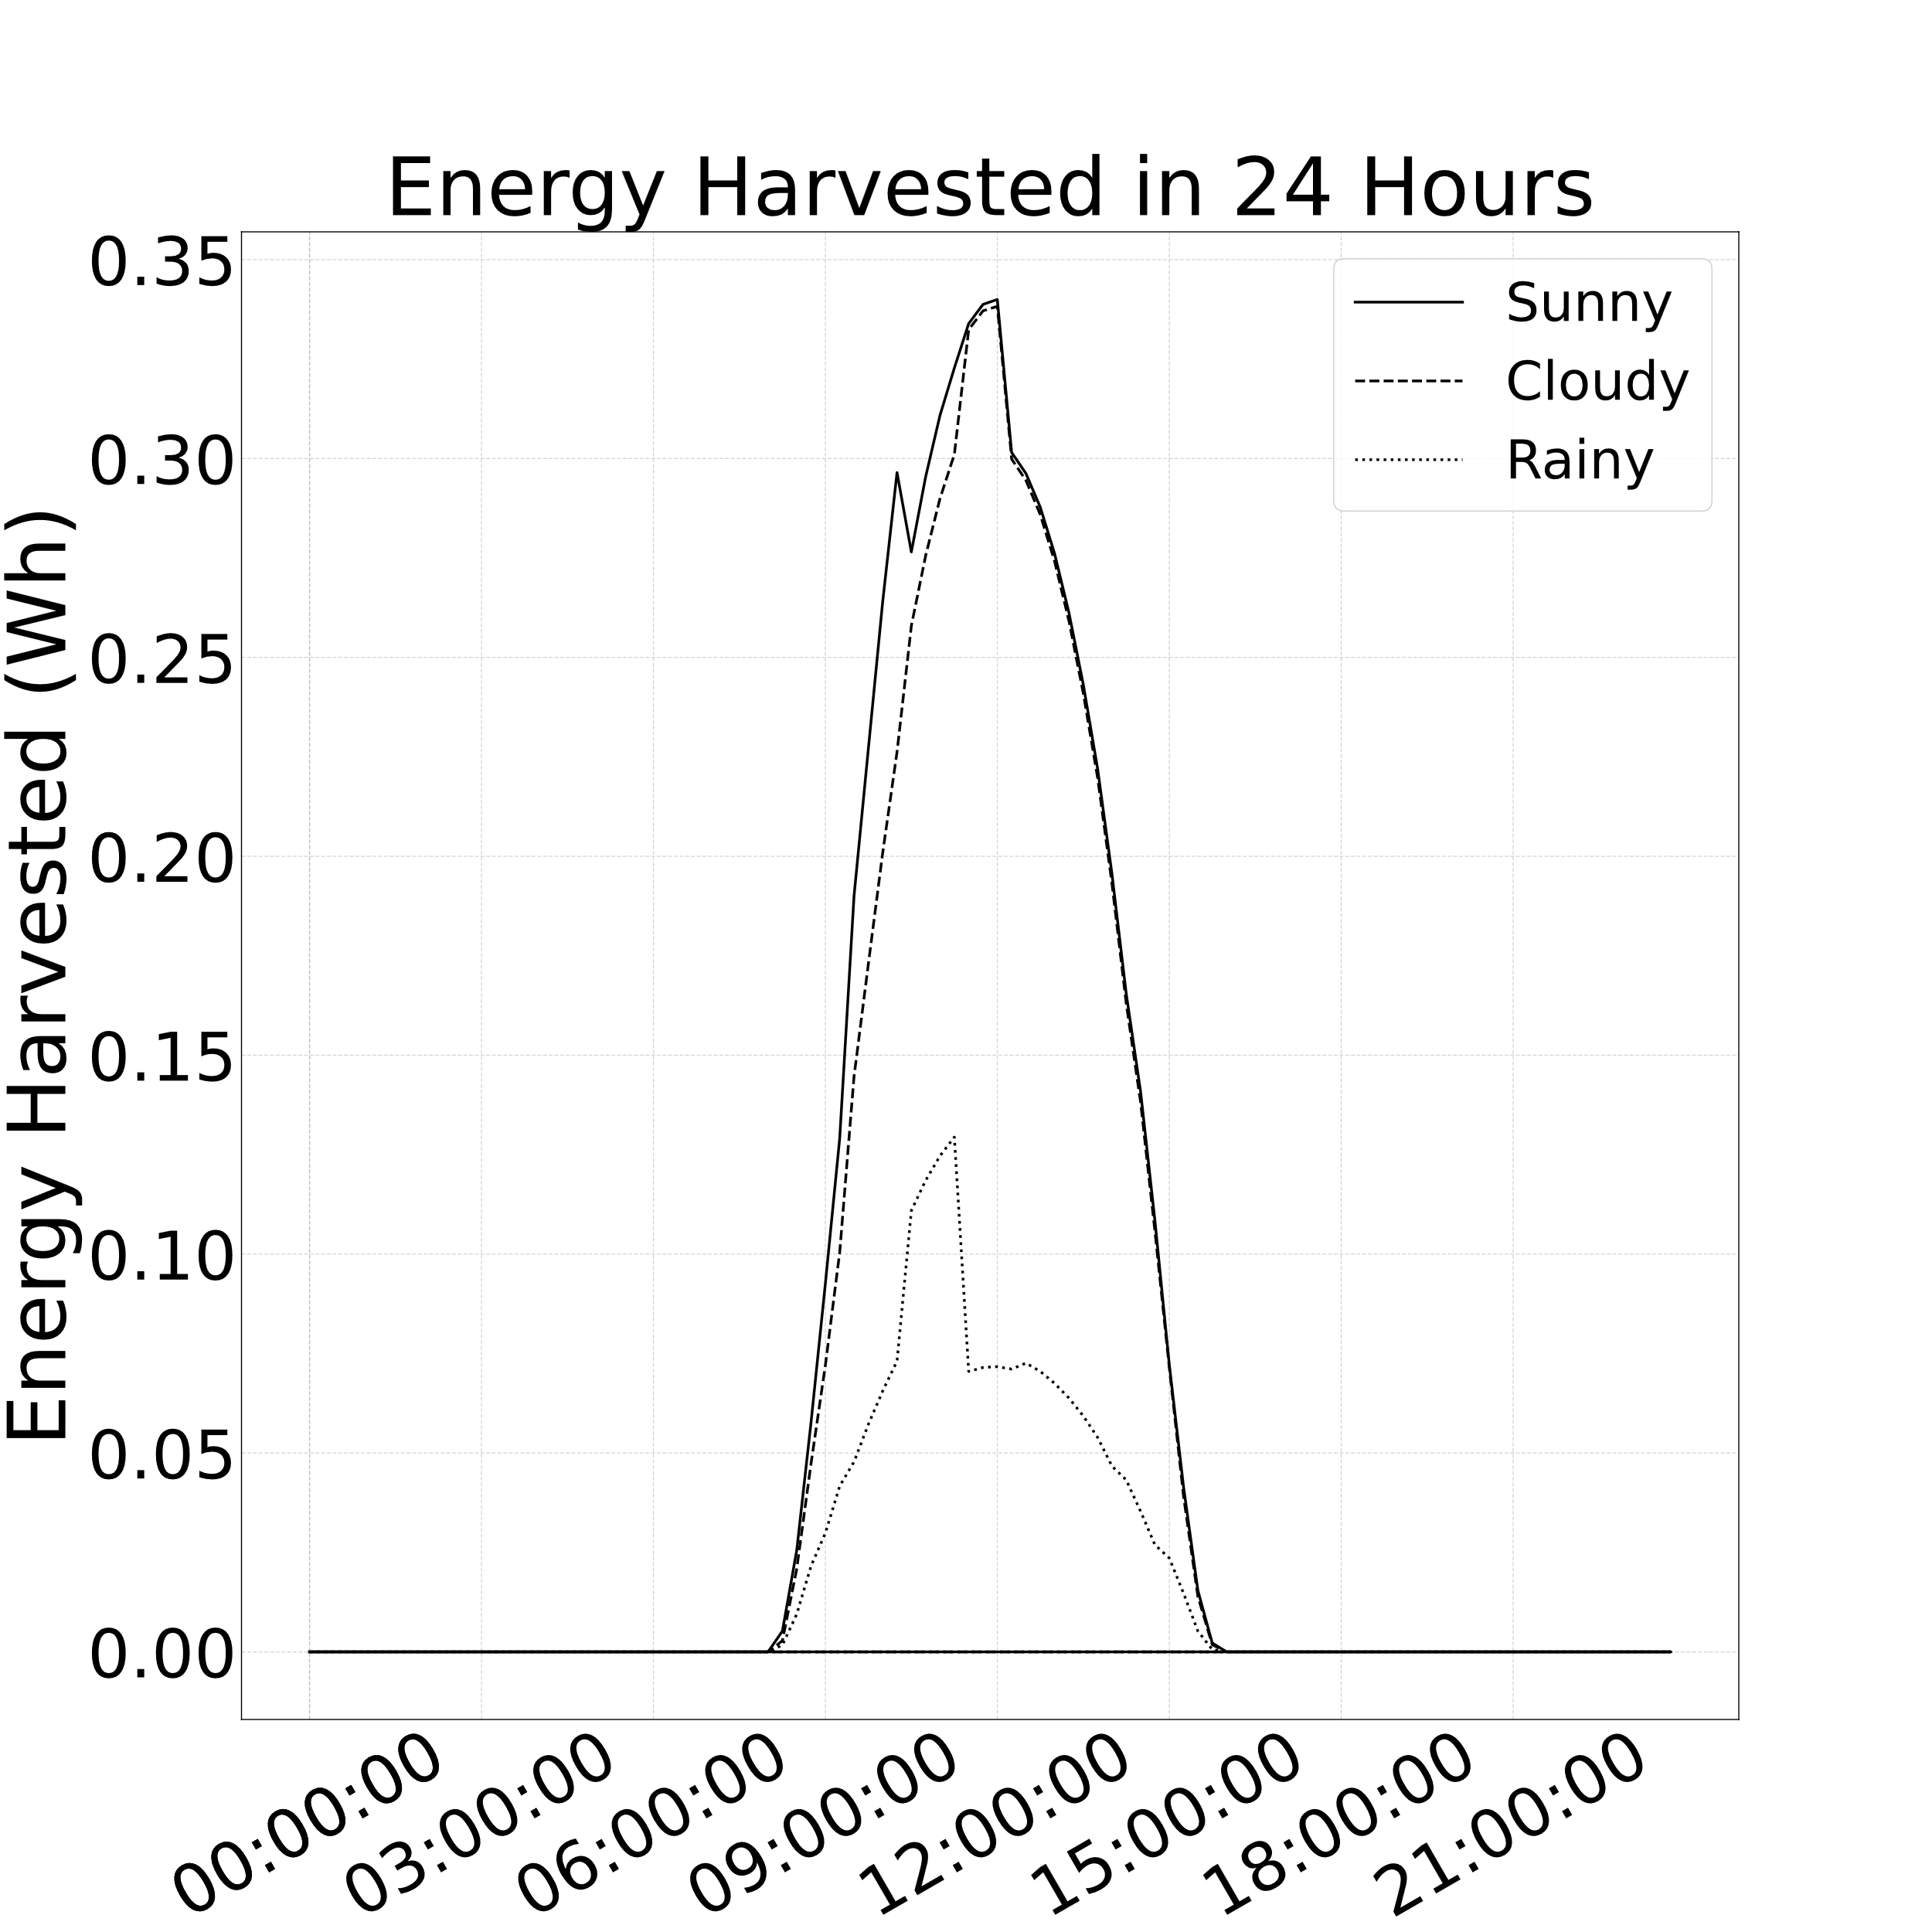
3. Solar Energy (cnt.)
open-sauce-quarts-solar-forecast
Input:
Location
Weather
Panel Capacity

Slide 15
4. Battery Degradation
Notes:
This is the architecture of each individual SNN model. The number of neurons in each layer is arbitrary. Weights are assigned to each connection between the layers, and the weights between input layer and excitatory layer are learning parameters. First, input spikes gets multiplied by weights and proceeds to excitatory layer. Then, if any of the neurons in excitatory layer emits a spike because of input, that neuron sends inhibitory signal to other neurons through inhibitory layer. This is to prevent several neurons from outputting similar spike patterns, making the learning more diverged.

Slide 16
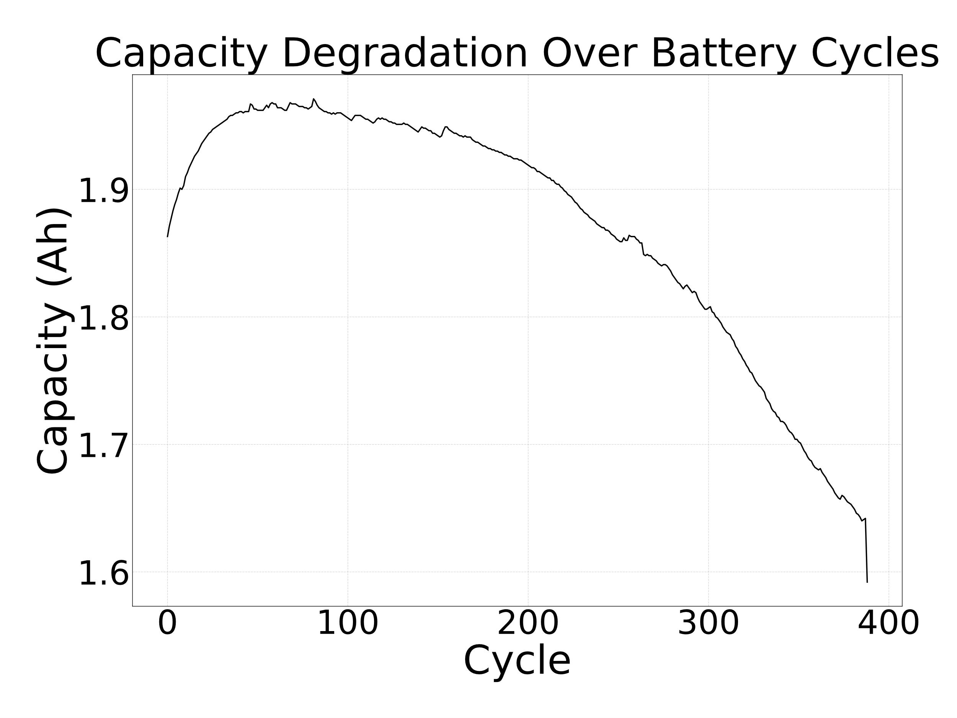
4. Battery Degradation (cnt.)
4.1 Obtain capacity data
One battery cycle:
Charging to 100%
Discharging to 0%
*In reality, battery does
not follow perfect battery cycle

Slide 17

4. Battery Degradation (cnt.)
4.2 Take summation at each cycle
Capacity Degradation: [1.0, 0.9, 0.8, 0.7…]
Total extracted energy at each cycle: [1.0, 1.9, 2.7, 3.4…]
4.3 Obtain current battery cycle N from total energy system used

Slide 18
4. Battery Degradation (cnt.)
4.4 Capacity Degradation[N]: Degraded Capacity.
4.5 Set upper bound to the solar energy harvested.
(Solar Energy Harvested) <= (Degraded Capacity)

Slide 19
Content
Research Introduction
Overall system/architecture
Research progress
Done
Doing
Todo
Schedule
Notes:
Before jumping to a new section, add a new slide:
Hide the other sections
Highlight the current section

Slide 20
Research Progress | Done
Framework to provide energy requirement in (%)
Evaluation for energy consumption
Solar energy under different weathers
Battery degradation under different weathers
Notes:
Here is what I have done so far. Training two models separately on different datasets, and simply concatenating neurons from two models. This is considered inefficient but primitive way of merging. In this step, it was important to confirm merging gives the better classifying accuracy due to the more diverged neurons in the final model. And manually compressing models and merge. This step was also important to make sure the merging is beneficial with good way of compressing.

Slide 21
Research Progress | Doing
Drafting the framework evaluation section
Notes:
Explain what you are doing now
_ Talk about what is the challenge
_ Suggest about the solution
Neurons is represented by a weight metrics assigned to it. However, comparing two metrices and accumulate distance between them is computationally expensive. The complexity can be reduced by down sampling metrices before comparing. However, the distance between two metrices does not necessarily represent the similarity between two neurons. To solve these problems, I will examine several ways of comparing.

Slide 22
Research Progress | Todo
Finish the framework evaluation section
Draw overall architecture for patent
Notes:
Explain what you are doing now
_ Talk about what is the challenge
_ Suggest about the solution
Here are what I need to do. Implement a viable algorithm for merging two models. To do this, I need to define measurement between two neurons. That is ultimately defining a difference between to metrices.
Once merging works with small models, I will experiment with bigger models. Here I will know the complexity of my method, and in case it’s too slow, I will need to explore another way.

Slide 23
Content
Research Introduction
Overall system/architecture
Research progress
Done
Doing
Todo
Schedule
Notes:
Before jumping to a new section, add a new slide:
Hide the other sections
Highlight the current section

Slide 24
Schedule
 | 0-6 months | 6-12 months | 12-18 months | 18-24 months
Energy Estimation
Finish Net Zero EnsembleSTDP
Implement Demo
Thesis Writing

Slide 25
Thank you for your attention!
Notes:
Always end with a thank you slide
_ Ask if there is any question

