Slide 1
Carbon-Neutral Ensemble Spike-Timing-Dependent Plasticity Learning
Yuga Hanyu
m5291018
24 June 2025
Notes:
Keep this slide clean
Do not add line number here

Slide 2
Content
Research Introduction
System architecture
Research progress
Done
Doing
Todo
Schedule
Notes:
The content should be bief

Slide 3
Content
Research Introduction
System architecture
Research progress
Done
Doing
Todo
Schedule
Notes:
Before jumping to a new section, add a new slide:
Hide the other sections
Highlight the current section

Slide 4
Research introduction
Growing usage of AI in our society
Running AI comes with carbon emissions
Energy efficient AI system is necessary
Achieving carbon neutrality by Spiking Neural Networks & on-chip low power technique is a solution
Notes:
I would like to introduce about my research. My research is about training multiple SNN models then merge them into one model. This way of training offers several benefits such as faster training process and collaborative learning. For example, if we decompose dataset and model into 10 datasets and 10 models, the training process becomes 10 times faster excluding the merging process after that. Also, since we will be working on separate dataset, we can do collaborative learning such as train small models in different places, then merge them to create one model that can perform in every place. My main goal is to propose a model merging method that is both computationally efficient and able to produce high accuracy

Slide 5
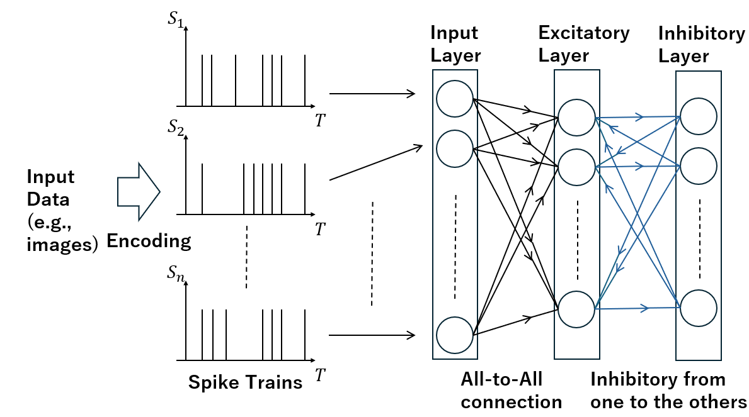
Spiking Neural Network
Spiking Neural Networks (SNNs) use spikes to communicate information
Compared to traditional ANNs, SNNs are energy efficient
Fig. 1 Structure of an SNN

Slide 6
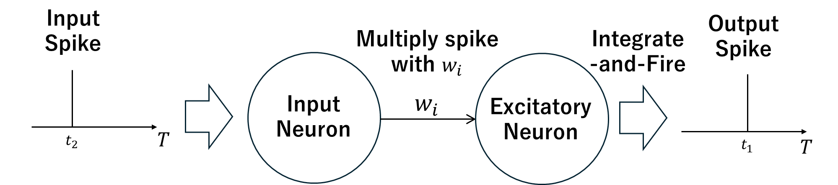
Spike Timing Dependent Plasticity
STDP is a learning method based on spike timings
lightweight computation
great energy efficiency
suitable for on-chip learning
Timings of two spikes
Fig. 2 Input and output spikes

Slide 7
Content
Research Introduction
System Architecture
Research progress
Done
Doing
Todo
Schedule
Notes:
Before jumping to a new section, add a new slide:
Hide the other sections
Highlight the current section

Slide 8
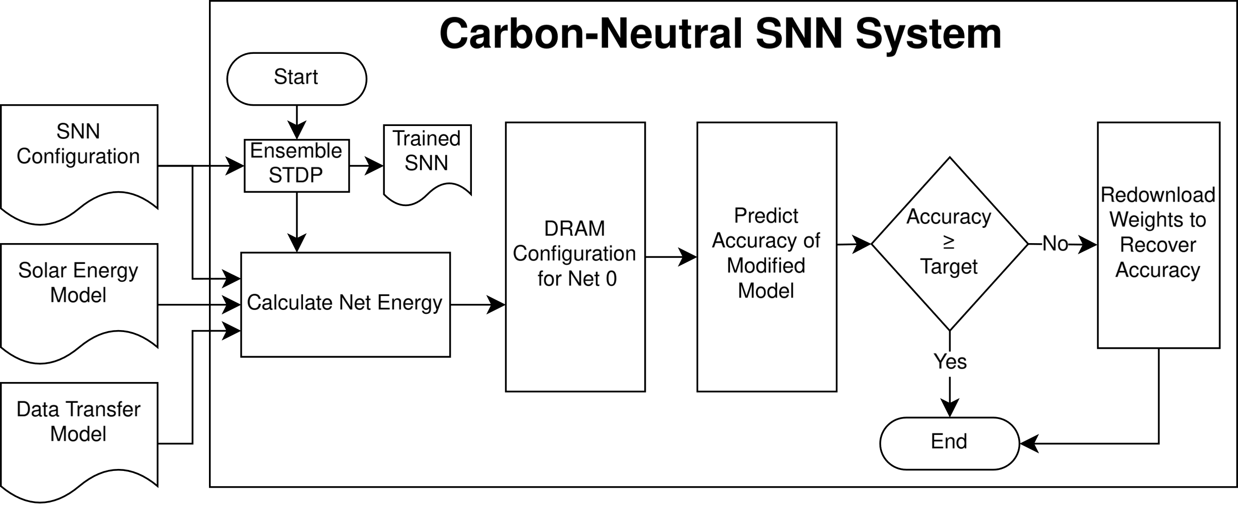
Overall Architecture
Fig. 3 Carbon-Neutral SNN System
Notes:
This is the architecture of each individual SNN model. The number of neurons in each layer is arbitrary. Weights are assigned to each connection between the layers, and the weights between input layer and excitatory layer are learning parameters. First, input spikes gets multiplied by weights and proceeds to excitatory layer. Then, if any of the neurons in excitatory layer emits a spike because of input, that neuron sends inhibitory signal to other neurons through inhibitory layer. This is to prevent several neurons from outputting similar spike patterns, making the learning more diverged.

Slide 9
EnsembleSTDP
Fig. 3 Carbon-Neutral SNN System
Notes:
This is the architecture of each individual SNN model. The number of neurons in each layer is arbitrary. Weights are assigned to each connection between the layers, and the weights between input layer and excitatory layer are learning parameters. First, input spikes gets multiplied by weights and proceeds to excitatory layer. Then, if any of the neurons in excitatory layer emits a spike because of input, that neuron sends inhibitory signal to other neurons through inhibitory layer. This is to prevent several neurons from outputting similar spike patterns, making the learning more diverged.

Slide 10
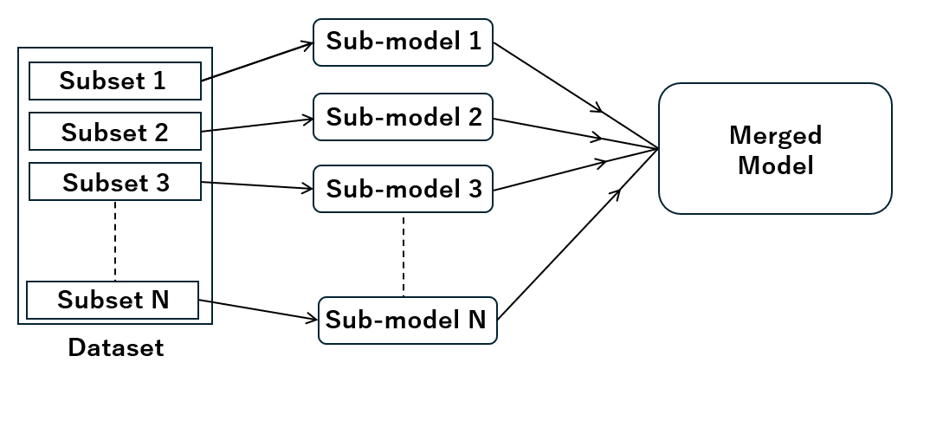
EnsembleSTDP (Cnt.)
Split a dataset, train sub-models, and merge into one model
Fig. 4 Overview of EnsembleSTDP

Slide 11
EnsembleSTDP (Cnt.)
EnsembleSTDP is energy efficient training for local SNNs
Reduced learning complexity for a single SNN
Transferring weights consumes less energy than training data

Slide 12
Calculation of Net Energy
Fig. 3 Carbon-Neutral SNN System
Notes:
This is the architecture of each individual SNN model. The number of neurons in each layer is arbitrary. Weights are assigned to each connection between the layers, and the weights between input layer and excitatory layer are learning parameters. First, input spikes gets multiplied by weights and proceeds to excitatory layer. Then, if any of the neurons in excitatory layer emits a spike because of input, that neuron sends inhibitory signal to other neurons through inhibitory layer. This is to prevent several neurons from outputting similar spike patterns, making the learning more diverged.

Slide 13
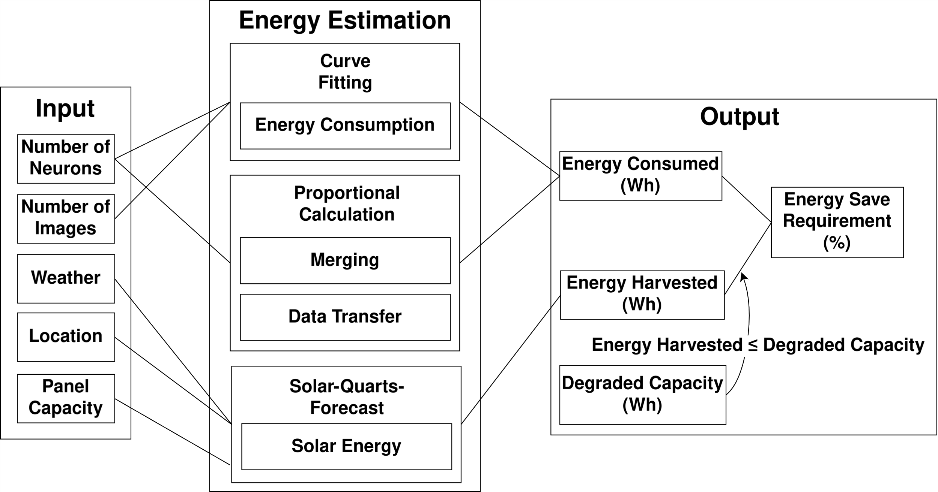
Calculation of Net Energy (Cnt.)

Slide 14
Calculation of Net Energy (Cnt.)
300 neurons, Raspberry Pi5, Panel Capacity: 1Wp, Battery: 5Wh

Slide 15
DRAM Configuration
Fig. 3 Carbon-Neutral SNN System
Notes:
This is the architecture of each individual SNN model. The number of neurons in each layer is arbitrary. Weights are assigned to each connection between the layers, and the weights between input layer and excitatory layer are learning parameters. First, input spikes gets multiplied by weights and proceeds to excitatory layer. Then, if any of the neurons in excitatory layer emits a spike because of input, that neuron sends inhibitory signal to other neurons through inhibitory layer. This is to prevent several neurons from outputting similar spike patterns, making the learning more diverged.

Slide 16
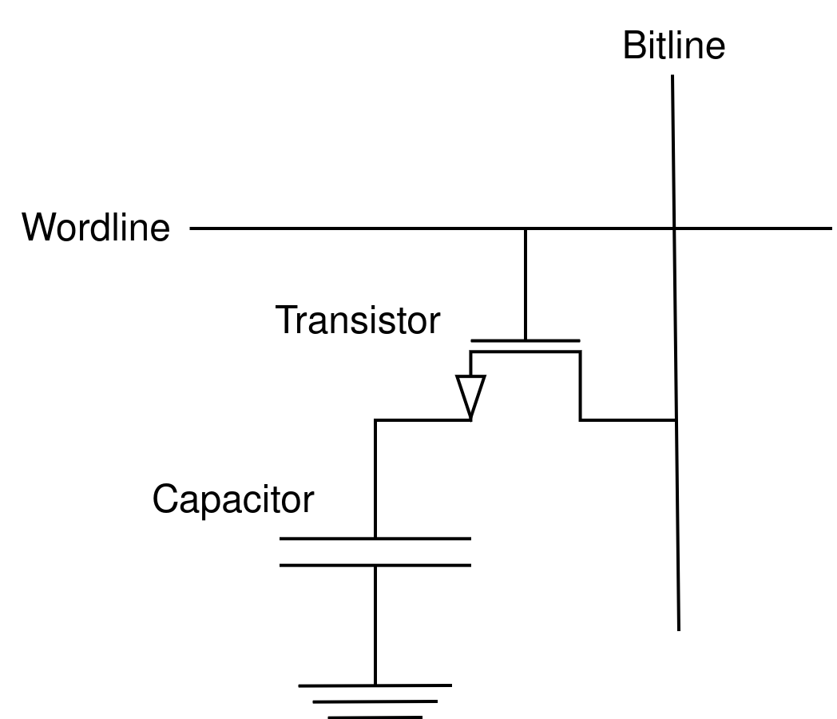
DRAM Configuration
DRAM stores weights of SNN
Each DRAM cell has
capacitor & transistor
Stored value corresponds to the
charged voltage of capacitor

Slide 17
DRAM Configuration (Cnt.)
Energy consumption is reduced by
undervolting the DRAM
Undervolting induces bit error:
value flips from 1 -> 0

Slide 18
Accuracy Prediction
Fig. 3 Carbon-Neutral SNN System
Notes:
This is the architecture of each individual SNN model. The number of neurons in each layer is arbitrary. Weights are assigned to each connection between the layers, and the weights between input layer and excitatory layer are learning parameters. First, input spikes gets multiplied by weights and proceeds to excitatory layer. Then, if any of the neurons in excitatory layer emits a spike because of input, that neuron sends inhibitory signal to other neurons through inhibitory layer. This is to prevent several neurons from outputting similar spike patterns, making the learning more diverged.

Slide 19

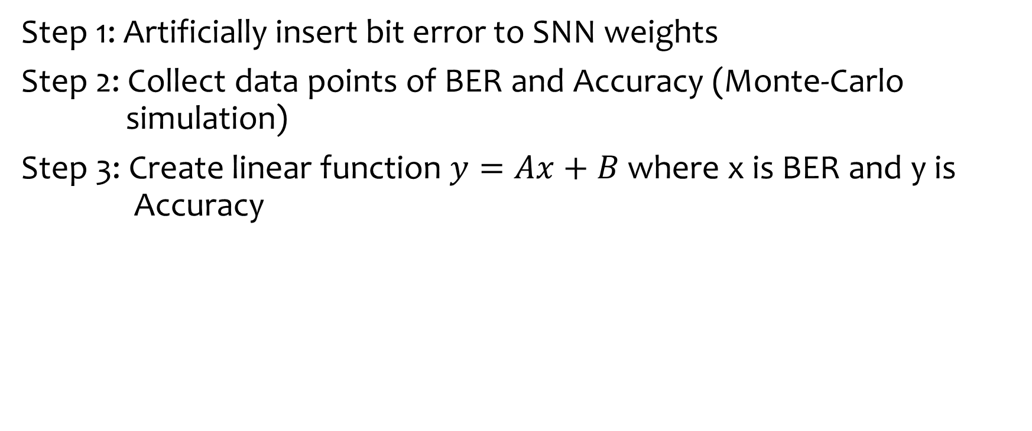
Accuracy Prediction (Cnt.)
Step 1: Artificially insert bit error to SNN weights
Step 2: Collect data points of BER and Accuracy (Monte-Carlo simulation)
Step 3: Create linear function $y=Ax+B$ where x is BER and y is Accuracy
BER | Accuracy
0.01 | 90%
0.05 | 85%
0.1 | 80%
0.2 | 70%
$$y=Ax+B$$
Predict accuracy from BER
Least square method

Slide 20
Redownloading weights
Fig. 3 Carbon-Neutral SNN System
Notes:
This is the architecture of each individual SNN model. The number of neurons in each layer is arbitrary. Weights are assigned to each connection between the layers, and the weights between input layer and excitatory layer are learning parameters. First, input spikes gets multiplied by weights and proceeds to excitatory layer. Then, if any of the neurons in excitatory layer emits a spike because of input, that neuron sends inhibitory signal to other neurons through inhibitory layer. This is to prevent several neurons from outputting similar spike patterns, making the learning more diverged.

Slide 21
Redownloading weights
Predicted accuracy < minimum accuracy requirement, download fresh trained weight
Redownloading also occurs periodically overtime
Accuracy
Minimum Accuracy
Redownload
Redownload
Time

Slide 22
Content
Research Introduction
Overall system/architecture
Research progress
Done
Doing
Todo
Schedule
Notes:
Before jumping to a new section, add a new slide:
Hide the other sections
Highlight the current section

Slide 23
Research Progress | Done
Evaluation of energy estimation
Table of hypothetical conditions
Weather: Sunny, Cloudy, Rainy
Battery: Fresh, Mid, Wear-out
Table of V | F | Power | BER | Accura
(Power is temporal approximation)
Notes:
Here is what I have done so far. Training two models separately on different datasets, and simply concatenating neurons from two models. This is considered inefficient but primitive way of merging. In this step, it was important to confirm merging gives the better classifying accuracy due to the more diverged neurons in the final model. And manually compressing models and merge. This step was also important to make sure the merging is beneficial with good way of compressing.

Slide 24
Research Progress | Todo
Write V and F finding mechanism (Based on SysOpt)
Collect data for error recovery
Write error recovery section
Collect data for dynamic pruning
Notes:
Explain what you are doing now
_ Talk about what is the challenge
_ Suggest about the solution
Here are what I need to do. Implement a viable algorithm for merging two models. To do this, I need to define measurement between two neurons. That is ultimately defining a difference between to metrices.
Once merging works with small models, I will experiment with bigger models. Here I will know the complexity of my method, and in case it’s too slow, I will need to explore another way.

Slide 25
Content
Research Introduction
Overall system/architecture
Research progress
Done
Doing
Todo
Schedule
Notes:
Before jumping to a new section, add a new slide:
Hide the other sections
Highlight the current section

Slide 26
Schedule
 | June 24-30 | July 1-4 | July 5-11
Write about V, F finding framework
Error recovery data and writing
Collect Data of Dynamic Pruning and writing

Slide 27
Thank you for your attention!
Notes:
Always end with a thank you slide
_ Ask if there is any question

