Slide 1
Thermal-Based Human Recognition via Spiking Neural Networks for Low-power Embedded Systems
m5291066@u-aizu.ac.jp
Rui Shiota

Slide 2
Content
Introduction
- Human Detection
- Temperature Detection
- Definition of LIF Neruon
- Why SNNs
Algorithm
Research Progress
- Done
- Doing
- Todo
Reference
6/3/2025
The University of Aizu
2

Slide 3
Human Detection
Inference of human intent
perception ability
Hand motion planning and control[1]
Problem : difficulty in decoding information and a low recognition rate of identifying action intention[2]
6/3/2025
The University of Aizu
3

Slide 4
Temperature Detection
perceive the infrared radiation emitted by humans[3]
can accurately identify and track human presence even in dark rooms[4]
Users can sense and distinguish temperature of objects[5]
6/3/2025
The University of Aizu
4

Slide 5
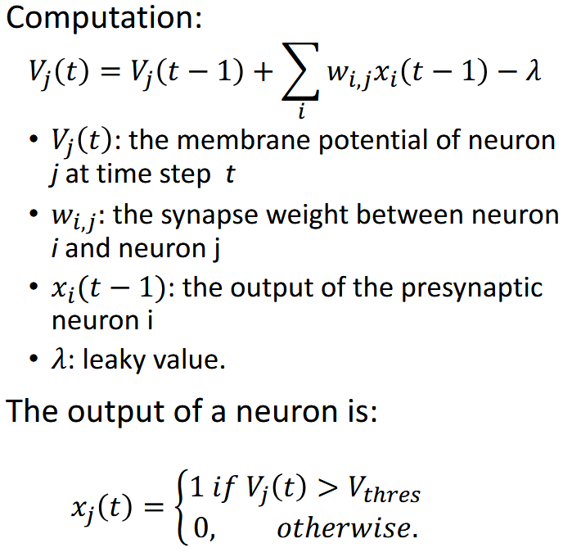
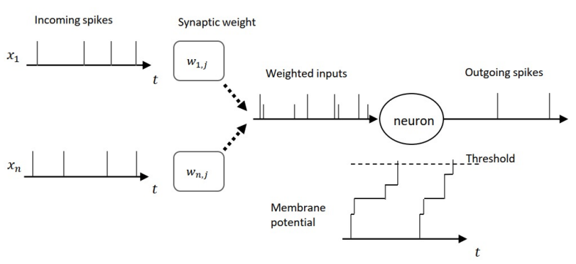
Definition of LIF Neuron
Leaky Integrate-and-Fire (LIF) neuron [6]
6/3/2025
The University of Aizu
5

Slide 6
Why SNNs
SNNs Can become from 100 to 1,000 times more energy-efficient
Possible to put much more AI into chips[7]
6/3/2025
The University of Aizu
6

Slide 7
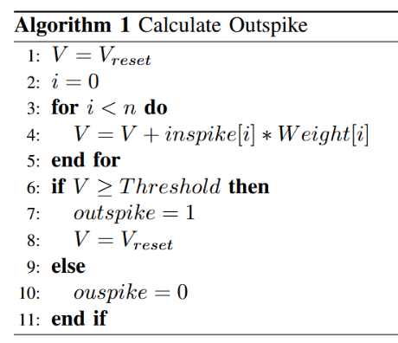

Algorithm
: membrane potential
= 0
: index of inspike and Weight
: number of bit of inspike
6/3/2025
The University of Aizu
7

Slide 8
Research Progress (Done)
Implementation of LIF neural network
Demonstration with Raspberry Pi Pico
6/3/2025
The University of Aizu
8

Slide 9
Research Progress (Doing)
Writing code to measure temperature with thermal camera
Introduction of leaky value
6/3/2025
The University of Aizu
9

Slide 10
Research Progress (Todo)
Data Collection
Data Visualization
Model Training
System Integration
Testing and Evaluation
6/3/2025
The University of Aizu
10

Slide 11
Schedule
 | M1 |  |  |  | M2
 | 4 ~ 6 | 7 ~ 9 | 10 ~ 12 | 1 ~ 3 | 4 ~ 6 | 7 ~ 9 | 10 ~ 12 | 1 ~ 3
Data Collection
Data Visualization
Model Training
System Integration
Testing and Evaluation
Writing Thesis
6/3/2025
The University of Aizu
11

Slide 12
Reference
[1] Mo Han, Sezen Yagmur Günay, Gunar Schirner, Taskın Padır, Deniz Erdogmus, “HANDS: a multimodal dataset for modeling toward human grasp intent inference in prosthetic hands“, arXiv, 8 March 2021
[2] Jian-Wei Cui, Han Du, Bing-Yan Yan, Xuan-Jie Wang, “Research on Upper Limb Action Intention Recognition Method Based on Fusion of Posture Information and Visual Information“, electronics, November 2022
[3] Jian-Wei Cui, Han Du, Bing-Yan Yan, Xuan-Jie Wang, “Exploring Human Detection through Thermal Sensors“, https://econtroldevices.com/safeguarding-with-simplicity-exploring-human-detection-through-thermal-sensors/?srsltid=AfmBOooTibd5ueJwrIBVqVA9BGsrmxH6J5B6aPLn4sleBNCltCxNFP0Z, 11 October 2023
[4] Anna A. Trofimova, Andrea Masciadri, Fabio Veronese, Fabio Salice, “Indoor Human Detection Based on Thermal Array Sensor Data and Adaptive Background Estimation“, Scientific Research Publishing, March 2017
[5] Anna A. Trofimova, Andrea Masciadri, Fabio Veronese, Fabio Salice, “Temperature-sensitive bionic hand improves dexterity and feelings of human connection“, https://www.elsevier.com/connect/temperature-sensitive-bionic-hand-improves-dexterity-and-feelings-of-human-connection, 15 February 2024
[6] “Robust Cognitive Brain-inspired Computing System: Architectures and Algorithms“, https://u-aizu.ac.jp/∼khanh/share/pubs/ETLTC-2022.pdf
[7]Bennie Mols, “Making AI more energy efficient with neuromorphic computing“, CWI, March 2024
6/3/2025
The University of Aizu
12

Slide 13
Thank you for your attention!
6/3/2025
The University of Aizu
13

