Slide 1
IF neural network on Raspberry Pi Pico
m5291066@u-aizu.ac.jp
Rui Shiota

Slide 2
Content
Introduction
Architecture
Algorithm
Result
Research Progress
  Done
  Doing
  Todo
Schedule

Slide 3
Introduction
Spiking Neural Networks (SNNs)
  Brain-inspired model
  Mimic biological neurons
  Communicate and compute using spikes [1]
Intagrate-and-Fire (IF) neuron [2]
  : membrane potential of neuron j at time step t
  : synapse weight between neuron i and j
  : outspike of the presynaptic neuron
  : threshold value

Slide 4
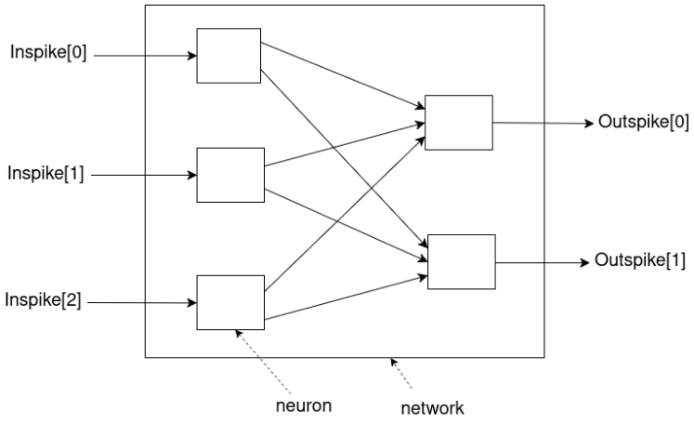
Architecture (1)
Overall Architecture of LIF Neural Network

Slide 5
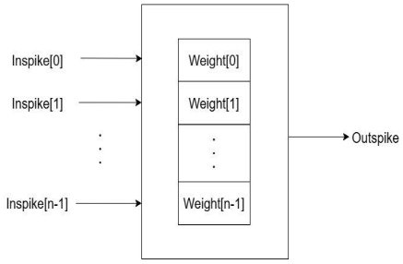
Architecture (2)
Neuron Architecture
Memory per one neuron
The number of weight = The number of Inspike

Slide 6
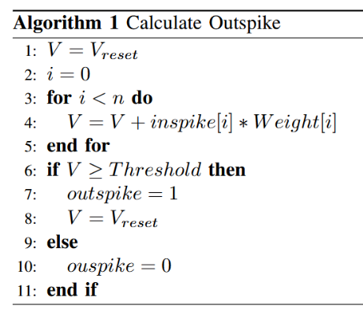
Algorithm
: membrane potential
: index of inspike and Weight
: number of bit of inspike

Slide 7
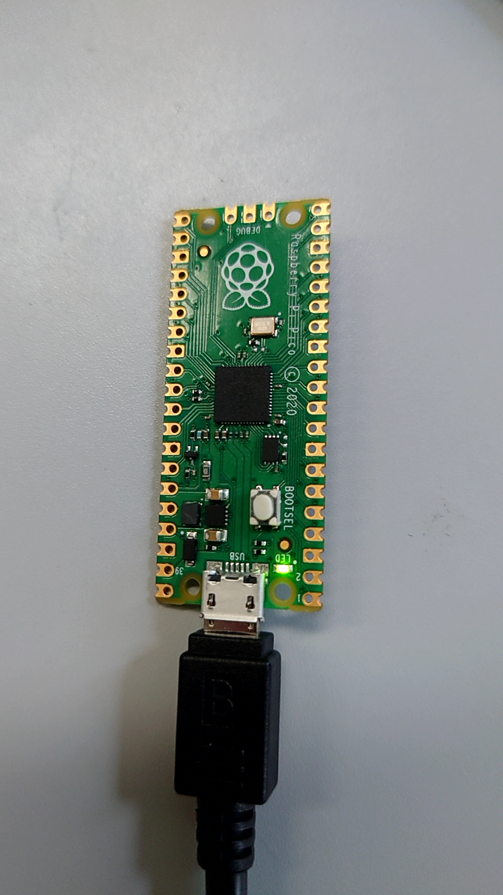
Result
Outspike[0] | 1 | 1 | 0 | 0
Outspike[1] | 1 | 0 | 1 | 0
LED | Always Shine | Shine Every 100ms | Shine Every 250ms | No Activity

Slide 8
Research Progress (Done)
Implementation of SNN (C Language)
Demonstration with Raspberry Pi Pico

Slide 9
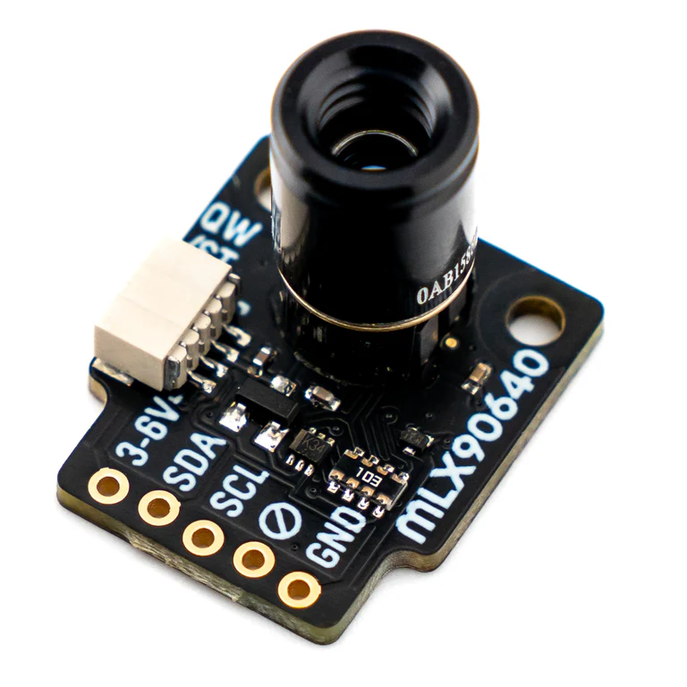
Research Progress (Doing)
Investigation of thermal camera

Slide 10
Research Progress (Todo)
Collection of data with thermal camera
Training on GPU (snnTorch and BindsNET)
Implementation on Raspberry Pi Pico

Slide 11
Schedule
Task | Deadline
Investigation of thermal camera | April 16
Collection of data
Training
Implementation

Slide 12
Reference
[1] Prithwineel Paul, Petr Sosik, Lucie Ciencialova, “A survey on learning models of spiking neural membrane systems and spiking neural net works“, arXiv, March 2024.
[2] “Robust Cognitive Brain-inspired Computing System: Architectures and Algorithms“, https://u-aizu.ac.jp/∼khanh/share/pubs/ETLTC-2022.pdf.

Slide 13
Thank you for your attention!

