Slide 1
Thermal-Based Human Recognition via Spiking Neural Networks for Low-power Embedded Systems
m5291066@u-aizu.ac.jp
Rui Shiota

Slide 2
Content
Introduction
  Overview of SNNs
  Definition of IF neuron
Architecture
Algorithm
Limitation of Raspberry Pi Pico
Future Tasks
Research Progress
  Done
  Doing
  Todo
Schedule
Reference

Slide 3
Overview of SNNs
Spiking Neural Networks (SNNs)
  Brain-inspired model
  Mimic biological neurons
  Communicate and compute using spikes [1]

Slide 4
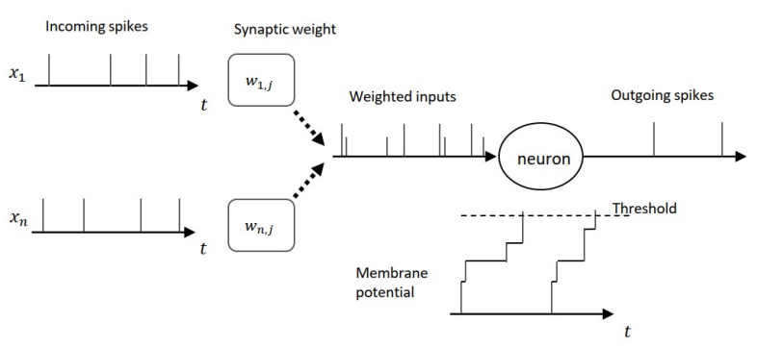
Definition of IF neuron
Intagrate-and-Fire (IF) neuron [2]
: membrane potential of neuron j at time step t
: synapse weight between neuron i and j
: outspike of the presynaptic neuron
: threshold value

Slide 5
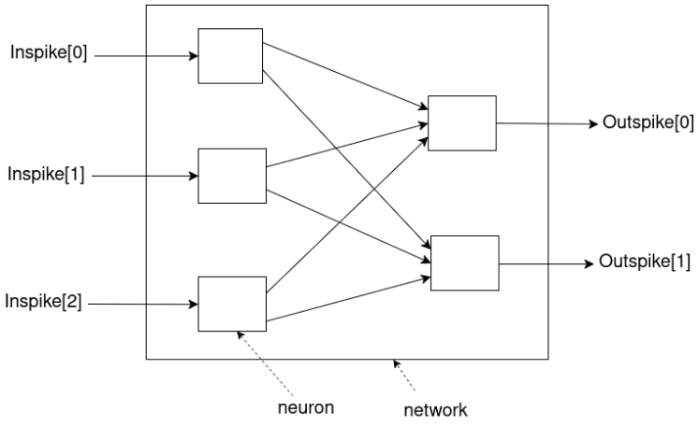
Architecture (1)
Overall Architecture of IF Neural Network

Slide 6
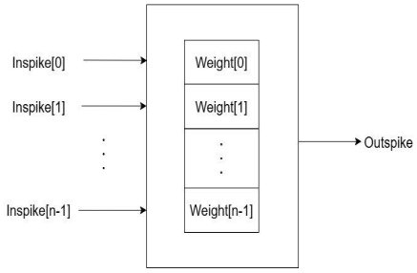
Architecture (2)
Neuron Architecture
Memory per one neuron
The number of weight = The number of Inspike

Slide 7
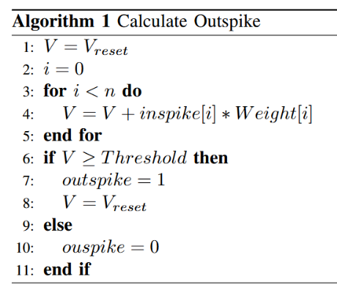
Algorithm
: membrane potential
: index of inspike and Weight
: number of bit of inspike

Slide 8
Limitation of Raspberry Pi Pico
The Number of Layers | Range
1 | 4978
2 | (1 : 1) ~
3 | (1 : 1 : 1) ~
4 | (1 : 1 : 1 : 1) ~
(1 : 4977),
(4190 : 1)
(1 : 1 : 4976),
(1 : 4189 : 1),
(4190 : 1 : 1)
(1 : 1 : 1 : 4975),
(1 : 1 : 4188 : 1),
(1 : 4189 : 1 : 1),
(4189 : 1 : 1 : 1)

Slide 9
Future Tasks
Collection of Temperature Data
Plot
Training
Implementation
Test

Slide 10
Research Progress (Done)
Implementation of IF neural network (C Language)
Demonstration with Raspberry Pi Pico
Investigation of limitation of Raspberry Pi Pico

Slide 11
Research Progress (Doing)
Writing Research Instruction Plan
Writing a code to measure temperature with the thermal camera (pimoroni MLX90640)

Slide 12
Research Progress (Todo)
Collection of data with thermal camera
Training on GPU (snnTorch and BindsNET)
Implementation on Raspberry Pi Pico
Test

Slide 13
Schedule
Task | Deadline
Data Collection | Mid June
Research Instruction Plan | June 6
Plot
Training
Implementation
Test

Slide 14
Reference
[1] Prithwineel Paul, Petr Sosik, Lucie Ciencialova, “A survey on learning models of spiking neural membrane systems and spiking neural net works“, arXiv, March 2024
[2] “Robust Cognitive Brain-inspired Computing System: Architectures and Algorithms“, https://u-aizu.ac.jp/∼khanh/share/pubs/ETLTC-2022.pdf.

Slide 15
Thank you for your attention!

