Slide 1
Thermal-Based Human Recognition via Spiking Neural Networks for Low-power Embedded Systems
m5291066@u-aizu.ac.jp
Rui Shiota

Slide 2
Content
Introduction
- Human Detection
- Temperature Detection
Measurement System
Temperature Measurement
Research Progress
- Done
- Doing
- Todo
Reference
7/7/2025
The University of Aizu
2

Slide 3
Human Detection
Inference of human intent
perception ability
Hand motion planning and control[1]
Problem : difficulty in decoding information and a low recognition rate of identifying action intention[2]
7/7/2025
The University of Aizu
3

Slide 4
Temperature Detection
perceive the infrared radiation emitted by humans[3]
can accurately identify and track human presence even in dark rooms[4]
Users can sense and distinguish temperature of objects[5]
7/7/2025
The University of Aizu
4

Slide 5
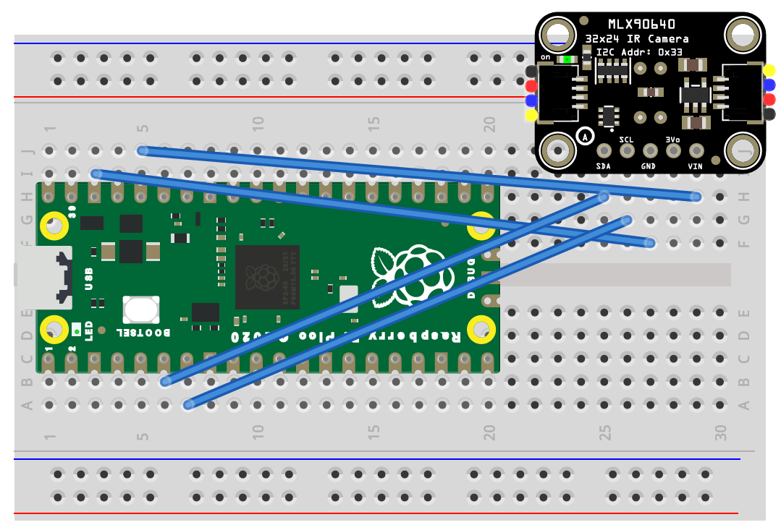
Measurement System
SDA → GPIO4
SCL → GPIO5
GND → GND
3-6V → 3V3

Slide 6
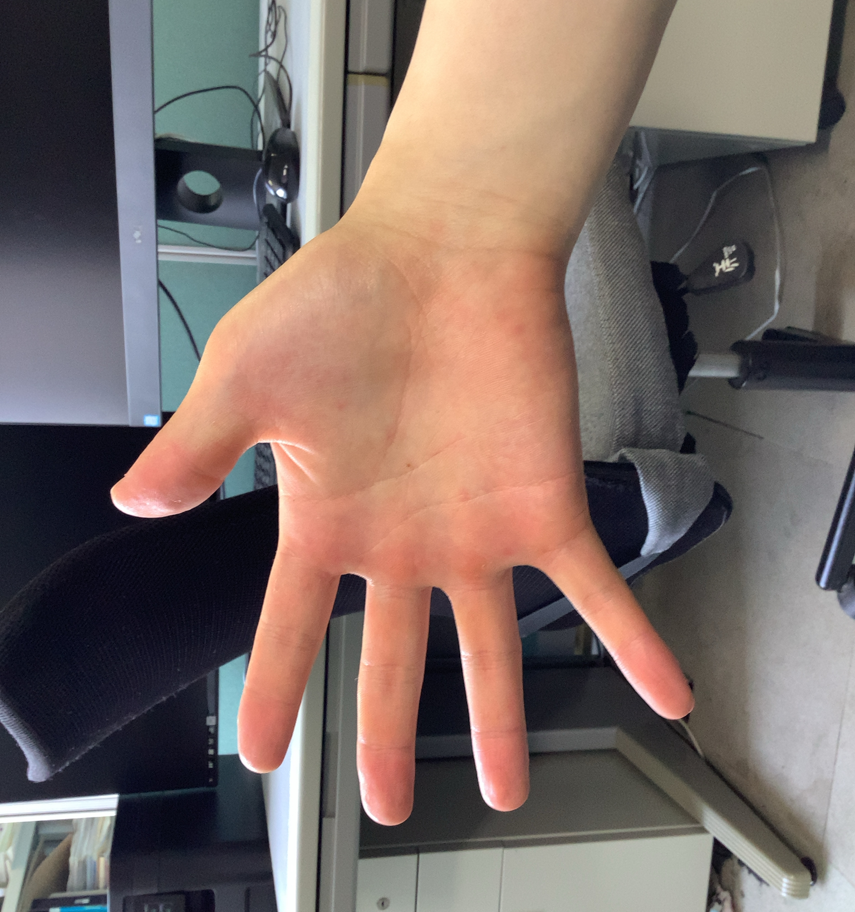
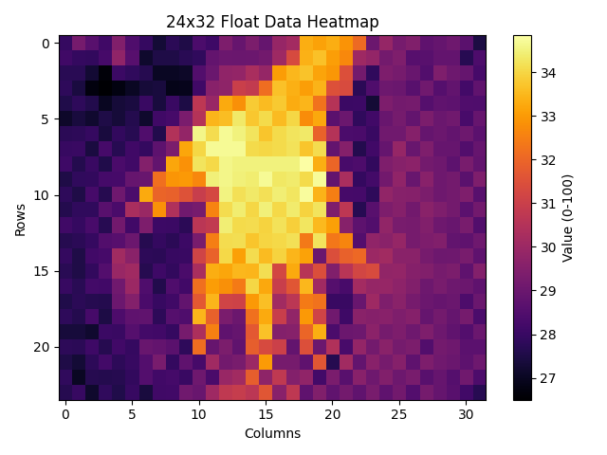
Temperature Measurement
27.95 29.25 ・・・
28.15 ・
・ ・
・ ・
・
Measure Temperature
Plot
(Matplotlib)
Log in Terminal

Slide 7
Research Progress (Done)
Implementation of Measurement System
7/7/2025
The University of Aizu
7

Slide 8
Research Progress (Doing)
Data Collection
Data Visualization
7/7/2025
The University of Aizu
8

Slide 9
Research Progress (Todo)
Model Training
System Integration
Testing and Evaluation
7/7/2025
The University of Aizu
9

Slide 10
Schedule
 | M1 |  |  |  | M2
 | 4 ~ 6 | 7 ~ 9 | 10 ~ 12 | 1 ~ 3 | 4 ~ 6 | 7 ~ 9 | 10 ~ 12 | 1 ~ 3
Data Collection
Data Visualization
Model Training
System Integration
Testing and Evaluation
Writing Thesis
7/7/2025
The University of Aizu
10

Slide 11
Reference
[1] Mo Han, Sezen Yagmur Günay, Gunar Schirner, Taskın Padır, Deniz Erdogmus, “HANDS: a multimodal dataset for modeling toward human grasp intent inference in prosthetic hands“, arXiv, 8 March 2021
[2] Jian-Wei Cui, Han Du, Bing-Yan Yan, Xuan-Jie Wang, “Research on Upper Limb Action Intention Recognition Method Based on Fusion of Posture Information and Visual Information“, electronics, November 2022
[3] Jian-Wei Cui, Han Du, Bing-Yan Yan, Xuan-Jie Wang, “Exploring Human Detection through Thermal Sensors“, https://econtroldevices.com/safeguarding-with-simplicity-exploring-human-detection-through-thermal-sensors/?srsltid=AfmBOooTibd5ueJwrIBVqVA9BGsrmxH6J5B6aPLn4sleBNCltCxNFP0Z, 11 October 2023
[4] Anna A. Trofimova, Andrea Masciadri, Fabio Veronese, Fabio Salice, “Indoor Human Detection Based on Thermal Array Sensor Data and Adaptive Background Estimation“, Scientific Research Publishing, March 2017
[5] Anna A. Trofimova, Andrea Masciadri, Fabio Veronese, Fabio Salice, “Temperature-sensitive bionic hand improves dexterity and feelings of human connection“, https://www.elsevier.com/connect/temperature-sensitive-bionic-hand-improves-dexterity-and-feelings-of-human-connection, 15 February 2024
7/7/2025
The University of Aizu
11

Slide 12
Thank you for your attention!
7/7/2025
The University of Aizu
12

