Slide 1
Implement STDP in 2 layers and update the weights
Komatsu Yamato
5/27
Notes:
Keep this slide clean
Do not add line number here

Slide 2
Content
Research Introduction
Overall system/architecture
Research progress
Done
Doing
Todo
Schedule
Notes:
The content should be bief

Slide 3
Content
Research Introduction
Overall system/architecture
Research progress
Done
Doing
Todo
Schedule
Notes:
Before jumping to a new section, add a new slide:
Hide the other sections
Highlight the current section

Slide 4
Research introduction
My Research Is About
Implementing Spike-Timing Dependent Plasticity (STDP) in a two-layer spiking neural network using Leaky Integrate-and-Fire (LIF) neurons.
Research Goal
To verify that STDP works properly across two layers and that weights change based on spike timing.

Slide 5
Content
Research Introduction
Overall system/architecture
Research progress
Done
Doing
Todo
Schedule
Notes:
Before jumping to a new section, add a new slide:
Hide the other sections
Highlight the current section

Slide 6
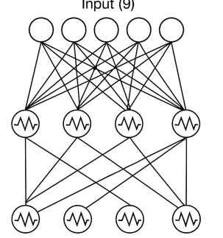
Overall system
Implement a 2-layer spiking neural network with STDP (Spike-Timing Dependent Plasticity).
Use LIF (Leaky Integrate-and-Fire) neuron models.
Architecture:
Layer 1: Input → Hidden
Layer 2: Hidden → Output
Each layer contains 9 neurons.

Slide 7
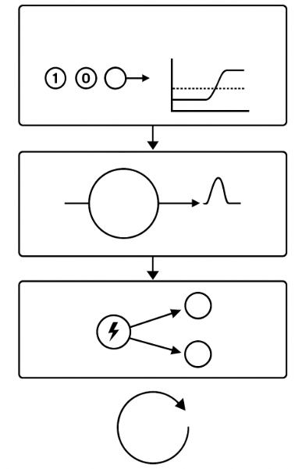
Time-Step Simulation Flow
1.Provide binary input at each time step.
2.LIF neurons accumulate potential and spike if threshold is exceeded.
3.Based on spike timing, update synaptic weights using STDP.
4.Repeat for next timestep.

Slide 8
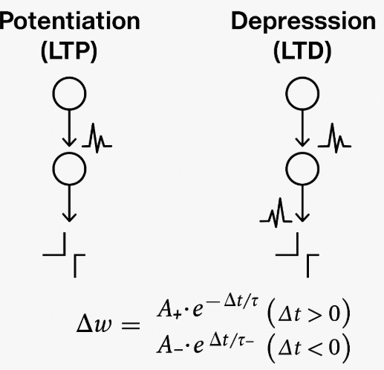
STDP Learning Rule
If pre-neuron fires before post-neuron → potentiation (LTP).
If post-neuron fires before pre-neuron → depression (LTD).
Time-based exponential update:

Slide 9
Content
Research Introduction
Overall system/architecture
Research progress
Done
Doing
Todo
Schedule
Notes:
Before jumping to a new section, add a new slide:
Hide the other sections
Highlight the current section

Slide 10
Research Progress | Completed
Implement STDP in 2 layers and update the weights
Notes:
Briefly talk about what you have done
If possible. Highlight it in the overall architecture/system figure

Slide 11
Research Progress | On-going
Log and save spike history
Notes:
Explain what you are doing now
_ Talk about what is the challenge
_ Suggest about the solution

Slide 12
Research Progress | Todo
Log and save spike history
Notes:
Explain what you are doing now
_ Talk about what is the challenge
_ Suggest about the solution

Slide 13
Content
Research Introduction
Overall system/architecture
Research progress
Done
Doing
Todo
Schedule
Notes:
Before jumping to a new section, add a new slide:
Hide the other sections
Highlight the current section

Slide 14
Schedule
Time | June 10 2025 | May 2025 | … | Jan 2026
Task 1
Task 1: Log and save spike history

Slide 15
Thank you for your attention!
Notes:
Always end with a thank you slide
_ Ask if there is any question

