Slide 1
An Attempt at Thermal Image Analysis Using Spiking Neural Networks
s1300053 Komatsu Yamato
5/27
Notes:
Keep this slide clean
Do not add line number here

Slide 2
Content
Research Introduction
Overall system/architecture
Research progress
Done
Doing
Todo
Schedule
Notes:
The content should be bief

Slide 3
Content
Research Introduction
Overall system/architecture
Research progress
Done
Doing
Todo
Schedule
Notes:
Before jumping to a new section, add a new slide:
Hide the other sections
Highlight the current section

Slide 4
Research introduction
My Research Is About
My Research is An Attempt at Thermal Image Analysis Using Spiking Neural Networks
I am currently reading a paper on a method to perform unsupervised training on the MNIST dataset using SNNs.

Slide 5
Content
Research Introduction
Overall system/architecture
Research progress
Done
Doing
Todo
Schedule
Notes:
Before jumping to a new section, add a new slide:
Hide the other sections
Highlight the current section

Slide 6
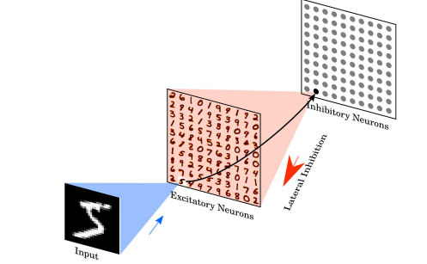
Overall system
28×28 input images converted into Poisson spike trains
Fully connected input to excitatory neurons
One-to-one excitatory–inhibitory connections suppress others
No label during training; assigned after based on highest response

Slide 7
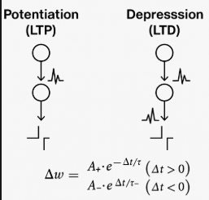
Neuron Model and STDP Learning
LIF neurons accumulate voltage and fire when a threshold is exceeded.
Conductance-based synapses modulate effect based on membrane potential
STDP updates synaptic weights based on the timing difference of spikes.

Slide 8
How images are converted into spikes
Each 28×28 grayscale image is converted into Poisson-distributed spike trains. The firing rate of each pixel is proportional to its intensity.
After unsupervised training, each output neuron is associated with the digit class it responded to most frequently.

Slide 9
Content
Research Introduction
Overall system/architecture
Research progress
Done
Doing
Todo
Schedule
Notes:
Before jumping to a new section, add a new slide:
Hide the other sections
Highlight the current section

Slide 10
Research Progress | Completed
Read the paper on how to use SNNs to perform unsupervised training on the MNIST dataset
Notes:
Briefly talk about what you have done
If possible. Highlight it in the overall architecture/system figure

Slide 11
Research Progress | On-going
Learn the Pytorch tutorial
Notes:
Explain what you are doing now
_ Talk about what is the challenge
_ Suggest about the solution

Slide 12
Research Progress | Todo
Try running the Bindsnet tutorial
Notes:
Explain what you are doing now
_ Talk about what is the challenge
_ Suggest about the solution

Slide 13
Content
Research Introduction
Overall system/architecture
Research progress
Done
Doing
Todo
Schedule
Notes:
Before jumping to a new section, add a new slide:
Hide the other sections
Highlight the current section

Slide 14
Schedule
Time | June 24 2025 | May 2025 | … | Jan 2026
Task 1
Task2
Task 1:Learn the Pytorch tutorial
Task2:Try running the Bindsnet tutorial

Slide 15
Thank you for your attention!
Notes:
Always end with a thank you slide
_ Ask if there is any question

