Slide 1
An Attempt at Thermal Image Analysis Using Spiking Neural Networks
s1300053 Komatsu Yamato
7/08
Notes:
Keep this slide clean
Do not add line number here

Slide 2
Content
Research Introduction
Overall system/architecture
Research progress
Done
Doing
Todo
Schedule
Notes:
The content should be bief

Slide 3
Content
Research Introduction
Overall system/architecture
Research progress
Done
Doing
Todo
Schedule
Notes:
Before jumping to a new section, add a new slide:
Hide the other sections
Highlight the current section

Slide 4
Research introduction
My Research Is About
My Research is An Attempt at Thermal Image Analysis Using Spiking Neural Networks
I’m currently studying the PyTorch tutorials and STDP (Spike-Timing-Dependent Synaptic Plasticity) in BindsNET to prepare for implementing a Spiking Neural Network (SNN).

Slide 5
Content
Research Introduction
Overall system/architecture
Research progress
Done
Doing
Todo
Schedule
Notes:
Before jumping to a new section, add a new slide:
Hide the other sections
Highlight the current section

Slide 6
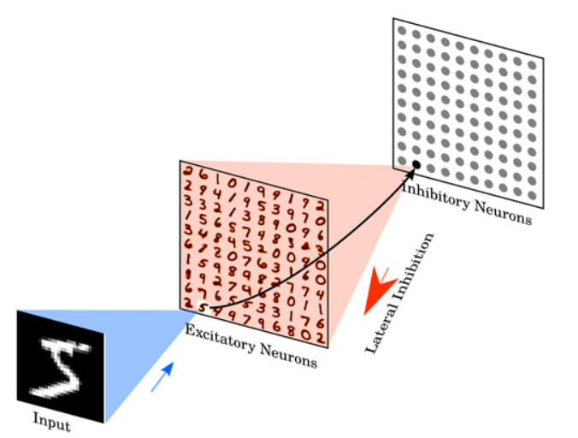
overview
・I have executed the STDP learning in BindsNET and confirmed its behavior.
STDP is a learning rule in which the strength of synapses changes depending on the timing of firing between neurons.
Objective of the Experiment
・To observe how spike-based learning is performed through STDP (Spike-Timing Dependent Plasticity)
・To visualize and analyze how neurons respond and adapt to input images

Slide 7
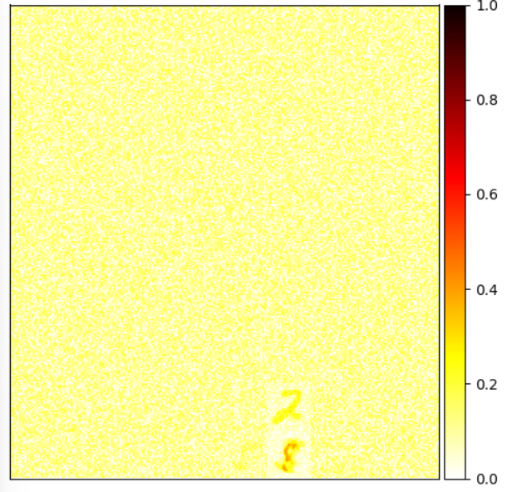
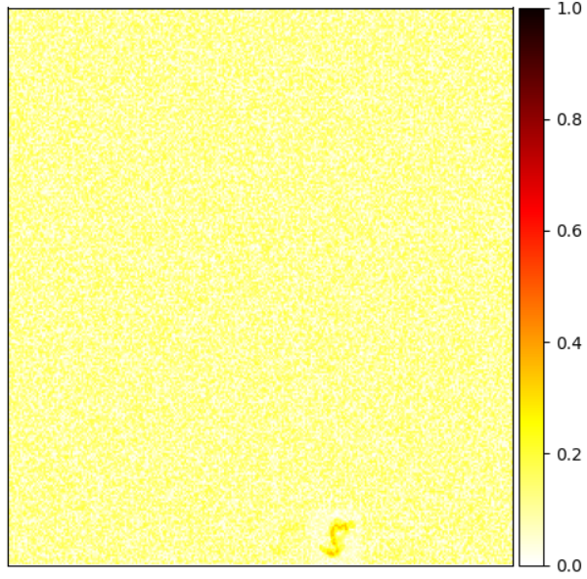
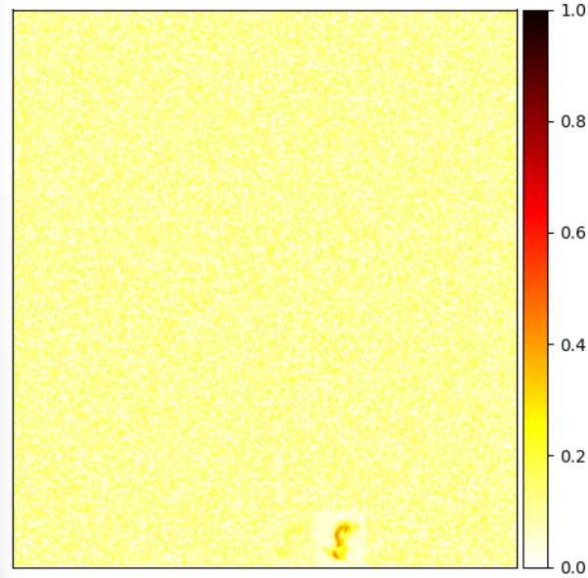
Neuronal behavior during learning and observations
Behavior of Neurons Under STDP
First Image (e.g., Digit 8):
Weights initialized randomly
One neuron starts firing consistently
Its receptive field starts resembling digit "8"
Next Image (Digit 5):
Same neuron adapts to digit 5 if shapes overlap
Receptive field adjusts dynamically
New Image (Digit 2):
A different neuron starts firing
Reflects new input-specific learning

Slide 8
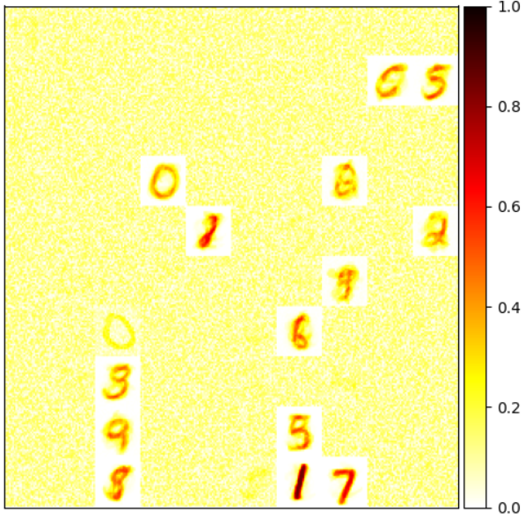
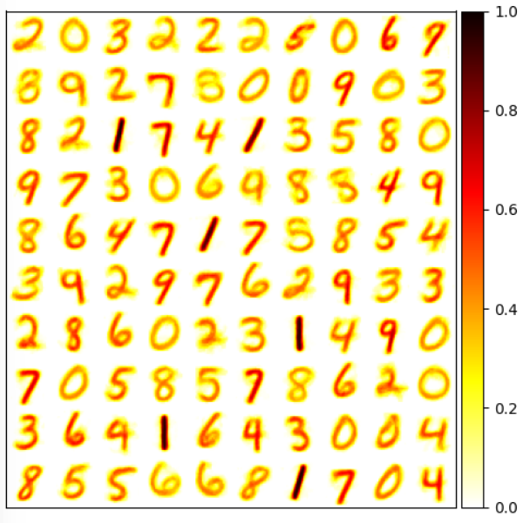
Observations
General Trends:
Neuron specialization via competition
Only one neuron tends to dominate after ~50 timesteps
Receptive fields evolve image by image
After 250 Images:
Receptive fields clearly resemble digit shapes
Labels can be assigned to neurons based on activity

Slide 9
Content
Research Introduction
Overall system/architecture
Research progress
Done
Doing
Todo
Schedule
Notes:
Before jumping to a new section, add a new slide:
Hide the other sections
Highlight the current section

Slide 10
Research Progress | Completed
Try running the Bindsnet tutorial
Learn sections 02 and 03 of the PyTorch tutorial
Notes:
Briefly talk about what you have done
If possible. Highlight it in the overall architecture/system figure

Slide 11
Research Progress | On-going
Learn Section 04 of the PyTorch tutorial
Notes:
Explain what you are doing now
_ Talk about what is the challenge
_ Suggest about the solution

Slide 12
Research Progress | Todo
Learn Section 04 of the PyTorch tutorial
Notes:
Explain what you are doing now
_ Talk about what is the challenge
_ Suggest about the solution

Slide 13
Content
Research Introduction
Overall system/architecture
Research progress
Done
Doing
Todo
Schedule
Notes:
Before jumping to a new section, add a new slide:
Hide the other sections
Highlight the current section

Slide 14
Schedule
Time | July 15 2025 |  |  | Jan 2026
Task 1
Task 1:Learn Section 04 of the PyTorch tutorial

Slide 15
Thank you for your attention!
Notes:
Always end with a thank you slide
_ Ask if there is any question

