Slide 1
An Attempt at Thermal Image Analysis Using Spiking Neural Networks
s1300053 Komatsu Yamato
7/22
Notes:
Keep this slide clean
Do not add line number here

Slide 2
Content
Research Introduction
Overall system/architecture
Research progress
Done
Doing
Todo
Schedule
Notes:
The content should be bief

Slide 3
Content
Research Introduction
Overall system/architecture
Research progress
Done
Doing
Todo
Schedule
Notes:
Before jumping to a new section, add a new slide:
Hide the other sections
Highlight the current section

Slide 4
Research introduction
My Research Is About
My Research is An Attempt at Thermal Image Analysis Using Spiking Neural Networks
Focusing on biologically inspired learning models, particularly Spiking Neural Networks (SNNs)
Currently, I am developing an unsupervised learning model using STDP (Spike-Timing Dependent Plasticity) with BindsNET to classify 3×3 numerical patterns.
Ultimately, I aim to apply this system on a microcontroller such as a Raspberry Pi Pico.

Slide 5
Content
Research Introduction
Overall system/architecture
Research progress
Done
Doing
Todo
Schedule
Notes:
Before jumping to a new section, add a new slide:
Hide the other sections
Highlight the current section

Slide 6
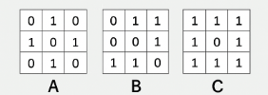
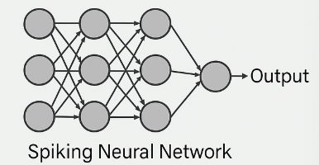
overview
Currently building an SNN model to classify 3×3 numerical patterns (A / B / C) Technologies used: ・Spiking Neural Network (SNN) ・Spike-Timing Dependent Plasticity (STDP) ・Poisson Encoding (conversion to spike trains)
Final goal: To classify noisy patterns through unsupervised learning

Slide 7
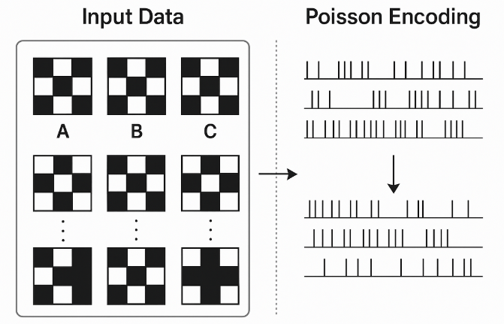
Learning flow and model configuration
Input Data
Three fixed 3×3 patterns (A / B / C)
Noisy versions generated for training and testing
Poisson Encoding
Converts numerical patterns into temporal spike trains
SNN Architecture
Input layer
Excitatory neuron layer
Synaptic weights updated via STDP (Spike-Timing Dependent Plasticity)

Slide 8
How inference and classification works
During training, each neuron becomes specialized to a specific pattern. Spike activity is recorded and associated with labels.
During inference, the input is classified based on the firing activity of the most responsive neuron.
Ultimately, the model determines whether the input pattern is "A", "B", or "C".

Slide 9
Content
Research Introduction
Overall system/architecture
Research progress
Done
Doing
Todo
Schedule
Notes:
Before jumping to a new section, add a new slide:
Hide the other sections
Highlight the current section

Slide 10
Research Progress | Completed
Designing the basic pattern of the dataset and generating data
Notes:
Briefly talk about what you have done
If possible. Highlight it in the overall architecture/system figure

Slide 11
Research Progress | On-going
Constructing an SNN model with unsupervised learning based on STDP rules
Notes:
Explain what you are doing now
_ Talk about what is the challenge
_ Suggest about the solution

Slide 12
Research Progress | Todo
Creating a learning and evaluation process
Application to Raspberry Pi Pico
Notes:
Explain what you are doing now
_ Talk about what is the challenge
_ Suggest about the solution

Slide 13
Content
Research Introduction
Overall system/architecture
Research progress
Done
Doing
Todo
Schedule
Notes:
Before jumping to a new section, add a new slide:
Hide the other sections
Highlight the current section

Slide 14
Schedule
Time | August 15 2025 | September 1 2025 | September 30
Task 1
Task 2
Task 3
Task 1:SNN model construction
Task 2:Creating learning and evaluation processes
Task 3:Application to Raspberry Pi Pico

Slide 15
Thank you for your attention!
Notes:
Always end with a thank you slide
_ Ask if there is any question

