Slide 1

Evaluating Bufferless Flow Control for On-Chip Networks
George Michelogiannakis, Daniel Sanchez,
William J. Dally, Christos Kozyrakis
Stanford University

Slide 2
In a nutshell
Many researchers report high buffer costs.
Motivates bufferless networks.
We compare bufferless networks with VC networks.
We perform simple optimizations on both sides and a thorough analysis.
We show that bufferless networks:
  Consume only marginally less energy than buffered networks at very low loads.
  Have higher latency and provide less throughput per unit power.
  Are more complex.

Slide 3
Outline
Methodology.
  Evaluation infrastructure.
Background.
Optimizing routing in BLESS.
Router microarchitecture.
Network evaluation.
Discussion.
Conclusion.

Slide 4

Methodology
Cycle-accurate network simulator.
Balfour and Dally [ICS ‘06] power and area models.
  Based on first-order principles.
  We validate our models against HSPICE.
32nm ITRS high performance models, as a worst case for leakage power.
  Also, a 45nm low-power commercial library.
2D 8x8 mesh.

Slide 5
Outline
Methodology.
Background.
  A quick overview.
Optimizing routing in BLESS.
Router microarchitecture.
Network evaluation.
Discussion.
Conclusion.

Slide 6
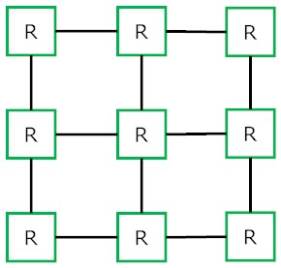


Bufferless flow control
Flits can’t wait in routers.
Contention is handled by:
  Dropping and retransmitting from the source.
  Deflecting to a free output.
Ouch

Slide 7
BLESS deflection network
[ISCA ’09]
Flits bid for a single output using dimension-ordered routing (DOR).
Body flits may get deflected.
  They must contain destination information.
  They may arrive out of order.
Oldest flits are prioritized to avoid livelocks.
We compare virtual channel (VC) networks against BLESS.

Slide 8
Outline
Methodology.
Background.
Optimizing routing in BLESS.
  Dimension-order revisited.
Router microarchitecture.
  Implications in router design.
Network evaluation.
Discussion.
Conclusion.

Slide 9
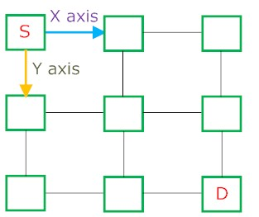
Optimizing routing in BLESS
Deadlocks impossible in bufferless networks, thus DOR unnecessary.
Multidimensional routing (MDR) requests all productive outputs.
5% lower latency, equal throughput compared to DOR.

Slide 10
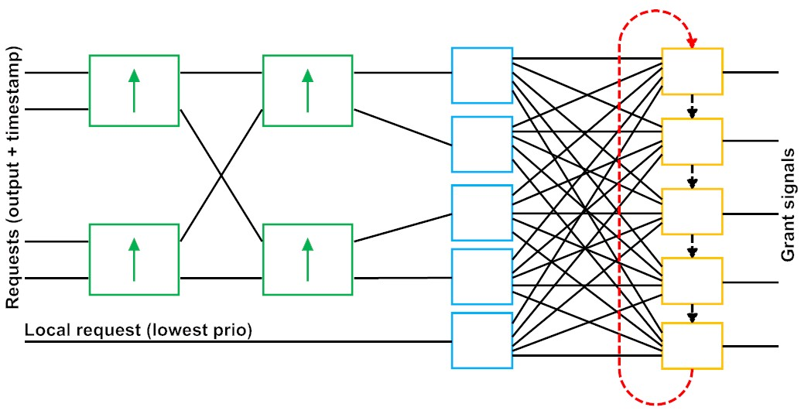
Allocator complexity
Deflection networks require a complete matching.
  Critical path through each output arbiter.
BLESS allocator increases cycle time by 81% compared to input-first, round-robin switch allocator.
Partial sorting
Input modules
Output modules

Slide 11
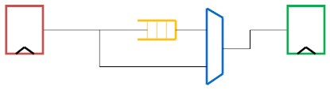
Buffer cost
We assume efficient custom SRAMs.
We use empty buffer bypassing.
Thus, at very low loads the extra power is only buffer leakage.
  1.5% of the overall network power.

Slide 12
Outline
Methodology.
Background.
Optimizing routing in BLESS.
Router microarchitecture.
Network evaluation.
  Let’s talk numbers.
Discussion.
Conclusion.

Slide 13
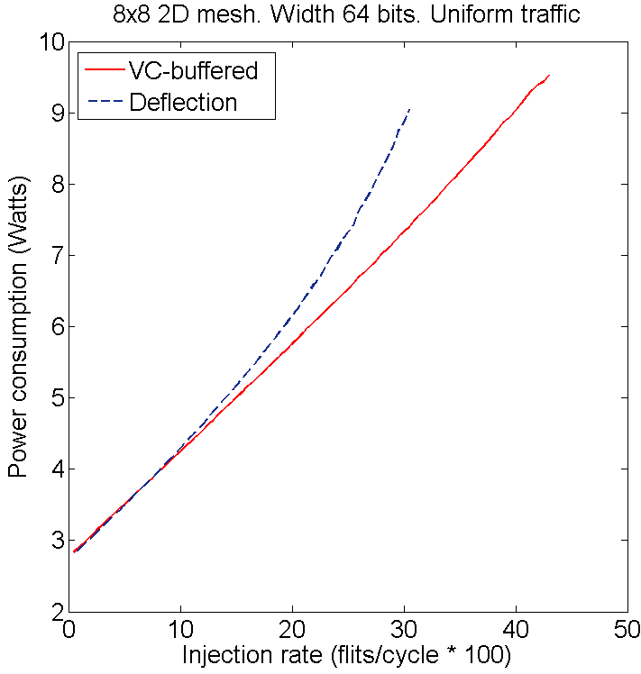
Power versus injection rate
BLESS: less power for flit injection rates lower than 7%.
Higher than that, activity factor from deflections costs more.
7% flit injection rate

Slide 14
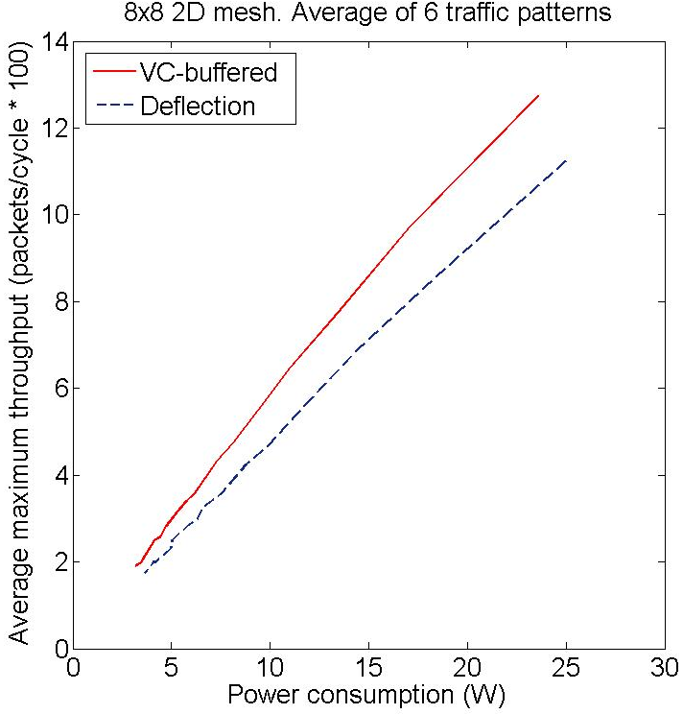
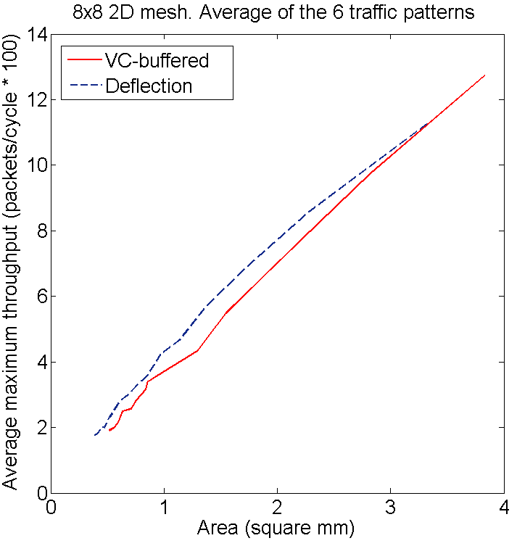
Throughput efficiency
Swept datapath width.
21% more for VC
5% less for VC

Slide 15
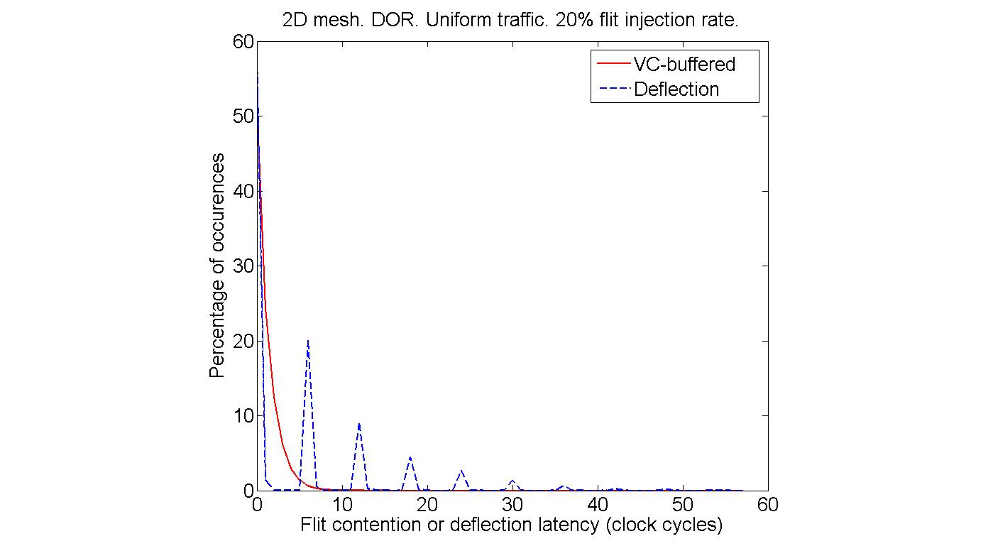
Latency distribution
Blocking or deflection latency:
One deflection costs 6 cycles (2 hops)
 | Avg. | Max. | Std.
VC | 0.75 | 13 | 1.18
Deflect. | 4.87 | 108 | 8.09

Slide 16
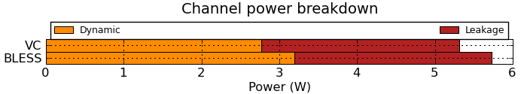

Power breakdown
Underlying cause:
  Reading & writing a buffer: 6.2pJ.
  One deflection: 42pJ. 6.7x the above.
BLESS: 4.6% activity factor increase.
20% flit injection rate
Buffer power: 2% compared to channel power. 7% without bypassing.

Slide 17
Outline
Methodology.
Background.
Optimizing routing in BLESS.
Router microarchitecture.
Network evaluation.
Discussion.
  Many parameters in such networks.
Conclusion.

Slide 18
Discussion
Topics covered in the paper in detail but not in this presentation:
Low-swing channels: Favor deflection.
  Never more than 1.5% less than VC power.
  VC:16% more throughput per unit power.
  VC becomes more area efficient.
Endpoint complexity: Need complexity, such as backpressure if ejection buffers are full, or very large ejection buffers.

Slide 19
Discussion
Points briefly mentioned in our study:
Dropping networks: Same fundamental hop-buffering energy tradeoff.
  Average hop count in dropping networks is affected more from topology and routing.
Self-throttling sources: Hide network performance inefficiencies.
  But CPU execution time really matters.
Sub-networks, network size, more traffic classes: No clear trend.

Slide 20
Conclusion
We compare VC and deflection networks. We show:
Deflection network consumes marginally (1.5%) less energy at very low loads.
VC network:
  12% lower average latency. Smaller std. dev.
  21% more throughput per unit power.
Deflection network are more complex.
  E.g. endpoint complexity & age-based allocation.
Unless buffer cost unusually high, bufferless networks less efficient & more complex.
  Designers should focus on optimizing buffers.

Slide 21


QUESTIONS?
That’s all folks

Slide 22
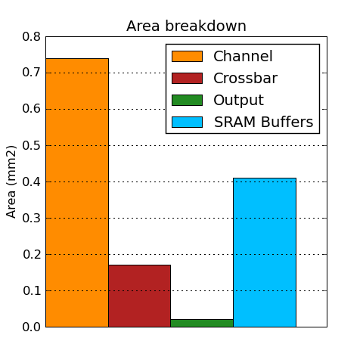
Area breakdown
Buffers 30% of the network area.

