Slide 1

Packet Chaining: Efficient Single-Cycle Allocation for On-Chip Networks
George Michelogiannakis, Nan Jiang,
Daniel Becker, William J. Dally
Stanford University
MICRO 44, 3-7 December 2011, Porto Allegre, Brazil

Slide 2
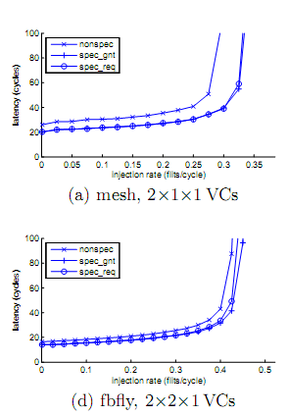
Introduction
Performance sensitive to allocator performance
Packet chaining improves quality of separable allocators
Packet chaining outperforms more complex allocators
Without the delay of those allocators

Slide 3
Outline
Motivation
Separable allocation without packet chaining
Packet chaining operation and basics
Packet chaining cost
Performance evaluation
Conclusions

Slide 4
Conventional separable allocation
Outputs
Step 1:
Requests propagate to output arbiters
Inputs
1,1
1
1
1,2
Step 2:
Both output arbiters pick the same input (1)
2
2,1
2
3
3,2
3
Step 3:
Input 1 can only pick one output
Example: output-first separable allocator
Arbitrating independently at each port degrades matching efficiency
If output 2 was aware of output 1’s decision, it would had picked input 3

Slide 5
Other ways to improve allocation
Increasing the number of iterations
Incremental allocation
Ineffective for single-flit packets
More complex allocators
Wavefont:
3x power and 20% more delay compared to a separable allocator
Augmenting paths:
Infeasible in a single cycle (approximately 10ns delay)

Slide 6
Outline
Motivation
Packet chaining operation and basics
Maintaining connections across packets
Packet chaining cost
Performance evaluation
Conclusions

Slide 7
Packet chaining operation
Inputs
Outputs
Starting from previous
Example:
Input 1 granted output 1.
This forms a connection
1
1,1
1
1,2
2
2
Next clock cycle:
Input 1 sends another packet to output 1.
Output 2 grants input 3
3
3
Example: output-first separable allocator
Key: packet chaining enables connection reuse between different packets destined to the same output as departing packets
The packets do not have to be in the same input

Slide 8
Packet chaining pipeline
Chaining is performed in the PC stage, before SA
Newly-arrived flits skip PC if SA does not have another flit. Thus, zero-load latency does not increase
Connections released if they cannot be used productively
PC: packet chaining
SA: switch allocation
ST: switch traversal
Cycle
PC
SA
ST
1
Packet 1 Tail
Packet 1 Body
Packet 1 Head
Cycle 2:
When the tail flit enters the SA stage, the chaining logic considers eligible chaining requests
2
Packet 2 Head
Packet 1 Tail
Packet 1 Body
3
Packet 2 Body
Packet 2 Head
Packet 1 Tail
Cycle 2: At the end of cycle 2, the chaining logic selects packet 2.
Packet 2 will reuse packet 1’s connection
Cycle 3: Packet 2 does not participate in SA. Its inputs
and outputs remain connected, blocking other requests

Slide 9
Starvation control
Packet chaining uses starvation control
In practice, connections are released by empty input VCs or output VCs without credits before starvation

Slide 10
Outline
Motivation
Packet chaining operation and basics
Packet chaining cost
The impact of adding a second allocator
Performance evaluation
Conclusions

Slide 11
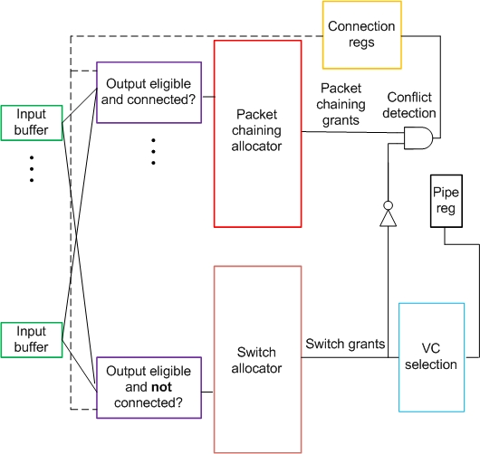
Packet chaining cost
PC and SA are in separate logical pipeline stages because they operate on different packets
Eligibility checking is very similar for both allocators
The two allocators are identical and in parallel
Conflict detection required by the PC allocator is simpler than VC selection for the combined allocator
Wavefront requires up to 1.5x more power and 20% more delay in a mesh

Slide 12
Outline
Motivation
Packet chaining operation and basics
Packet chaining cost
Performance evaluation
Throughput, latency and execution time
Conclusions

Slide 13
Methodology
8x8 2D mesh with DOR
Baseline iSLIP-1 with incremental allocation
Synthetic benchmarks to stress network
Execution-driven CMP applications
64 scalar out-of-order CPUs
CPUs clocked four times faster than network
Single-flit control packets
Five-flit data packets (32-byte cache lines)

Slide 14
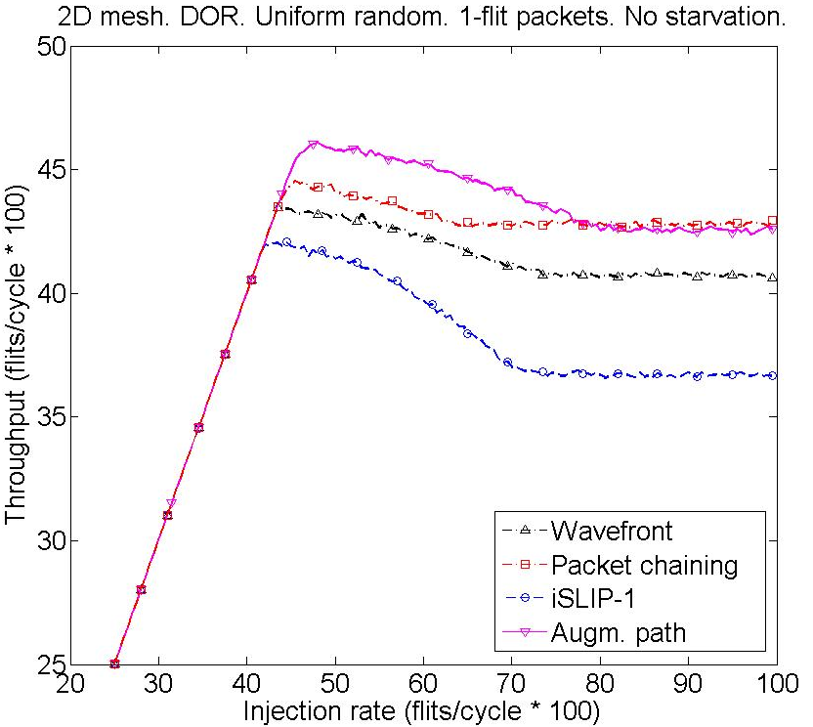
Throughput under heavy load
2.5%
6%
15%

Slide 15
Comparison of saturation points
Increases saturation throughput by 5-6%
Is comparable to augmenting paths

Slide 16
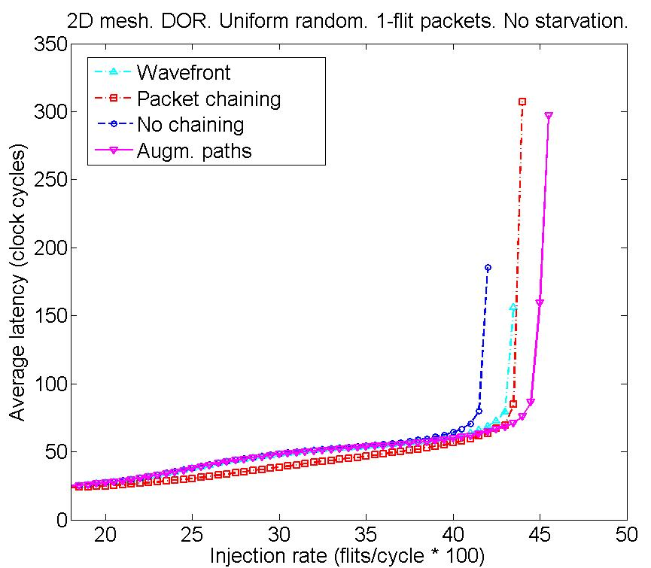
Latency
Packet chaining reduces average latency by 22.5%

Slide 17
The effect of packet length
Throughput gains drop with the increase of flits per packet
Because incremental allocation becomes effective
However, packet chaining still offers comparable or slightly higher throughput compared to wavefront and augmenting paths

Slide 18
Application execution results
53% of the packets in our simulations were single-flit
Packet chaining: comparable throughput to wavefront on average
Packet chaining versus iSLIP-1 using benchmarks

Slide 19
Conclusions
Packet chaining outperforms other allocators – even ones that are slower or infeasible in one clock cycle
True for packets of any length
Throughput gains increase with single-flit packets

Slide 20


Questions?
That’s all folks

