Slide 1
Three-dimension neural network chip with Staking Memories method v1: 2023/10/20
School of Computer Science and Engineering
Dang Nam Khanh, Abderazek Ben Abdallah, Nguyen Ngo Doanh

Slide 2
Contents
（目次）
1. General Description of the Invention
(発明内容の概要)
2. Prospective Applications
(想定される用途)
3. Prospective Market/Business
(想定される業界）
4. Challenges for Practical Use
(実用化に向けた課題)
5. Patent Claims
(特許請求の範囲)
Q & A

Slide 3
1. General Description of the Invention[1]
(発明内容の概要[1])
Technical Background (技術概要)
Neuromorphic Computing or Spiking Neural Network (SNN) is the third generation of Neuron Network architecture.
The operation of the Spiking Neural Network is based on action potentials (or spikes).
For certain applications (i.e., biomedical, sensor network, etc…), an ultra-low power solution is needed

Slide 4
1. General Description of the Invention[1]
(発明内容の概要[1])
Description of the Invention
A design methodology for neural network chip:
Instead of having a full word in a memory cell, words are split into sub-sets. Here, each sub-sets are placed in different layers of 3-D Integrated Circuit (3D-IC).
The lower 3D-IC’s layers host the most significant bits. The upper layers host the least significant bits.
In a normal mode, a full word can be read from all layers. Neural Network chips operate normally.
In a low-power mode, the upper layers are turned off and their values are considered as all zeros. Neural Network chips can operate like normal with distorted weight values. In this mode, accuracy losses are introduced.

Slide 5
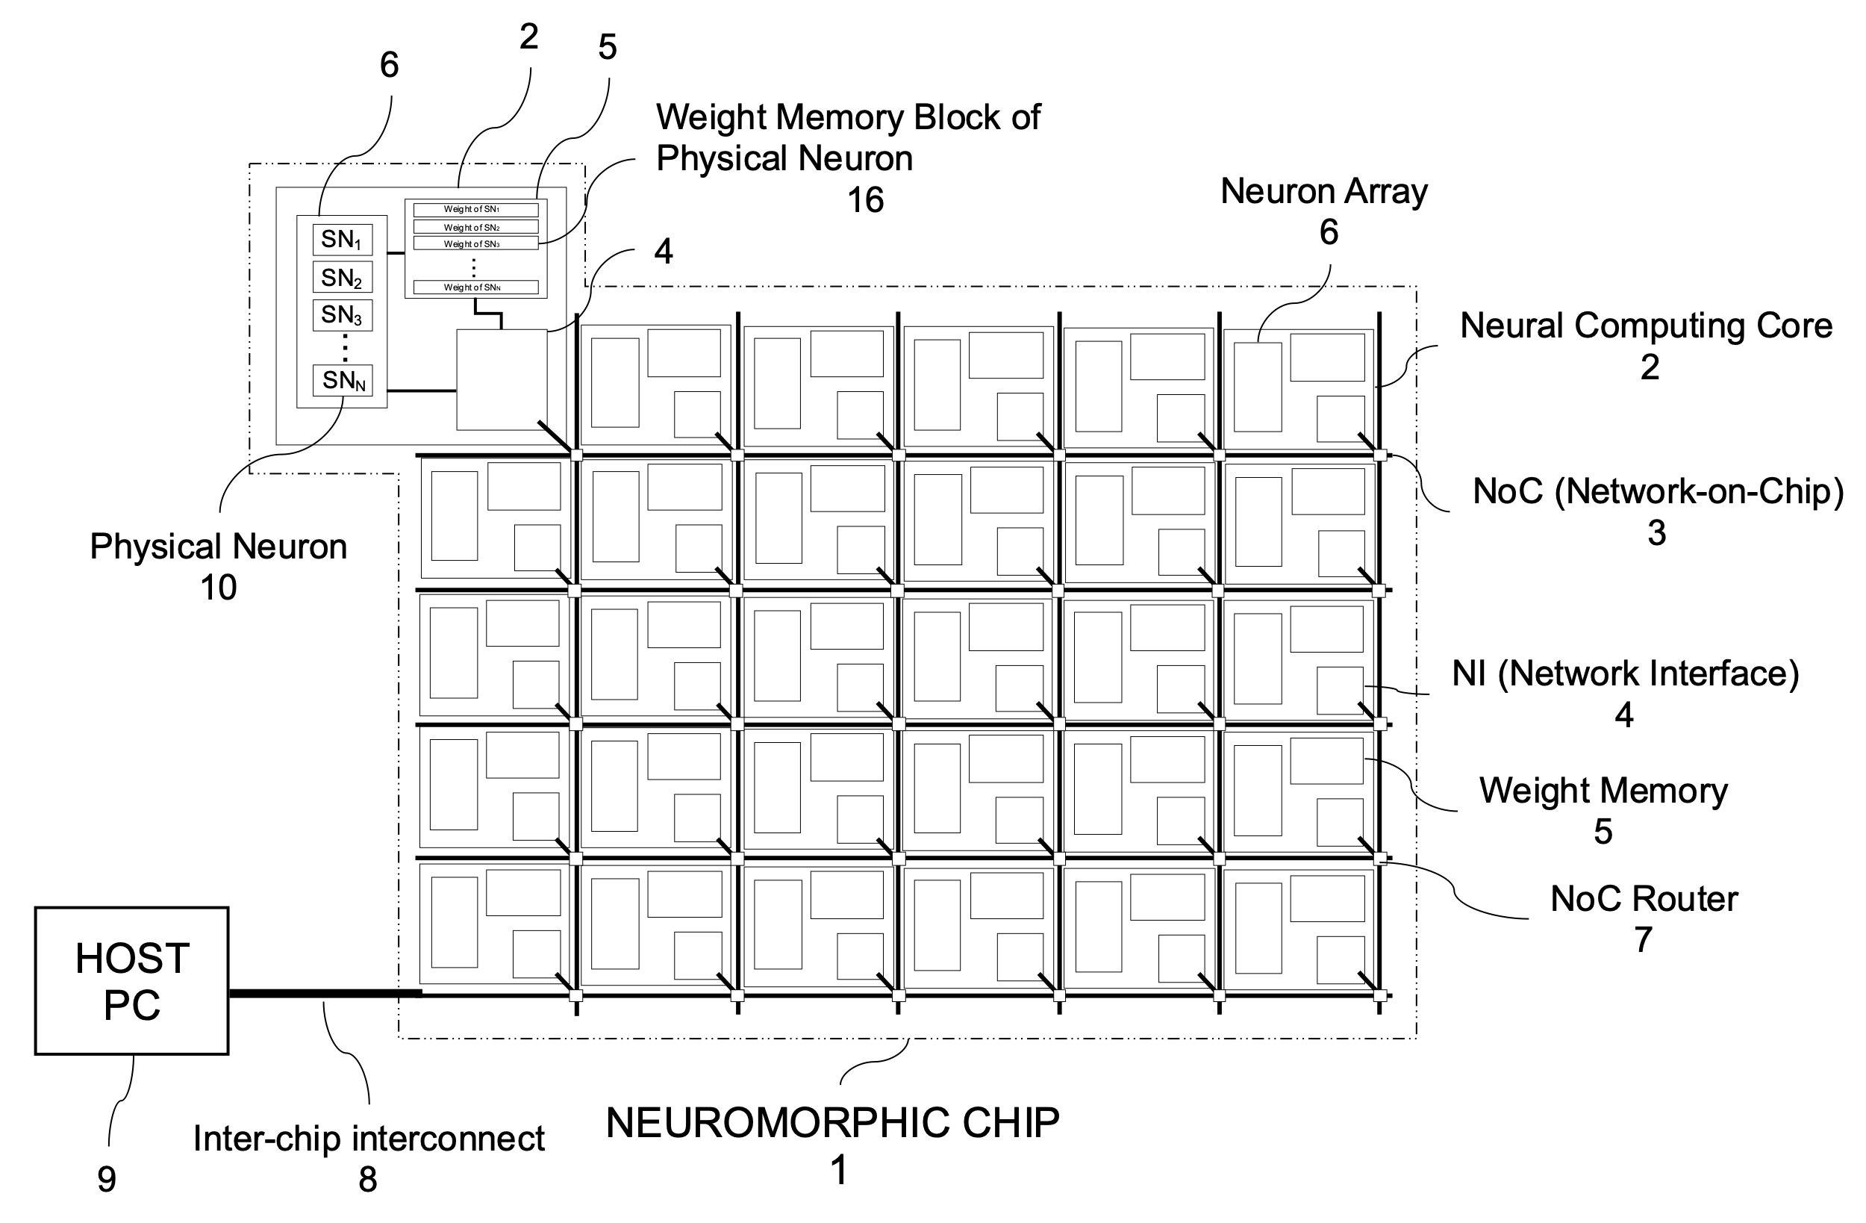
1. General Description of the Invention[2]
(発明内容の概要[2])
Conventional technologies and the problems (従来技術とその問題点)
Fig. 1. An exemplary of conventional neuromorphic inference chip

Slide 6
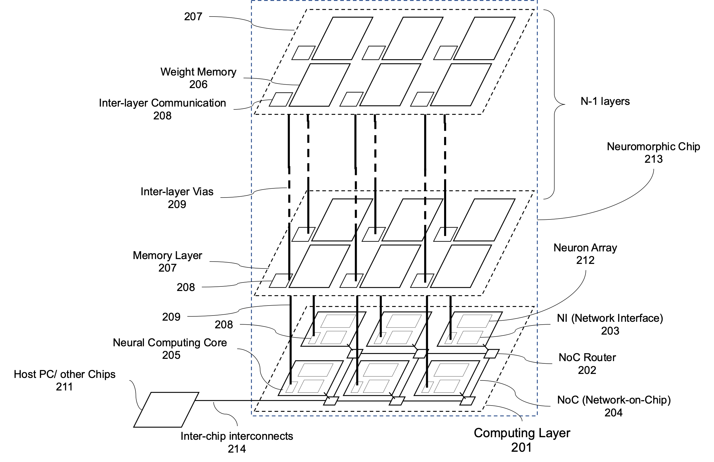
1. General Description of the Invention[2]
(発明内容の概要[2])
Conventional technologies and the problems (従来技術とその問題点)
Fig. 2. An exemplary of proposed neuromorphic inference chip .

Slide 7
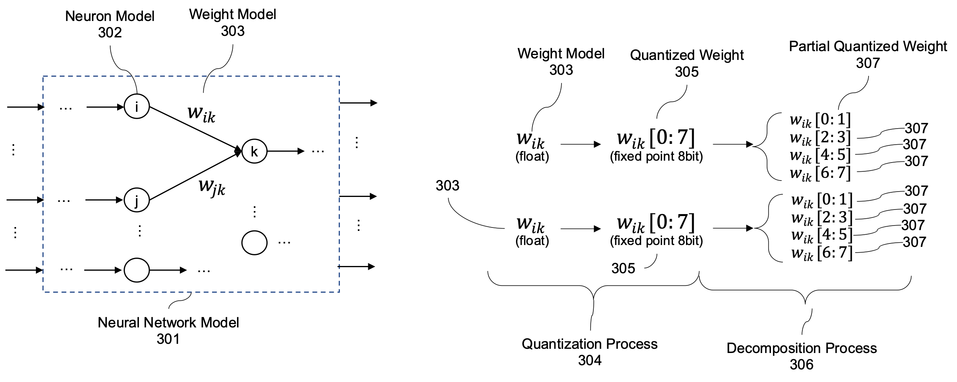
1. General Description of the Invention[2]
(発明内容の概要[2])
Description of the Invention
Fig. 4. The dynamic quantization process.

Slide 8
1. General Description of the Invention[2]
(発明内容の概要[2])
Description of the Invention
Fig. 4: Examples of dynamic quantization.

Slide 9
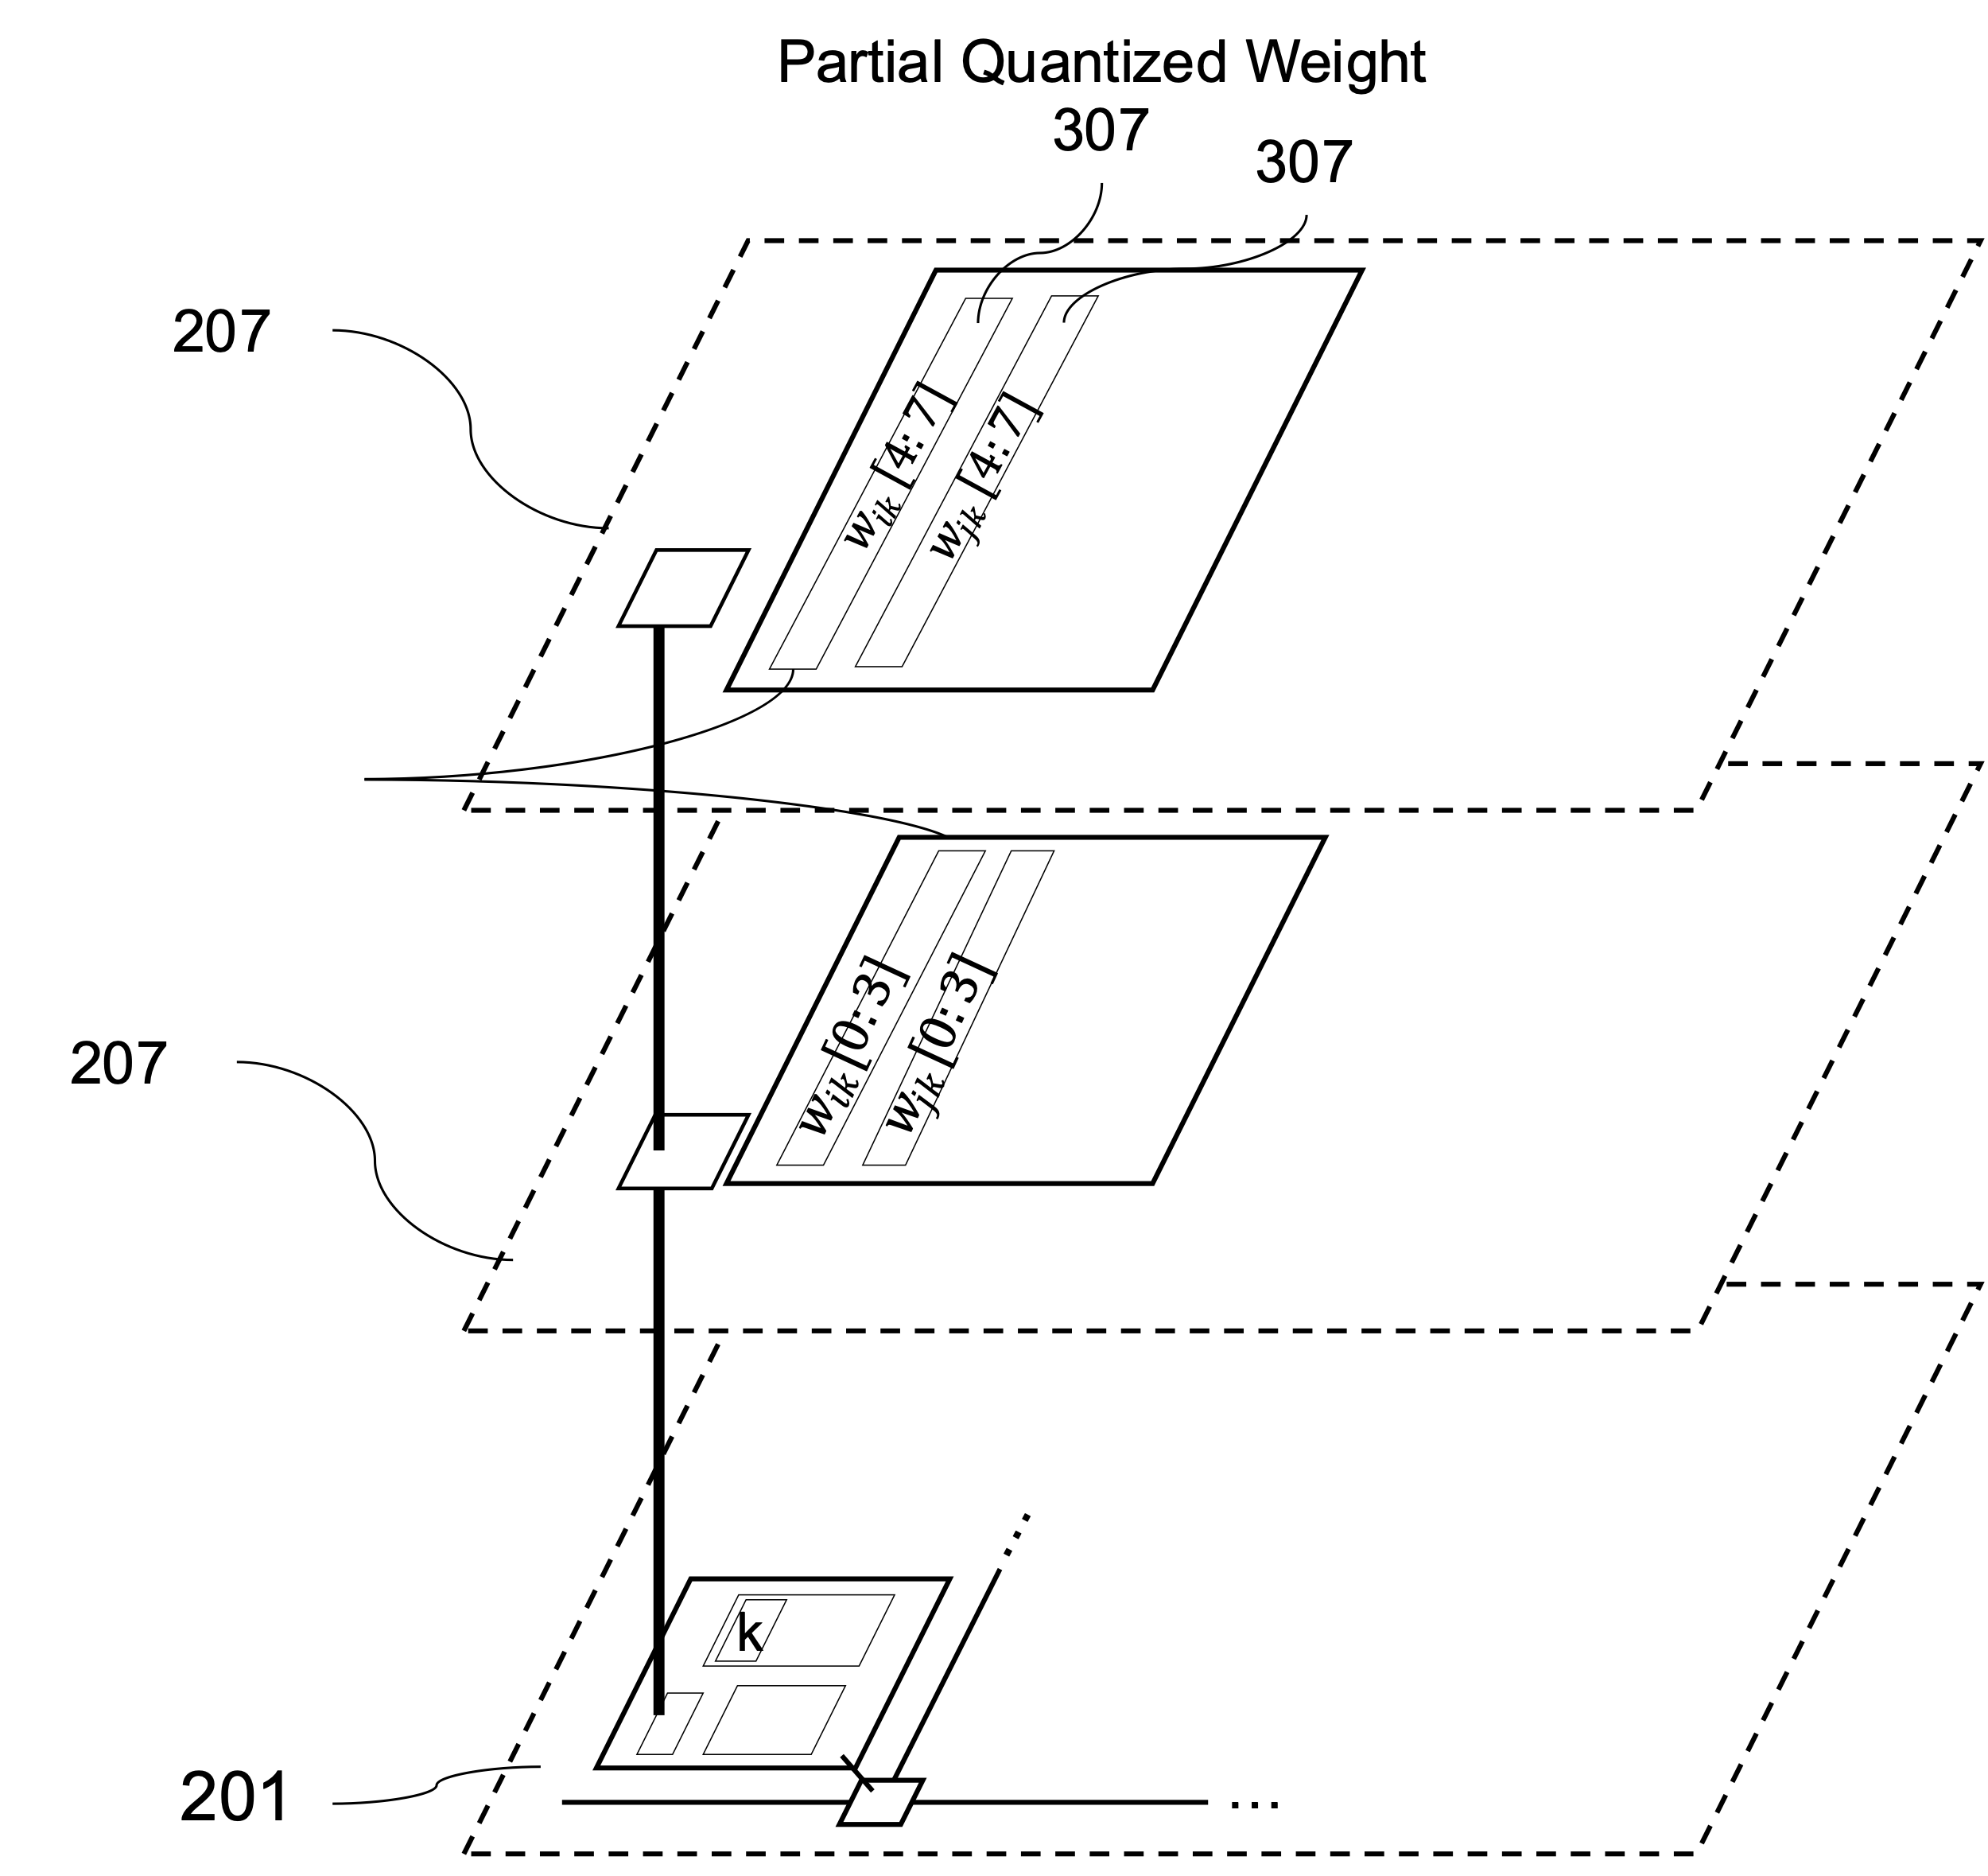
1. General Description of the Invention[2]
(発明内容の概要[2])
Description of the Invention
Fig. 5: Mapping location of partial quantized weight.

Slide 10
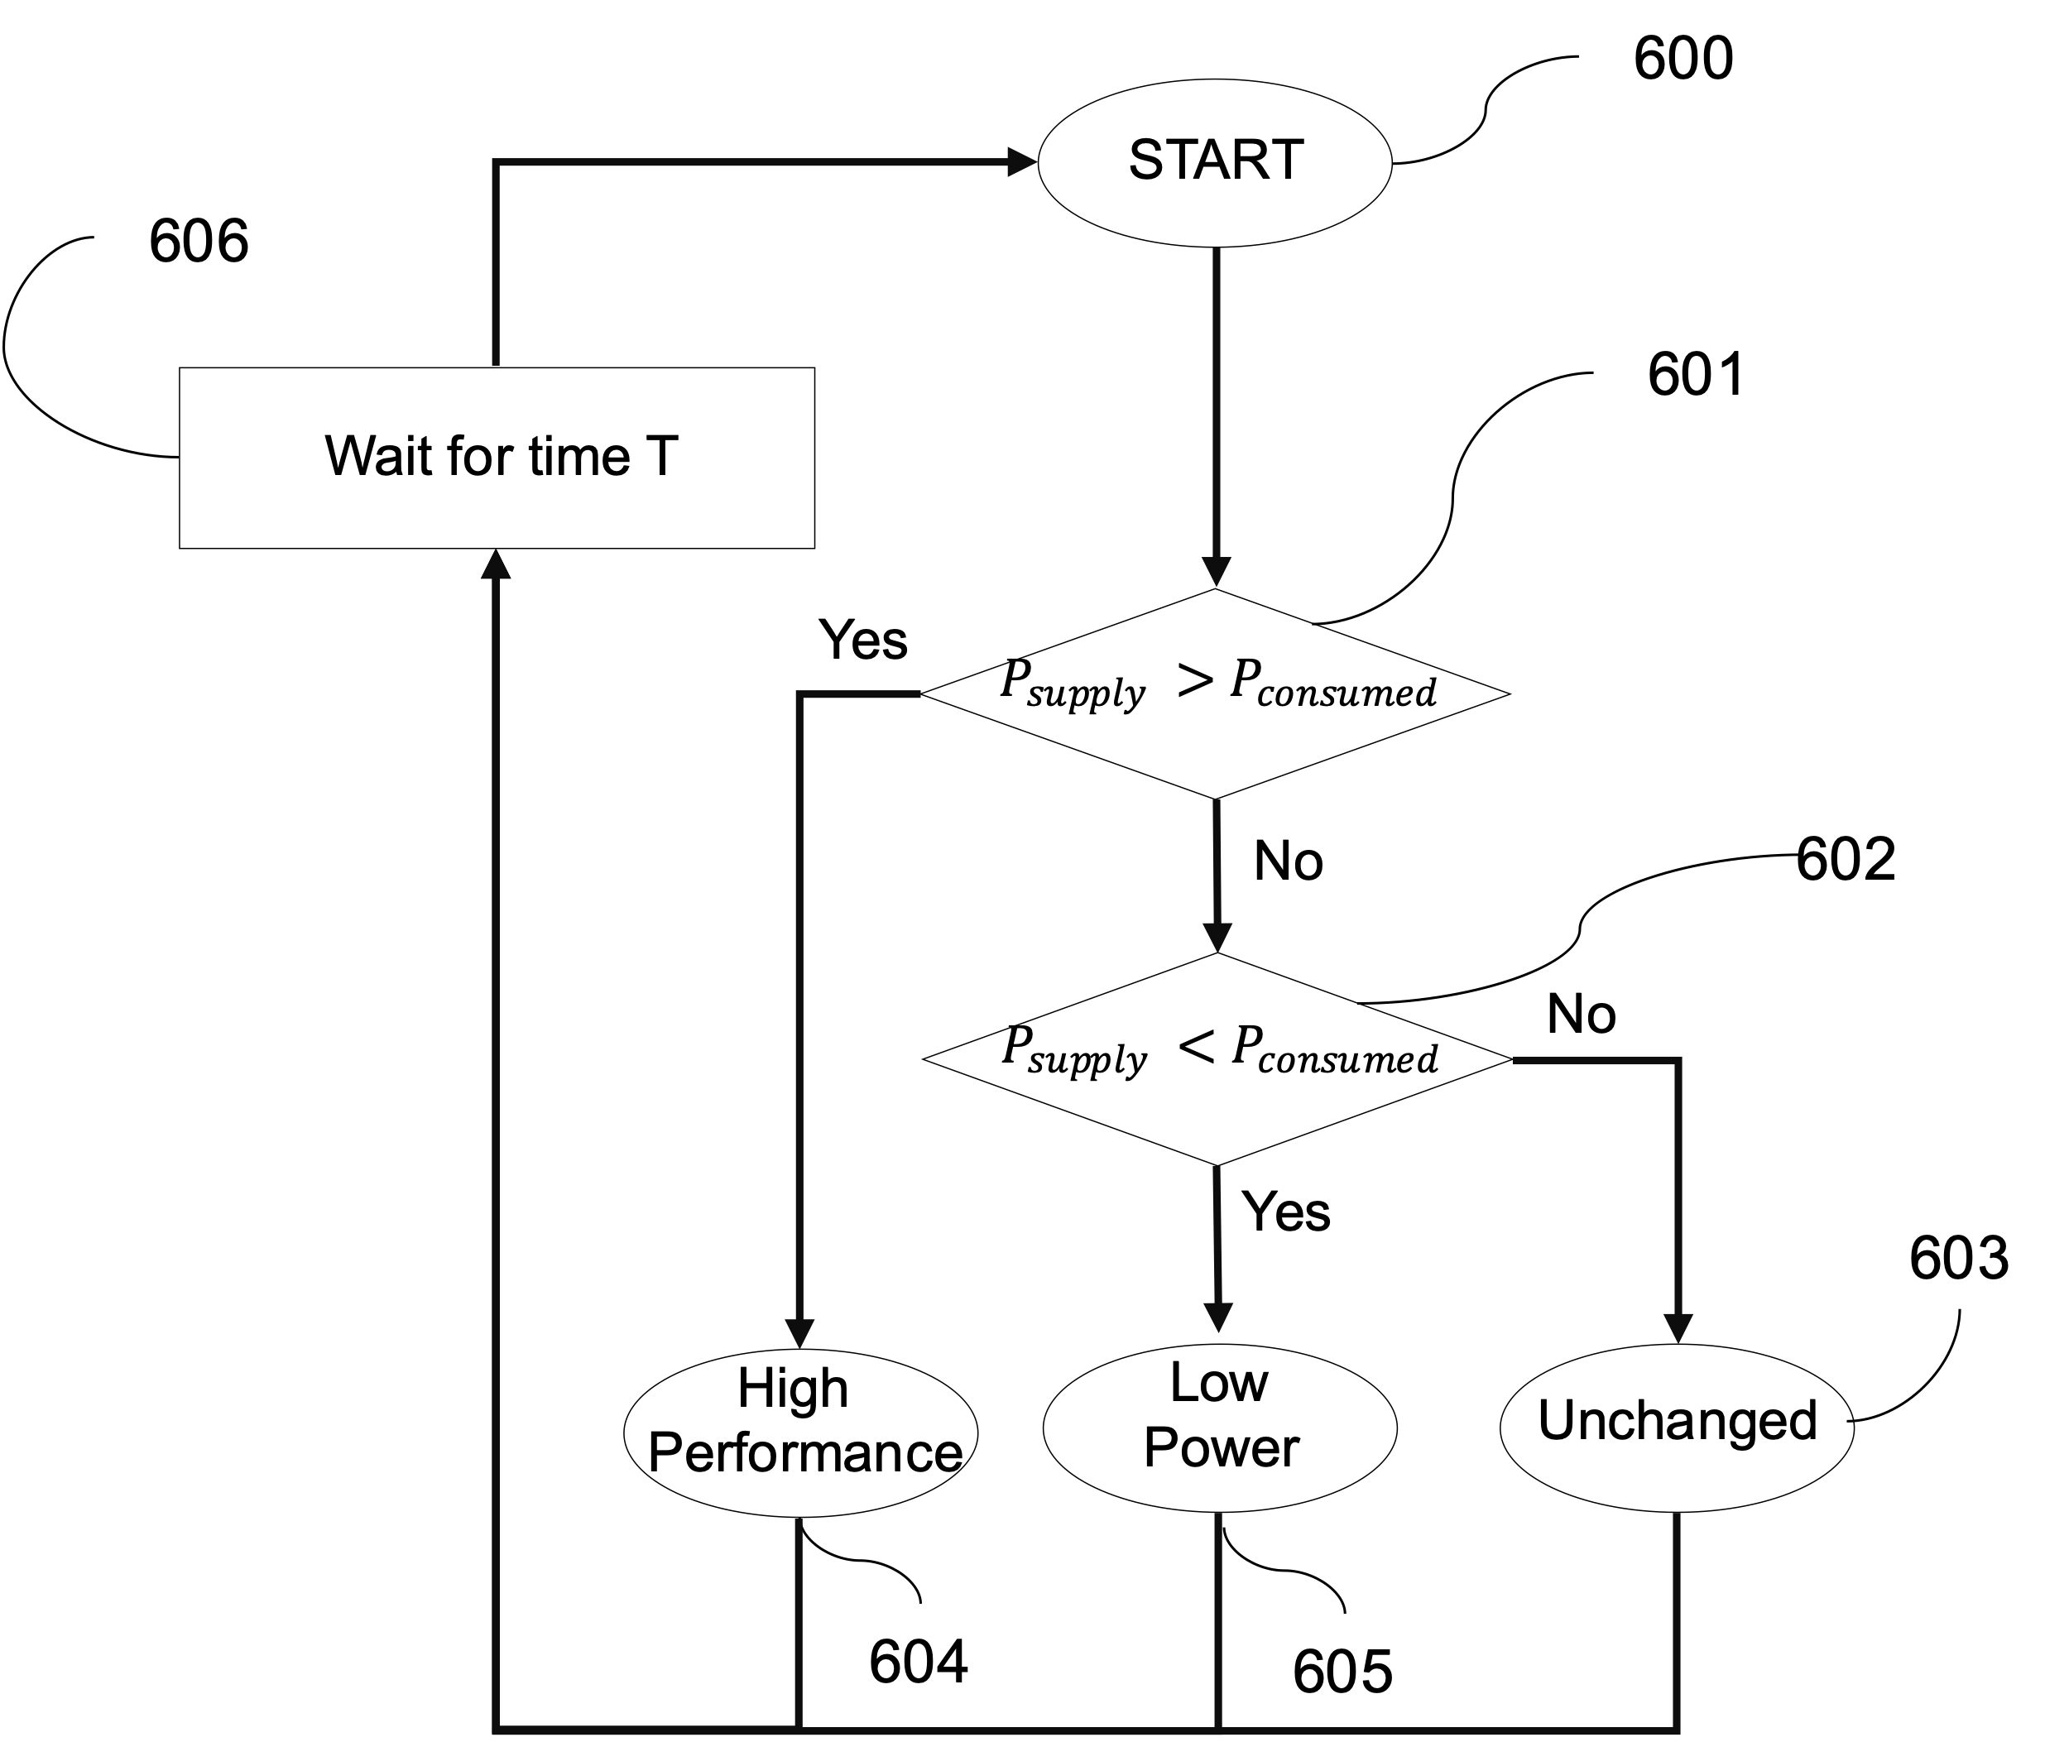
1. General Description of the Invention[2]
(発明内容の概要[2])
Description of the Invention
Fig. 6: Mode decision flow-chart.

Slide 11
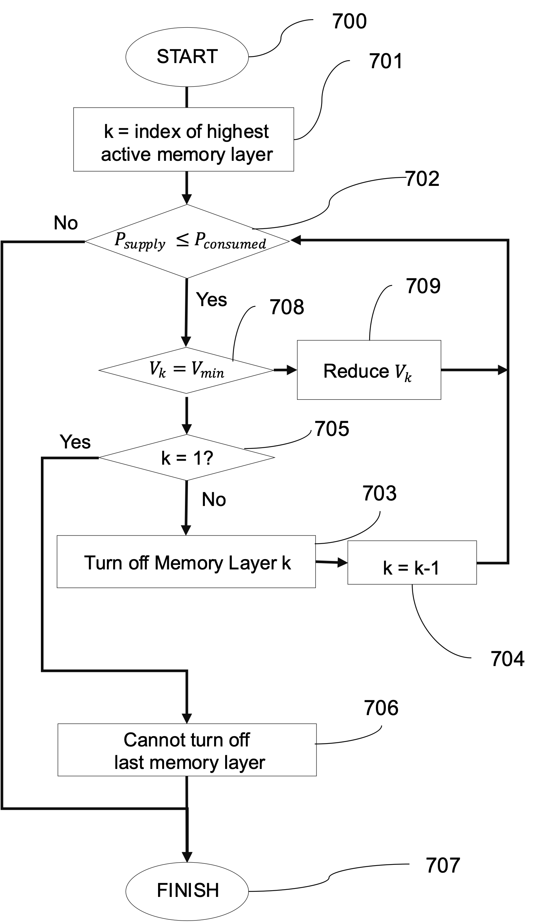
1. General Description of the Invention[2]
(発明内容の概要[2])
Description of the Invention
Fig. 7: Flow low-power mode (605).

Slide 12
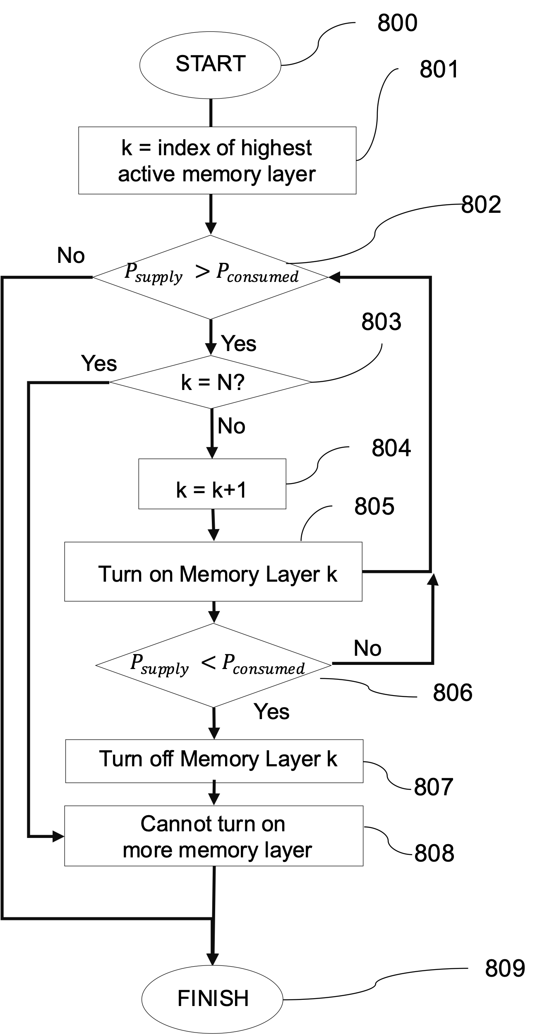
1. General Description of the Invention[2]
(発明内容の概要[2])
Description of the Invention
Fig. 8: Flow of high-performance mode (604).

Slide 13
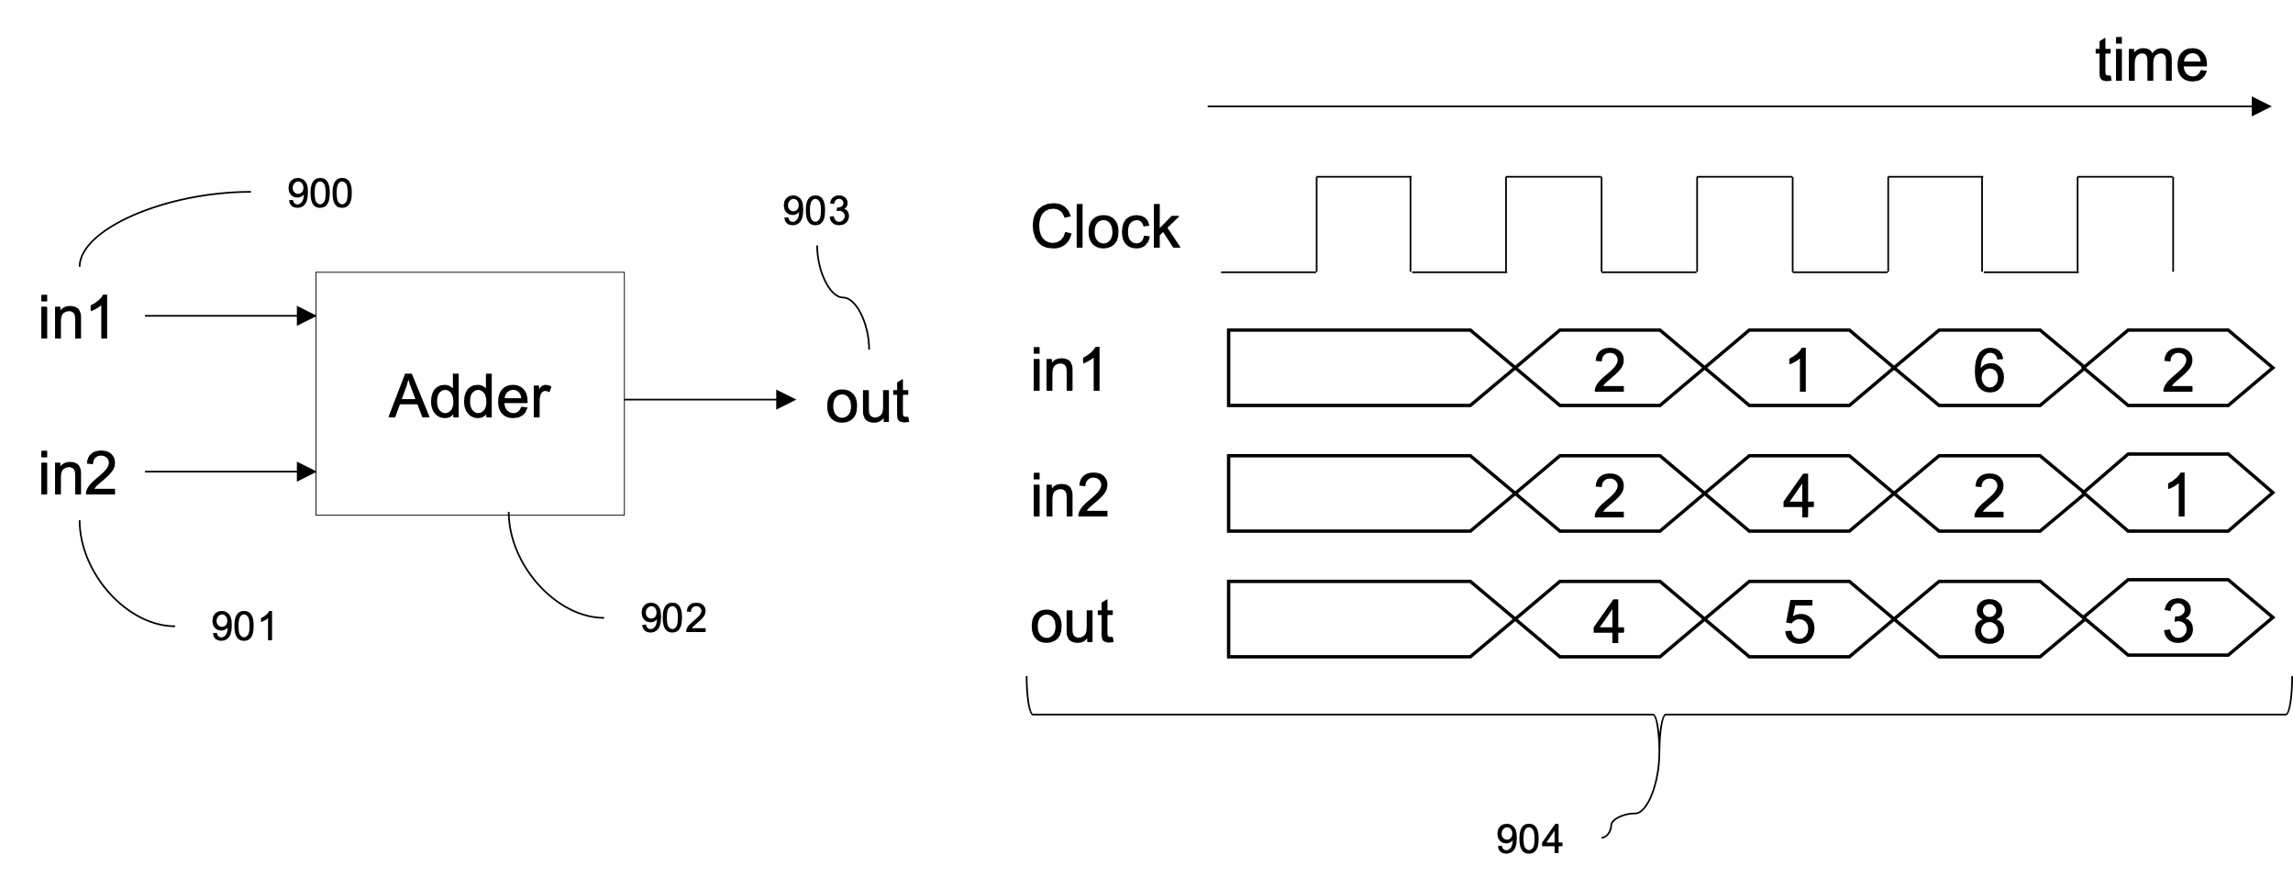
1. General Description of the Invention[2]
(発明内容の概要[2])
Description of the Invention
Fig. 9: Conventional Adder.

Slide 14
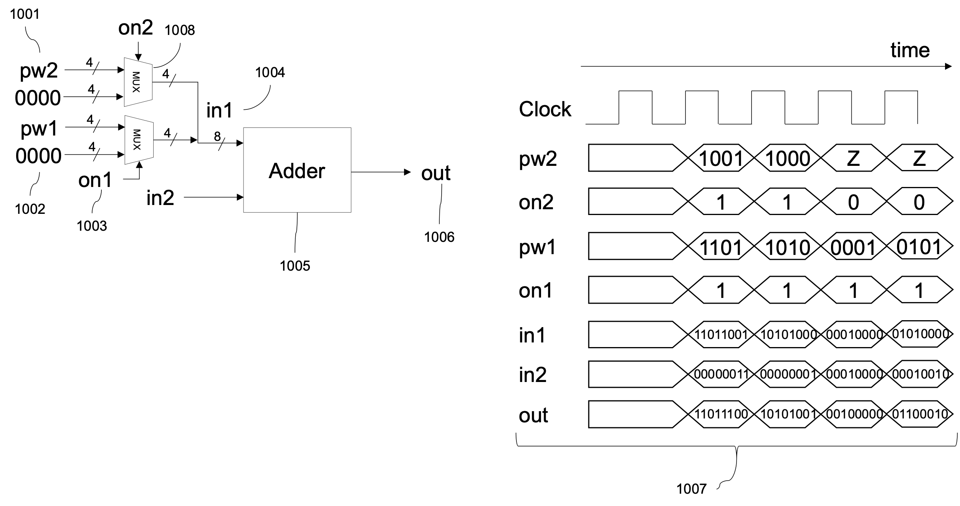
1. General Description of the Invention[2]
(発明内容の概要[2])
Description of the Invention
Fig. 10: Modified Adder to support turning off layers.

Slide 15
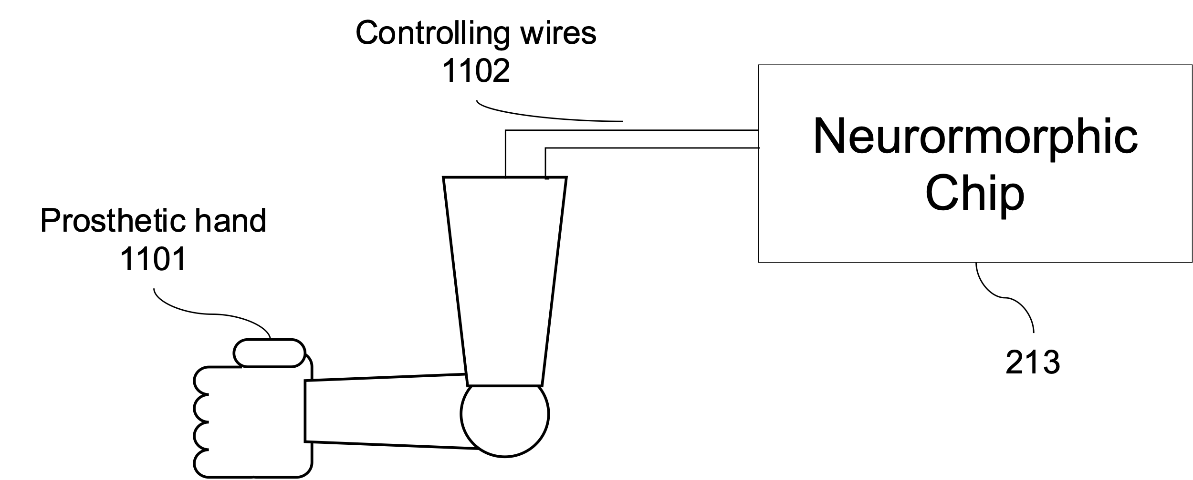
1. General Description of the Invention[2]
(発明内容の概要[2])
Fig. 11: Prosthetic hand controlling system.

Slide 16
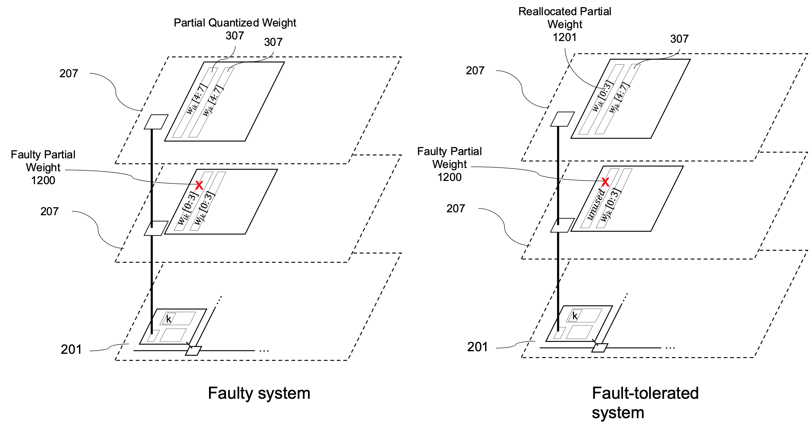
1. General Description of the Invention[2]
(発明内容の概要[2])
Description of the Invention
Fig. 12: Reallocating partial weights for fault-tolerant Prosthetic hand controlling system.

Slide 17
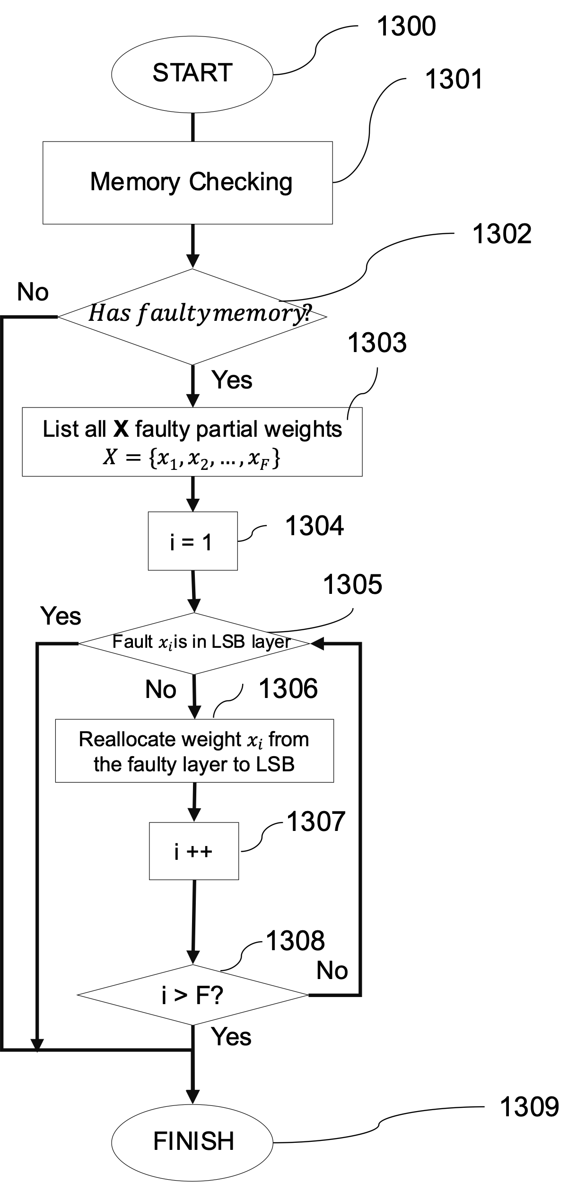
1. General Description of the Invention[2]
(発明内容の概要[2])
Description of the Invention
Fig. 13: Flow-chart for Reallocating partial weights for fault-tolerant Prosthetic hand controlling system.

Slide 18
2. Prospective Applications
(想定される用途）
Industrial applications
Perform spiking neural network applications
Image classification
Control
High-reliable applications:
Medical
Aerospace

Slide 19
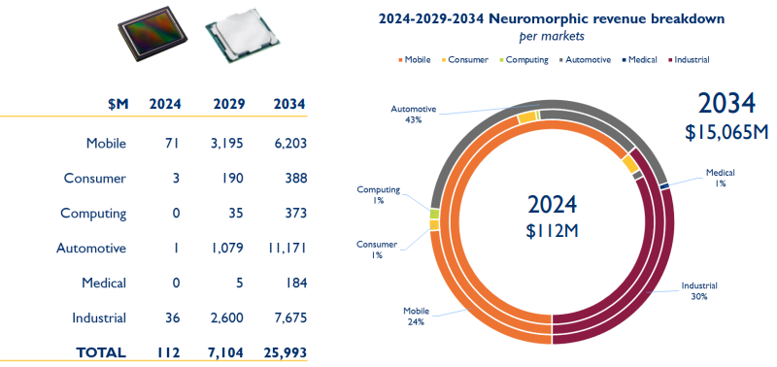
3. Prospective Market/Business[2] – Market Size
(想定される業界[2] ～ 市場規模）
https://www.eetimes.eu/neuromorphic-revolution-to-start-in-2024/

Slide 20
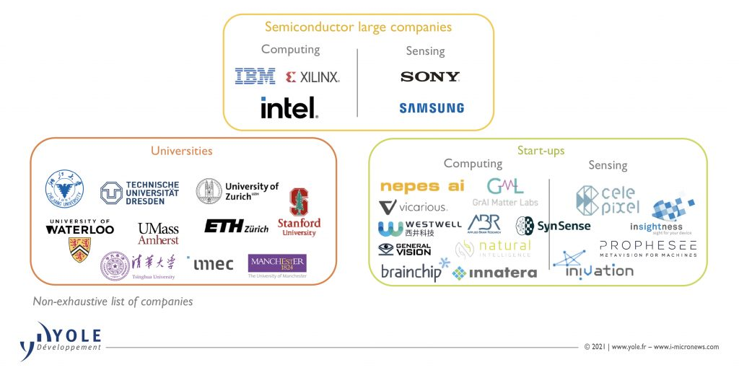
3. Prospective Market/Business[2] – Eco-systems
(想定される業界[2] ～ 市場規模）
https://www.i-micronews.com/?action=download-attachment&file_id=154294&source_id=154196&key=eb24bf29ad44667b75e07aa713e6039f&type=sample

Slide 21
4. Challenges for Practical Use
(実用化に向けた課題)
Technically, there are no challenges to realize this technology.

Slide 22
5. Patent Claims
(特許請求の範囲)
Country(s) for Application(出願国)
Japan
Patent Claims(特許請求の範囲)
An aspect of the disclosure provides a method to adapt power consumption in AI chips. The method consists of splitting the weight into multiple layers of 3D-ICs and turning off layers to save power as an act of quantization.
A fault-tolerant method is proposed for dealing with defective memory cells.

Slide 23
Q & A

Slide 24
Appendix

Slide 25
Genetic Algorithm
S1: get the directed graph;
S2: randomize the K migrating solutions;
// evolve phase
for (generation g in 1 to G) do
S3: calculate cost function for each solution of the population;
S4: select the B best out of K solutions based on the lowest cost function;
S5: mutate the B best solutions to have new K solutions ;
S6: crossover the new K solutions to have new population ;
// finalize phase
S7: calculate cost function for each solution of the population;
S8: select the B = 1 best out of K solutions based on the cost function;
Fig. 1. Multi-Stage Power Consumption Prediction.
Notes:
As shown in Fig. 2, to overcome the aforementioned challenges faced by the conventional system, we propose an AI-enabled smart biomedical detection/diagnosis system.
Particularly, we present a smart software-hardware platform which combines the merits of
software (refers to user interfaces) and hardware (i.e., AI Chip) in terms of efficient processing, high speed, and low cost.
Furthermore, we develop a deep learning (DL)-based system for automatic diagnosis of COVID-19.
Based on the proposed system, users can conveniently upload their chest X-ray images for automatic diagnosis and returning timely results.
In addition to improve the diagnosis accuracy, we then develop a federated model learning (FML) architecture for aggregating a global model.
Since the FML architecture allows hospitals sharing trained models without revealing real datasets, the data privacy of patients is thereby preserved.

Slide 26


