Slide 1

FPGA-based Neuromorphic Acceleration of Spiking Neural Networks for Event-Driven Humanoid Robotics
9th International Conference on Knowledge Innovation and Invention 2026 (ICKII 2026)
Authors: Aruki Komatsuzaki , Atharv Sharma, Yuga Hanyu,
Khanh N. Dang, Abderazek Ben Abdallah and Zhishang Wang
University of Aizu, Fukushima, Japan
August 14, 2026
Notes:
Hello, everyone.
My name is Aruki Komatsuzaki (from The University of Aizu).
Today, I will present our research titled "FPGA-based Neuromorphic Acceleration of Spiking Neural Networks for Event-Driven Humanoid Robotics."
[20s]

Slide 2
Contents
1. Introduction
2. Proposed Framework
2.1. Software
2.2. Hardware
3. Evaluation
3.1. Experimental Setup
3.2. Computation Comparison
3.3. FPGA Implementation
4. Conclusion
Notes:
This slide is a contents.
[20s]

Slide 3
Introduction
Problem:
Generative Adversarial Networks (GANs¹) demand high computational capability.
Deployment is limited on humanoid robots with strict power budgets.
Solution:
Spiking Neural Networks (SNNs⁶) offer event-driven, multiplication-free computation.
Objective:
Map SNNs onto FPGAs⁸ exploiting spike sparsity without power-hungry computational blocks.
1 Goodfellow, Ian, et al. "Generative adversarial networks." Communications of the ACM 63.11 (2020): 139-144.
6 Merolla, Paul A., et al. "A million spiking-neuron integrated circuit with a scalable communication network and interface." Science 345.6197 (2014): 668-673.
8 Mittal, Sparsh. "A survey of FPGA-based accelerators for convolutional neural networks." Neural computing and applications 32.4 (2020): 1109-1139.
Notes:
Generative Adversarial Networks achieve strong performance but their high computational cost limits deployment on embedded humanoid robotic systems, which have strict power budgets.
To resolve this, Spiking Neural Networks offer event-driven, multiplication-free computation.
However, mapping SNNs onto FPGAs requires a dedicated architecture that exploits spike sparsity without relying on power-hungry computational blocks.
[1m]

Slide 4
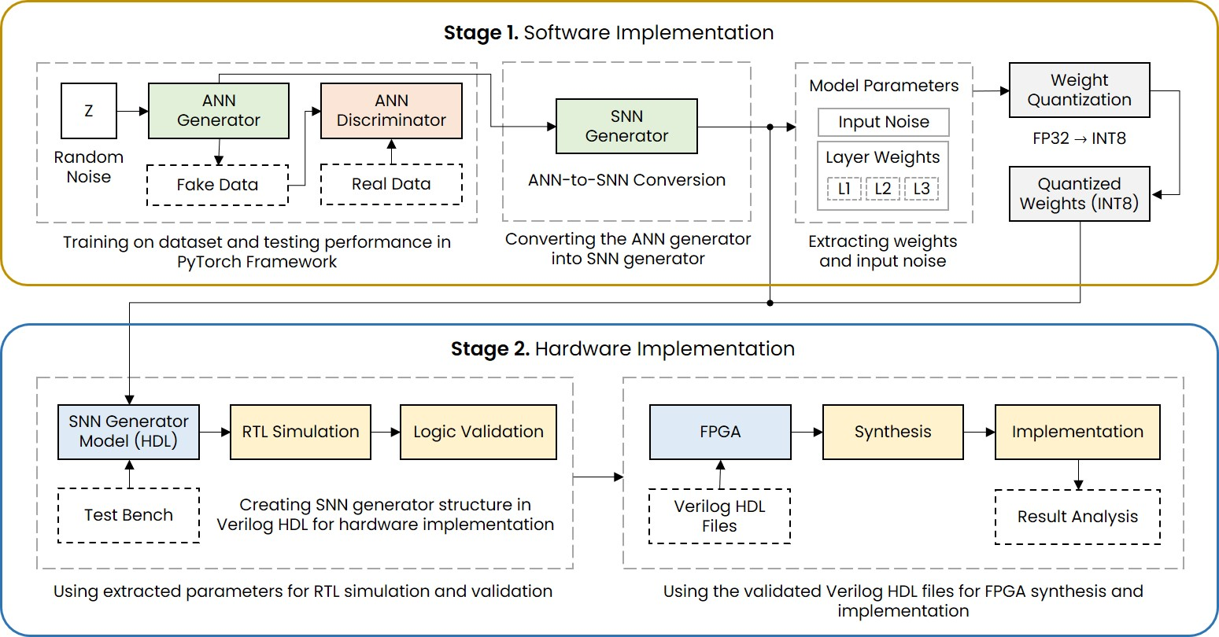
Proposed Framework: Software & Hardware Implementation
Figure 1. Design flow of the implementation framework for GAN model.
Notes:
Figure 1 summarizes the design flow of our proposed framework, which consists of two primary domains, that is Software (as shown in Stage 1) and Hardware (as shown in Stage 2).
Stage 1 is the software implementation, where an ANN-based GAN is trained and converted into an SNN.
Critical network parameters, such as weights, biases, and input spikes, are extracted and quantized.
In Stage 2, the hardware implementation is done, where these parameters are integrated into on-chip memory modules.
RTL simulation is performed for logic validation, followed by FPGA synthesis and device implementation.
[1m 50s]

Slide 5
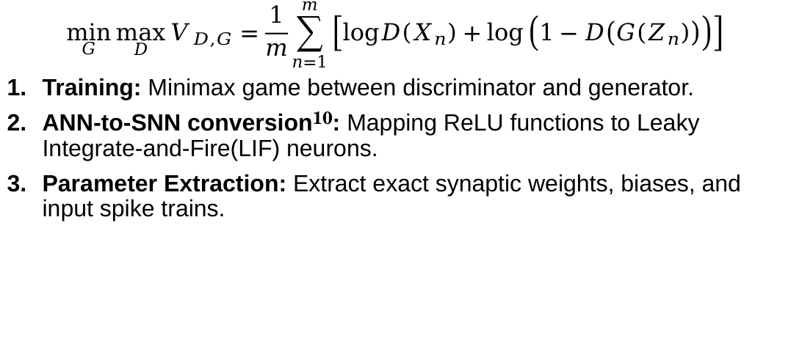
Proposed Framework: Software Implementation
$$\min_{G} \max_{D} V_{D,G}=\frac{1}{m}\sum_{n=1}^{m}{\left[logD\left(X_{n}\right)+log\left(1−D\left(G\left(Z_{n}\right)\right)\right)\right]}$$
Training: Minimax game between discriminator and generator.
ANN-to-SNN conversion¹⁰: Mapping ReLU functions to Leaky Integrate-and-Fire(LIF) neurons.
Parameter Extraction: Extract exact synaptic weights, biases, and input spike trains.
10 Diehl, Peter U., et al. "Fast-classifying, high-accuracy spiking deep networks through weight and threshold balancing." 2015 International joint conference on neural networks (IJCNN). ieee, 2015.
Notes:
In the software phase, the GAN is trained using a standard minimax game, shown in the equation.
The ANN generator is then converted into an SNN by mapping ReLU functions to Leaky Integrate-and-Fire neurons.
This event-driven LIF mechanism eliminates multiplication operations.
Finally, exact synaptic weights, biases, and input spike trains are extracted for the hardware implementation.
[2m 30s]

Slide 6
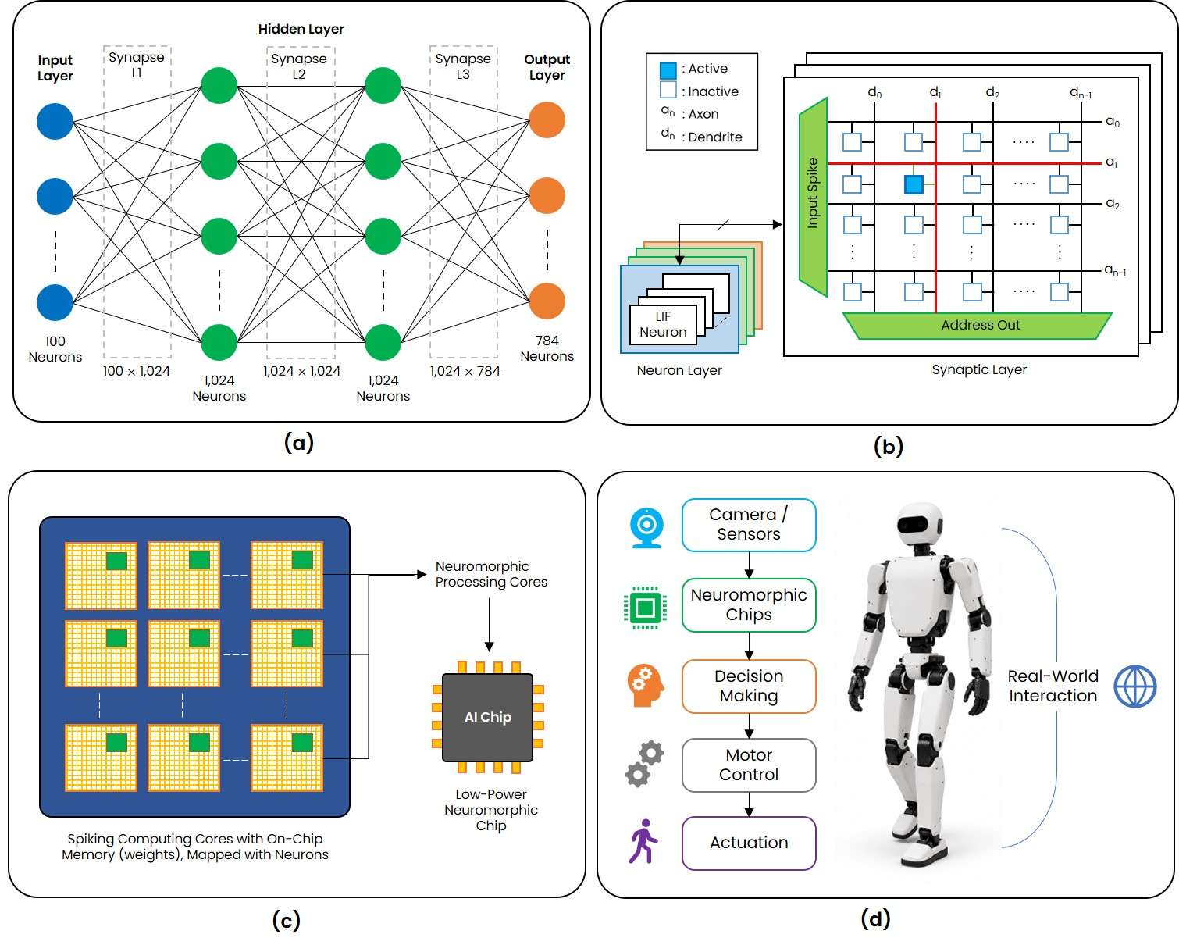
Hardware Architecture
Figure 2. Hardware architecture of the SNN-GAN generator.
Structure of GAN Spiking Neural Network.
Computing core; consisting of synapse crossbar and neuron layer.
Neuromorphic computing chips with computing core.
Humanoid robot application using neuromorphic chips.
(d)
(c)
(b)
(a)
Notes:
[figure 2]As illustrated in Figure 2, our hardware architecture is organized hierarchically to support large-scale generative models.
First, part (a) shows the network topology, consisting of 100 input neurons, two hidden layers of 1024 neurons each, and 784 output neurons.
Part (b) details the fundamental computing core, which integrates a synapse crossbar for weighted accumulations and an LIF(Leaky Integrate-and-Fire) neuron array. Operating in a timestep-driven manner, it processes input spikes sequentially through multiple layers.
In part (c), these cores are tiled to form neuromorphic chips, with weights stored in OpenRAM-based SRAM macros. Because neuron states update only upon spike arrival, the architecture effectively exploits spike sparsity to minimize memory access and computational overhead.
Finally, part (d) highlights that this logic-centric approach enables the real-time, energy-efficient inference necessary for humanoid robotics.
[3m]

Slide 7
Experimental Setup
Table 1. Model architecture and parameters¹²
Table 2. Hardware and software environment setup
Parameter | Value
Training Data | MNIST Handwritten Digits
Training Numbers | 600 Images per Batch × 20 Epochs
Input Layer | 100 Neurons
Layer 1 | 1,024 Neurons
Layer 2 | 1,024 Neurons
Layer 3 (Output) | 784 Neurons
Software Model Parameter Format | Signed FP32
RTL Model Parameter Format | Signed INT8
Component | Specification
Software (Host PC)
OS | Windows 11
Framework | PyTorch (Python)
CPU | Intel Core i9-14900KF
RAM | 128GB (32GB × 4)
GPU | NVIDIA GeForce RTX 4060 8GB
Storage | 4TB SSD (NVMe Gen4)
Hardware (FPGA) ^{12,13}
Platform | AMD VCK5000 Versal Development Card
Architecture | Versal 7nm ACAP
LUTs / FFs | ~ 899,840 / ~ 1,799,680
DSP Engines | 1,968
Advanced Micro Devices, Inc. (AMD). AMD VCK5000 Versal Development Card Product Brief. Available online: https://japan.xilinx.com/content/dam/xilinx/publications/product-briefs/amd-xilinx-vck5000- product-brief.pdf.
Advanced Micro Devices, Inc. (AMD). VCK5000 Gen4x8 Vitis Platform User Guide. Available online: https://xilinx.github.io/Alveo-Versal-Platforms/alveoversalplatforms/build/html/docs/user-guide/ug_vck5000_gen4x8_qdma.html.
Notes:
This slide shows the experimental setup, where:
Table 1 shows the model architecture and parameters of SNN-GAN generator.
And Table 2 shows the hardware and software environment setup.
For the hardware evaluation, the system was synthesized and implemented on AMD VCK5000 Versal Development Card.
[4m]

Slide 8
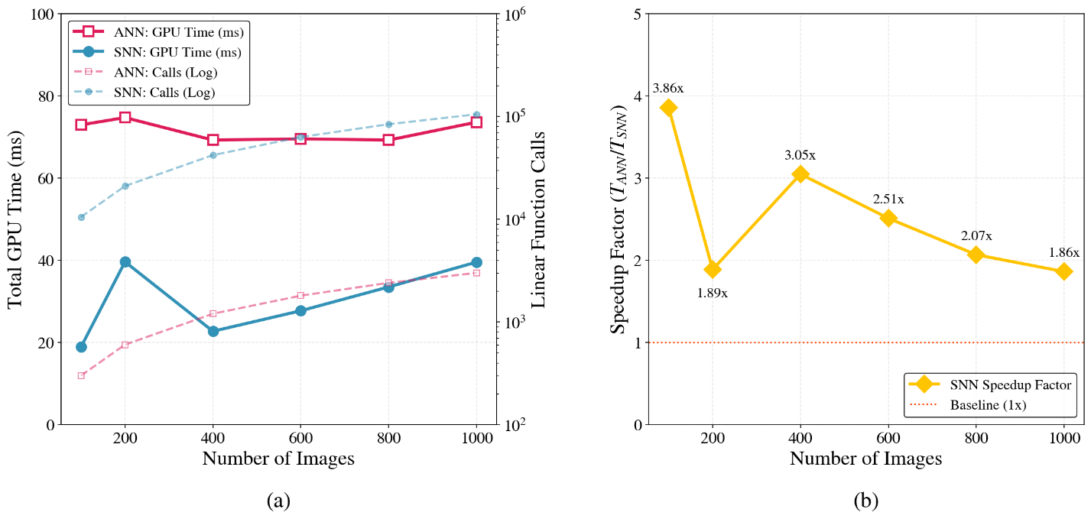
Computation Comparison
Table 3. Computational comparison between ANN and SNN generator
Images | Generator | Linear Function Calls | Total GPU Time (ms)
100 | ANN | 300 | 72.94
 | SNN | 10,500 | 18.90
200 | ANN | 600 | 74.71
 | SNN | 21,000 | 39.61
400 | ANN | 1,200 | 69.24
 | SNN | 42,000 | 22.71
600 | ANN | 1,800 | 69.55
 | SNN | 63,000 | 27.70
800 | ANN | 2,400 | 69.24
 | SNN | 84,000 | 33.50
1,000 | ANN | 3,000 | 73.60
 | SNN | 105,000 | 39.552
Figure 3. Performance analysis of ANN and SNN generators:
Total GPU execution time and linear function calls across different image scales.
SNN speedup ratio relative to the ANN.
Notes:
Table 3 presents the computational comparison between ANN and SNN generators.
While the SNN operates over multiple timesteps and requires more linear function calls, its event-driven, multiplication-free operations significantly reduce overall computational overhead.
As a result, the SNN achieves a lower execution time.
The proposed SNN implementation achieves a 1.86 to 3.86 x(times) execution speedup over the conventional ANN generator baseline, as demonstrated in figure 3.
[5m]

Slide 9
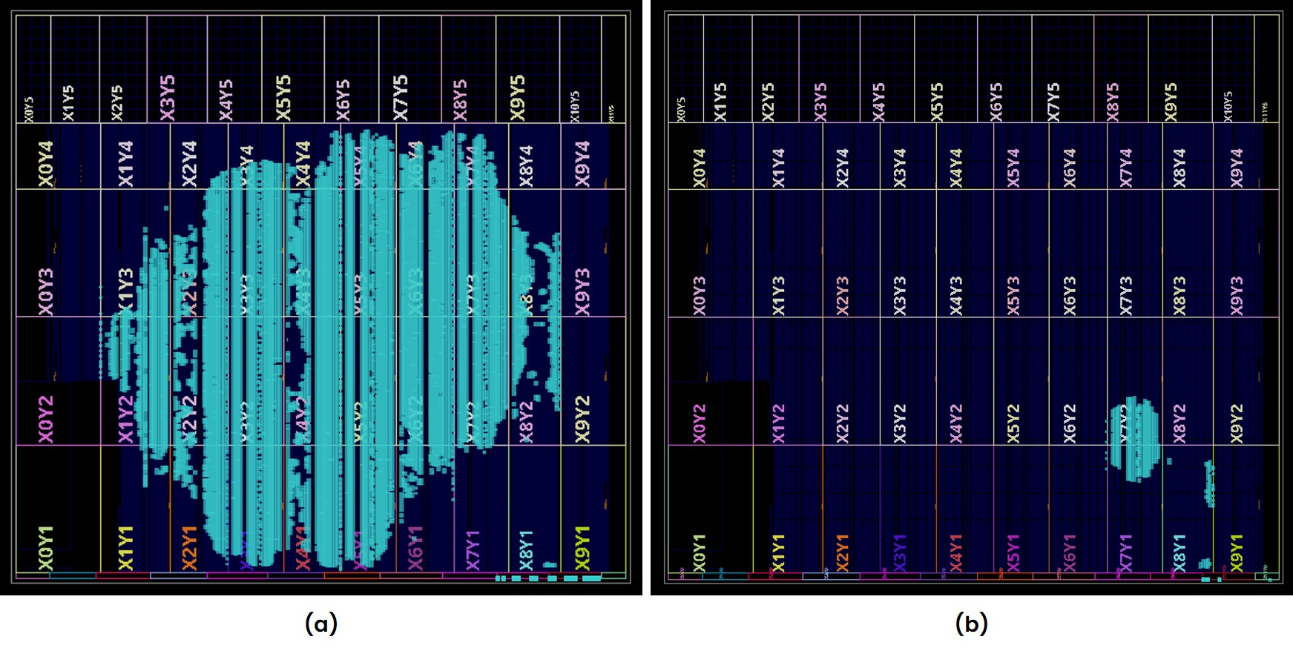
FPGA implementation
Table 4. FPGA resource utilization
Resource | Used | Available | Utilization (%)
LUT | 307,977 | 899,840 | 34.22
LUTRAM | 10,528 | 449,920 | 2.34
FF | 81,093 | 1,799,680 | 4.40
BRAM | 580 | 967 | 59.98
DSP | 0 | 1,968 | 0.00
Table 5. FPGA on-chip power breakdown
Category | Component | Power (W) | Share (%)
Dynamic Power | Clock | 0.475 | 15
 | Signals | 1.007 | 33
 | Logic | 1.150 | 37
 | BRAM | 0.461 | 15
 | Dynamic Total | 3.095 | 19
Static Power | Device Static | 13.496 | 81
Total On-Chip Power |  | 16.591 | 100
Figure4. FPGA floorplan comparison highlighting hardware scale and resource density
SNN-GAN generator.
SNN-MLP classification model.
Notes:
Table 4 summarizes the FPGA resource utilization. The architecture completely eliminates the use of DSP slices, utilizing zero DSP engines. (DSP = Digital Signal Processing block)
Table 5 shows the power consumption. The implementation is highly energy-efficient, with dynamic power consumption restricted to just 3.095 W (, representing only 19% of the total on-chip power).
Additionally, Figure 4 shows that the generative SNN requires a highly dense implementation spanning the majority of the FPGA fabric.
[6m]

Slide 10
Conclusion
Hardware Acceleration: SNN-GAN on AMD VCK5000 Versal Development Card.
Zero-DSP Utilization: Complete elimination of power-hungry DSP blocks.
Low Dynamic Power: Restricted to 3.095 W.
Performance Gain: Event-driven nature delivers a 1.86–3.86× speedup over conventional ANN baselines.
Future Work: Physical deployment into embedded humanoid robotic systems.
Notes:
We successfully demonstrated a hardware-accelerated generative SNN on the AMD VCK5000 Versal Development Card.
The architecture completely eliminates power-hungry DSP blocks, utilizing zero DSP engines.
It restricts dynamic power to just 3.095 W and delivers a 1.86 to 3.86 x(times) execution speedup over conventional ANN baselines.
This approach enables real-time, energy-efficient inference for autonomous robotic platforms.
Future work will focus on physical deployment.
[7m]

Slide 11
References
Goodfellow, Ian, et al. "Generative adversarial networks." Communications of the ACM 63.11 (2020): 139-144.
Aggarwal, Alankrita, Mamta Mittal, and Gopi Battineni. "Generative adversarial network: An overview of theory and applications." International Journal of Information Management Data Insights 1.1 (2021): 100004.
Wang, Kunfeng, et al. "Generative adversarial networks: introduction and outlook." IEEE/CAA Journal of Automatica Sinica 4.4 (2017): 588-598.
Tong, Yuchuang, Haotian Liu, and Zhengtao Zhang. "Advancements in humanoid robots: A comprehensive review and future prospects." IEEE/CAA Journal of Automatica Sinica 11.2 (2024): 301-328.
Liu, Dingbang, Hao Yu, and Yang Chai. "Low‐power computing with neuromorphic engineering." Advanced Intelligent Systems 3.2 (2021): 2000150.
Merolla, Paul A., et al. "A million spiking-neuron integrated circuit with a scalable communication network and interface." Science 345.6197 (2014): 668-673.
Bouvier, Maxence, et al. "Spiking neural networks hardware implementations and challenges: A survey." ACM Journal on Emerging Technologies in Computing Systems (JETC) 15.2 (2019): 1-35.
Mittal, Sparsh. "A survey of FPGA-based accelerators for convolutional neural networks." Neural computing and applications 32.4 (2020): 1109-1139.
Rathi, Nitin, et al. "Exploring neuromorphic computing based on spiking neural networks: Algorithms to hardware." ACM Computing Surveys 55.12 (2023): 1-49.
Diehl, Peter U., et al. "Fast-classifying, high-accuracy spiking deep networks through weight and threshold balancing." 2015 International joint conference on neural networks (IJCNN). ieee, 2015.
Guthaus, Matthew R., et al. "OpenRAM: An open-source memory compiler." Proceedings of the 35th International Conference on Computer-Aided Design. 2016.
Advanced Micro Devices, Inc. (AMD). AMD VCK5000 Versal Development Card Product Brief. Available online: https://japan.xilinx.com/content/dam/xilinx/publications/product-briefs/amd-xilinx-vck5000-product-brief.pdf.
Advanced Micro Devices, Inc. (AMD). VCK5000 Gen4x8 Vitis Platform User Guide. Available online: https://xilinx.github.io/Alveo-Versal-Platforms/alveoversalplatforms/build/html/docs/user-guide/ug_vck5000_gen4x8_qdma.html.
Notes:
This slide is References. Thank you for your attention.

