Slide 1
A Resilient On-Chip STDP Learning Under Memory Voltage Scaling
Subbaiah Ravi Hariprakash
Supervised by Prof. Khanh N. Dang
m5282026
06/08/2026

Slide 2
Content
Introduction
Proposed Method
Results
Conclusion

Slide 3
Content
Introduction
Energy Consumption
Types of Learning
Spiking Neural Networks (SNNs)
LIF Neuron
On-Chip STDP Learning
Overall Architecture
Voltage effects on DRAM and SNNs
Proposed Method
Results
Conclusion

Slide 4
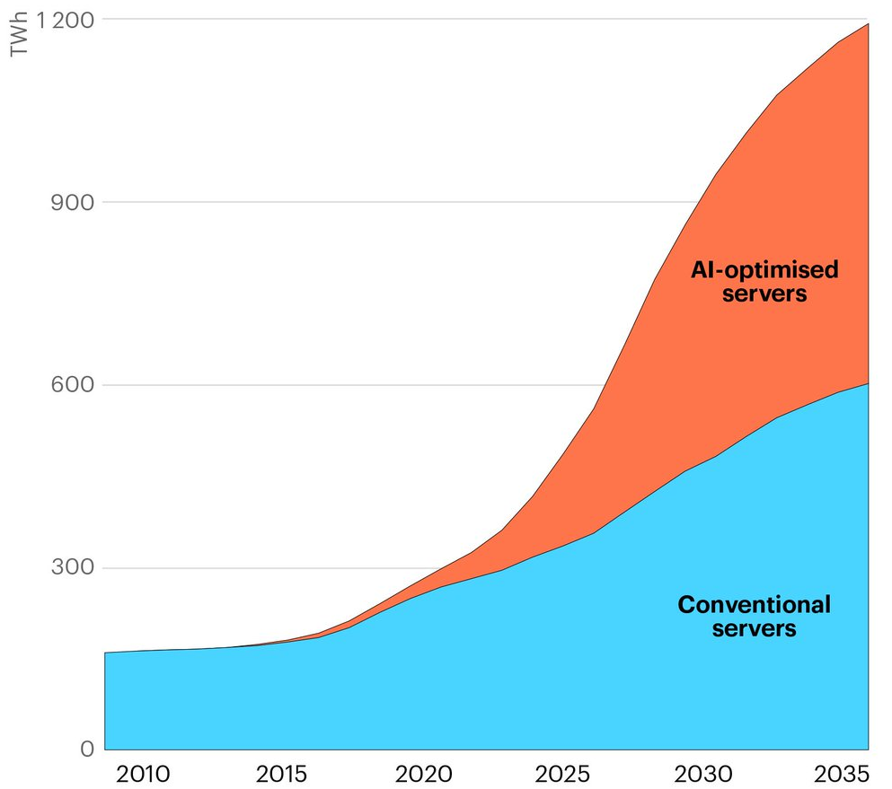
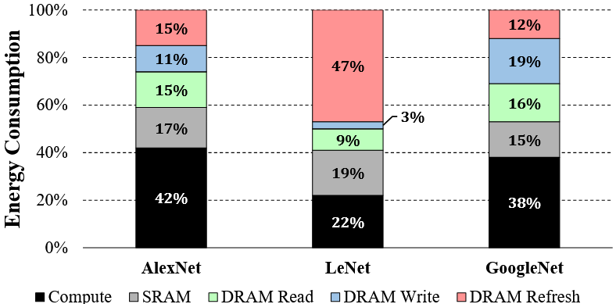
Introduction
Energy consumption due to memory (DRAM) ~50% - 70%
(a) Predicted power consumption due to AI usage$^{[1]}$
(b) Energy consumption breakdown of three CNNs on a modern CNN accelerator$^{[2]}$
Notes:
AI consumes lot of power
Of that memory is 50 % to 70%

Slide 5


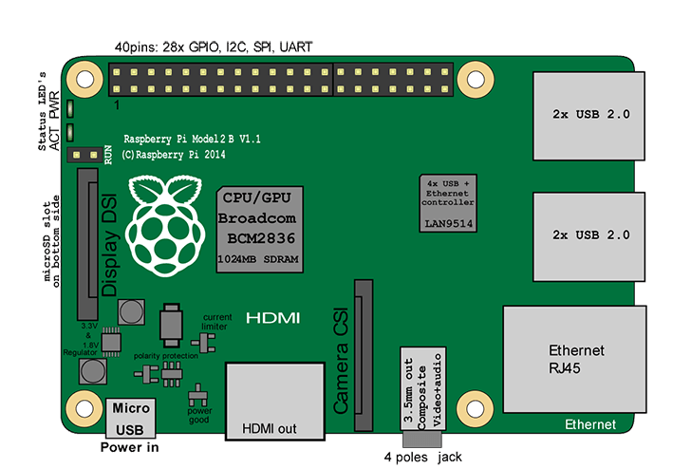
Off-Chip and On-Chip Learning
Neural Network trained
Neural network trained locally
Raw Data
(e.g Images)
Fixed Model
High energy efficiency needed for on chip
(a) Off-Chip learning
(b) On-Chip learning
Notes:
In AI computation, training takes time and energy
2 types of training
Off chip: upload to server,
On chip: no cloud, system learn on its own
In this research, we want to do on chip
Fundamental problem is energy,

Slide 6
Spiking Neural Networks
0
L
a
t
e
r
a
l
I
n
h
i
b
i
t
o
r
1
y
Input Spike
2
Output Spike
3
4
L
a
b
e
l
1
:
2
s
p
i
k
e
s
L
a
b
e
l
2
:
0
s
p
i
k
e
5
L
s
a
b
e
l
L
a
b
e
l
3
:
1
0
s
p
i
k
e
C
s
o
u
n
t
i
n
I
g
n
p
u
t
…
S
…
Excitatory
p
i
k
e
s
L
a
b
e
l
N
:
1
s
p
i
k
e
s
C
l
a
s
s
i
f
i
c
a
t
i
o
n
O
u
t
p
u
I
t
n
p
u
t
s
i
g
n
a
l
N
-
4
N
-
3
N
-
2
N
-
1
A Spiking Neural Network (SNN) topology employing On–Chip Spike-Timing Dependent Plasticity (STDP)
Notes:
Fig shows A Spiking Neural Network (SNN) topology employing On–Chip Spike-Timing Dependent Plasticity (STDP)
I/p spikes enter, causes neuron to excite, sends negative signal to other neurons
Classification based on which neuron has most spikes
i/p from rate coding
How does the neuron work? LIF neuron

Slide 7
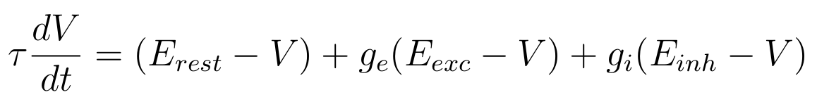

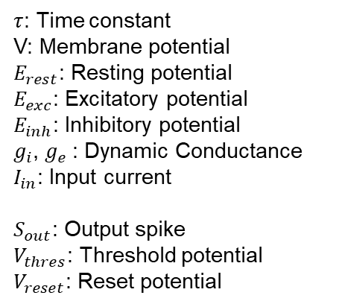



Leaky Integrate and Fire (LIF) Neuron
$τ$: Time constant
V: Membrane potential
$E_{rest}$: Resting potential
$E_{exc}$: Excitatory potential
$E_{inh}$: Inhibitory potential
$g_{i}$, $g_{e}$: Dynamic Conductance
$I_{in}$: Input current
$S_{out}$: Output spike
$V_{thres}$: Threshold potential
$V_{reset}$: Reset potential
$$I_{in}$$
Inputs
Dendrites
t
$$V_{thres}$$
Axon
V(t)
t
t
$$V_{reset}$$
Neuron Body
Output
t
$$S_{out}$$
t
(a) Typical SNN Neuron
(b) LIF Potential dynamics
LIF equation:
Notes:
Illustration of LIF neuron
Fig a shows typical neuron connection
Fig b shows dynamics of LIF neurons with i/p current and how i/p potential V leak and Vthres

Slide 8
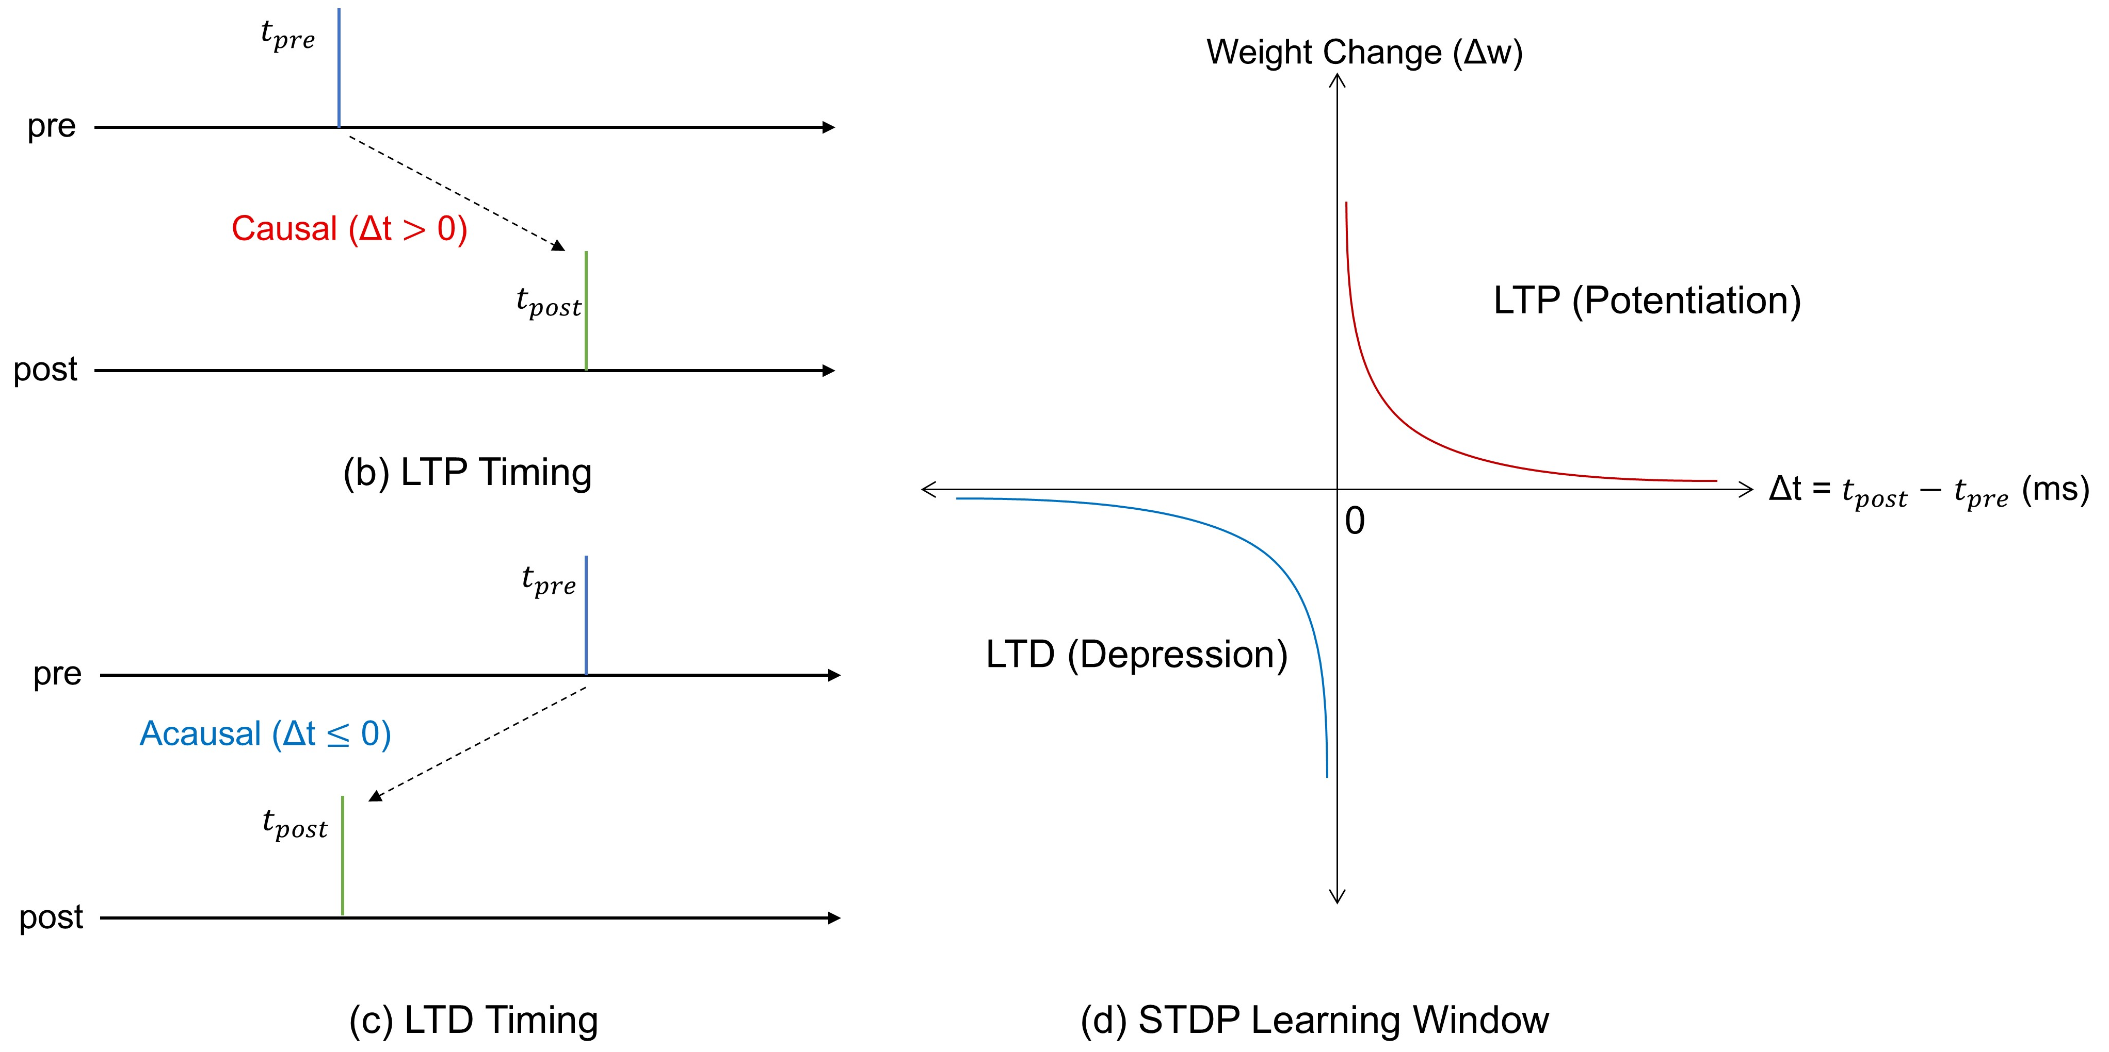





On-Chip STDP Learning
$$t_{pre}$$
$$t_{ }$$
LIF
$$t_{post}$$
$$t_{ }{=t}_{post}−t_{pre}$$
(a) LIF neuron and spike timings
Equation: $Δw=η\left(x_{pre}−x_{tar}\right)\left(w_{max}−w{\left.)\right.}^{μ}\right.$
Notes:
This slide shows how On-chip STDP works
Fig a is a single LIF neuron with spike timing tpre and tpost
Fig b and c show 2 cases: tpre before tpost and tpost before tpre
Fig d shows how the weights are updated with the timings

Slide 9
Overall Architecture
Our Thesis/Research focus
.....
TSV
k^{th} Memory Die
TSV
3rd Memory Die
2nd Memory Die
1st Memory Die
TSV
LIF
Neurons
STDP Learning Controller
TSV
STDP-DIP Boot-Time BIST
Logic Die
Package Substrate
Architecture of proposed system
Part of "Y. Hanyu, R. Kobayashi, S. R. Hariprakash, S. Ganesh, N.-D. Nguyen, D.-A. Nguyen, M. Maatar, A. Ben Abdallah, Z. Wang, and K. N. Dang, 'E3STDP: Energy-Efficient Ensemble Spike-Timing-Dependent Plasticity for Carbon-Aware Neuromorphic Computation.’” IEEE Transactions on Sustainable Computing (under major revision)
Notes:
This slide shows our Overall Architecture and where the focus of this research is which is DRAM stacking on top of the logic die
This research is a part of a collaborative research which is under major revision in IEEE Transactions on Sustainable Computing at the moment
Although SNN offers better Energy efficiency, we are still searching for even lower energy numbers. As we mention earlier memory plays a major part, we would like to tackle it in this research

Slide 10
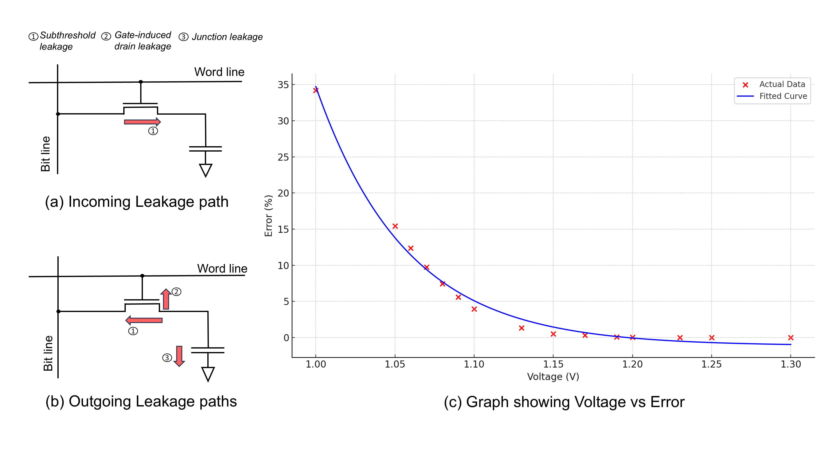
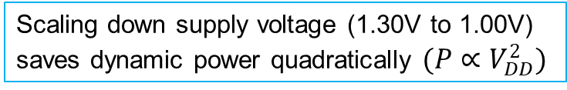
Undervolting DRAM
Trade-off: Triggers an exponential increase in memory retention errors (up to ~35% BER)
Scaling down supply voltage (1.30V to 1.00V) saves dynamic power quadratically $(P∝V_{DD}^{2})$
(c) Graph showing Voltage vs Error obtained from HSPICE simulations using a 45 nm CMOS technology
Notes:
One of the solution is Undervolting the memory or reducing the supply voltage
There are drawbacks of undervolting DRAM cell,
Fig a shows incoming leakage
Fig b shows outgoing leakage
To understand more we ran a single DRAM cell HSPICE sim with Monte Carlo Sim and 45nm and obtained graph c
In summary we can scale down power consumption dramatically, however memory retention error increases

Slide 11
Memory Fault Behaviours Under Undervolting
Soft Errors (Bit-Flips):
Temporary data glitches
Permanent Errors:
Caused by manufacturing defects
Exposed due to aggressive undervolting
This research focuses on Stuck-at Faults
Weak cells leak charge, permanently locks physical cell to ground (0) or supply voltage (1)
0
1
0
1
0
1
(a) Normal bit update
(b) Bit flip
(c) Bit stuck-at
Notes:
Now we see the effects
Soft errors are Temporary data glitches
Permanent errors

Slide 12
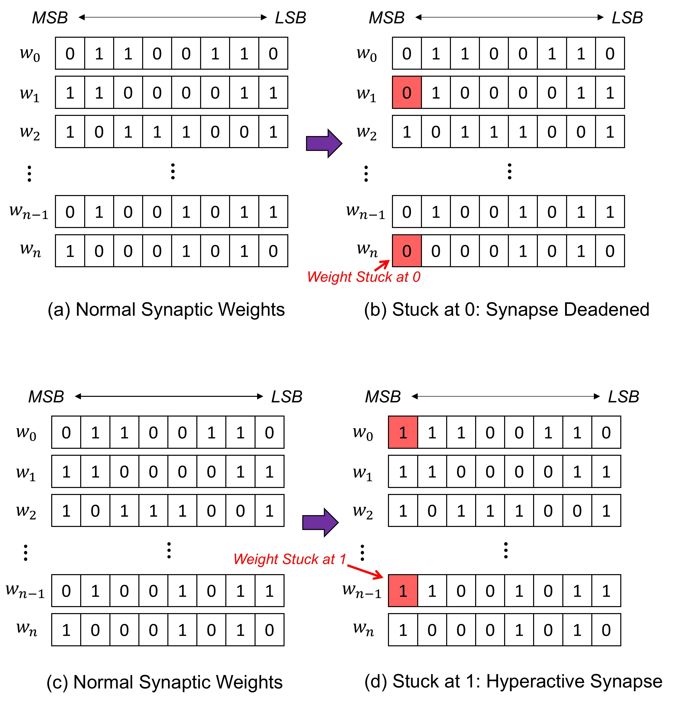
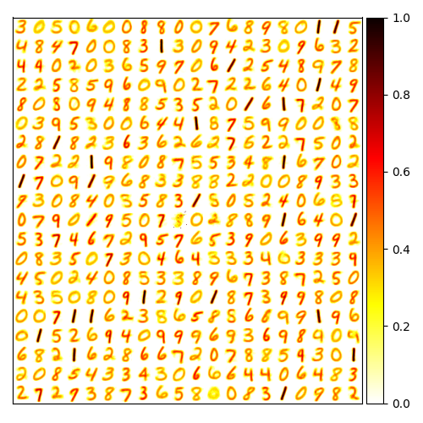

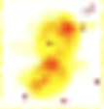
Impact of SA0 vs SA1 Faults
Stuck-at-0 (SA0):
Weight locked to minimum conductance
Easily absorbed, accuracy remains stable (>90%).
Stuck-at-1 (SA1):
Weight locked to maximum conductance
Neuron fires continuously
Suppresses all healthy neurons
Accuracy collapses from 92.0% to 10.9%*
(e) Normal Field
(f) SA0 Field
(g) SA1 Field
*Data obtained from STDP Learning model with 784 weights per 1000 neuron network, MNIST dataset
Notes:
We would like to see the impact of SA0 and SA1 on On-chip STDP learning
LHS is how we insert fault.
To have the most impact we insert in the MSB
Other bit indices have lower impact
B/w SA0 and SA1, we observe SA0 has almost no impact, and SA1 collapses STDP learning
Accuracy collapses from 92.0% to 10.9% *Data obtained from STDP Learning model with 784 weights per 1000 neuron network, MNIST dataset
Fig e f g show receptive fields of same neuron under 3 cases: Normal, SA0, SA1

Slide 13
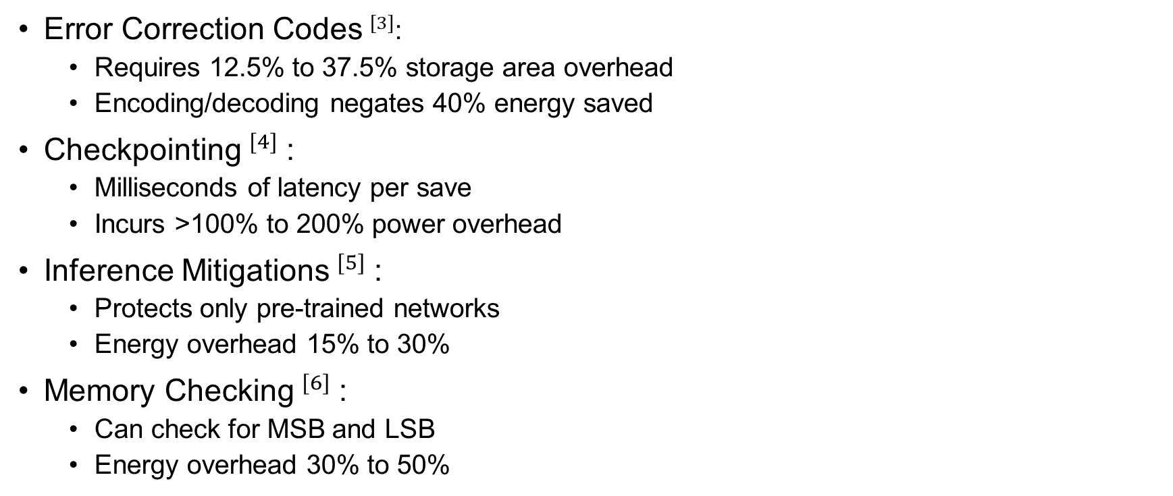
Related Work
Error Correction Codes$^{[3]}$:
Requires 12.5% to 37.5% storage area overhead
Encoding/decoding negates 40% energy saved
Checkpointing$^{[4]}$:
Milliseconds of latency per save
Incurs >100% to 200% power overhead
Inference Mitigations$^{[5]}$:
Protects only pre-trained networks
Energy overhead 15% to 30%
Memory Checking$^{[6]}$:
Can check for MSB and LSB
Energy overhead 30% to 50%
Unsuitable for On-chip STDP learning
Notes:
How others have approached this problem
(Read first bullet point for all methods)
However, the common problem is overhead in power and energy which makes them unsuitable of On-chip STDP learning

Slide 14
Problem Statement and Contributions
Problem:
Near-threshold undervolting to lower consumption
Low voltages cause stuck-faults and flip bits
SA1 destroys STDP learning
Contributions:
Characterized SA1 behavior under eDRAM voltage scaling
Proposed STDP-DIP to identify, isolate and prune faulty neurons

Slide 15
Content
Introduction
Proposed Method
Results
Conclusion

Slide 16
STDP-DIP: Diagnostic Isolation Pruning
Phase 1: Detects SA1 at MSB in the weight matrix
Phase 2: Faulty neuron is structurally severed
Phase 3: Output of faulty neuron unlabeled

Slide 17
STDP-DIP: Proposal Overview
0
Stuck at 1
DIP: Inhibitory connection severed
1
Lateral Inhibition
Input Spike
2
Output Spike
3
4
L
a
b
e
l
1
:
2
s
p
i
k
e
s
L
a
b
e
l
2
:
0
s
p
i
k
e
5
L
s
a
b
e
l
L
a
b
e
l
3
:
1
0
s
p
i
k
e
C
s
o
u
n
t
i
n
I
g
n
p
u
t
…
S
Excitatory
p
i
k
e
s
L
a
b
e
l
N
:
1
s
p
i
k
e
…
s
C
l
a
s
s
i
f
i
c
a
t
i
o
n
O
u
t
p
u
I
t
n
p
u
t
s
i
g
n
a
l
N
-
4
N
-
3
N
-
2
N
-
1
Overview of STDP network and STDP-DIP
Notes:
This slide shows an overview of STDP –DIP
The red neuron 1 has SA1 fault, out principle is to detect and cut it off

Slide 18


STDP-DIP: Detection
MSB faults observed to cause most impact
Synaptic weights of neurons checked for Stuck-at-1 MSBs
Another way is to detect hyperactive (fires continuously) neuron
Why?
Memory check exists but needs 30% to 50% more energy
ECC negates 40% energy saved
Bit permanently Stuck at 1
MSB
LSB
MSB
LSB
$$w_{0}$$
0
1
1
0
0
1
1
0
$$w_{0}$$
1
1
1
0
0
1
1
0
(a) Bit values of synaptic weights of healthy neuron
(b) Bit values of synaptic weights of SA1 neuron
Notes:
As previously mentioned, SA1 at MSB cause the most impact
Our principle is to check stuck at 1 MSB
(Just read)

Slide 19



STDP-DIP: Algorithm (1)
Brief lateral inhibition triggered by each spike
Healthy competition and diverse feature learning
Input Spike
0
Lateral Inhibition
Output Spike
4
Input Spikes
1
Label Counting (Output)
$N_{0}$: Digit 4
$N_{1}$: Digit 2
Input Signal
Excitatory
$N_{2}$: Digit 7
2
Excitatory Layer
Normal STDP Operation
Notes:
This slide shows a simplified visualisation with only 3 neurons for ease of understanding
Here after receiving input spike, this neuron can fire and exhibits Lateral Inhibition to other neurons

Slide 20



STDP-DIP: Algorithm (2)
Faulty neuron fires continuously
Runaway lateral inhibition, paralyzes neurons, stops learning
Healthy neurons paralyzed by continuous lateral inhibition
0
Lateral Inhibition
Input Spike
Stuck at 1
4
Input Spikes
1
Label Counting (Output)
$N_{0}$: 0 Spikes
$N_{1}$: Many Spikes
Input Signal
$N_{2}$: 0 Spikes
2
2
Neuron Index
1
0
Excitatory Layer
Time t
(a) Uncorrected SA1 Fault
(b) Spike timing
Notes:
Here is the same visualisation where Neuron 1 has SA1
As mentioned before, it becomes hyperactive
(Just read)

Slide 21



STDP-DIP: Algorithm (3)
Detect faulty neuron
Faulty neuron connection severed
Healthy STDP spiking restored
0
SA1 Detected: Inhibition Severed
Input Spike
Output Spike
4
Input Spikes
1
Label Counting (Output)
$N_{0}$: Digit 4
$N_{1}$: (Masked)
Input Signal
$N_{2}$: Digit 7
Normal Lateral Inhibition
2
Excitatory Layer
Corrected using STDP-DIP
Notes:
This slide shows how we fixed it
We detect the faulty neuron

Slide 22
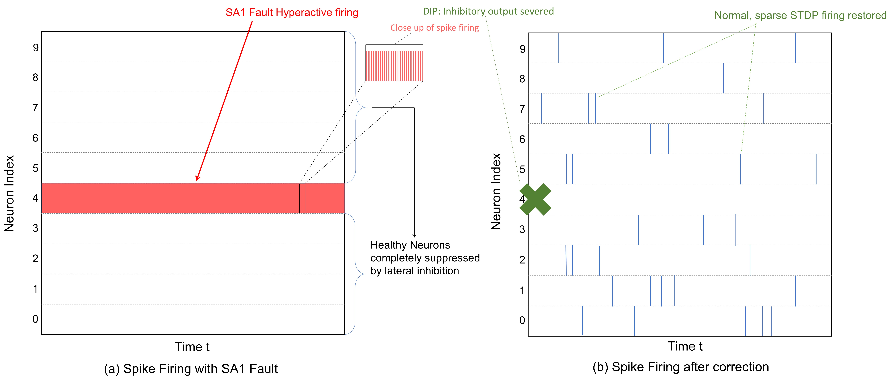
Spike Behaviour Restoration
Notes:
LHS is spike timing with SA1 at Neuron 4
RHS is by doing STDP-DIP to restore other neurons

Slide 23
Content
Introduction
Proposed Method
Results
Conclusion

Slide 24
Simulation Setup
Environment: Python, PyTorch, BindsNET, Ran with 3 different seeds
Hardware Model: 45nm PTM CMOS eDRAM, Monte Carlo simulation done with HSPICE (100000 trials per case)
Network: LIF-STDP model
Dataset: Poisson-encoded MNIST

Slide 25





















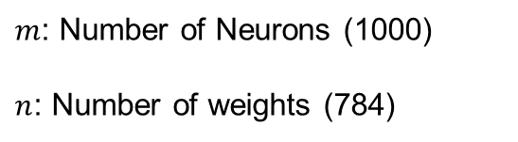
Fault Insertion
$$w_{0}$$
1
1
1
0
0
1
1
0
Faulty neurons chosen randomly
MSB of weights flipped manually
Simulates SA1 fault
$$N_{0}$$
$$N_{1}$$
$$N_{2}$$
…
$$N_{m}$$
$$w_{0}$$
$$w_{0}$$
$$w_{0}$$
$$w_{0}$$
$$w_{1}$$
$$w_{1}$$
$$w_{1}$$
$$w_{1}$$
$$w_{2}$$
$$w_{2}$$
$$w_{2}$$
$$w_{2}$$
…
…
…
…
$$w_{n}$$
$$w_{n}$$
$$w_{n}$$
…
$$w_{n}$$
$m$: Number of Neurons (1000)
$n$: Number of weights (784)

Slide 26
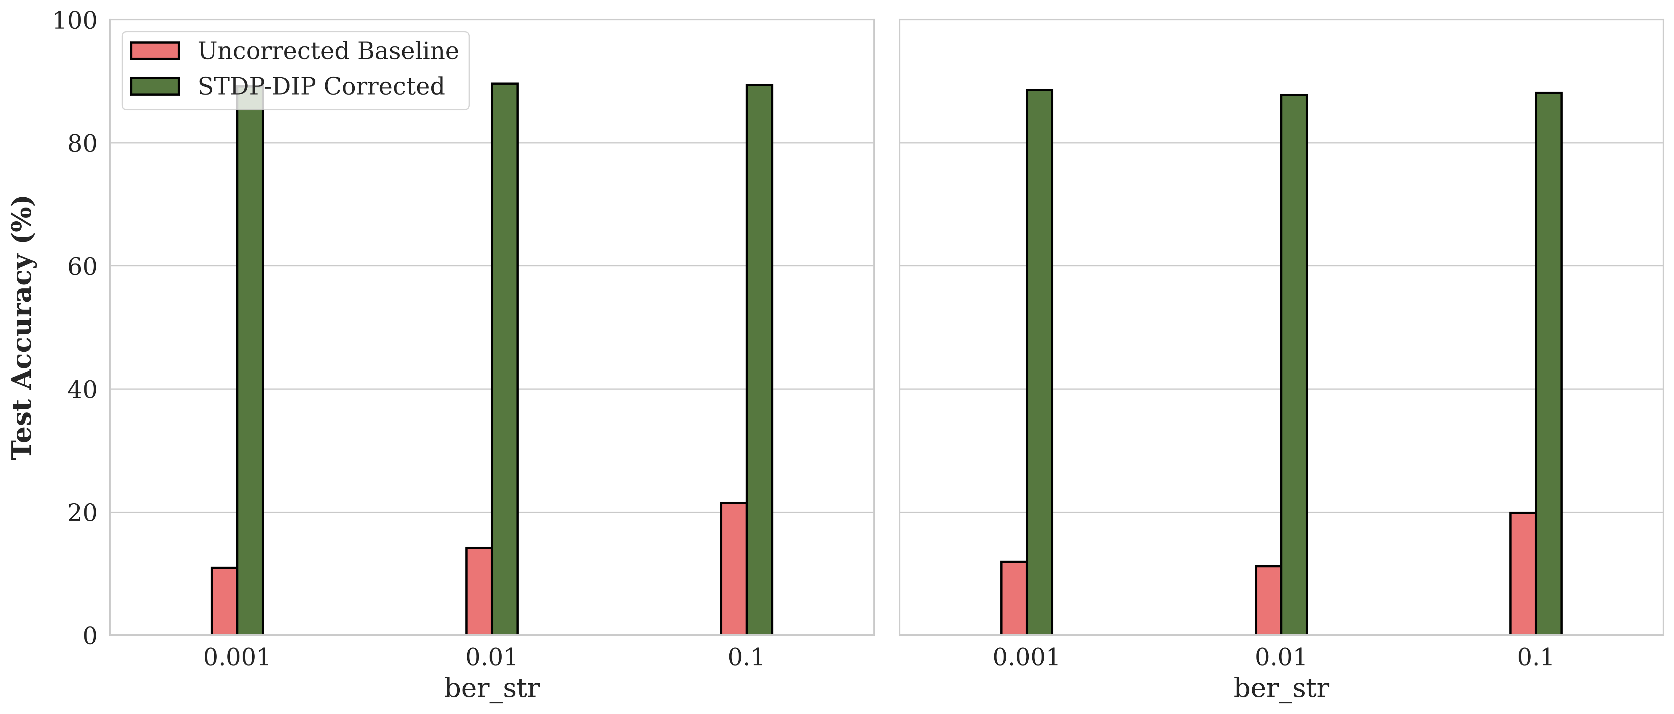
Results: 400 Neurons
Test Accuracy (%)
Bit Error Rate (BER)
Bit Error Rate (BER)
(a) Plot between accuracy before and after correction for 5 SA1 neurons in a 400 neuron network
(b) Plot between accuracy before and after correction for 15 SA1 neurons in a 400 neuron network
Accuracy improved by 73% - 79%
Notes:
400 neuron with diff BER, in summary accuracy improved by …

Slide 27
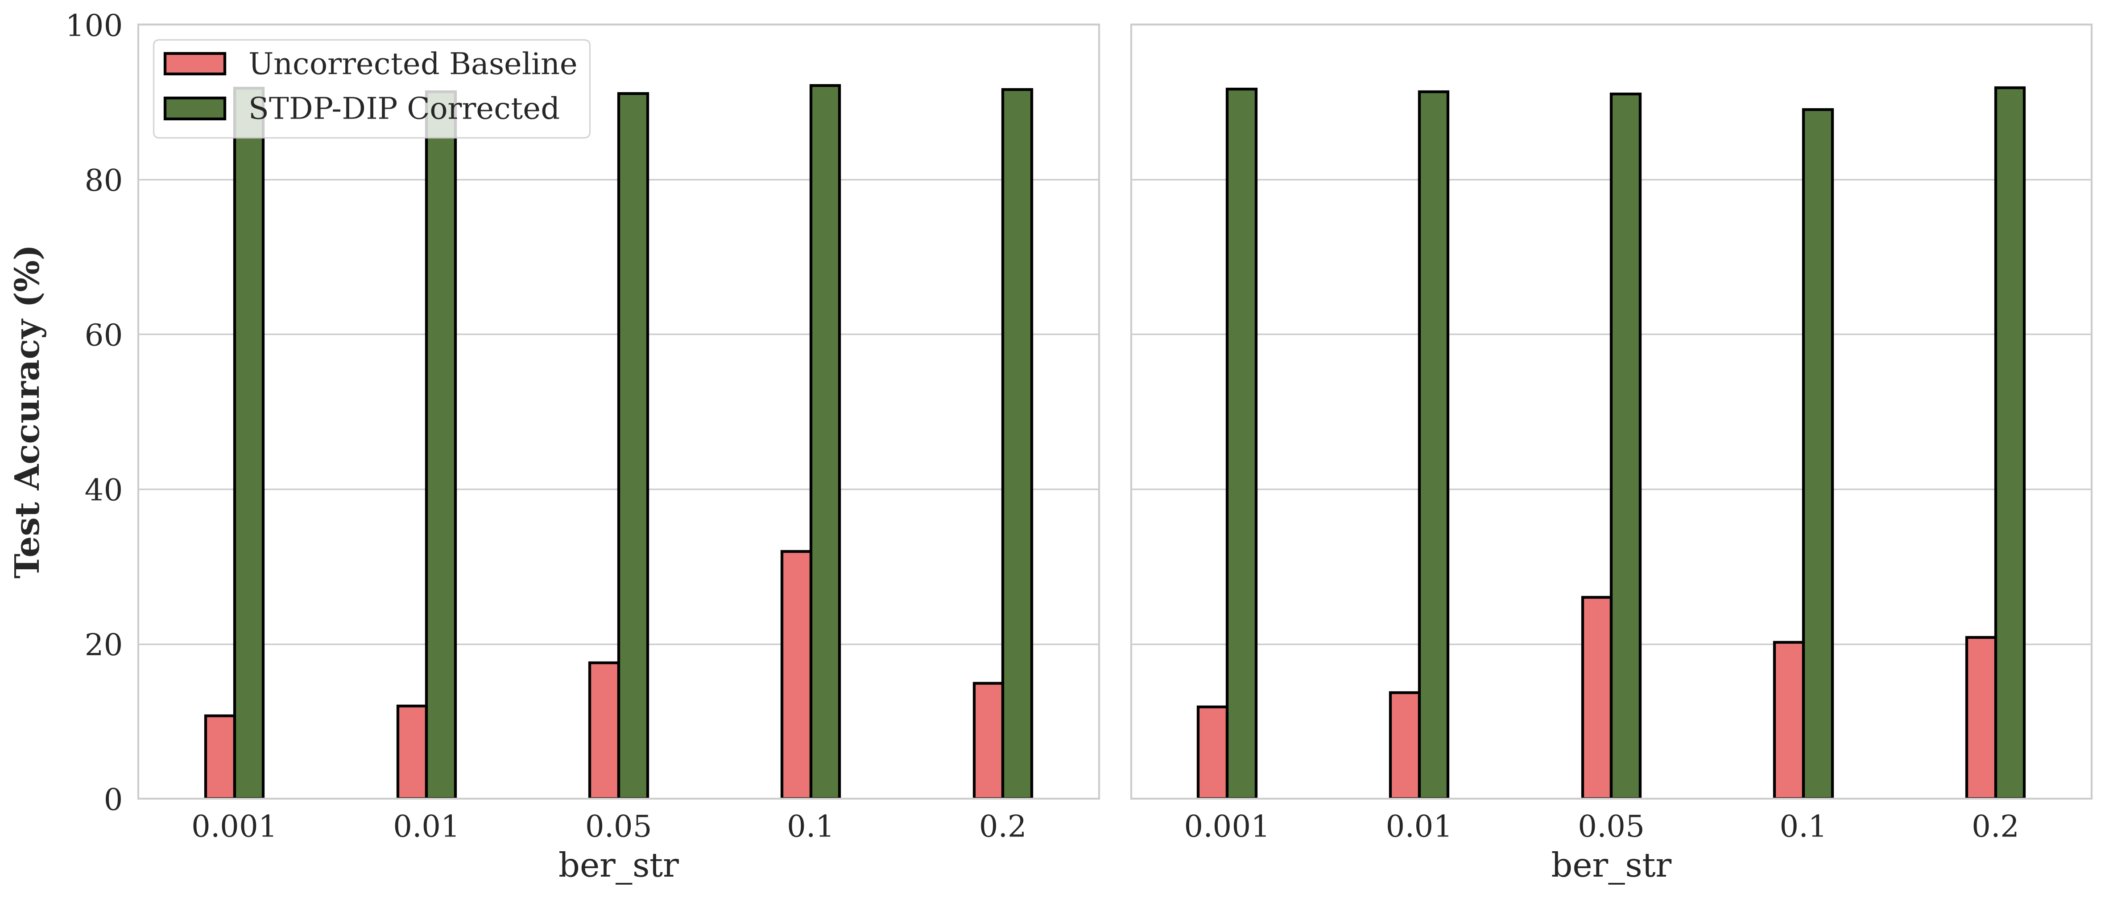
Results: 1000 Neurons
Test Accuracy (%)
Bit Error Rate (BER)
Bit Error Rate (BER)
(a) Plot between accuracy before and after correction for 5 SA1 neurons in a 1000 neuron network
(b) Plot between accuracy before and after correction for 15 SA1 neurons In a 1000 neuron network
Accuracy improved by 71% - 81%
Notes:
1000 neuron with diff BER, in summary accuracy improved by …

Slide 28
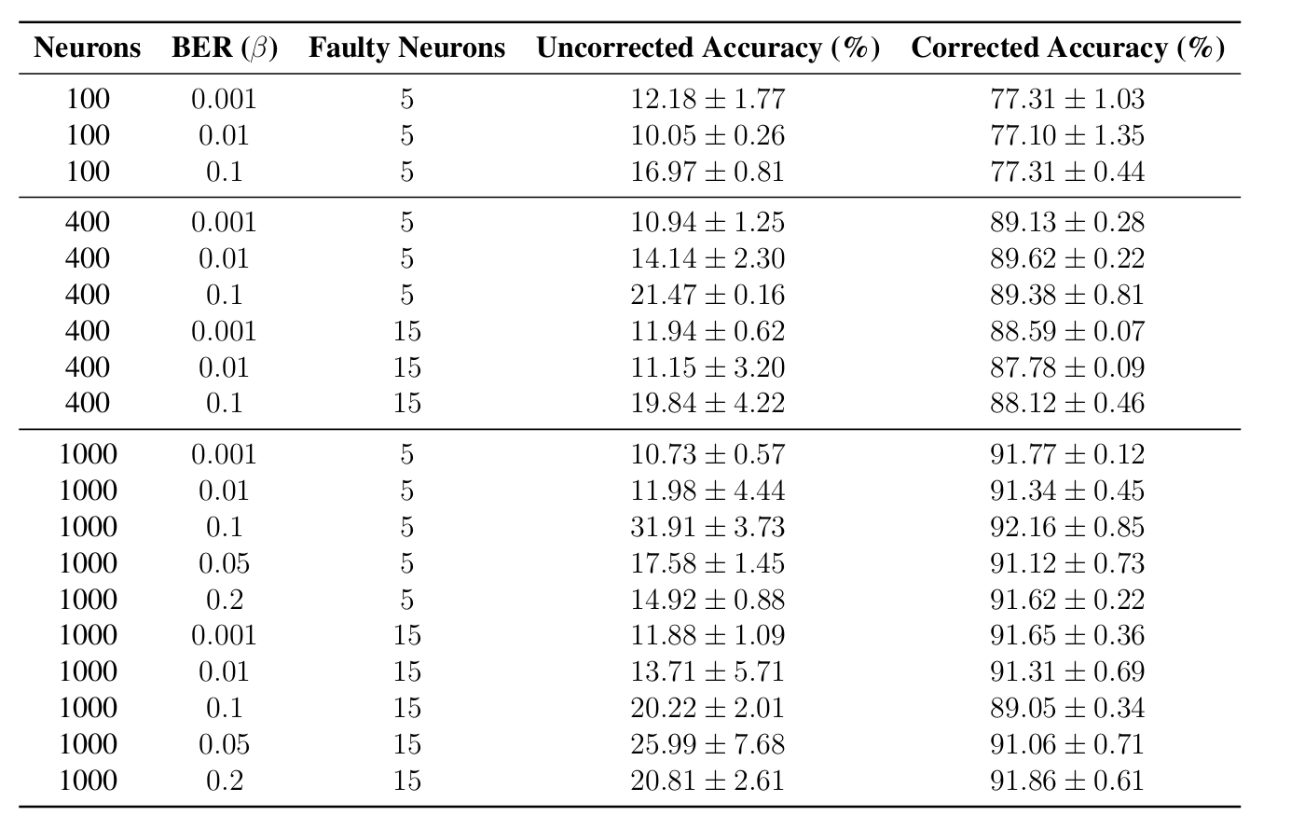
Results: All cases
Notes:
This slide shows all cases
In summary we can restore to original accuracy

Slide 29
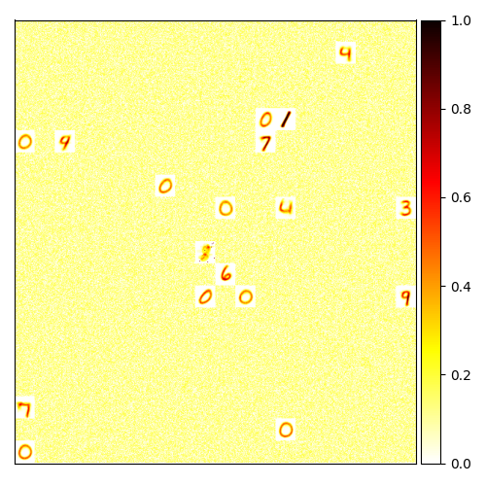
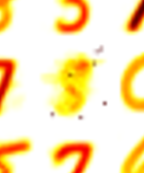
Results: Training With Fault Correction
Faulty neuron isolated
(a) Network trained with SA1 fault and no correction
(b) Network trained using proposed STDP-DIP framework

Slide 30
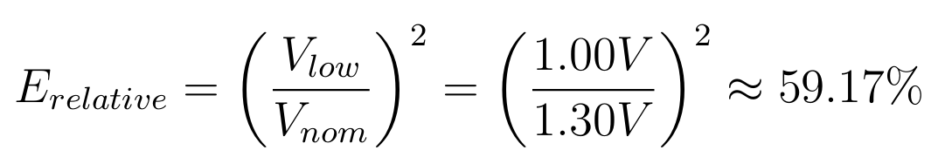
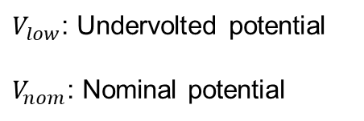
Results: Energy Saved
Relative Energy reduction
$V_{low}$: Undervolted potential
$V_{nom}$: Nominal potential
40.83% reduction by scaling supply voltage down to 1.00V
20.4% to 30.6% total energy reduction
Assumption: Memory energy 50% to 75%
Notes:
We have shown that we can restore the overall accuracy
One question is how much energy can be saved with undervolting
This equation shows the relative energy reduction
(Just read)

Slide 31
Content
Introduction
Proposed Method
Results
Conclusion

Slide 32
Conclusion
Identified impact of SA1 memory faults on On-Chip STDP learning
Developed STDP-DIP to improve accuracy
Restored >91% accuracy while saving 30.6% system energy
Future Work
Explore different learning approach
Explore mixed-fault scenarios (SA0 + SA1)

Slide 33
References
[1] International Energy Agency (IEA), "Global Data Centre Electricity Consumption Report," Paris, France, Tech. Rep., 2025.
[2] Y.-H. Chen, T. Krishna, J. S. Emer, and V. Sze, "Eyeriss: An Energy-Efficient Reconfigurable Accelerator for Deep Convolutional Neural Networks," IEEE Journal of Solid-State Circuits, vol. 52, no. 1, pp. 127–138, Jan. 2017, doi: 10.1109/JSSC.2016.2616357.
[3] P. J. Nair, D. A. Roberts, and M. K. Qureshi, "Faulty: A Reliable Data-Bus Architecture for Low-Voltage DRAMs," 2013 IEEE 31st International Conference on Computer Design (ICCD), Asheville, NC, USA, 2013, pp. 432–439, doi: 10.1109/ICCD.2013.6657078.
[4] H. Hassan, L. Orosa, R. Ausavarungnirun, and O. Mutlu, "SoftMC: A Flexible and Open-Source FPGA-Based Memory Controller for Memory Characterization and Testing," IEEE Transactions on Computers, vol. 72, no. 4, pp. 1020–1034, Apr. 2023, doi: 10.1109/TC.2022.3198765.
[5] W. W. Hargrove and J. Pickering, "Pseudoreplication: a review of its history and a recommendation for its avoidance," Conservation Biology, vol. 3, no. 4, pp. 389–397, Dec. 1989, doi: 10.1111/j.1523-1739.1989.tb00245.x.
[6] R. V. W. Putra, M. A. Hanif, and M. Shafique, "DRiP: Dynamic Refresh and Precision Scaling for Approximate DRAM in DNN Accelerators," 2021 IEEE/ACM International Conference On Computer Aided Design (ICCAD), Munich, Germany, 2021, pp. 1–9, doi: 10.1109/ICCAD51581.2021.9643534.
[7] R. Kobayashi and K. N. Dang, "An Efficient Hardware Implementation of Spiking Neural Network Using Approximate Izhikevich Neuron," 2024 9th International Conference on Integrated Circuits, Design, and Verification (ICDV), Hanoi, Vietnam, 2024, pp. 13-18, doi: 10.1109/ICDV61346.2024.10616602.
[8] Ryoji Kobayashi, Ngo-Doanh Nguyen, Nguyen Anh Vu Doan and Khanh N. Dang, '’Energy-Efficient Spiking Neural Networks Using Approximate Neuron Circuits and 3D Stacking Memory’‘, 2024 IEEE 17th International Symposium on Embedded Multicore/Many-core Systems-on-Chip (MCSoC), Dec. 16-19, 2024.

Slide 34
References
[9] Du, Y. Decentralized Smart IoT. Encyclopedia. Available online: https://encyclopedia.pub/entry/8977 (accessed on 22 November 2022).
[10] S. H. Tsang, https://towardsdatascience.com//review-refinenet-multi-path-refinement-network-semantic-segmentation
[11] John L. Hennessy, David A. Patterson, A New Golden Age for Computer Architecture, Communications of the ACM, February 2019, Vol. 62 No. 2, Pages 48-60, 10.1145/3282307
[12] J. Wuu et al., "3D V-Cache: the Implementation of a Hybrid-Bonded 64MB Stacked Cache for a 7nm x86-64 CPU," 2022 IEEE International Solid-State Circuits Conference (ISSCC), San Francisco, CA, USA, 2022, pp. 428-429, doi: 10.1109/ISSCC42614.2022.9731565.
[13] H. Songara and A. Deshwal, "Towards Tackling Capacity-Bound Models Using DRAMs Over SRAMs," 2024 IEEE 21st India Council International Conference (INDICON), Kharagpur, India, 2024, pp. 1-6, doi: 10.1109/INDICON63790.2024.10958400.
[14] IEA (2025), Global data centre electricity consumption by sensitivity case, 2020-2035, IEA, Paris https://www.iea.org/data-and-statistics/charts/global-data-centre-electricity-consumption-by-sensitivity-case-2020-2035, Licence: CC BY 4.0
[15] Micron Technology, Inc, 4Gb DDR3 SDRAM Component Data Sheet: MT41J512M8, 2009.
[16] A. Ben Abdallah and K. N. Dang, Neuromorphic Computing Principles and Organization, 2nd ed., Springer, 2025, ISBN: 978-3-031-83091-4.
[17] Y. Hanyu and K. N. Dang, "EnsembleSTDP: Distributed in-situ Spike Timing Dependent Plasticity Learning in Spiking Neural Networks," 2024 IEEE 17th International Symposium on Embedded Multicore/Many-core Systems-on-Chip (MCSoC), pp. 434-440, 2024.

Slide 35
Thank you for your attention!

Slide 36
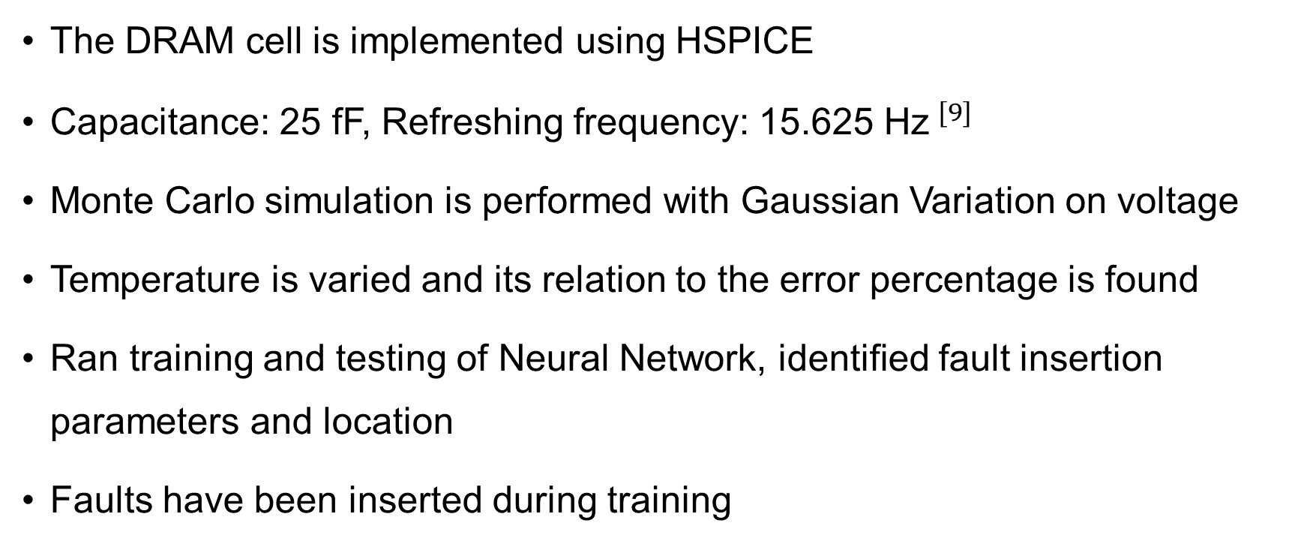
Details
The DRAM cell is implemented using HSPICE
Capacitance: 25 fF, Refreshing frequency: 15.625 Hz$^{[9]}$
Monte Carlo simulation is performed with Gaussian Variation on voltage
Temperature is varied and its relation to the error percentage is found
Ran training and testing of Neural Network, identified fault insertion parameters and location
Faults have been inserted during training

Slide 37



Rate Coding
Converts raw sensor data into spike trains and processed by an SNN
High pixel intensity = High spike frequency
Transmitting 1-bit spikes is more efficient
Input = 0
$$t$$
Input = 1
$$t$$
Spikes generated from MNIST image
Notes:
Now that we have converted our heavy image data into lightweight binary spikes, how does the hardware actually process them

