Slide 1
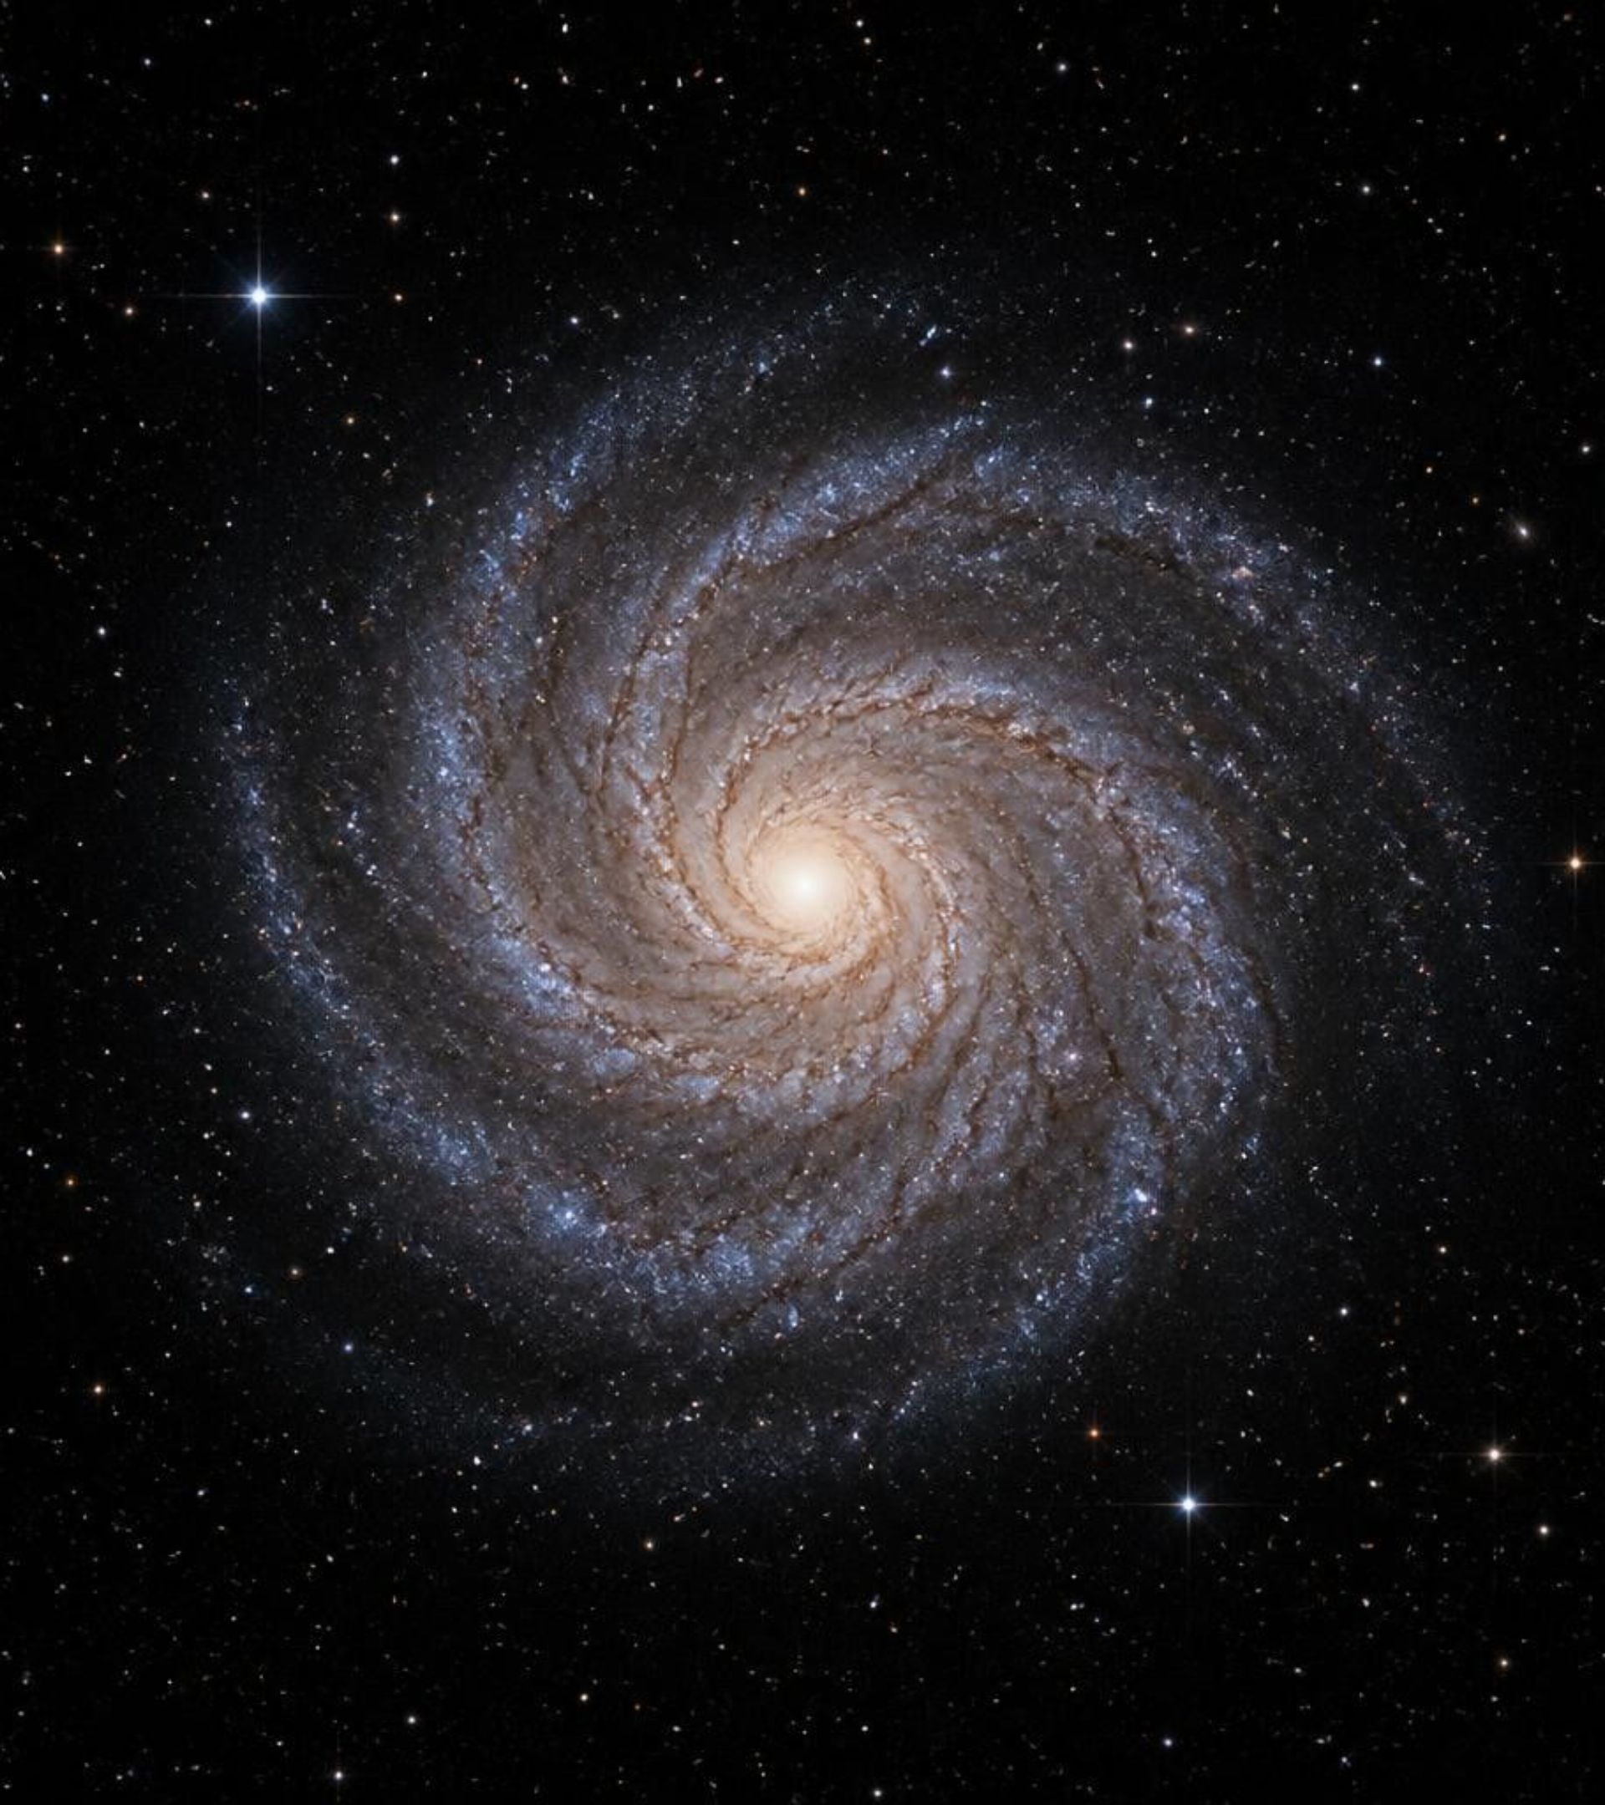
Galaxy
Morphology
Analysis

Slide 2
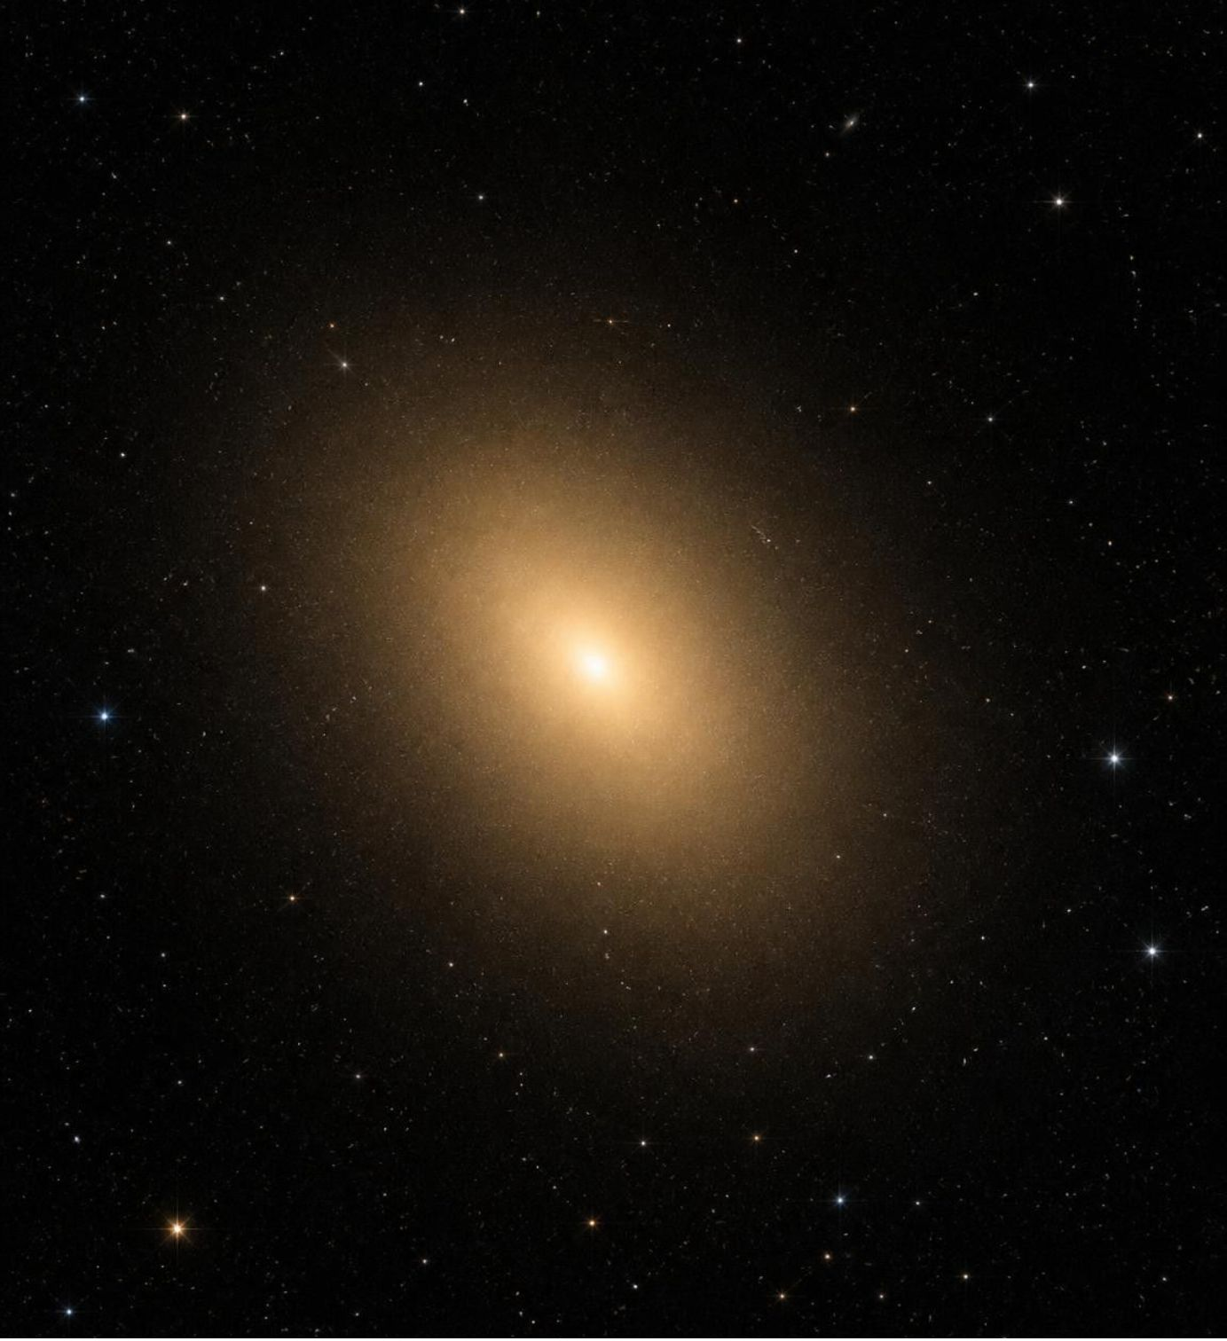
Explore morphology alongside classification participation
Analyze patterns in galaxy classifications, morphological features, and vote volume.
239,695
231
rows
columns
9
relevant columns retained for analysis

Slide 3
Prepare the data for analysis
1
2
3
Load and standardize
Create groups
Load into PostgreSQL
Use Python and pandas to load, inspect, and standardize columns.
Create vote and classification groups.
Load the cleaned DataFrame into PostgreSQL.
Retain missing values
Questions may be skipped based on earlier responses, so missing does not necessarily mean zero.

Slide 4
Analyze morphology and participation in SQL
Participation
Morphology
Hypothetical limit
Group galaxies by vote participation and examine classification and vote distributions.
Compare morphology thresholds and one-arm versus two-arm fractions.
20
Evaluate a hypothetical maximum of 20 classifications per galaxy.

Slide 5
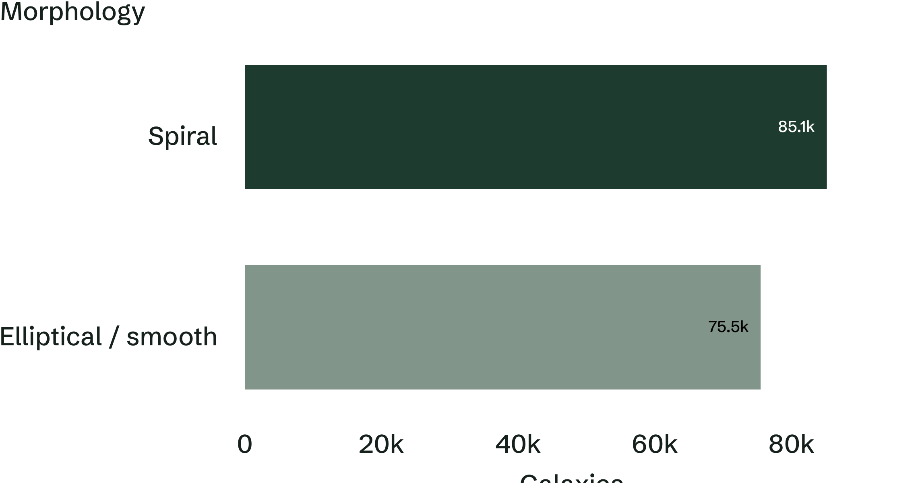
Spiral and smooth categories lead the morphology distribution
At the analysis’s 70% threshold
35.52%
Spiral
31.48%
Elliptical / smooth
Other categories include unclear / mixed morphology and disk / lower spiral fraction.

Slide 6
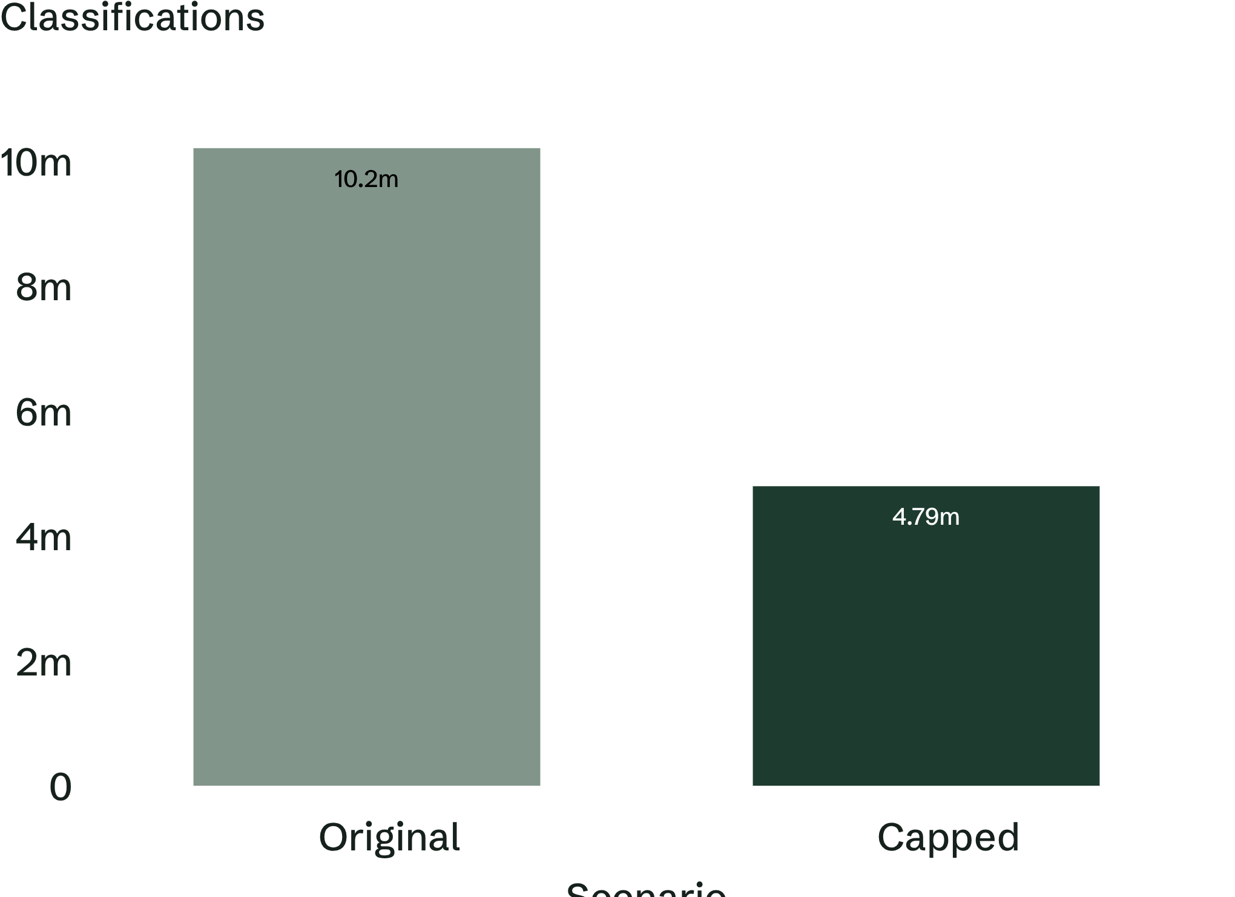
A hypothetical cap suggests a 53.02% volume reduction
53.02%
Hypothetical reduction
5,409,880 classifications
Under a 20-per-galaxy maximum.
Evaluate whether classification reliability is maintained before applying a limit.

Slide 7
Thresholds change the unresolved queue
Compare requirements to examine how stricter thresholds affect a hypothetical unresolved classification queue.
60%
85%
Requirement
Requirement
Use primary morphology fractions and high-confidence fractions to identify galaxies for further review.

Slide 8
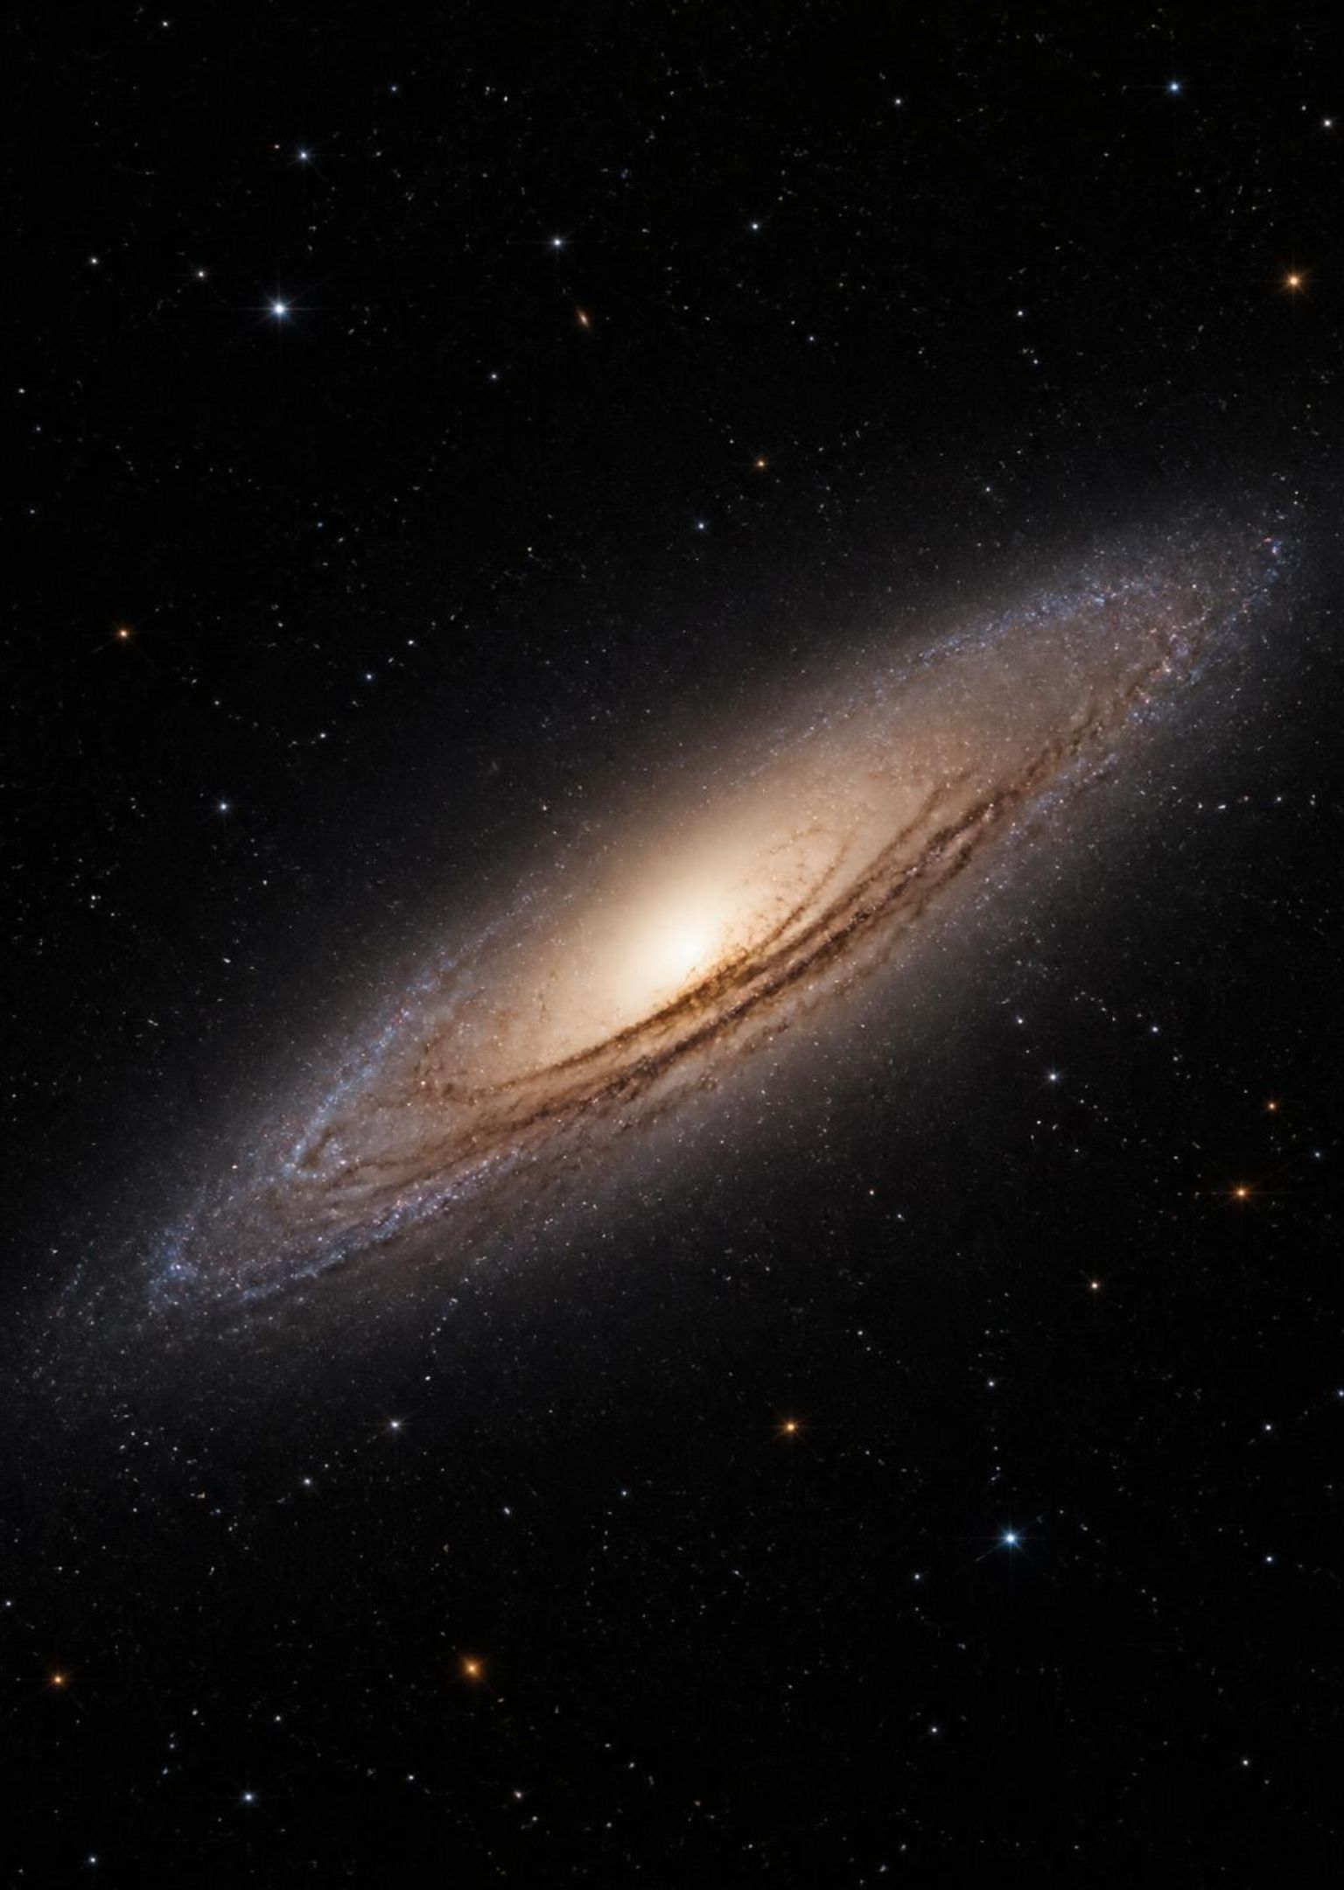
Monitor participation and morphology together
Track vote and classification distributions to identify galaxies receiving higher participation.
Explore one-arm, two-arm, smooth, and spiral fraction patterns.
Use the Power BI dashboard to bring participation and morphology analysis together.

Slide 9
Build a data-driven classification workflow
1
2
3
Evaluate classification limits while maintaining reliable classifications.
Combine participation metrics and morphology fractions to prioritize galaxies for review.
Expand the analysis of morphological feature patterns.

