Slide 1
Titanic: Learning From Disaster
By Keaton LaBorde & Michael Maxwell

Slide 2
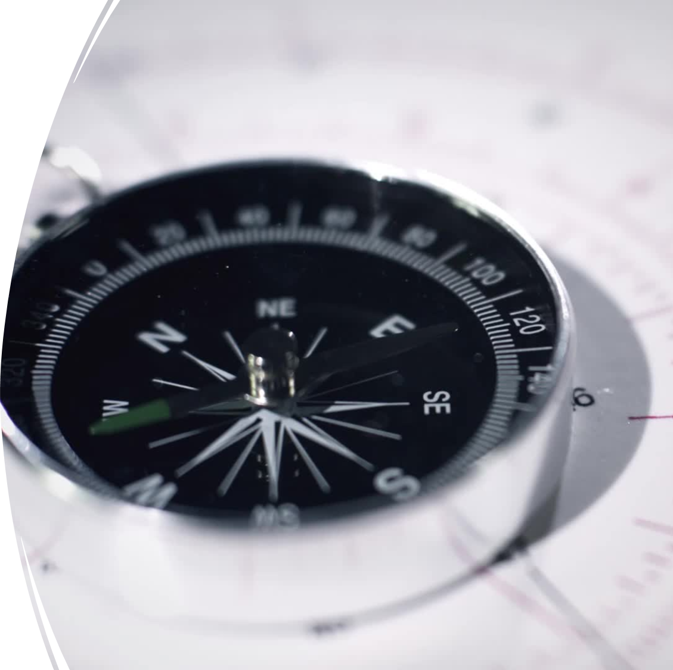
Agenda
•What is the Titanic Kaggle Dataset?
•Milestones and how we worked together
•What is our data?
•Initial Analysis
•Technical Approach
•Results

Slide 3
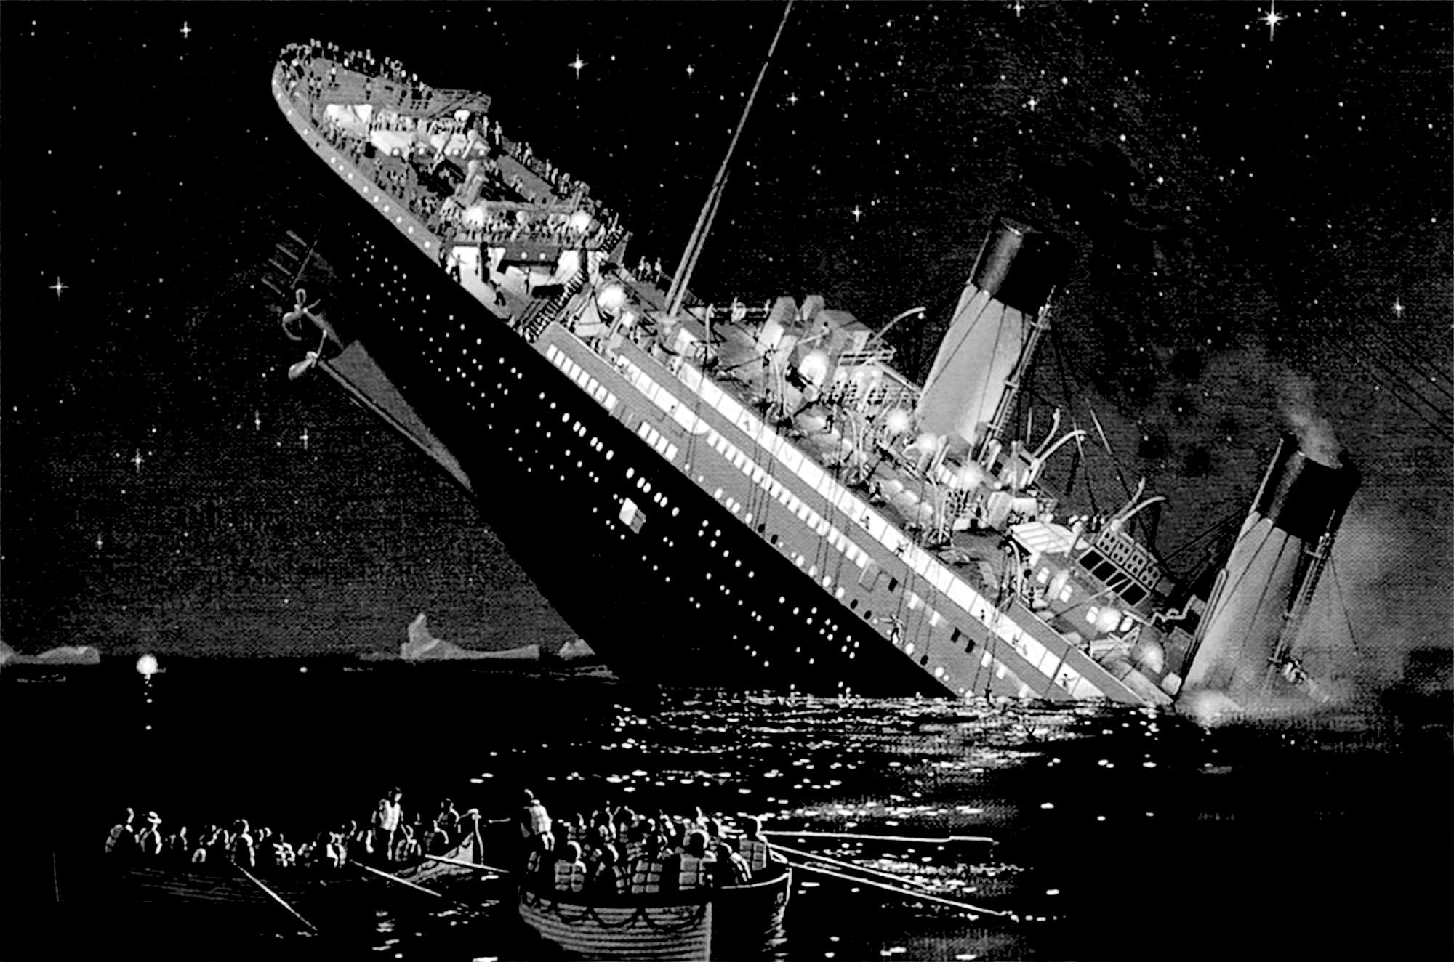
Background
General Information

Slide 4
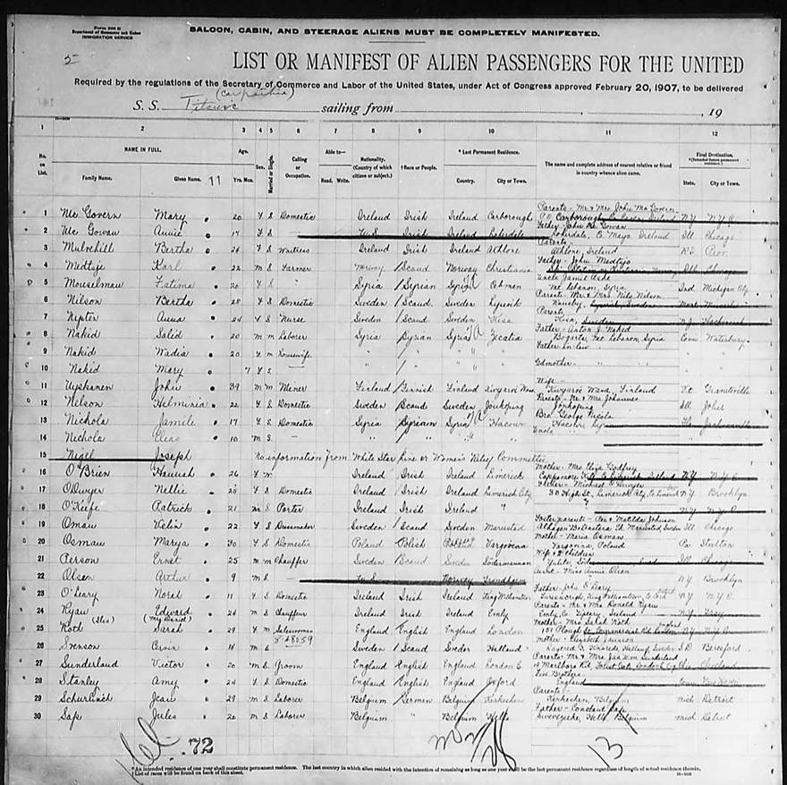
What is the Kaggle Dataset
•Based off the Titanic Survivor Records
•Titanic Manifest (people who were present)
•Records who survived and individual information

Slide 5
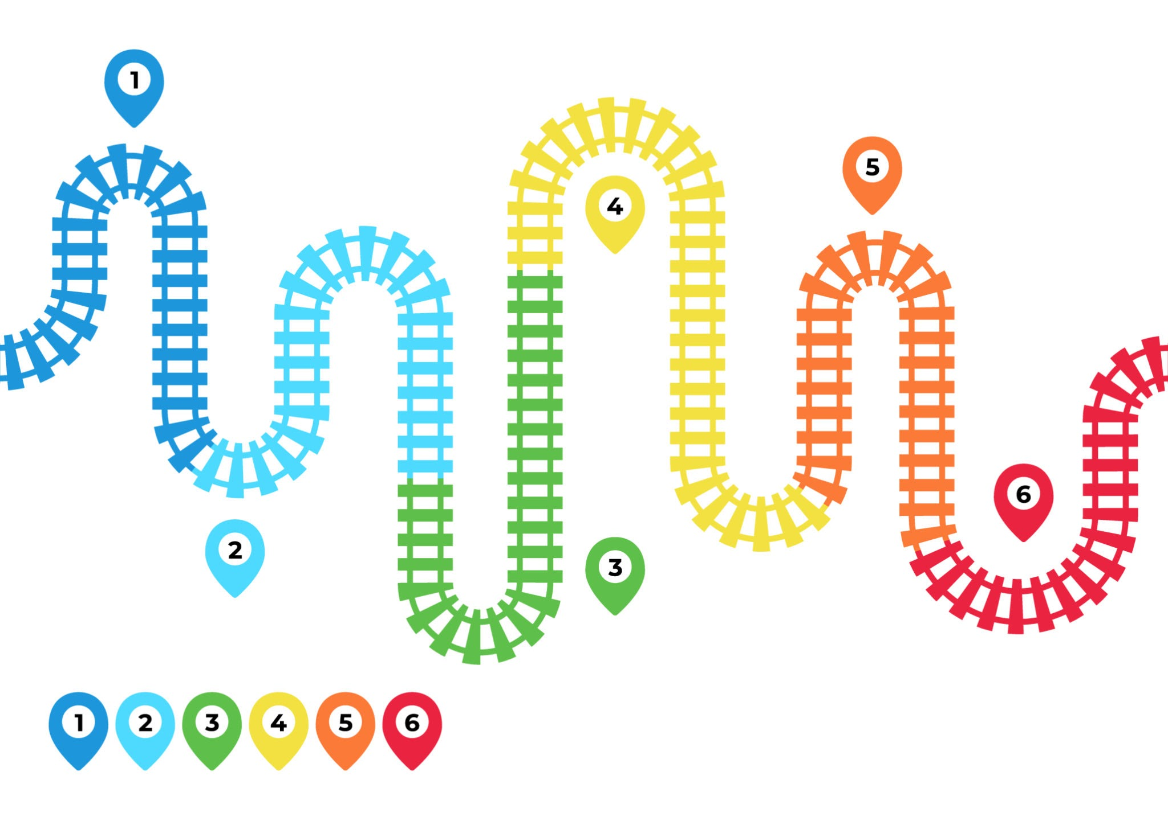
Milestones
Description | Date | Completed on Time
Download | 4/4 | Yes
Perform Feature Engineering | 4/7 | Yes
Test and Submit our Initial Models | 4/11 | Yes
Progress Report | 4/22 | Yes
Adjust | 4/25 | Yes
Final Submission | 4/27 | Yes

Slide 6
Data, Data, Data

Slide 7
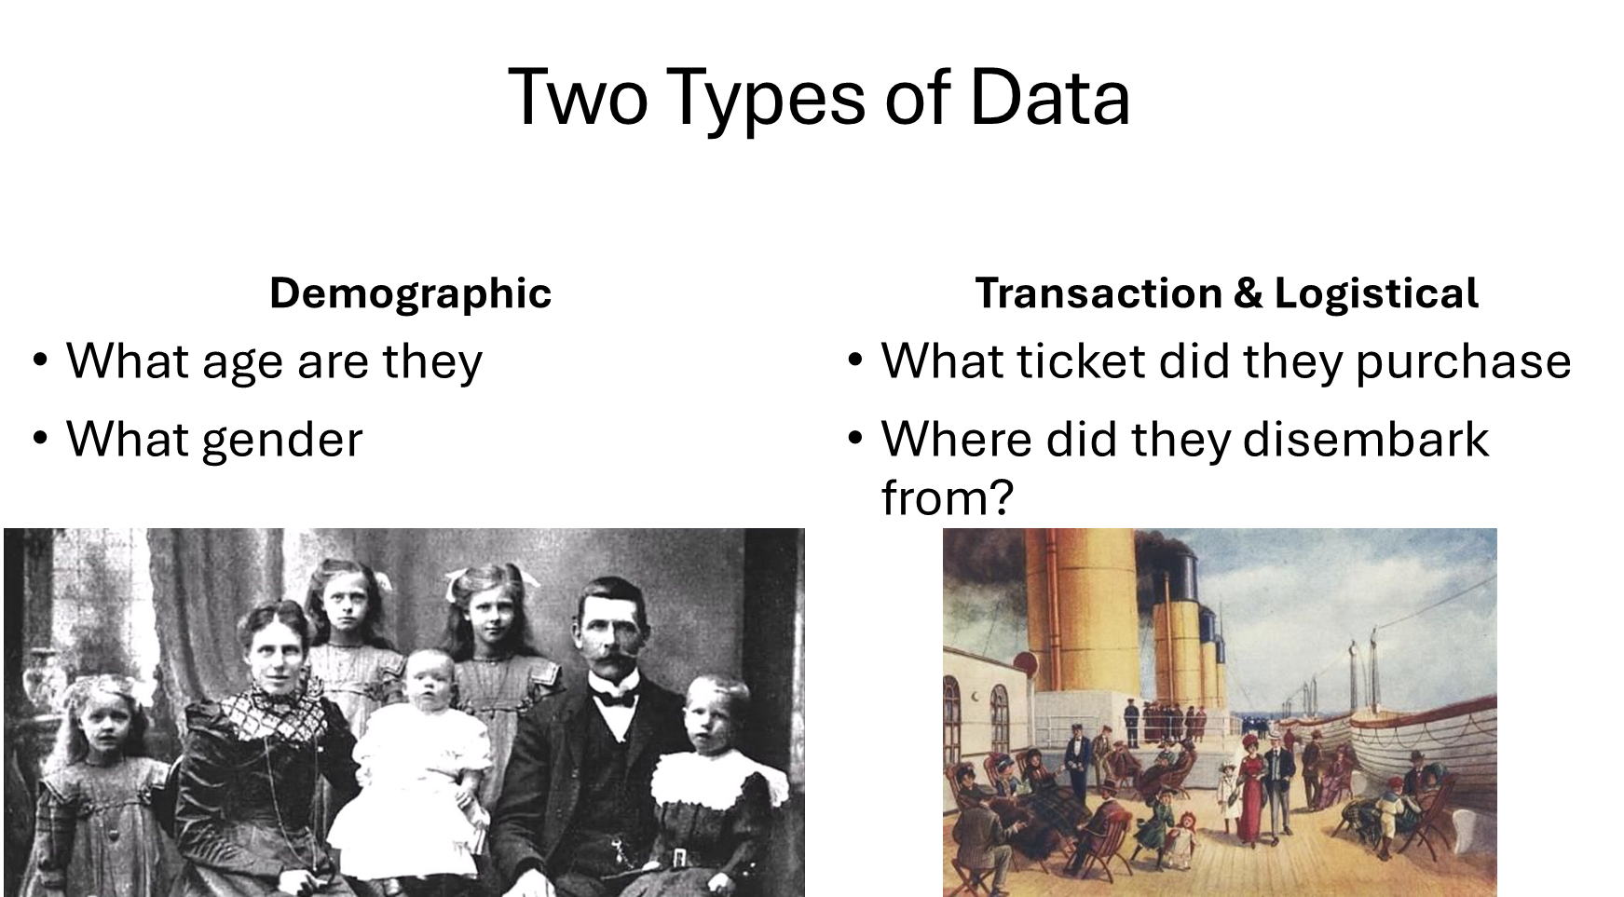

Slide 8
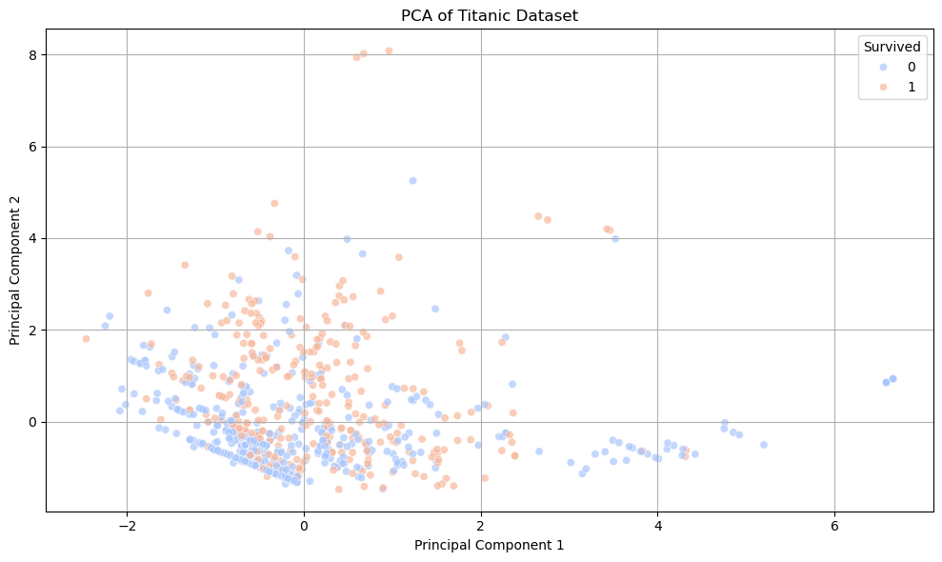
Data Investigation

Slide 9
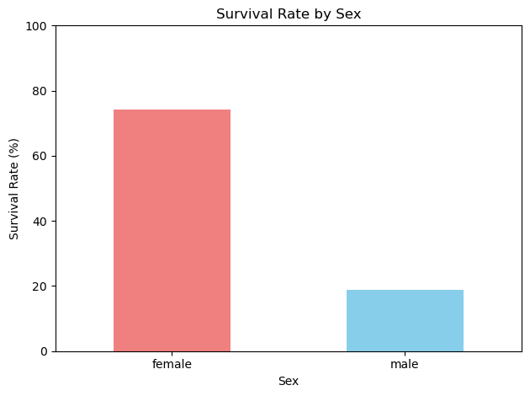
Data II
Better to be a woman than a man in this case

Slide 10
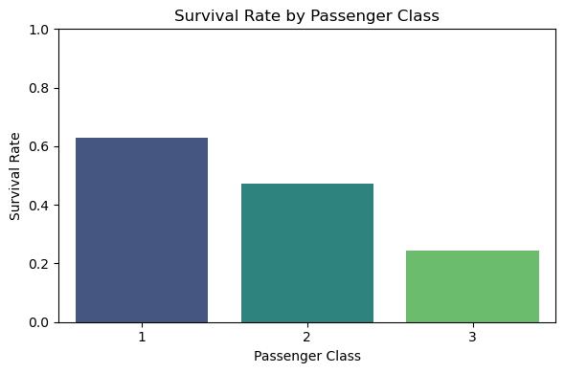
Data III
Richer Passengers were more likely to survive

Slide 11
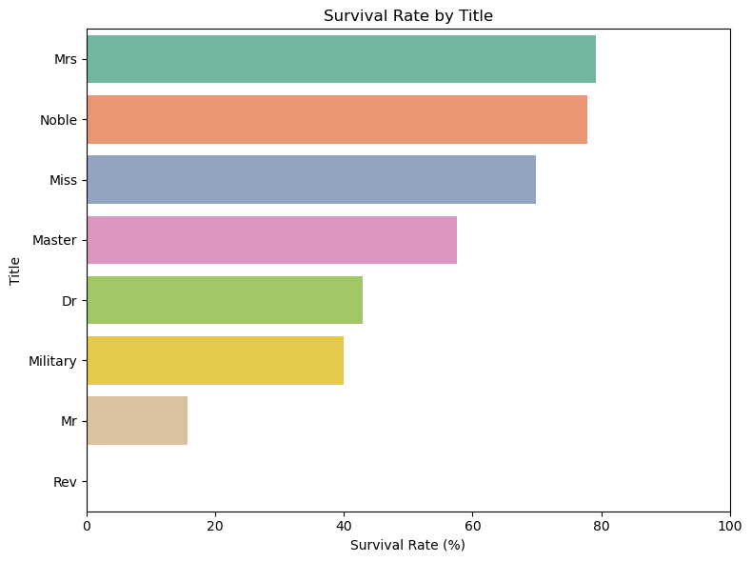
Data IV
Not that large of difference between married and unmarried women.
None of the Rev. made it

Slide 12
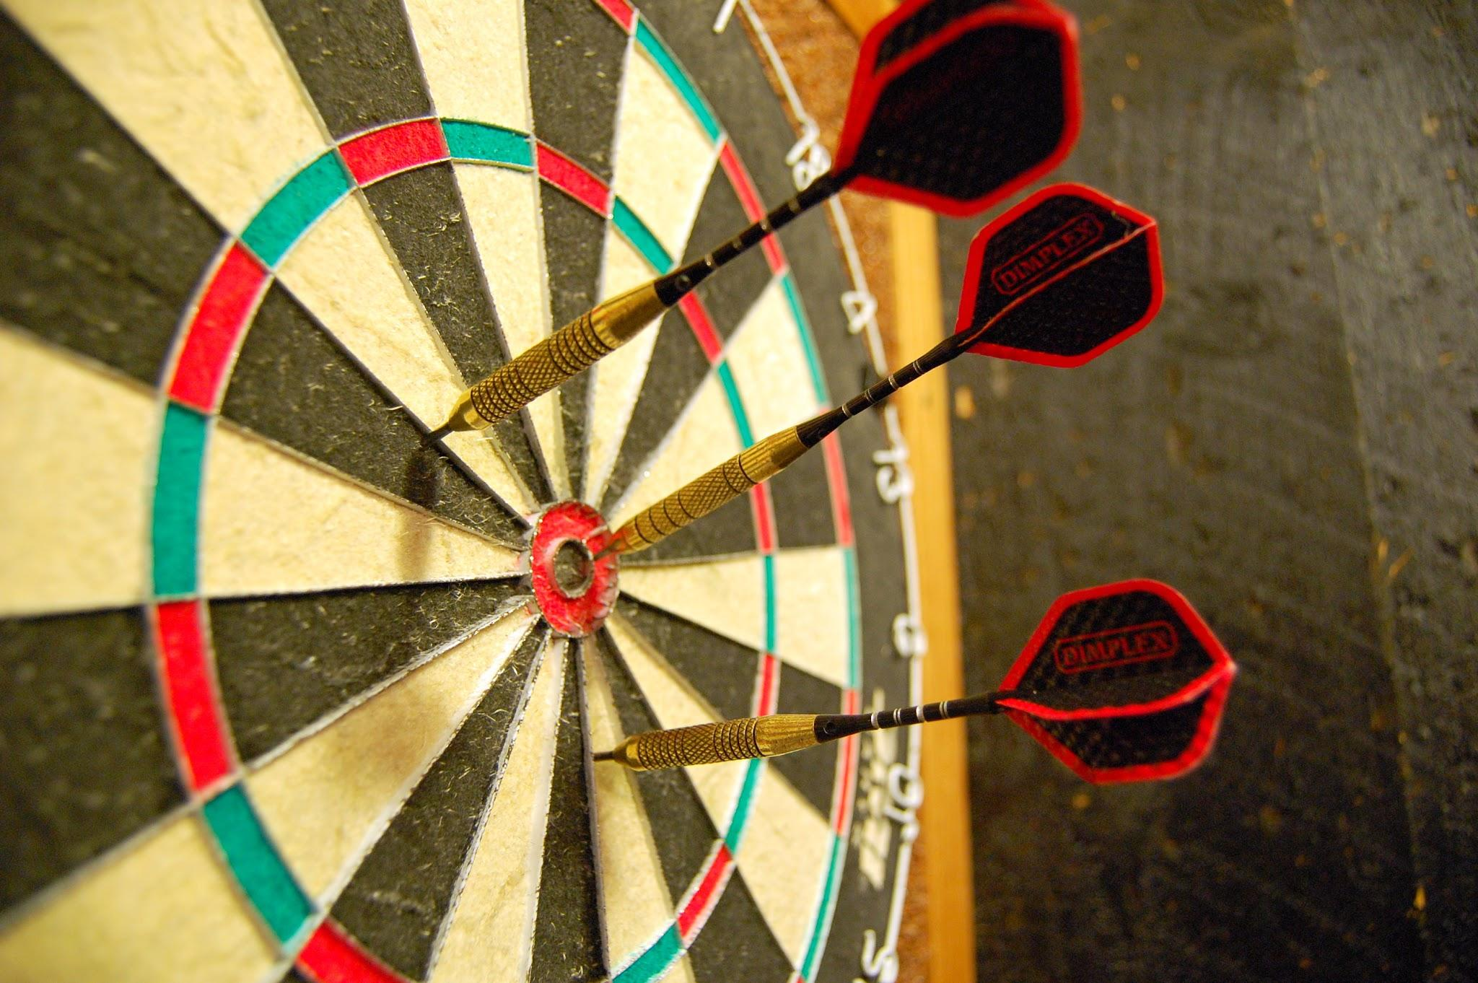
Technical Approach
We took a very Experimental Approach

Slide 13
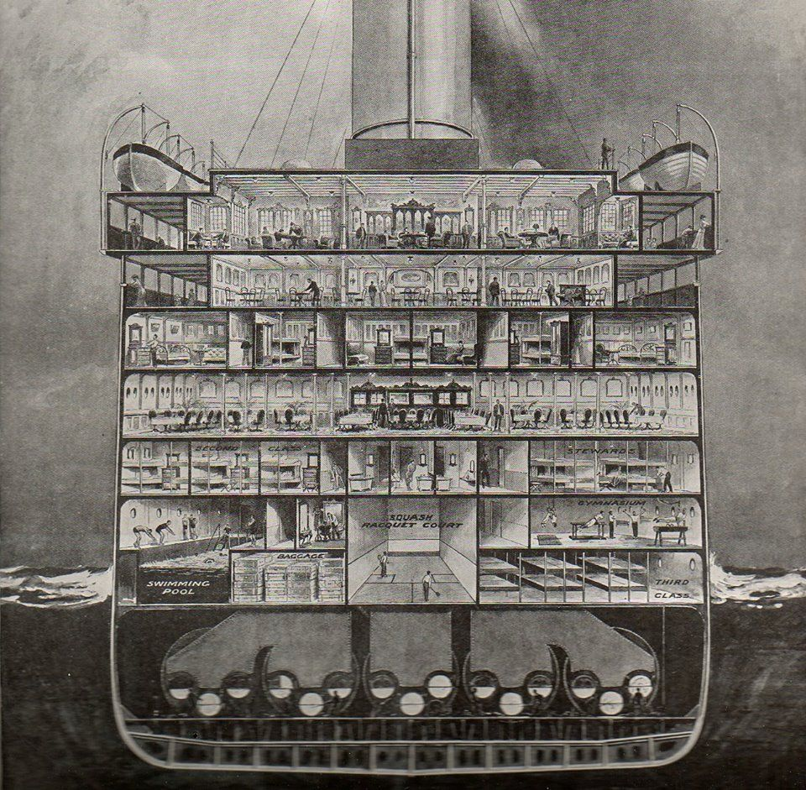
Feature Engineering
Did they have a wife/husband
How many people were in the cabin
Classifying people based on titles
Standardizing the ticket format

Slide 14
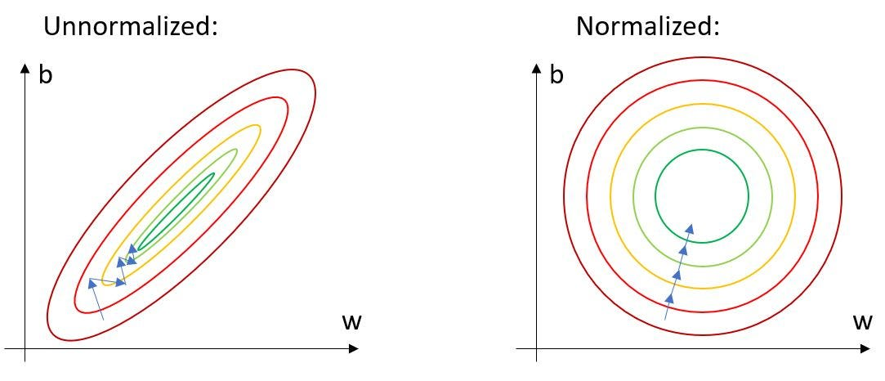
Normalization & Standardization
We went through the list of features and found a list of them we wanted to normalize

Slide 15
Results!!!

Slide 16
Results
Name | Parameters | Results
Random Forest | Entropy, Max Depth 10, 150 Estimators | 77%
Decision Tree | Entropy, Max Depth 10, 150 Estimators | 77%
KNN | P1, uniform | 77%
Support Vector Classifier | C = 10, rbf | 77.8%
Logistic | C = 0.1 | 75.6%
Gaussian NB | Variable Smoothing = 1*10^-8 | 73.9%

Slide 17
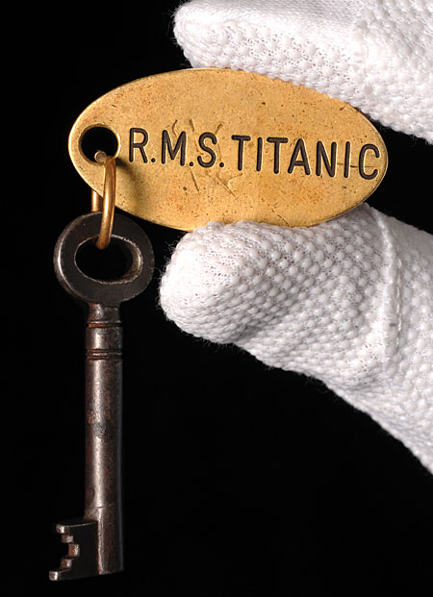
Key Takeaways
Social Norms played a bigger factor
Data pre-processing didn’t make a big impact
Well planned meetings & organization make a big difference
Testing Parameters and Models make a big difference
Simple Data Simple Models

Slide 18
The End!

