Slide 1
July ?

Slide 2
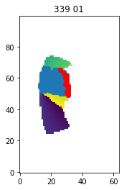
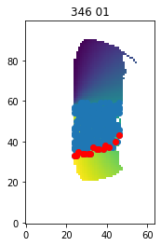
regions
Shown in red, pixels repeated across days which go from bordering sat to not (explains the weird shape of repeated points)
Shown in blue, all repeated pixels
2 days (339-346)
You should replot this over a map of
the moon for clarity

