Slide 1

RECORD of the 60’s
Kalia Lafferty
Julia Gabriel

Slide 2
Data Info
Variables :
- Artist: nominal categorical variable
- Track.Name: nominal categorical variable
- Popularity: ratio numerical variable
- Duration..ms.: ratio numerical variable
- Track.ID: nominal categorical variable
Dimensions :
484 columns
5 rows
Variable of interest :
Popularity
Missing Variables :
There were no missing/NA/null variables.
Artist Track.Name Popularity
Length:484 Length:484 Min. : 0.00
Class :character Class :character 1st Qu.:43.75
Mode :character Mode :character Median :59.00
Mean :56.16
3rd Qu.:70.00
Max. :90.00
Duration..ms. Track.ID
Min. : 82680 Length:484
1st Qu.:151656 Class :character
Median :169867 Mode :character
Mean :190543
3rd Qu.:206310
Max. :544640

Slide 3
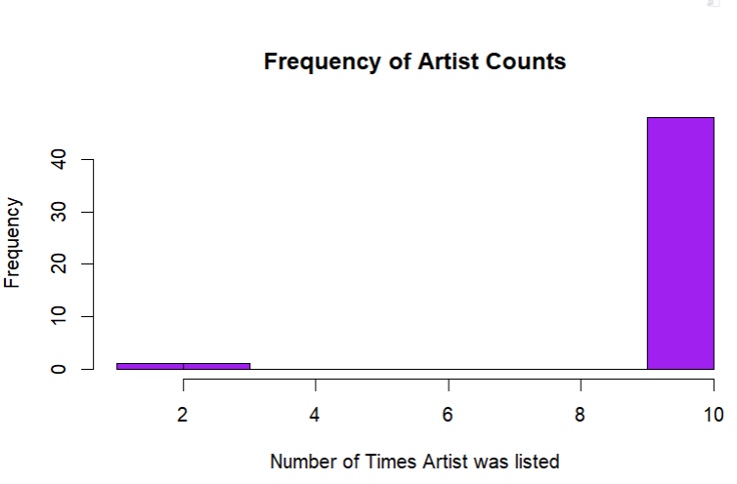

Artist Frequency
Listed exactly 10 times
Data bias
Minimum - Incompleteness in listing all 10 times

Slide 4
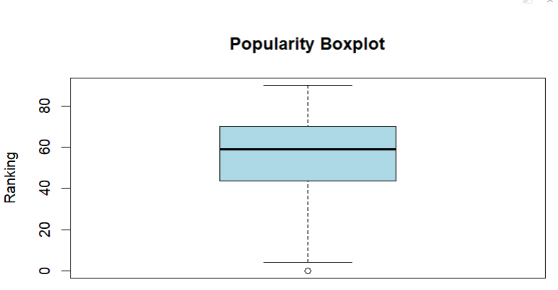
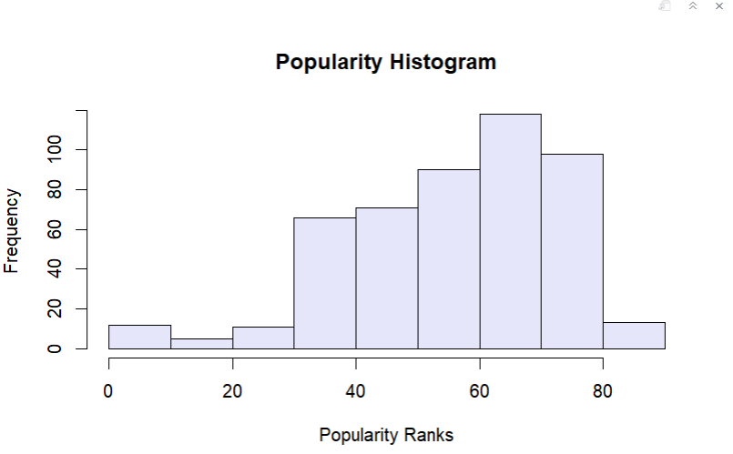
Popularity Distributions
MARS
IQR between 40 and 70
Spread of 0 to 90
Impact with Spotify Users
Left- skewed - tend to rank higher
Mode between 60 and 70
Frequent streams and saves

Slide 5
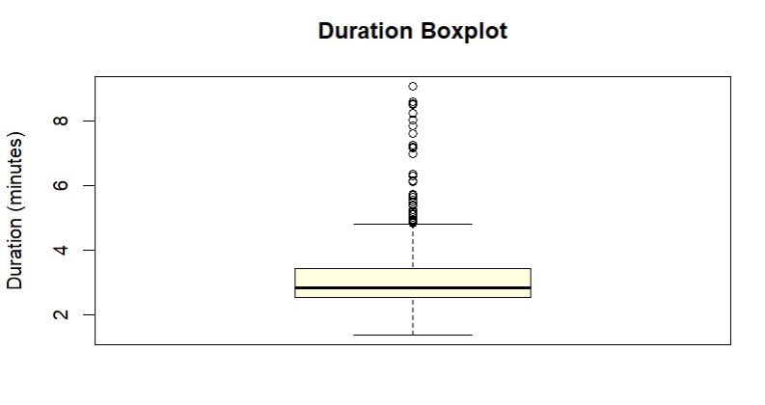
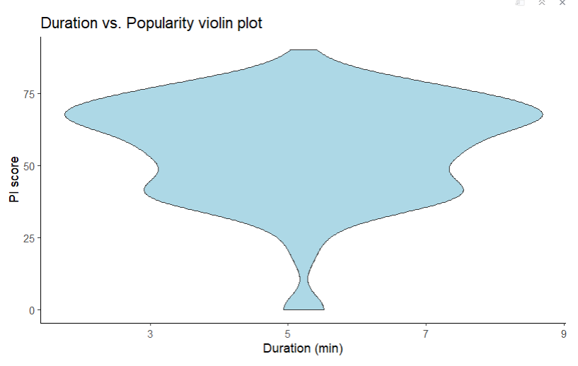
Duration Distributions
IQR between 2 and 4 minutes
Spread of about 1 to over 8
Multiple outliers - unusually long compared to the majority
Cluster between 3 and 6 minutes
Certain durations are more popular
High PI scores

Slide 6
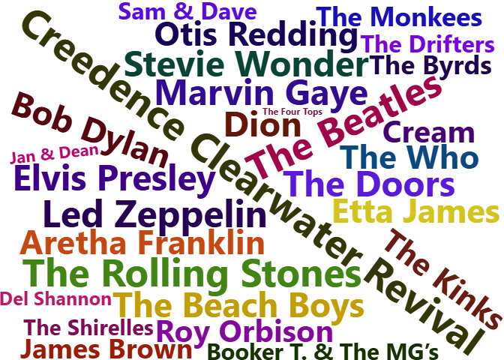
Word Cloud
Popularity Index
Artist MeanPI
1 Creedence Clearwater Revival 80.1
2 The Beatles 77.2
3 The Rolling Stones 77.1
4 Led Zeppelin 73.9
5 Marvin Gaye 71.2
6 The Doors 70.9

Slide 7
Results
Most 1960s tracks on Spotify have a popularity index (PI) between 60 and 70, with a mean PI of 63.45, showing strong contemporary appeal.
Songs 3-6 minutes long are the most popular, with a mean duration of 3.5 minutes matching modern listening habits.
Top 1960s artists like The Beatles have high average PIs, with top performers averaging a PI of 85.
48 out of 50 artists appear exactly 10 times, suggesting enduring influence or data selection bias.
While individual song characteristics driving 1960s popularity remain unclear, the analysis highlights the enduring cultural impact of iconic artists like Creedence Clearwater Revival in contemporary music culture.

Slide 8
Q & A
Sources:
Wickham, Hadley, et al. R for Data Science: Import, Tidy, Transform, Visualie, and Model Data. O’Reilly, 2023.
Kanchana. (2024, March). Spotify Oldies Dataset, Version 1. from https://www.kaggle.com/datasets/kanchana1990/spotify-oldies-dataset.

