Slide 1

Bugipedia
Notes:
Sara

Slide 2
Member roles for Group 5
Sara Frackiewicz ~~~~~~~ Project Lead, Database, Frontend Alexander Franco ~~~~~~ Database, Frontend David Maria ~~~~~~~~~~ API Emil Dolorfino ~~~~~~~~ API Klayton Killough ~~~~~~ App development Soukaina Assou ~~~~~~~ App development Kristoff Kounlavong ~~~ App development Baylor Maloney ~~~~~~~ App development
Notes:
Everyone says their part

Slide 3

What is Bugipedia?
Bugipedia is an on-the-go reference for Florida entomologists and hobbyists.
Features include:
Searching for bugs based on their features and characteristics
A description and gallery of user-submitted pictures for each bug
Option to add sightings of bugs and view other sightings on a map
Wikipedia-like editing of entries and information
Notes:
Sara

Slide 4

Tech used
Web Stack
Operating System
Linux
HTTP Server
Apache
Database
MySQL
Programming Language (Backend)
Python
Flask
SQLAlchemy
Other
Front End
Bootstrap, JQuery
Android Development
Android Studio
Retrofit
Database Management
phpMyAdmin
Certificate Authority
LetsEncrypt
Version Control
Github
Communication
Discord
Notes:
David

Slide 5
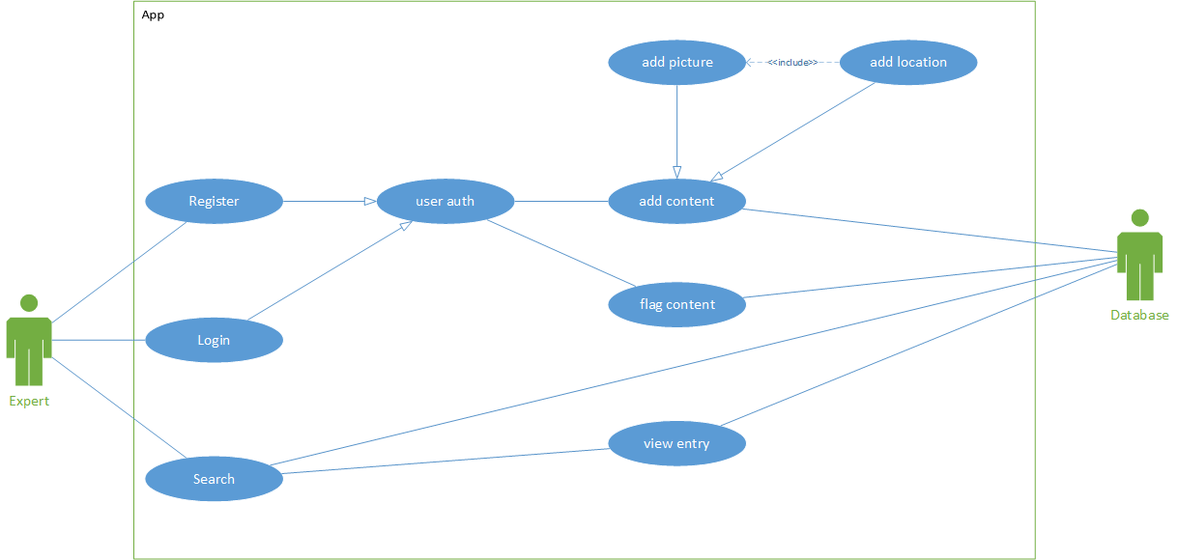
Use Case - App
Notes:
Klayton

Slide 6
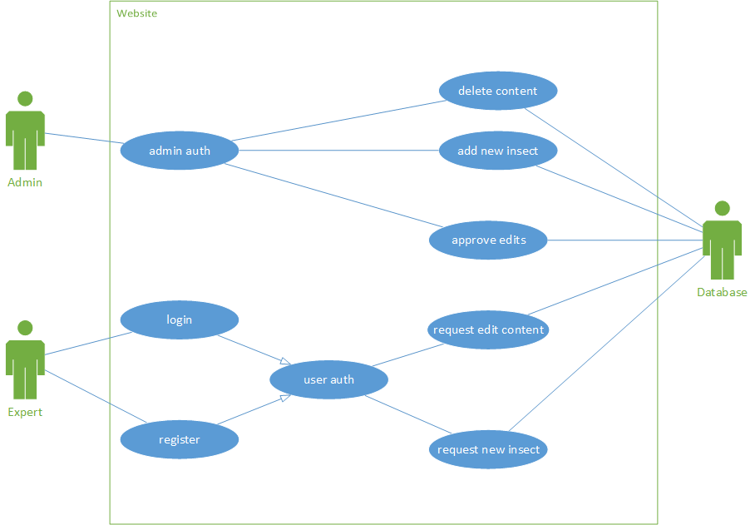
Use Case - Website
Notes:
Baylor

Slide 7
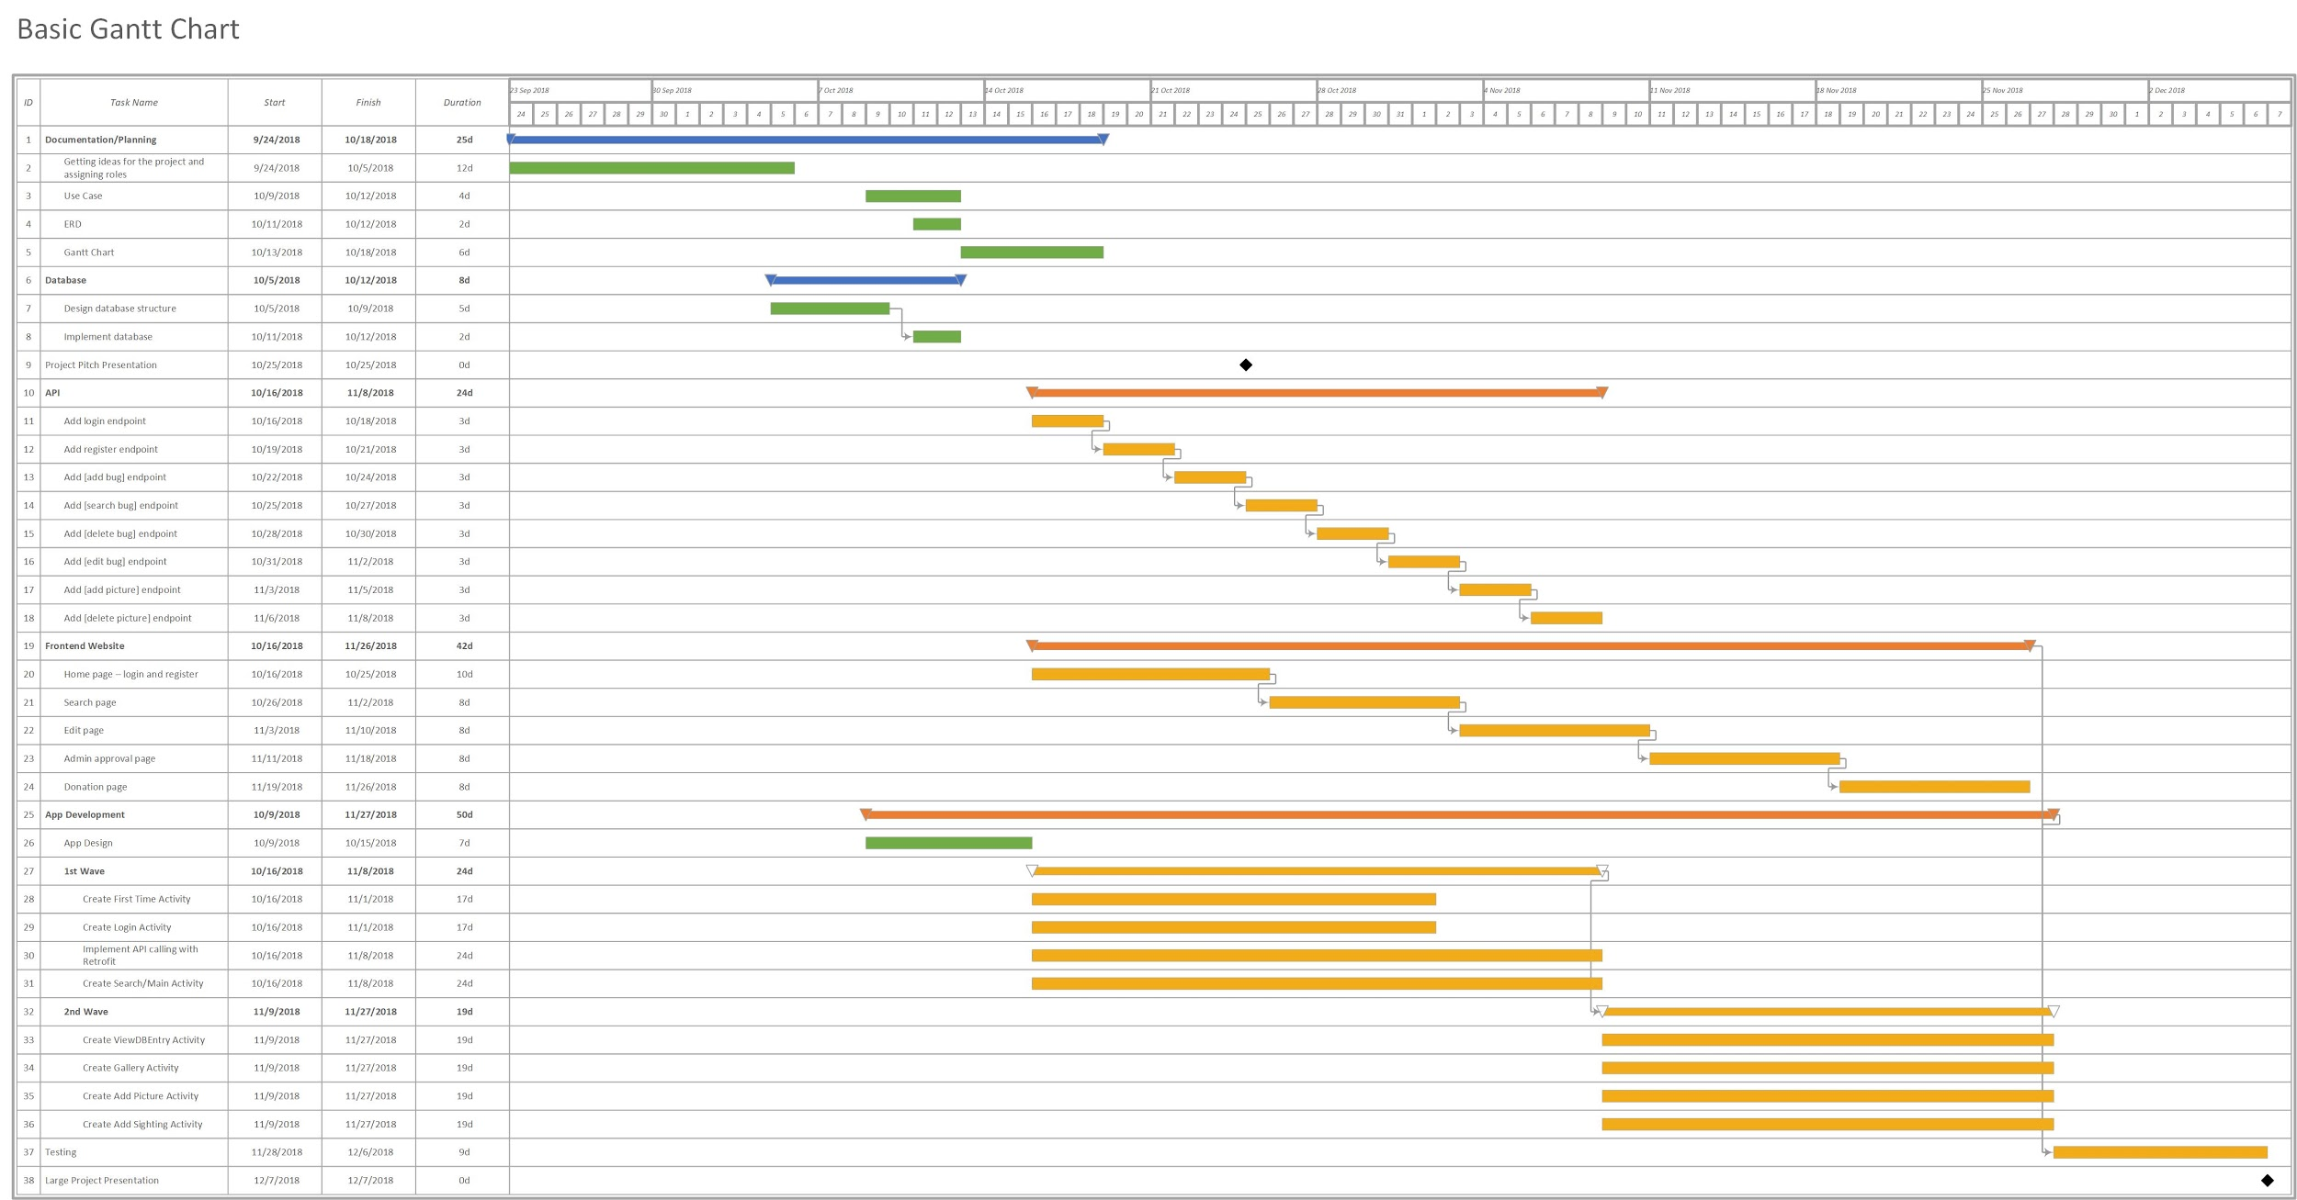
Gantt Chart
Notes:
Selena

Slide 8
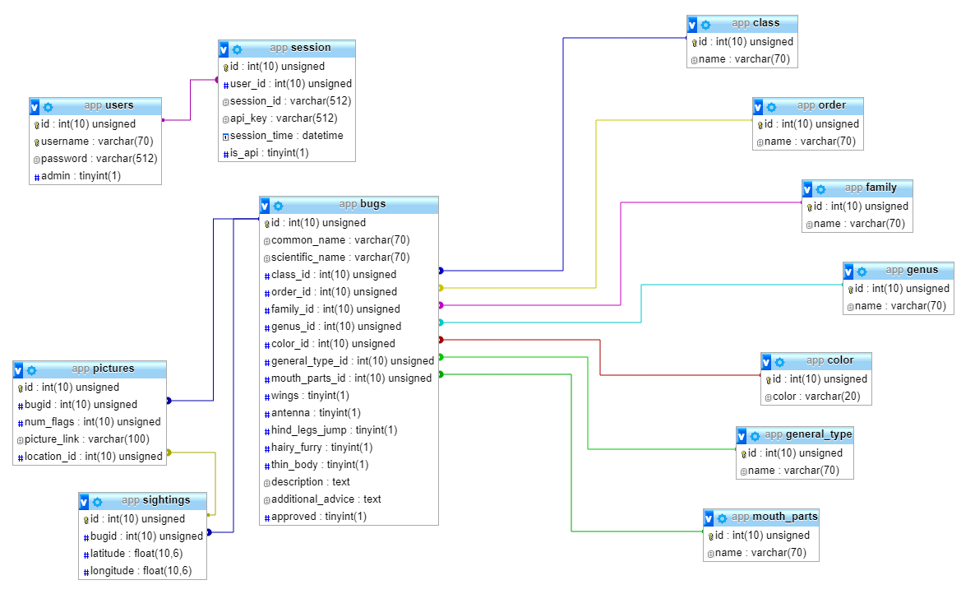
ERD
Notes:
Alex

Slide 9
Ideas for Monetization
Subscription-based service for users
Payments on a monthly basis
Discourages malicious users from editing the content
Ads on the website and app
Selling data to research groups
Donation button on app and website
Notes:
Krystoff

Slide 10
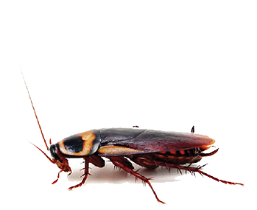
How’s the project going?
Going Well:
Work is getting done on time
Good progress on API and app development
Working well together
Difficulties:
Completely redesigned project twice because of misunderstandings
Having all the members present during meetups
Notes:
Emil

Slide 11
Questions?

