Slide 1
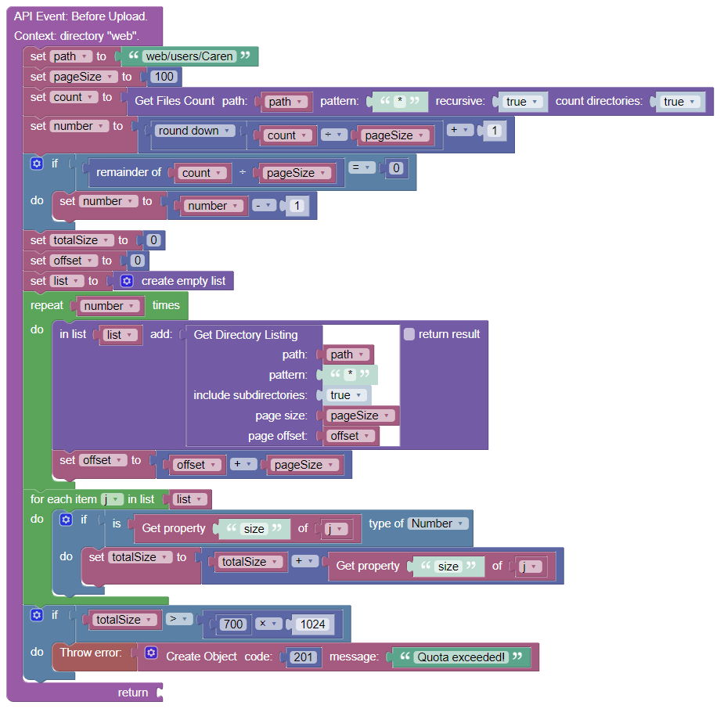
This path must be set dynamically based on the currently logged-in user
This comparison may have to be done dynamically based on a user dependent quota

