Slide 1
Formal definition for the C++ lexical structure using lex/flex tool.
Done by Milana Nurgalieva & Kuznetsov Ilya

Slide 2
Flex compilation
3 main stages:
1. Writing grammar definition
2. Generating lexical analyzer source code
3. Lexical analyzer creation
1. source.l
2. lex.yy.c
3. output program

Slide 3
Source file
1. source.l
2. lex.yy.c
3. Lexer

Slide 4
Flex source structure
Declaration & options section
%{
/* Code here will be copied verbatim to head of lex.yy.c file
%}
%%
List of patterns & actions
%%
User subroutines

Slide 5
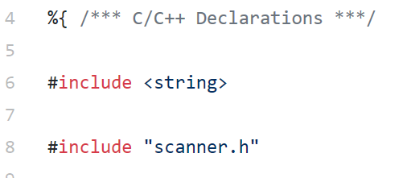
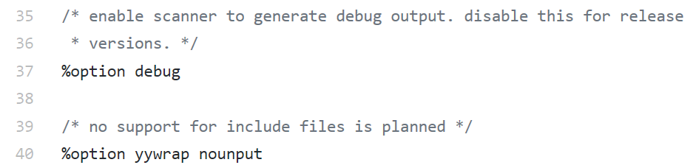
Definition section
Set up flex
Include headers
Define
etc…
…

Slide 6
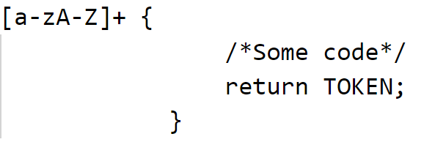
Flex rule format
Input is matched by regular expression
Defined by parser
Usually .y file

Slide 7
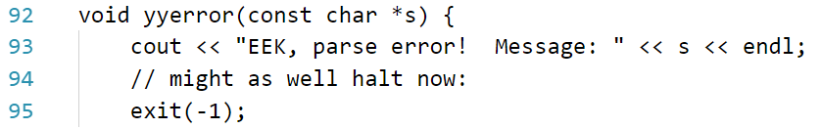
User subroutines
- This section typically includes routines called from the rules.
- The contents of the user subroutines section are copied verbatim by flex to the C file.

Slide 8
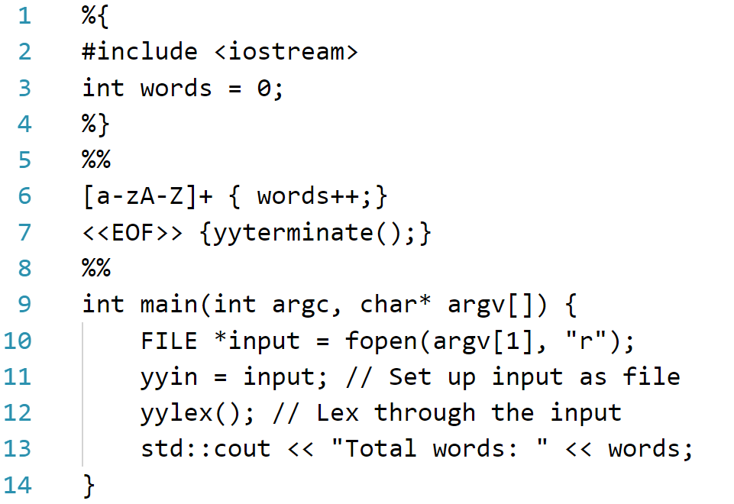
Example: words counter

Slide 9
Source file
1. source.l
2. lex.yy.c
3. Lexer

Slide 10
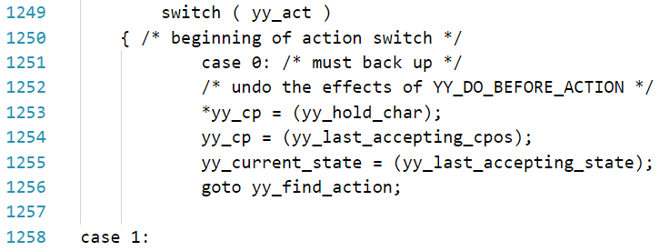
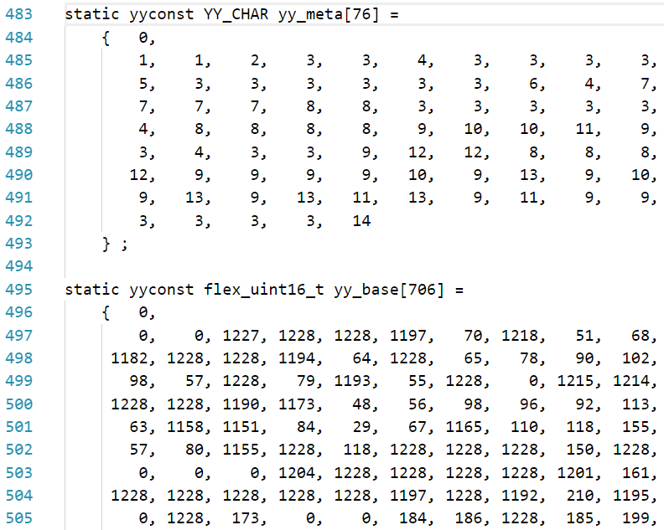
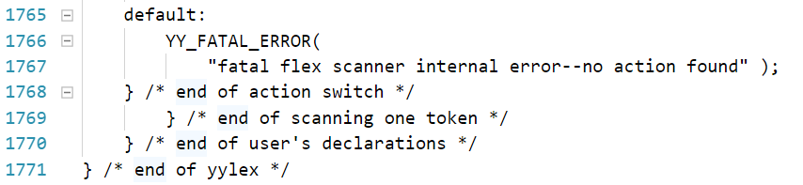
What’s inside “lex.yy.c”?
Lookup tables: finite state automata
Really big (BIG) switch-case
…

Slide 11
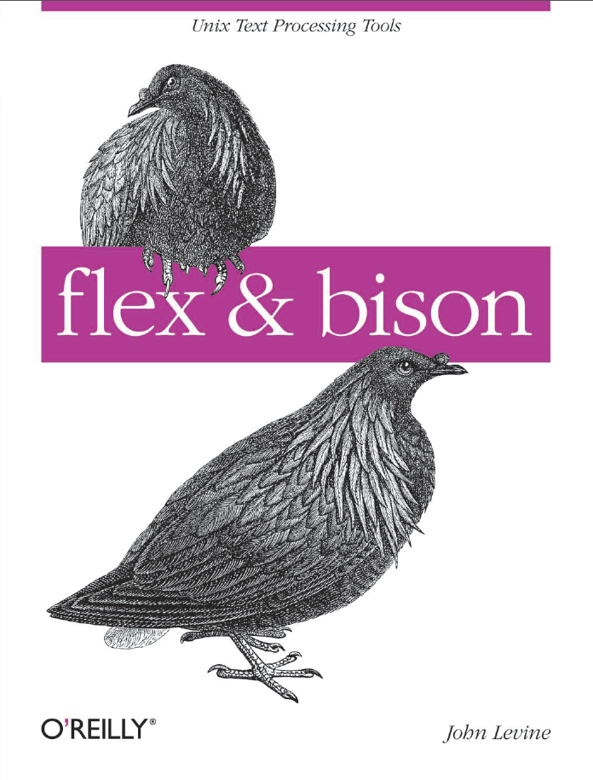
Our way
References:
- Book "Flex & Bison" By John Levine
http://en.cppreference.com/
http://dinosaur.compilertools.net/flex/
http://aquamentus.com/
https://regexr.com/
https://regex101.com/

Slide 12
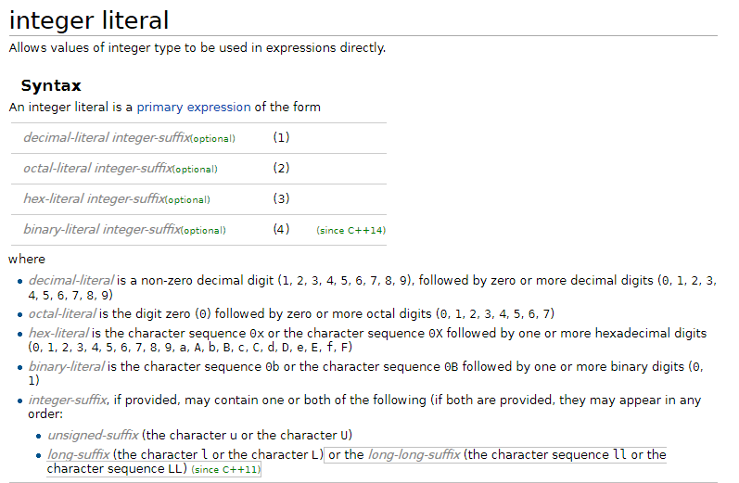
Literals
The literals are perfectly described at
cppreference.com, and our mission was provide regexp for them.
We are new to regular expressions.
As result: big, scary regexps.

Slide 13
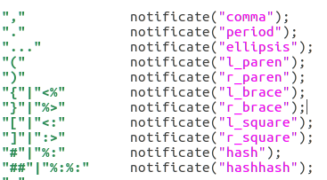
Operators
Operators were taken from cppreference. Forgotten operators were added in testing period.

Slide 14
Keywords
Clang has strange vision on keywords, some of them Clang recognize as keywords, but some of them are just identifiers for it.
For Clang compatibility we decided to use same notation as used in Clang.
Thus keywords are special-case and they are separate.

Slide 15
Testing
Clang compiler can give all tokens from file.
clang -Xclang -dump-tokens code.cpp |& tee clangTokens.txt
We decided to check if tokens sequences from our lexer and Clang are the same.

Slide 16
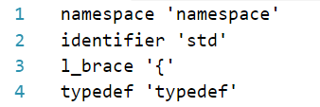
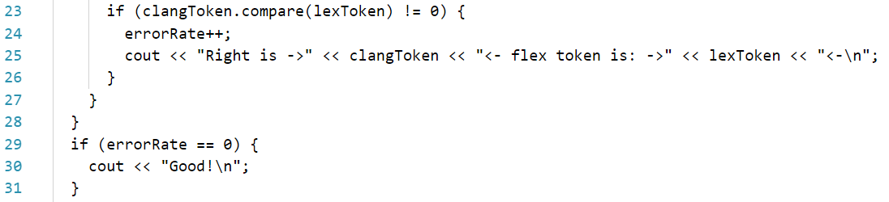
Testing script
Checks whether tokens from Clang lexer and our lexer are the same.

Slide 17
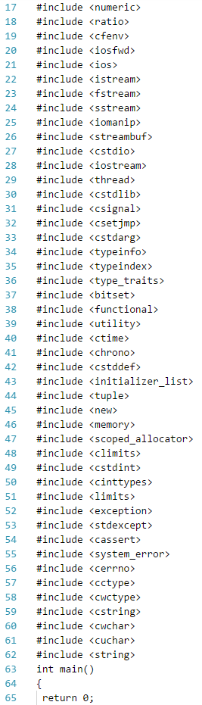
Testing file
We created c++ program with bunch of include statements (62)
and analyzed them by both lexers.
Special thanks for g++ -E command that do only preprocessing.

Slide 18
Questions?

