Slide 1
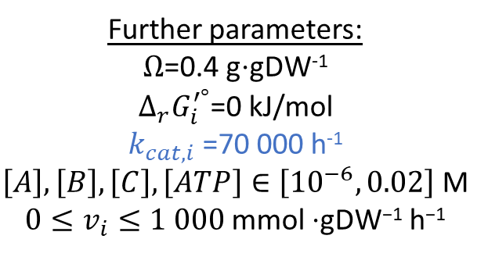
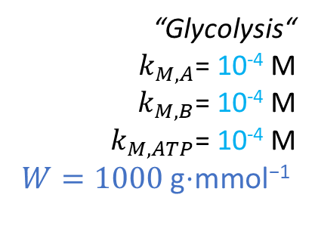
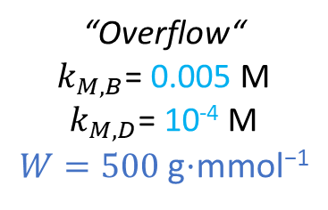
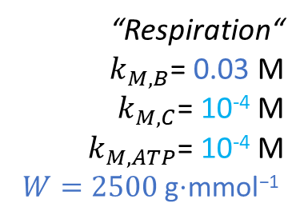
EX_{A}
Further parameters:
$Ω\text{=}\text{0.}$4 g⋅gDW⁻¹
$∆_{r}G_{i}^{′°}$=0 kJ/mol
$k_{cat,i}$=70 000 h⁻¹
$\left[A\right],\left[B\right],\left[C\right],\left[ATP\right]∈\left[{10}^{−6},0.02\right]$ M
$0≤v_{i}≤1 000$ mmol $\text{⋅}\text{gDW}\text{−1}$ $\text{h}\text{−1}$
1
S
“Glycolysis“
$k_{M,A}$= 10⁻⁴ M
$k_{M,B}$= 10⁻⁴ M
$k_{M,ATP}$= 10⁻⁴ M
$W=1000$g$\text{⋅}\text{mmol}\text{−1}$
1
2
1
1
1
1
1
1
ATP
M
D
EX_{ATP}
“Overflow“
$k_{M,B}$= 0.005 M
$k_{M,D}$= 10⁻⁴ M
$W=500$g$\text{⋅}\text{mmol}\text{−1}$
EX_{D}
6
1
“Respiration“
$k_{M,B}$= 0.03 M
$k_{M,C}$= 10⁻⁴ M
$k_{M,ATP}$= 10⁻⁴ M
$W=2500$g$\text{⋅}\text{mmol}\text{−1}$
1
C
1
EX_{C}

