Slide 1
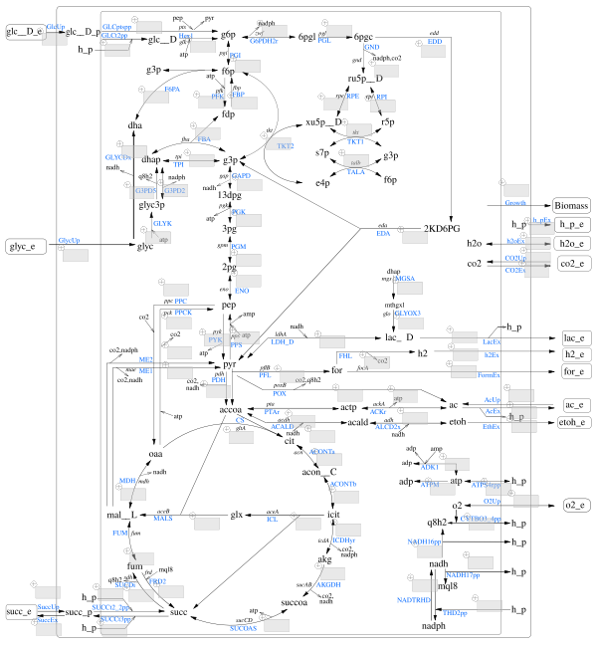
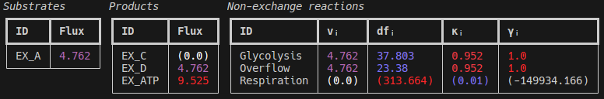
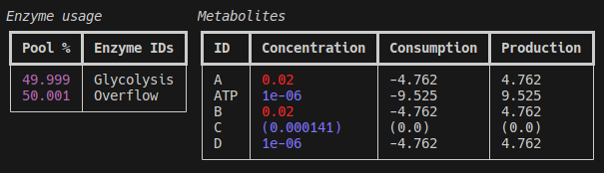

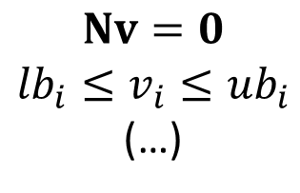




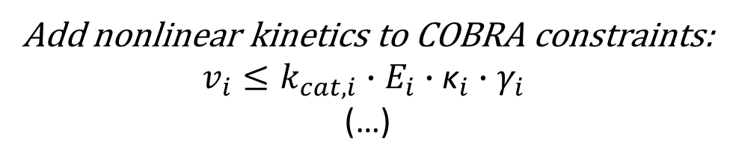

Run “classic“ COBRA methods, optionally with enzyme and/or thermodynamic constraints
Load/store models
as JSON and/or (kinetic) SBML,
both with COBRA-k
parameters support …
TFBA
FBA
$$Nv=0$$
$${lb}_{i}≤v_{i}≤{ub}_{i}$$
(…)
ecFVA
Auto-retrieve enzymatic and/or
thermodynamic parameters from databses…
Pretty-print results and models
in your console
CVA
ecTFBA
…and many more
$$k_{cat}$$
COBRA-k
$$∆_{r}G^{′°}$$
$$W$$
$$K_{M}$$
$$K_{A}$$
COBRA-k modeling and optimization framework
$$K_{I}$$
…and/or edit the model and its
parameters manually
Add nonlinear kinetics to COBRA constraints:
$v_{i}≤k_{cat,i}{∙E}_{i}$ $∙{\text{κ}}_{i}∙$ $γ_{i}$
(…)
…and export results
as JSON, XLSX spreadsheets or CNApy scenarios
Solve the resulting MINLP problems with the COBRA-k solver or with global MINLP solvers

