Slide 1
Lumen
Your home energy, handled.
Not another dashboard. An assistant that tells you what to do.
Enpal track · iOS app + TypeScript backend · voice in, voice out

Slide 2
THE PROBLEM
02
Your home got smart. Making sense of it didn't.
Solar
Battery
Solar, a battery, a heat pump, an EV, a dynamic tariff, and a contract nobody reads —
scattered across four apps and a PDF.
Heat pump
EV
So two things happen: people don't know how to act — and they give up trying.
Dynamic tariff
The contract

Slide 3
THE LANDSCAPE
03
Everyone is one of two things — and one seat is empty
Silent automators
Dashboards
Do it for you — and never tell you why.
Charts you interpret yourself.
Enpal · Tibber · Octopus · 1KOMMA5°
SolarEdge · Fronius · SMA
The empty seat — an assistant that forecasts, explains, advises, and converses in plain language.
That seat is Lumen.

Slide 4
THE HONEST SCORECARD
04
Some do prices. Some do fault alerts. Nobody is an assistant.
 | Forward prices | Plain advice | Conversational | Fault detection | Tells you what to do
Enpal | ✗ | ✗ | ✗ | ~ | ✗
Tibber | ✓ | ✗ | ✗ | ✗ | ✗
Octopus | ✓ | ✗ | ✗ | ✗ | ✗
SolarEdge | ✗ | ✗ | ✗ | ✓ | ✗
SMA | ✗ | ~ | ✗ | ~ | ✗
1KOMMA5° | ~ | ✗ | ✗ | ? | ✗
Lumen | ~ | ✓ | ✓ | ✓ | ✓
✓ yes · ~ partial / gated · ✗ none · ? unverified
Last two columns: empty for everyone but us.

Slide 5
JOBS TO BE DONE
05
Four jobs. One happens every single day.
1
Run my day on my own power
MOST FREQUENT
−60%
every day
2
Is it still working?
weekly — fades fast
dashboard engagement drops within the first month
3
Is something broken?
rare, expensive
Hargreaves et al., Energy Policy; in-home-display field studies
4
Right tariff / contract?
People don't want to watch charts. They want the daily job done.
once a year

Slide 6
THE PRODUCT DECISION
06
So the daily job is the home screen — and it comes to you
7:00 · Lumen
The home screen isn't a dashboard.
It's “tell me your day, I'll plan it around your sun.”
And because people stop opening apps,
it comes to you — a 7am briefing with the day's
outlook and anything to act on. The rare jobs
surface themselves.
Good morning — today's energy briefing
☀
Strong sun today — powering the house and exporting the surplus.
€
Cheapest power around 13:00. Battery at 100%.
↑
On track to earn about €1.80 selling solar back today.
Plan my day

Slide 7
Live demo
1 Plan your day by voice
2 See the plan — green is your own power
3 It catches a fault, and explains it

Slide 8
TECHNICAL · 1 OF 2
08
How it catches a fault — not a hardcoded threshold
From your home's own history, it learns what the panels — or the heat pump — should do at each outdoor temperature, then flags a sustained break from that pattern.
expected
observed
shortfall
~48
21
−55%
kWh / day for these sunny days
kWh / day, sustained 4 days
“likely dirt or shading”
Weather-normalized against your own home — it tells a cloudy day from dirty panels, and “it's just cold out” from a failing heat pump.

Slide 9
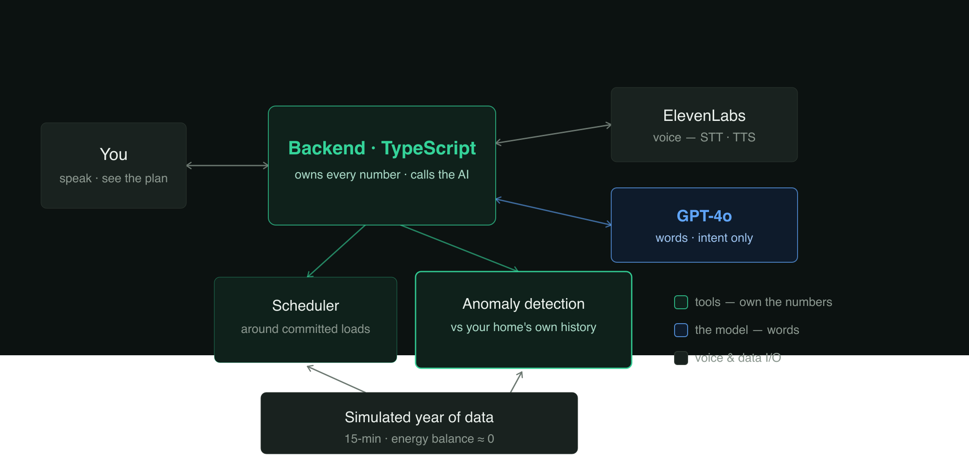
TECHNICAL · 2 OF 2
09
Tools do the math. The model does the words.
The phone only talks to our server.
GPT-4o turns speech into structured tasks — it never sees or invents a number.
The server prices and schedules everything; the anomaly evidence is itself a tool the model calls.
So the euros are correct and repeatable.

Slide 10
Not another dashboard.
An assistant.
Dynamic tariffs now mandatory
Soiling quietly costs
1 in 3 heat pumps
but 53% don't know they exist
~5% of generation a year
underperform — silently
Lumen

