Slide 1
VAST: Groundfish spatial distribution and covariates
30 January 2023

Slide 2
Objectives
Explore relationships between groundfish abundance/ distribution and various habitat covariates through time
Create holistic indices of abundance using all available data
Approach: VAST
Modeling approach designed to estimate spatio-temporal variation in density
Notes:
This tool is designed to estimate spatial variation in density using spatially referenced data, with the goal of habitat associations (correlations among species and with habitat) and estimating total abundance for a target species in one or more years

Slide 3
Potential research questions
How has cod abundance in the NW Atlantic varied through time, according to combined survey observations?
What are the effects of various environmental factors (bottom substrate, temperature, etc.) on cod spatial distribution and abundance?
Do trends in cod indices of abundance vary between distinct spatial areas?
Fishery “footprint” vs. overall NW Atlantic area
Rock/Cobble/Gravel-bottom vs. Sand/Mud-bottom
How do abundance and distribution change for different age classes of cod?

Slide 4
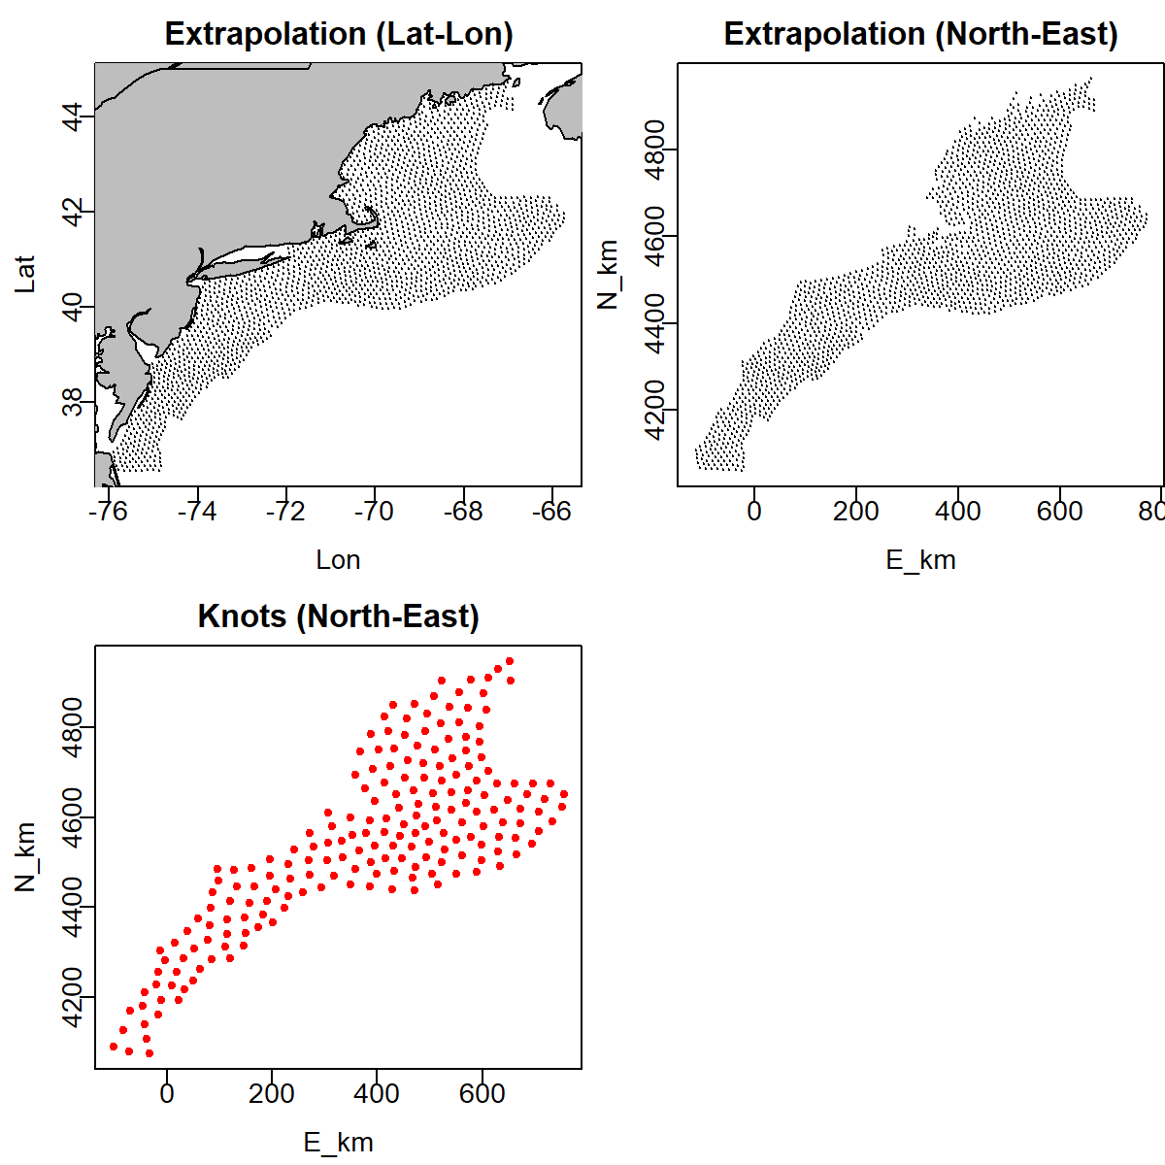
Model setup – space
Higher number of knots produces a smoother estimate of abundance over space
Increased computational strain at a higher number of knots

Slide 5
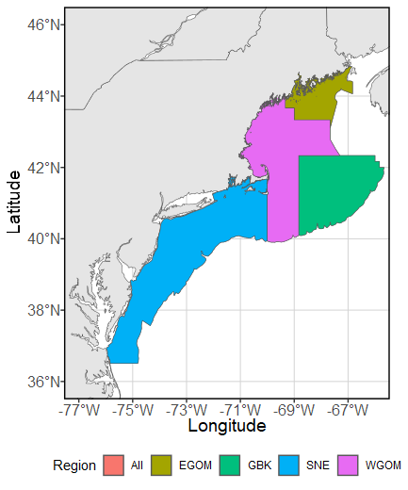
Model setup – space
Spatial area can be split into multiple regions, each with its own indices of abundance
Stock areas as defined by the research working group
“Footprint” vs. entire stock area
Gravel/ Cobble/ Rock –bottom areas vs. Sand/ Mud –bottom areas
Spatial splitting introduces great computational strain. It cannot be used in conjunction with complicated models.

Slide 6
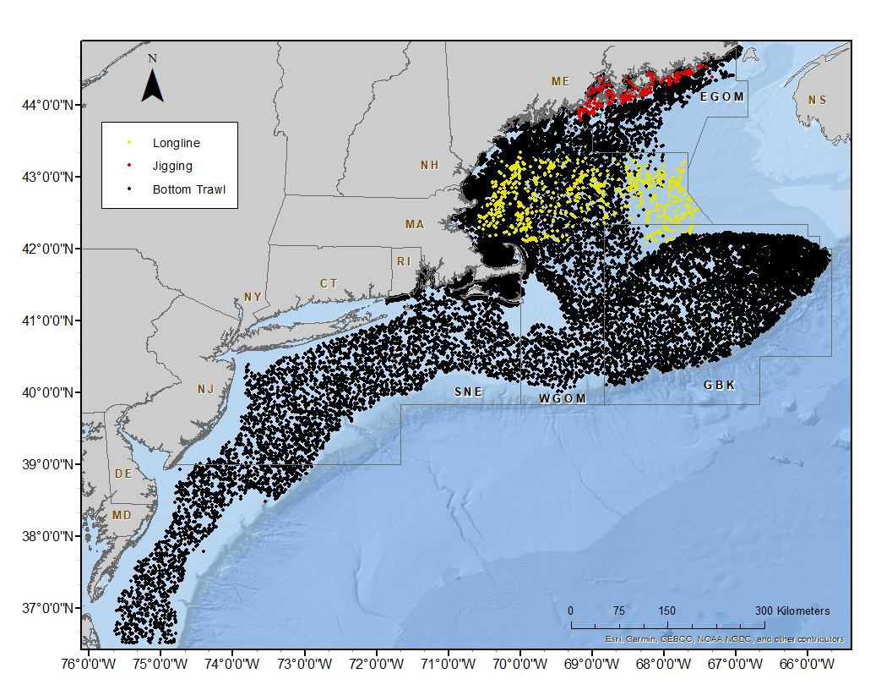
Model setup – observations
Include all data possible, 1982-2022
Future: test model sensitivity to the difference in sampling effort between gear types

Slide 7
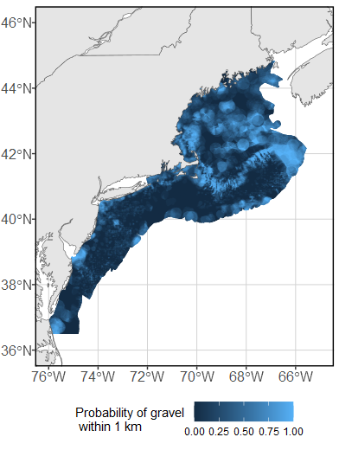
Model setup – covariates
Include spatial covariates
Affect density of cod over space
Include catchability covariates
Affect ability to capture cod, but not necessarily distribution
Define relationships between covariates and catch

Slide 8
Example output
How do abundance and distribution change for different age classes of cod?
Model space: 200 knots, no spatial segmentation
Observations: All surveys in which length of cod were recorded for each sample tow (removes some surveys)
Covariates: Probability of gravel, probability of sand, water depth, sea surface temperature

Slide 9
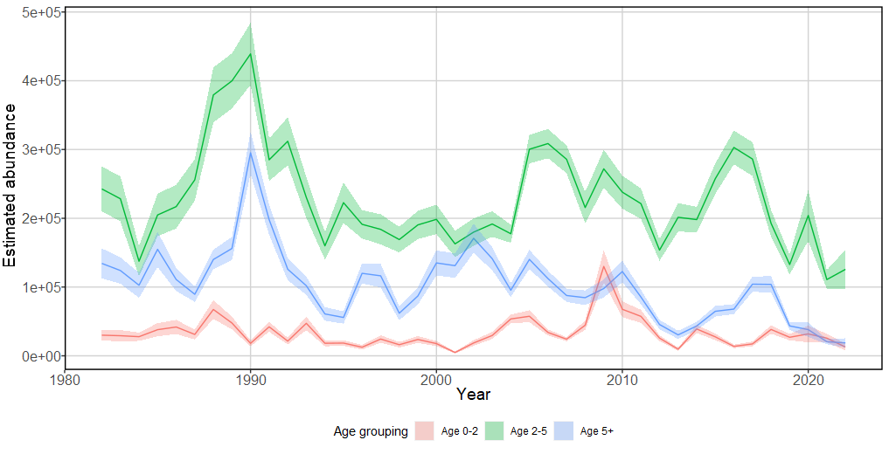
Split indices of abundance

Slide 10
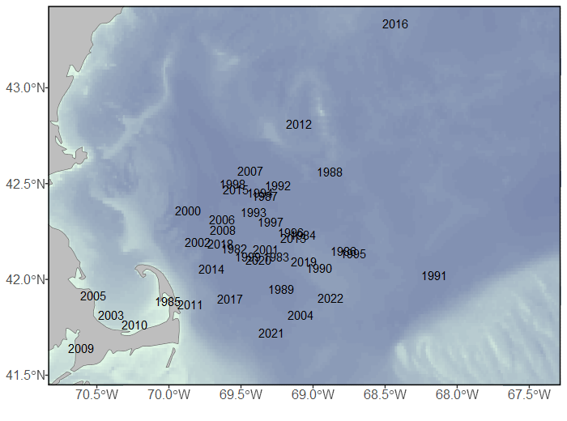
Split centers of gravity
Ages 0 - 2

Slide 11
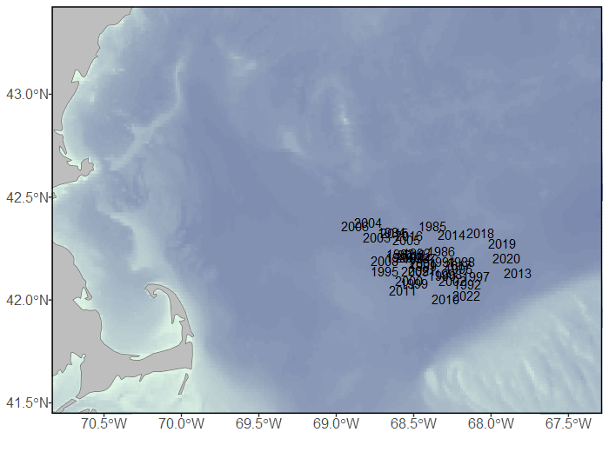
Split centers of gravity
Ages 2 - 5

Slide 12
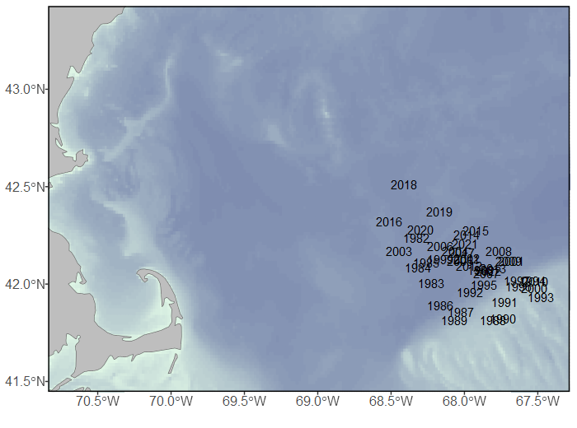
Split centers of gravity
Ages 5 +

Slide 13
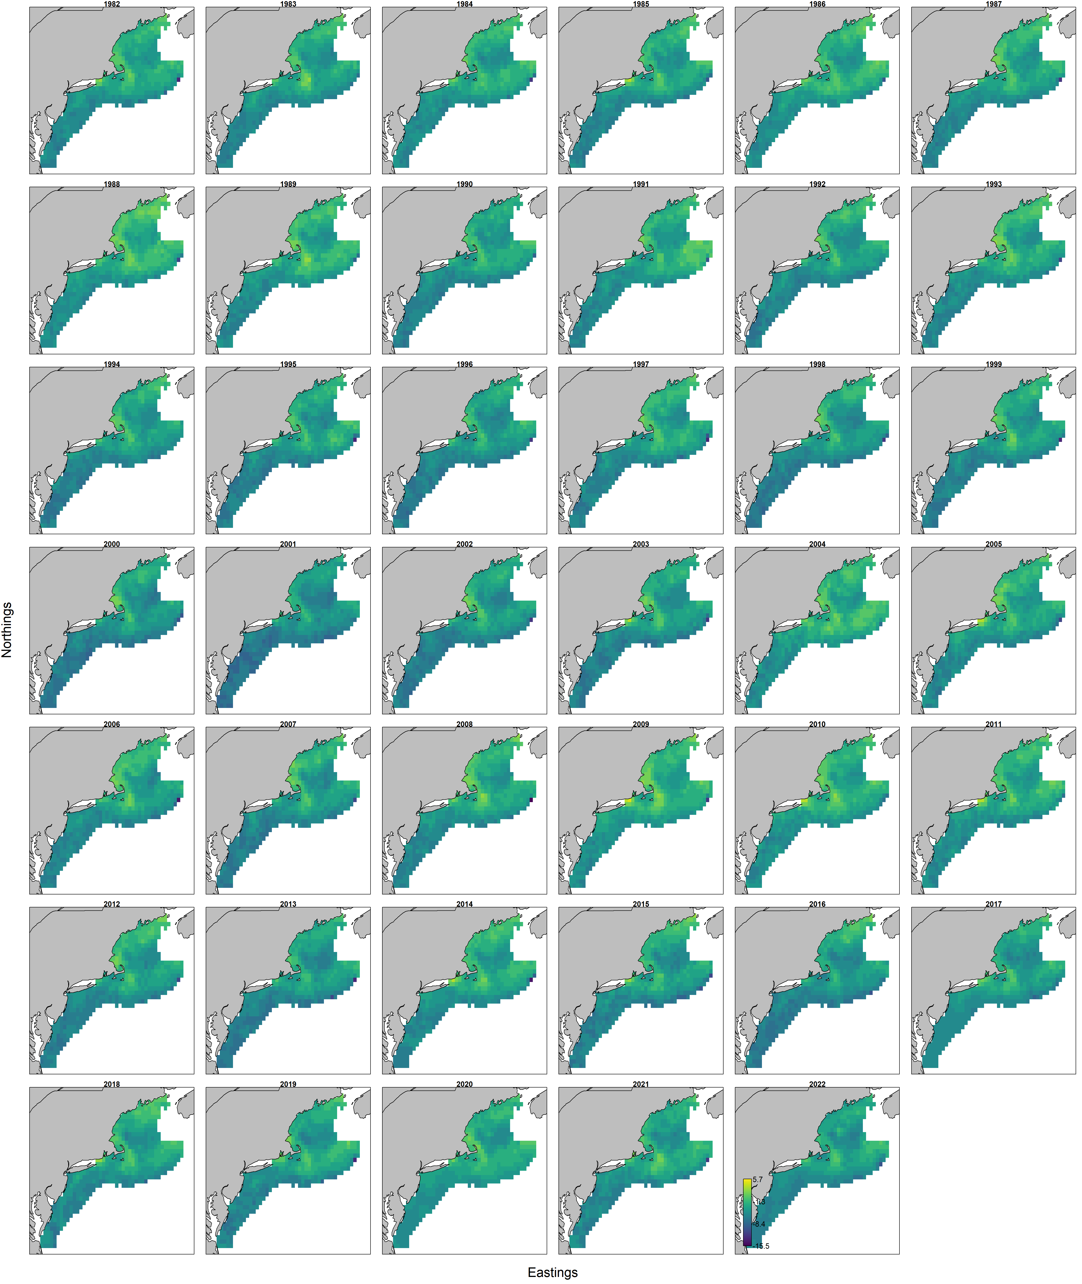
Split predicted spatial density
Ages 0 - 2

Slide 14
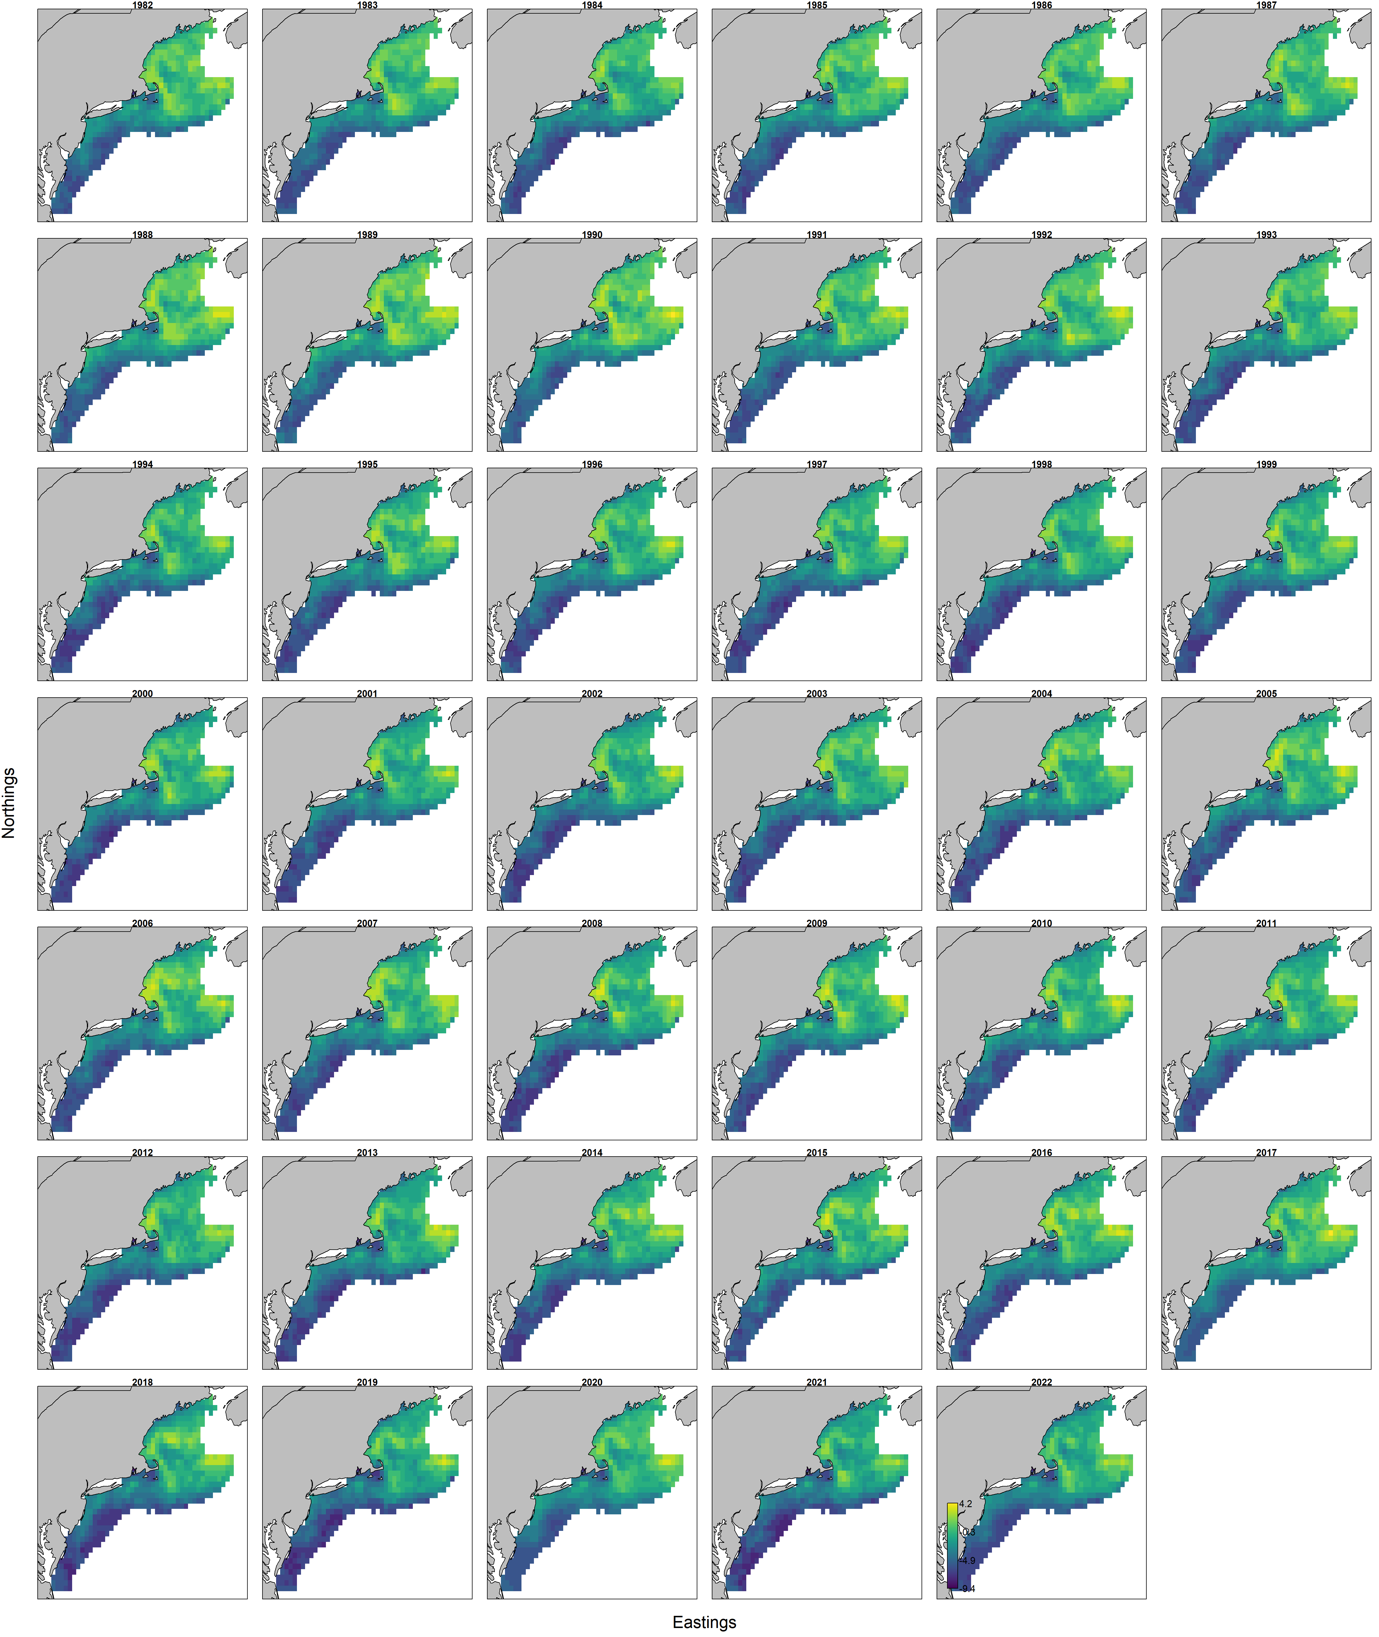
Split predicted spatial density
Ages 2 - 5

Slide 15
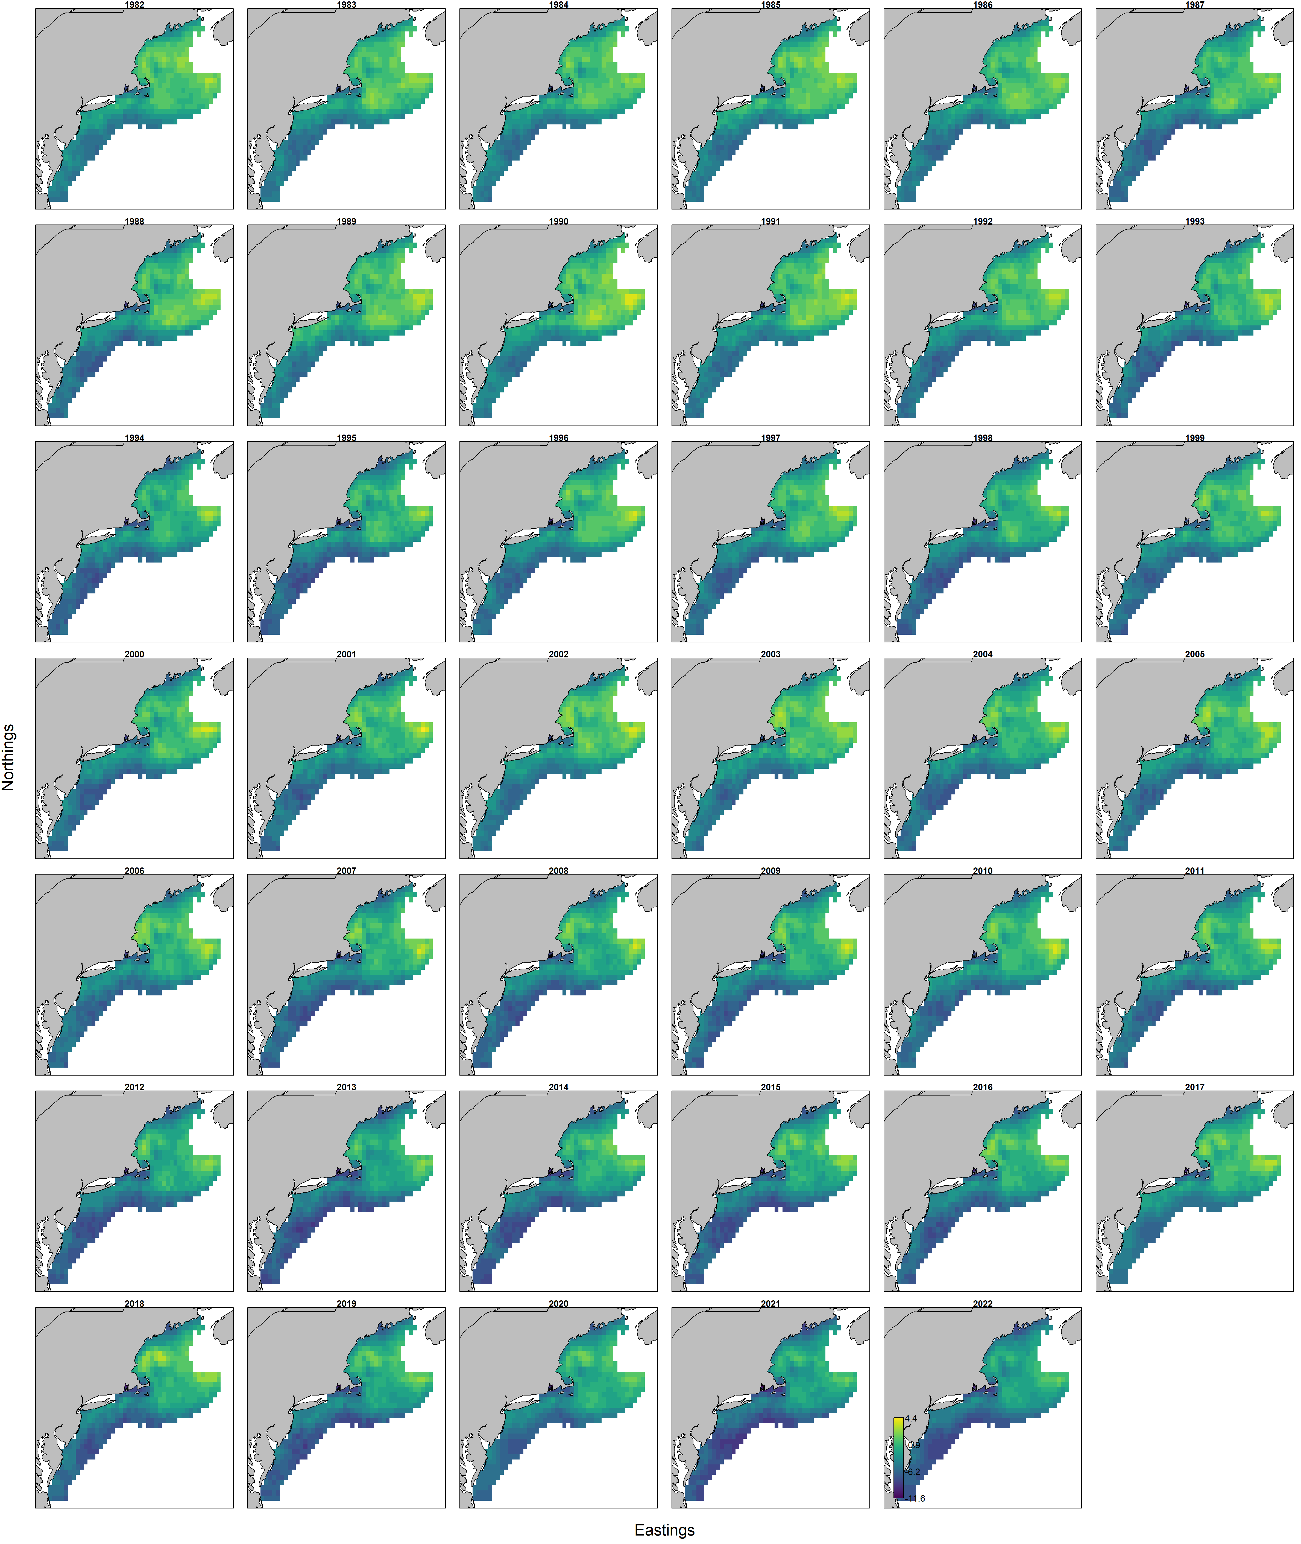
Split predicted spatial density
Ages 5+

Slide 16
Questions, Comments

Slide 17
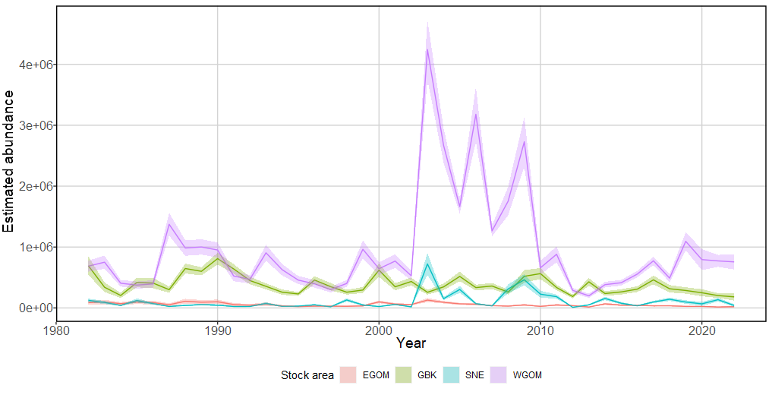
Split indices of abundance

