Slide 1
VAST Approach: Groundfish spatial distribution and covariates
Cod Research Track Working Group Meeting
9 December 2022

Slide 2
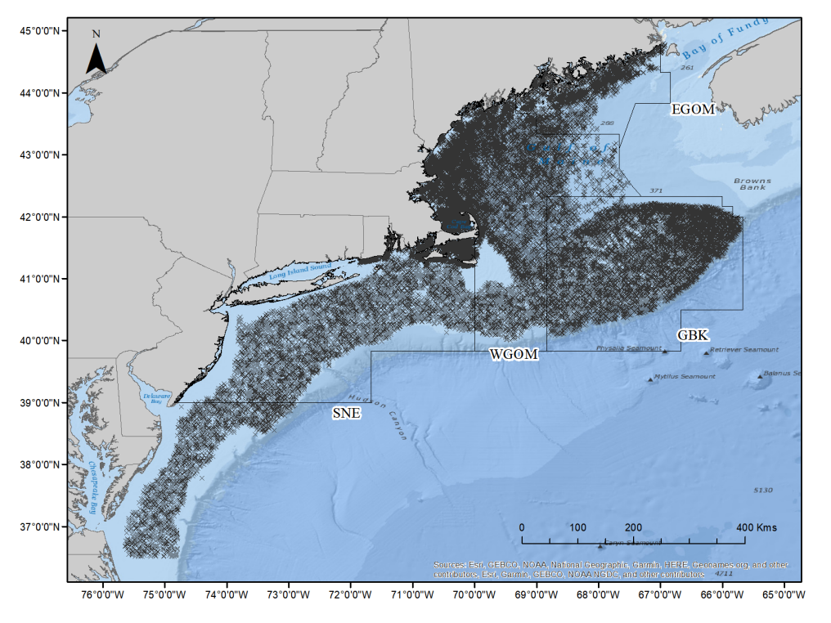
Fishery-independent data
Groundfish surveys across:
Decades of sampling
Multiple seasons
Temperature, salinity
Four stock areas
Bottom substrate, rugosity
Several gear types/ vessels

Slide 3
Objectives
Explore relationship between groundfish abundance/ distribution and various habitat covariates
Create holistic indices of abundance using all available data
Approach: VAST
Modeling approach designed to estimate spatio-temporal variation in density
Notes:
This tool is designed to estimate spatial variation in density using spatially referenced data, with the goal of habitat associations (correlations among species and with habitat) and estimating total abundance for a target species in one or more years

Slide 4
VAST Decisions
Spatial Domain: entire sampled spatial area
Demographic categories: binned lengths (age & maturity data spotty)
Quantitative data: counts (biomass data spotty)
Density/ habitat covariates: sediment type, rugosity
Catchability covariates: surface temperature (OISST or field), gear type
Area swept offsets: known for DFO & BTS, estimated for other gears
Vessel effects: will include when vessel is recorded

Slide 5
Habitat covariates
Sediment model based on NEFMC “Northeast Fishing Effects Model”
1km by 1km grid cells
Probability and CV of each cell containing: mud, sand, gravel, cobble, boulder
Rugosity model based on McElroy (2019)
15 arc-second grid cells
Within BTS strata, rugosity higher than 70th percentile labeled “rough”

Slide 6
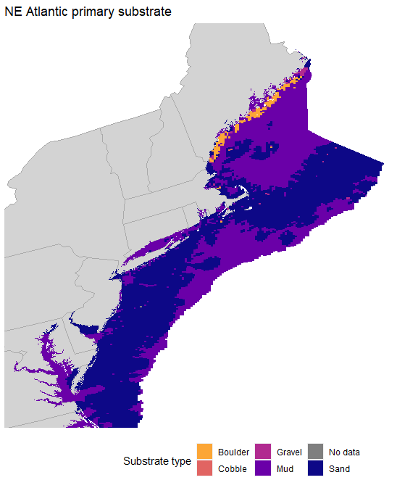
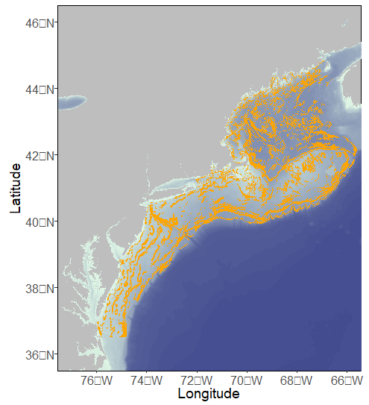
Habitat covariates
NE Atlantic rugosity

Slide 7
VAST Decisions
Spatial Domain: entire sampled spatial area
Demographic categories: binned lengths (age & maturity data spotty)
Quantitative data: counts (biomass data spotty)
Density/ habitat covariates: sediment type, rugosity
Catchability covariates: surface temperature (OISST or field), gear type, other environmental covariates and indicators
Area swept offsets: known for DFO & BTS, estimated for other gears
Vessel effects: will include when vessel is recorded

Slide 8
Catchability covariates
Survey gear (bottom trawl, longline, jig)
Surface temperature (grabbed from OISST when not field sampled)
Considering other environmental covariates outlined by ToR1 group

Slide 9
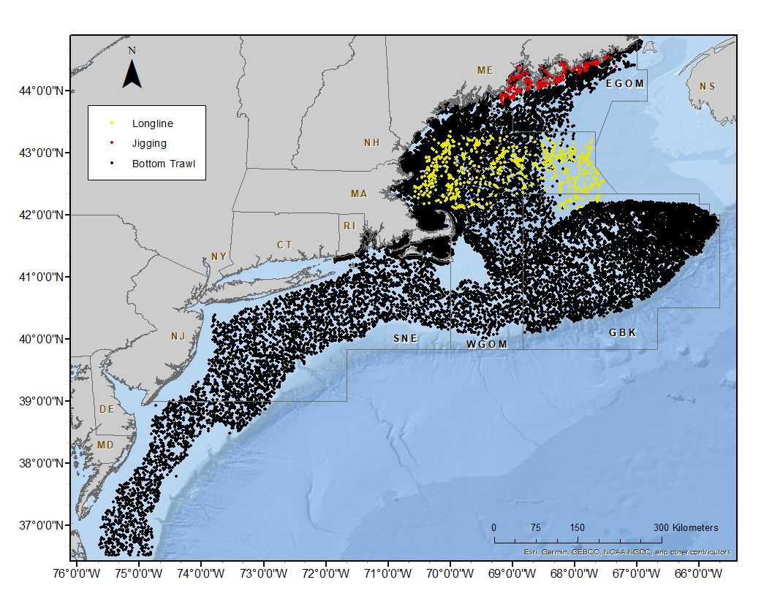
Catchability covariates

Slide 10
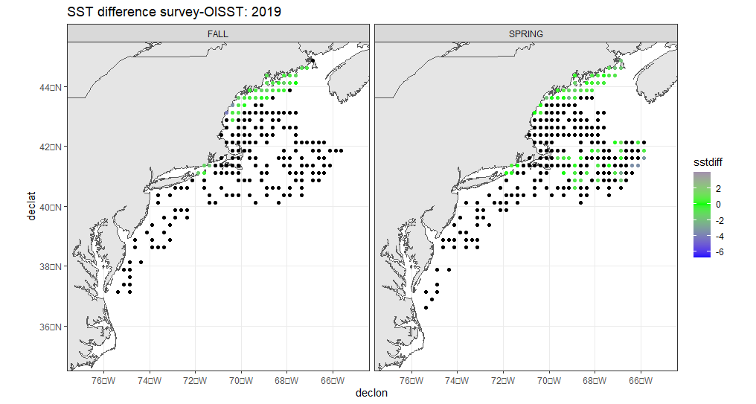
Catchability covariates

Slide 11
VAST Decisions
Spatial Domain: entire sampled spatial area
Demographic categories: binned lengths (age & maturity data spotty)
Quantitative data: counts (biomass data spotty)
Density/ habitat covariates: sediment type, rugosity
Catchability covariates: surface temperature (OISST or field), gear type, other environmental covariates and indicators
Area swept offsets: known for DFO & BTS, estimated for other gears
Vessel effects: will include when vessel is recorded

Slide 12
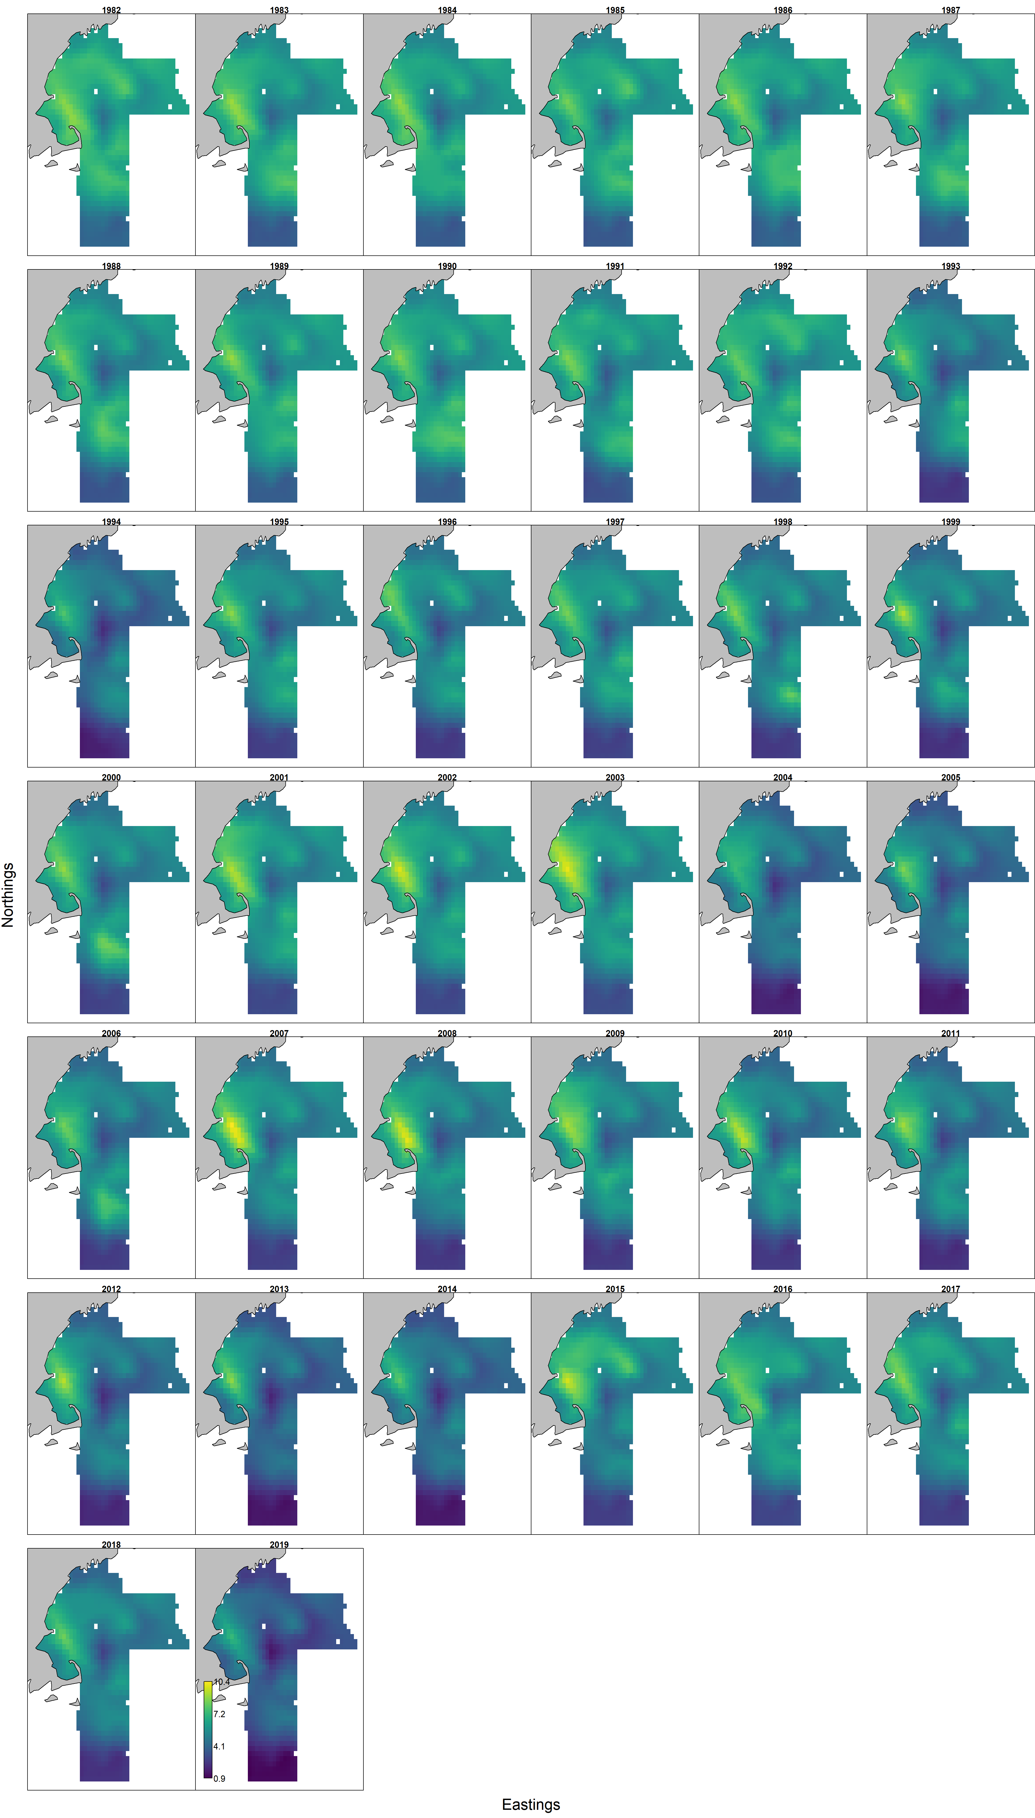
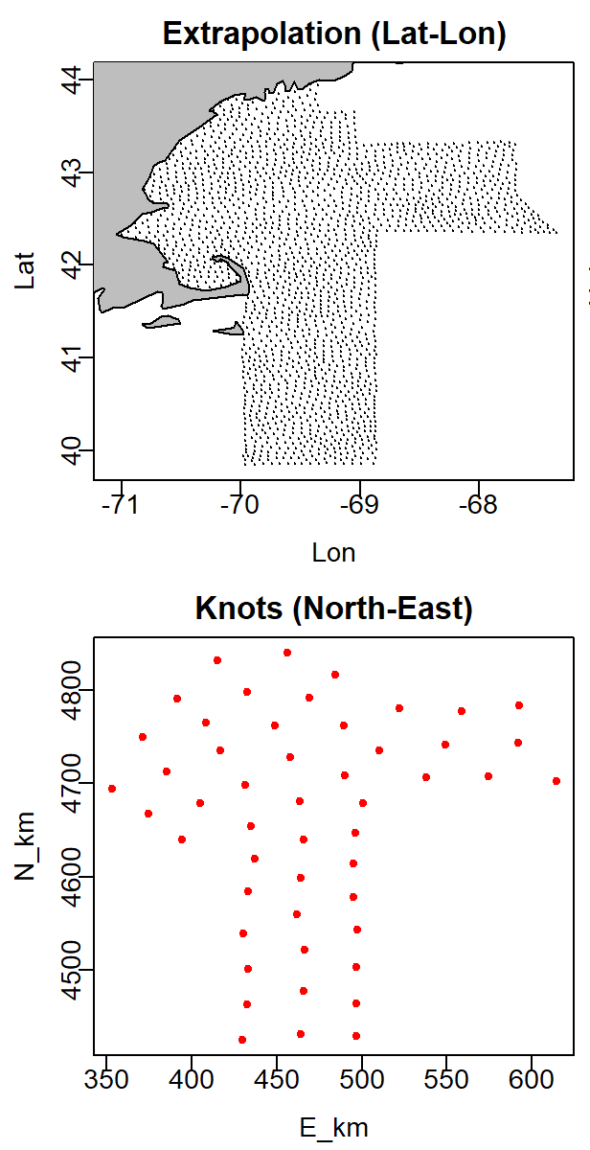
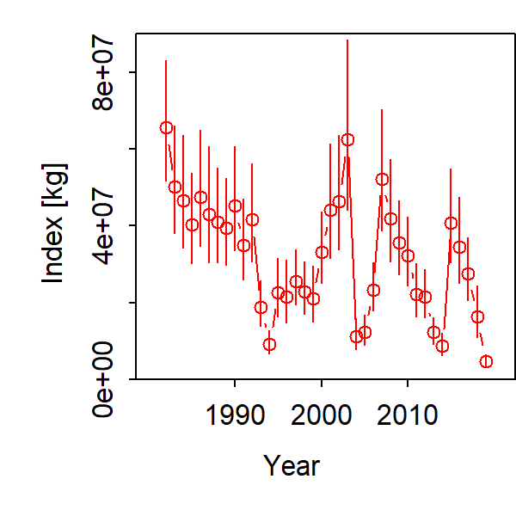
Outputs
MODEL TESTING: DO NOT USE

Slide 13
Questions, Comments

