Slide 1
CBASS species distribution and growth modeling

Slide 2
Goal 1
Qualify how common or unusual the species we caught are to Casco Bay, using both CBASS catch data and theoretical distribution maps from FishBase

Slide 3
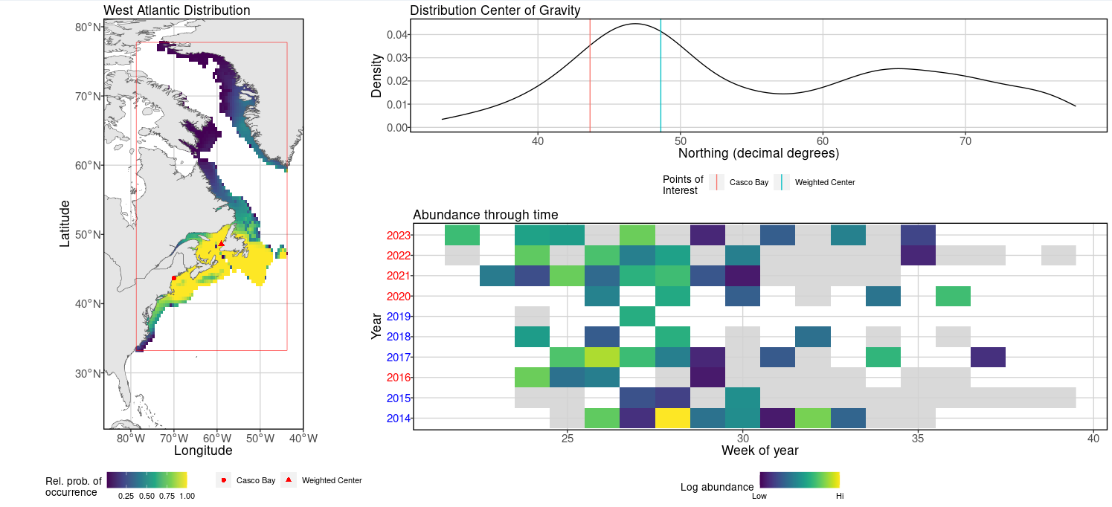
Common / South of center: Atlantic herring

Slide 4
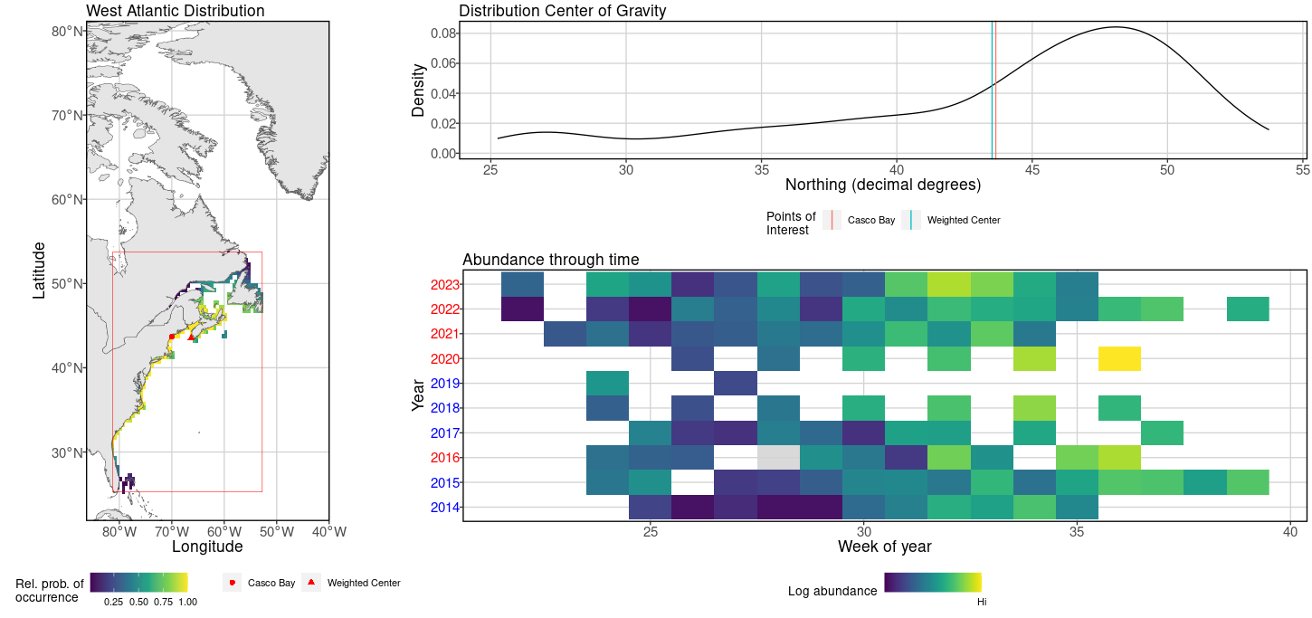
Common / At center: Atlantic silverside

Slide 5
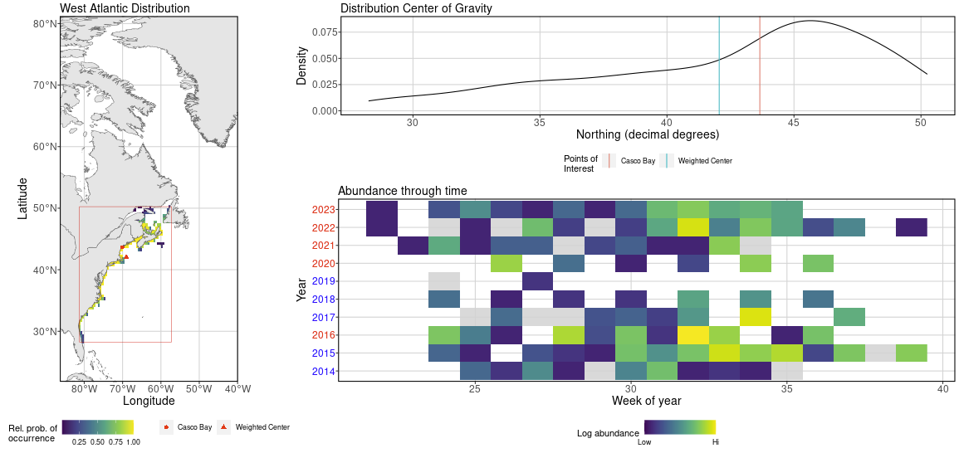
Common / North of center: Mummichog

Slide 6
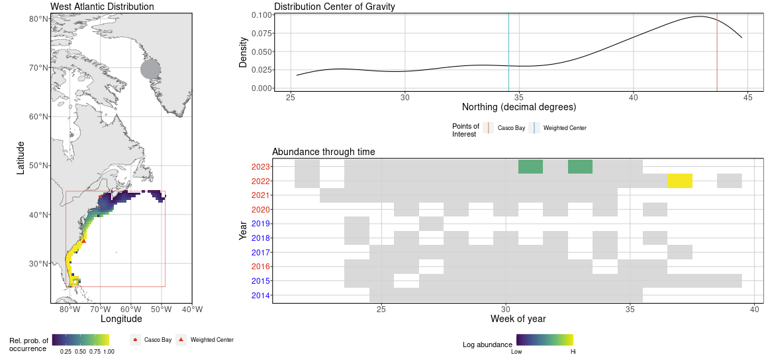
Uncommon / North of center: Crevalle jack

Slide 7
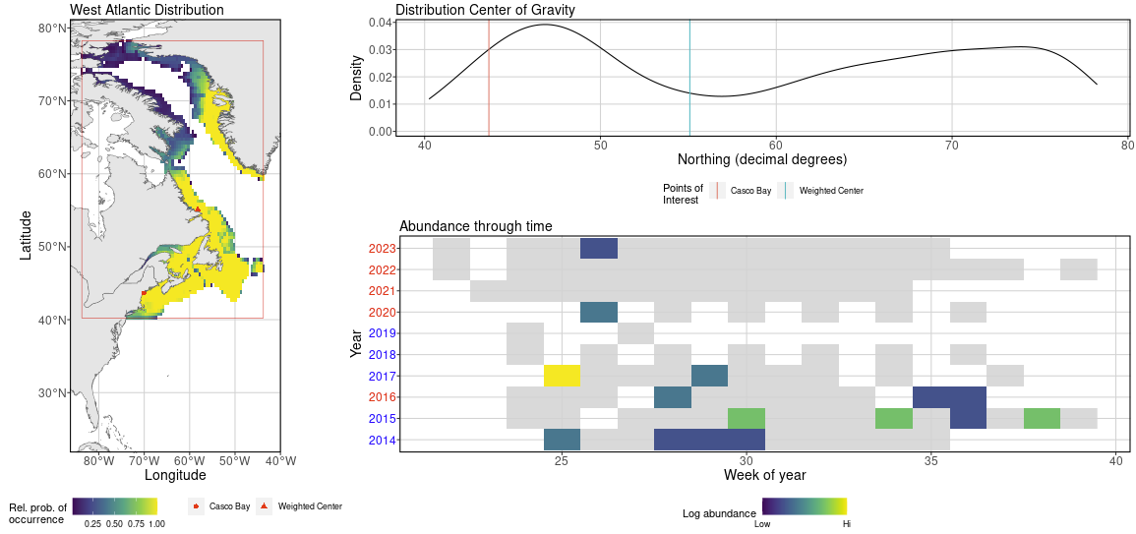
Uncommon / South of center: Shorthorn sculpin

Slide 8
Goal 2
Determine weekly growth rates of commonly-captured species

Slide 9
Methods

Slide 10
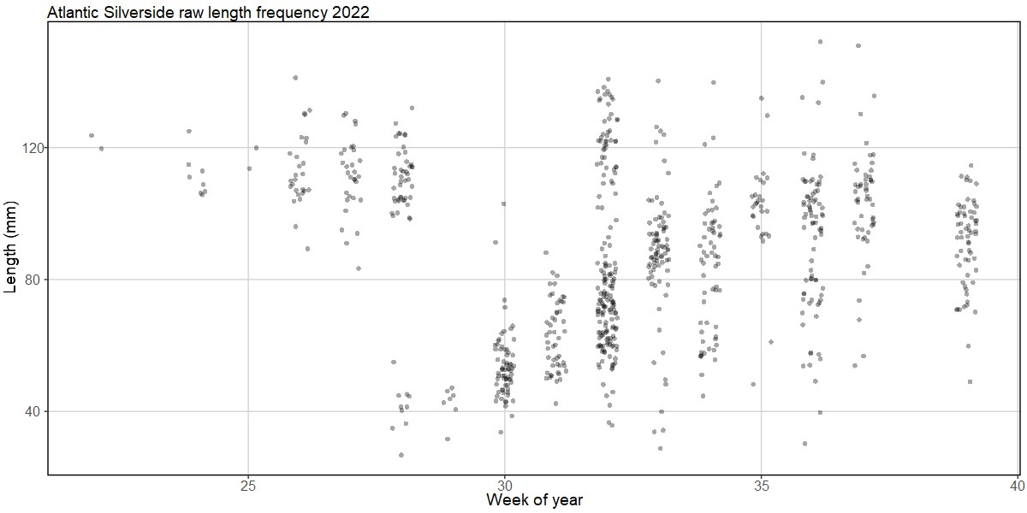
Raw data
Age 1+

Slide 11
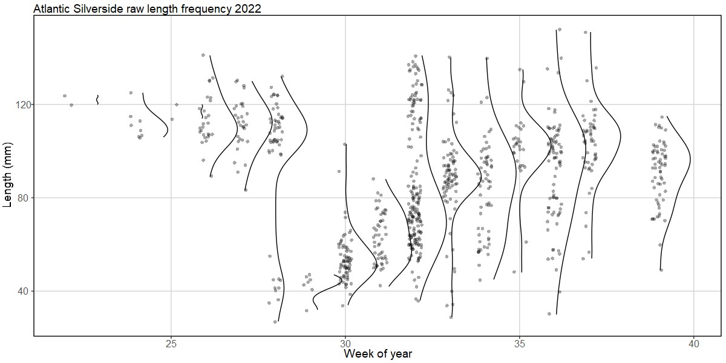
Length Kernel Density Estimation
Notes:
Plot KDE showing full distribution of lengths per week in each year Identify number of modes, assuming a mode is the mean length of a group of similarly-aged fish in that week
Can sometimes be either TOO sensitive or NOT sensitive enough. Deterministic function that differences KDE of x and reports number of modes equal to half the number of changes in direction.

Slide 12
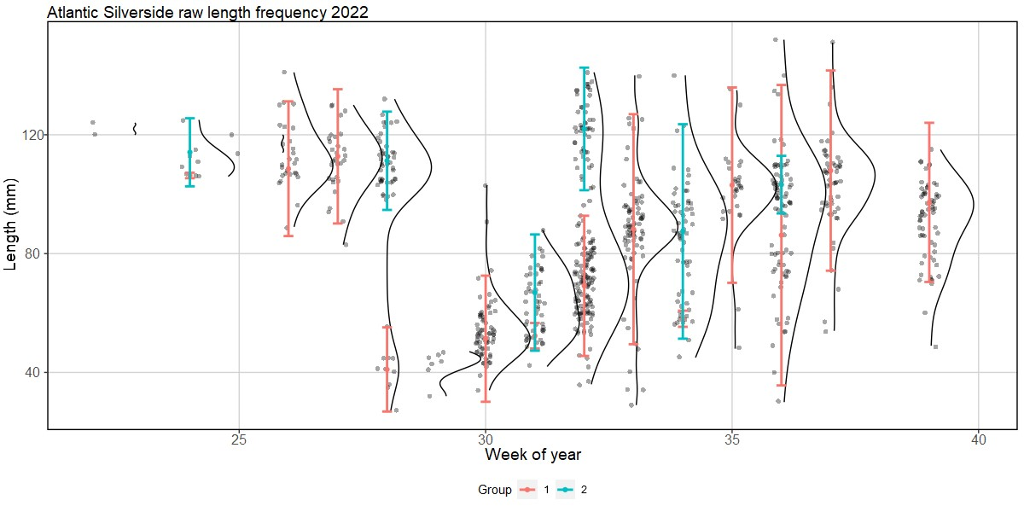
Mixed-distribution modeling
Notes:
Remove weeks with fewer than 7 fish observed and lengthed
Use expectation-maximization (EM) algorithm to determine the mixture of normal distributions.
Set k number of components equal to number of modes identified in previous step.
Obviously assuming normal distribution of lengths within each cohort
Retain lambda (mixing proportions), mu (means) and sigma (standard deviations).
Approximate 95% CI (2 times SD)

Slide 13
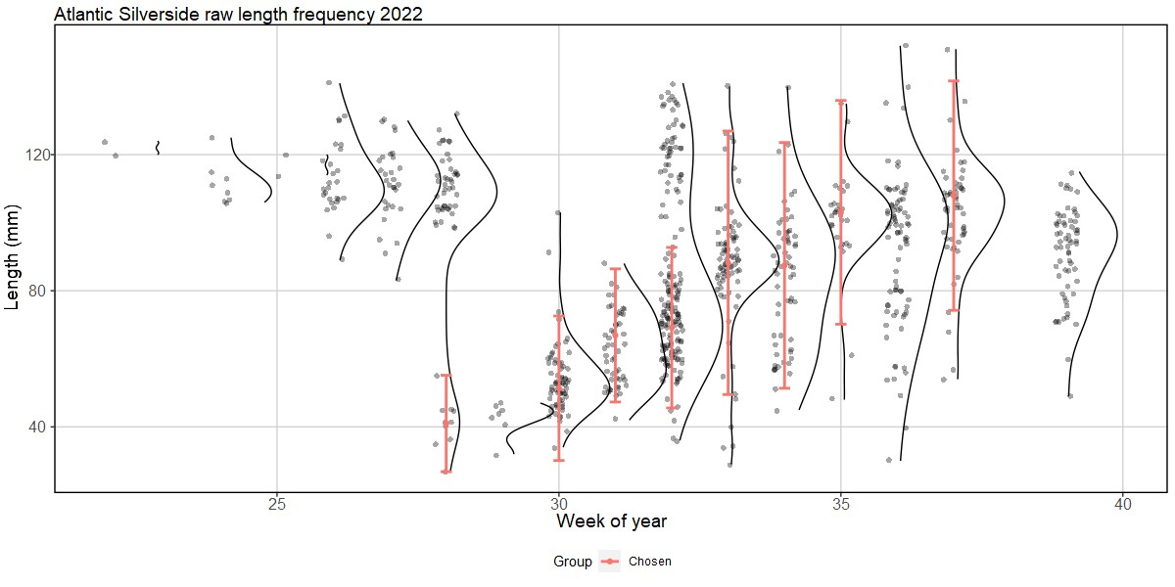
Handwave-y Bullshit
Notes:
By eye
Remove distributions with fish large enough to be age-1
Find week with first instance of newly-recruited fish
Track that corhort weekly, remove distributions of other cohorts
Also: remove weeks in which the length distribution for that corhort is distorted by a few fish of other cohorts coming in

Slide 14
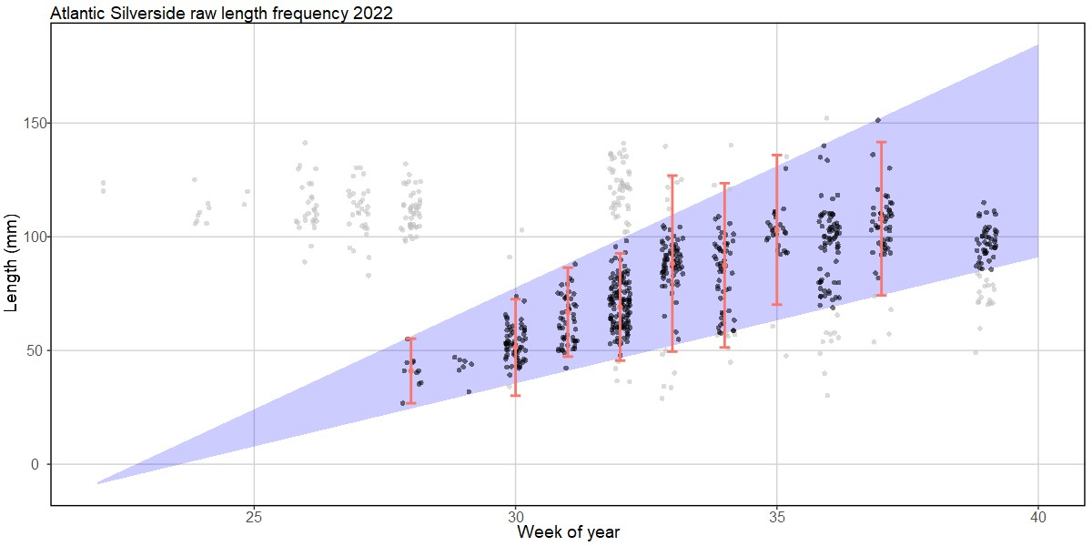
Generalized linear models of expected length limits
Notes:
Use upper and lower limits of remaining distributions to create linear model of expected upper and lower limit (95% CI) of lengths per week
Remove fish longer or shorter than expected lengths

Slide 15
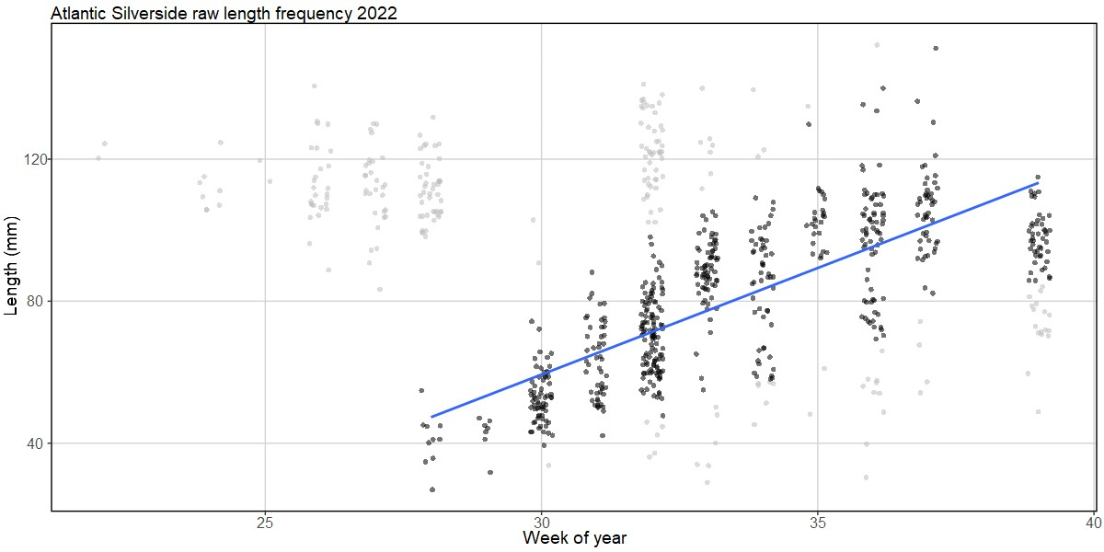
Generalized linear model of mean size
Notes:
Use upper and lower limits of remaining distributions to create linear model of expected upper and lower limit (95% CI) of lengths per week
Remove fish longer or shorter than expected lengths

Slide 16
Results

Slide 17
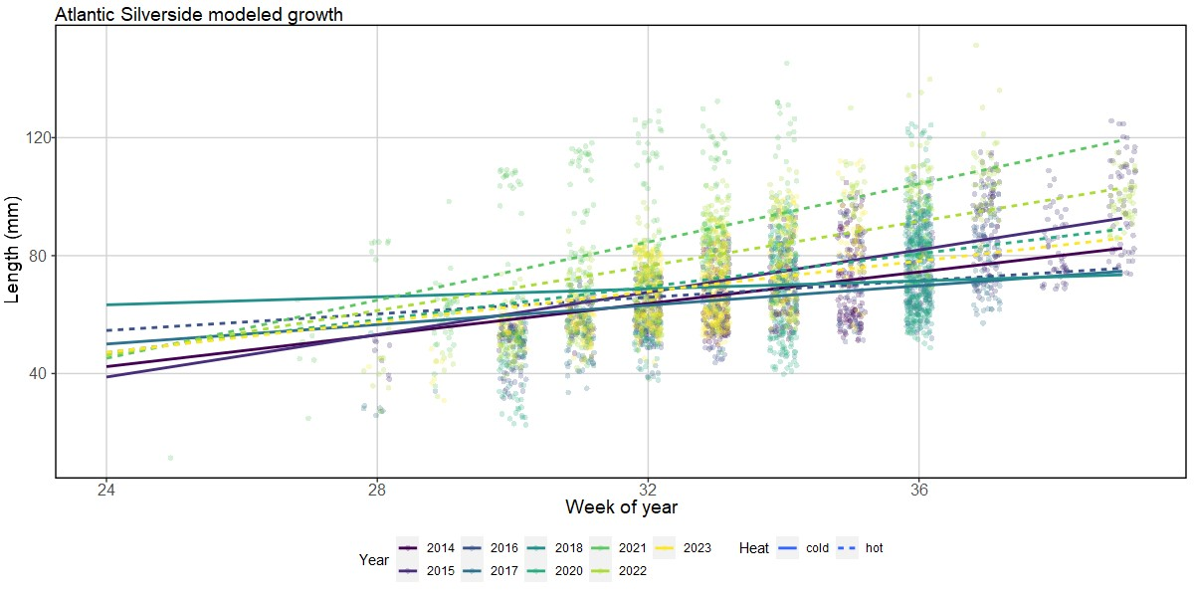
Modeled growth rates
Notes:
Use upper and lower limits of remaining distributions to create linear model of expected upper and lower limit (95% CI) of lengths per week
Remove fish longer or shorter than expected lengths

Slide 18
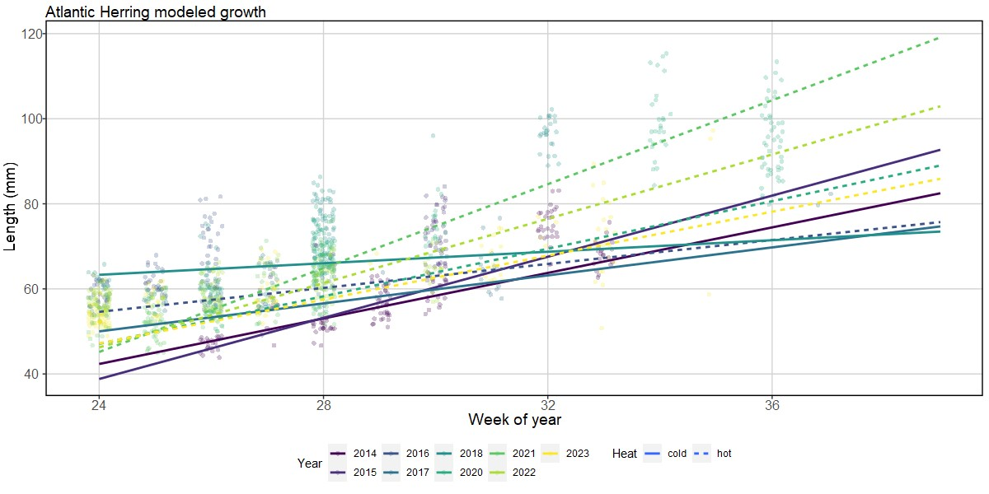
Modeled growth rates
Notes:
Use upper and lower limits of remaining distributions to create linear model of expected upper and lower limit (95% CI) of lengths per week
Remove fish longer or shorter than expected lengths

Slide 19
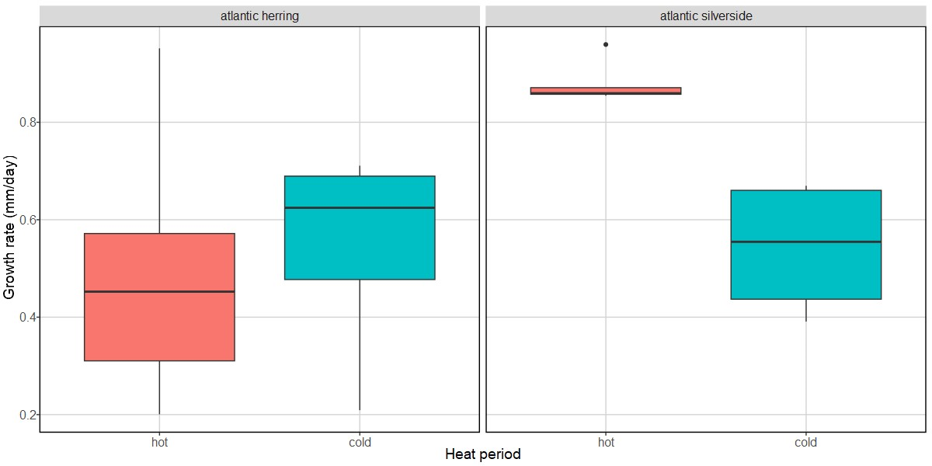
Links to temperature

Slide 20
Other issues
Categorization of heat periods
Adam uses reference period of 1991-2011, I used 2003-2023
Portland buoy record is 2002 - today
Portland airport record is 1948 - today

